Slide 1
ECE 277 Ninad Ekbote
Pid :- A69026968 Topic:- Matrix Multiplication and Optimization

Slide 2
CPU VS GPU
CPU :- In CPU programming due to limited parallelism, we cannot calculate the values of resultant matrix in a single go instead we calculate values one at a time. This makes the overall calculation very slow.
GPU:- In Cuda programming we launch multiple threads and these threads can perform the same type of calculation for different memory address. This leads to parallelism reducing overall calculation time.

Slide 3
CPU Matrix Multiplication
b00 | b01 | b02
b10 | b11 | B12
b20 | b21 | b22
a00 | a01 | a02
a10 | a11 | a12
a20 | a21 | a22
c00 | c01 | c02
c10 | c11 | c12
c20 | c21 | c22

Slide 4
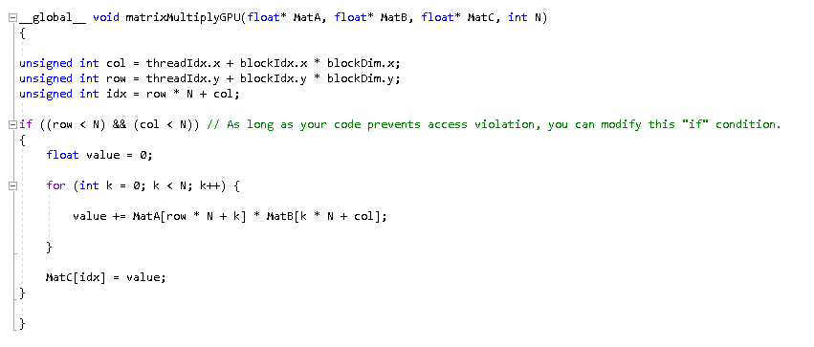
Matrix Multiplication using GEMM
Matrix B
b00 | b01 | b02 | b03 | B04
B10 | b11 | b12 | b13 | b14
b20 | b21 | b22 | b23 | B24
B30 | b31 | b32 | b33 | b34
b40 | b41 | b42 | b43 | b44
Axis x
a00 | a01 | a02 | a03 | a04
a10 | a11 | a12 | a13 | a14
a20 | a21 | a22 | a23 | a24
a30 | a31 | a32 | a33 | a34
a40 | a41 | a42 | a43 | a44
c00 | c01 | c02 | c03 | C04
C10 | c11 | c12 | c13 | c14
c20 | c21 | c22 | c23 | C24
C30 | c31 | c32 | c33 | c34
c40 | c41 | c42 | c43 | c44
Axis y
Matrix A

Slide 5
GEMM VS Shared Memory
Shared Memory:- Shared memory is significantly faster than global memory because it's on-chip and accessible only within a thread block.
Global Memory:-
Global memory is off-chip and accessible by all threads. Hence, it’s
becomes hard to access global memory.

Slide 6
B00 | B01 | B02 | B03
B10 | B11 | B12 | B13
B20 | B21 | B22 | B23
B30 | B31 | B32 | B33
C00_1 = A00*B00 + A01*B10
C00_2 = A02*B20 + A03*B30 Finally, C00 = C00_1 + C00_2
B00 | B01
B10 | B11
B20 | B21
B30 | B31
A00 | A01 | A02 | A03
A10 | A11 | A12 | A13
A20 | A21 | A22 | A23
A30 | A31 | A32 | A33
A00 | A01
A10 | A11
C00 | C01
C10 | C11
A02 | A03
A12 | A13

Slide 7
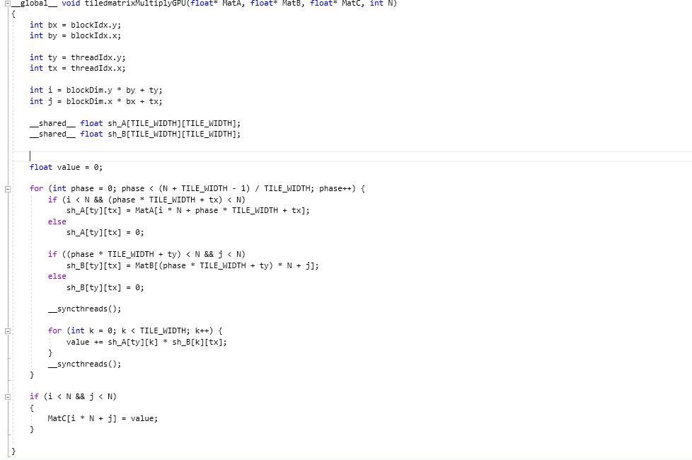

Slide 8
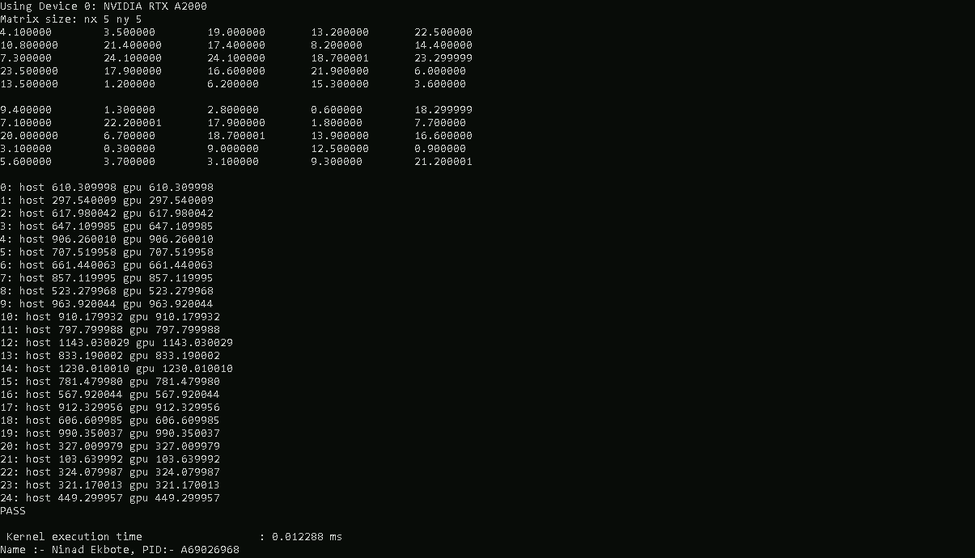
Results Global Memory output

Slide 9
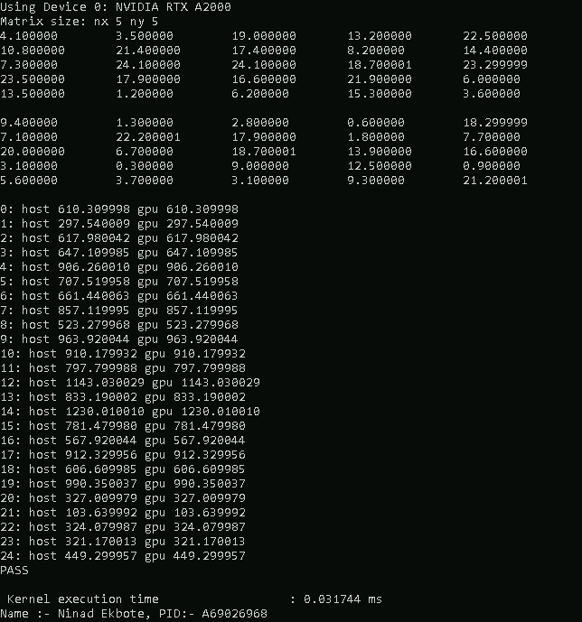
Results Shared memory

Slide 10
Thank You

