Slide 1
Bluestock Mutual Fund Analytics
End-to-End Data Analytics for Fund Performance,
Investor Behavior, and Risk Assessment
Capstone Project Submission by Ninad Uchil

Slide 2
Problem & Objectives
The Challenge
India's mutual fund sector has grown significantly, but investors lack integrated analytics for fund selection Limited visibility into fund performance, investor behaviour, and industry trends Need for data-driven decision-making framework.
Project Objectives
1. Industry Insight: To analyze AUM growth, SIP trends, folio expansion; identify market consolidation and retail participation patterns.
2. Fund Performance: Compare risk-adjusted returns across schemes and evaluate volatility, drawdown, and benchmark performance.
3. Investor Analysis: To profile investor demographics and geographic distribution, and assess SIP continuity and cohort behaviour.
4. Data Infrastructure: Build scalable ETL pipeline and create a structured analytics database to later enable interactive dashboards for decision-making.

Slide 3
Data Sources
Fund & Scheme Data:
Fund master and NAV history.
Market & Industry Data:
AUM by fund house and Monthly SIP inflows.
Category inflows:
Industry folio count and Benchmark indices.
Investor & Portfolio Data:
Investor transactions: SIP, Lumpsum, or Redemption.
Portfolio holdings.
Scheme performance metrics.

Slide 4
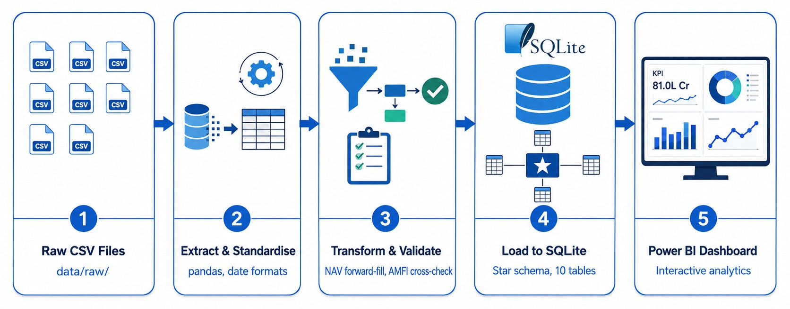
ARCHITECTURE

Slide 5
EDA Highlights: Industry
Folio Growth: Total mutual fund folios nearly doubled from 13.26 crore (Jan 2022) to 26.12 crore (Dec 2025).
SIP Inflow Peak: Monthly SIP inflows reached ₹31,002 crore in December 2025, showing continued growth throughout the 2022-2025 period.
AMC Dominance: SBI Mutual Fund remained the largest AMC, with AUM growing from ₹6.3 lakh crore (2022) to ₹12.5 lakh crore (2025).
Category Inflows: Liquid funds consistently attracted the highest monthly net inflows, ranging from ₹32,374 crore to ₹41,952 crore.

Slide 6
EDA Highlights: Investor & SIP
Age Distribution: The 26-35 age group is the largest investor segment, accounting for 41.1% of SIP investors, followed by 36-45 at 24.9%.
City Tier Distribution: T30 cities contribute 66.3% of SIP inflows, compared to 33.7% from B30 cities.
State-Level Activity: Punjab and Tamil Nadu recorded the highest aggregate SIP amounts among analyzed states.
SIP Ticket Size: Median SIP contributions are consistent across age groups at approximately ₹5,000-₹5,420, with high-value outliers approaching ₹60,000.

Slide 7
Performance Metrics
Strong long-term performance: 3-year returns averaged 16.41%, with wide variation across schemes.
Small & Mid Cap led performance: Small Cap and Mid Cap funds delivered higher average 3-year returns than Large Cap funds.
Risk-adjusted performance varied significantly: Sharpe ratios showed clear differences in performance relative to volatility, with Liquid funds standing out due to very low risk.
Benchmark comparison: Several top-performing Small Cap funds outperformed their relevant benchmarks over the 3-year period.
Wide performance dispersion: Returns ranged from lower-risk categories such as Gilt/Liquid to significantly higher-performing equity schemes.
Axis Midcap Fund was the top Equity performer (35.36% 3-year return), while ICICI Pru Liquid Fund led Debt (7.39%), highlighting wide performance differences across schemes.

Slide 8
Risk & Advanced Analytics
Downside risk varies sharply by category: Small Cap funds showed substantially higher potential daily losses than Liquid funds.
Drawdowns are much deeper in equity: Small Cap funds experienced the largest historical declines, while Liquid funds showed minimal drawdown.
Portfolio concentration varies: HHI analysis identified both highly concentrated and well-diversified portfolios.
SIP continuity is a key concern: Only 2.2% of investors with 6+ SIPs met the defined continuity threshold, indicating potential retention risk.
Fund Scoring: A scoring model combined performance and risk metrics to support comparative fund evaluation.

Slide 9
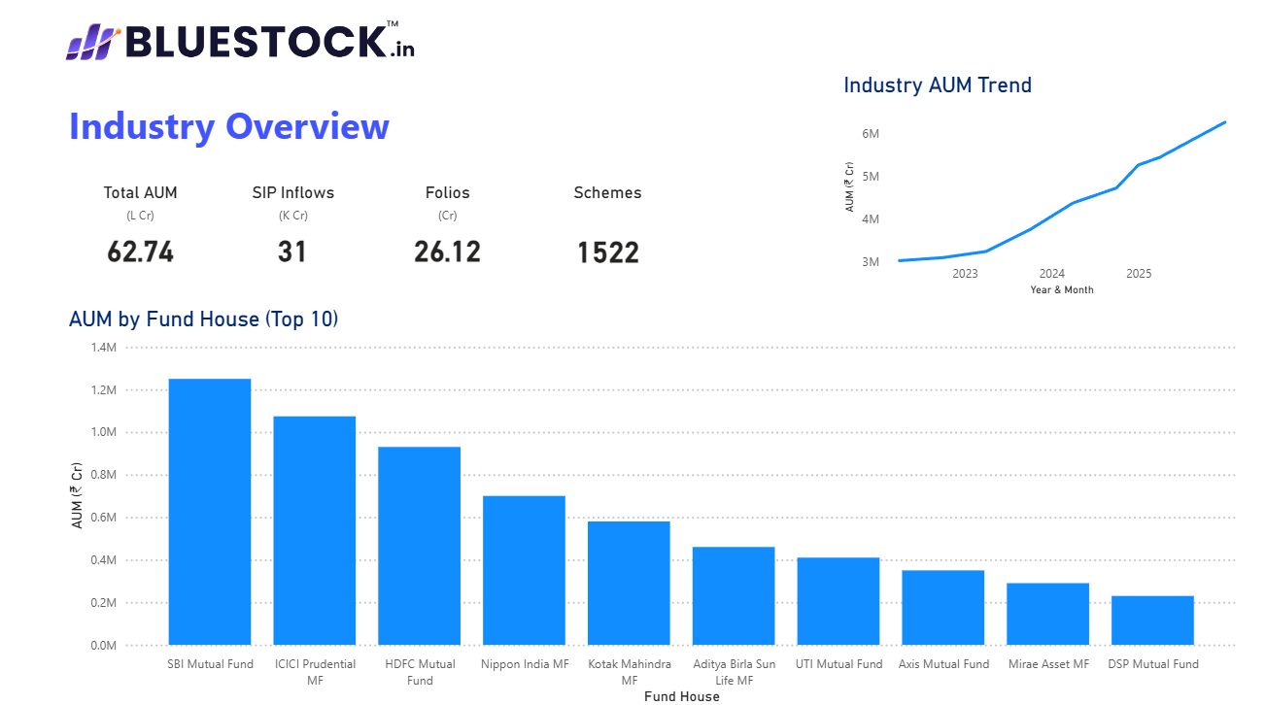
Industry Overview Dashboard

Slide 10
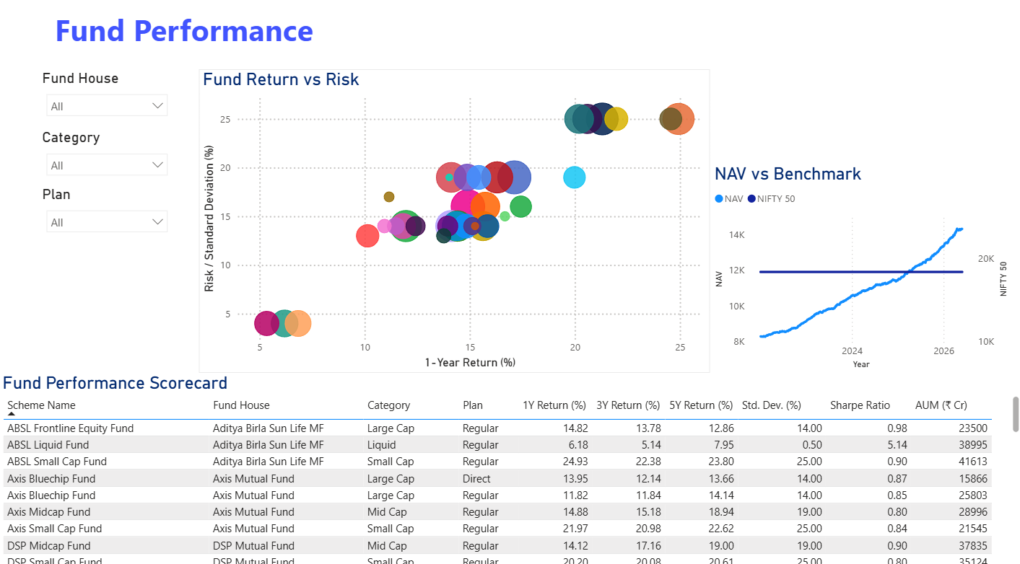
Fund Performance Dashboard

Slide 11
Key Findings & Recommendations
Industry is growing: AUM, SIP participation and folio counts increased strongly over the analysis period.
Returns come with different risk levels: Small and Mid Cap funds delivered higher returns but also higher volatility.
Investor participation is concentrated: Younger, male investors and T30 cities make up a large share of the investor base.
Risk and SIP continuity need attention: Some funds show higher downside risk, while SIP continuity is low among the analyzed long-term SIP investors.
Recommendation: Compare returns with risk, maintain diversification, and improve investor outreach and SIP continuity.

Slide 12
Thank you

