Slide 1

Decathlon presentation
-By
Ninad S. Mandavkar

Slide 2

Understanding the data
Decathlon ‘customer_transactions_sample’ file comprises of:
Invoice Details. (E.g. Invoice No, Date)
Customer details (Customer ID)
Quantity & Price of the order placed.
Country where the order is placed.
Stock Code of the product.
Description of the product.
Data spans from 2009-2011.
Gives us a brief invoice of orders placed by the customers.

Slide 3
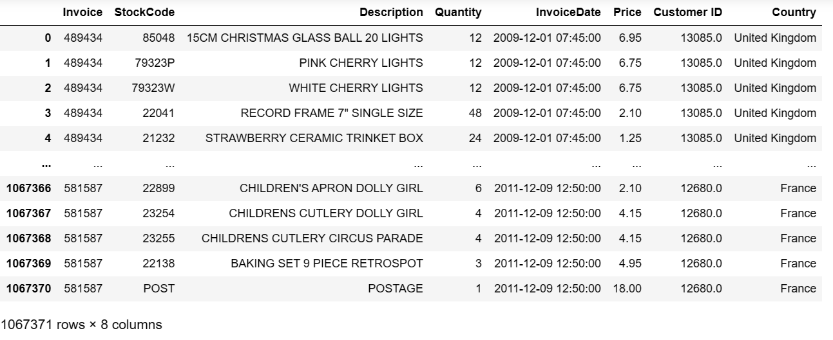
Understanding the data (Data preview)
Term & Interest rate
Customer
Details
Invoice no.
(unique primary key)
Stock code
Country where the order is placed
Description of products
Invoice Date & time at which the order is placed

Slide 4
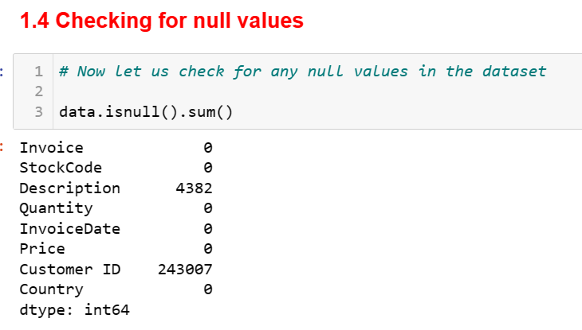
Data Cleaning (Preprocessing)
Most important step is to make sure the
data is cleaned well before we do EDA.
Append ‘2009-10’ & ‘2010-11’ data.
Checking the null values.
Treating the null values with mode.
Converting 'InvoiceDate’ to datetime.
Converting ‘Quantity’ to numeric.
Converting ‘Price’ to numeric.
Saving the cleaned data.

Slide 5
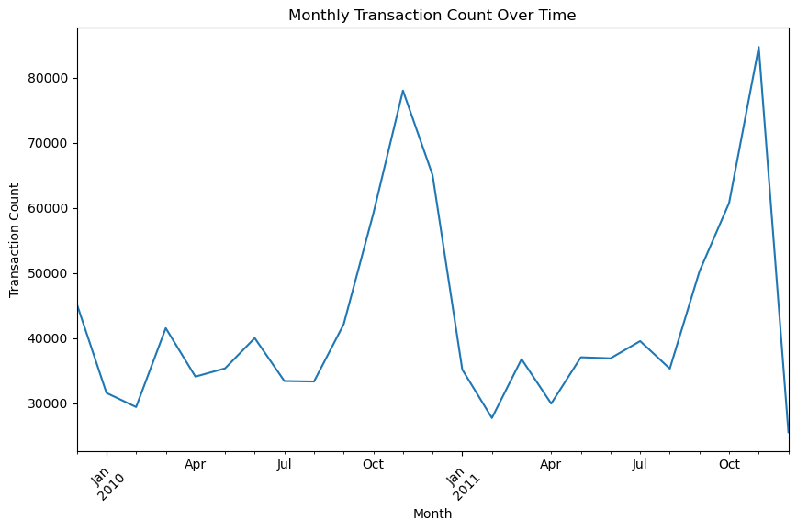
Exploratory Data Analysis: Transaction count over time
Will give us an overview of the number of
transactions over the years.
Increasing trend.
Spike in prices from Oct-Dec.
Consumers spend more on festive
seasons.
Hike in prices should be gradual.
Gradual inflation in prices will retain
CRR more as compared to a sudden
spike in price.
*CRR- Customer Retention ratio

Slide 6
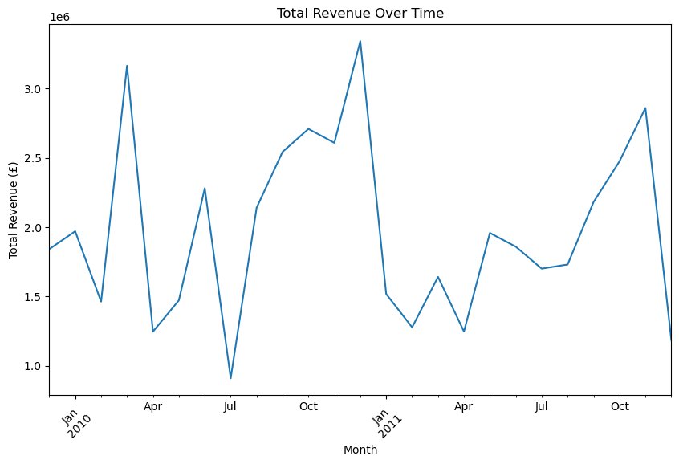
Exploratory Data Analysis: Total Revenue over time
Will show us the total revenue generated
over the years.
Mimics the trend for Prices.
The revenue fluctuations are quite
volatile.
Remedy is to implement good
marketing strategies.
4. Non-consensual advertising via social
media.
Constant inundation on the feed.
Regular quality check of products to
ensure consumers don’t get to
compromise on the product/service.

Slide 7
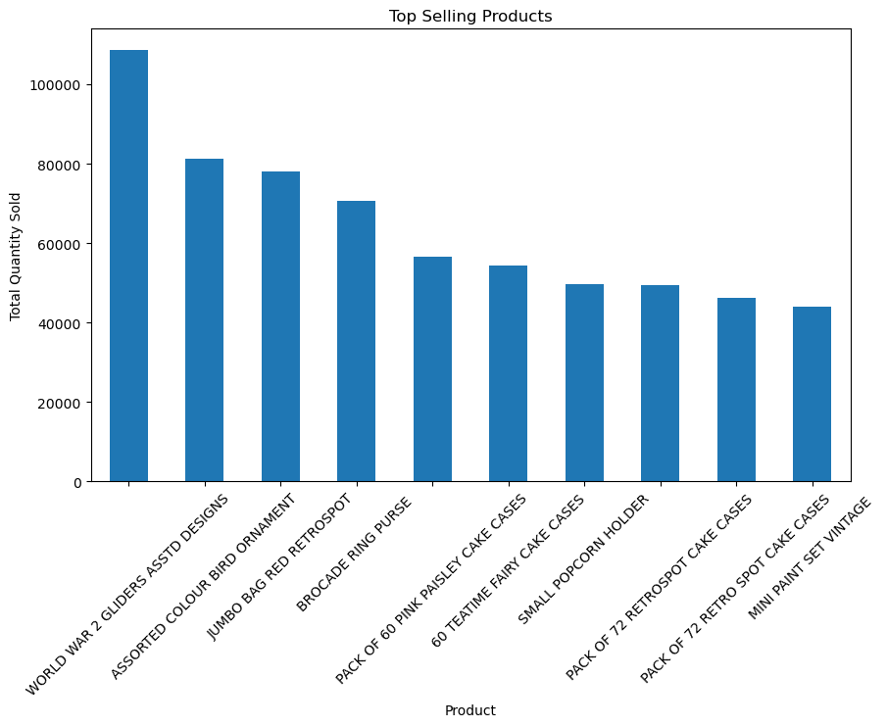
Exploratory Data Analysis: Top Selling Products
Understanding what actually works
in the market.
Most of the Top products comprises
of cake cases.
One should figure out reasons. Why?
Branding of a product garners
a blind faith of customers.
Branding builds over time.
4. Durability & viability of the product are
pivotal reasons as well.
How accessible & affordable is the
product also contributes to high sales.
How much the product is flexible and
adaptive enough to new changes in market also
corroborates growth in Prices.

Slide 8
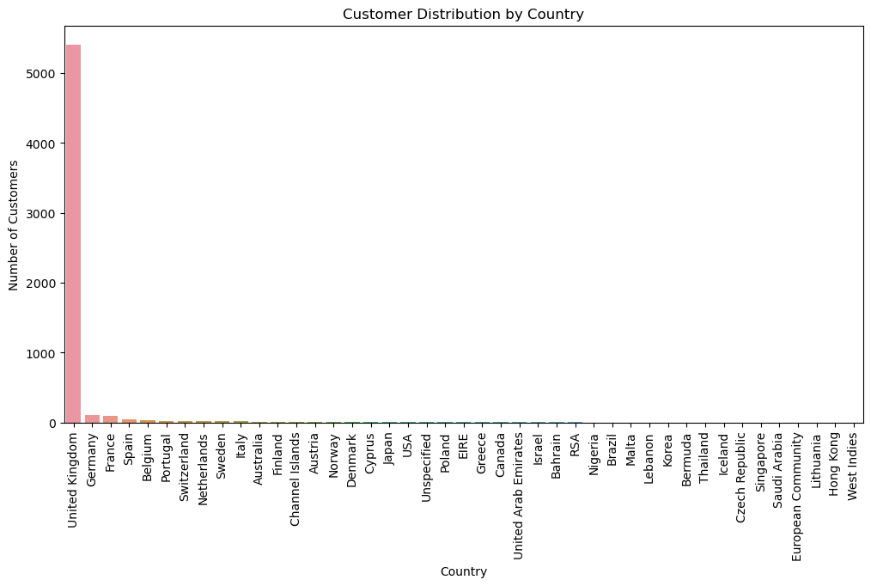
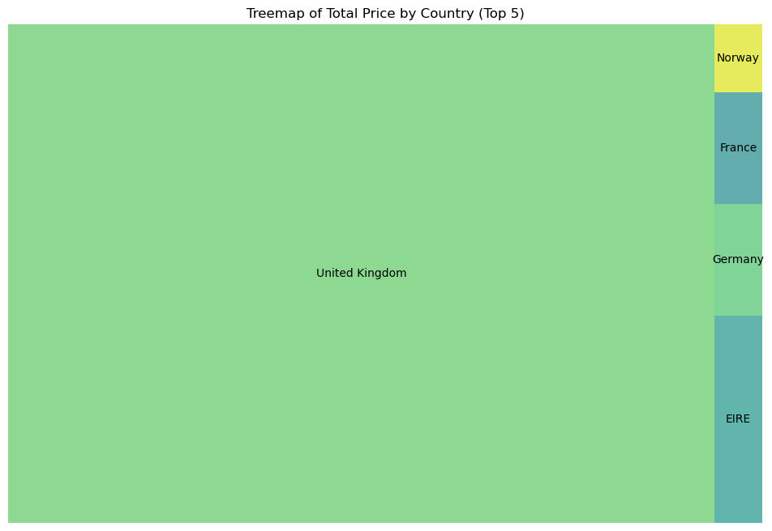
Exploratory Data Analysis: Customer distribution by country
Understanding how price is distributed per country.
UK have significantly higher customer
base compared to others.
Can be attributed to Gross Domestic
Product and Per Capita income of the
country.
3. Developed countries have higher
spending power.
4. Lesser drift b/w Income &
expenditure.
5. Remote places would have an access
to a Decathlon store in a developed
country as compared to a third world
country.
6. Shipping costs, custom duties are also
some of the factors that do affect consumer
mindset.

Slide 9
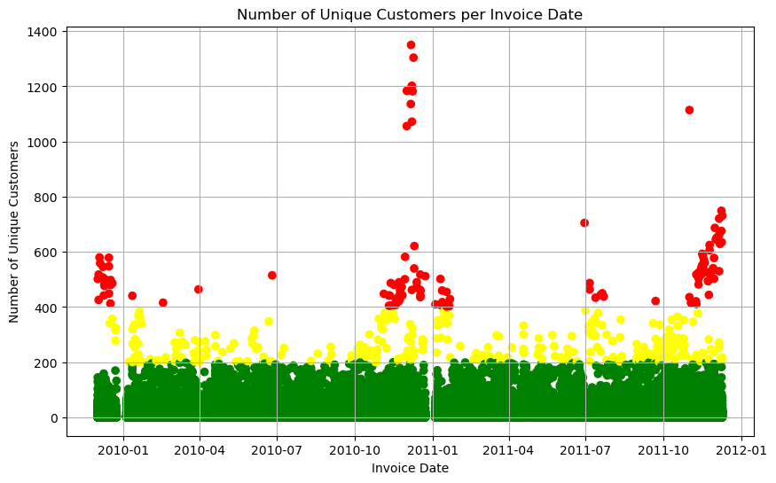
Exploratory Data Analysis: Repeat Customers
Understanding the customer traffic
per month.
Red co-ordinates indicates
high consumer traffic.
Gives retail owners a clear
idea about the dates one can
stock their Inventory.
Less consumer traffic>
more permissible time to
stock up & vice versa.
Scatter plot mimics the price &
revenue plot, where one can see
high consumer purchase for the
month of Oct-Dec.

Slide 10
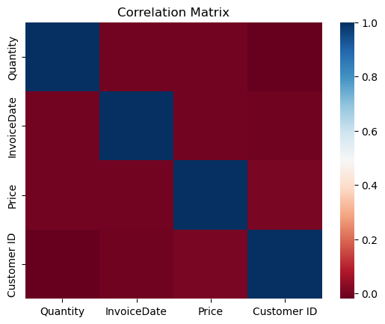
Exploratory Data Analysis: Analysing Correlations
Understanding how different attributes are correlated.
Correlation matrix displays any kind of dependency visible
in data.
This helps analysts to see whether the data is showing any
kind of proportional trend.
3. Higher dependency is translated as (1) lighter colour gradient
and darker colour gradient (0) means no correlation.
4. To give an example, No relation between Quantity and
Customer ID, however the correlation between Quantity and
Price exists (lighter shade of red).
5. This translates to the fact that the Price scales equally with
quantity.
6. It is important to check correlation if one has to predict/forecast values in future

Slide 11
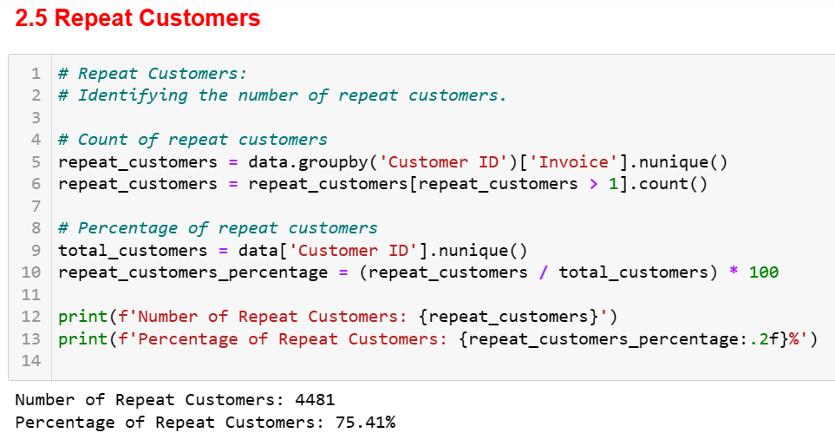
Exploratory Data Analysis: Repeat Customers
Understanding the CRR (Customer retention Ratio)
CRR is a metric to check the highly frequent
customers.
Customers are drawn towards a product when
the product satiates the need of consumers.
Some consumers are choosy, so
an eclectic range of product availability is
something a consumer looks forward to.
Elite brands do sell well because they do
have attractive designs for consumers to
select.
5. Comfort & durability of a product is also
something that’s very pivotal for a customer.
6. Using Customer segmentation (with K-means) one can cluster the customers depending on their frequency of purchase
and provide some tempting offers/discounts/cashbacks to less frequent customers to boost the sales.

Slide 12
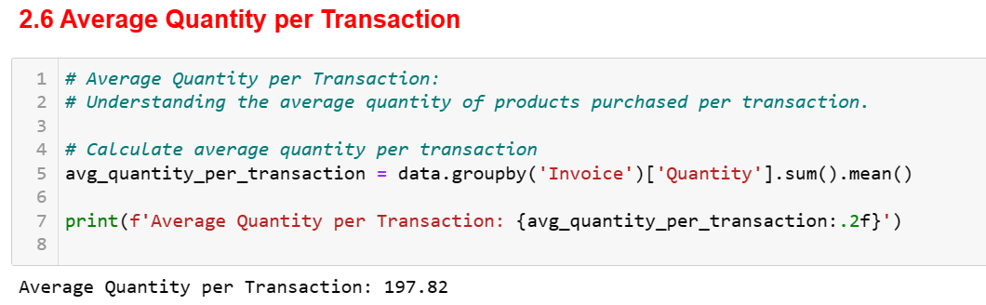
Exploratory Data Analysis: Average Quantity per Transaction
Understanding the average quantity of products purchased per single invoice.
It isn’t humanly possible to keep a track of
every single entry of a purchased item.
2. This could be fast-tracked if we estimate Avg.
Quantity per transaction.
Helps dealer get transparency on
frequency of products purchased per invoice.
This is helpful in handling consumer grievances
regarding untimely deliveries.

Slide 13
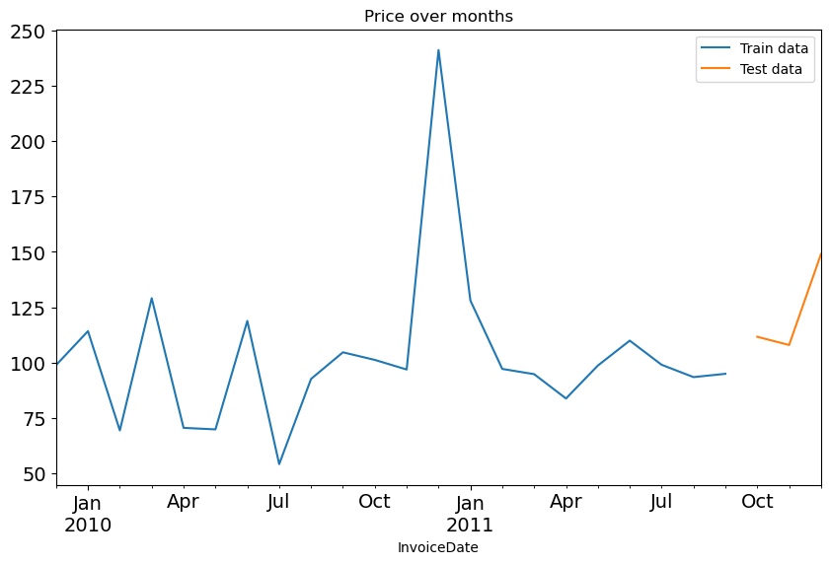
Forecasting the Price in future using Reinforcement ML
We can also forecast the value of Price in future using Reinforcement ML (Time Series analysis).
We’ve to perform some preprocessing before we train our data.
# Preprocessing
Filtering out unnecessary columns.
2. Sorting InvoiceDate in ascending order.
Grouping InvoiceDate
Setting InvoiceDate as Index.
Resampling the data in ‘y’.
Splitting ‘y’ in train & test.
Furthermore, EDA on ‘y’ will clearly display us the split of
training & testing data. More the training data, better would be the forecast.

Slide 14
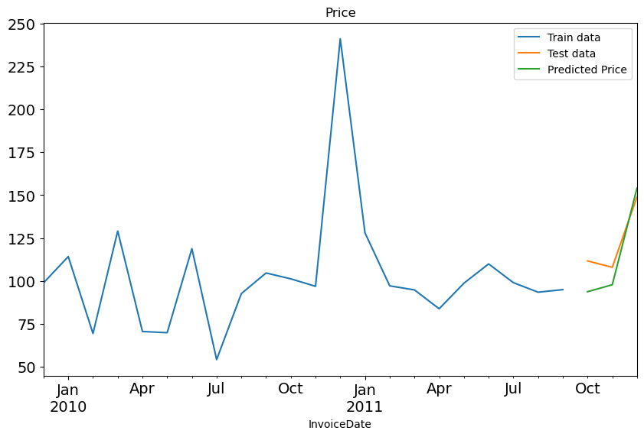
Forecasting the Price in future using Reinforcement ML
We now apply the Holt Winter (Triple exponential smoothing model) to forecast values on test data.
# Forecasting
Here we fit the model on train data.
We add seasonality & trend with seasonal period = 6.
Green colour (Predicted price) is the forecasted price.
4. This curve closely maps the test data indicating correct
predictions.
5. Forecasting will give analysts an idea on how much the
price is going to inflate or deflate making them cognizant
about handling the market capital, inventory regulation
& monitoring supply chain workflow.
The accuracy of the model can be confirmed by further
evaluation using RMSE which turns out to be as low as 12.24.
Lastly, I’ve saved the model in ‘model.pkl’ file which can be used
by Decathlon to forecast Price for any InvoiceDate

Slide 15

Thank you

