Slide 1
Solutions to Bayesian Inverse Problems using VAE
Ninad Chavan
MTech Data Science
142202021

Slide 2
Content
Dataset Preparation
Parameter estimation using Conditional VAE (C-VAE)
Parameter estimation using UQ-VAE
Results & Conclusion

Slide 3
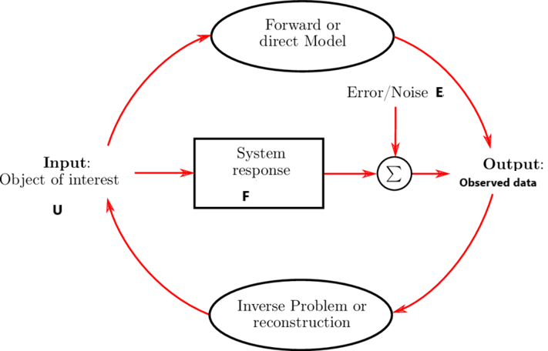
Inverse Problem
Inverse Problems mathematically,
Yobs = F (U ) + E
U – parameter to be estimated
F – parameter to Observations function
Yobs – observed data
E – Error in observations (measurements)

Slide 4
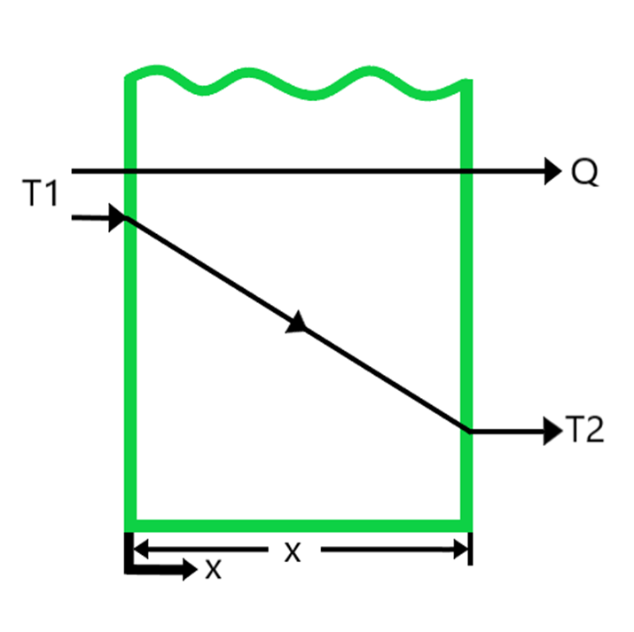


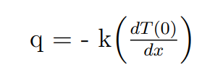

One Parameter Estimation Inverse Problem
To find thermal conductivity k of material from data of temperature distribution
General Equation for One dimensional heat conduction through a slab
Considering steady state with no heat generation,
and isotropic material :
Conduction
Convection
Heat Flux
q
k
h
Boundary Conditions

Slide 5


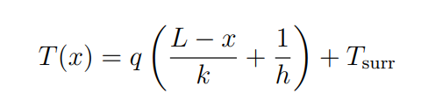
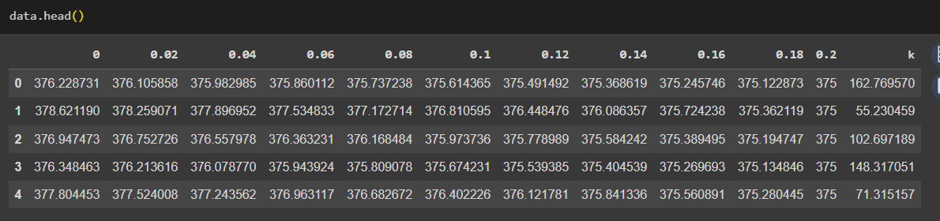
Dataset for One Parameter Estimation
Integrating wrt x, once twice
Applying Boundary Conditions, we get
Dataset of 1000 rows and 12 columns

Slide 6
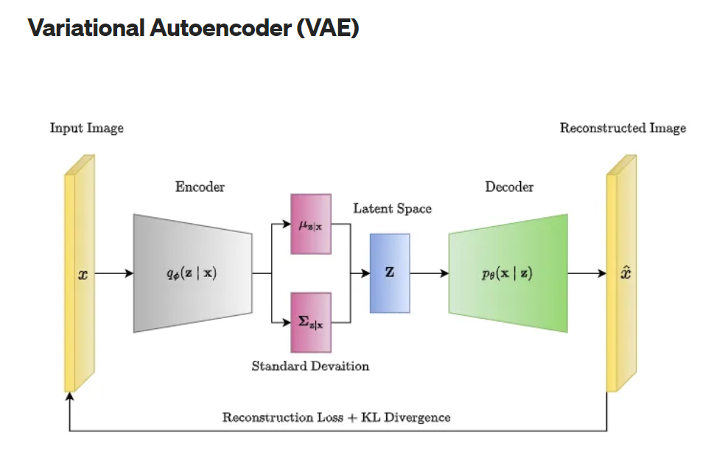
VAE Architecture

Slide 7
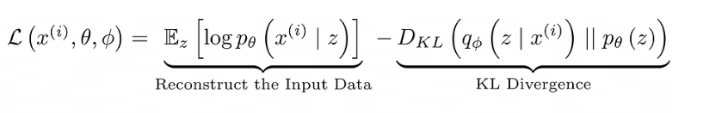
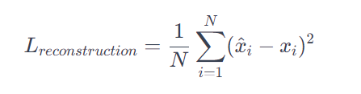


VAE Loss Function
Expressing loss function in terms of x, mean variances:
Substitute Γ₂= 1 ; μ₂ = 0 in above eqn

Slide 8
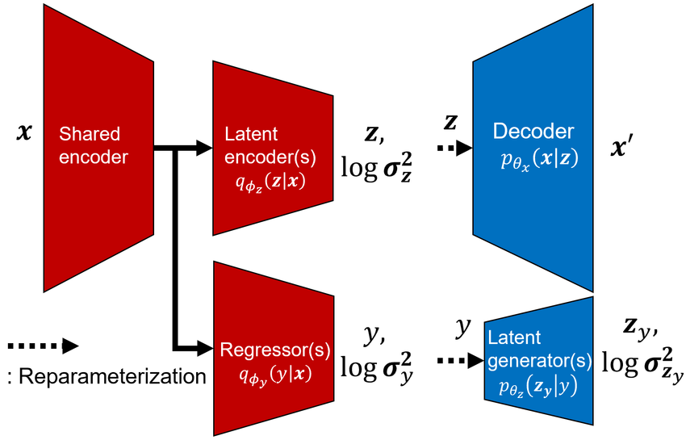
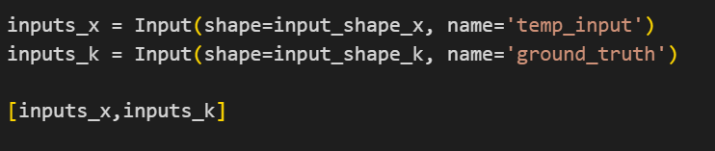
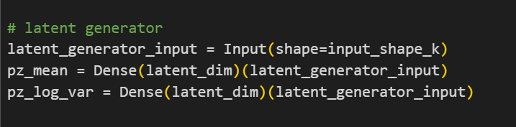
Conditional VAE (C-VAE) Architecture
In this picture, consider y as the variable for thermal conductivity k

Slide 9
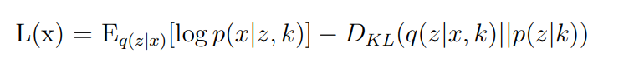

Conditional VAE Loss Function
Reconstruction Loss - Encourages the decoded reconstruction from the latent representation to resemble the input x
KL divergence loss - Encourages the posterior q(z|x) to resemble the specific prior conditional distribution p(z|k)
Label Loss - Aids in training the model to generate latent representations that accurately predicts the provided conditional information

Slide 10


Final Equation of Loss Function C-VAE
1) Reconstruction Loss
2) KL Divergence Loss: Substitute
3) Label Loss: Substitute

Slide 11
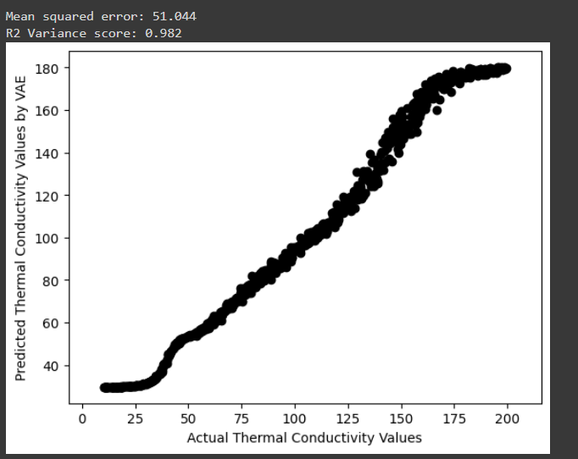
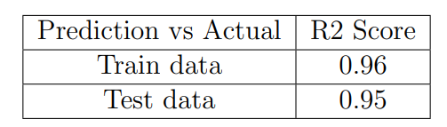
Results: C-VAE
5 % Std Gaussian Noise

Slide 12
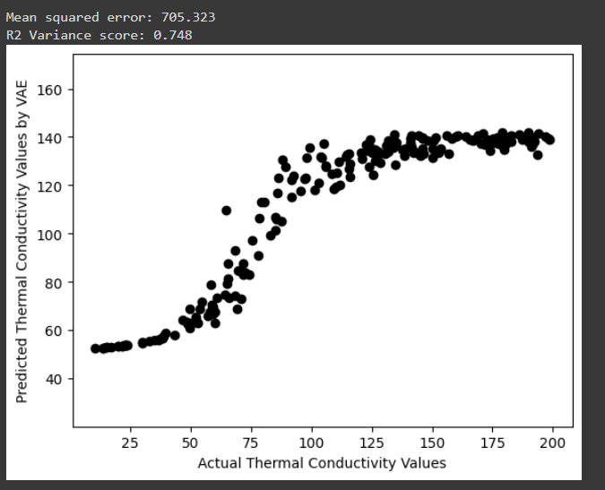
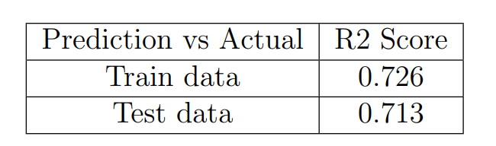
Results : C-VAE
50 % Std Gaussian Noise

Slide 13
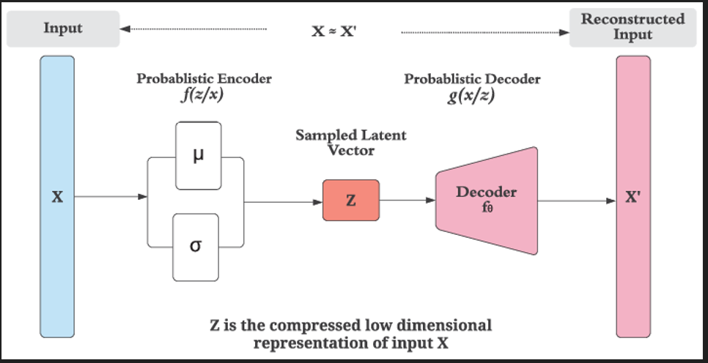
UQ – VAE Architecture
Only 1 latent space, unlike C-VAE. Dimension of z(latent space) is based on the number of parameters to estimate.

Slide 14
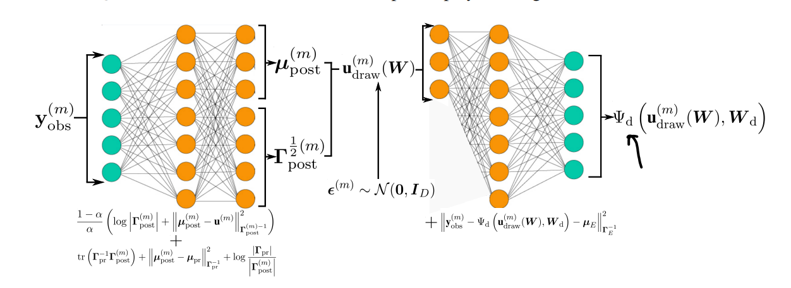
UQ-VAE Notations

Slide 15


UQ – VAE Loss Function
1) Reconstruction Loss
(upost​,Γpost​) is obtained after encoding
2) KL Divergence Loss:
We have data-pairs of (um,ym) Sub
Label Loss:
We have prior information (upr​,Γpr​) Sub

Slide 16
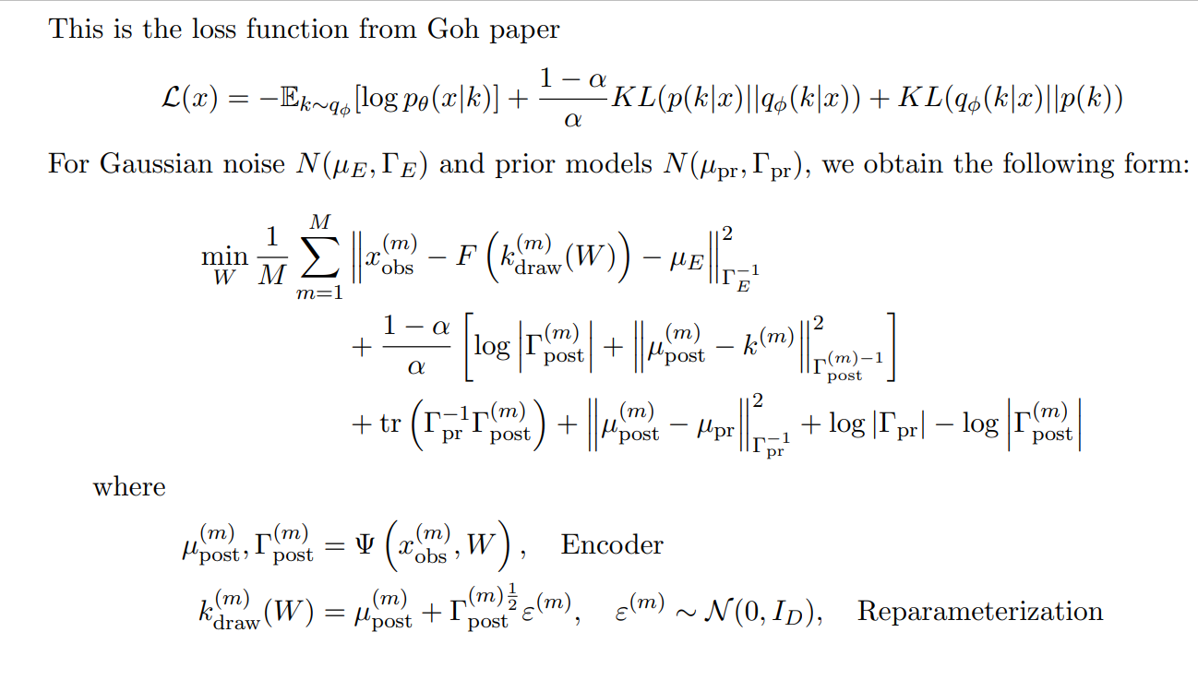
Final Equation Loss Function: UQ-VAE

Slide 17
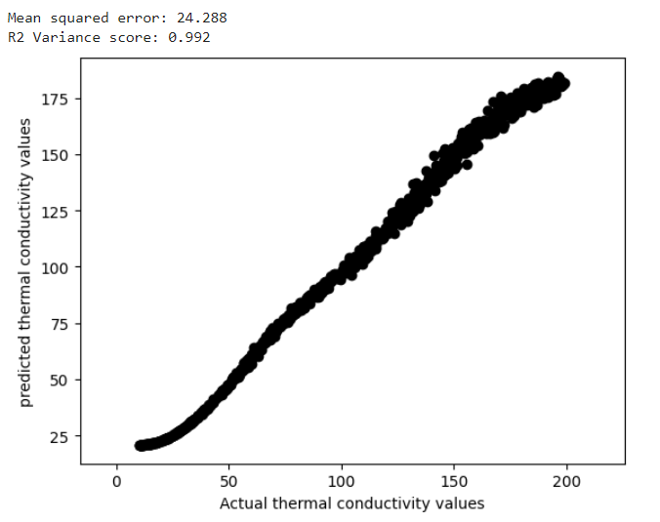
Results : UQ - VAE
5 % Std Gaussian Noise
Prediction vs Actual | R2 Score
Train data | 0.992
Test Data | 0.98

Slide 18
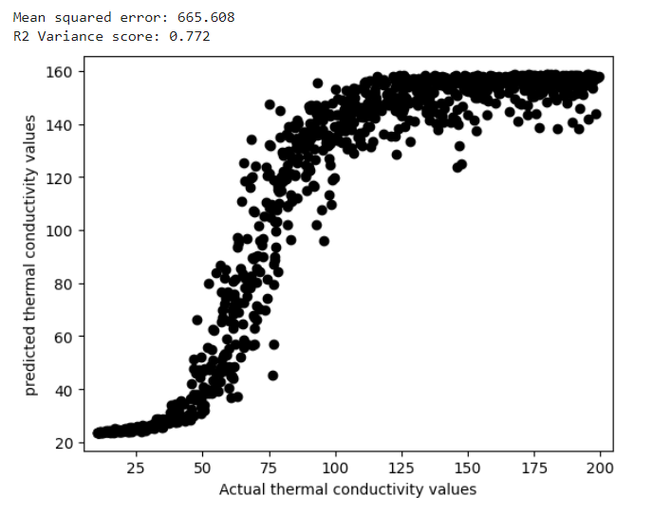
Results : UQ - VAE
50 % Std Gaussian Noise
Prediction vs Actual | R2 Score
Train data | 0.772
Test Data | 0.71

Slide 19
THANKYOU

