Slide 1
QUANTUM VS CLASSICAL OPTIMIZATION
Solving the Capacitated Vehicle Routing Problem
OR-Tools (classical) vs. QAOA on Qiskit Aer (quantum) — an honest, reproducible benchmark
Internship Project | Ninad Hirani

Slide 2
The Problem
Capacitated Vehicle Routing Problem (CVRP)
A depot must dispatch a fleet of vehicles to serve a set of customers, each with its own demand
Goal: minimize total distance traveled, without any vehicle exceeding its capacity
NP-hard — it generalizes the Traveling Salesman Problem, so exact solvers don't scale
This is exactly why both classical heuristics and quantum optimization are worth comparing
Depot
Customer nodes with demand

Slide 3
Two Approaches, One Benchmark
Same problem instance, solved both ways, compared honestly
CLASSICAL
QUANTUM
OR-Tools — Guided Local Search
QAOA on Qiskit Aer
1
Build the distance matrix from customer coordinates
1
Encode routes as a QUBO (binary decision variables + penalty terms)
2
Metaheuristic search: local moves + guided perturbation
2
Map QUBO to an Ising Hamiltonian
3
Fast, scalable, no optimality guarantee
3
Run p-layer QAOA; classical optimizer (COBYLA) tunes the circuit angles

Slide 4
Experiment Setup
Fixed instance, seeded for reproducibility
3
2
15
42
Customers
Vehicles
Capacity / Vehicle
Random Seed
QAOA configuration
Why only 3 customers?
17 qubits (position-encoded QUBO)
p = 2 QAOA layers
COBYLA classical optimizer, 100 max iterations
Statevector simulator (no real QPU access)
Statevector simulation scales exponentially. 4 customers needs 24 qubits (~1hr+ to simulate); 5 needs 33 qubits — intractable on a standard CPU. 3 customers keeps the demo honest and fast (~1 minute).

Slide 5
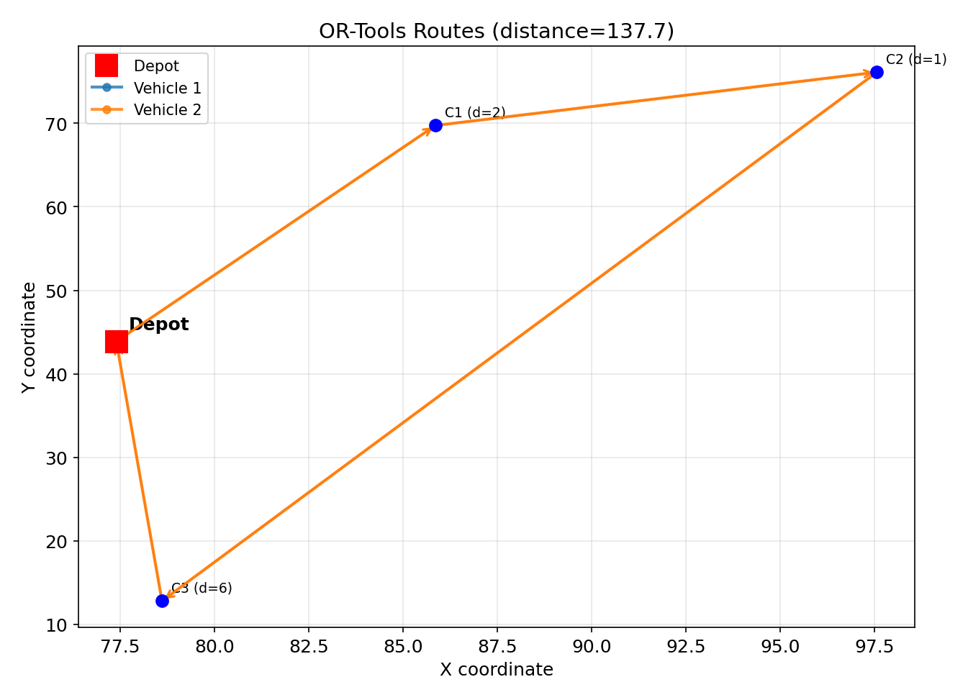
Classical Results — OR-Tools
137.71
Total Distance
5.0s
Runtime
100%
Feasible

Slide 6
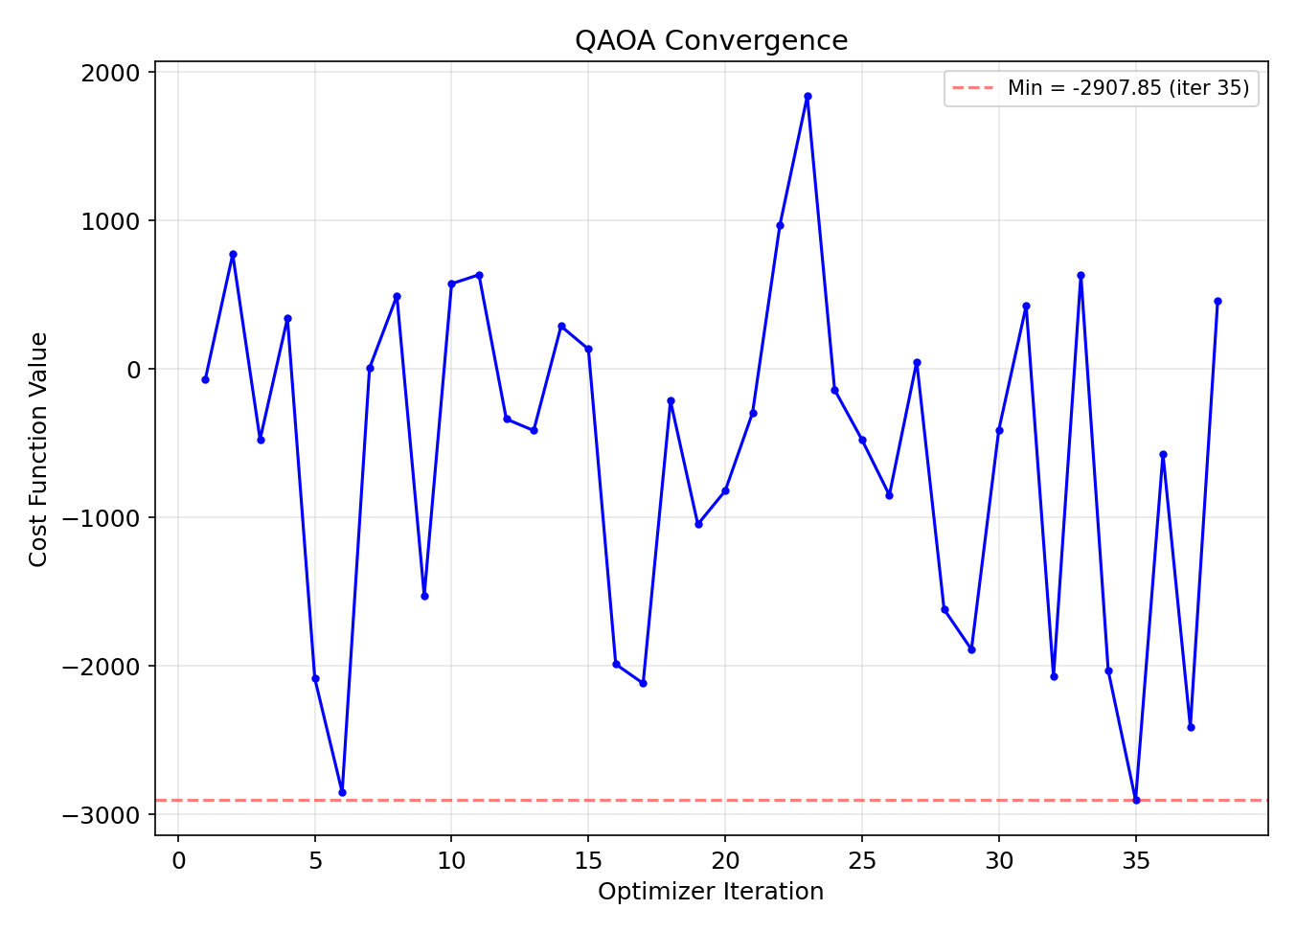
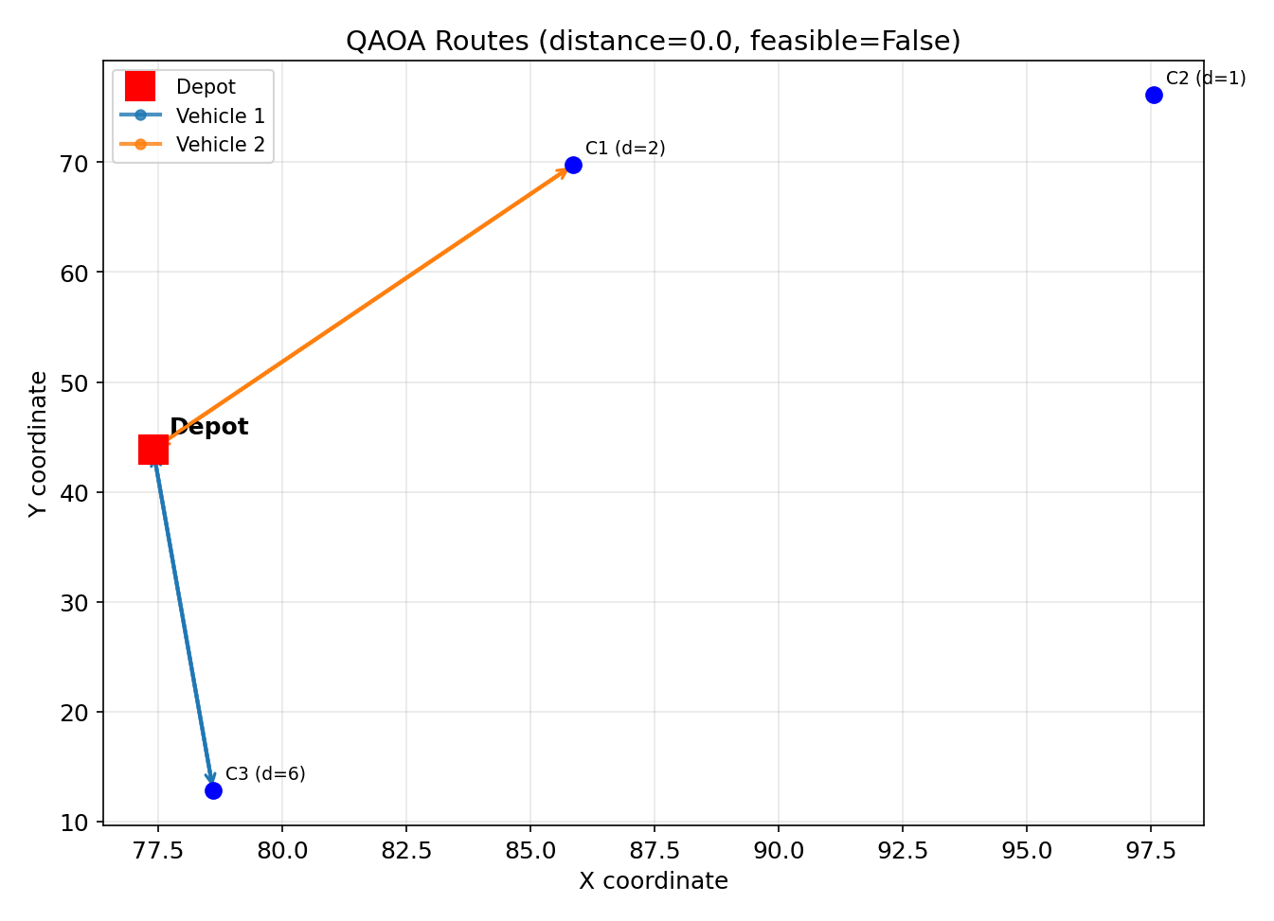
Quantum Results — QAOA
67.8s
Runtime
17
Qubits
Infeasible
Decoded Solution

Slide 7
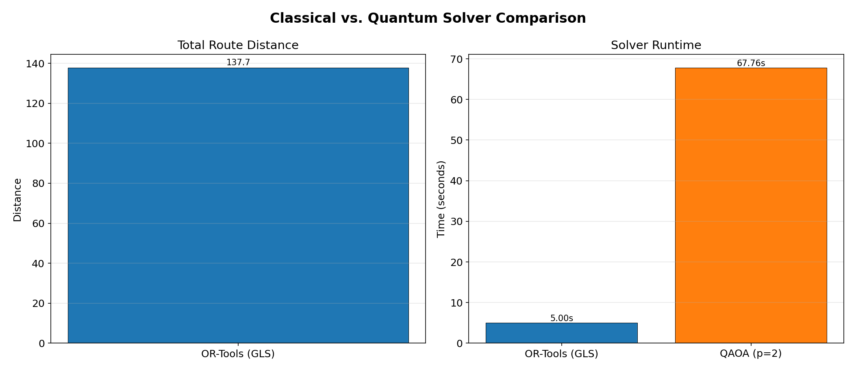
Head-to-Head Comparison
On this instance size, classical wins on every axis that matters today.

Slide 8
Key Findings
1
2
OR-Tools consistently wins
QAOA is honestly reported
Feasible, near-optimal solutions in seconds — no surprise, it's a mature, purpose-built solver.
The p=2 run came back infeasible rather than being cherry-picked — this is expected at NISQ-era scale, not a bug.
3
4
Qubit count is the real bottleneck
Reproducibility was fixed and verified
Position encoding scales fast: 3 customers → 17 qubits, 4 → 24, 5 → 33. Simulation cost grows exponentially.
Fresh-clone install, full pipeline run, and figures/benchmark numbers now match the code exactly.

Slide 9
What I'd Try Next
Increase QAOA layers (p ≥ 3) to improve approximation quality, trading off circuit depth
1
Tune penalty weights more carefully — infeasibility is often a penalty-balance problem, not just qubit count
2
Try warm-started parameters instead of random initial angles
3
Explore a more qubit-efficient encoding to push past the 3-customer ceiling
4
Benchmark against real QPU hardware once problem size allows
5

Slide 10
Thank You
Questions & discussion

