Slide 1


DoTA: Latent Distribution Conditioned Data Attribution for Diffusion Models
Authored by
Ninad Joshi
Vivek Srivastava
Shirish Karande

Slide 2

Problem Formulation: Data Attribution in Diffusion Models
Given a generated image, which training samples influenced it?
Why it matters:
Legal transparency
Dataset auditing
Bias detection
Model debugging
Challenges faced while working with Diffusion Models?
No single forward pass decision
Multi-step denoising trajectory
Stochastic sampling

Slide 3
Existing Attribution Paradigms
Training-Based / Model Dependent Methods
Influence Function Approaches:
Loss-derivative–based influence estimation [6], [1], [12] .
Retraining / Counterfactual Methods
Leave-one-out or upweighting via retraining [14], [15] .
Diffusion-Specific Training-Time Methods:
Surrogate trajectory modeling [7], [8].
Runtime attribution (Montrage) [2].
Gradient based methods:
TRAK, DTRAK [11], [4].
Shapley based Group attribution [3], [9].
Training-Free / Model-Agnostic Methods
Similarity-Based: Heuristics CLIP / DINO v2 embedding similarity [13], [10].

Slide 4
Limitations of Existing Attribution Paradigms
Scalability
Retraining and unlearning require repeated optimization [13], [14].
Influence functions require Hessian inversion; unstable in deep non-convex models [5], [1], [11].
Architectural Dependence
Gradient / training-log access required (TRAK-style methods) [10], [4].
Runtime instrumentation tied to internal model execution [2].
Latent-trajectory methods restricted to specific diffusion architectures [6], [7].
Fragility in Diffusion Settings
Stochastic denoising undermines gradient-linearity assumptions [5], [1].
Classical convexity assumptions violated in deep diffusion models [5], [11].
Faithfulness
Similarity-based methods capture correlation, not causal influence [12], [9].
Shapley utilities often rely on retraining or simplified surrogates [3], [8].
.
Absence of generic, free from model dependency method that can be scaled.

Slide 5
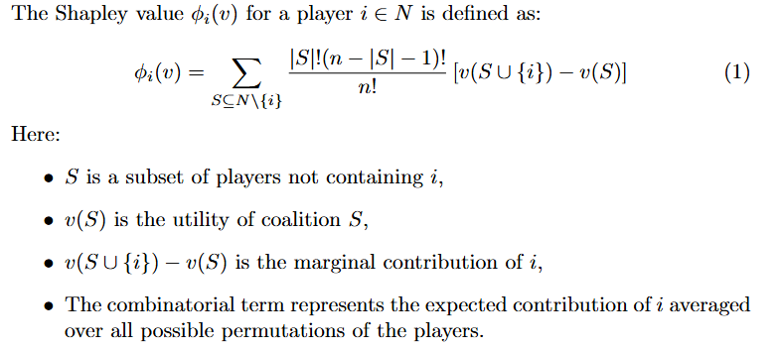
Mathematical Prerequisites - Shapley Values
Proposed by Lloyd Shapley in the year 1953 [15] .
Inspired by the Coalitional Game theory, We employ the concept of Shapley Values for computing per sample contribution. We define the problem of attribution as a coalitional game, where each sample is a player and we wish to numerically quantify the importance of each players to win the game.
Shapley values are computed based on the study of marginal contribution of a sample across various coalitions. Hence, the sample with the highest Shapley values could have contributed the most across all the possible coalitions.

Slide 6
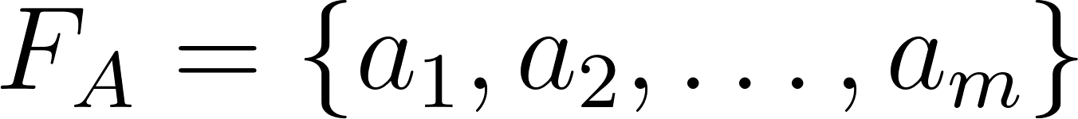
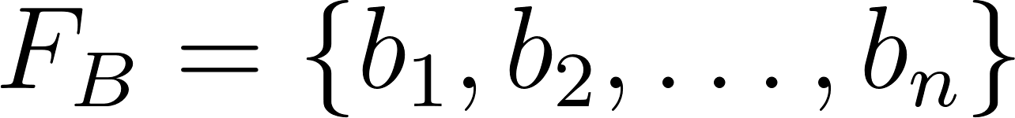

Mathematical Prerequisites - Energy Distance
We use Energy Distance (ED) as the metric to compute the dissimilarity between two distributions. The equation given for computing ED between two distributions P and Q is given by Equation given below. Let and be two sets of latent representations drawn from distribution P and Q, respectively.
(2)
Energy Distance enables us to compute distribution dissimilarity with no parametric assumptions.
High Energy Distance implies more dissimilar distributions.
We Mathematically back the utilization of Energy Distance as a metric that can be used as a utility function for computing shapley values in the supplementary material.

Slide 7
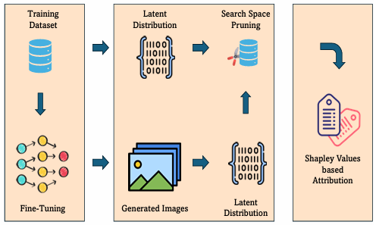
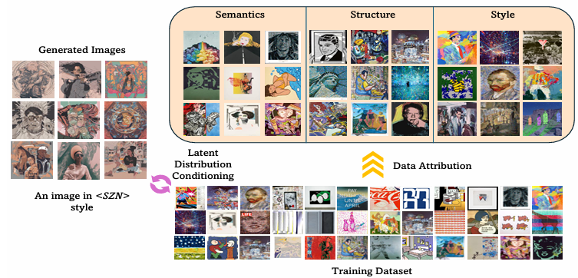
Proposed Framework: Distribution-Conditioned Attribution

Slide 8
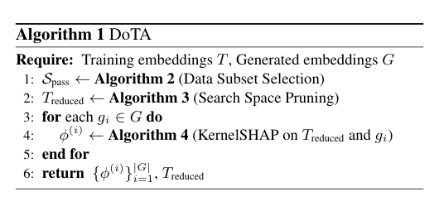
DoTA: Algorithm
Note that: we utilize dimensionality reduction approach such as PCA to reduce the dimension of the embeddings.
Attribute | Representation Used
Semantics | CLIP [20]
Structure | DINO v2 [21]
Style | Gram Matrix (VGG-19)[22]

Slide 9
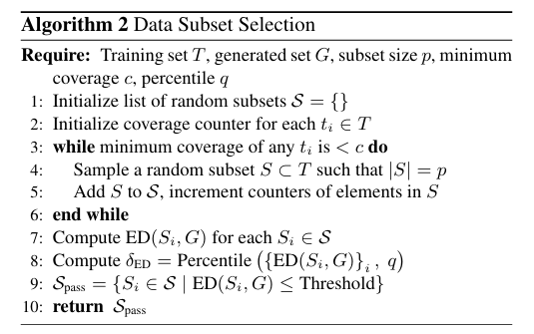
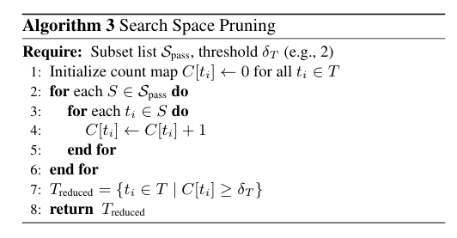
DoTA: Data Subset Selection and Search Space Pruning

Slide 10
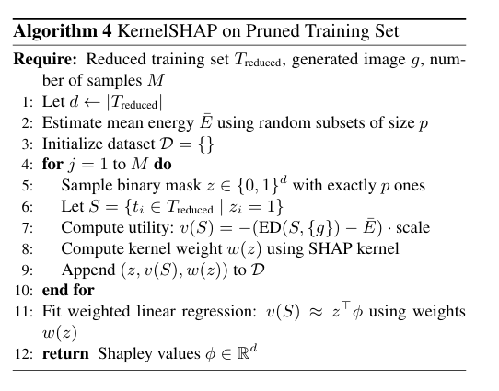
DoTA: KernelSHAP
DoTA proposes using Enegry Distance as utility function.
Avoids training.
Distribution-aware utility.
Ensures attribute specific utility.

Slide 11
Counterfactual Evaluation Protocol
We conduct extensive experiments on the proposed approach under two counterfactual setups:
Take-K
Train only on top K% attributed samples (taken K = 5) → Does model reconstruct style?
Leave-K
Remove top K% attributed samples (taken K = 5) → Does style confidence drop?
We employ a multi-class style classifier trained on multiple artistic styles as proposed in the UnlearnCanvas [16].
We define two metric based on the classification probability assigned by the classifier.
Absolute Style Confidence (ASC) : average classification probability of the target style.
Relative Style Confidence (RSC) : average of classification probability normalized by rank of the target style.
Note that: Ideal pattern for a effective attribution method must be that the ASC and RSC must go high for samples generated via model trained on Take-K. Likewise, it must go low for samples generated via model trained on Leave-K.
We further evaluate robustness under an adversarial attack setup by injecting adversarial artworks into the attribution pool and measuring the stability of top-K influential samples and counterfactual retraining fidelity.

Slide 12
Experimental Setup
We perform Low-Rank Adaptation based fine-tuning of the Stable Diffusion XL mode [23].
We evaluated our approach on three datasets:
PopArt (Wikiart) [17]: 1482 artworks.
Ukiyo-e [18]: 2000 artworks.
Edvard Munch [19]: 5891 artworks.
These datasets vary in scale and capture unique fine-grained artistic details, providing a robust testbed for attribution.
We also report runtime and memory for DoTA without pruning, and DoTA with ED-based Search Space Pruning, demonstrating significant computational reduction while preserving attribution fidelity.

Slide 13
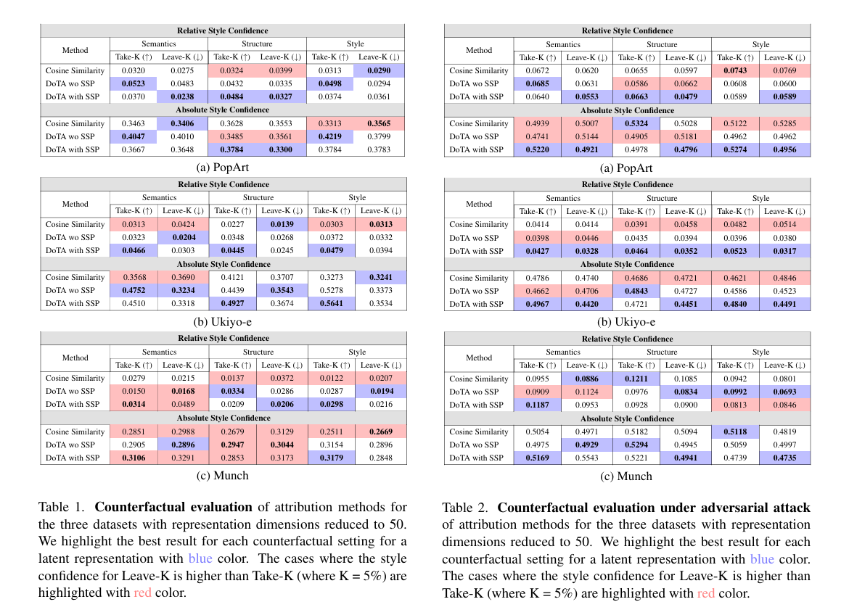
Qualitative Results

Slide 14
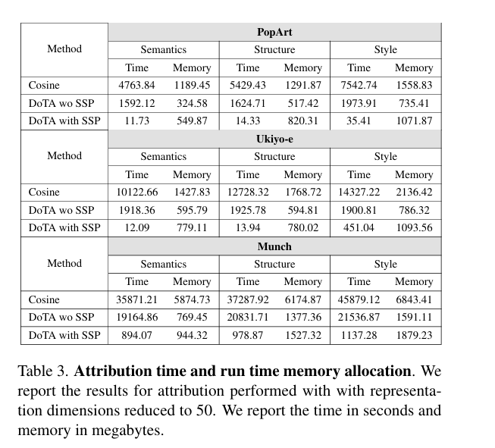
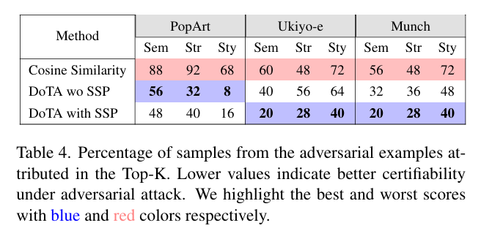
Qualitative Results

Slide 15
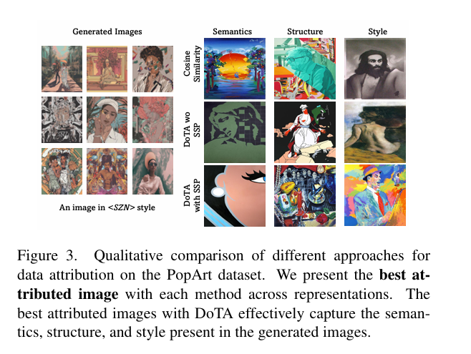
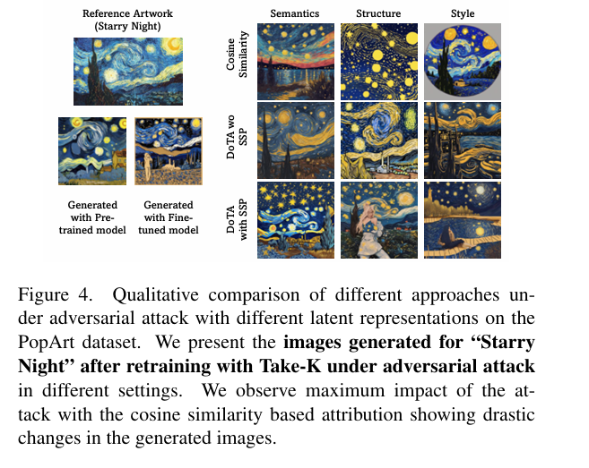
Quantitative Results

Slide 16
Conclusion
We propose the first latent distribution conditioned attribution for diffusion models.
We introduce an approach for Search space pruning via Energy Distance.
A generic algorithm, which is
model agnostic, hence can be used in black-box setting.
scalable.
attribute of choice.
Robust under adversarial settings

Slide 17
References
[1] S. Basu et al., Influence Functions Are Fragile, arXiv, 2020.
[2] J. Brokman et al., Montrage: Monitoring Training for Attribution of Generative Diffusion Models, ECCV, 2025.
[3] A. Ghorbani and J. Zou, Data Shapley: Equitable Valuation of Data for Machine Learning, ICML, 2019.
[4] A. Jha et al., Data Attribution in Diffusion Models via TRAK, CVPR, 2023.
[5] P. W. Koh and P. Liang, Understanding Black-Box Predictions via Influence Functions, ICML, 2017.
[6] Y. Lin et al., Efficient Attribution for Diffusion Models Without Retraining, arXiv, 2024.
[7] (Surrogate trajectory modeling paper as cited in DoTA.)
[8] S. Lundberg and S.-I. Lee, A Unified Approach to Interpreting Model Predictions, NeurIPS, 2017.
[9] M. Oquab et al., DINOv2: Learning Robust Visual Features Without Supervision, CVPR, 2023.
[10] S. Park et al., TRAK: Understanding the Transfer of Knowledge in Transfer Learning, ICLR, 2023.

Slide 18
References
[11] G. Pruthi et al., Estimating Training Data Influence by Tracing Gradient Descent, NeurIPS, 2020.
[12] A. Radford et al., CLIP: Learning Transferable Visual Models from Natural Language Supervision, ICML, 2021.
[13] N. Sohoni et al., No Subpopulation Left Behind, NeurIPS, 2020.
[14] S.-Y. Wang et al., Data Attribution for Text-to-Image Models by Unlearning Synthesized Images, arXiv, 2025.
[15] L. S. Shapley, A Value for n-Person Games, in Contributions to the Theory of Games, vol. II, Princeton University Press, 1953.
[16] S.-Y. Wang, A. Hertzmann, A. A. Efros, J.-Y. Zhu, and R. Zhang, UnlearnCanvas: A Stylized Image Dataset to Benchmark Machine Unlearning for Diffusion Models, arXiv, 2023.
[17] F. Saleh and A. Elgammal, Large-scale Classification of Fine-Art Paintings: Learning The Right Metric on The Right Feature, arXiv:1505.00855, 2015. (WikiArt dataset)
[18] J. P. Bell and S. Ommer, Style Classification and Visualization of Art Paintings, ECCV Workshops, 2014. (Ukiyo-e subset commonly used in style recognition works)

Slide 19
References
[19] M. Tan, J. Peng, and L. Wang, Munch: A High-Resolution Artistic Style Dataset for Diffusion Model Evaluation, arXiv, 2023. (Curated Edvard Munch dataset)
[20] A. Radford, J. W. Kim, C. Hallacy, et al., Learning Transferable Visual Models from Natural Language Supervision (CLIP), ICML, 2021.
[21] M. Oquab, T. Darcet, T. Moutakanni, et al., DINOv2: Learning Robust Visual Features Without Supervision, CVPR, 2023.
[22] L. A. Gatys, A. S. Ecker, and M. Bethge, Image Style Transfer Using Convolutional Neural Networks, CVPR, 2016. (Introduced Gram Matrix–based style representation)
[23] D. Podell, Z. English, K. Lacey, A. Blattmann, T. Dockhorn, J. Müller, J. Penna, and R. Rombach, SDXL: Improving Latent Diffusion Models for High-Resolution Image Synthesis, arXiv:2307.01952, 2023.

Slide 20
Thank you

