Slide 1
DoTA: Latent Distribution Conditioned Data Attribution for Diffusion Models
Tata Consultancy Services
The IEEE/CVF Winter Conference
on Applications of Computer Vision 2026
Presented by
Ninad
Vivek
Shirish
Tata Consultancy Services
WACV 2026

Slide 2
Problem Formulation: Data Attribution in Diffusion Models
Given a generated image, which training samples influenced it?
Why it matters:
Legal transparency
Dataset auditing
Bias detection
Model debugging
Challenges faced while working with Diffusion Models?
No single forward pass decision
Multi-step denoising trajectory
Stochastic sampling
Tata Consultancy Services
WACV 2026

Slide 3
Existing Attribution Paradigms
Training-Based / Model Dependent Methods
Influence Function Approaches:
Loss-derivative–based influence estimation [1], [7], [8]
Retraining / Counterfactual Methods
Leave-one-out or upweighting via retraining [9], [19]
Diffusion-Specific Training-Time Methods:
Surrogate trajectory modeling [13]
Runtime attribution (Montrage) [14]
Gradient based methods:
TRAK, DTRAK, JTRAK [10–12]
Shapley based Group attribution
Training-Free / Model-Agnostic Methods
Similarity-Based: Heuristics CLIP / DINO v2 embedding similarity [20], [21]
Tata Consultancy Services
WACV 2026

Slide 4
Limitations of Existing Attribution Paradigms
Scalability
Retraining and unlearning require repeated optimization.
Influence functions require Hessian inversion; unstable in deep non-convex models.
Architectural Dependence
Gradient / training-log access required (TRAK-style methods).
Runtime instrumentation tied to internal model execution.
Latent-trajectory methods restricted to specific diffusion architectures.
Fragility in Diffusion Settings
Stochastic denoising undermines gradient-linearity assumptions.
Classical convexity assumptions violated in deep diffusion models.
Faithfulness
Similarity-based methods capture correlation, not causal influence.
Shapley utilities often rely on retraining or simplified surrogates
.
Absence of generic, free from model dependency method that can be scaled.
Tata Consultancy Services
WACV 2026

Slide 5
Mathematical Prerequisites
Tata Consultancy Services
WACV 2026
Notes:
Latent Distribution Conditioning + Energy Distance + Shapley Values to discuss

Slide 6
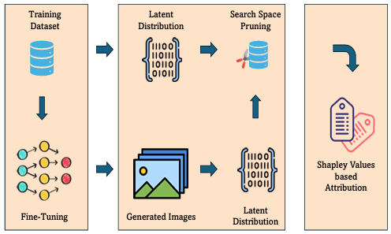
Proposed Framework: Distribution-Conditioned Attribution
Tata Consultancy Services
WACV 2026
Notes:
Latent Distribution Conditioning + Energy Distance + Shapley Values to discuss

Slide 7
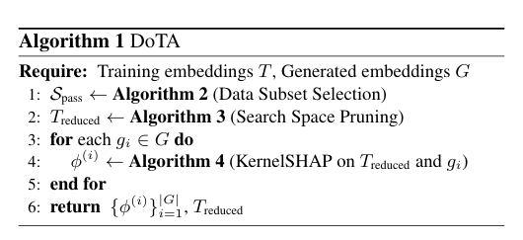
DoTA: Algorithm
Note that: we utilize dimensionality reduction approach such as PCA to reduce the dimension of the embeddings.
Attribute | Representation Used
Semantics | CLIP
Structure | DINO v2
Style | Gram Matrix (VGG-19)
Tata Consultancy Services
WACV 2026

Slide 8
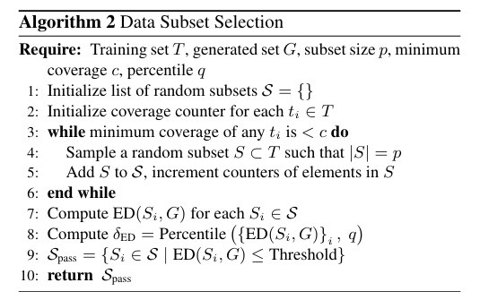
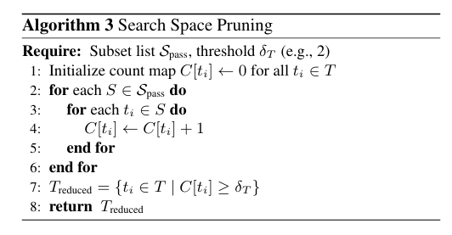
DoTA: Data Subset Selection and Search Space Pruning
Tata Consultancy Services
WACV 2026

Slide 9
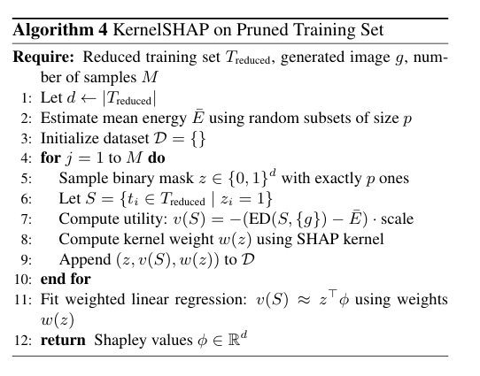
DoTA: KernelSHAP
DoTA proposes using Enegry Distance as utility function.
Avoids training.
Distribution-aware utility.
Ensures attribute specific utility.
Tata Consultancy Services
WACV 2026

Slide 10
Counterfactual Evaluation Protocol
We conduct extensive experiments on the proposed approach under two counterfactual setups:
Take-K
Train only on top K% attributed samples (taken K = 5) → Does model reconstruct style?
Leave-K
Remove top K% attributed samples (taken K = 5) → Does style confidence drop?
We employ a multi-class style classifier trained on multiple artistic styles as proposed in the UnlearnCanvas framework [].
We define two metric based on the classification probability assigned by the classifier.
Absolute Style Confidence (ASC) : average classification probability of the target style.
Relative Style Confidence (RSC) : average of classification probability normalized by rank of the target style.
Note that: Ideal pattern for a effective attribution method must be that the ASC and RSC must go high for samples generated via model trained on Take-K. Likewise, it must go low for for samples generated via model trained on Leave-K.
We further evaluate robustness under an adversarial attack setup by injecting adversarial artworks into the attribution pool and measuring the stability of top-K influential samples and counterfactual retraining fidelity.
Tata Consultancy Services
WACV 2026

Slide 11
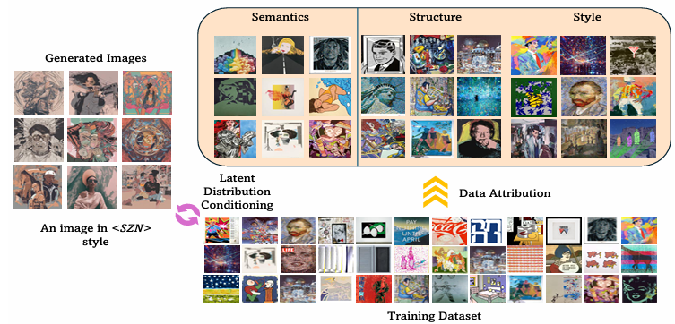
Experimental Setup
We perform Low-Rank Adaptation based fine-tuning of the Stable Diffusion XL model.
We evaluated our approach on three datasets:
PopArt (Wikiart): 1482 artworks.
Ukiyo-e: 2000 artworks.
Edvard Munch: 5891 artworks.
These datasets vary in scale and capture unique fine-grained artistic details, providing a robust testbed for attribution.
Attribute | Representation Used
Semantics | CLIP
Structure | DINO v2
Style | Gram Matrix (VGG-19)
Tata Consultancy Services
WACV 2026

Slide 12
Qualitative Results
Tata Consultancy Services
WACV 2026

Slide 13
Quantitative Results
Tata Consultancy Services
WACV 2026

Slide 14
Conclusion
We propose the first latent distribution conditioned attribution for diffusion models.
We introduce an approach for Search space pruning via Energy Distance.
A generic algorithm, which is
model agnostic, hence can be used in black-box setting.
scalable.
attribute of choice.
Robust under adversarial settings
Tata Consultancy Services
WACV 2026

Slide 15
References
[1]
Tata Consultancy Services
WACV 2026

Slide 16
Thank you
Tata Consultancy Services
WACV 2026
Year

