Slide 1
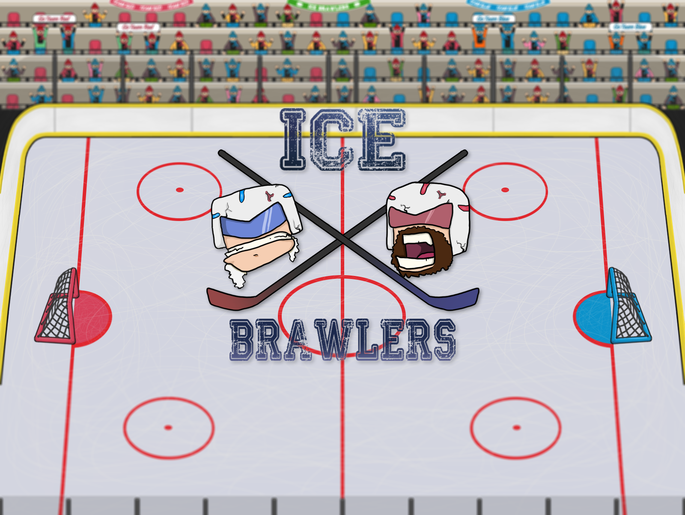

Slide 2
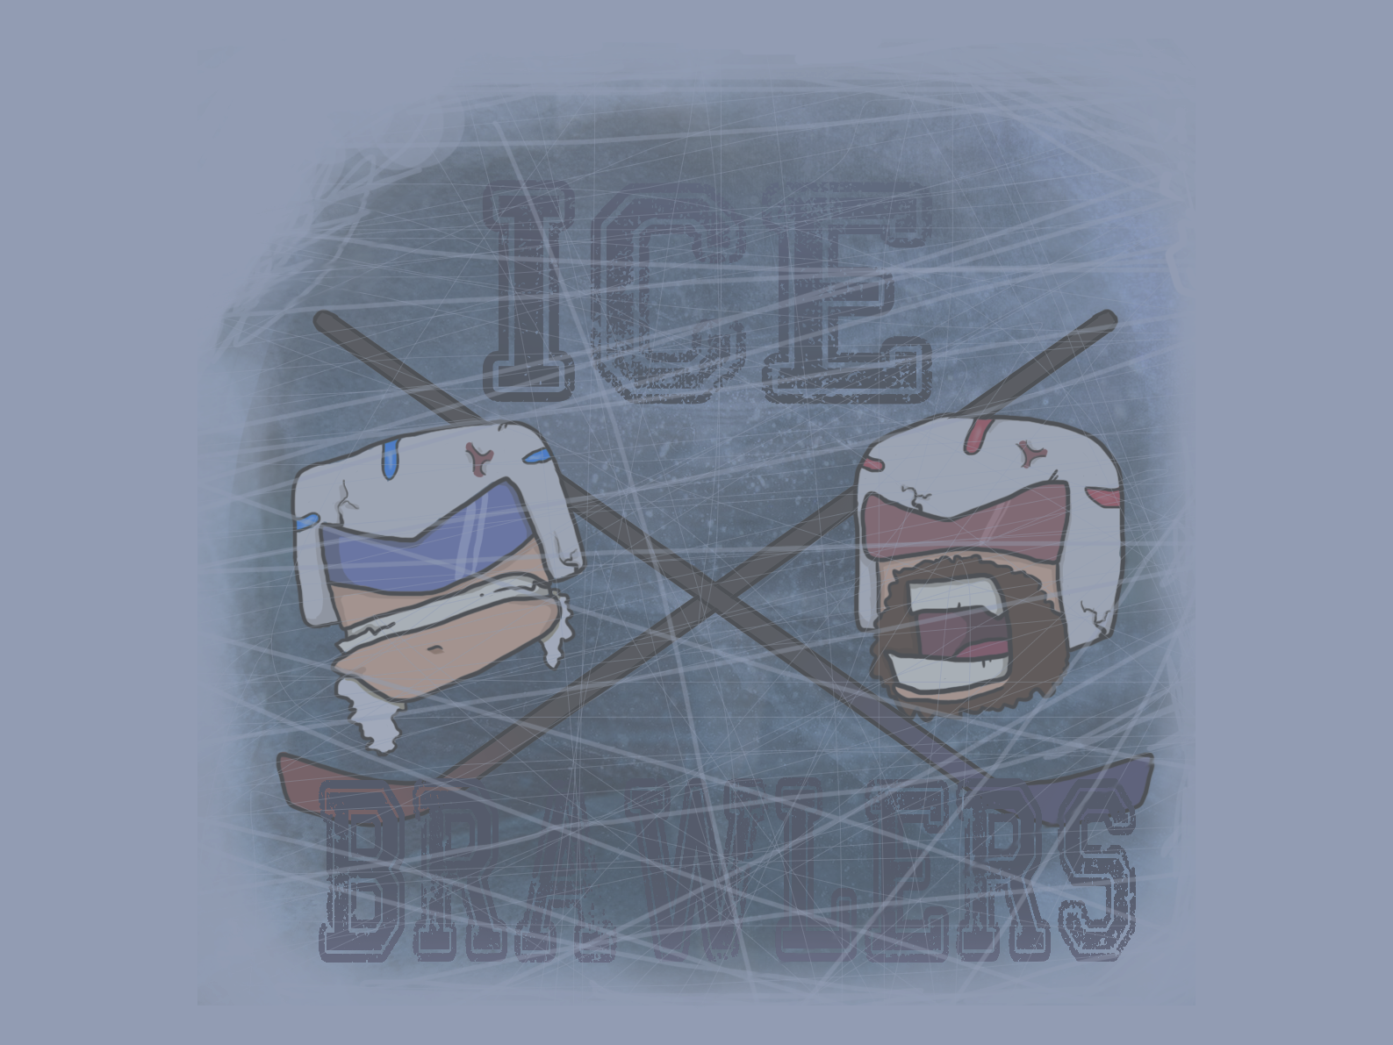
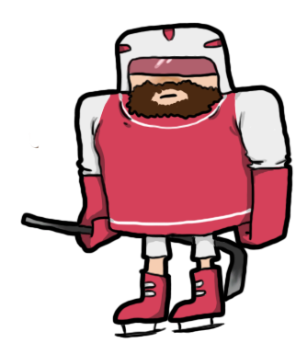
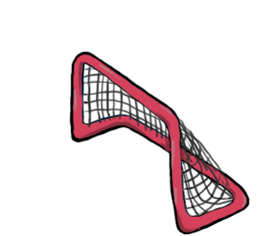

3.. 2.. 1.. Start!
ice hockey game
two players
defeat your opponent in 5 minutes!

Slide 3
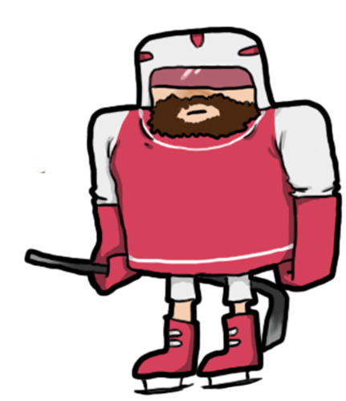
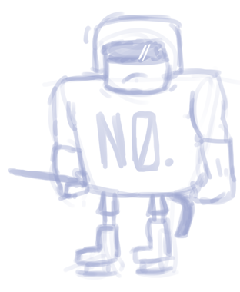
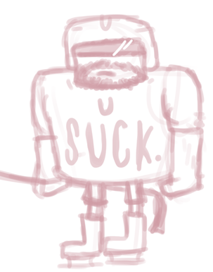
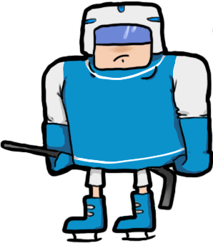
Game design
Colour scheme
concept style sheet
design style sheet
Thick dark outline
A bit faded colours

Slide 4
Planning
asset list
moscow
scrumsheet
burndown chart

Slide 5



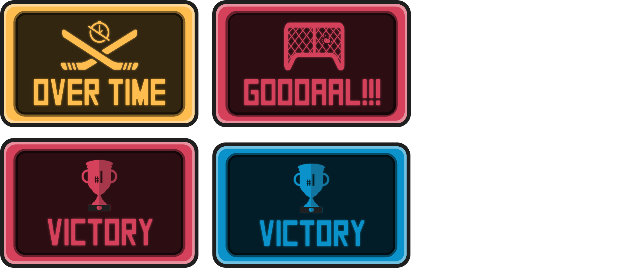
Creative design
Power-ups
User interface
Menu buttons

Slide 6
Technical design

Slide 7
The actual game

Slide 8
Lessons learned

Slide 9
Any questions?
Thanks for your attention

