Slide 1
COMP5331 GROUP 7 / WANG YIFAN
Social-LSTM pools neighboring motion histories
8 observed positions
12 future positions
Individual LSTM states
Spatial grid of neighbors
Pooled social representation
Gaussian displacement decoder
Residual-velocity adaptation
Autoregressive rollout
5 folds 3 seeds 15 training runs 20 sampled paths
EXPLORATORY STUDY · Shared causal_v2 evaluation pending
1 / 3
Notes:
My part is Social-LSTM, which adds information about nearby pedestrians to a recurrent trajectory predictor. The key idea comes from Alahi and colleagues: each pedestrian has a hidden state, and a spatial grid pools the hidden states of neighbors. This lets the next prediction depend on both individual motion and surrounding people.
Our model observes eight positions and predicts the next twelve. I implemented the pooling and recurrent prediction in PyTorch and ran five held-out scenes with three seeds, giving fifteen training runs. This implementation uses a Gaussian decoder with an additional residual-velocity connection. That is an adaptation, so I describe the results as an implementation study rather than an exact reproduction.
Source: Alahi et al., CVPR 2016, doi:10.1109/CVPR.2016.110. Local exploratory evidence only.

Slide 2
COMP5331 GROUP 7 / WANG YIFAN
Best-of-20 coverage differs from typical error
0.923 m
Average sample ADE
remains above the
constant-velocity baseline.
0.20 m history noise raises mean ADE to 2.548 m.
EXPLORATORY STUDY · Shared causal_v2 evaluation pending
2 / 3
Notes:
The main result is that best-sample accuracy and typical prediction error tell different stories. On our exploratory split, constant velocity has an ADE of about zero point five three meters. Social-LSTM's average error over twenty sampled paths is about zero point nine two meters. However, selecting the best of those twenty paths reduces the error to about zero point three five meters.
This means the model can generate a path close to the observed future, but many other samples drift away. The best-of-twenty number therefore does not show that our predictor is better than constant velocity for a single forecast. Robustness is also a limitation: with zero point two meters of observation noise, average ADE increases to about two point five five meters.
Source: Alahi et al., CVPR 2016, doi:10.1109/CVPR.2016.110. Local exploratory evidence only.

Slide 3
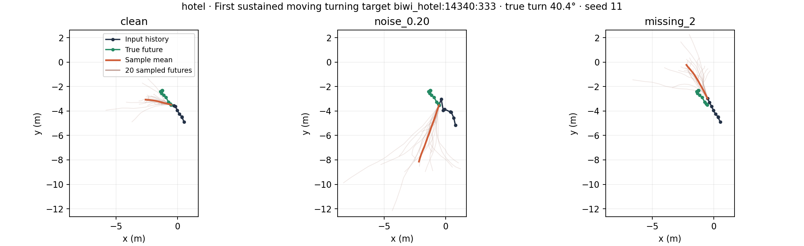
COMP5331 GROUP 7 / WANG YIFAN
Rollout diagnostics reveal accumulated drift
Sampled velocity feeds forward. Closed-loop quality needs validation.
EXPLORATORY STUDY · Shared causal_v2 evaluation pending
3 / 3
Notes:
The turning example illustrates this gap. Some predictions follow the future more closely, while others diverge. Our diagnostics identified one possible mechanism: the decoder feeds a sampled displacement into the next velocity estimate, so an early disturbance can influence several later positions. Also, selecting a checkpoint using teacher-forced likelihood does not directly evaluate the quality of a complete rollout.
A small control experiment did not solve the problem, so I am keeping that limitation explicit. The implementation and exploratory analysis are packaged, but the group's formal evaluation is still pending. It requires deterministic prediction, shared trajectory windows, and the same target-only perturbations as the other models. Until those checks pass, these numbers stay outside the common leaderboard. This gives us a reproducible starting point and a clear explanation of what needs validation before the final comparison.
Source: Alahi et al., CVPR 2016, doi:10.1109/CVPR.2016.110. Local exploratory evidence only.

