Slide 1
ONE-TIME PAD

Slide 2
Modern Cryptography
Definitions
Constructions
Proof
reductions
assumptions

Slide 3
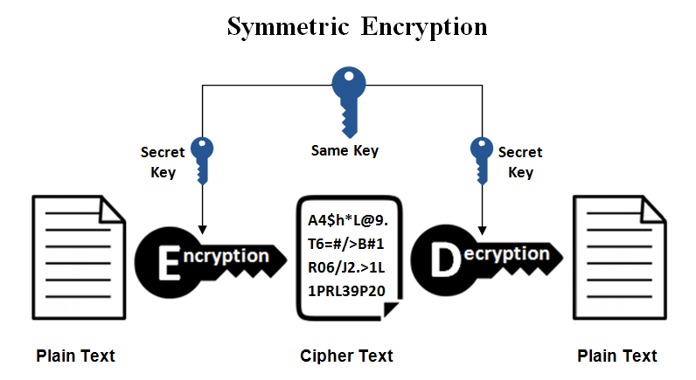
Symmetric-key Encryption

Slide 4

Definitions for encryption
Algorithms:
  $K$: secret key, $M$: message, $C$: ciphertext
  $K$ $=Gen()$
  $C= Enc(k,m)$
  $M=Dec(k,c)$

Slide 5
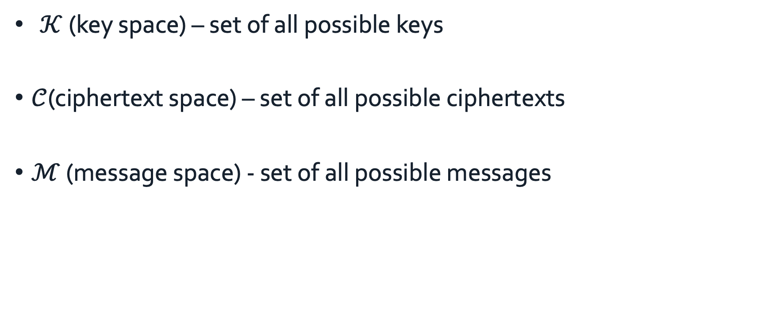
Notation
  $𝒦$ (key space) – set of all possible keys
$𝒞$(ciphertext space) – set of all possible ciphertexts
$ℳ$ (message space) - set of all possible messages

Slide 6
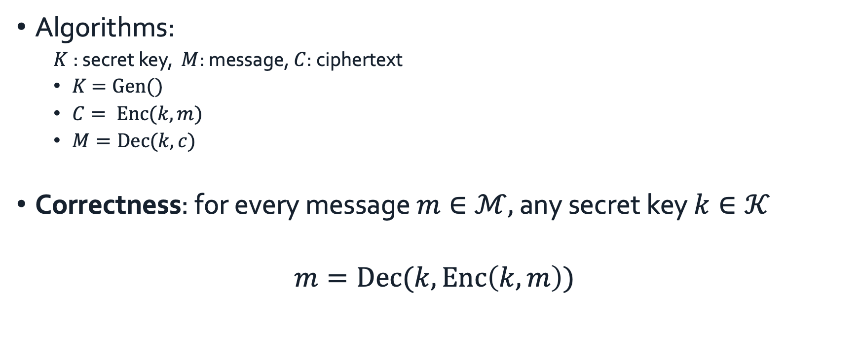
Definitions for encryption
Algorithms:
  $K$: secret key, $M$: message, $C$: ciphertext
  $K$ $=Gen()$
  $C= Enc(k,m)$
  $M=Dec(k,c)$
Correctness: for every message $m∈ℳ,$ any secret key $k∈𝒦$
$$m=Dec(k,Enc\left(k,m\right))$$
m
Enc(k, ·)
c
Dec(k, ·)
m
message
ciphertext
same message back
Notes:
Privacy def

Slide 7
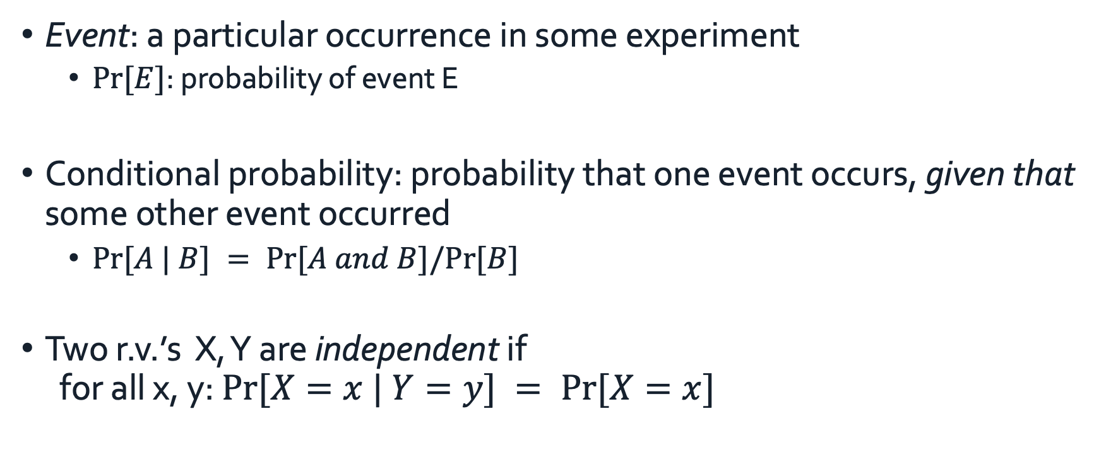
Probability
Event: a particular occurrence in some experiment
  $Pr⁡[E]$: probability of event E
Conditional probability: probability that one event occurs, given that some other event occurred
  $Pr⁡[A | B] = Pr⁡[A and B]/Pr⁡[B]$
Two r.v.’s X, Y are independent if
for all x, y: $Pr⁡[X=x | Y=y] = Pr⁡[X=x]$
Notes:
we'll also use the terminology of an event, which is something that has
a formal definition within probability theory, but for our purposes,
we can just think of, as a particular occurrence, in some randomized experiment.
And we'll write probability bracket E, to denote the probability of
some particular event E,
A random variable is just going to be a variable that takes on
certain values with some probabilities that we're going to specify.
And in particular, a probability distribution for
a random variable is going to be a specification of the probabilities
with which that variable takes on each possible value.

Slide 8

Probability
Law of total probability: say E₁, …, E_{n} are a partition of all possibilities. Then for any A:
$Pr⁡[A] =∑i Pr⁡[A and Ei] = i Pr⁡[A | Ei] · Pr⁡[Ei]$

Slide 9
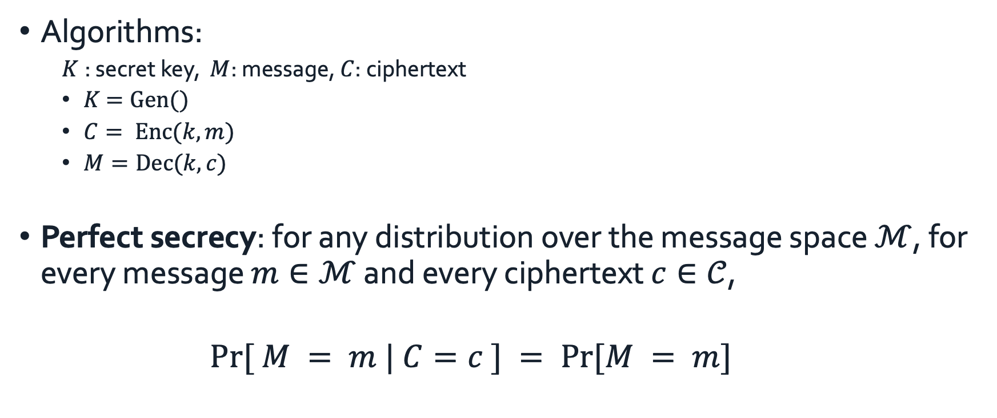
Definitions for encryption
Algorithms:
  $K$: secret key, $M$: message, $C$: ciphertext
  $K$ $=Gen()$
  $C= Enc(k,m)$
  $M=Dec(k,c)$
Perfect secrecy: for any distribution over the message space $ℳ$, for every message $m∈ℳ$ and every ciphertext $c∈𝒞$,
    $$Pr⁡[ M = m | C=c ] = Pr⁡[M = m]$$
Notes:
after seeing the ciphertext, the adversary doesn't know more about the message than before seeing the ciphertext; the a posteriori knowledge is the same as the a priori knowledge. We think of M as known to the adversary
t holds that the A Posterior probability, that the message,
is equal to M, conditioned on the observed cipher text being equal to C. is exactly equal to the a priori probability, that the message,
is equal to M

Slide 10
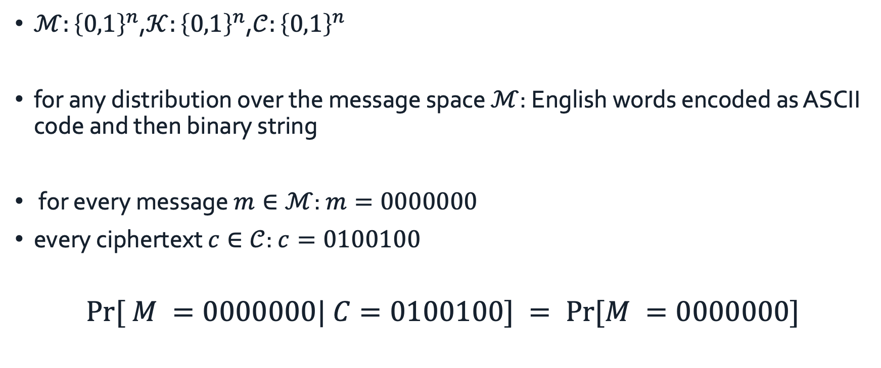
Example
$ℳ:{\left\{0,1\right\}}^{n}$,$𝒦:{\left\{0,1\right\}}^{n}$,$𝒞:{\left\{0,1\right\}}^{n}$
for any distribution over the message space $ℳ$: English words encoded as ASCII code and then binary string
for every message $m∈ℳ$: $m=0000000$
every ciphertext $c∈𝒞$: $c=0100100$
$$Pr⁡[ M =0000000| C=0100100] = Pr⁡[M =0000000]$$

Slide 11

Example: rotation cipher (rotation by k=3)
If $C = xx, Pr⁡[M=ab|C=xx] = 0 ≠ Pr⁡[M=ab]$

Slide 12
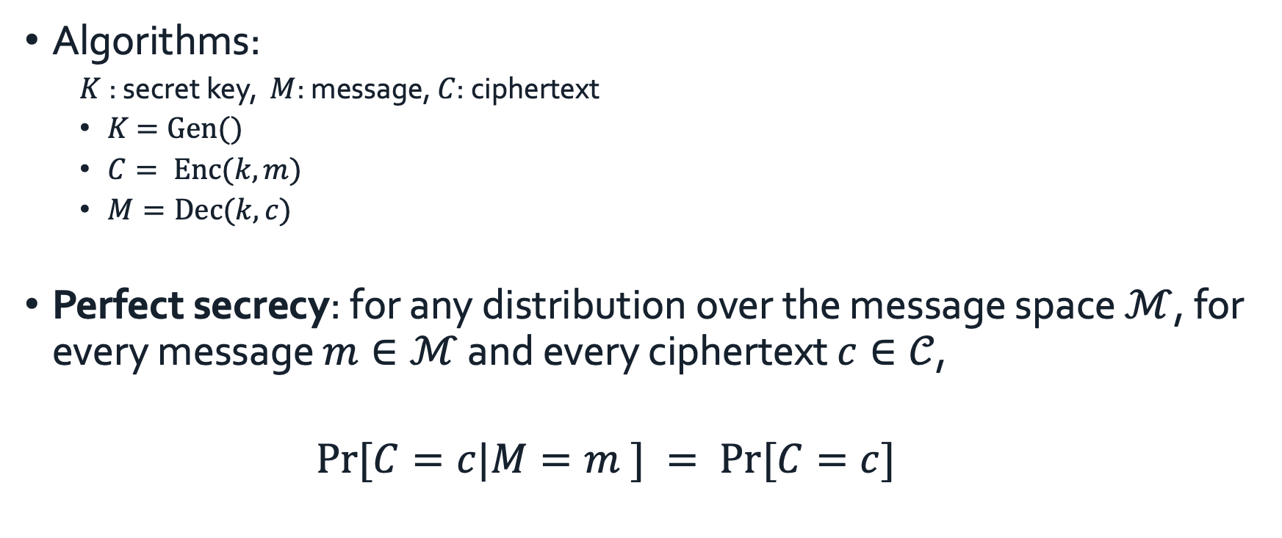
An equivalent definition
Algorithms:
  $K$: secret key, $M$: message, $C$: ciphertext
  $K$ $=Gen()$
  $C= Enc(k,m)$
  $M=Dec(k,c)$
Perfect secrecy: for any distribution over the message space $ℳ$, for every message $m∈ℳ$ and every ciphertext $c∈𝒞$,
    $$Pr⁡[C=c|M=m ] = Pr⁡[C=c]$$

Slide 13
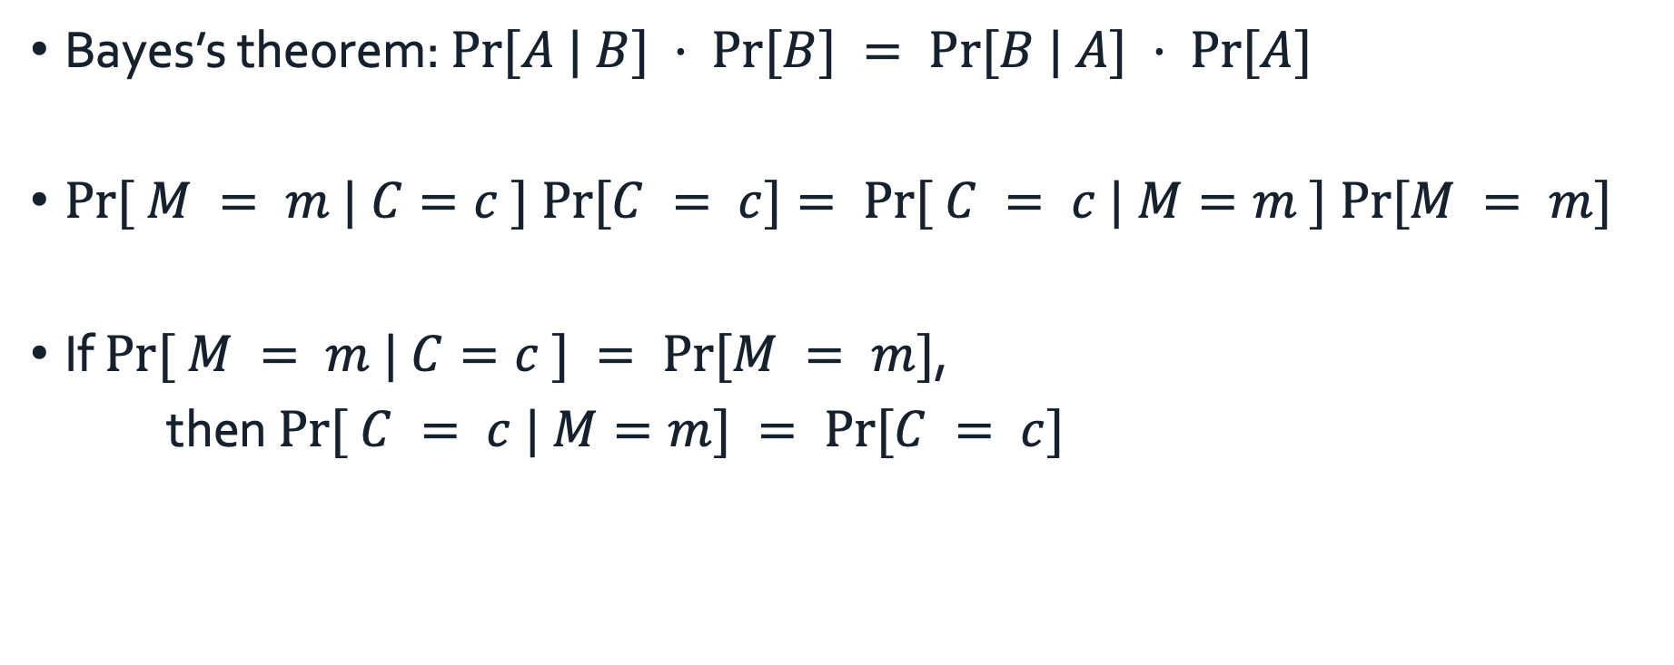
Proof
Bayes’s theorem: $Pr⁡[A | B] · Pr⁡[B] = Pr⁡[B | A] · Pr⁡[A]$
$Pr⁡[ M = m | C=c ] Pr⁡[C = c]= Pr⁡[ C = c | M=m ] Pr⁡[M = m]$
If $Pr⁡[ M = m | C=c ] = Pr⁡[M = m]$,
then $Pr⁡[ C = c | M=m] = Pr⁡[C = c]$

Slide 14

Key Length
Algorithms:
  $K$: secret key, $M$: message, $C$: ciphertext
  $K∈ \{0, 1\}^{k}, M∈ \{0, 1\}^{m}$, $C∈ \{0, 1\}^{c}$

Slide 15
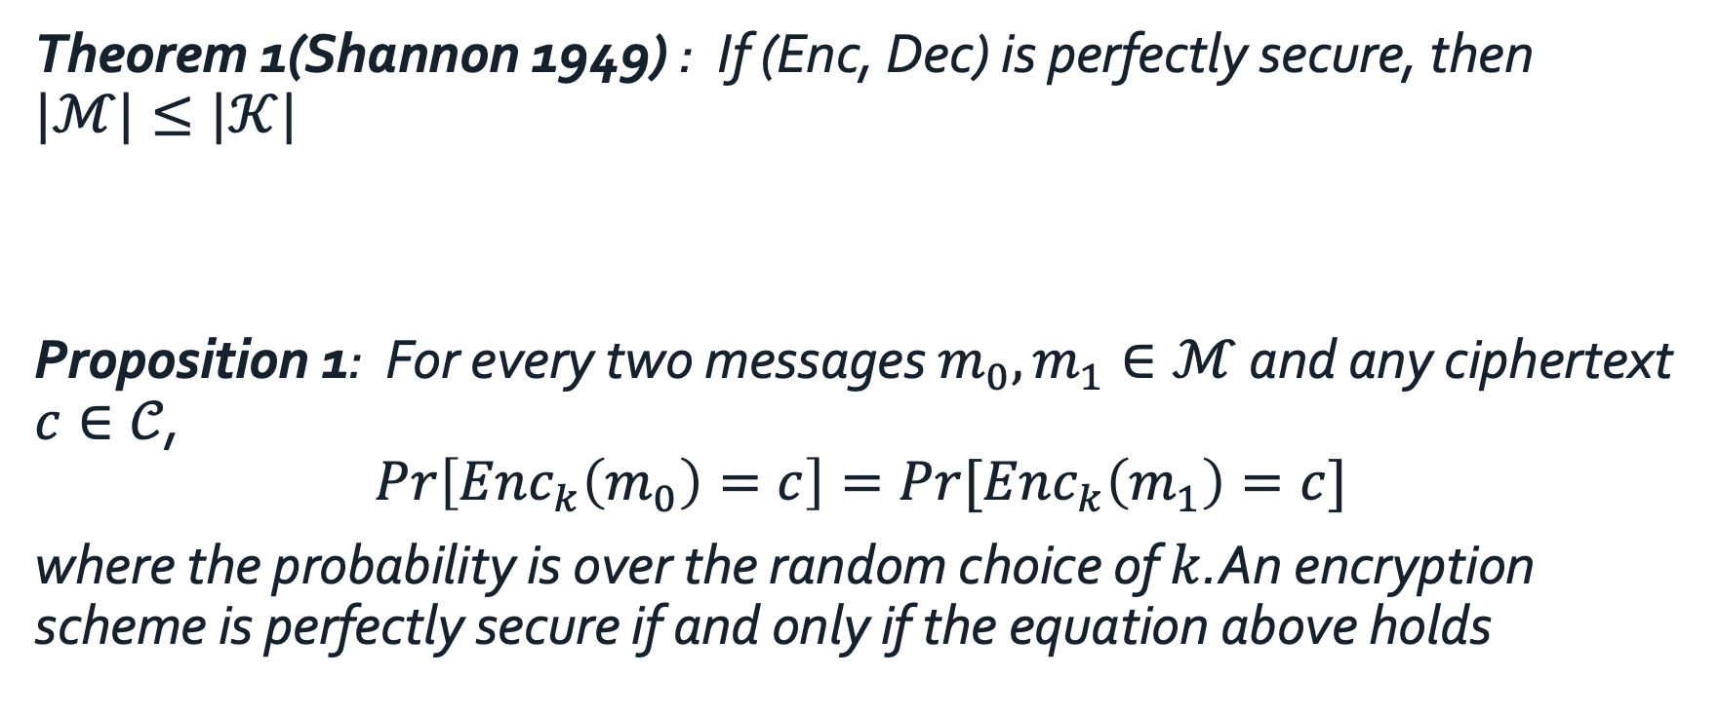
Theorem 1(Shannon 1949) : If (Enc, Dec) is perfectly secure, then $|ℳ|≤|𝒦|$
Proposition 1: For every two messages $m_{0}, m_{1}∈ℳ$ and any ciphertext $c∈𝒞$,
$$\operatorname{Pr}\left[Enc_{k}\left(m_{0}\right)=c\right]=\operatorname{Pr}{[Enc_{k}\left(m_{1}\right)=c]}$$
where the probability is over the random choice of $k$.An encryption scheme is perfectly secure if and only if the equation above holds

Slide 16
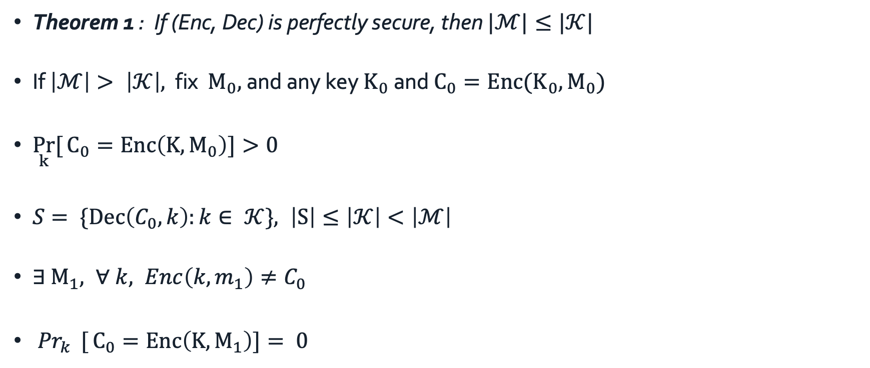
Theorem 1 : If (Enc, Dec) is perfectly secure, then $|ℳ|≤|𝒦|$
If $\left|ℳ\right|> \left|𝒦\right|,$ fix $M_{0},$ and any key $K_{0}$ and $C_{0}=Enc(K_{0},M_{0})$
$\underset{k}{Pr}{[}C_{0}=Enc\left(K,M_{0}\right)]>0$
$S= \{Dec\left(C_{0},k\right):k∈ 𝒦\}, \left|S\right|≤\left|𝒦\right|<\left|ℳ\right|$
${∃ M}_{1}, ∀ k, Enc\left(k, m_{1}\right)≠C_{0}$
${Pr}_{k}{ [}C_{0}=Enc\left(K,M_{1}\right)]= 0$

Slide 17
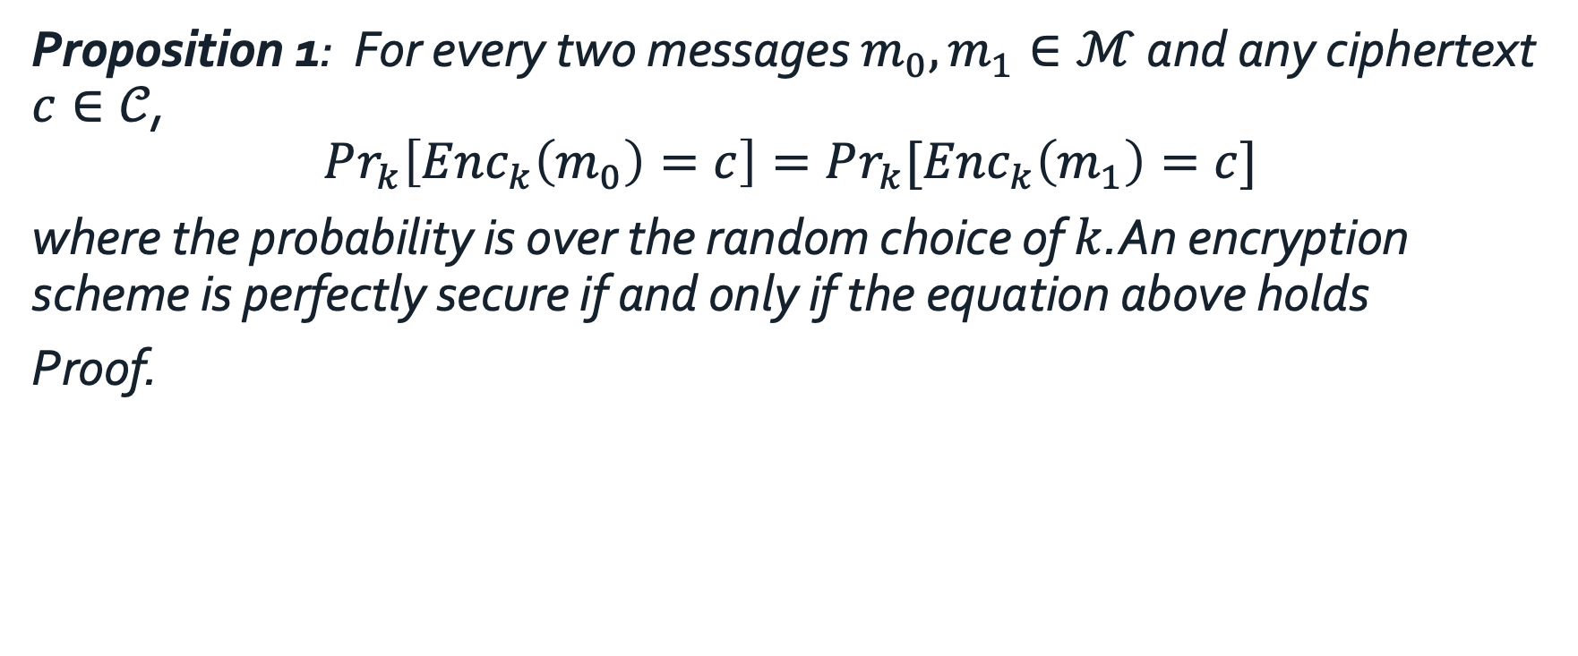
Proposition 1: For every two messages $m_{0}, m_{1}∈ℳ$ and any ciphertext $c∈𝒞$,
$$Pr_{k}\left[Enc_{k}\left(m_{0}\right)=c\right]=Pr_{k}{[Enc_{k}\left(m_{1}\right)=c]}$$
where the probability is over the random choice of $k$.An encryption scheme is perfectly secure if and only if the equation above holds
Proof.

Slide 18
One-time pad
Key length the same as message length

Slide 19
XOR
A ⊕ B
Equivalent to addition mod 2
input |  | output
0 | 0 | 0
0 | 1 | 1
1 | 0 | 1
1 | 1 | 0

Slide 20
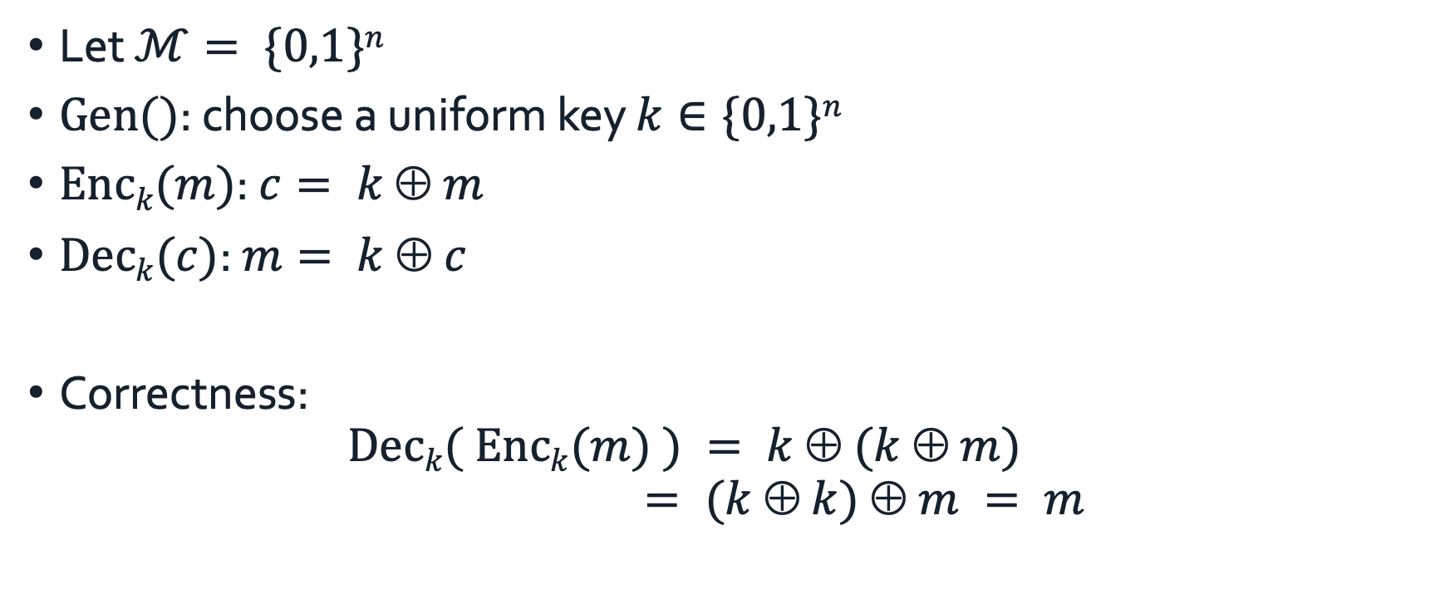
One-time pad
Let $ℳ= \{0,1\}n$
$Gen()$: choose a uniform key $k∈\{0,1\}n$
$Enck(m)$: $c= k  m$
$Deck(c)$: $m= k  c$
Correctness:
$Deck( Enck(m) ) = k  (k  m)$
$= (k  k)  m = m$

Slide 21
One-time pad
n bits
key
n bits
n bits
⊕
message
ciphertext

Slide 22
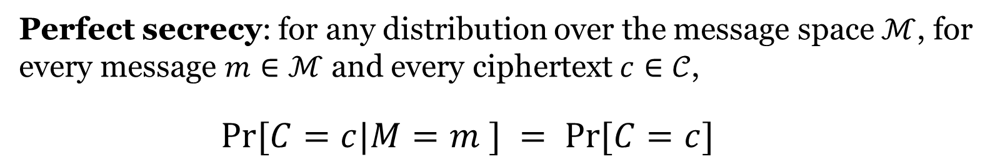
Theorem
Theorem 1: One-time pad encryption is perfectly secure.
Perfect secrecy: for any distribution over the message space $ℳ$, for every message $m∈ℳ$ and every ciphertext $c∈𝒞$,
    $$Pr⁡[C=c|M=m ] = Pr⁡[C=c]$$

Slide 23

Proof
$Pr⁡[C=c|M=m] = Pr⁡[k  m =c|M=m]$
$$=Pr⁡[k=m  c | M=m] = 2^{−n}$$

Slide 24
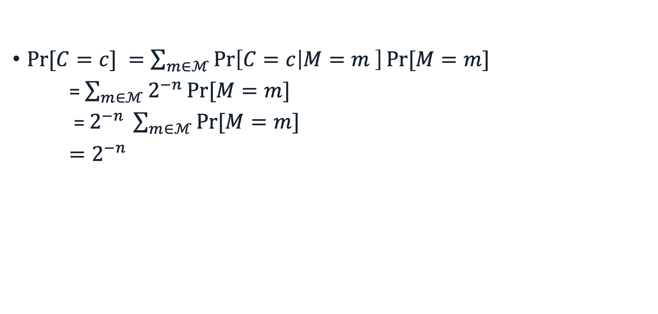
Proof
$Pr⁡[C=c] =\sum_{m∈ℳ}{\operatorname{Pr}\left[C=c | M=m \right]\operatorname{Pr}{[M=m]}}$
= $\sum_{m∈ℳ}{2^{−n}\operatorname{Pr}{[M=m] }}$
= $2^{−n} \sum_{m∈ℳ}{\operatorname{Pr}{[M=m] }}$
$=2^{−n}$

Slide 25


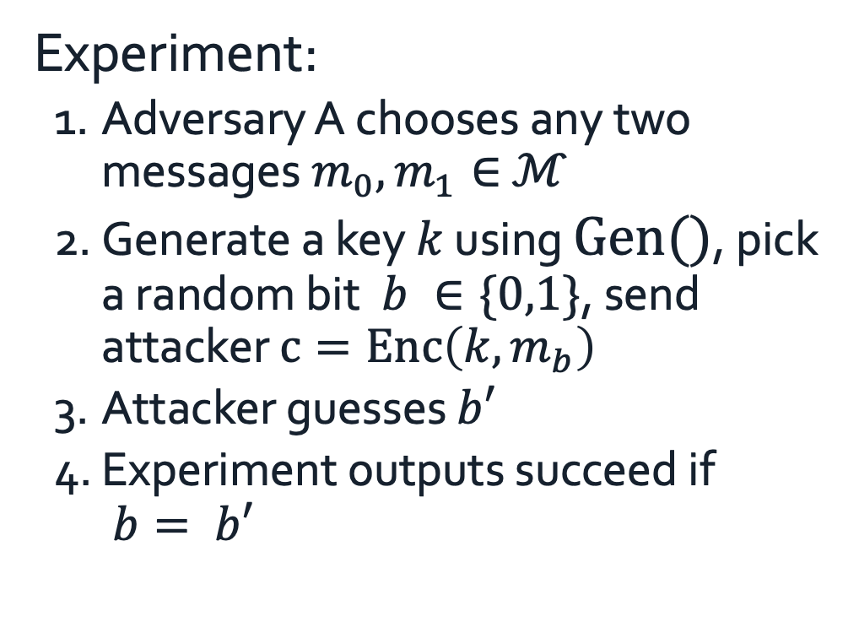


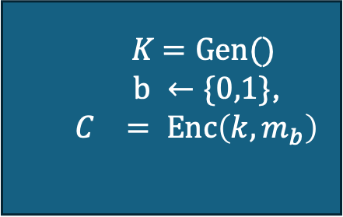
Another def: perfect indistinguishability
Experiment:
  Adversary A chooses any two messages $m_{0}, m_{1}∈$ $ℳ$
  Generate a key $k$ using $Gen()$, pick a random bit$b ∈\{0,1\}$, send attacker $c=Enc\left(k,m_{b}\right)$
  Attacker guesses ${b′}_{}$
  Experiment outputs succeed if ${ b= b′}_{}$
  $K$ $=Gen()$
  $b ←\{0,1\}$,
  $$C_{}= Enc\left(k,m_{b}\right)$$
$$m_{0},m_{1}$$
$$C_{}$$
$${b′}_{}$$
Perfectly indistinguishable: for every adversary A
Pr[Experiment outputs 1] = ½

Slide 26
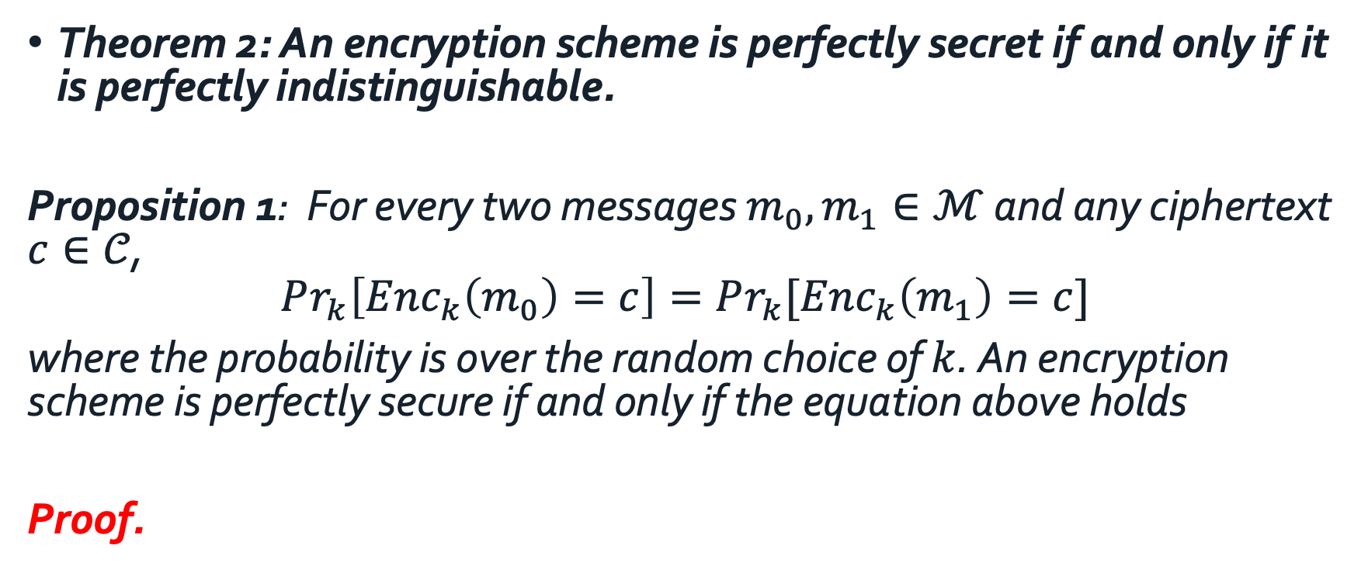
Perfect indistinguishability
Theorem 2: An encryption scheme is perfectly secret if and only if it is perfectly indistinguishable.
Proposition 1: For every two messages $m_{0}, m_{1}∈ℳ$ and any ciphertext $c∈𝒞$,
$$Pr_{k}\left[Enc_{k}\left(m_{0}\right)=c\right]=Pr_{k}{[Enc_{k}\left(m_{1}\right)=c]}$$
where the probability is over the random choice of $k$. An encryption scheme is perfectly secure if and only if the equation above holds
Proof.

Slide 27
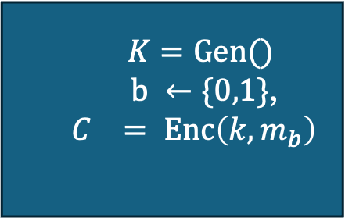

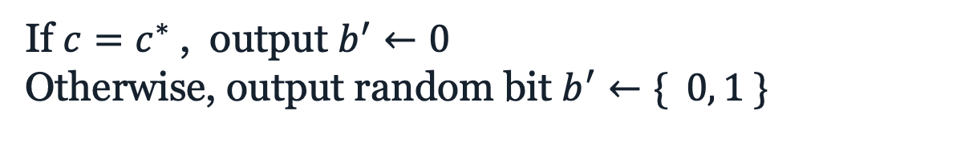


$$∃m_{0},m_{1},c^{∗}. Pr_{k}\left[Enc_{k}\left(m_{0}\right)=c^{∗}\right]>Pr_{k}{[Enc_{k}\left(m_{1}\right)=c^{∗}]}$$
$$m_{0},m_{1}$$
  $K$ $=Gen()$
  $b ←\{0,1\}$,
  $$C_{}= Enc\left(k,m_{b}\right)$$
$$c$$
If $c=c^{∗}$, output $b^{′}←0$
Otherwise, output random bit $b^{′}←\{ 0, 1 \}$

Slide 28
Using the same key twice?
m₁ ⊕ m₂ is information about m₁, m₂
Is this significant?
    No longer perfectly secret!
    m₁ ⊕ m₂ reveals where m₁, m₂ differ
    Frequency analysis

