Slide 1
Last time: Computational security
Two relaxations:
Security only against Probabilistic Polynomial Time adversaries.
Security can fail with a negligible probability

Slide 2
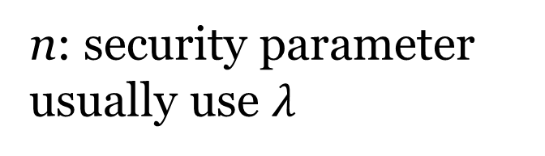
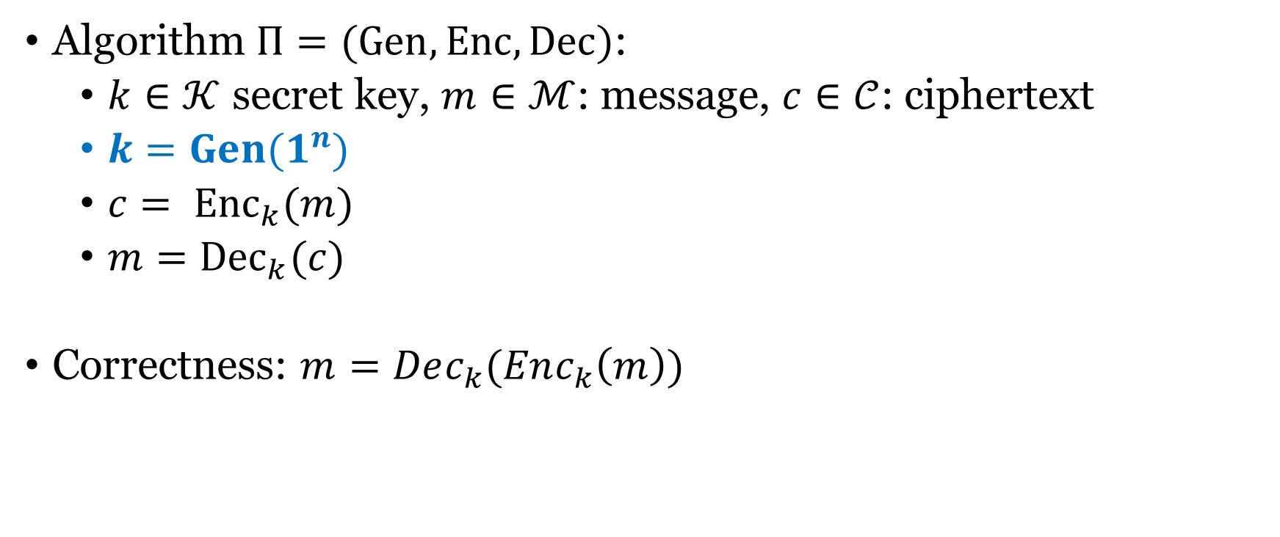
Definition of computational security
Algorithm $Π=(Gen, Enc, Dec)$:
  $k∈𝒦$ secret key, $m∈ℳ$: message, $c∈𝒞$: ciphertext
  $k=Gen(1^{n})$
  $c= {Enc}_{k}(m)$
  $m={Dec}_{k}(c)$
Correctness: $m=Dec_{k}(Enc_{k}\left(m\right))$
n: security parameter
usually use $λ$

Slide 3
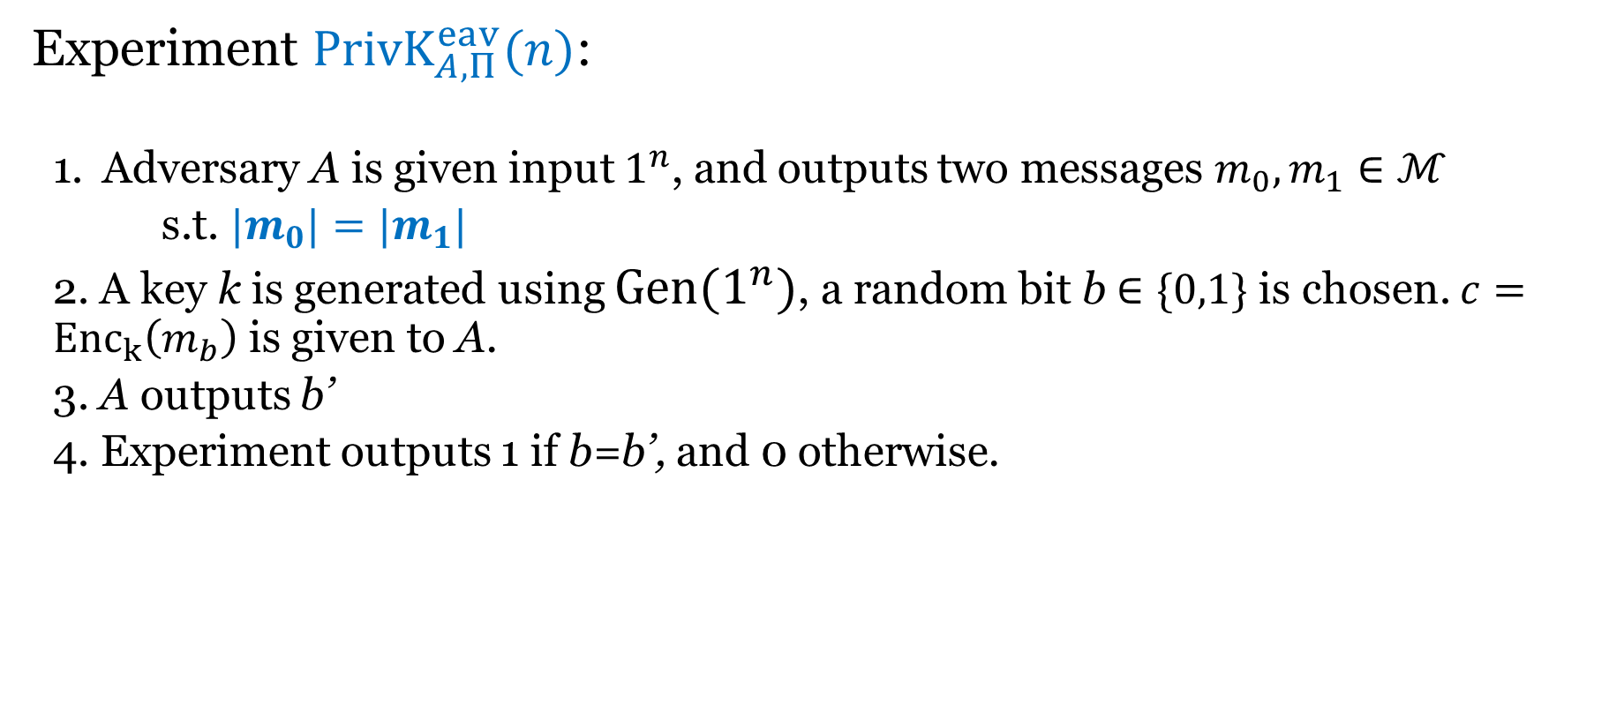
Computation indistinguishability against eavesdropper
Experiment ${PrivK}_{A,Π}^{eav}(n)$:
  Adversary A is given input $1^{n}$, and outputs two messages $m_{0}, m_{1}∈ℳ$
  s.t. ${|m}_{0}|=|m_{1}|$
  2. A key k is generated using $Gen(1^{n})$, a random bit b $∈\{0,1\}$ is chosen. $c={Enc}_{k}\left(m_{b}\right)$ is given to A.
  3. A outputs b’
  4. Experiment outputs 1 if b=b’, and 0 otherwise.

Slide 4
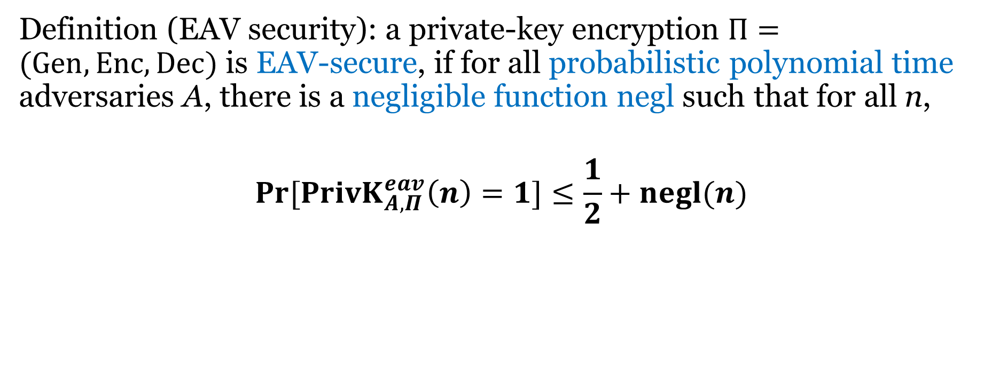
Computational Indistinguishability against eavesdropper
Definition (EAV security): a private-key encryption $Π=(Gen, Enc, Dec)$ is EAV-secure, if for all probabilistic polynomial time adversaries A, there is a negligible function negl such that for all n,
$$\operatorname{Pr}{[{PrivK}_{A,Π}^{eav}\left(n\right)=1}]≤\frac{1}{2}+negl(n)$$

Slide 5
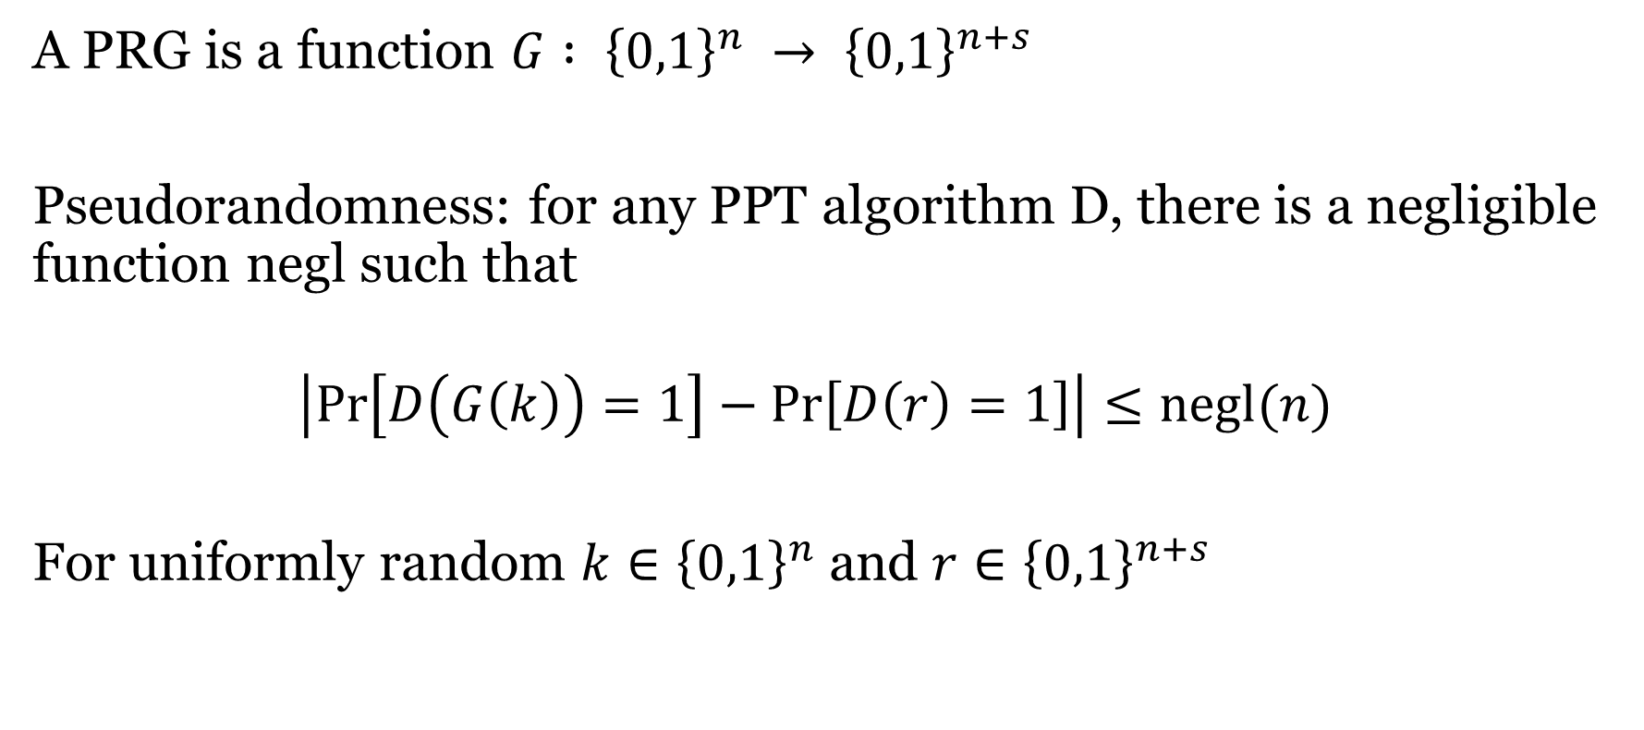
Definition
A PRG is a function $G : {\left\{0,1\right\}}^{n} → {\left\{0,1\right\}}^{n+s}$
Pseudorandomness: for any PPT algorithm D, there is a negligible function negl such that
$$\left|\operatorname{Pr}\left[D\left(G\left(k\right)\right)=1\right]−\operatorname{Pr}\left[D\left(r\right)=1\right]\right|≤negl(n)$$
For uniformly random $k∈{\left\{0,1\right\}}^{n}$ and $r∈{\left\{0,1\right\}}^{n+s}$

Slide 6

Example that is not a PRG
$G : {\left\{0,1\right\}}^{n} → {\left\{0,1\right\}}^{n+1}$ by computing the XOR of the first n bits
D: if $r_{n+1}=⊕_{i=1}^{n}r_{i}$, output 1, otherwise, output 0.

Slide 7
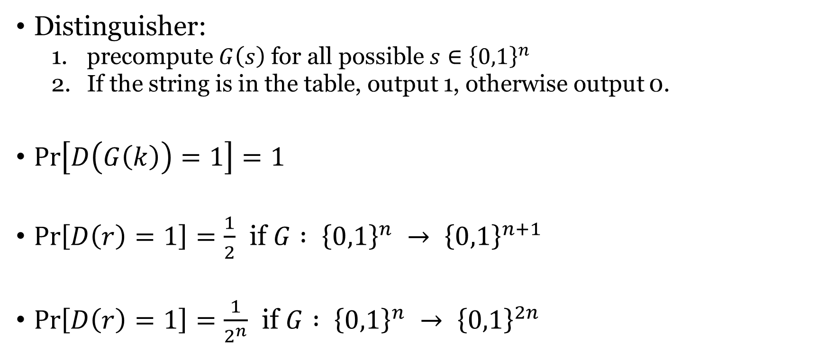
Brute-force search
Distinguisher:
  precompute $G\left(s\right)$ for all possible $s∈{\left\{0,1\right\}}^{n}$
  If the string is in the table, output 1, otherwise output 0.
$\operatorname{Pr}\left[D\left(G\left(k\right)\right)=1\right]=1$
$\operatorname{Pr}\left[D\left(r\right)=1\right]=\frac{1}{2}$ if $G : {\left\{0,1\right\}}^{n} → {\left\{0,1\right\}}^{n+1}$
$\operatorname{Pr}\left[D\left(r\right)=1\right]=\frac{1}{2^{n}}$ if $G : {\left\{0,1\right\}}^{n} → {\left\{0,1\right\}}^{2n}$

Slide 8
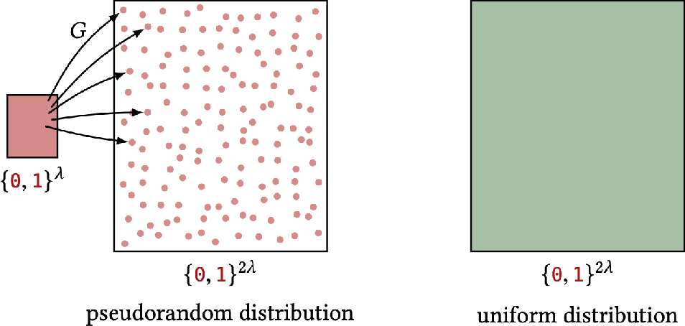
01101010
G
101101111011001
111011000110110

Slide 9
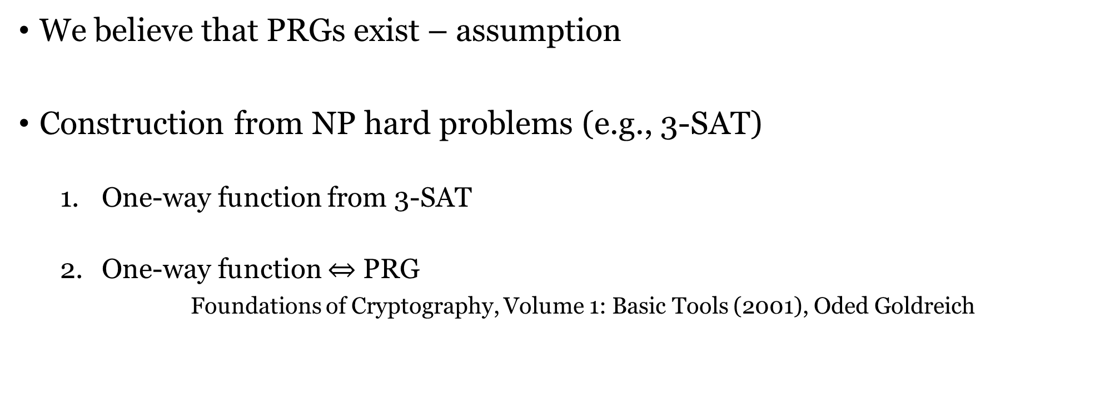
Existence of PRG
We believe that PRGs exist – assumption
Construction from NP hard problems (e.g., 3-SAT)
  One-way function from 3-SAT
  One-way function $⇔$ PRG
    Foundations of Cryptography, Volume 1: Basic Tools (2001), Oded Goldreich
(additional assumption on worst-case hardness to average-case hardness)
If PRG exists, then P!=NP

Slide 10
One-time pad
n bits
key
n bits
n bits
⊕
message
ciphertext

Slide 11
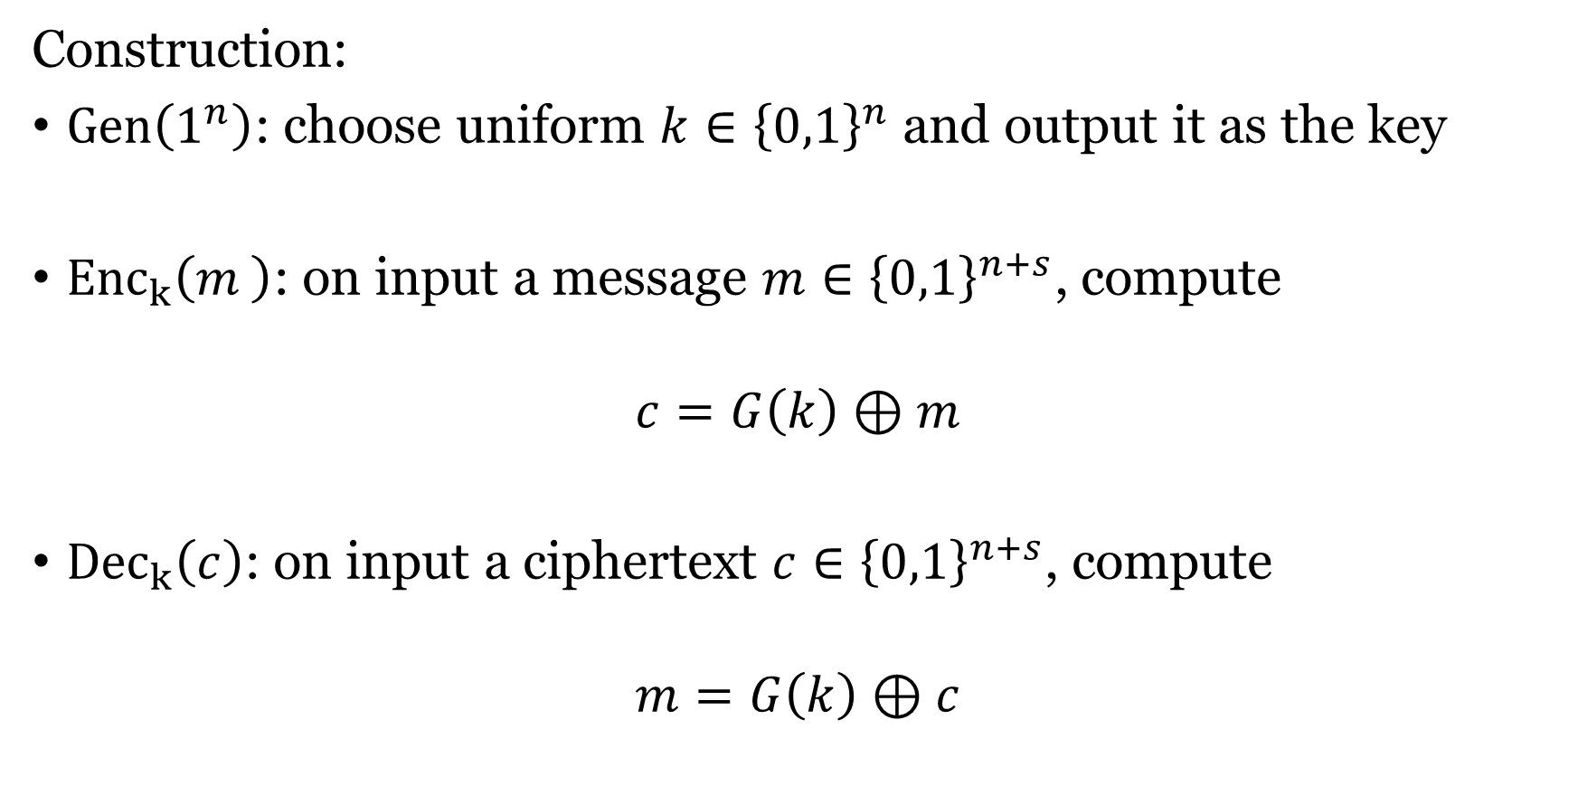
EAV-security from PRG
Construction:
$Gen\left(1^{n}\right)$: choose uniform $k∈{\left\{0,1\right\}}^{n}$ and output it as the key
${Enc}_{k}\left(m_{ }\right)$: on input a message $m∈{\left\{0,1\right\}}^{n+s}$, compute
$$c=G\left(k\right)⊕m$$
${Dec}_{k}\left(c\right)$: on input a ciphertext $c∈{\left\{0,1\right\}}^{n+s}$, compute
$$m=G\left(k\right)⊕c$$

Slide 12
EAV-security from PRG
Theorem: if G is a PRG, then the construction is EAV secure.
  Game and Demo;

Slide 13
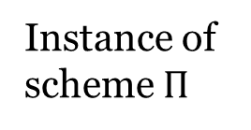
Proof by reduction
X is the hard problem in the assumption
Polynomial time reduction
Non-negligible success probability
Instance of problem X
A’
Instance of scheme $Π$
A
Solution of problem X
“break”

Slide 14
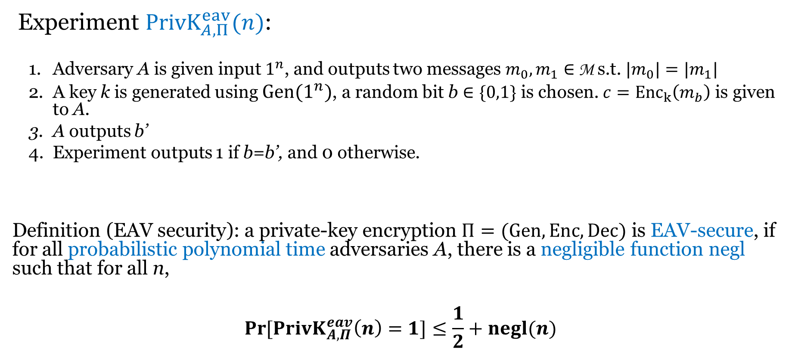
Indistinguishability experiment
Experiment ${PrivK}_{A,Π}^{eav}(n)$:
  Adversary A is given input $1^{n}$, and outputs two messages $m_{0}, m_{1}∈$ M s.t. ${|m}_{0}|=|m_{1}|$
  A key k is generated using $Gen(1^{n})$, a random bit b $∈\{0,1\}$ is chosen. $c={Enc}_{k}\left(m_{b}\right)$ is given to A.
  A outputs b’
  Experiment outputs 1 if b=b’, and 0 otherwise.
Definition (EAV security): a private-key encryption $Π=(Gen, Enc, Dec)$ is EAV-secure, if for all probabilistic polynomial time adversaries A, there is a negligible function negl such that for all n,
$$\operatorname{Pr}{[{PrivK}_{A,Π}^{eav}\left(n\right)=1}]≤\frac{1}{2}+negl(n)$$

Slide 15
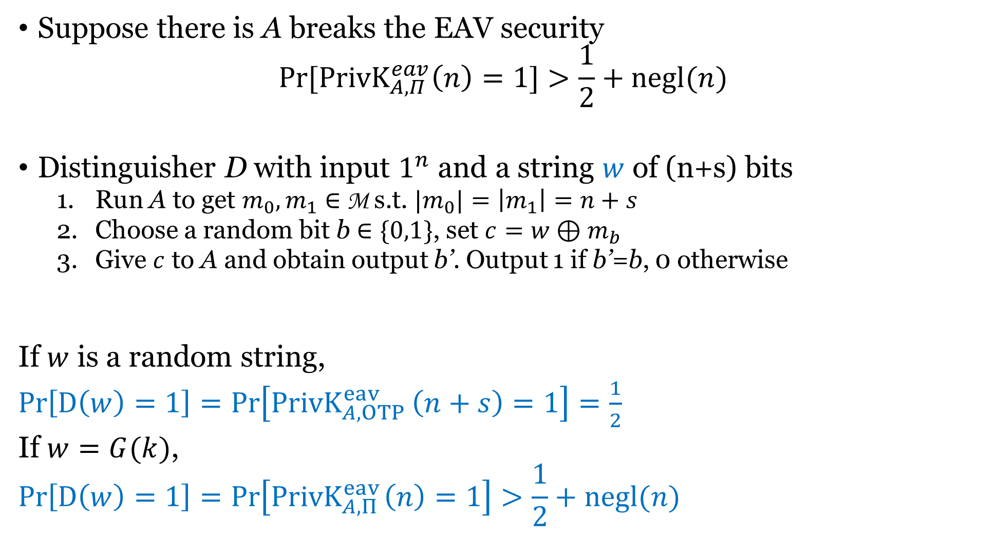
Suppose there is A breaks the EAV security
$$\operatorname{Pr}{[{PrivK}_{A,Π}^{eav}\left(n\right)=1}]>\frac{1}{2}+negl(n)$$
Distinguisher D with input $1^{n}$ and a string $w$ of (n+s) bits
  Run A to get $m_{0}, m_{1}∈$ M s.t. ${|m}_{0}|=\left|m_{1}\right|=n+s$
  Choose a random bit b $∈\{0,1\}$, set $c=w⊕m_{b}$
  Give $c$ to A and obtain output b’. Output 1 if b’=b, 0 otherwise
If $w$ is a random string,
$Pr\left[D\left(w\right)=1\right]=Pr\left[{PrivK}_{A,OTP }^{eav}\left(n+s\right)=1\right]=\frac{1}{2}$
If $w=G(k)$,
$$Pr\left[D\left(w\right)=1\right]=Pr\left[{PrivK}_{A,Π }^{eav}\left(n\right)=1\right]>\frac{1}{2}+negl(n)$$

Slide 16

PRG $→$ EAV secure encryption
  Key shorter than message, but still one encryption
Common reductions in crypto and TCS

Slide 17
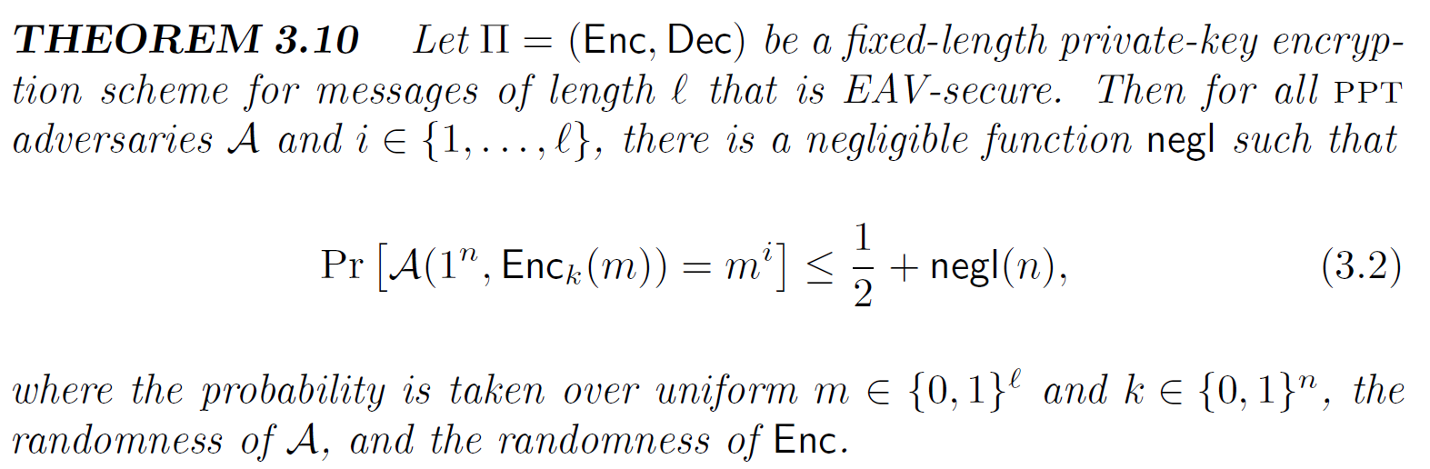
Semantic security
Adversary can’t infer any information about the message m.

Slide 18
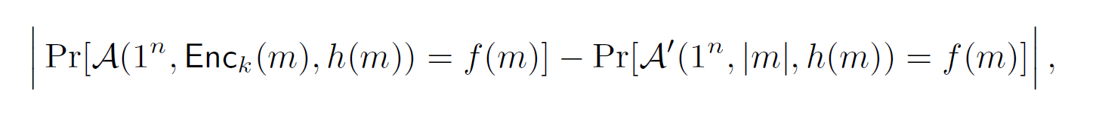
Semantic security
EAV-security is equivalent to semantic security.
  Demo

Slide 19
Can you encrypt 2 messages now?
Construction:
$Gen\left(1^{n}\right)$: choose uniform $k∈{\left\{0,1\right\}}^{n}$ and output it as the key
${Enc}_{k}\left(m_{ }\right)$: on input a message $m∈{\left\{0,1\right\}}^{n+s}$, compute
$$c=G\left(k\right)⊕m$$
${Dec}_{k}\left(c\right)$: on input a ciphertext $c∈{\left\{0,1\right\}}^{n+s}$, compute
$$m=G\left(k\right)⊕c$$

Slide 20
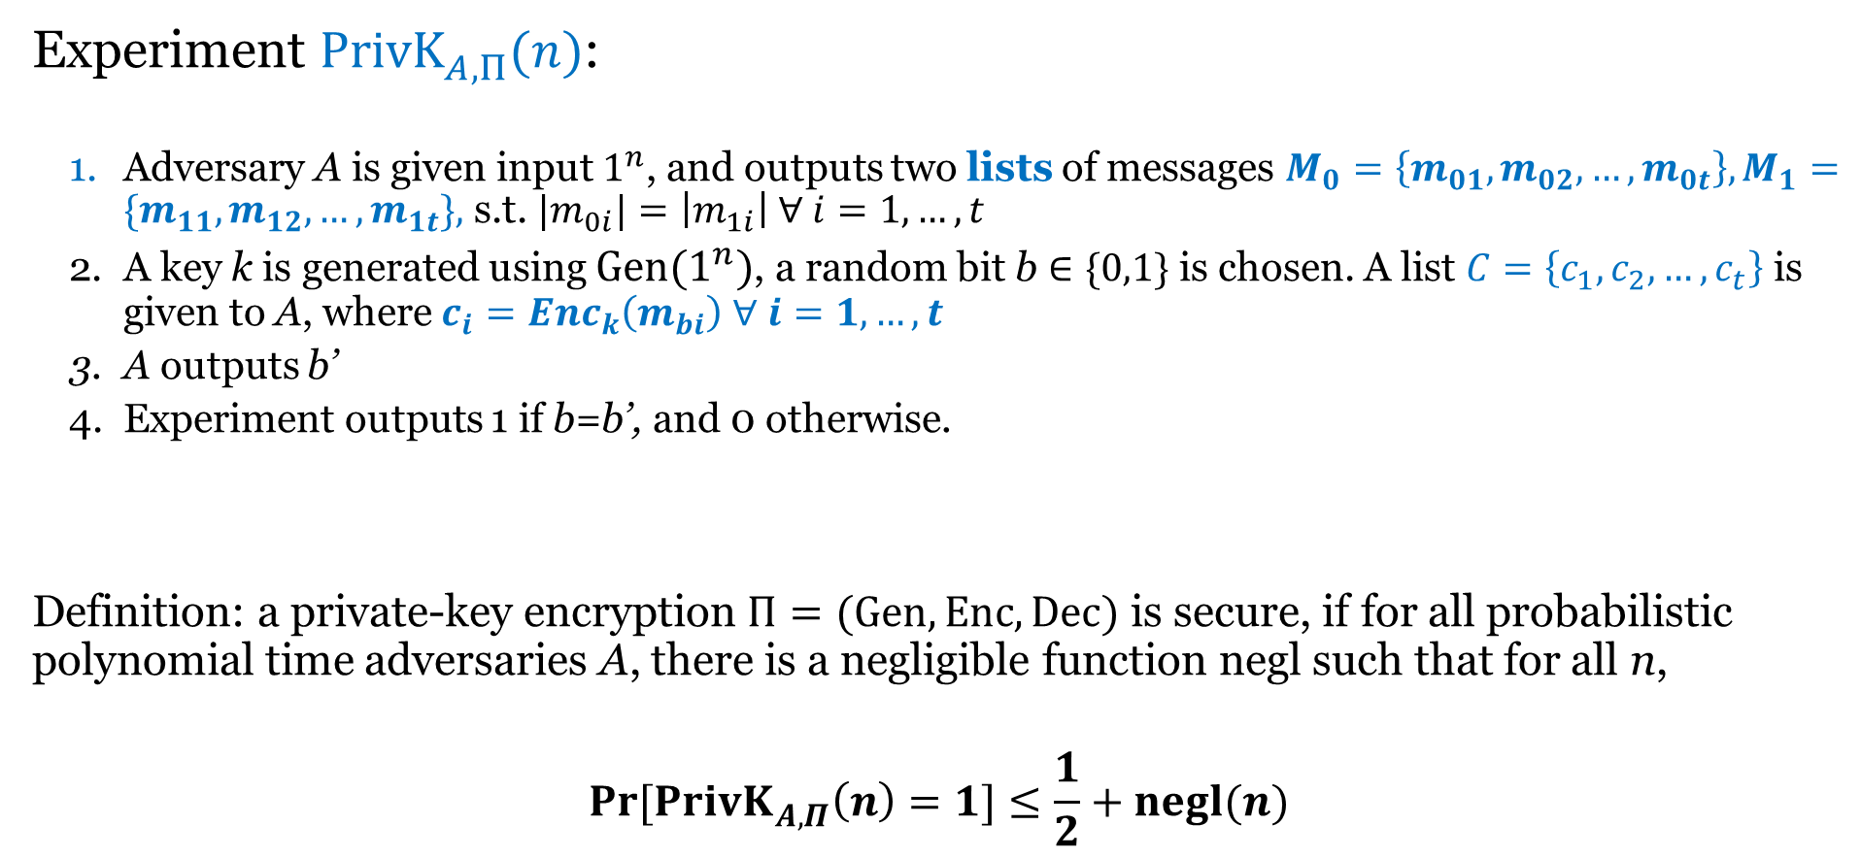
Indistinguishability for multiple encryptions
Experiment ${PrivK}_{A,Π}^{ }(n)$:
  Adversary A is given input $1^{n}$, and outputs two lists of messages $M_{0}=\left\{m_{01},m_{02},…,m_{0t}\right\}, M_{1}=\{m_{11},m_{12},…,m_{1t}\},$ s.t. ${|m}_{0i}|=\left|m_{1i}\right| ∀ i=1,…,t$
  A key k is generated using $Gen(1^{n})$, a random bit b $∈\{0,1\}$ is chosen. A list $C=\left\{c_{1},c_{2},…,c_{t}\right\}$ is given to A, where $c_{i}={Enc}_{k}\left(m_{bi}\right)$ $∀ i=1,…,t$
  A outputs b’
  Experiment outputs 1 if b=b’, and 0 otherwise.
Definition: a private-key encryption $Π=(Gen, Enc, Dec)$ is secure, if for all probabilistic polynomial time adversaries A, there is a negligible function negl such that for all n,
$$\operatorname{Pr}{[{PrivK}_{A,Π}^{ }\left(n\right)=1}]≤\frac{1}{2}+negl(n)$$

Slide 21

Security now?
The construction is not secure under the new definition
$$M_{0}=\left\{0^{n+s},0^{n+s}\right\}, M_{1}=\{0^{n+s},1^{n+s}\},$$

Slide 22
Necessity of probabilistic encryption
No deterministic encryption can be secure under the definition of multiple encryptions.
Demo

Slide 23
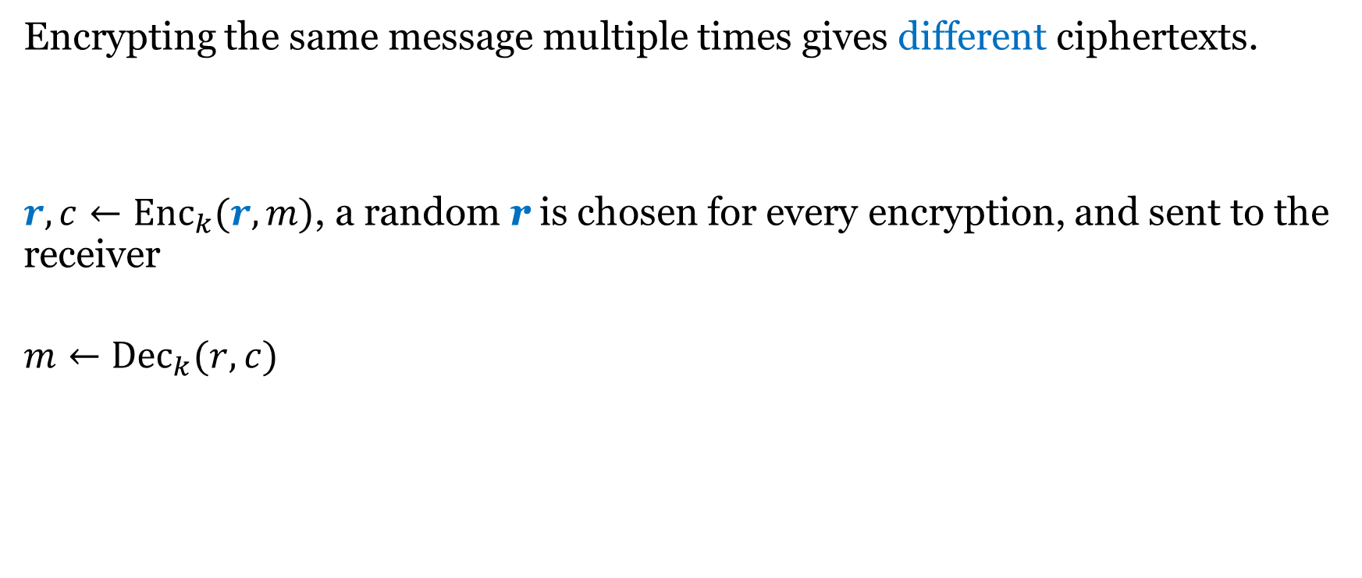
Probabilistic encryption
Encrypting the same message multiple times gives different ciphertexts.
$r,c←{Enc}_{k}(r,m)$, a random r is chosen for every encryption, and sent to the receiver
$$m←{Dec}_{k}(r,c)$$

Slide 24
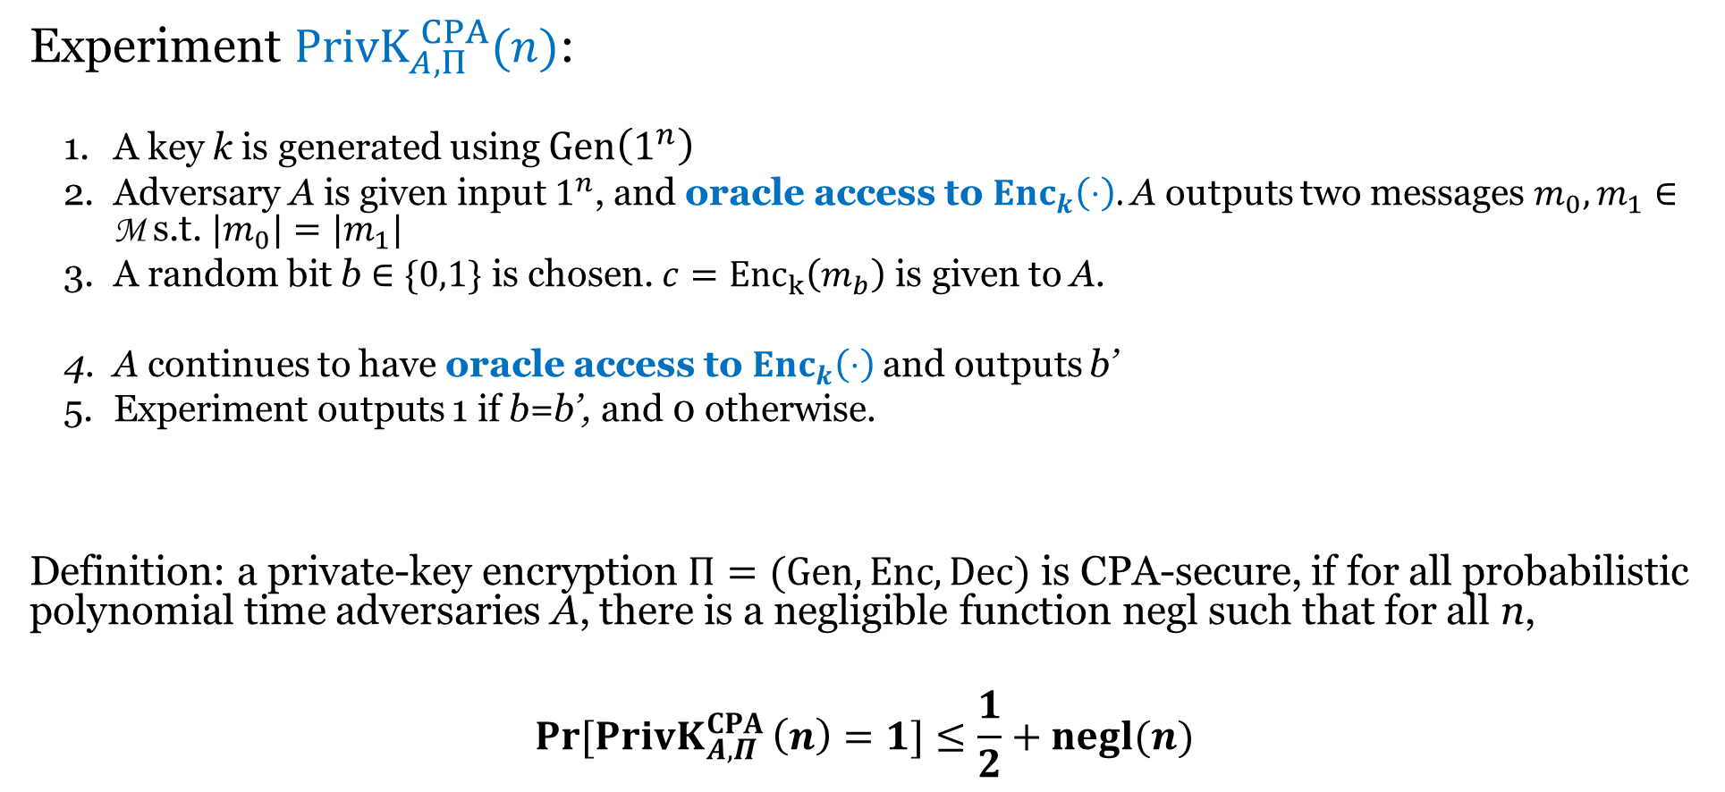
Chosen-plaintext attack (CPA) security
Experiment ${PrivK}_{A,Π}^{ CPA}(n)$:
  A key k is generated using $Gen\left(1^{n}\right)$
  Adversary A is given input $1^{n}$, and oracle access to ${Enc}_{k}\left(⋅\right)$. A outputs two messages $m_{0}, m_{1}∈$ M s.t. ${|m}_{0}|=|m_{1}|$
  A random bit b $∈\{0,1\}$ is chosen. $c={Enc}_{k}\left(m_{b}\right)$ is given to A.
  A continues to have oracle access to ${Enc}_{k}\left(⋅\right)$and outputs b’
  Experiment outputs 1 if b=b’, and 0 otherwise.
Definition: a private-key encryption $Π=(Gen, Enc, Dec)$ is CPA-secure, if for all probabilistic polynomial time adversaries A, there is a negligible function negl such that for all n,
$$\operatorname{Pr}{[{PrivK}_{A,Π}^{CPA }\left(n\right)=1}]≤\frac{1}{2}+negl(n)$$

Slide 25
What about multiple encryptions now?
Theorem: any private-key encryption scheme that is CPA-secure, is also CPA-secure for multiple encryptions.
  Demo

Slide 26
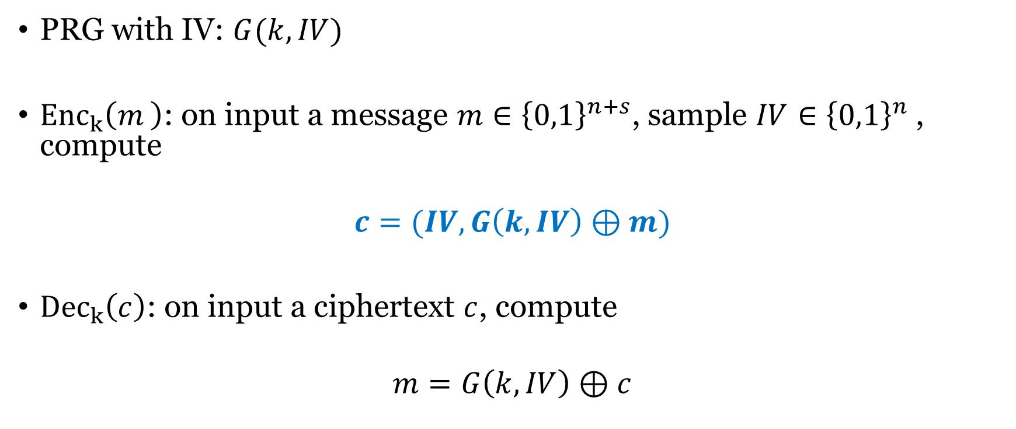
Stream cipher with Initialization Vector (IV)
PRG with IV: $G(k,IV)$
${Enc}_{k}\left(m_{ }\right)$: on input a message $m∈{\left\{0,1\right\}}^{n+s}$, sample $IV∈{\left\{0,1\right\}}^{n}$, compute
$$c=(IV,G\left(k,IV\right)⊕m)$$
${Dec}_{k}\left(c\right)$: on input a ciphertext $c$, compute
$$m=G\left(k,IV\right)⊕c$$

Slide 27
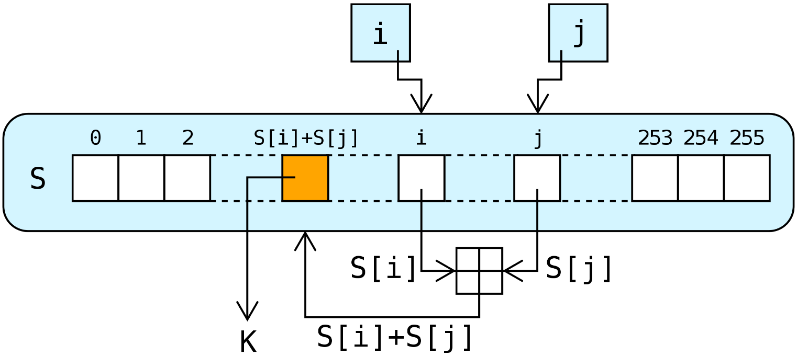
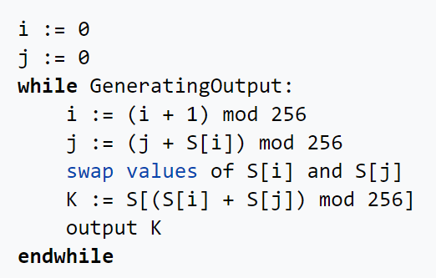
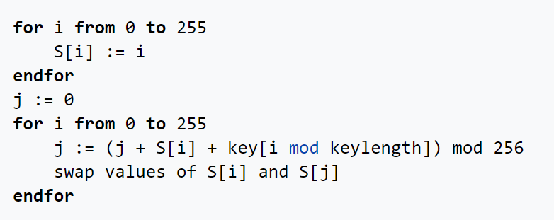
RC4 (Ron Rivest 1987)
Key scheduling
PRG

Slide 28
Vulnerability of RC4
Output not uniform
Handling IV is not secure
Replacement: ChaCha20
See more in textbook Chapter 7.1*

