Slide 1
Last time
Pseudo random generator (PRG)
Encryption scheme using PRG that is EAV-secure
Proof by reduction

Slide 2
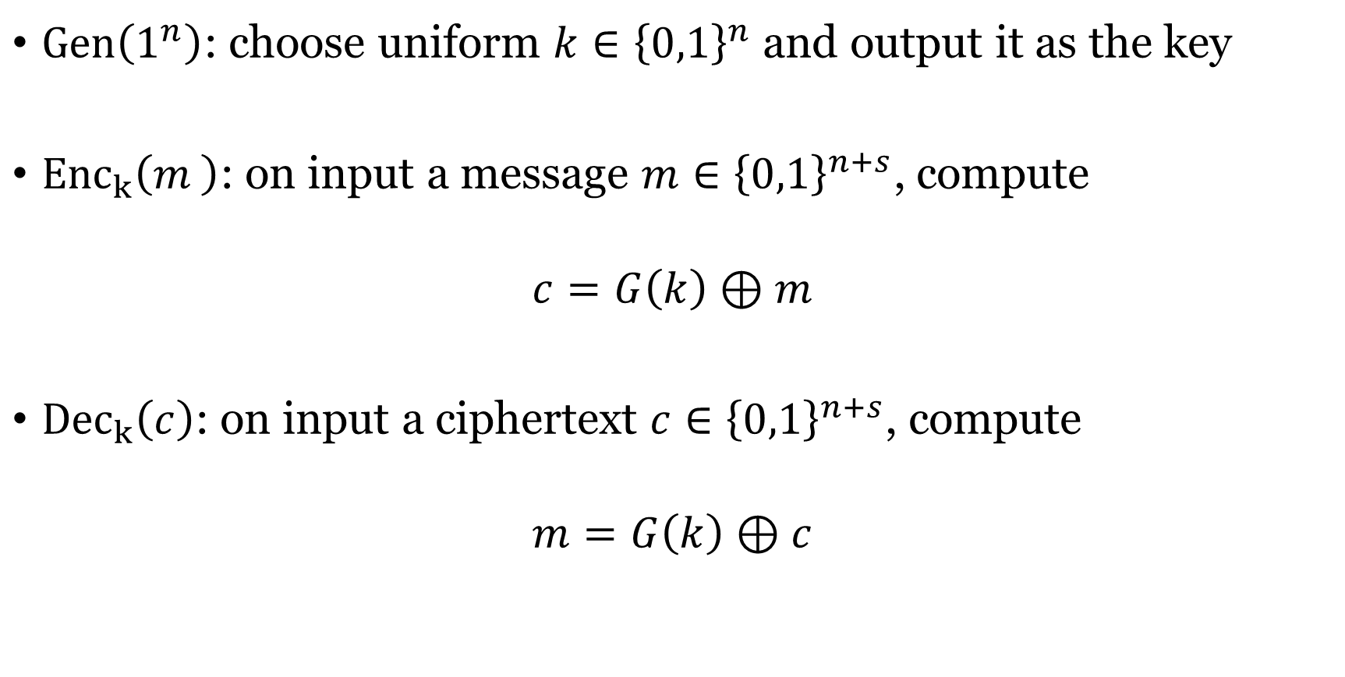
EAV-security from PRG
$Gen\left(1^{n}\right)$: choose uniform $k∈{\left\{0,1\right\}}^{n}$ and output it as the key
${Enc}_{k}\left(m_{ }\right)$: on input a message $m∈{\left\{0,1\right\}}^{n+s}$, compute
$$c=G\left(k\right)⊕m$$
${Dec}_{k}\left(c\right)$: on input a ciphertext $c∈{\left\{0,1\right\}}^{n+s}$, compute
$$m=G\left(k\right)⊕c$$

Slide 3
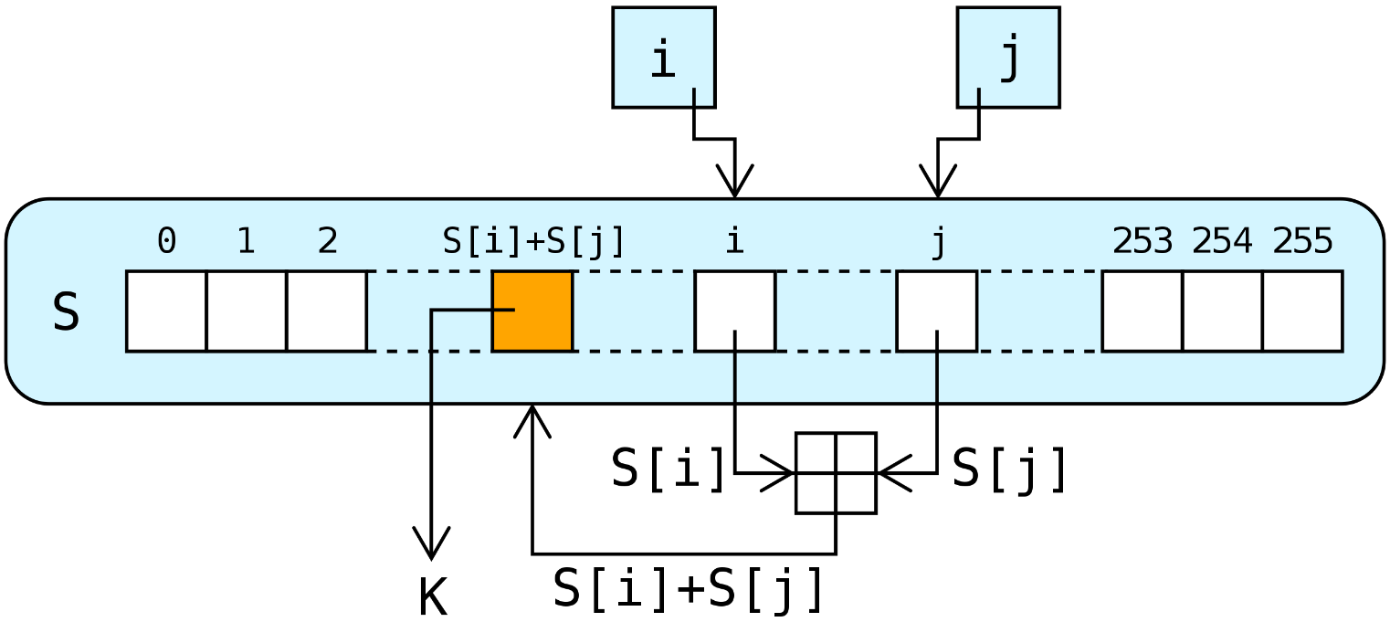
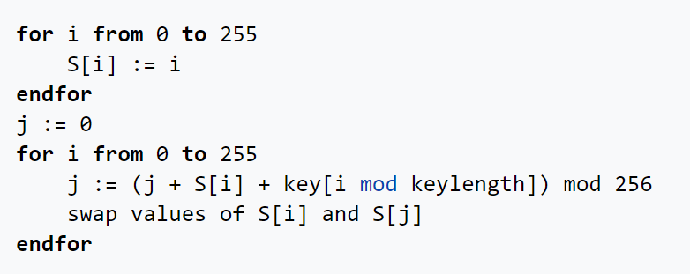
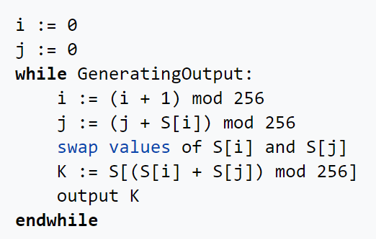
RC4 (Ron Rivest 1987)
linear-feedback shift register
Key scheduling
PRG

Slide 4
Vulnerability of RC4
Output not uniform
Handling IV is not secure
Replacement: ChaCha20
See more in Chapter 7.1*

Slide 5
The Two Definitions
EAV-indistinguishability. For every PPT A and every pair m₀, m₁ with |m₀| = |m₁| that A outputs:
| Pr[A(Encₖ(m₀)) = 1] − Pr[A(Encₖ(m₁)) = 1] | ≤ negl(n)
Semantic security. For every PPT A there is a PPT A′ such that for every efficiently sampleable Samp, every poly-time target f, and every auxiliary info h:
| Pr[A(1ⁿ, Encₖ(m), h(m)) = f(m)] − Pr[A′(1ⁿ, |m|, h(m)) = f(m)] | ≤ negl(n)
The simulator A′ sees no ciphertext — only the length and the side information.

Slide 6
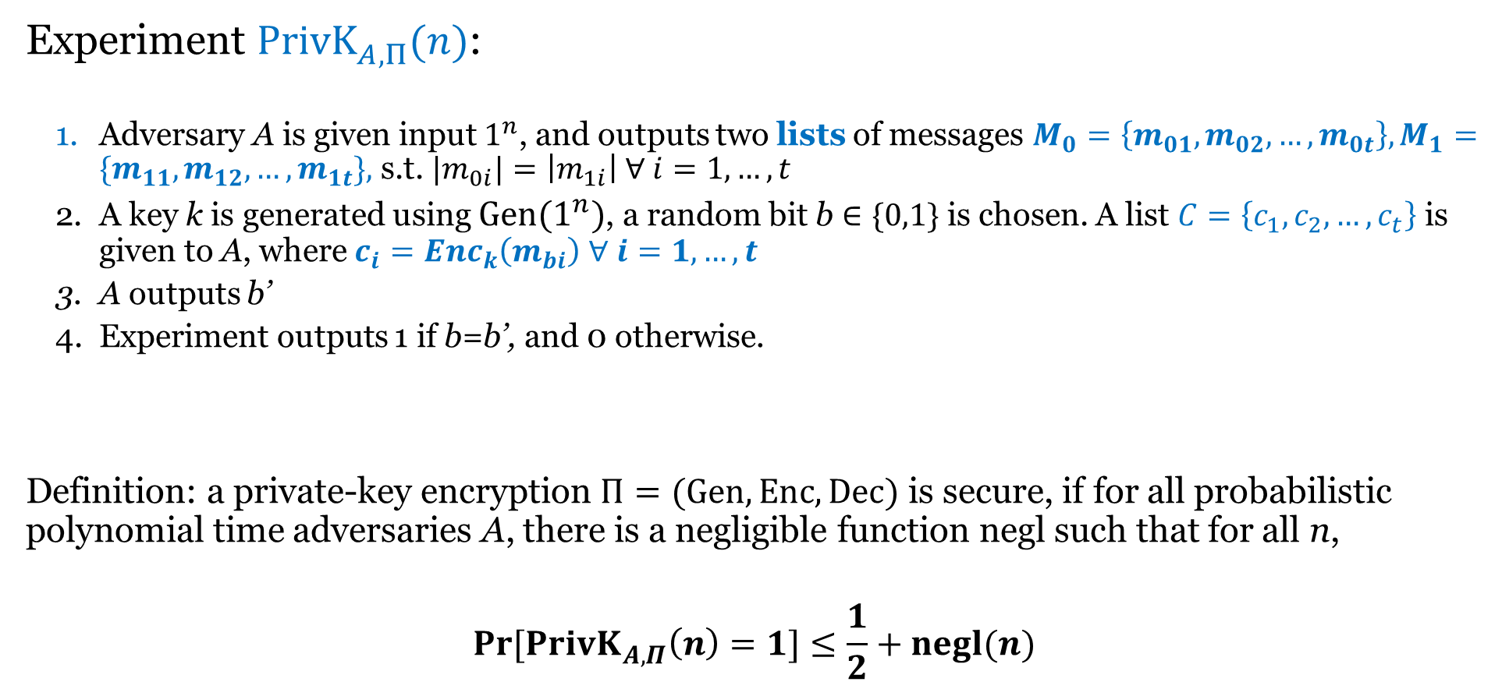
Indistinguishability for multiple encryptions
Experiment ${PrivK}_{A,Π}^{ }(n)$:
  Adversary A is given input $1^{n}$, and outputs two lists of messages $M_{0}=\left\{m_{01},m_{02},…,m_{0t}\right\}, M_{1}=\{m_{11},m_{12},…,m_{1t}\},$ s.t. ${|m}_{0i}|=\left|m_{1i}\right| ∀ i=1,…,t$
  A key k is generated using $Gen(1^{n})$, a random bit b $∈\{0,1\}$ is chosen. A list $C=\left\{c_{1},c_{2},…,c_{t}\right\}$ is given to A, where $c_{i}={Enc}_{k}\left(m_{bi}\right)$ $∀ i=1,…,t$
  A outputs b’
  Experiment outputs 1 if b=b’, and 0 otherwise.
Definition: a private-key encryption $Π=(Gen, Enc, Dec)$ is secure, if for all probabilistic polynomial time adversaries A, there is a negligible function negl such that for all n,
$$\operatorname{Pr}{[{PrivK}_{A,Π}^{ }\left(n\right)=1}]≤\frac{1}{2}+negl(n)$$

Slide 7
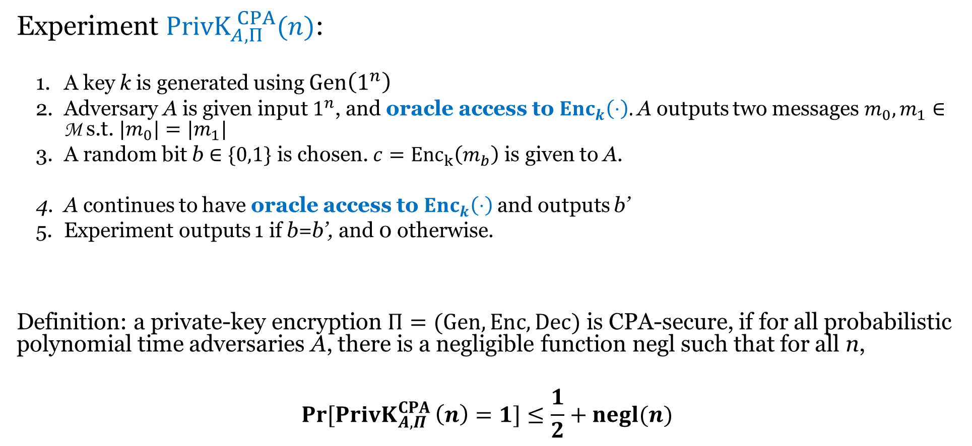
Chosen-plaintext attack (CPA) security
Experiment ${PrivK}_{A,Π}^{ CPA}(n)$:
  A key k is generated using $Gen\left(1^{n}\right)$
  Adversary A is given input $1^{n}$, and oracle access to ${Enc}_{k}\left(⋅\right)$. A outputs two messages $m_{0}, m_{1}∈$ M s.t. ${|m}_{0}|=|m_{1}|$
  A random bit b $∈\{0,1\}$ is chosen. $c={Enc}_{k}\left(m_{b}\right)$ is given to A.
  A continues to have oracle access to ${Enc}_{k}\left(⋅\right)$and outputs b’
  Experiment outputs 1 if b=b’, and 0 otherwise.
Definition: a private-key encryption $Π=(Gen, Enc, Dec)$ is CPA-secure, if for all probabilistic polynomial time adversaries A, there is a negligible function negl such that for all n,
$$\operatorname{Pr}{[{PrivK}_{A,Π}^{CPA }\left(n\right)=1}]≤\frac{1}{2}+negl(n)$$

Slide 8
Theorem: any private-key encryption scheme that is CPA-secure, is also CPA-secure for multiple encryptions.

Slide 9
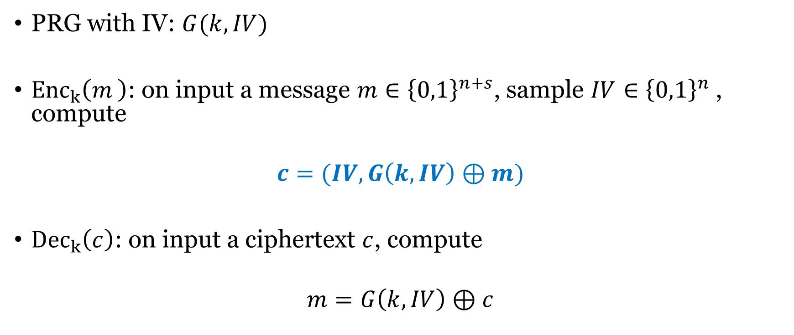
Stream cipher with Initialization Vector (IV)
PRG with IV: $G(k,IV)$
${Enc}_{k}\left(m_{ }\right)$: on input a message $m∈{\left\{0,1\right\}}^{n+s}$, sample $IV∈{\left\{0,1\right\}}^{n}$, compute
$$c=(IV,G\left(k,IV\right)⊕m)$$
${Dec}_{k}\left(c\right)$: on input a ciphertext $c$, compute
$$m=G\left(k,IV\right)⊕c$$

Slide 10
Block Cipher
In a block cipher:
  Plaintext and ciphertext have fixed length b (e.g., 128 bits)
  A plaintext of length n is partitioned into a sequence of m blocks, P[0], …, P[m−1], where n ≤ bm < n + b
Each message is divided into a sequence of blocks and encrypted or decrypted in terms of its blocks.
Requires padding
with extra bits.
Plaintext
Blocks of
plaintext

Slide 11
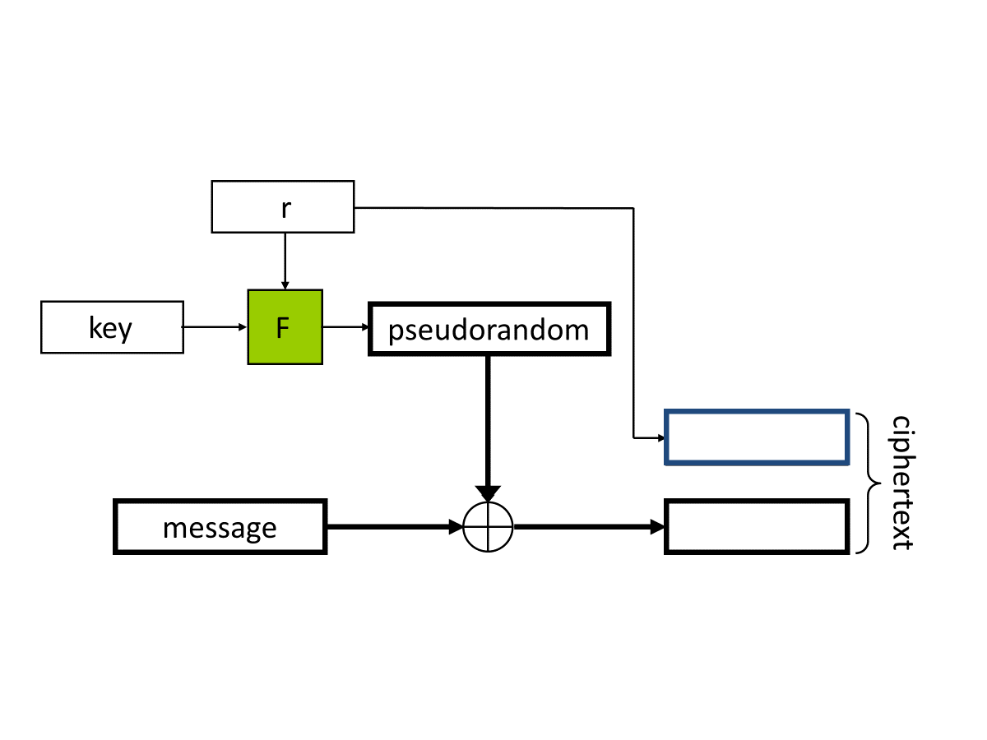

Slide 12
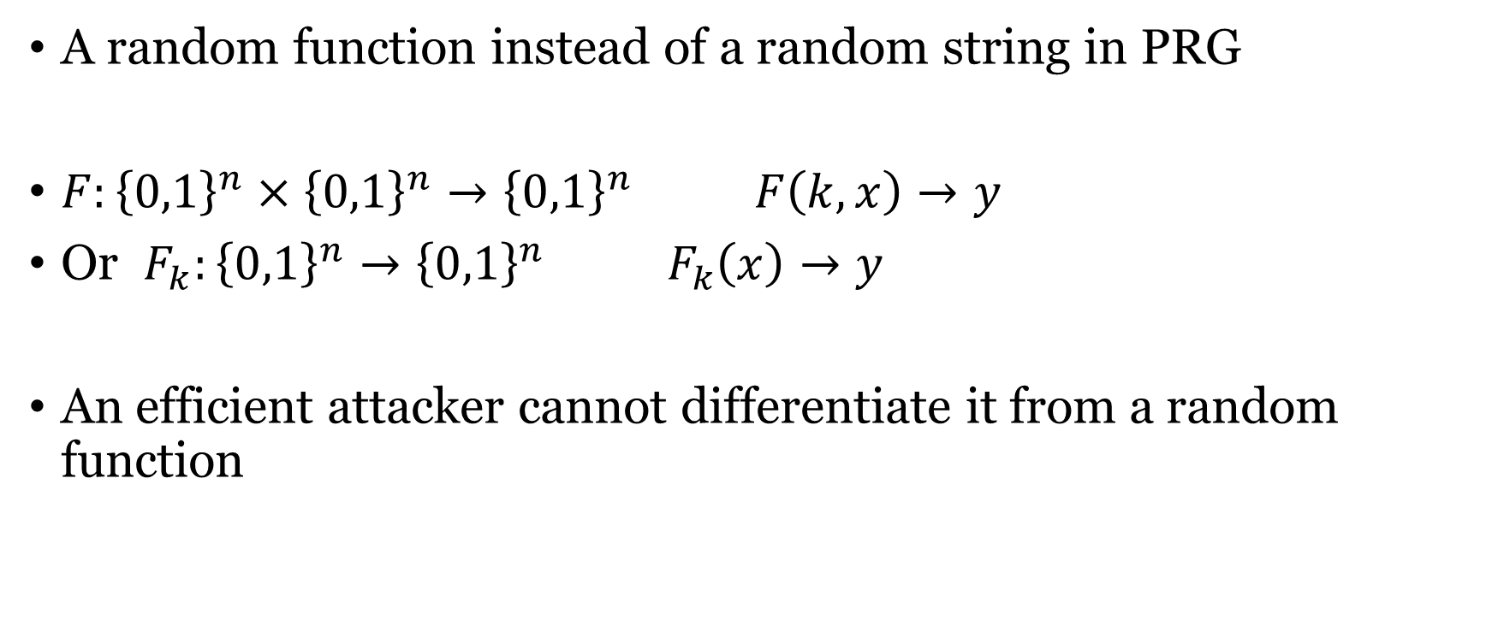
Pseudorandom Function (PRF)
A random function instead of a random string in PRG
$F:{\left\{0,1\right\}}^{n}×{\left\{0,1\right\}}^{n}→{\left\{0,1\right\}}^{n} F\left(k,x\right)→y$
Or $F_{k}:{\left\{0,1\right\}}^{n}→{\left\{0,1\right\}}^{n} F_{k}\left(x\right)→y$
An efficient attacker cannot differentiate it from a random function

Slide 13
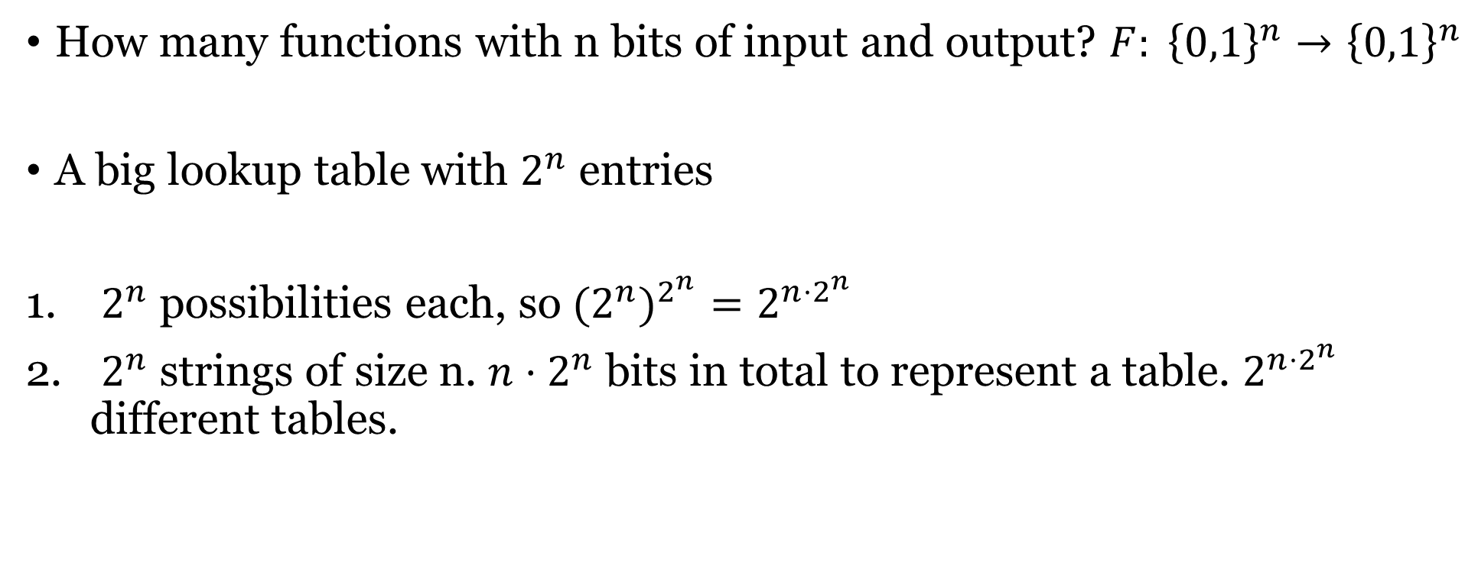
Number of functions
How many functions with n bits of input and output? $F: {\left\{0,1\right\}}^{n}→{\left\{0,1\right\}}^{n}$
A big lookup table with $2^{n}$ entries
$2^{n}$ possibilities each, so ${{(2}^{n})}^{2^{n}}=2^{n⋅2^{n}}$
$2^{n}$ strings of size n. $n⋅2^{n}$ bits in total to represent a table. $2^{n⋅2^{n}}$ different tables.

Slide 14
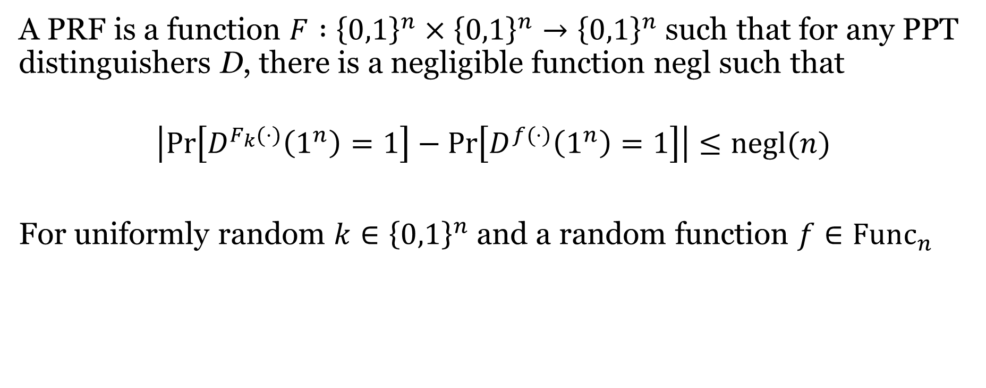
Definition of PRF
A PRF is a function $F :{\left\{0,1\right\}}^{n}×{\left\{0,1\right\}}^{n}→{\left\{0,1\right\}}^{n}$ such that for any PPT distinguishers D, there is a negligible function negl such that
$$\left|\operatorname{Pr}\left[D^{F_{k}(⋅)}\left(1^{n}\right)=1\right]−\operatorname{Pr}\left[D^{f(⋅)}\left(1^{n}\right)=1\right]\right|≤negl(n)$$
For uniformly random $k∈{\left\{0,1\right\}}^{n}$ and a random function $f∈Func_{n}$

Slide 15

PRF vs PRG
$PRG : {\left\{0,1\right\}}^{n} → {\left\{0,1\right\}}^{2n}$
  Key space size: $2^{n}$ # of random strings: $2^{2n}$
$PRF :{\left\{0,1\right\}}^{n}×{\left\{0,1\right\}}^{n}→{\left\{0,1\right\}}^{n}$
  Key space size: $2^{n}$ # of random functions : $2^{n⋅2^{n}}$

Slide 16
PRF vs PRG
PRF F immediately implies a PRG G:
  Define PRG(k) = F_{k}(1) | F_{k}(2) | F_{k}(3) | …
PRF
PRG
Goldreich-Goldwasser-Micali construction

Slide 17
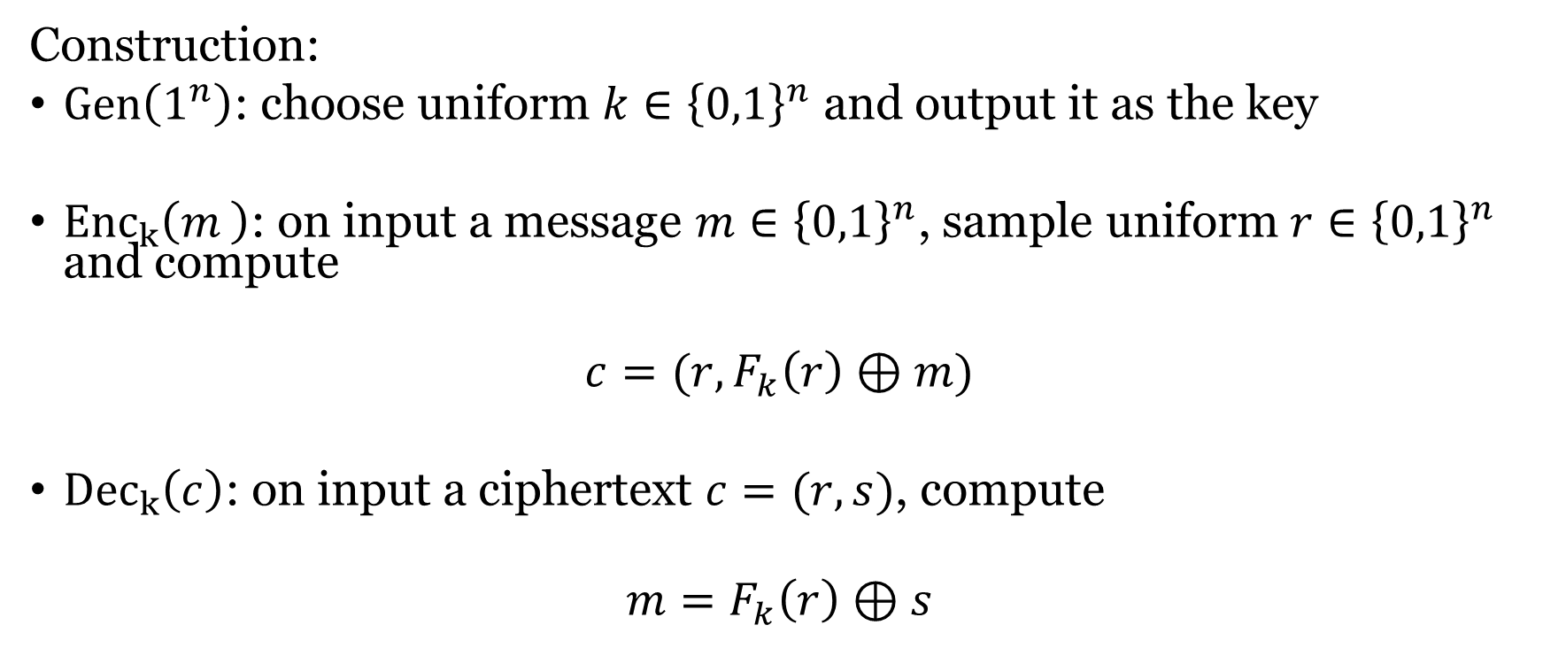
CPA-security from PRF
Construction:
$Gen\left(1^{n}\right)$: choose uniform $k∈{\left\{0,1\right\}}^{n}$ and output it as the key
${Enc}_{k}\left(m_{ }\right)$: on input a message $m∈{\left\{0,1\right\}}^{n}$, sample uniform $r∈{\left\{0,1\right\}}^{n}$ and compute
$$c=(r,F_{k}\left(r\right)⊕m)$$
${Dec}_{k}\left(c\right)$: on input a ciphertext $c=(r,s)$, compute
$$m=F_{k}\left(r\right)⊕s$$

Slide 19
Chosen-plaintext attack (CPA) security
Experiment ${PrivK}_{A,Π}^{ CPA}(n)$:
  A key k is generated using $Gen\left(1^{n}\right)$
  Adversary A is given input $1^{n}$, and oracle access to ${Enc}_{k}\left(⋅\right)$. A outputs two messages $m_{0}, m_{1}∈$ M s.t. ${|m}_{0}|=|m_{1}|$
  A random bit b $∈\{0,1\}$ is chosen. $c={Enc}_{k}\left(m_{b}\right)$ is given to A.
  A continues to have oracle access to ${Enc}_{k}\left(⋅\right)$and outputs b’
  Experiment outputs 1 if b=b’, and 0 otherwise.
Definition: a private-key encryption $Π=(Gen, Enc, Dec)$ is CPA-secure, if for all probabilistic polynomial time adversaries A, there is a negligible function negl such that for all n,
$$\operatorname{Pr}{[{PrivK}_{A,Π}^{CPA }\left(n\right)=1}]≤\frac{1}{2}+negl(n)$$

Slide 20
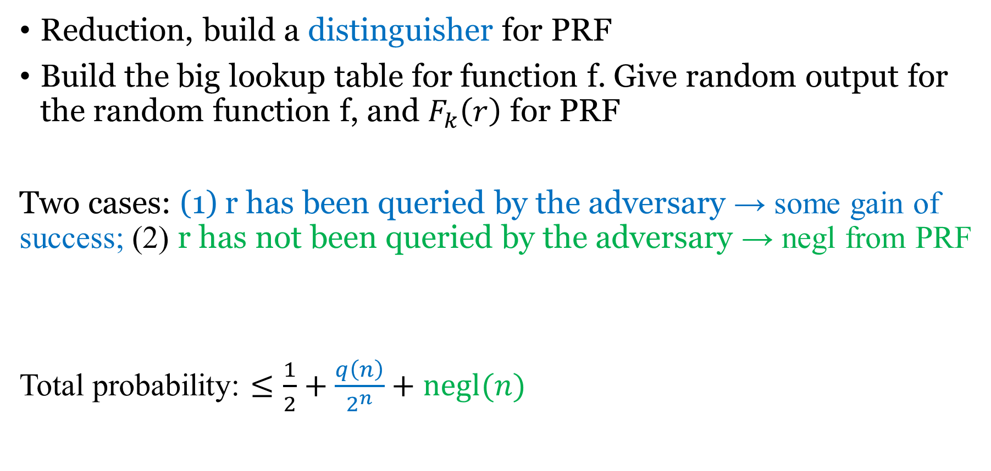
Proof idea
Reduction, build a distinguisher for PRF
Build the big lookup table for function f. Give random output for the random function f, and $F_{k}\left(r\right)$ for PRF
Two cases: (1) r has been queried by the adversary → some gain of success; (2) r has not been queried by the adversary → negl from PRF
Total probability: $≤\frac{1}{2}+\frac{q\left(n\right)}{2^{n}}+negl(n)$

Slide 21
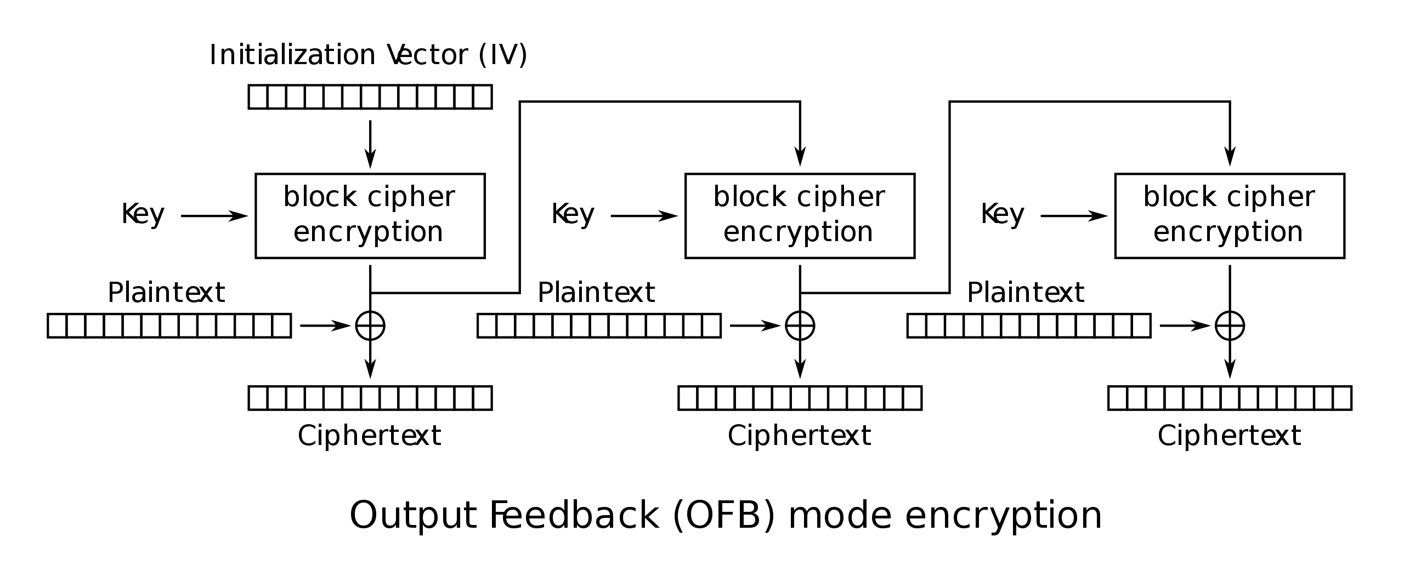
Output Feedback (OFB) mode
Block cipher
Mode of encryption
Padding

Slide 22
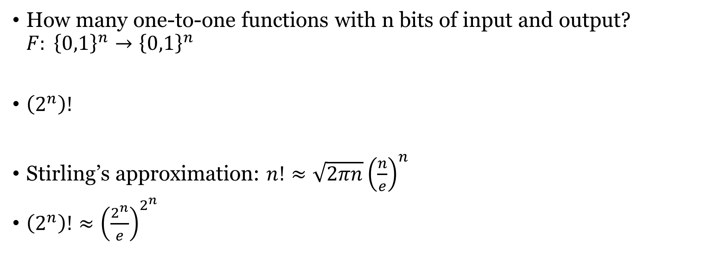
Number of permutations
How many one-to-one functions with n bits of input and output? $F: {\left\{0,1\right\}}^{n}→{\left\{0,1\right\}}^{n}$
$\left(2^{n}\right)!$
Stirling’s approximation: $n!≈\sqrt{2πn}{\left(\frac{n}{e}\right)}^{n}$
$\left(2^{n}\right)!≈{\left(\frac{2^{n}}{e}\right)}^{2^{n}}$

Slide 23

Pseudorandom Permutations
One-to-one, a subset of PRF
Invertible. Both $F_{k}\left(x\right)→y$ and $F_{k}^{−1}\left(y\right)→x$ are efficiently computable.
$$\left|\operatorname{Pr}\left[D^{F_{k}\left(⋅\right),F_{k}^{−1}\left(⋅\right)}\left(1^{n}\right)=1\right]−\operatorname{Pr}\left[D^{f\left(⋅\right),f^{−1}(⋅)}\left(1^{n}\right)=1\right]\right|≤negl(n)$$

