Slide 1
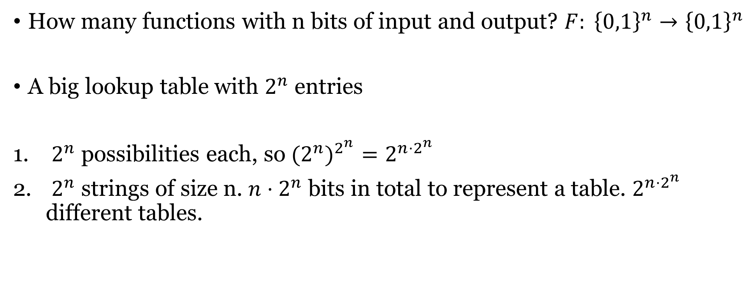
Number of functions
How many functions with n bits of input and output? $F: {\left\{0,1\right\}}^{n}→{\left\{0,1\right\}}^{n}$
A big lookup table with $2^{n}$ entries
$2^{n}$ possibilities each, so ${{(2}^{n})}^{2^{n}}=2^{n⋅2^{n}}$
$2^{n}$ strings of size n. $n⋅2^{n}$ bits in total to represent a table. $2^{n⋅2^{n}}$ different tables.

Slide 2
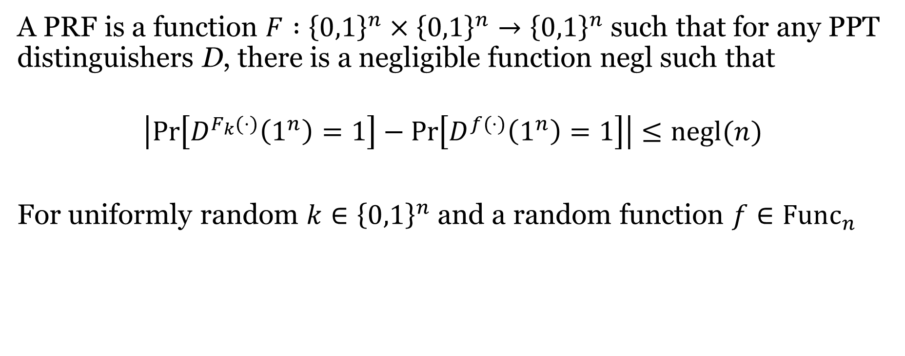
Last time: Pseudorandom Function (PRF)
A PRF is a function $F :{\left\{0,1\right\}}^{n}×{\left\{0,1\right\}}^{n}→{\left\{0,1\right\}}^{n}$ such that for any PPT distinguishers D, there is a negligible function negl such that
$$\left|\operatorname{Pr}\left[D^{F_{k}(⋅)}\left(1^{n}\right)=1\right]−\operatorname{Pr}\left[D^{f(⋅)}\left(1^{n}\right)=1\right]\right|≤negl(n)$$
For uniformly random $k∈{\left\{0,1\right\}}^{n}$ and a random function $f∈Func_{n}$

Slide 3
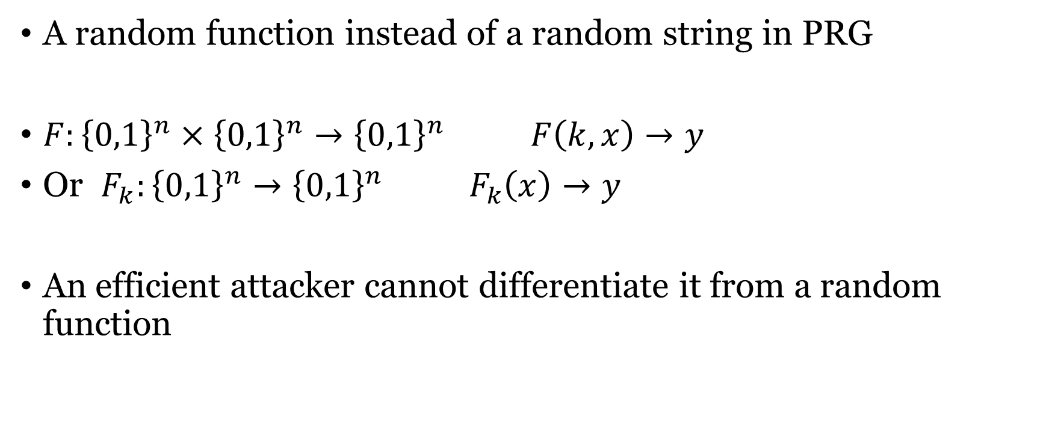
Pseudorandom Function (PRF)
A random function instead of a random string in PRG
$F:{\left\{0,1\right\}}^{n}×{\left\{0,1\right\}}^{n}→{\left\{0,1\right\}}^{n} F\left(k,x\right)→y$
Or $F_{k}:{\left\{0,1\right\}}^{n}→{\left\{0,1\right\}}^{n} F_{k}\left(x\right)→y$
An efficient attacker cannot differentiate it from a random function

Slide 4
Definition of PRF
A PRF is a function $F :{\left\{0,1\right\}}^{n}×{\left\{0,1\right\}}^{n}→{\left\{0,1\right\}}^{n}$ such that for any PPT distinguishers D, there is a negligible function negl such that
$$\left|\operatorname{Pr}\left[D^{F_{k}(⋅)}\left(1^{n}\right)=1\right]−\operatorname{Pr}\left[D^{f(⋅)}\left(1^{n}\right)=1\right]\right|≤negl(n)$$
For uniformly random $k∈{\left\{0,1\right\}}^{n}$ and a random function $f∈Func_{n}$

Slide 5

PRF vs PRG
$PRG : {\left\{0,1\right\}}^{n} → {\left\{0,1\right\}}^{2n}$
  Key space size: $2^{n}$ # of random strings: $2^{2n}$
$PRF :{\left\{0,1\right\}}^{n}×{\left\{0,1\right\}}^{n}→{\left\{0,1\right\}}^{n}$
  Key space size: $2^{n}$ # of random functions : $2^{n⋅2^{n}}$

Slide 6
PRF vs PRG
PRF F immediately implies a PRG G:
  Define PRG(k) = F_{k}(1) | F_{k}(2) | F_{k}(3) | …
PRF
PRG
Goldreich-Goldwasser-Micali construction

Slide 7
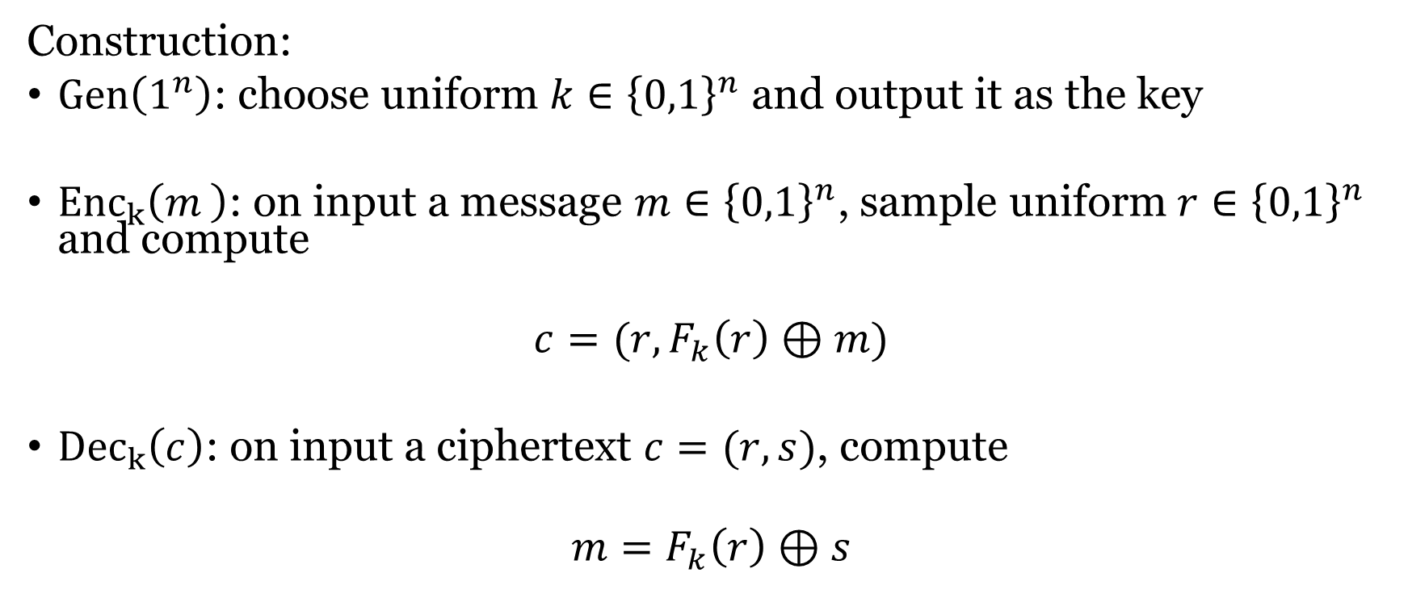
CPA-security from PRF
Construction:
$Gen\left(1^{n}\right)$: choose uniform $k∈{\left\{0,1\right\}}^{n}$ and output it as the key
${Enc}_{k}\left(m_{ }\right)$: on input a message $m∈{\left\{0,1\right\}}^{n}$, sample uniform $r∈{\left\{0,1\right\}}^{n}$ and compute
$$c=(r,F_{k}\left(r\right)⊕m)$$
${Dec}_{k}\left(c\right)$: on input a ciphertext $c=(r,s)$, compute
$$m=F_{k}\left(r\right)⊕s$$

Slide 8
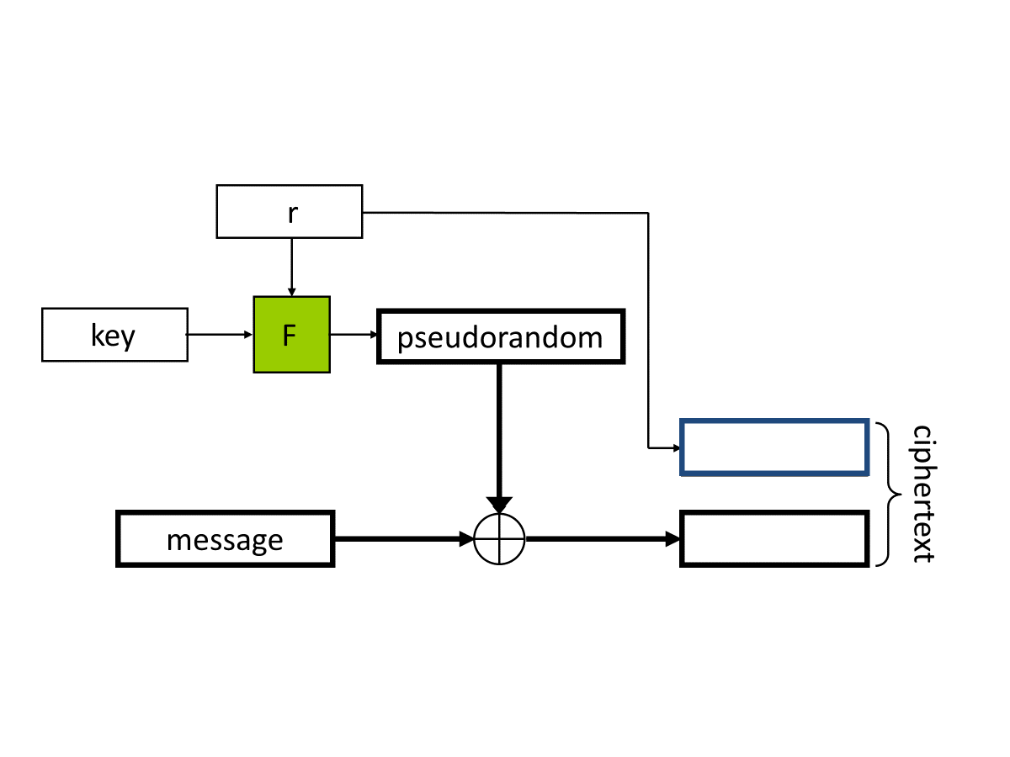

Slide 9
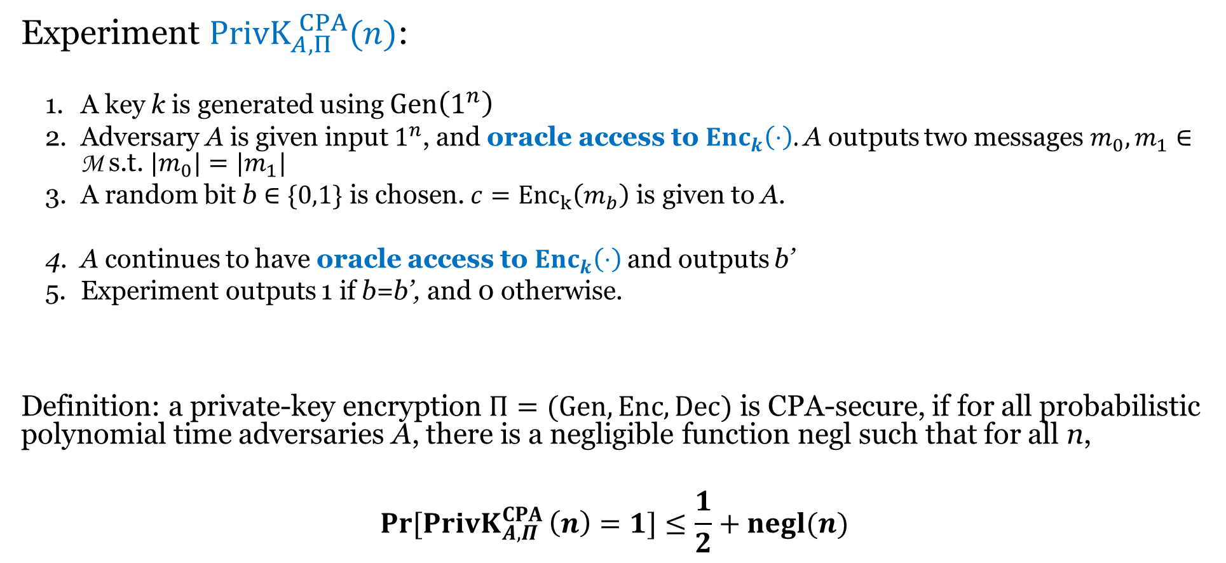
Chosen-plaintext attack (CPA) security
Experiment ${PrivK}_{A,Π}^{ CPA}(n)$:
  A key k is generated using $Gen\left(1^{n}\right)$
  Adversary A is given input $1^{n}$, and oracle access to ${Enc}_{k}\left(⋅\right)$. A outputs two messages $m_{0}, m_{1}∈$ M s.t. ${|m}_{0}|=|m_{1}|$
  A random bit b $∈\{0,1\}$ is chosen. $c={Enc}_{k}\left(m_{b}\right)$ is given to A.
  A continues to have oracle access to ${Enc}_{k}\left(⋅\right)$and outputs b’
  Experiment outputs 1 if b=b’, and 0 otherwise.
Definition: a private-key encryption $Π=(Gen, Enc, Dec)$ is CPA-secure, if for all probabilistic polynomial time adversaries A, there is a negligible function negl such that for all n,
$$\operatorname{Pr}{[{PrivK}_{A,Π}^{CPA }\left(n\right)=1}]≤\frac{1}{2}+negl(n)$$

Slide 10
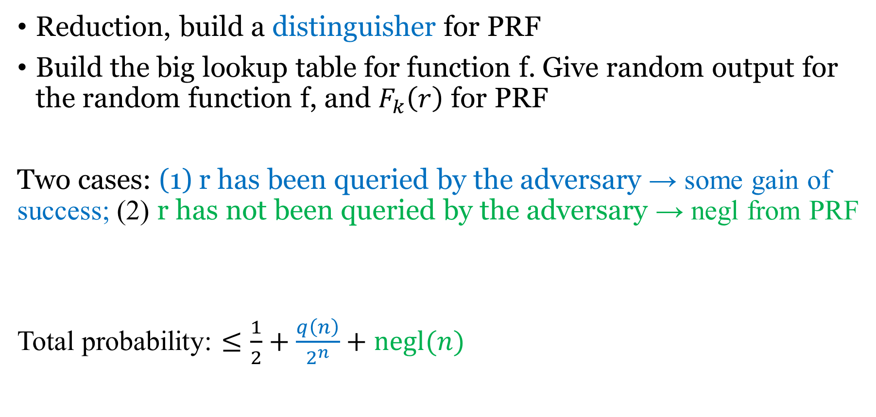
Proof idea
Reduction, build a distinguisher for PRF
Build the big lookup table for function f. Give random output for the random function f, and $F_{k}\left(r\right)$ for PRF
Two cases: (1) r has been queried by the adversary → some gain of success; (2) r has not been queried by the adversary → negl from PRF
Total probability: $≤\frac{1}{2}+\frac{q\left(n\right)}{2^{n}}+negl(n)$

Slide 11

Pseudorandom Permutations
One-to-one, a subset of PRF
Invertible. Both $F_{k}\left(x\right)→y$ and $F_{k}^{−1}\left(y\right)→x$ are efficiently computable.
$$\left|\operatorname{Pr}\left[D^{F_{k}\left(⋅\right),F_{k}^{−1}\left(⋅\right)}\left(1^{n}\right)=1\right]−\operatorname{Pr}\left[D^{f\left(⋅\right),f^{−1}(⋅)}\left(1^{n}\right)=1\right]\right|≤negl(n)$$

Slide 12
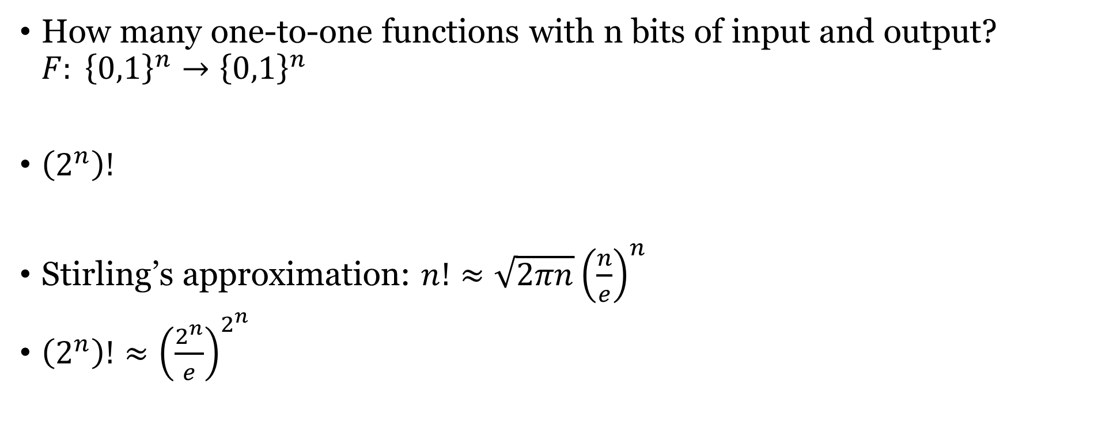
Number of permutations
How many one-to-one functions with n bits of input and output? $F: {\left\{0,1\right\}}^{n}→{\left\{0,1\right\}}^{n}$
$\left(2^{n}\right)!$
Stirling’s approximation: $n!≈\sqrt{2πn}{\left(\frac{n}{e}\right)}^{n}$
$\left(2^{n}\right)!≈{\left(\frac{2^{n}}{e}\right)}^{2^{n}}$

Slide 13
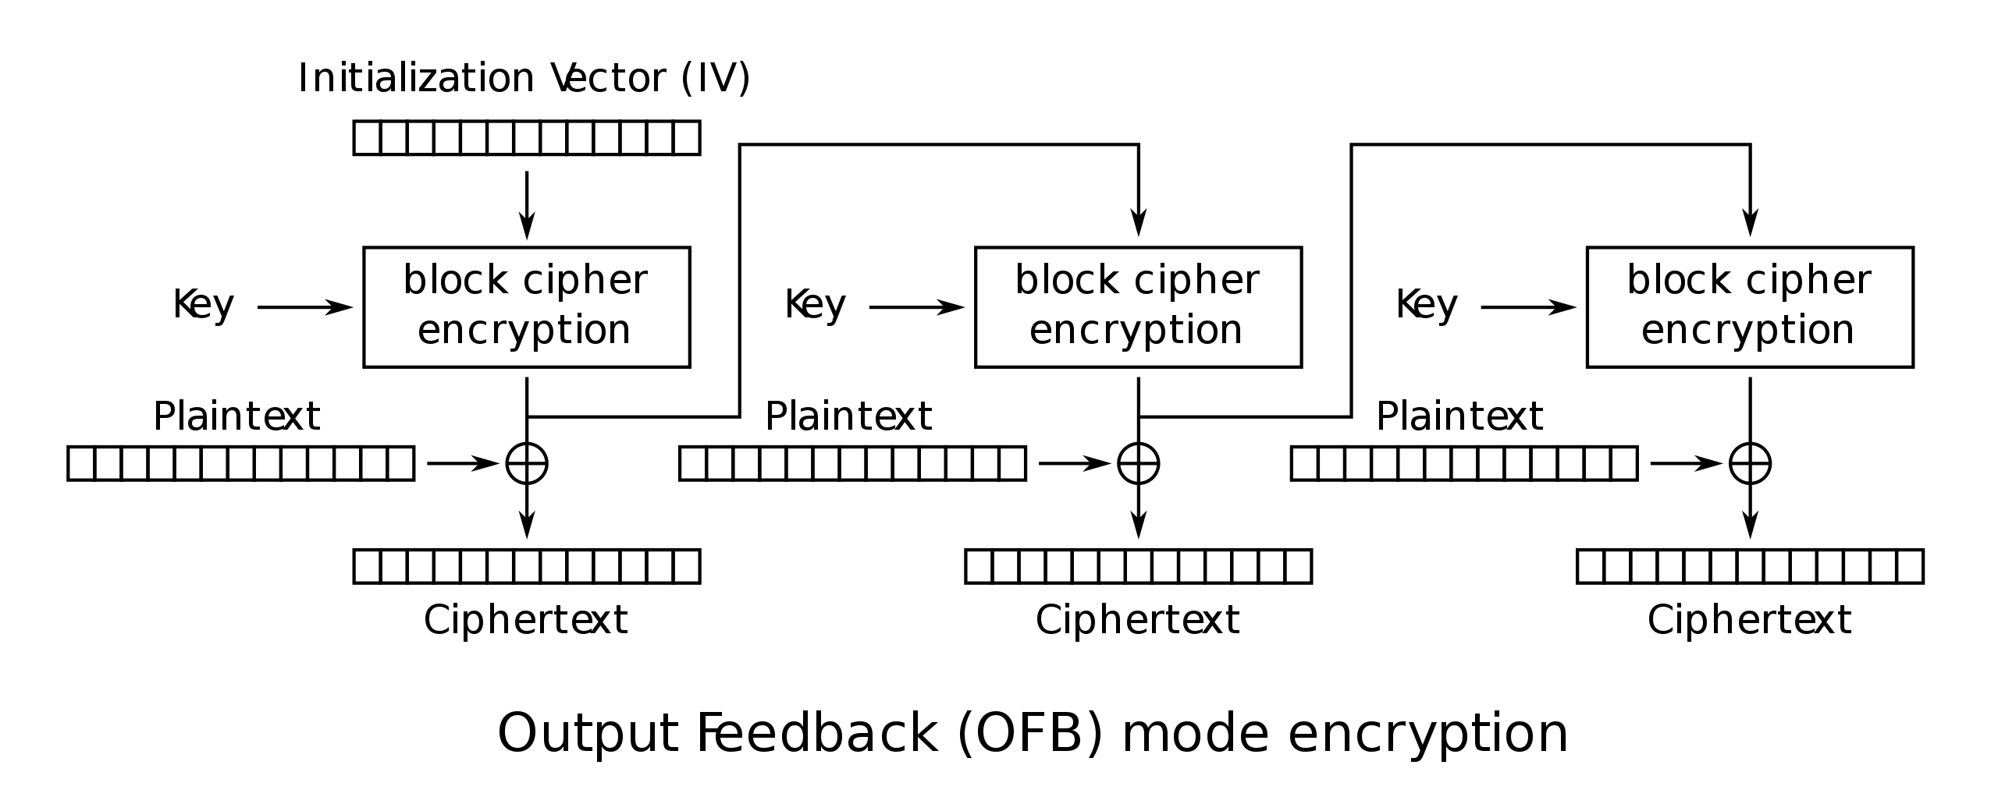
Output Feedback (OFB) mode
Block cipher
Mode of encryption
Padding

Slide 14
Designing block ciphers
Want F_{k} (for uniform, unknown key k) to be indistinguishable from a random function
If x and x’ differ in one bit, what should the relation between F_{k}(x) and F_{k}(x’) be?
  How many bits should change (on average)?
  Which bits should change?

Slide 15

Confusion-diffusion paradigm
$F_{k}\left(x\right)=f_{1}\left(x_{1}\right)$|| $f_{2}\left(x_{2}\right)$||…||$f_{16}(x_{16})$
Smaller random blocks $f_{i}\left( \right)$: confusion
Mixing permutation: diffusion
Notes:
Confusion — make the relationship between key and ciphertext complicated. Each output bit should depend on the key in a messy, nonlinear way, so an attacker can't write down simple algebraic equations relating key bits to ciphertext bits. On your slide this is the round functions f₁, …, f₁₆-→ the S-boxes. Each fᵢ is a small, key-dependent (or key-mixed) random-looking lookup table acting on one 8-bit chunk: F_k(x) = f₁(x₁) ‖ f₂(x₂) ‖ … ‖ f₁₆(x₁₆). Because each fᵢ is a random permutation on a small domain, it's highly nonlinear.
Diffusion — spread local changes over the whole block. Flipping one input bit should affect roughly half of all output bits (the avalanche effect), so statistical structure in the plaintext is smeared across the entire ciphertext.→ This is the mixing permutation

Slide 16
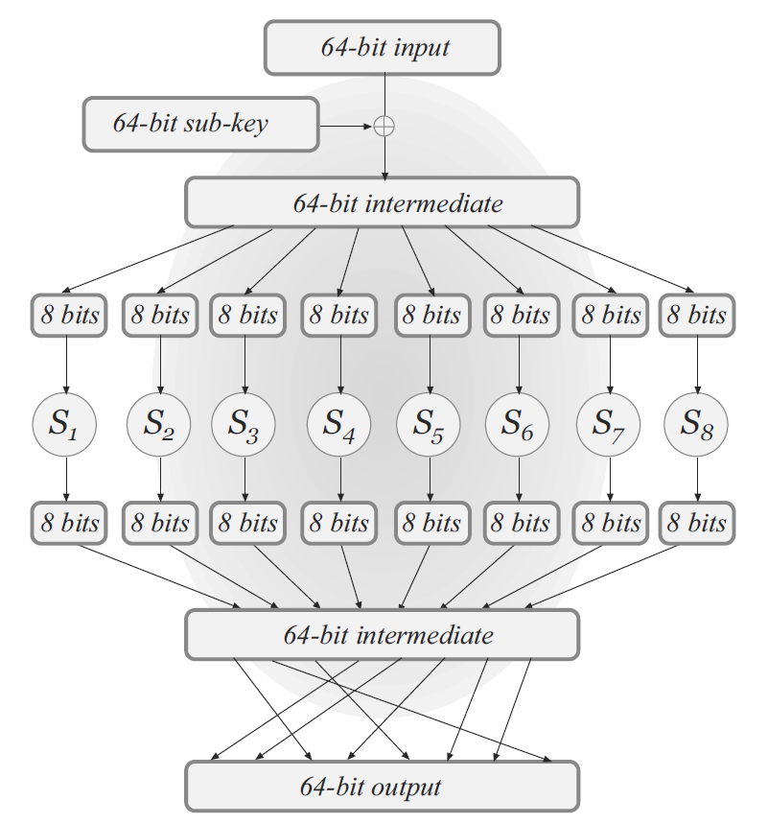
Substitution-Permutation Networks (SPN)
XOR with secret key
Substitution boxes
Permutation

Slide 17
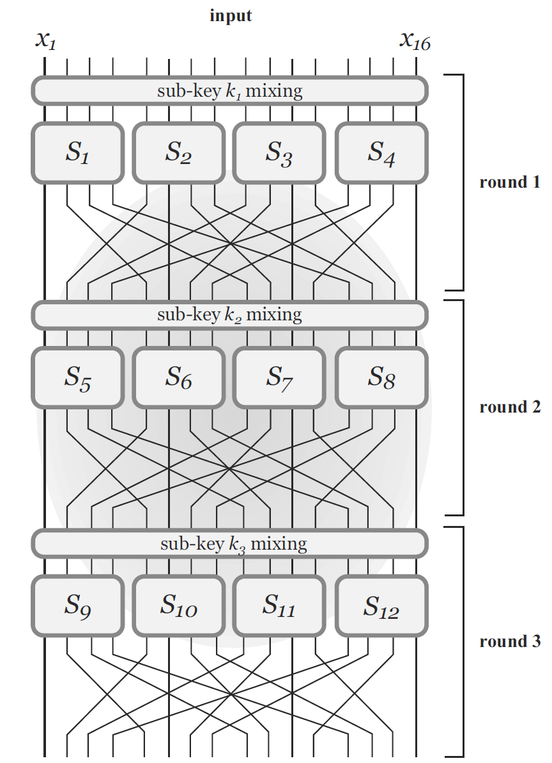
Multi-round design

Slide 18
Avalanche effect
1-bit difference in the input should “affect” every bit of the output.

Slide 19
Avalanche effect
Design S-boxes and mixing permutation to ensure avalanche effect
  Small differences should eventually propagate to entire output
S-boxes: any 1-bit change in input causes ≥2-bit change in output, non-linear!
  Not so easy to ensure!
Mixing permutation
  Each bit output from a given S-box should feed into a different S-box in the next round

Slide 20
Avalanche effect

Slide 21
Sub-keys and master key
Master key: secret key
Sub-keys for different rounds are derived from the master key
L+1 sub-keys for L-round SPN: always XOR a sub-key at the end

Slide 22
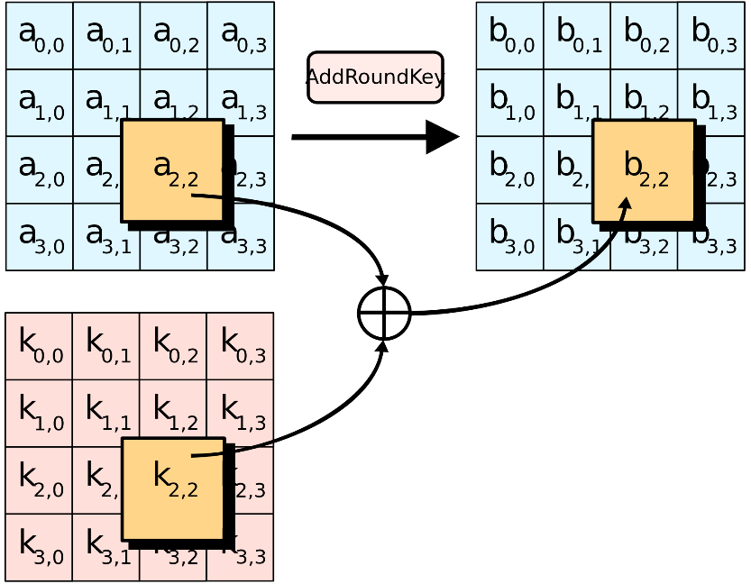
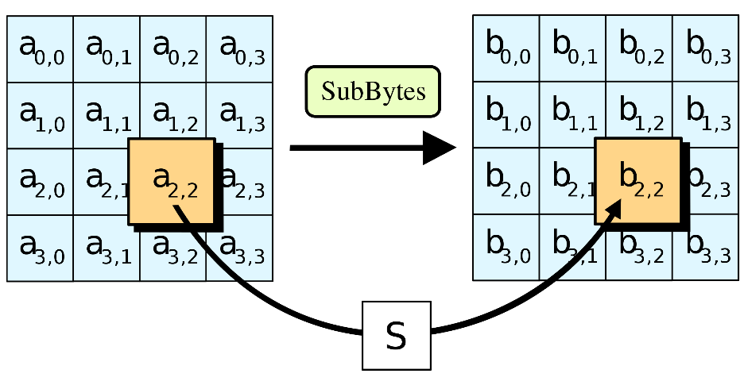
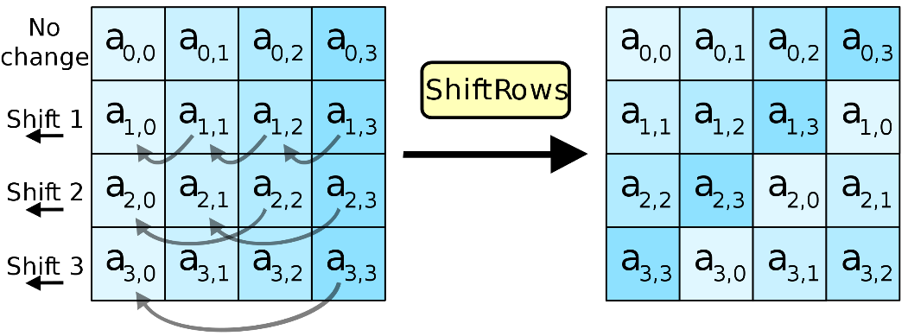
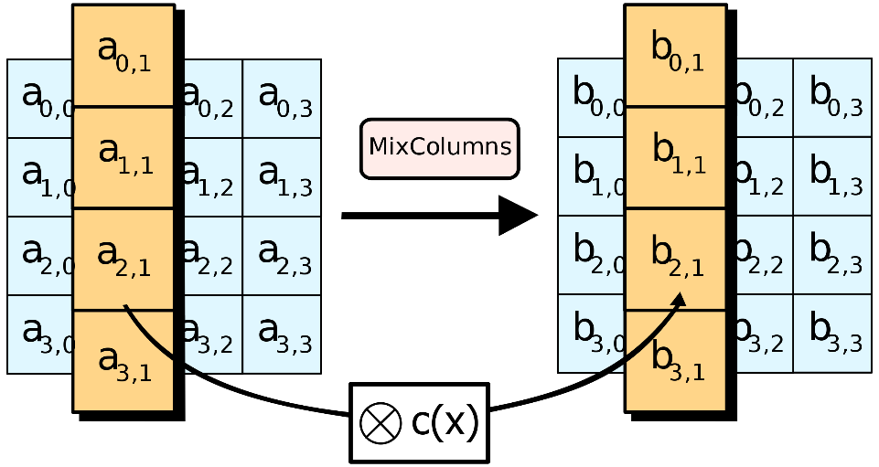
AES
https://en.wikipedia.org/wiki/Advanced_Encryption_Standard

Slide 23
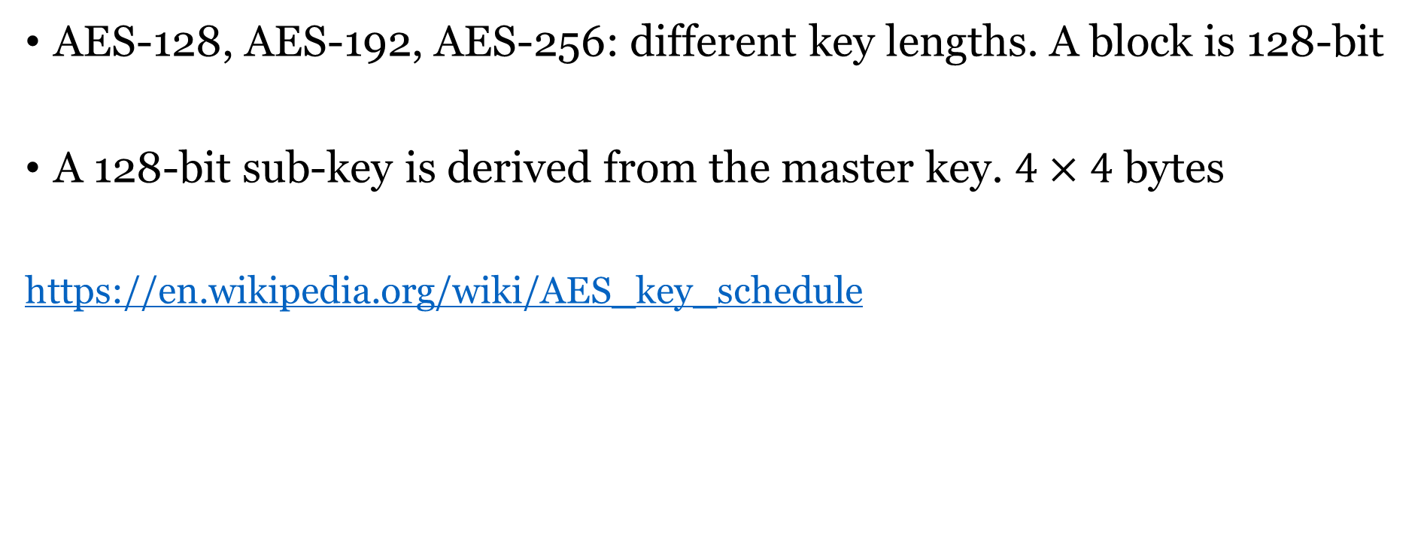
AES
AES-128, AES-192, AES-256: different key lengths. A block is 128-bit
A 128-bit sub-key is derived from the master key. $4×4$ bytes
https://en.wikipedia.org/wiki/AES_key_schedule

Slide 24
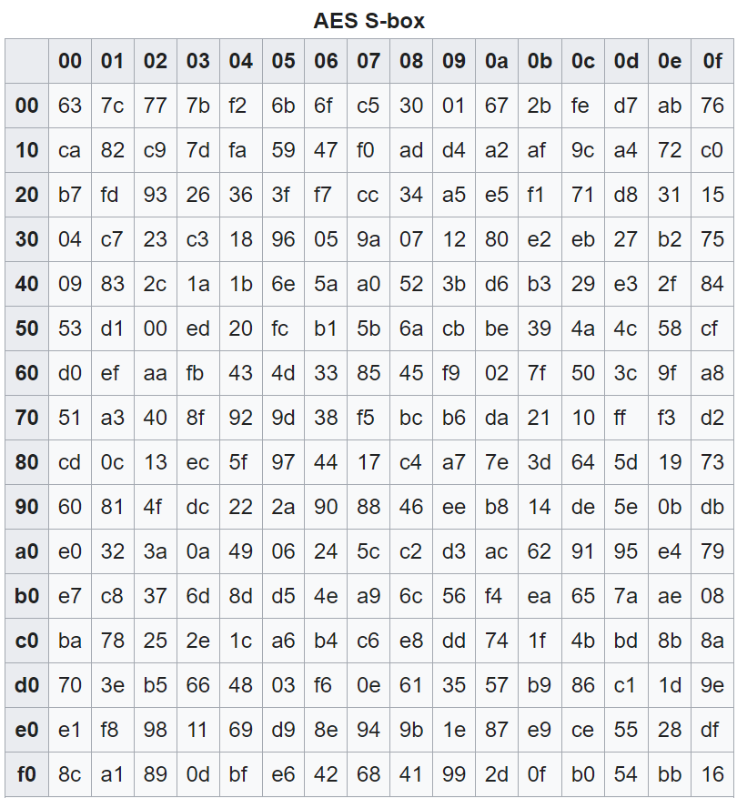

AES substitution boxes
$${\left\{0,1\right\}}^{8}→{\left\{0,1\right\}}^{8}$$

Slide 25
ShiftRows and MixColumns

Slide 26
Multi-round
AES has 10 rounds for 128-bit keys, 12 rounds for 192-bit keys, and 14 rounds for 256-bit keys.

Slide 27
Open design principle
  Security should only rely on the secret key

Slide 28
Assumptions
AES/DES is a PRF/PRP
What’s the difference? Enigma machine, Vigenère cipher
  Modular and composable constructions
  Years of cryptanalysis
Don’t Roll Your Own Crypto!!!

Slide 29
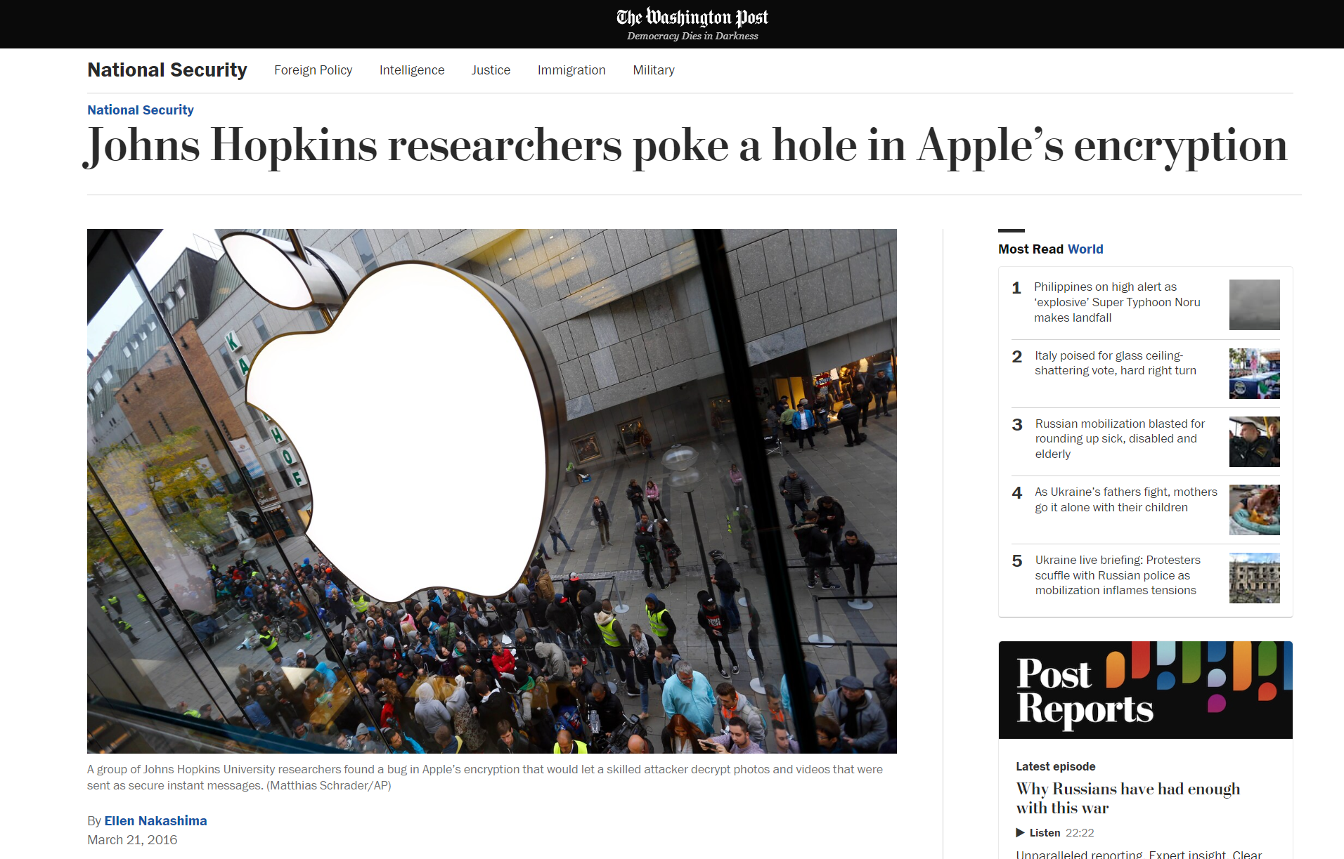

Slide 30
AES is invertible given k
S-box is invertible
We do need AES decryptions in some block cipher modes

Slide 31
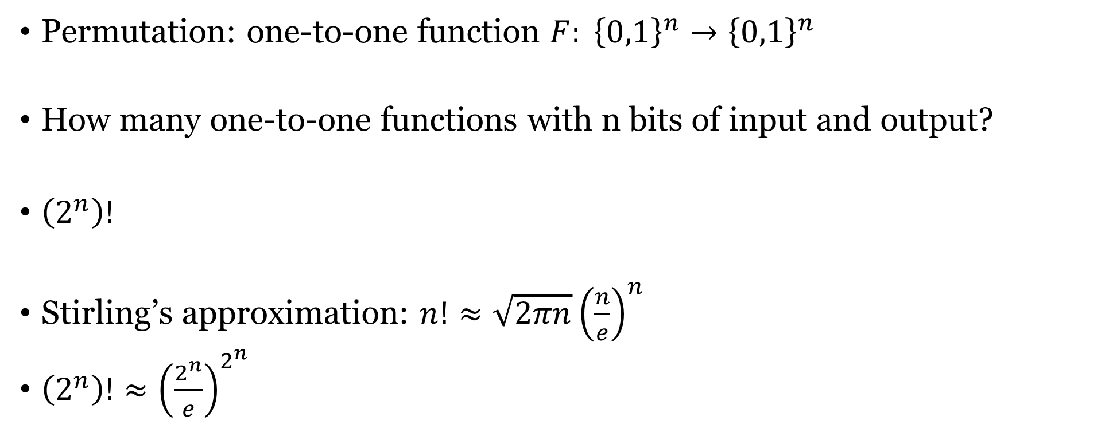
Permutations vs functions
Permutation: one-to-one function $F: {\left\{0,1\right\}}^{n}→{\left\{0,1\right\}}^{n}$
How many one-to-one functions with n bits of input and output?
$\left(2^{n}\right)!$
Stirling’s approximation: $n!≈\sqrt{2πn}{\left(\frac{n}{e}\right)}^{n}$
$\left(2^{n}\right)!≈{\left(\frac{2^{n}}{e}\right)}^{2^{n}}$

Slide 32

Pseudorandom Permutations
One-to-one, a subset of PRF
Invertible. Both $F_{k}\left(x\right)→y$ and $F_{k}^{−1}\left(y\right)→x$ are efficiently computable.
$$\left|\operatorname{Pr}\left[D^{F_{k}\left(⋅\right),F_{k}^{−1}\left(⋅\right)}\left(1^{n}\right)=1\right]−\operatorname{Pr}\left[D^{f\left(⋅\right),f^{−1}(⋅)}\left(1^{n}\right)=1\right]\right|≤negl(n)$$

Slide 33
Feistel network
Used in DES
Advantage over SPN: S-boxes don’t need to be invertible

Slide 34
Feistel network
$$L_{i}=R_{i−1}, R_{i}=L_{i−1}⊕f_{i}(R_{i−1})$$
L₀
R₀
⊕
f_{k}
L₁
R₁

Slide 35
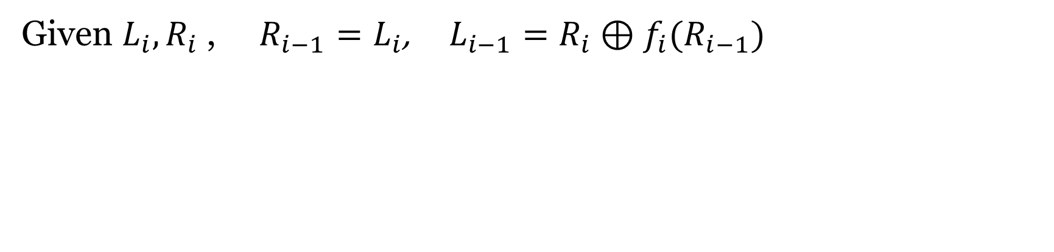
Inverting Feistel network
$$L_{i}=R_{i−1}, R_{i}=L_{i−1}⊕f_{i}(R_{i−1})$$
Given $L_{i},R_{i}$ , $R_{i−1}=L_{i}$, $L_{i−1}=R_{i}⊕f_{i}(R_{i−1})$

Slide 36
DES overview
56 bit key K
64 bit input M
Developed in 1970s
Block length 64 bits, key length 56 bits
Feistel cipher, 16 stages
K₁,…, K₁₆ are 48 bit subkeys derived from K
Subkey generator
Initial permutation
K₁
K₁₆
Feistel network
(16 rounds)
32-bit swap
Final permutation
64 bit output C

Slide 37
Feistel network in DES
32 bits L_{i}
32 bits R_{i}
Expansion
48 bits
K_{i}
Mangler function
S-boxes
Permutation
32 bits
32 bits L_{i+1}
32 bits R_{i+1}

Slide 38
Substitution Boxes in DES
8 different S-Boxes (48 bits input)
6-bit input to 4-bit output (48 to 32 bits)
Not invertible

Slide 39
DES mangler function
S-boxes
  Changing 1 bit of input changes at least 2 bits of output
Mixing permutation
  The 4 bits of output from any S-box affect the input to 6 S-boxes in the next round

Slide 40
Avalanche effect
Consider 1-bit difference in left half of input
  After 1 round, 1-bit difference in right half
  S-boxes cause a 2-bit difference, implying a 3-bit difference overall after 2 rounds
  Mixing permutation spreads differences into different S-boxes
  …

Slide 41
Security of DES
DES is extremely well-designed
  Except for some attacks that require large amounts of plaintext, no attacks better than brute-force are known
But … parameters are too small!

Slide 42
56-bit key length
A concern as soon as DES was released
Brute-force search over 2⁵⁶ keys is possible
  1997: 1000s of computers, 96 days
  1998: distributed.net, 41 days
  1999: Deep Crack ($250,000), 56 hours
  Today: 48 FPGAs, ~1 day

Slide 43
Double DES
Simple extension to DES, using two 56-bit keys
Key K₁
Key K₂
DES
Encryption
DES
Encryption
Plaintext
Ciphertext

Slide 44
Meet-in-the-middle attack
No! There is an attack taking 2^{n} time…
  (And 2^{n} memory)
The attack applies any time a block cipher can be “factored” into 2 independent components

Slide 45
Triple DES
Simple extension to DES, using or three 56-bit keys
Key K₁
Key K₂
Key K₃
DES
Encryption
DES
Decryption
DES
Encryption
Plaintext
Ciphertext
Security level of 2¹¹², currently thought to be enough
  Can also use K₁, K₂, K₁

