Slide 2
Designing block ciphers
Want F_{k} (for uniform, unknown key k) to be indistinguishable from a random function
If x and x’ differ in one bit, what should the relation between F_{k}(x) and F_{k}(x’) be?
  How many bits should change (on average)?
  Which bits should change?

Slide 3

Confusion-diffusion paradigm
$F_{k}\left(x\right)=f_{1}\left(x_{1}\right)$|| $f_{2}\left(x_{2}\right)$||…||$f_{16}(x_{16})$
Smaller random blocks $f_{i}\left( \right)$: confusion
Mixing permutation: diffusion
Notes:
Confusion — make the relationship between key and ciphertext complicated. Each output bit should depend on the key in a messy, nonlinear way, so an attacker can't write down simple algebraic equations relating key bits to ciphertext bits. On your slide this is the round functions f₁, …, f₁₆-→ the S-boxes. Each fᵢ is a small, key-dependent (or key-mixed) random-looking lookup table acting on one 8-bit chunk: F_k(x) = f₁(x₁) ‖ f₂(x₂) ‖ … ‖ f₁₆(x₁₆). Because each fᵢ is a random permutation on a small domain, it's highly nonlinear.
Diffusion — spread local changes over the whole block. Flipping one input bit should affect roughly half of all output bits (the avalanche effect), so statistical structure in the plaintext is smeared across the entire ciphertext.→ This is the mixing permutation

Slide 4
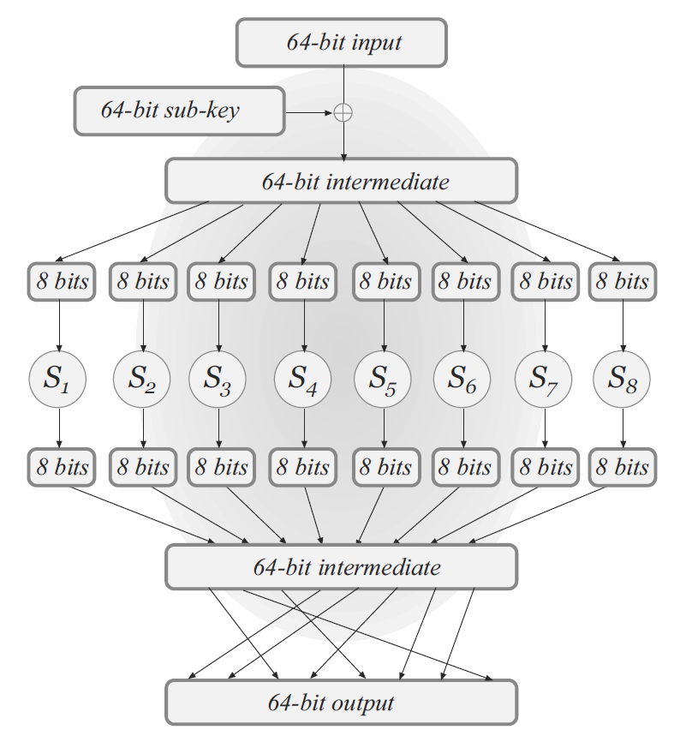
Substitution-Permutation Networks (SPN)
XOR with secret key
Substitution boxes
Permutation

Slide 5
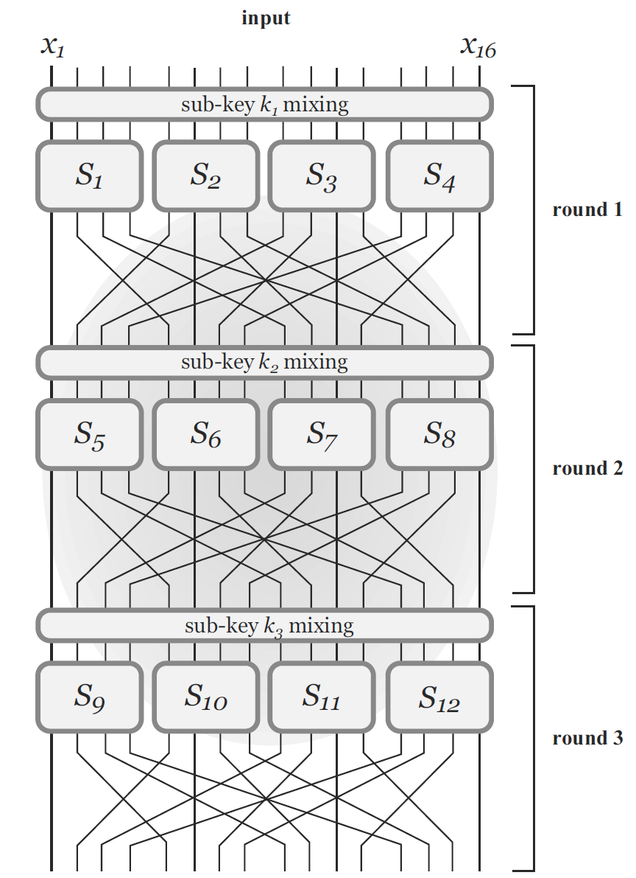
Multi-round design

Slide 6
Avalanche effect
1-bit difference in the input should “affect” every bit of the output.

Slide 7
Avalanche effect
Design S-boxes and mixing permutation to ensure avalanche effect
  Small differences should eventually propagate to entire output
S-boxes: any 1-bit change in input causes ≥2-bit change in output, non-linear!
  Not so easy to ensure!
Mixing permutation
  Each bit output from a given S-box should feed into a different S-box in the next round

Slide 8
Avalanche effect

Slide 9
Sub-keys and master key
Master key: secret key
Sub-keys for different rounds are derived from the master key
L+1 sub-keys for L-round SPN: always XOR a sub-key at the end

Slide 10
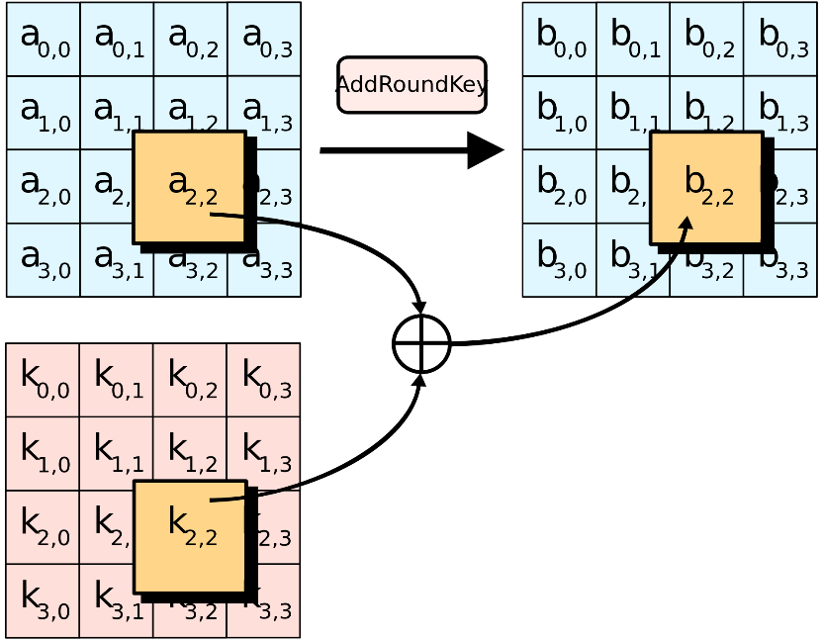
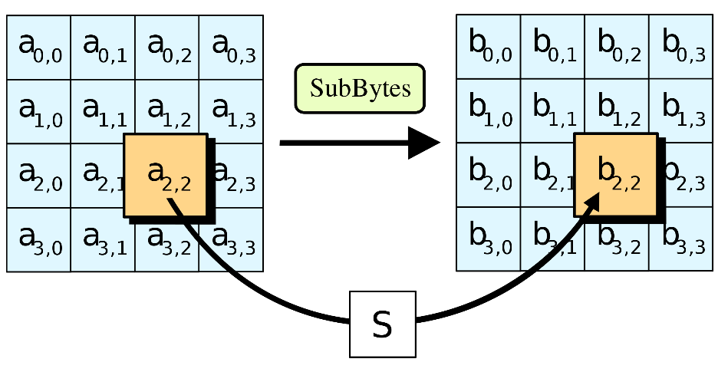
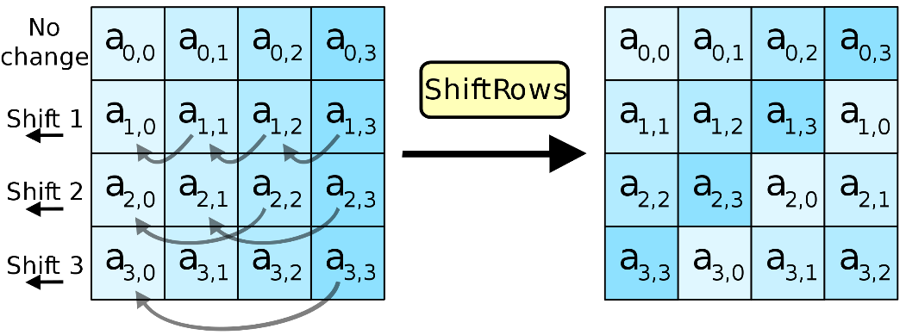
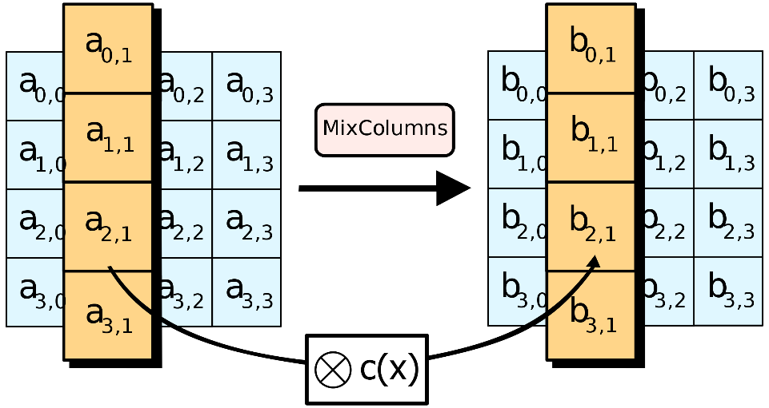
AES
https://en.wikipedia.org/wiki/Advanced_Encryption_Standard

Slide 11
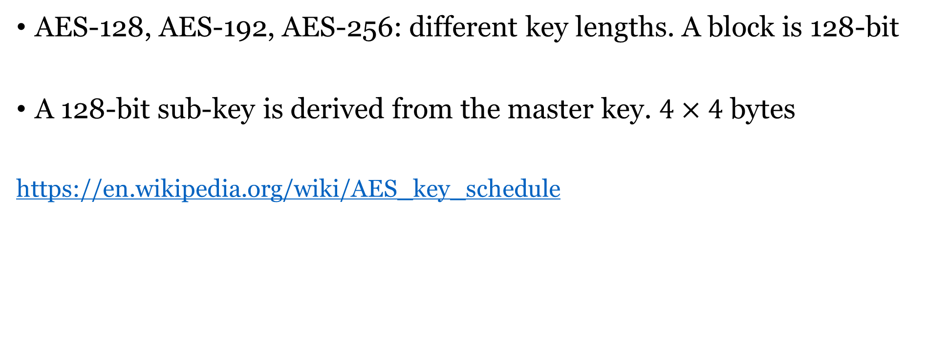
AES
AES-128, AES-192, AES-256: different key lengths. A block is 128-bit
A 128-bit sub-key is derived from the master key. $4×4$ bytes
https://en.wikipedia.org/wiki/AES_key_schedule

Slide 12
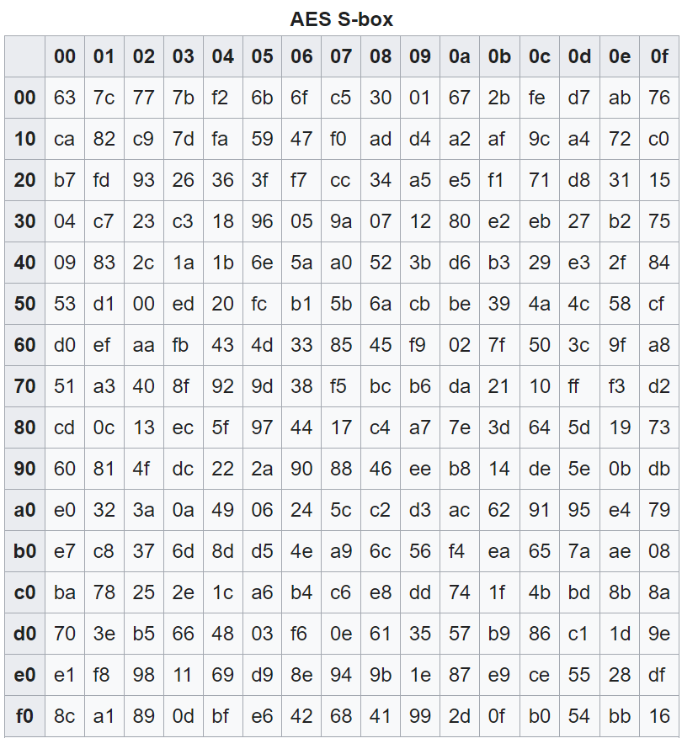

AES substitution boxes
$${\left\{0,1\right\}}^{8}→{\left\{0,1\right\}}^{8}$$

Slide 13
ShiftRows and MixColumns

Slide 14
Multi-round
AES has 10 rounds for 128-bit keys, 12 rounds for 192-bit keys, and 14 rounds for 256-bit keys.

Slide 15
Open design principle
  Security should only rely on the secret key

Slide 16
Assumptions
AES/DES is a PRF/PRP
What’s the difference? Enigma machine, Vigenère cipher
  Modular and composable constructions
  Years of cryptanalysis
Don’t Roll Your Own Crypto!!!

Slide 17
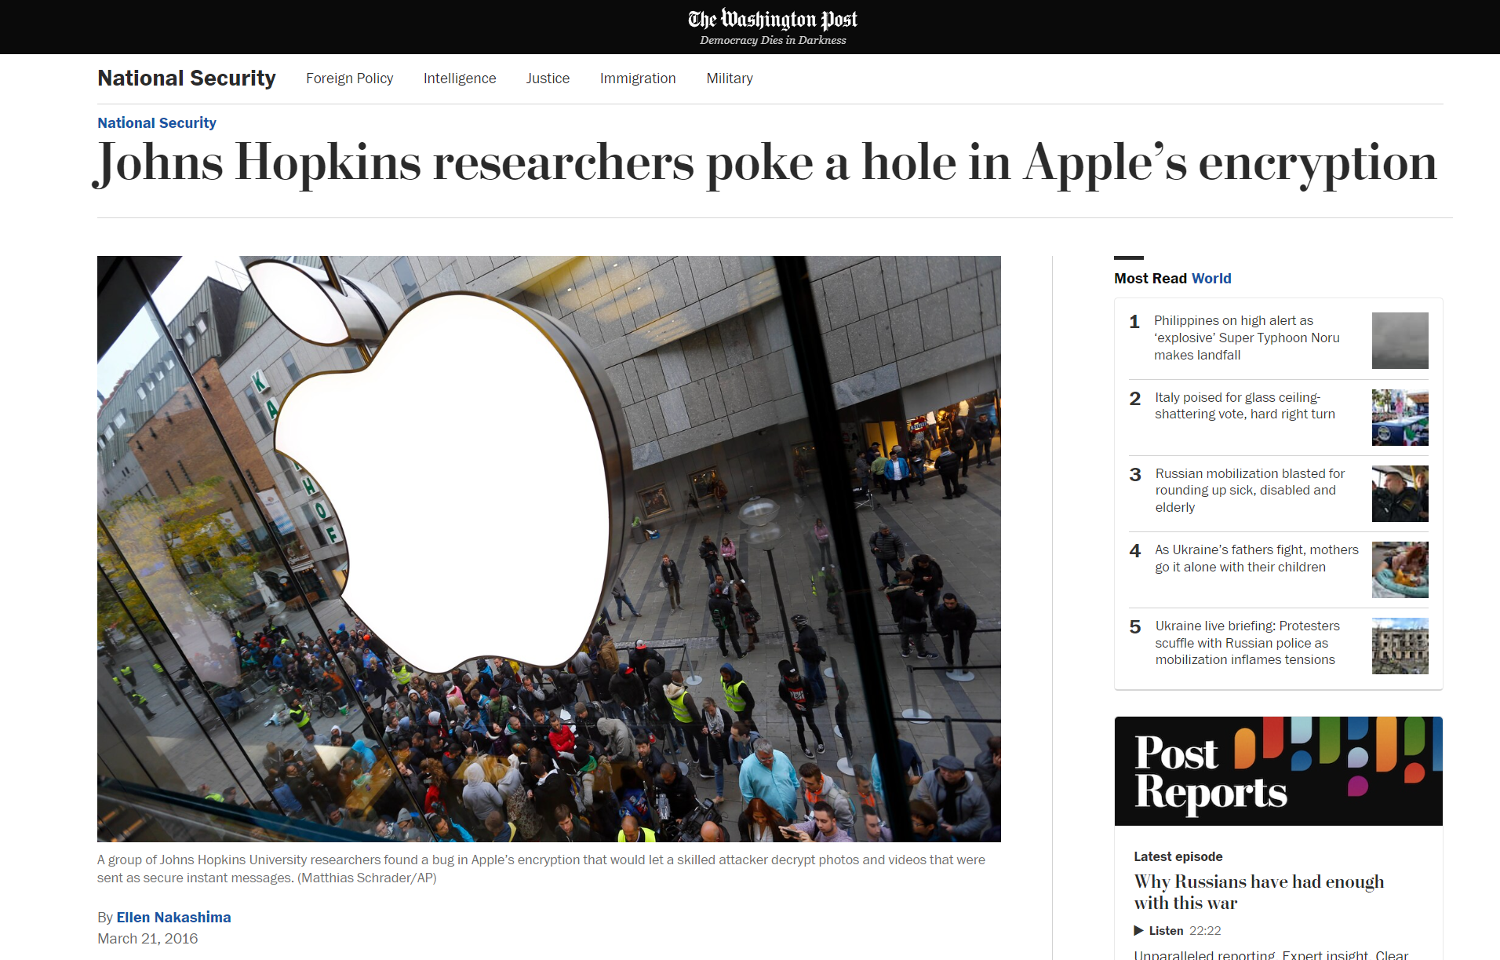

Slide 18
AES is invertible given k
S-box is invertible
We do need AES decryptions in some block cipher modes

Slide 19
Activity: build a cipher, then break the next team’s
Build — 20 min
Teams of three. Design a block cipher for 32-bit blocks and a 32-bit key, or a mode built on a 4-bit S-box we give you
Write the spec precisely: number of rounds, S-box table, permutation, key schedule, how blocks chain
Anything goes except restating AES
Hand the written spec to the team on your right. No verbal explanation — if the spec is ambiguous, that is a finding
Break — 20 min
You also get four plaintext-ciphertext pairs and the right to ask the designers for five more encryptions
Win by recovering the key, or by predicting any bit of an unseen ciphertext better than guessing
Look for: linearity across rounds, a round that omits the key, an S-box with fixed points, short key schedule period, repeated blocks visible in the output
State your break in three lines: assumption, observation, exploit
Report out — 10 min: each attacking team states the flaw in one sentence and demonstrates it. Nobody in this room will break AES; every break will be a design mistake around it — the same shape of error as the iMessage attack.

Slide 20
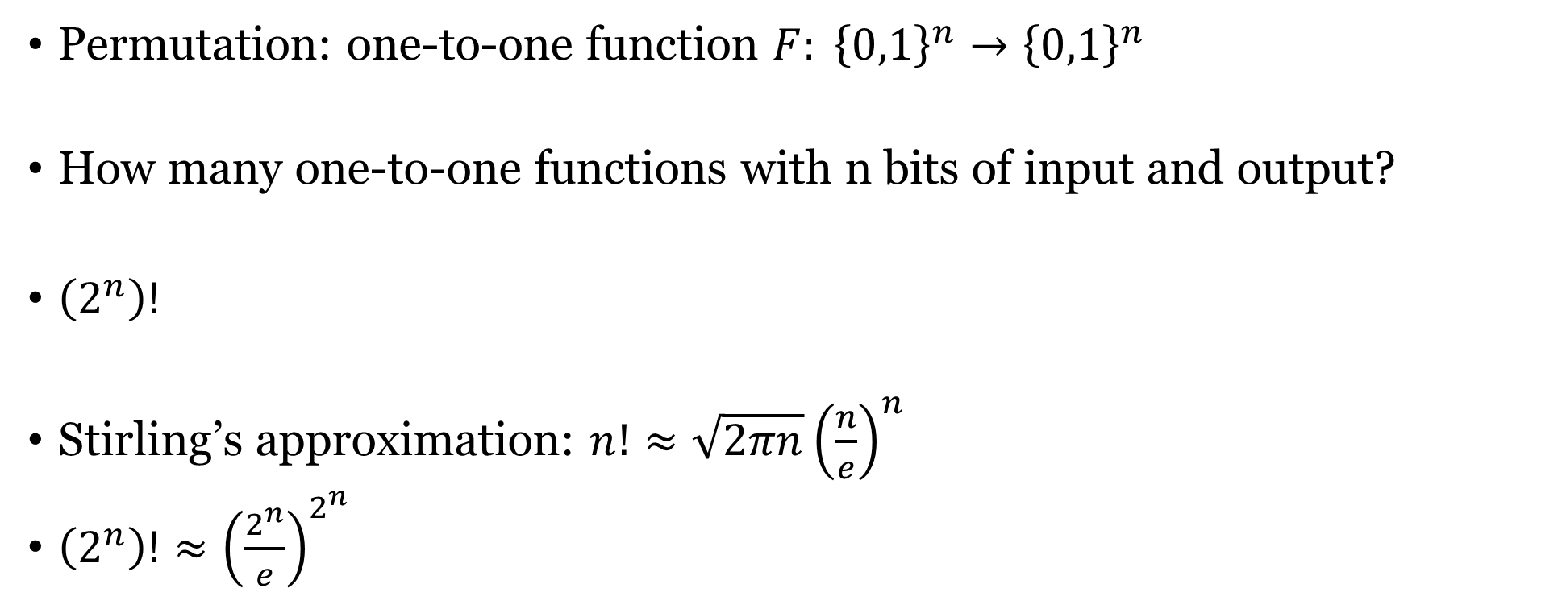
Permutations vs functions
Permutation: one-to-one function $F: {\left\{0,1\right\}}^{n}→{\left\{0,1\right\}}^{n}$
How many one-to-one functions with n bits of input and output?
$\left(2^{n}\right)!$
Stirling’s approximation: $n!≈\sqrt{2πn}{\left(\frac{n}{e}\right)}^{n}$
$\left(2^{n}\right)!≈{\left(\frac{2^{n}}{e}\right)}^{2^{n}}$

Slide 21

Pseudorandom Permutations
One-to-one, a subset of PRF
Invertible. Both $F_{k}\left(x\right)→y$ and $F_{k}^{−1}\left(y\right)→x$ are efficiently computable.
$$\left|\operatorname{Pr}\left[D^{F_{k}\left(⋅\right),F_{k}^{−1}\left(⋅\right)}\left(1^{n}\right)=1\right]−\operatorname{Pr}\left[D^{f\left(⋅\right),f^{−1}(⋅)}\left(1^{n}\right)=1\right]\right|≤negl(n)$$

Slide 22
Feistel network
Used in DES
Advantage over SPN: S-boxes don’t need to be invertible

Slide 23
Feistel network
$$L_{i}=R_{i−1}, R_{i}=L_{i−1}⊕f_{i}(R_{i−1})$$
L₀
R₀
⊕
f_{k}
L₁
R₁

Slide 24
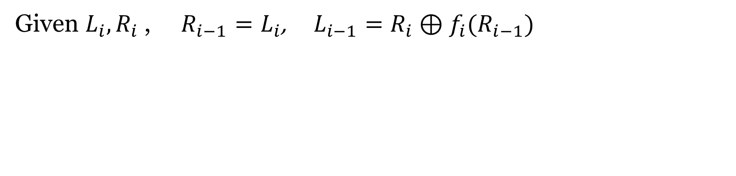
Inverting Feistel network
$$L_{i}=R_{i−1}, R_{i}=L_{i−1}⊕f_{i}(R_{i−1})$$
Given $L_{i},R_{i}$ , $R_{i−1}=L_{i}$, $L_{i−1}=R_{i}⊕f_{i}(R_{i−1})$

Slide 25
DES overview
56 bit key K
64 bit input M
Developed in 1970s
Block length 64 bits, key length 56 bits
Feistel cipher, 16 stages
K₁,…, K₁₆ are 48 bit subkeys derived from K
Subkey generator
Initial permutation
K₁
K₁₆
Feistel network
(16 rounds)
32-bit swap
Final permutation
64 bit output C

Slide 26
Feistel network in DES
32 bits L_{i}
32 bits R_{i}
Expansion
48 bits
K_{i}
Mangler function
S-boxes
Permutation
32 bits
32 bits L_{i+1}
32 bits R_{i+1}

Slide 27
Substitution Boxes in DES
8 different S-Boxes (48 bits input)
6-bit input to 4-bit output (48 to 32 bits)
Not invertible

Slide 28
DES mangler function
S-boxes
  Changing 1 bit of input changes at least 2 bits of output
Mixing permutation
  The 4 bits of output from any S-box affect the input to 6 S-boxes in the next round

Slide 29
Avalanche effect
Consider 1-bit difference in left half of input
  After 1 round, 1-bit difference in right half
  S-boxes cause a 2-bit difference, implying a 3-bit difference overall after 2 rounds
  Mixing permutation spreads differences into different S-boxes
  …

Slide 30
Security of DES
DES is extremely well-designed
  Except for some attacks that require large amounts of plaintext, no attacks better than brute-force are known
But … parameters are too small!

Slide 31
56-bit key length
A concern as soon as DES was released
Brute-force search over 2⁵⁶ keys is possible
  1997: 1000s of computers, 96 days
  1998: distributed.net, 41 days
  1999: Deep Crack ($250,000), 56 hours
  Today: 48 FPGAs, ~1 day

Slide 32
Double DES
Simple extension to DES, using two 56-bit keys
Key K₁
Key K₂
DES
Encryption
DES
Encryption
Plaintext
Ciphertext

Slide 33
Meet-in-the-middle attack
No! There is an attack taking 2^{n} time…
  (And 2^{n} memory)
The attack applies any time a block cipher can be “factored” into 2 independent components

Slide 34
Triple DES
Simple extension to DES, using or three 56-bit keys
Key K₁
Key K₂
Key K₃
DES
Encryption
DES
Decryption
DES
Encryption
Plaintext
Ciphertext
Security level of 2¹¹², currently thought to be enough
  Can also use K₁, K₂, K₁

Slide 35
Block Cipher Modes
A block cipher mode describes the way a block cipher encrypts and decrypts a sequence of message blocks.
  ECB mode: Electronic Codebook
  CBC mode: Cipher Block Chaining
  OFB mode: Output Feedback
  CTR mode: Counter mode
Public domain images from http://en.wikipedia.org/wiki/File:Ecb_encryption.png and http://en.wikipedia.org/wiki/File:Ecb_decryption.png

Slide 36
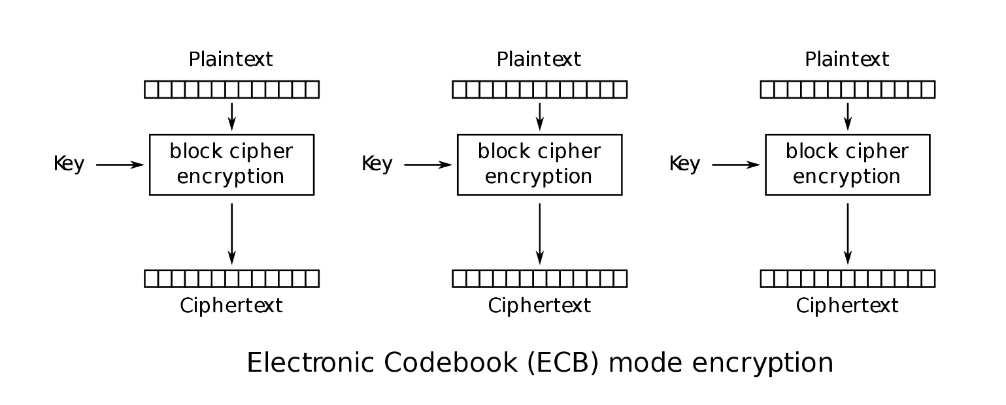
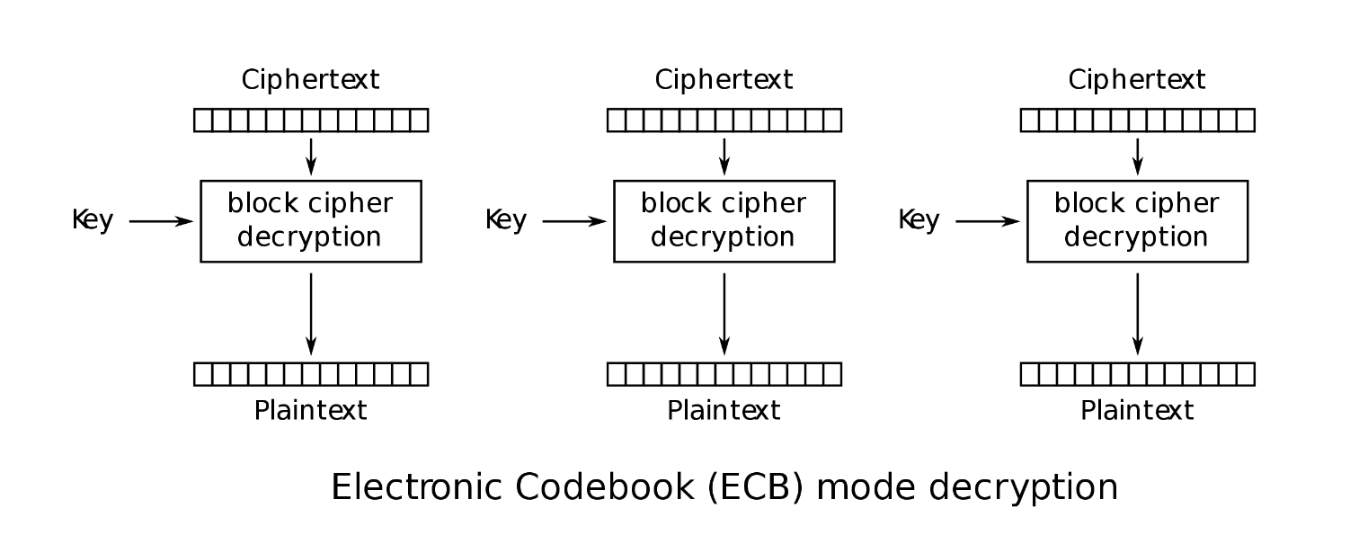
ECB mode
Block P[i] encrypted into ciphertext block C[i] = Enc_{k}(M[i])
Block C[i] decrypted into plaintext block M[i] = Dec_{k}(C[i])

Slide 37
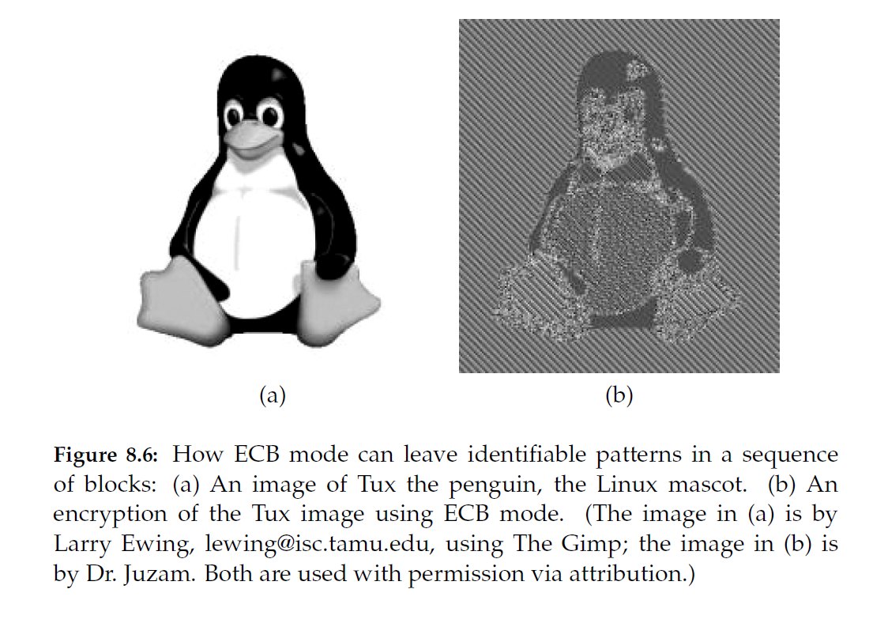
Insecurity of ECB
Weakness:
  Documents and images are not suitable for ECB encryption since patters in the plaintext are repeated in the ciphertext:

Slide 38
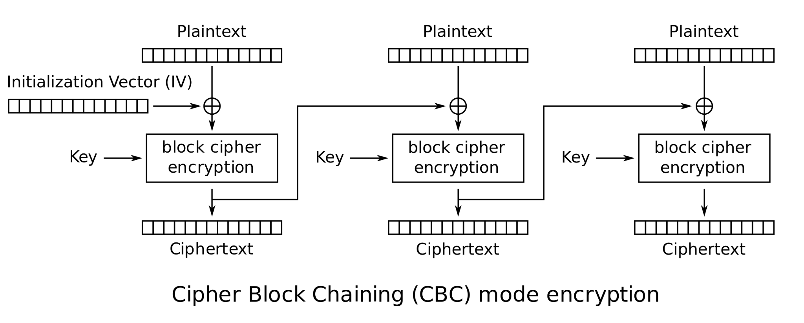
Cipher Block Chaining (CBC) Mode

Slide 39
Cipher Block Chaining (CBC) Mode

Slide 40
Cipher Block Chaining (CBC) Mode
  The previous ciphertext block is combined with the current plaintext block C[i] = Enc_{K} (C[i −1] ⊕ M[i])
  C[−1] = IV, a random block separately transmitted encrypted (known as the initialization vector, randomly chose every time)
  Decryption: M[i] = C[i −1] ⊕ Dec_{K} (C[i])

Slide 41
Cipher Block Chaining (CBC) Mode
  The previous ciphertext block is combined with the current plaintext block C[i] = Enc_{K} (C[i −1] ⊕ M[i])
  C[−1] = IV, a random block separately transmitted encrypted (known as the initialization vector, randomly chose every time)
  Decryption: M[i] = C[i −1] ⊕ Dec_{K} (C[i])

Slide 42
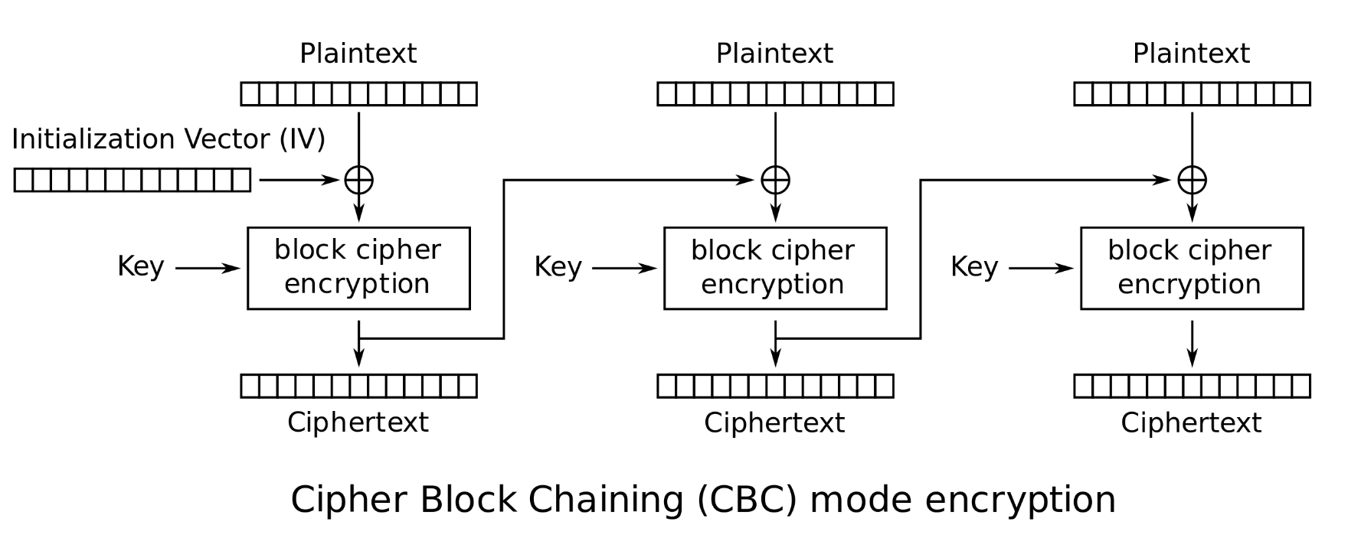
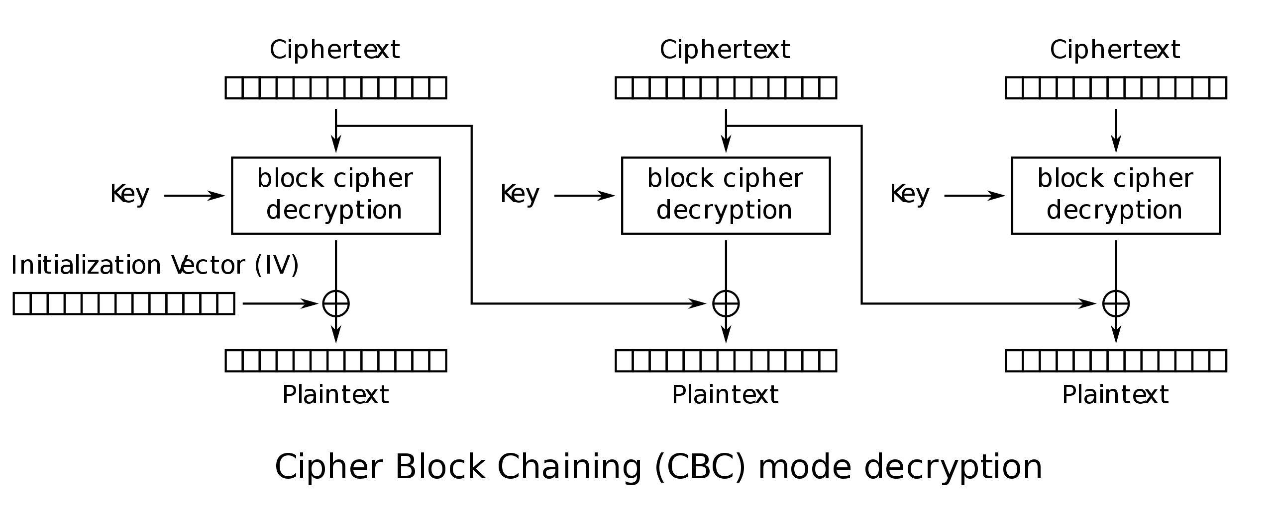
CBC Mode

Slide 43
Reduction of block cipher
Assumption: Pseudo-Random Permutation
Prove security of block cipher modes
  Very non-trivial

Slide 44
CRYPTO 2019 Best Paper
Cryptanalysis of OCB2: Attacks on Authenticity and Confidentiality, Akiko Inoue, Tetsu Iwata, Kazuhiko Minematsu, Bertram Poettering

Slide 45
Strengths and Weaknesses of CBC
Strengths:
  CPA-secure
  Is fast and relatively simple
Weaknesses:
  CBC requires the reliable transmission of all the blocks sequentially
  CBC is not suitable for applications that allow packet losses (e.g., music and video streaming)

Slide 46
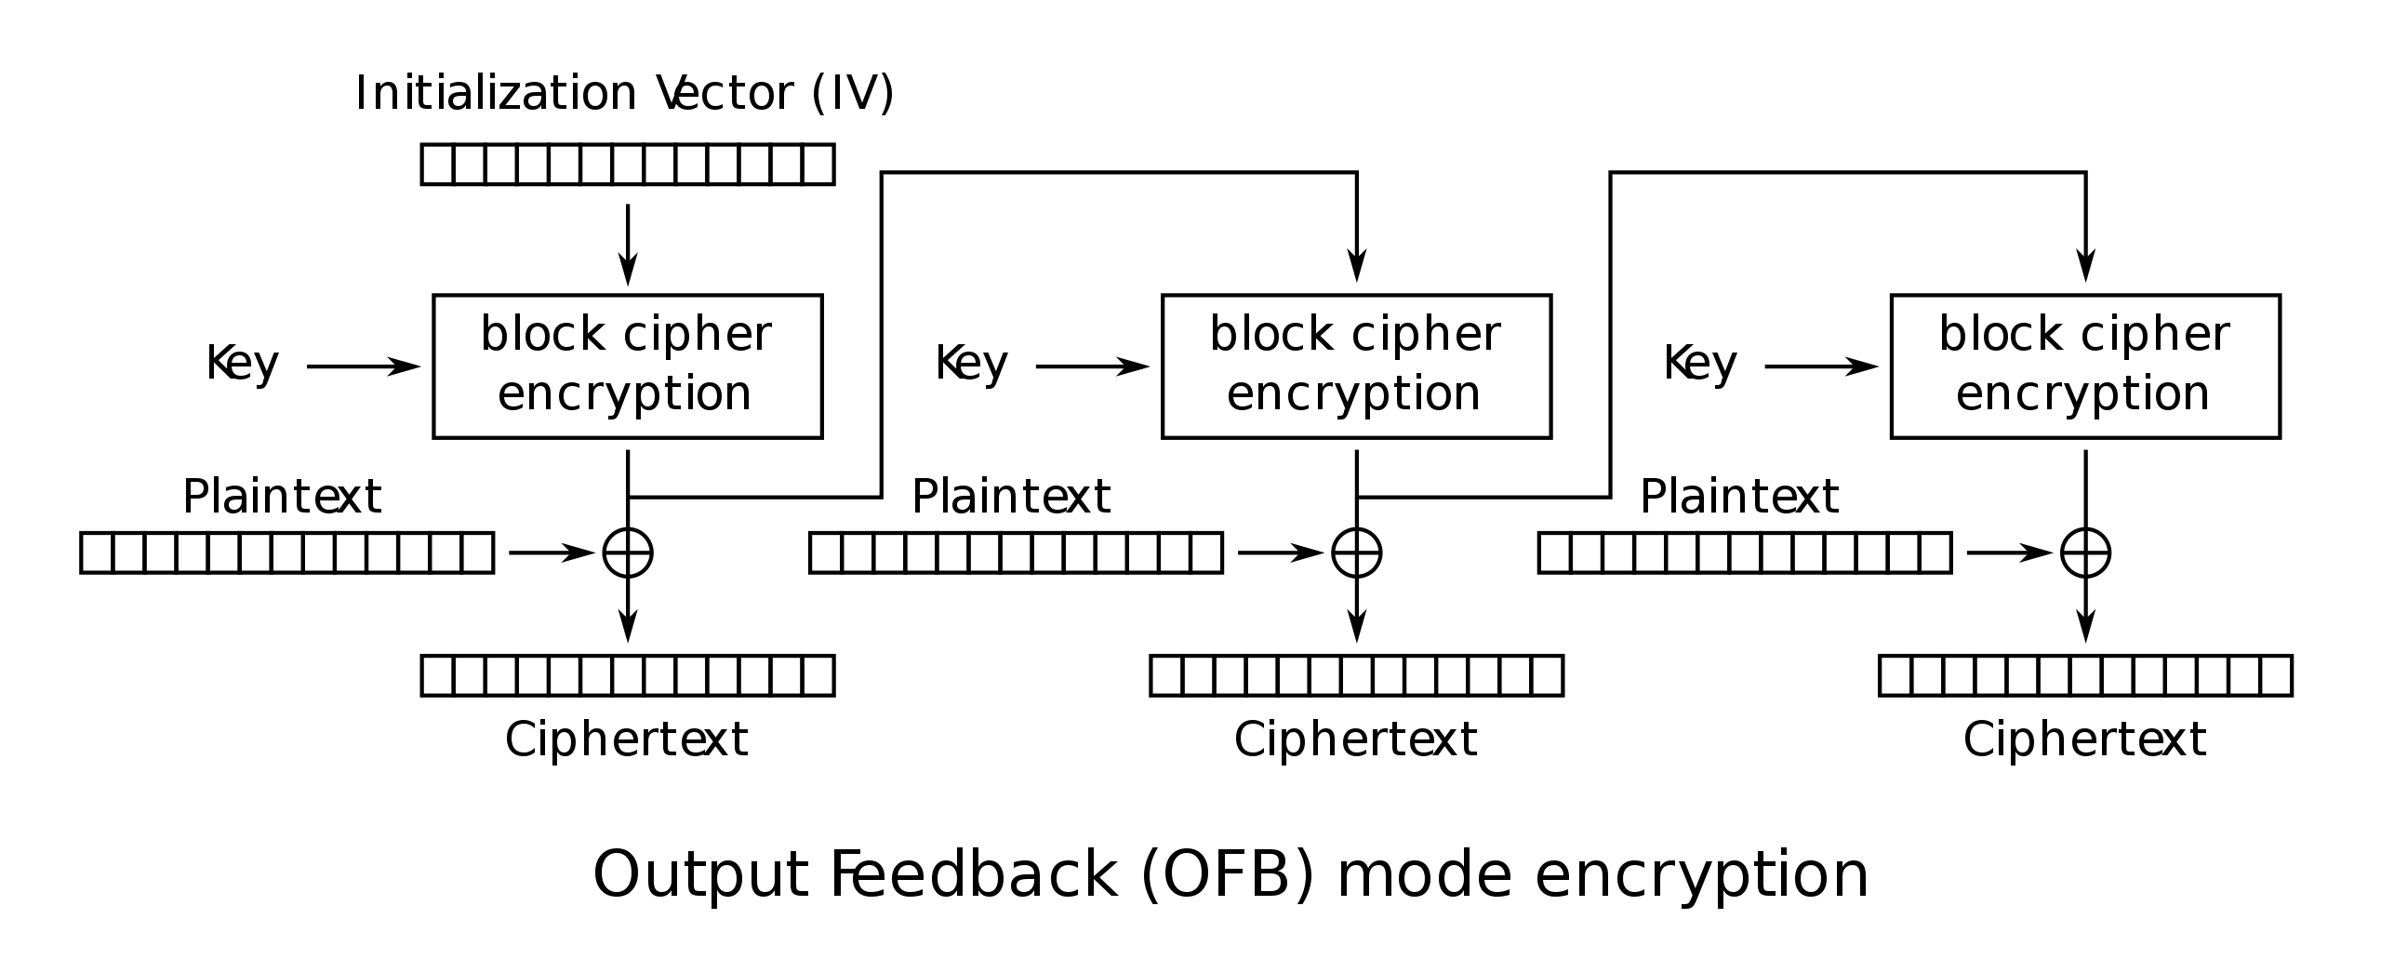
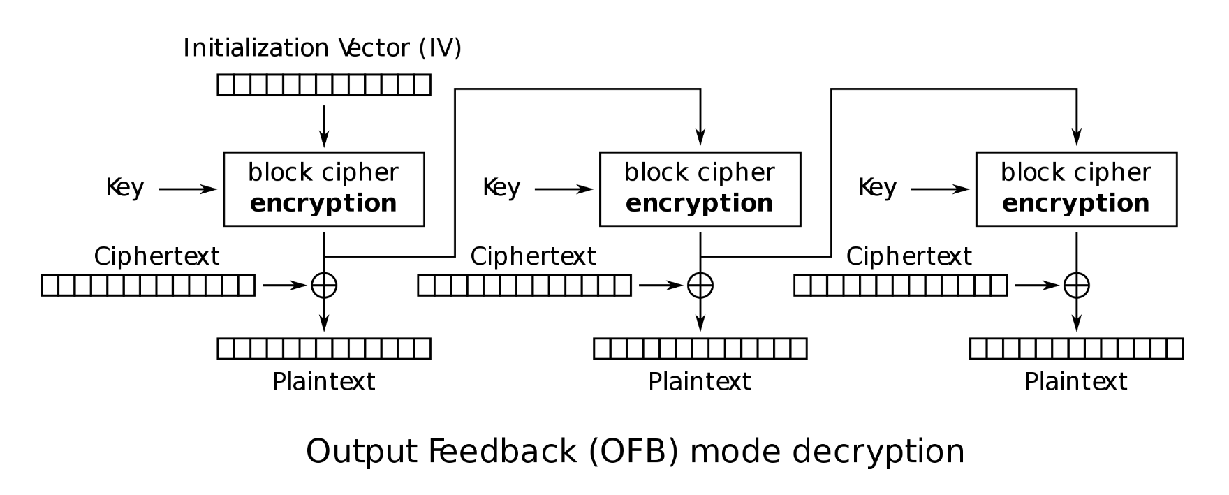
Output Feedback (OFB)

