Slide 1
ECE/CS 407
Cryptography

Slide 2
About Me
Ning Luo, CSL 457, https://ning0luo.github.io/
Email: nl27@illinois.edu
Assistant Professor, UIUC 2024-now
Postdoc, Northwestern University 2023-2024
PhD, Yale University 2017-2022
Research: Cryptography, Formal Methods, Automated Reasoning, Achieve privacy and security in practical setting

Slide 3
Course Information
Time and Location:
TuTh 5:00-6:20 pm, ECEB 1013
My office hour: TBD
TA: Tianyi Liu, tianyi.liu.08@gmail.co
Office hour: TBD

Slide 4
Resources
Webpage:https://ning0luo.github.io/ece407/index.html
Canvas https://canvas.illinois.edu/
  Slides and files
  Assignment submission and grading
  Announcements
  In-class quizzes
Piazza
  Access Code: MD5 of “I love cryptography”
  Do not know MD5? Shame on you! https://piazza.com/illinois/fall2025/c93b

Slide 5
Prerequisites
CS 225: Introduction to Data Structures and Algorithms
CS/ECE 374: Introduction to Algorithms and Models of Computation
Prerequisite overrides will be considered on a case-by-case basis. We expect that you are familiar with basic probability, modular arithmetic, and logarithms.

Slide 6
Grading Policy
Class participation (10%).
In-class quiz 10%,
  Each quiz is selected with probability 80%.
  The final grade is calculated as the average score of the selected quizzes, scaled to 100.
  Test: Crypto34399
Homework (50%):
  5 assignments
  Each homework will include careful instructions, with long-form problem write-ups and proofs.
  Submit a single PDF compiled from LaTeX. No Word/Google Docs/Pictures
  No late submission.
  AI-based tool is not allowed.
Midterm Exam (20%):
  5:00-6:20pm, Tuesday, October 7, in class
Final Exam (20%):
  cumulative

Slide 7
4 credit hours project
Paper review and report: 20%.
In teams of 2, you will read and present papers in the cryptography literature.
Please make an appointment with me on your paper selection.
https://registrar.illinois.edu/registration/registration-process/variable-credit-hours/

Slide 8
Ethics & Academic Integrity
Collaboration. Homeworks are to be submitted individually. However, you may collaborate with up to one other student on homework assignments. On each homework submission, declare your collaborator (if any). In your collaboration you are expected to discuss the homework, not merely copy answers. Plagiarism will not be tolerated
https://studentcode.illinois.edu/

Slide 9
Emergencies
Emergencies can happen anywhere and at any time, so it’s important that we take a minute to prepare for a situation in which our safety could depend on our ability to react quickly. Take a moment to learn the different ways to leave this building. If there’s ever a fire alarm or something like that, you’ll know how to get out and you’ll be able to help others get out. Next, figure out the best place to go in case of severe weather – we’ll need to go to a low-level in the middle of the building, away from windows. And finally, if there’s ever someone trying to hurt us, our best option is to run out of the building. If we cannot do that safely, we’ll want to hide somewhere we can’t be seen, and we’ll have to lock or barricade the door if possible and be as quiet as we can. We will not leave that safe area until we get an Illini-Alert confirming that it’s safe to do so. If we can’t run or hide, we’ll fight back with whatever we can get our hands on. If you want to better prepare yourself for any of these situations, visit police.illinois.edu/safe. Remember you can sign up for emergency text messages at emergency.illinois.edu.

Slide 10
Diversity, Equity, and Inclusion
We in the Illinois ECE community are committed to understanding, empathizing with, and respecting each other, embracing the many differences among us.

Slide 11

What is this course not about?

Slide 12

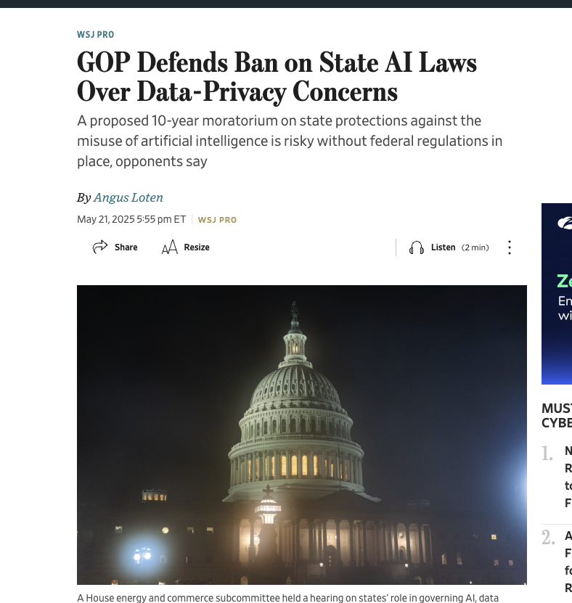
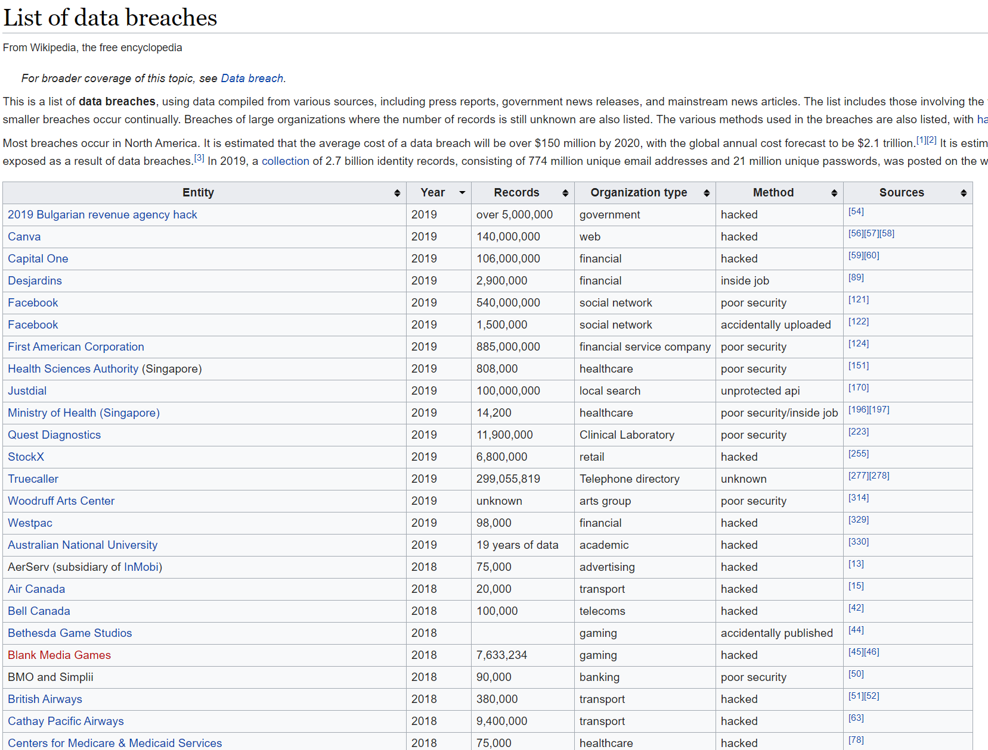
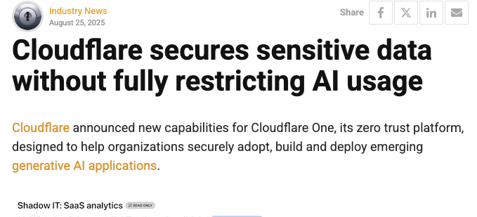
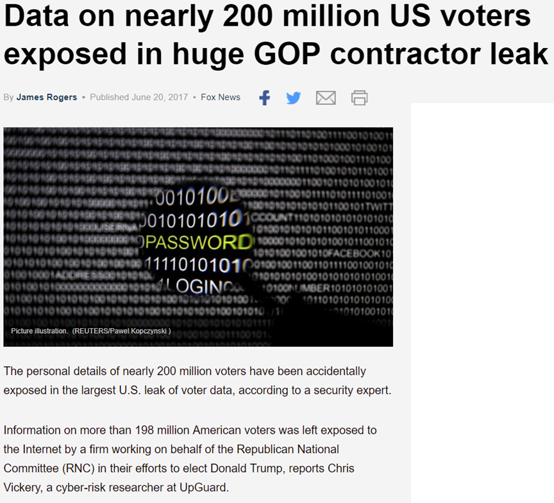
Why cryptography?
Web browsing
Data on computers and mobile phones
Data collected by companies
CS 598: Security and Privacy in Machine Learning: Beyond Reactive Approaches

Slide 13
Why cryptography?
Confidentiality
  Keeping data and resources hidden
Integrity
  Data integrity (integrity)
  Origin integrity (authentication)
Availability
  Denial-of-service attacks

Slide 14
Cryptography
1.1 Definition Cryptography is the study of mathematical techniques related to aspects of information security such as confidentiality, data integrity, entity authentication, and data origin authentication.
Encryption: Converting plaintext into ciphertext using a secret key, so only authorized parties can recover the original message.
Decryption: Reversing encryption to get back the plaintext, also requiring a secret key.
Digital Signatures: Allowing a party to prove that a message truly came from them and has not been modified.
Hash Functions: Mapping data of any size to a fixed-size value in a way that is hard to reverse or manipulate, often used for integrity checking.
Key Exchange: Protocols that let two or more parties agree on a shared secret key over an insecure channel (e.g., Diffie–Hellman).

Slide 15
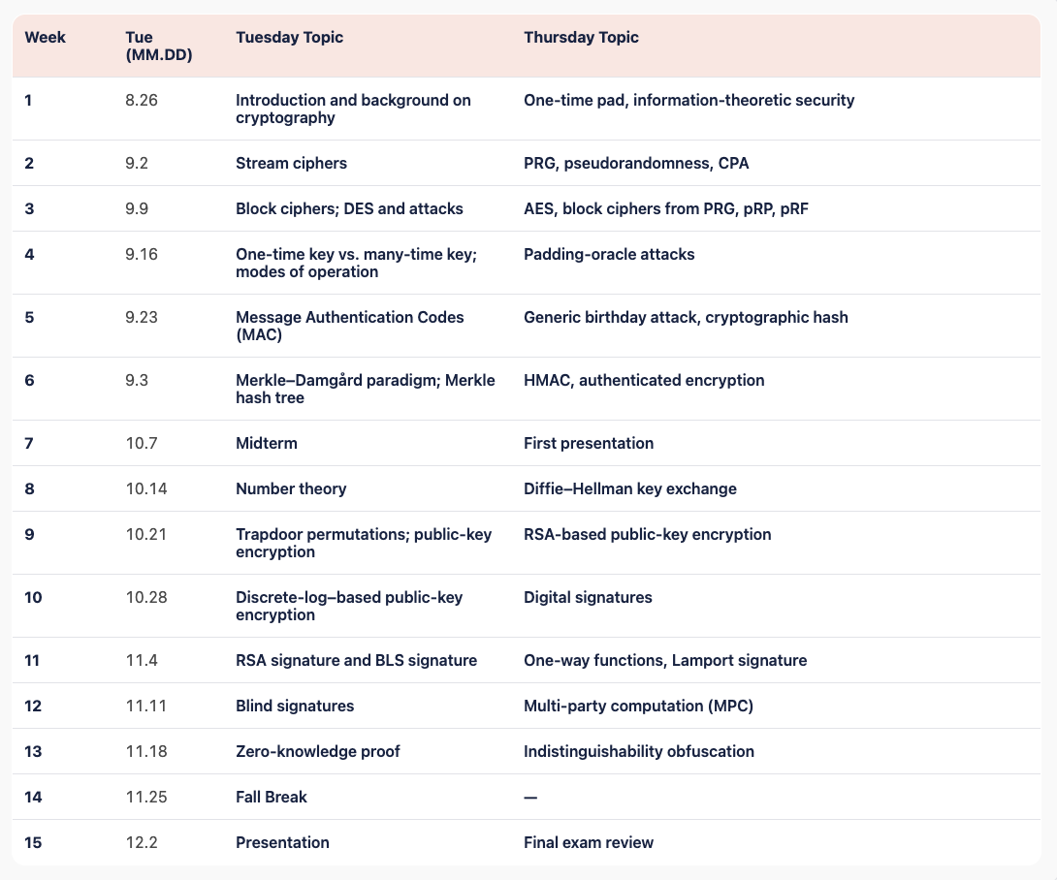
Symmetric key cryptography
Public key cryptography
Advanced topics

Slide 16
Textbook
Introduction to Modern Cryptography, 3rd edition, Jonathan Katz and and Yehuda Lindell.
A Graduate Course in Applied Cryptography, Dan Boneh’s and Victor Shoup

Slide 17
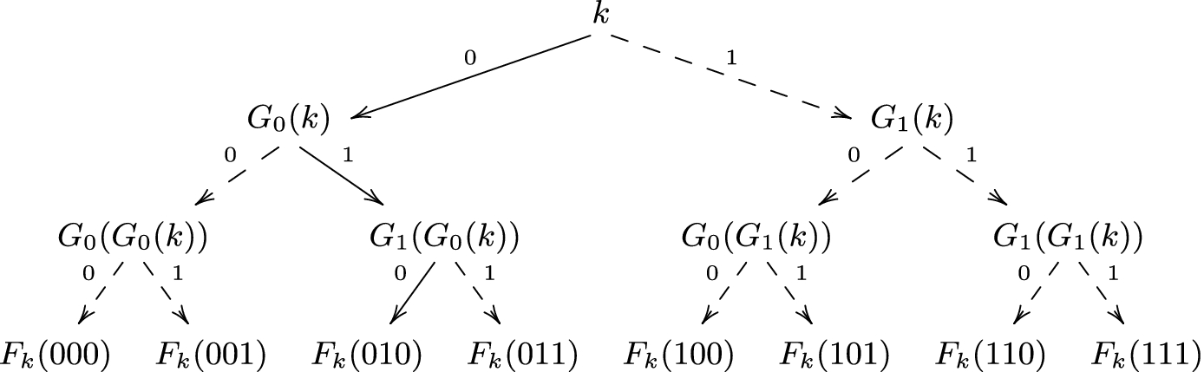





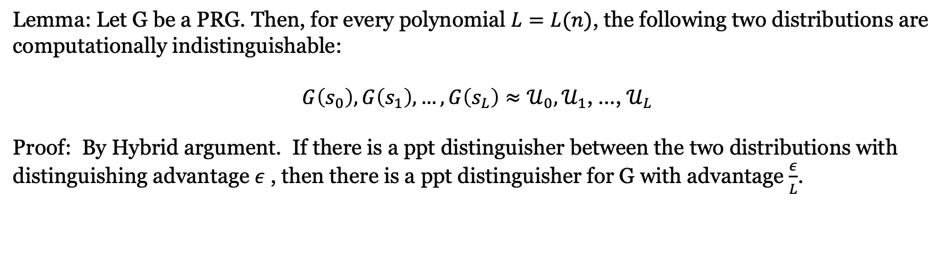

What is this course about? Proof
Example: The Goldreich-Goldwasser-Micali Construction [GGM’84]
$s_{0}$
Hybrid 1
$s_{1}$
$s_{00}$
$s_{01}$
$s_{10}$
Hybrid 2
$s_{11}$
Lemma: Let G be a PRG. Then, for every polynomial $L=L(n)$, the following two distributions are computationally indistinguishable:
$G\left(s_{0}\right),G\left(s_{1}\right), …, G\left(s_{L}\right)≈𝒰_{0},𝒰_{1}$, …, $𝒰_{L}$
Proof: By Hybrid argument. If there is a ppt distinguisher between the two distributions with distinguishing advantage $ε$ , then there is a ppt distinguisher for G with advantage $\frac{ε}{L}$.

Slide 18

What is this course about? Math
Example: Baby step- Giant step algorithm
Let $G$be a group and let $h ∈ G$be an element of order $N$, i.e., $h^{N} = e$and no smaller power of $h$ is equal to $e$. Then, assuming that the discrete logarithm problem $h^{x} = b$ has a solution.
Let ${x= k}_{0} × \sqrt{N} + k_{1}$, $k_{0},k_{1} ≤ \sqrt{N}$
Baby step$: { L_{0}= \{ h}^{1},h^{ 2}$, $h^{3}, …,h^{\sqrt{N}}\}$
Giant step: ${L_{1}= \{ bg}^{−1},{bg}^{ −2}$, ${bg}^{−3}, …,{bg}^{−\sqrt{N} }\},$ where ${g= h}^{\sqrt{N}}$
Find two collided elements in $L_{0}$and $L_{1}$ , such that $h^{i}=b g^{−j}$, then $x = i +\sqrt{N}× j$
In-Class Quiz: Prove that there always exists a collision between the two lists
Quiz Code: Crypto57556

Slide 19
(NOT) All Background You Need for This Course
https://joyofcryptography.com/pdf/chap0.pdf

Slide 20

Exponentiation and log
$x^{a}⋅x^{b}=x^{a+b}$
${(x^{a})}^{b}=x^{ab}$
${\log_{x}{ab }=\log_{x}{a}}^{ }+\log_{x}{b}$
${alog}_{x}{b }=\log_{x}{b^{a}}$
$x^{a}⋅x^{b}$ is not equal to $x^{ab}$ !!!

Slide 21
Prime Number
Prime number p:
  p is an integer
  p ≥ 2
  The only divisors of p are 1 and p
Examples
  2, 7, 19 are primes
  -3, 0, 1, 6 are not primes
Prime decomposition of a positive integer n:
n = p₁e1 × … × p_{k}^{e}k
Example:
  200 = 2³ × 5²
Primality test in polynomial time
  ^{Read AKS primality test}

Slide 22
Modular Arithmetic
Modulo operator for a positive integer n
r = a mod n
equivalent to
a = r + kn
and
r = a − ⎣a/n⎦ n
Example:
  29 mod 13 = 3 13 mod 13 = 0 −1 mod 13 = 12
  29 = 3 + 2×13 13 = 0 + 1×13 12 = −1 + 1×13

Slide 23

Modular Arithmetic
simplify intermediate values mod n
$a+b+c+…mod n=\left(\left(a+b\right) mod n+c\right)mod n+ …. mod n$
$a⋅b⋅c⋅…mod n=\left(\left(a⋅b\right) mod n⋅c\right)mod n+ …. mod n$

Slide 24

Modular exponentiation
$x^{a}⋅x^{b}=x^{a+b}$ mod n
${(x^{a})}^{b}=x^{ab}$ mod n

Slide 25
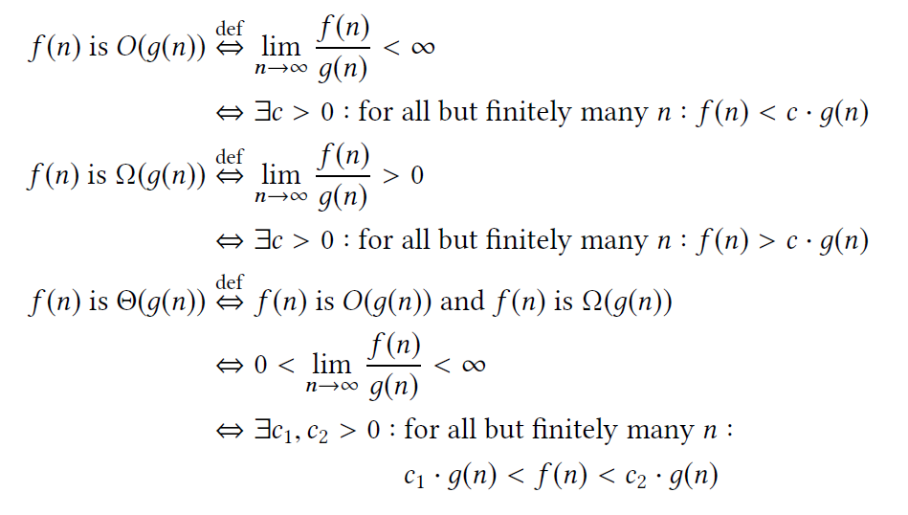
Asymptotic complexity
Big O notation O(n), O(2^{n})
  E.g., for sufficiently large integer n, O(2^{n})>O(n^{c})

Slide 26
Binary representation
17 = 10001, 38 = 100110
Bitlength of number k is log₂ k
Complexity of an algorithm taking an integer k as input is computed on its bitlength

Slide 27
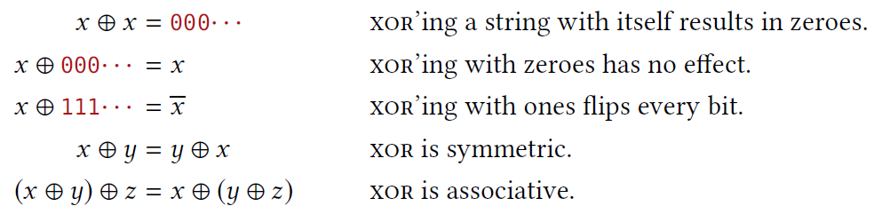
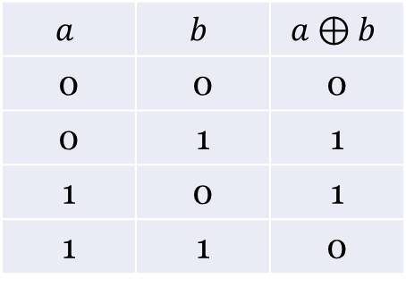

Binary string
${\left\{0,1\right\}}^{n}$ denotes the set of n-bit binary string.
$⊕$ xor:
  Same as addition mod 2
$$a$$ | $$b$$ | $$a⊕b$$
0 | 0 | 0
0 | 1 | 1
1 | 0 | 1
1 | 1 | 0

Slide 28
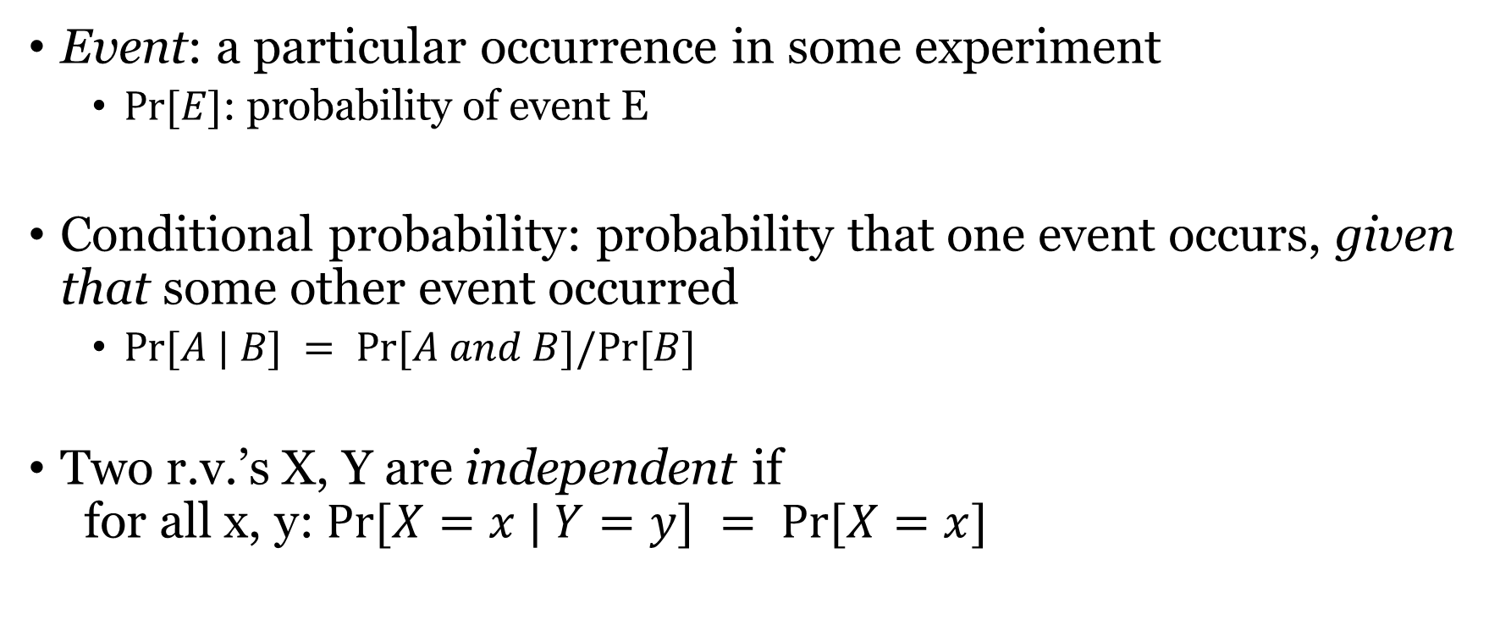
Probability
Event: a particular occurrence in some experiment
  $Pr⁡[E]$: probability of event E
Conditional probability: probability that one event occurs, given that some other event occurred
  $Pr⁡[A | B] = Pr⁡[A and B]/Pr⁡[B]$
Two r.v.’s X, Y are independent if
for all x, y: $Pr⁡[X=x | Y=y] = Pr⁡[X=x]$

Slide 29
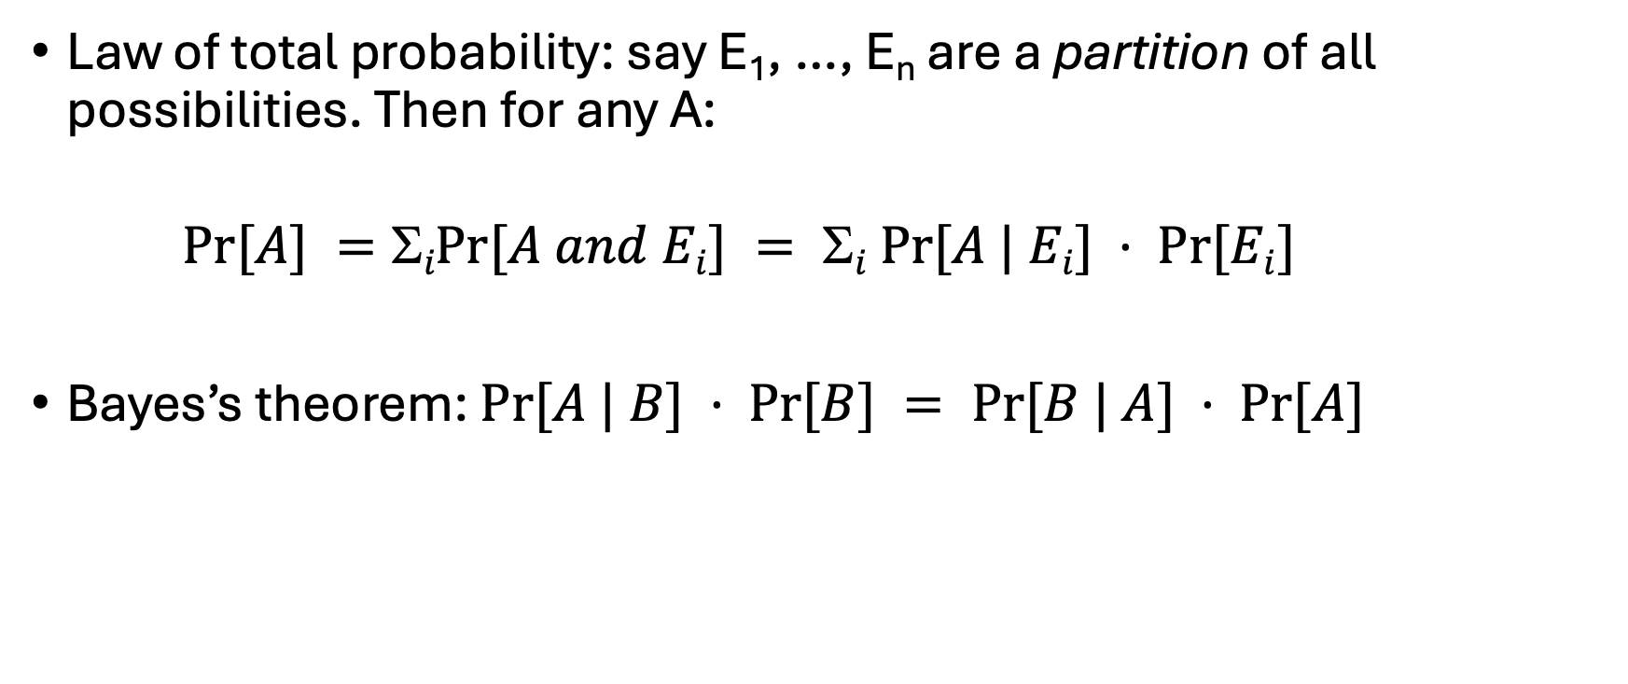
Probability
Law of total probability: say E₁, …, E_{n} are a partition of all possibilities. Then for any A:
$Pr⁡[A] =iPr⁡[A and Ei] = i Pr⁡[A | Ei] · Pr⁡[Ei]$
Bayes’s theorem: $Pr⁡[A | B] · Pr⁡[B] = Pr⁡[B | A] · Pr⁡[A]$

