Slide 1
My office hour: 3-4PM Friday CSL 457

Slide 2
(NOT) All Background You Need for This Course
https://joyofcryptography.com/pdf/chap0.pdf

Slide 3

Exponentiation and log
$x^{a}⋅x^{b}=x^{a+b}$
${(x^{a})}^{b}=x^{ab}$
${\log_{x}{ab }=\log_{x}{a}}^{ }+\log_{x}{b}$
${alog}_{x}{b }=\log_{x}{b^{a}}$
$x^{a}⋅x^{b}$ is not equal to $x^{ab}$ !!!

Slide 4
Prime Number
Prime number p:
  p is an integer
  p ≥ 2
  The only divisors of p are 1 and p
Examples
  2, 7, 19 are primes
  -3, 0, 1, 6 are not primes
Prime decomposition of a positive integer n:
n = p₁e1 × … × p_{k}^{e}k
Example:
  200 = 2³ × 5²
Primality test in polynomial time
  ^{Read AKS primality test}

Slide 5
Modular Arithmetic
Modulo operator for a positive integer n
r = a mod n
equivalent to
a = r + kn
and
r = a - ⎣a/n⎦ n
Example:
  29 mod 13 = 3 13 mod 13 = 0 -1 mod 13 = 12
  29 = 3 + 2×13 13 = 0 + 1×13 12 = -1 + 1×1

Slide 6

Modular Arithmetic
simplify intermediate values mod n
$a+b+c+…mod n=\left(\left(a+b\right) mod n+c\right)mod n+ …. mod n$
$a⋅b⋅c⋅…mod n=\left(\left(a⋅b\right) mod n⋅c\right)mod n+ …. mod n$

Slide 7

Modular exponentiation
$x^{a}⋅x^{b}=x^{a+b}$ mod n
${(x^{a})}^{b}=x^{ab}$ mod n
What is $2^{64}$ mod 10?

Slide 8
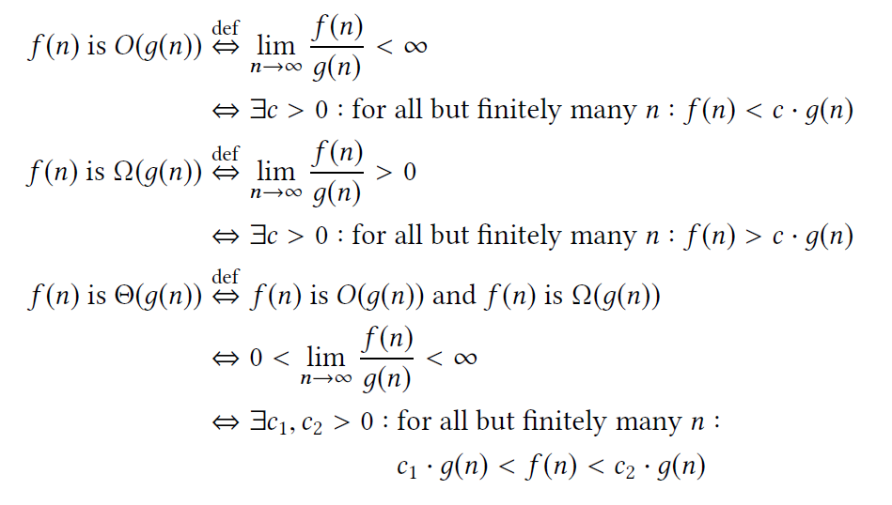
Asymptotic complexity
Big O notation O(n), O(2^{n})
  E.g., for sufficiently large integer n, O(2^{n})>O(n^{c})

Slide 9
Quiz

Slide 10
Ancient Ciphers

Slide 11




How to encrypt a message?
PLAY

Slide 12
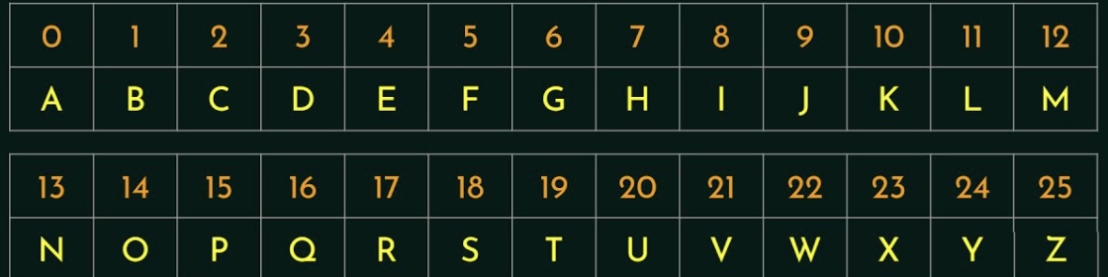
Idea 1: rotation (shift) cipher
C = X + K mod 26
C, X, K are number of corresponding letters.
a | b | c | d | e | f | g | h | i | j | k | l | m | n | o | p | q | r | s | t | u | v | w | x | y | z
Number of Possible Key?
The lecture is so boring !!!
Ymj qjhyzwj nx xt gtwnsl !!!
rotate by 5, K = 5
rotate by 5, K = 5
Notes:
Julius Caesar, Roman dictator

Slide 13
Idea 2: substitution cipher
original | a | b | c | d | e | f | g | h | i | j | k | l | m | n | o | p | q | r | s | t | u | v | w | x | y | z
replace | u | e | s | f | d | t | a | p | z | v | r | c | i | q | m | g | w | n | o | h | k | j | x | b | l | y
hpd mevdshzjdo mt hpzo smknod und hm zqtmni ohkfdqho uemkh hpd tzdcf mt smigkhdn oszdqsd uqf dqazqddnzqa, uqf hm zqhnmfksd hpdi hm hpd xzfd nuqad mt dbszhzqa uggczsuhzmqo mt smigkhuhzmq uqf hdspqmcmal zq omszdhl. xd xzcc dbgcuzq hpuh smigkhdn oszdqsd zo qmh vkoh uemkh gnmanuiizqa, ekh uemkh smigkhuhzmquc hpzqrzqa uqf hpd ohkfl mt ucamnzhpio. zigmnhuqh hdnio uqf smqsdgho zq hpd tzdcf xzcc ed zqhnmfksdf, uo u gndjzdx hm xpuh xzcc ed cdunqdf zq mhpdn smknodo. xd xzcc dbgcuzq hpd imhzjuhzmq tmn junzmko uogdsho mt mkn iuvmn, zqsckfzqa hpd smnd smknod odwkdqsd zq mkn sknnzskcki, iuhp ndwkzndidqho, okggmnhzqa undu, sm-mgo, dhs.
Try all possible substitutions? 26! = $4×{10}^{26}$

Slide 14
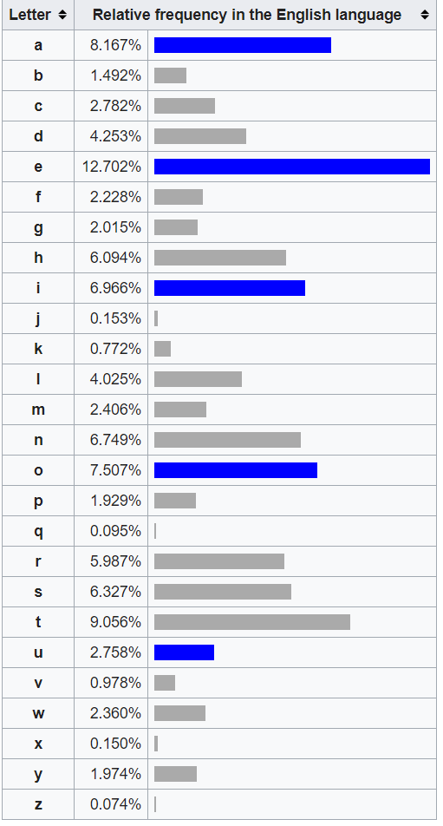
Attack: frequency analysis
hpd mevdshzjdo mt hpzo smknod und hm zqtmni ohkfdqho uemkh hpd tzdcf mt smigkhdn oszdqsd uqf dqazqddnzqa, uqf hm zqhnmfksd hpdi hm hpd xzfd nuqad mt dbszhzqa uggczsuhzmqo mt smigkhuhzmq uqf hdspqmcmal zq omszdhl. xd xzcc dbgcuzq hpuh smigkhdn oszdqsd zo qmh vkoh uemkh gnmanuiizqa, ekh uemkh smigkhuhzmquc hpzqrzqa uqf hpd ohkfl mt ucamnzhpio. zigmnhuqh hdnio uqf smqsdgho zq hpd tzdcf xzcc ed zqhnmfksdf, uo u gndjzdx hm xpuh xzcc ed cdunqdf zq mhpdn smknodo. xd xzcc dbgcuzq hpd imhzjuhzmq tmn junzmko uogdsho mt mkn iuvmn, zqsckfzqa hpd smnd smknod odwkdqsd zq mkn sknnzskcki, iuhp ndwkzndidqho, okggmnhzqa undu, sm-mgo, dhs.
Observation: substitution preserves frequency!!

Slide 15
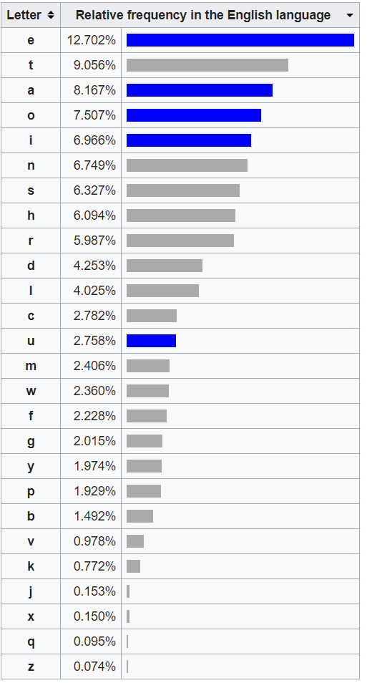
d | 10.85%
h | 10.08%
m | 9.11%
z | 8.53%
q | 7.56%
u | 6.20%
n | 6.01%
s | 5.43%
k | 5.04%
o | 5.04%
c | 3.68%
g | 3.10%
p | 3.10%
i | 3.10%
f | 2.91%
a | 2.13%
t | 1.94%
x | 1.74%
e | 1.36%
j | 0.78%
b | 0.58%
l | 0.58%
v | 0.58%
r | 0.39%
w | 0.19%
y | 0
original | a | b | c | d | e | f | g | h | i | j | k | l | m | n | o | p | q | r | s | t | u | v | w | x | y | z
replace | u | e | s | f | d | t | a | p | z | v | r | c | i | q | m | g | w | n | o | h | k | j | x | b | l | y

Slide 16
Attacking substitution cipher
hpd mevdshzjdo mt hpzo smknod und hm zqtmni ohkfdqho uemkh hpd tzdcf mt smigkhdn oszdqsd uqf dqazqddnzqa, uqf hm zqhnmfksd hpdi hm hpd xzfd nuqad mt dbszhzqa uggczsuhzmqo mt smigkhuhzmq uqf hdspqmcmal zq omszdhl. xd xzcc dbgcuzq hpuh smigkhdn oszdqsd zo qmh vkoh uemkh gnmanuiizqa, ekh uemkh smigkhuhzmquc hpzqrzqa uqf hpd ohkfl mt ucamnzhpio. zigmnhuqh hdnio uqf smqsdgho zq hpd tzdcf xzcc ed zqhnmfksdf, uo u gndjzdx hm xpuh xzcc ed cdunqdf zq mhpdn smknodo. xd xzcc dbgcuzq hpd imhzjuhzmq tmn junzmko uogdsho mt mkn iuvmn, zqsckfzqa hpd smnd smknod odwkdqsd zq mkn sknnzskcki, iuhp ndwkzndidqho, okggmnhzqa undu, sm-mgo, dhs.
the objectipes og this course are to ingorm students about the gield og comwuter enfineerinf, and to introduce them to the yide ranfe og evcitinf awwlications og comwutation and technolofk in societk. ye yill evwlain that comwuter enfineerinf is not just about wroframminf, but about comwutational thinqinf and the studk og alforithms. imwortant terms and concewts in the gield yill be introduced, as a wrepiey to yhat yill be learned in other courses. ye yill evwlain the motipation gor parious aswects og our major, includinf the core course sexuence in our curriculum, math rexuirements, suwwortinf area, co-ows, etc.

Slide 17
The objectives of this course are to inform students about the field of Computer Engineering, and to introduce them to the wide range of exciting applications of computation and technology in society. We will explain that Computer Engineering is not just about programming, but about computational thinking and the study of algorithms. Important terms and concepts in the field will be introduced, as a preview to what will be learned in other courses. We will explain the motivation for various aspects of our major, including the core course sequence in our curriculum, math requirements, supporting area, co-ops, etc.

Slide 18
Vigenere cipher
Idea 3: rotation by different shifts
Plaintext | Plaintext value P | Key | Key value K | Ciphertext Value E | Ciphertext
C | 2 | K | 10 | 12 | M
R | 17 | E | 4 | 21 | V
Y | 24 | Y | 24 | 22 | W
P | 15 | K | 10 | 25 | Z
T | 19 | E | 4 | 23 | X
O | 14 | Y | 24 | 12 | M
G | 6 | K | 10 | 16 | Q
R | 17 | E | 4 | 21 | V
A | 0 | Y | 24 | 24 | Y
P | 15 | K | 10 | 25 | Z
H | 7 | E | 4 | 11 | L
Y | 24 | Y | 24 | 22 | W
Notes:
Shift by the key
What that means by shift by key
Align the plaintext and the repeating keyword
Encrypt each letter of the plaintext with the corresponding letter of the repeated key by rotation.

Slide 19
Attacking Vigenere cipher
If the key length is known
  Every 3th letter still following letter frequency
Plaintext | Plaintext value P | Key | Key value K | Ciphertext Value E | Ciphertext
C | 2 | K | 10 | 12 | M
R | 17 | E | 4 | 21 | V
Y | 24 | Y | 24 | 22 | W
P | 15 | K | 10 | 25 | Z
T | 19 | E | 4 | 23 | X
O | 14 | Y | 24 | 12 | M
G | 6 | K | 10 | 16 | Q
R | 17 | E | 4 | 21 | V
A | 0 | Y | 24 | 24 | Y
P | 15 | K | 10 | 25 | Z
H | 7 | E | 4 | 11 | L
Y | 24 | Y | 24 | 22 | W

Slide 20
How to find the key length?
Try key length of 1, 2, 3,…
  If key length is correct: following letter frequency

Slide 21
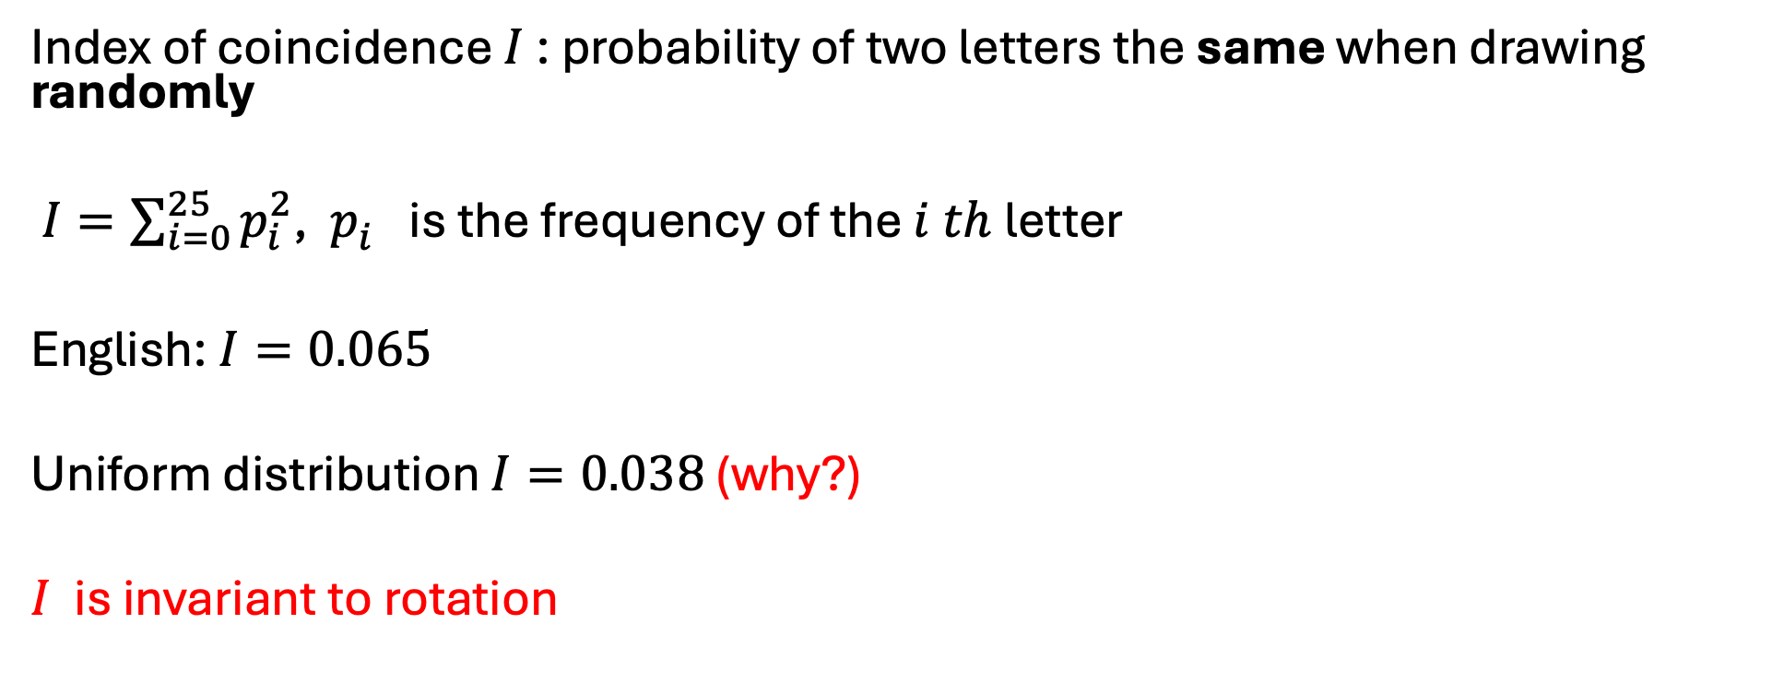
Friedman Test
Index of coincidence $I$: probability of two letters the same when drawing randomly
$I=\sum_{i=0}^{25}{p_{i}^{2}}$, $p_{i}^{}$is the frequency of the $i th$letter
English: $I=0.065$
Uniform distribution $I=0.038$ (why?)
$I$ is invariant to rotation

Slide 22
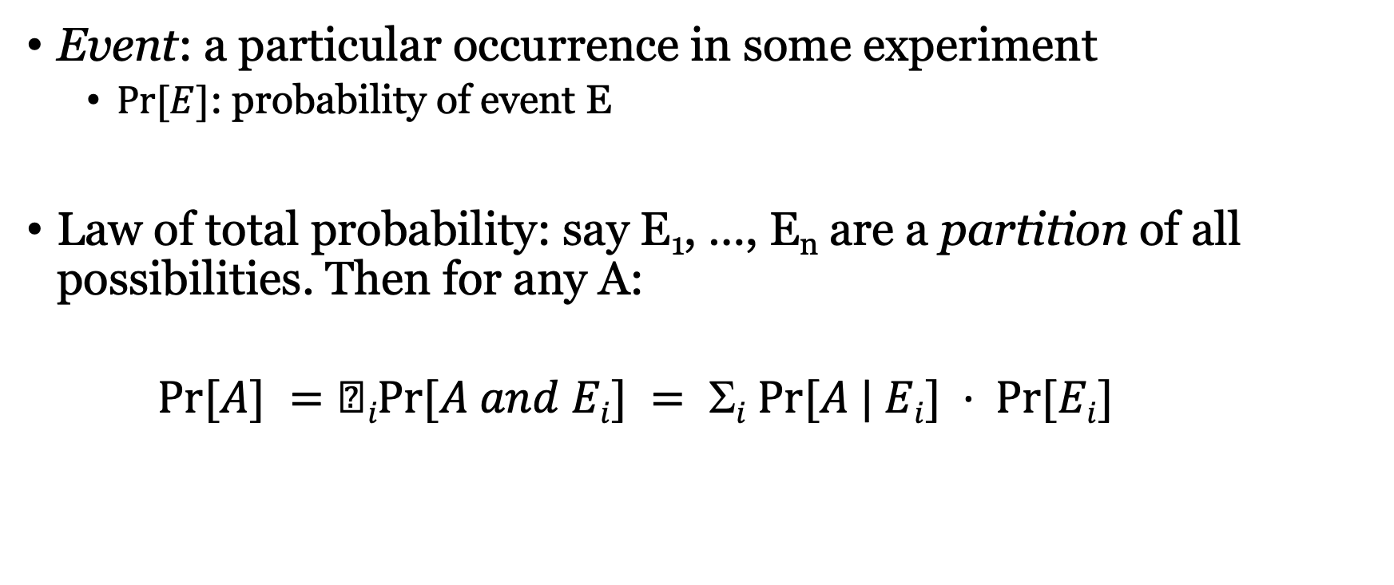
Probability
Event: a particular occurrence in some experiment
  $Pr⁡[E]$: probability of event E
Law of total probability: say E₁, …, E_{n} are a partition of all possibilities. Then for any A:
$Pr⁡[A] =iPr⁡[A and Ei] = i Pr⁡[A | Ei] · Pr⁡[Ei]$

Slide 23
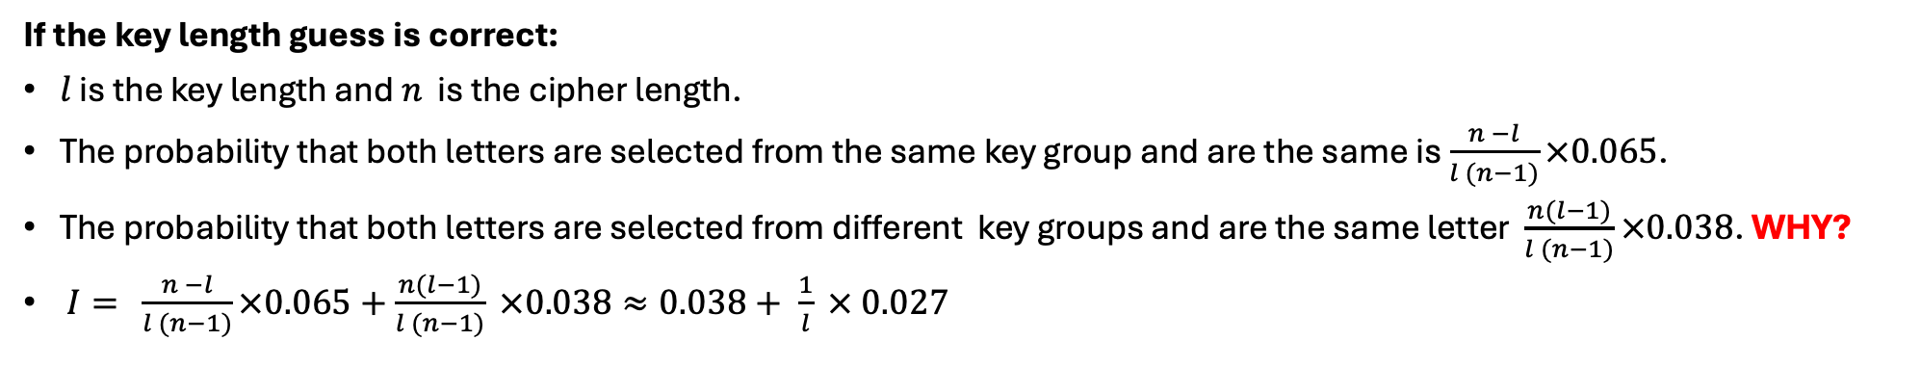
Friedman Test
Plaintext | Plaintext value P | Key | Key value K | Ciphertext Value E | Ciphertext
C | 2 | K | 10 | 12 | M
R | 17 | E | 4 | 21 | V
Y | 24 | Y | 24 | 22 | W
P | 15 | K | 10 | 25 | Z
T | 19 | E | 4 | 23 | X
O | 14 | Y | 24 | 12 | M
G | 6 | K | 10 | 16 | Q
R | 17 | E | 4 | 21 | V
A | 0 | Y | 24 | 24 | Y
P | 15 | K | 10 | 25 | Z
H | 7 | E | 4 | 11 | L
Y | 24 | Y | 24 | 22 | W
If the key length guess is correct:
$l$ is the key length and $n$ is the cipher length.
The probability that both letters are selected from the same key group and are the same is $\frac{n −l}{l (n−1)}×0.065$.
The probability that both letters are selected from different key groups and are the same letter $\frac{n(l−1)}{l (n−1)}×0.038$. WHY?
$I= \frac{n −l}{l (n−1)}×0.065+\frac{n(l−1)}{l (n−1)} ×0.038≈0.038+ \frac{1}{l} × 0.027$
Notes:
1/l 0.065 +

Slide 24
Quiz
What index of coincidence should be if the key length is infinite

Slide 25

Some Other Old Things
Enigma Machine

Slide 26
Classical Cryptography
Design
Try to break
broken
Catastrophic
failure
Deploy

Slide 27
Modern Cryptography
Definitions
Constructions
Proof
reductions
assumptions

Slide 28
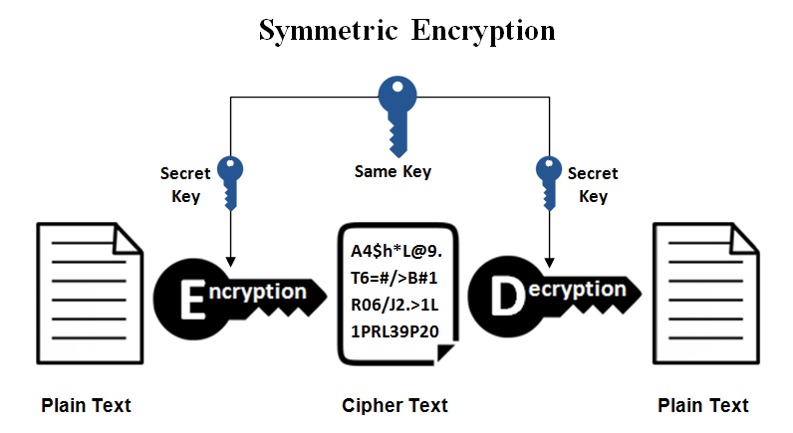
Symmetric-key Encryption

Slide 29

Definitions for encryption
Algorithms:
  k: secret key, m: message, c: ciphertext
  $k=Gen( )$
  $c= Enc(k,m)$
  $m=Dec(k,c)$

Slide 30
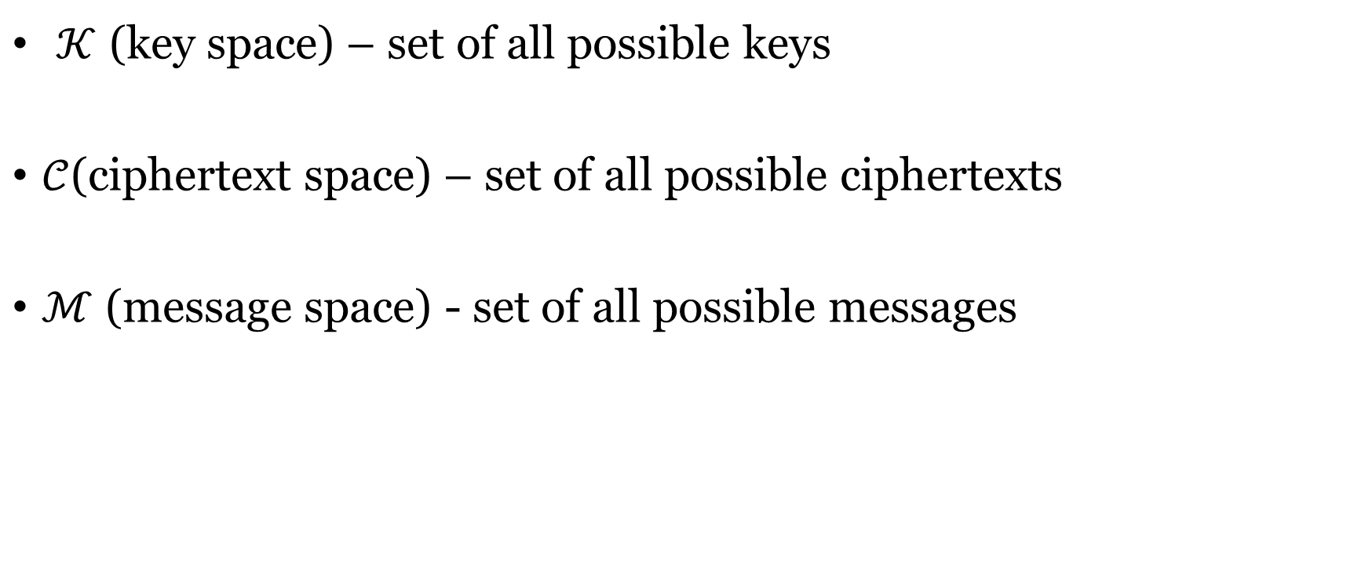
Notation
  $𝒦$ (key space) – set of all possible keys
$𝒞$(ciphertext space) – set of all possible ciphertexts
$ℳ$ (message space) - set of all possible messages

Slide 31
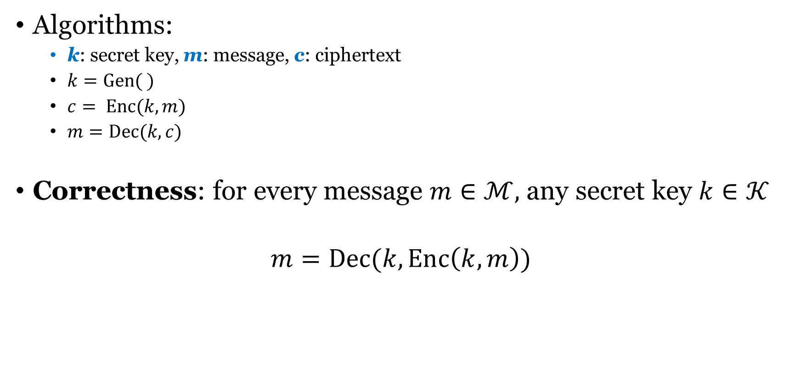
Definitions for encryption
Algorithms:
  k: secret key, m: message, c: ciphertext
  $k=Gen( )$
  $c= Enc(k,m)$
  $m=Dec(k,c)$
Correctness: for every message $m∈ℳ,$ any secret key $k∈𝒦$
$$m=Dec(k,Enc\left(k,m\right))$$

Slide 32
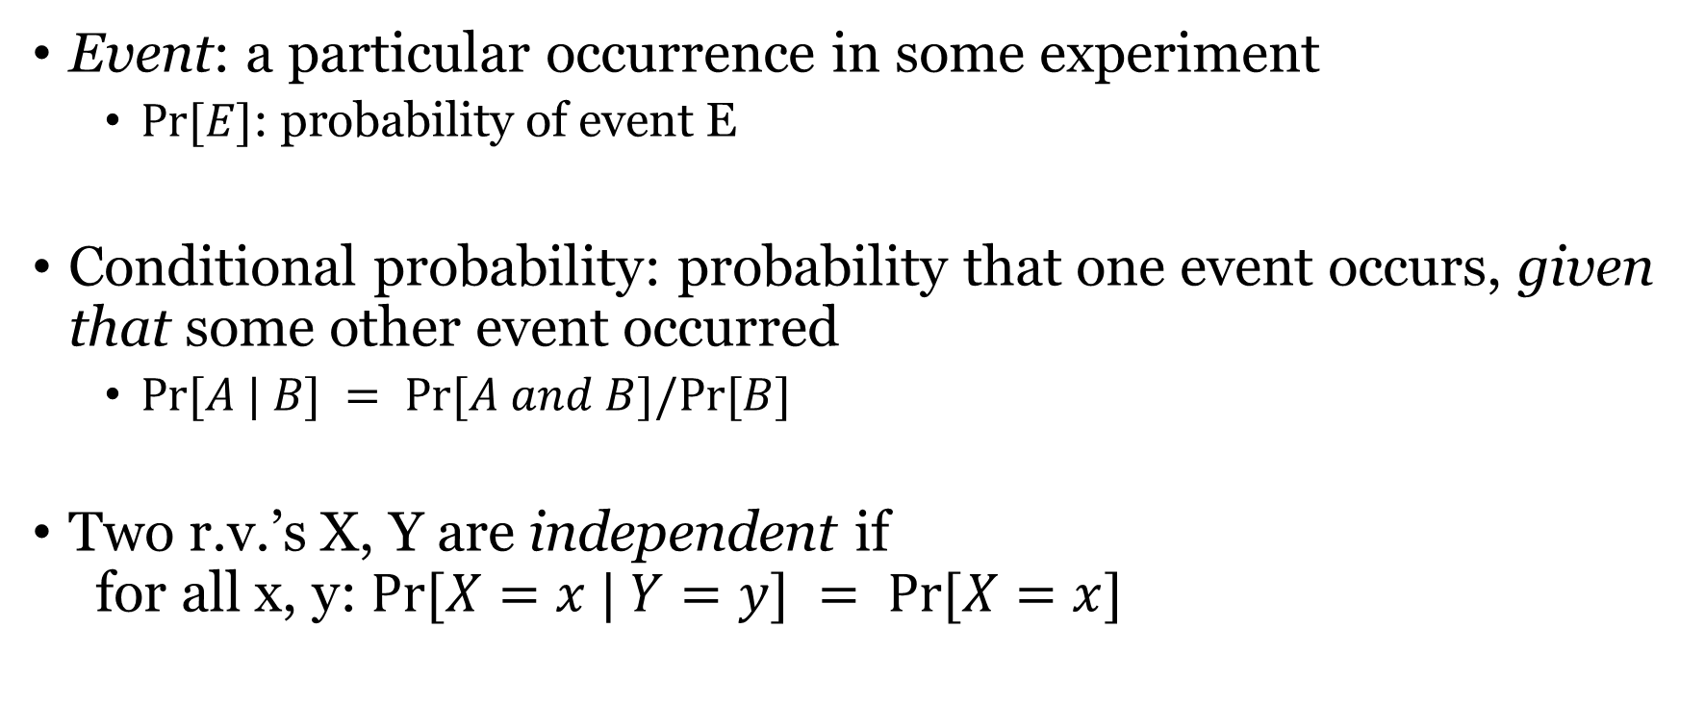
Probability
Event: a particular occurrence in some experiment
  $Pr⁡[E]$: probability of event E
Conditional probability: probability that one event occurs, given that some other event occurred
  $Pr⁡[A | B] = Pr⁡[A and B]/Pr⁡[B]$
Two r.v.’s X, Y are independent if
for all x, y: $Pr⁡[X=x | Y=y] = Pr⁡[X=x]$

Slide 33

Definitions for encryption
Algorithms:
  k: secret key, m: message, c: ciphertext
  $k=Gen( )$
  $c= Enc(k,m)$
  $m=Dec(k,c)$
Perfect secrecy: for any distribution over the message space $ℳ$, for every message $m∈ℳ$ and every ciphertext $c∈𝒞$,
    $$Pr⁡[ M = m | C=c ] = Pr⁡[M = m]$$

Slide 34
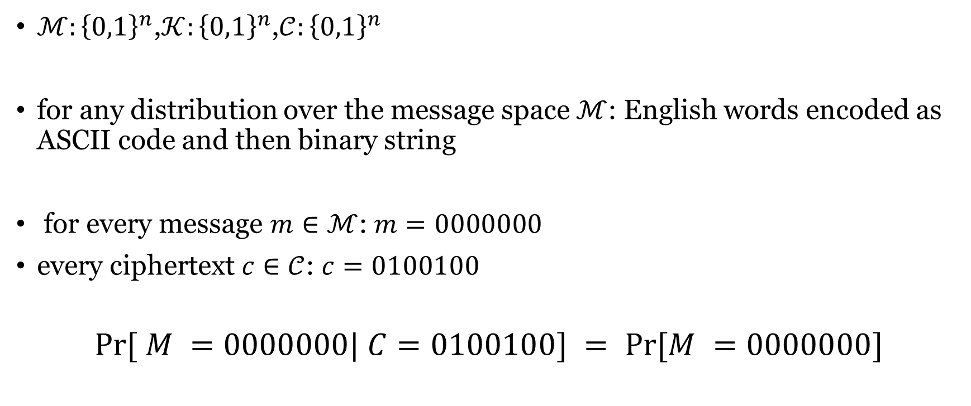
Example
$ℳ:{\left\{0,1\right\}}^{n}$,$𝒦:{\left\{0,1\right\}}^{n}$,$𝒞:{\left\{0,1\right\}}^{n}$
for any distribution over the message space $ℳ$: English words encoded as ASCII code and then binary string
for every message $m∈ℳ$: $m=0000000$
every ciphertext $c∈𝒞$: $c=0100100$
$$Pr⁡[ M =0000000| C=0100100] = Pr⁡[M =0000000]$$

Slide 35

Example: rotation cipher (rotation by k=3)
If $C = xx, Pr⁡[M=ab|C=xx] = 0 ≠ Pr⁡[M=ab]$

Slide 36

An equivalent definition
Algorithms:
  k: secret key, m: message, c: ciphertext
  $k=Gen()$
  $c= Enc(k,m)$
  $m=Dec(k,c)$
Perfect secrecy: for any distribution over the message space $ℳ$, for every message $m∈ℳ$ and every ciphertext $c∈𝒞$,
    $$Pr⁡[C=c|M=m ] = Pr⁡[C=c]$$

Slide 37
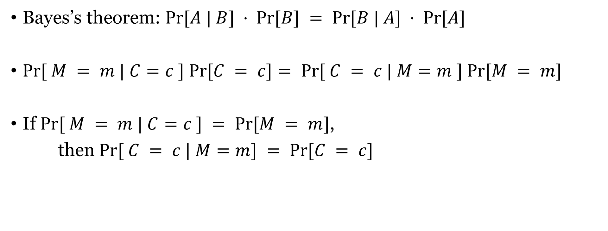
Proof
Bayes’s theorem: $Pr⁡[A | B] · Pr⁡[B] = Pr⁡[B | A] · Pr⁡[A]$
$Pr⁡[ M = m | C=c ] Pr⁡[C = c]= Pr⁡[ C = c | M=m ] Pr⁡[M = m]$
If $Pr⁡[ M = m | C=c ] = Pr⁡[M = m]$,
then $Pr⁡[ C = c | M=m] = Pr⁡[C = c]$

Slide 38
One-time pad
rotation by different shifts
Key length the same as message length

Slide 39
Rotation vs modular addition
M: r K: 24 -- C: p
18 + 24 = 16 mod 26

Slide 40
XOR
A ⊕ B
Equivalent to addition mod 2
input |  | output
0 | 0 | 0
0 | 1 | 1
1 | 0 | 1
1 | 1 | 0

Slide 41
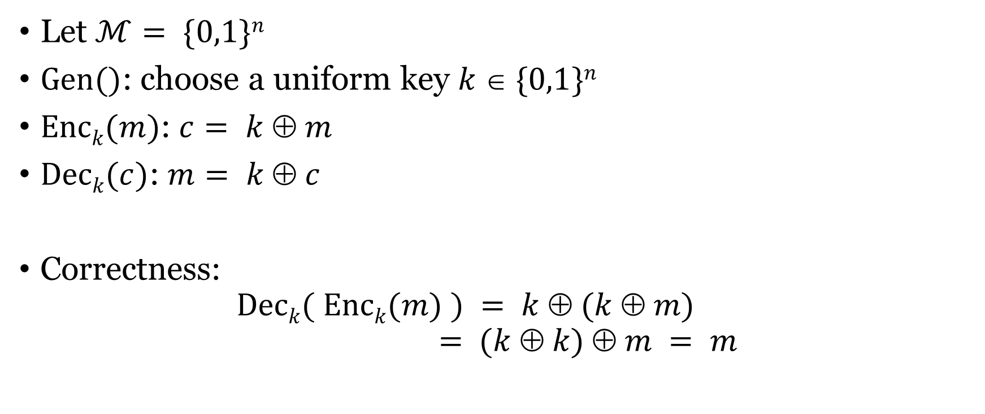
One-time pad
Let $ℳ= \{0,1\}n$
$Gen()$: choose a uniform key $k  \{0,1\}n$
$Enck(m)$: $c= k  m$
$Deck(c)$: $m= k  c$
Correctness:
$Deck( Enck(m) ) = k  (k  m)$
$= (k  k)  m = m$

Slide 42
One-time pad
n bits
key
n bits
n bits
⊕
message
ciphertext

Slide 43
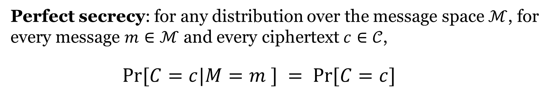
Theorem
Theorem 1: One-time pad encryption is perfectly secure.
Perfect secrecy: for any distribution over the message space $ℳ$, for every message $m∈ℳ$ and every ciphertext $c∈𝒞$,
    $$Pr⁡[C=c|M=m ] = Pr⁡[C=c]$$

Slide 44

Proof
$Pr⁡[C=c|M=m] = Pr⁡[k  m =c|M=m]$
$$=Pr⁡[k=m  c | M=m] = 2^{−n}$$

Slide 45

Probability
Law of total probability: say E₁, …, E_{n} are a partition of all possibilities. Then for any A:
$Pr⁡[A] =∑i Pr⁡[A and Ei] = i Pr⁡[A | Ei] · Pr⁡[Ei]$

Slide 46

Proof
$Pr⁡[C=c] =\sum_{m∈ℳ}{\operatorname{Pr}\left[C=c | M=m \right]\operatorname{Pr}{[M=m]}}$
= $\sum_{m∈ℳ}{2^{−n}\operatorname{Pr}{[M=m] }}$
= $2^{−n} \sum_{m∈ℳ}{\operatorname{Pr}{[M=m] }}$
$=2^{−n}$

Slide 47
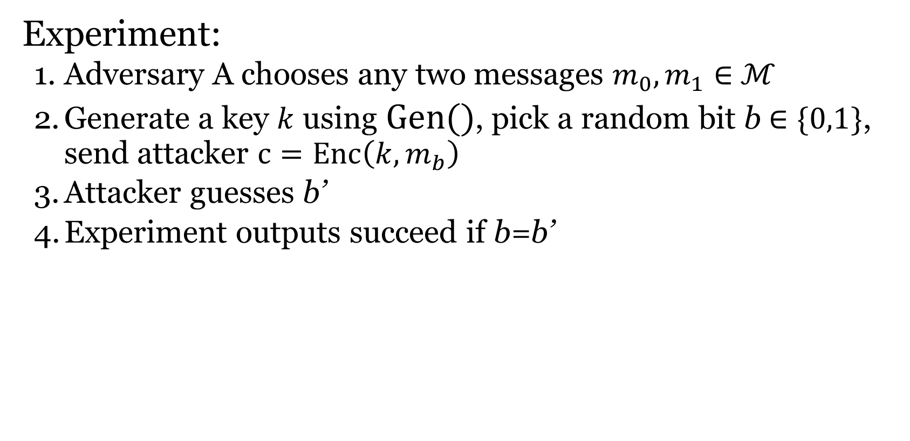
Another def: perfect indistinguishability
Experiment:
  Adversary A chooses any two messages $m_{0}, m_{1}∈$ $ℳ$
  Generate a key $k$ using $Gen()$, pick a random bit b $∈\{0,1\}$, send attacker $c=Enc\left(k,m_{b}\right)$
  Attacker guesses b’
  Experiment outputs succeed if b=b’
Perfectly indistinguishable: for every adversary A
Pr[Experiment outputs 1] = ½

Slide 48
Perfect indistinguishability
Lemma 2 (2.7 in the book): An encryption scheme is perfectly secret if and only if it is perfectly indistinguishable.

Slide 49
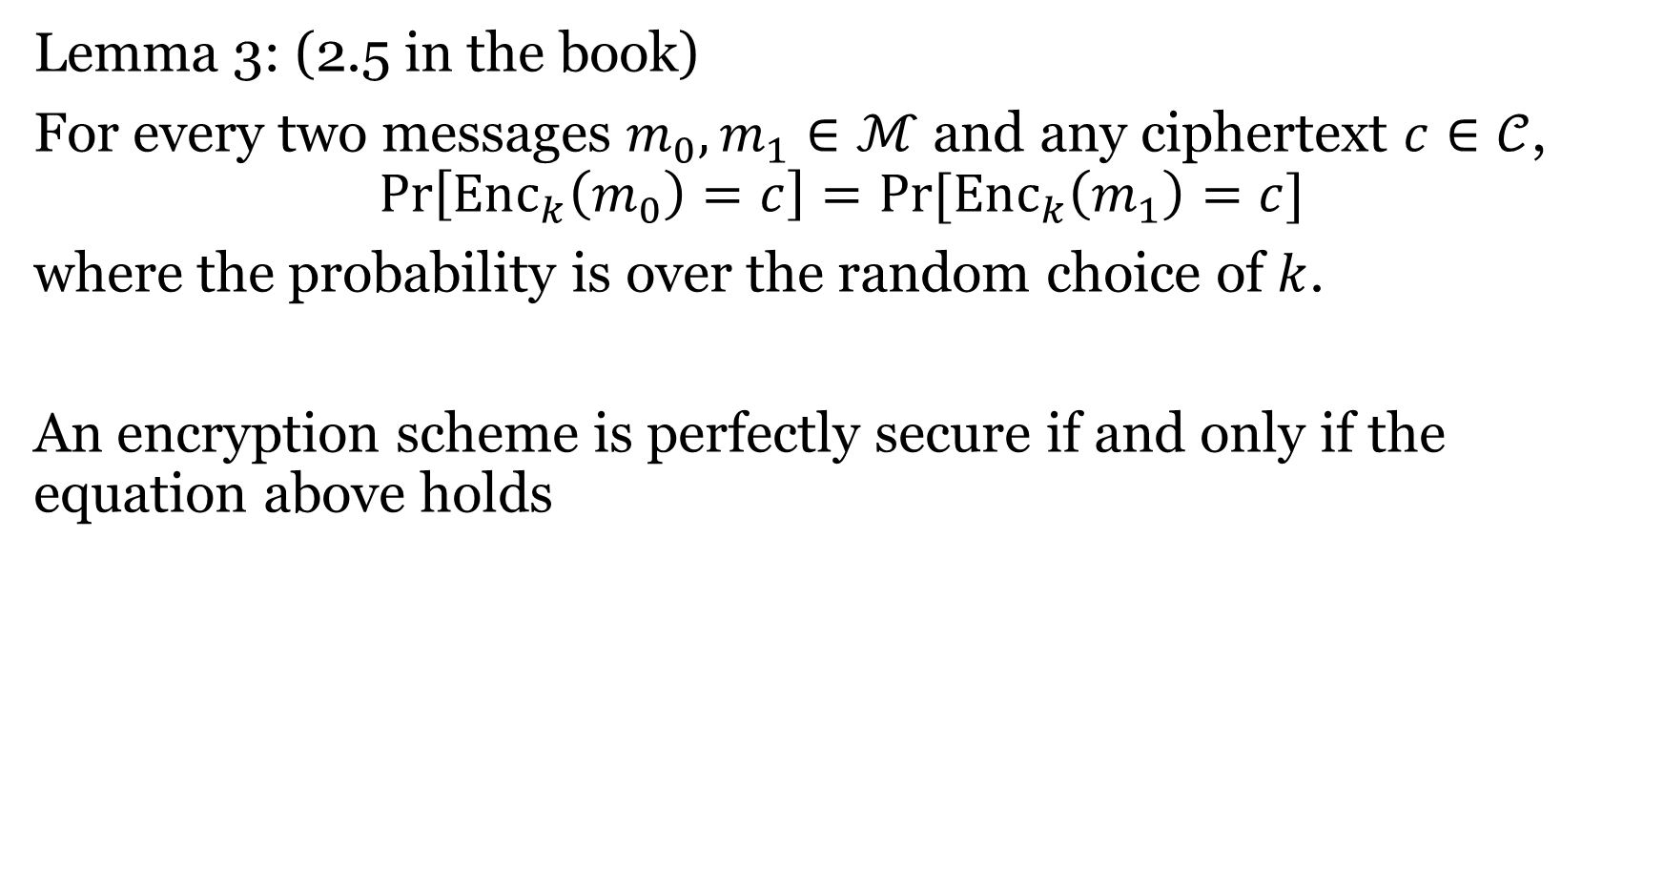
Lemma 3: (2.5 in the book)
For every two messages $m_{0}, m_{1}∈ℳ$ and any ciphertext $c∈𝒞$,
$$\operatorname{Pr}\left[Enc_{k}\left(m_{0}\right)=c\right]=\operatorname{Pr}{[Enc_{k}\left(m_{1}\right)=c]}$$
where the probability is over the random choice of $k$.
An encryption scheme is perfectly secure if and only if the equation above holds

Slide 50
Using the same key twice?
m₁ ⊕ m₂ is information about m₁, m₂
Is this significant?
    No longer perfectly secret!
    m₁ ⊕ m₂ reveals where m₁, m₂ differ
    Frequency analysis
    Exploiting characteristics of ASCII…

Slide 51
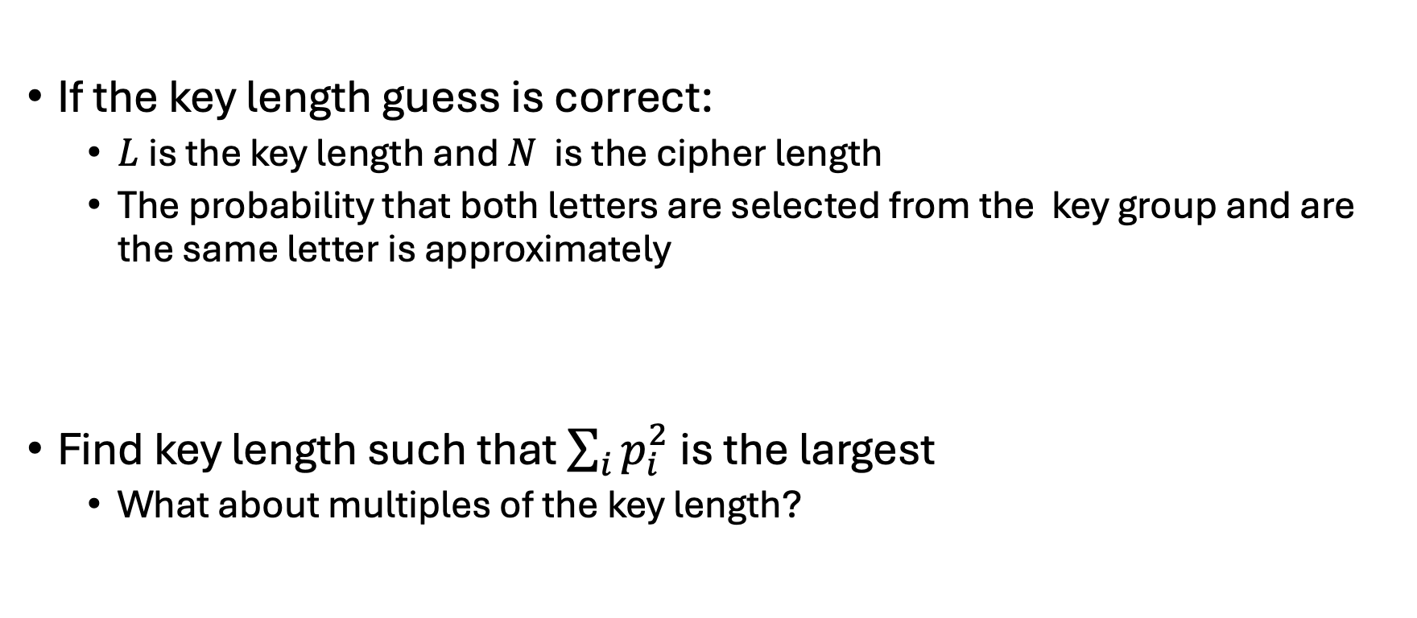
Index of coincidence
If the key length guess is correct:
  $L$ is the key length and $N$ is the cipher length
  The probability that both letters are selected from the key group and are the same letter is approximately
Find key length such that $\sum_{i}{p_{i}^{2}}$ is the largest
  What about multiples of the key length?

