Slide 1
ECE/CS 407 Cryptography
Notes:
[~1 min] Welcome to ECE/CS 407, Cryptography. I'm Ning Luo.
Today has two halves. First, the logistics: how the course runs, how you're graded, and what I expect from you. Second, the fun part: what cryptography actually is, what this course is and is not about, and a refresher on the math we'll lean on all semester.
Opening hook: cryptography is the only field where we routinely prove that an attacker with a supercomputer still cannot do something. By the end of this course you'll be able to write those proofs yourself.
Housekeeping: ask questions at any point — do not wait until the end.

Slide 2
About Me
Ning Luo, CSL 457, https://ning0luo.github.io/
Email: nl27@illinois.edu
Assistant Professor, UIUC 2024-now
Postdoc, Northwestern University 2023-2024
PhD, Yale University 2017-2022
Research: Cryptography, Formal Methods, Automated Reasoning, Achieve privacy and security in practical settings
Notes:
[~2 min] Quick introduction so you know who you're spending the semester with.
I'm an assistant professor here at UIUC since 2024. Before that I was a postdoc at Northwestern, and I did my PhD at Yale, finishing in 2022.
My research sits at the intersection of cryptography, formal methods, and automated reasoning — essentially, using machine-checkable reasoning to make privacy and security guarantees hold up in real deployed systems, not just on paper.
My office is CSL 457. Email is on the slide; please put ECE407 in the subject line. If you're curious about research or looking for a project, come to office hours — that's the easiest way to start a conversation.

Slide 3
Course Information
Time and Location:
TTh 5:00-6:20 pm, ECEB 3013
My office hour: Upon on request
TA: Pranav Rajpal
Office hour: TBD
Notes:
[~1 min] Logistics. We meet Tuesdays and Thursdays, 5:00 to 6:20 pm, in ECEB 1013. Please come on time — I tend to put the key definition of the day in the first ten minutes.
My office hours are still TBD; I'll post them on the course page and announce them on Canvas within the first week. Same for our TA, Pranav Rajpal.
Between the two of us you'll have coverage most days of the week. If neither slot works for you, email me and we'll find a time — I'd much rather meet you than have you stuck on a problem set for three hours.

Slide 4
Resources
Webpage:
Canvas https://courses.grainger.illinois.edu/ece407/fa2026/
Slides and files
Assignment submission and grading
Announcements
In-class quizzes
Piazza
https://piazza.com/illinois/fall2026/csece407
Access Code: MD5 of “I love cryptography”
Do not know MD5? Shame on you!
Notes:
[~2 min] Four places you need to bookmark today.
The course webpage is the syllabus of record — schedule, readings, policies. Canvas is where slides, assignments, grades, and announcements live, and where in-class quizzes happen, so bring a device you can submit from.
Piazza is for questions. Post there rather than emailing me individually — if one of you is confused, usually five others are too, and everyone benefits from the answer.
And yes, the Piazza access code is the MD5 hash of 'I love cryptography'. That's your first exercise: go compute it. If you don't know what MD5 is yet — you will by week four, and by then you'll also know why nobody should still be using it.

Slide 5
Prerequisites
CS 225: Introduction to Data Structures and Algorithms
CS/ECE 374: Introduction to Algorithms and Models of Computation
Prerequisite overrides will be considered on a case-by-case basis. We expect that you are familiar with basic probability, modular arithmetic.
Notes:
[~2 min] Prerequisites. Formally, CS 225 and CS/ECE 374. If you don't have both, talk to me — I consider overrides case by case, but I want to be honest with you about what you'll be walking into.
What actually matters is not the course numbers, it's three habits of mind. One: you're comfortable reading and writing a proof, especially a reduction. Two: basic discrete probability — conditional probability, independence, expectation. Three: modular arithmetic and logarithms.
374 matters most because this course is fundamentally about reductions: 'if you could break my scheme, you could solve this problem nobody knows how to solve.' That is the same move as an NP-hardness reduction, pointed in a different direction.
The last third of today's lecture is a refresher on exactly this math, so use it as a self-assessment. If most of it feels new rather than rusty, come talk to me after class.

Slide 6
Grading Policy
In-Class Quizzes (10%)
Average of all quiz scores, scaled to 100
Homework (20%)
5 assignments
Submit a single PDF compiled from LaTeX — no Word, Google Docs, or photos
No late submissions
AI tools are NOT allowed unless stated otherwise
Midterm Exam (20%)
In class
You must pass the midterm to pass the course
Final Exam (30%)
Cumulative
Final Project (20%)
Design a cryptographic application of the course content
AI tools ARE allowed

Slide 7
4 credit hours project
Paper review and report:
You will read and write reviews of papers in the cryptography literature.
Please make an appointment with me on your paper selection.
https://registrar.illinois.edu/registration/registration-process/variable-credit-hours/

Slide 8
Ethics & Academic Integrity
Collaboration. Homeworks are to be submitted individually. However, you may collaborate with up to one other student on homework assignments. On each homework submission, declare your collaborator (if any). In your collaboration you are expected to discuss the homework, not merely copy answers. Plagiarism will not be tolerated
https://studentcode.illinois.edu/

Slide 9
Emergencies
Emergencies can happen anywhere and at any time, so it’s important that we take a minute to prepare for a situation in which our safety could depend on our ability to react quickly. Take a moment to learn the different ways to leave this building. If there’s ever a fire alarm or something like that, you’ll know how to get out and you’ll be able to help others get out. Next, figure out the best place to go in case of severe weather – we’ll need to go to a low-level in the middle of the building, away from windows. And finally, if there’s ever someone trying to hurt us, our best option is to run out of the building. If we cannot do that safely, we’ll want to hide somewhere we can’t be seen, and we’ll have to lock or barricade the door if possible and be as quiet as we can. We will not leave that safe area until we get an Illini-Alert confirming that it’s safe to do so. If we can’t run or hide, we’ll fight back with whatever we can get our hands on. If you want to better prepare yourself for any of these situations, visit police.illinois.edu/safe. Remember you can sign up for emergency text messages at emergency.illinois.edu.

Slide 10
Diversity, Equity, and Inclusion
We in the Illinois ECE community are committed to understanding, empathizing with, and respecting each other, embracing the many differences among us.

Slide 11

What is this course not about?

Slide 12
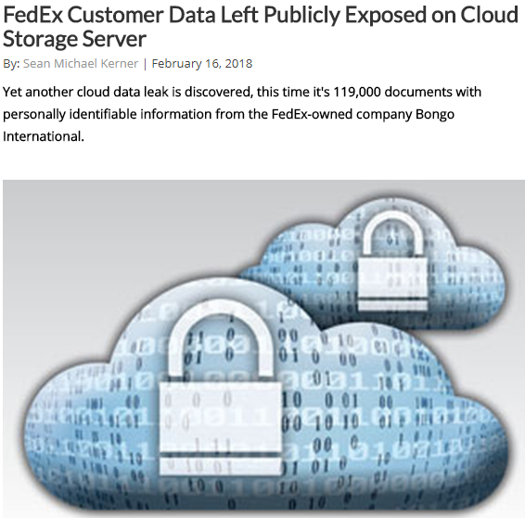
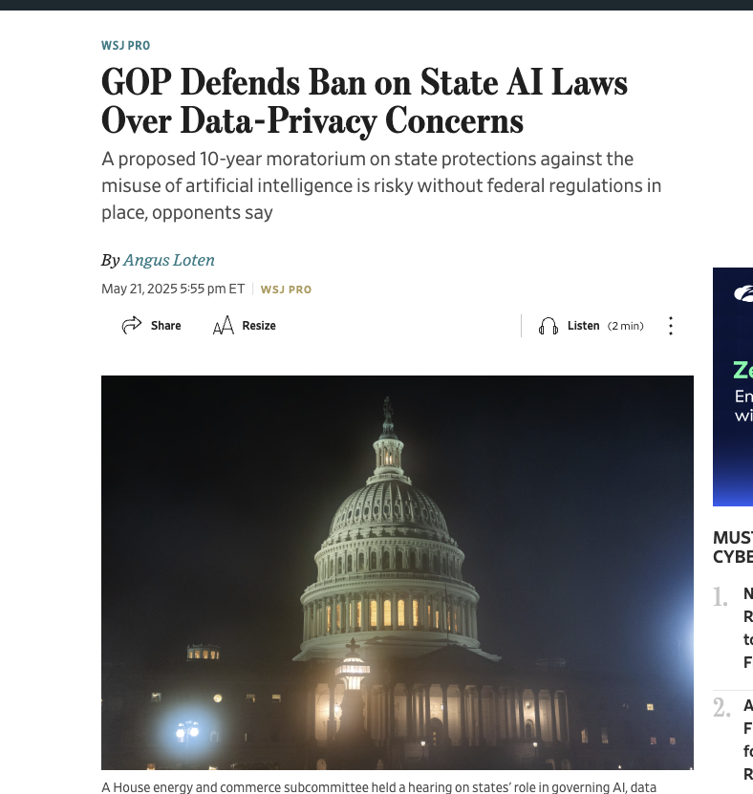
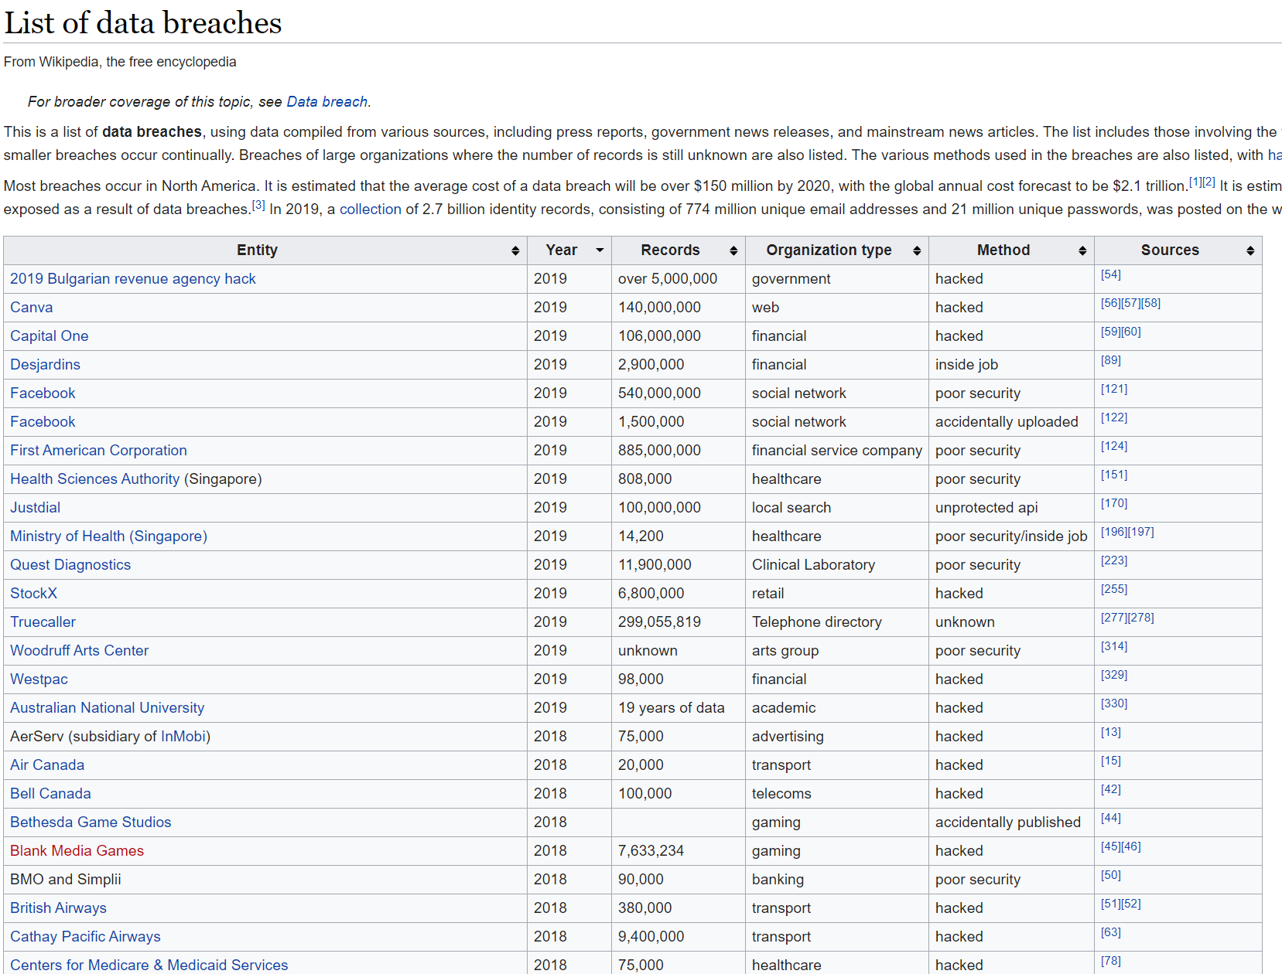
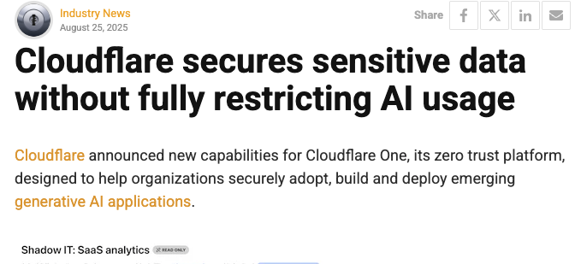
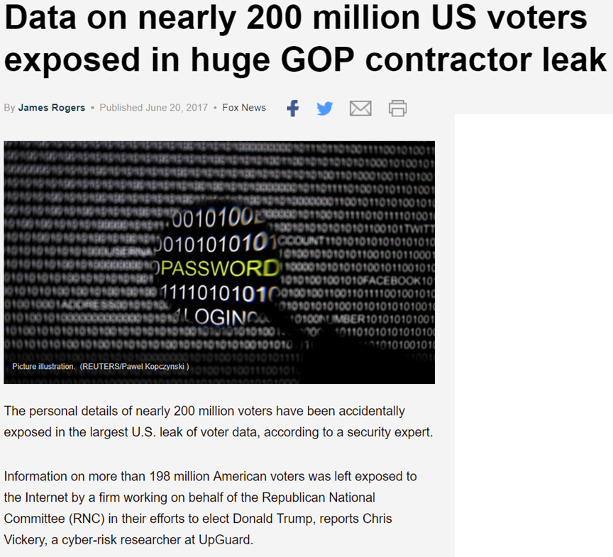
Why cryptography?

Slide 13
Why cryptography?
Confidentiality
Keeping data and resources hidden
Integrity
Data integrity (integrity)
Origin integrity (authentication)
Availability
Denial-of-service attacks

Slide 14
Cryptography
1.1 Definition Cryptography is the study of mathematical techniques related to aspects of information security such as confidentiality, data integrity, entity authentication, and data origin authentication.
Encryption: Converting plaintext into ciphertext using a secret key, so only authorized parties can recover the original message.
Decryption: Reversing encryption to get back the plaintext, also requiring a secret key.
Digital Signatures: Allowing a party to prove that a message truly came from them and has not been modified.
Hash Functions: Mapping data of any size to a fixed-size value in a way that is hard to reverse or manipulate, often used for integrity checking.
Key Exchange: Protocols that let two or more parties agree on a shared secret key over an insecure channel (e.g., Diffie–Hellman).

Slide 15
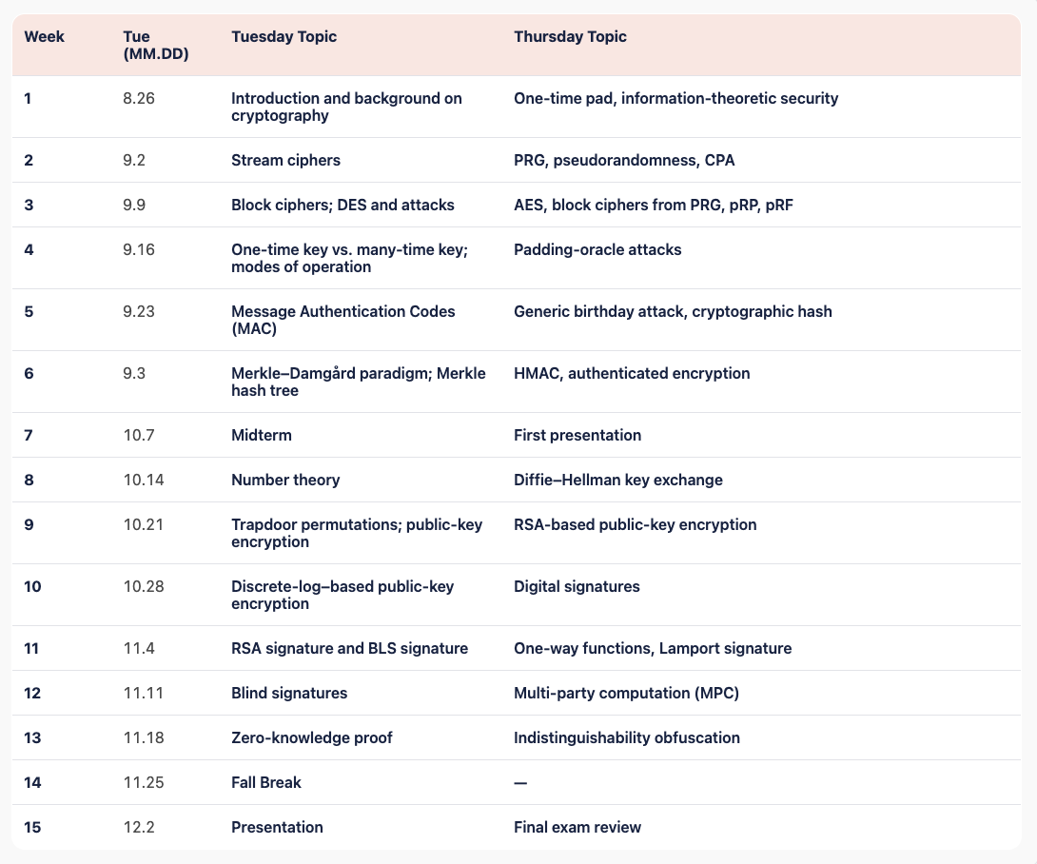
Symmetric key cryptography
Public key cryptography
Advanced topics

Slide 16
Textbook
Introduction to Modern Cryptography, 3rd edition, Jonathan Katz and and Yehuda Lindell.
A Graduate Course in Applied Cryptography, Dan Boneh’s and Victor Shoup

Slide 17
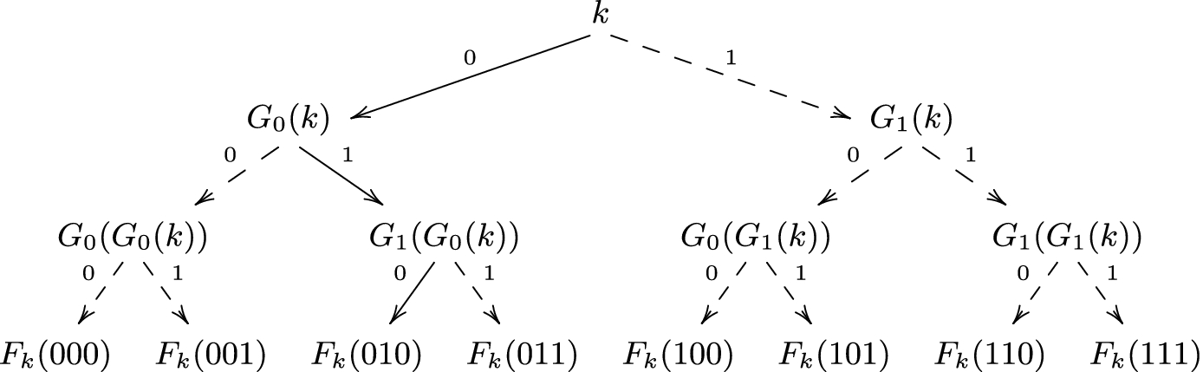





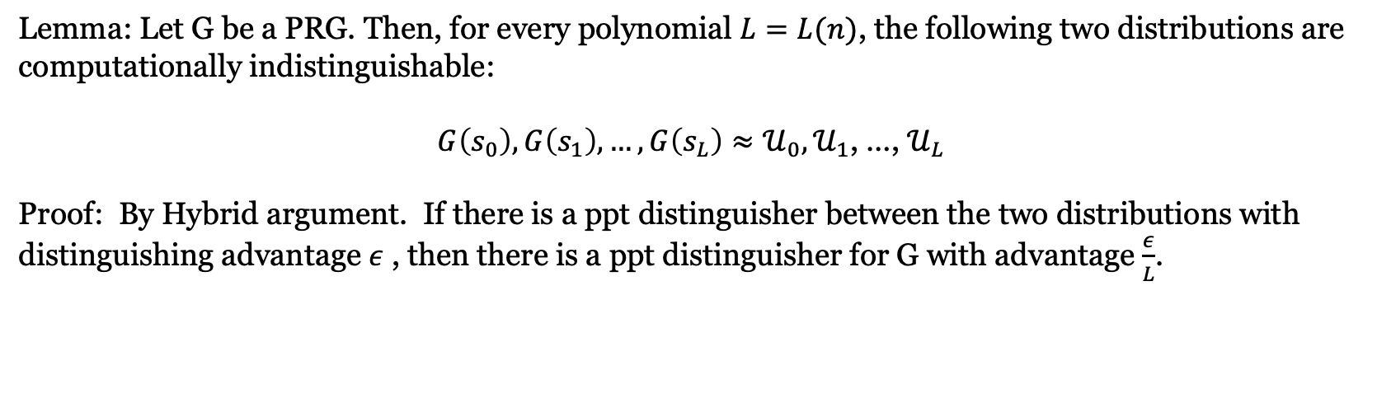

What is this course about? Proof
Example: The Goldreich-Goldwasser-Micali Construction [GGM’84]
$s_{0}$
Hybrid 1
$s_{1}$
$s_{00}$
$s_{01}$
$s_{10}$
Hybrid 2
$s_{11}$
Lemma: Let G be a PRG. Then, for every polynomial $L=L(n)$, the following two distributions are computationally indistinguishable:
$G\left(s_{0}\right),G\left(s_{1}\right), …, G\left(s_{L}\right)≈𝒰_{0},𝒰_{1}$, …, $𝒰_{L}$
Proof: By Hybrid argument. If there is a ppt distinguisher between the two distributions with distinguishing advantage $ε$ , then there is a ppt distinguisher for G with advantage $\frac{ε}{L}$.

Slide 18

What is this course about? Math
Example: Baby step- Giant step algorithm
Let $G$be a group and let $h ∈ G$be an element of order $N$, i.e., $h^{N} = e$and no smaller power of $h$ is equal to $e$. Then, assuming that the discrete logarithm problem $h^{x} = b$ has a solution.
Let ${x= k}_{0} × \sqrt{N} + k_{1}$, $k_{0},k_{1} ≤ \sqrt{N}$
Baby step$: { L_{0}= \{ h}^{1},h^{ 2}$, $h^{3}, …,h^{\sqrt{N}}\}$
Giant step: ${L_{1}= \{ bg}^{−1},{bg}^{ −2}$, ${bg}^{−3}, …,{bg}^{−\sqrt{N} }\},$ where ${g= h}^{\sqrt{N}}$
Find two collided elements in $L_{0}$and $L_{1}$ , such that $h^{i}=b g^{−j}$, then $x = i +\sqrt{N}× j$
In-Class Quiz: Prove that there always exists a collision between the two lists
Quiz Code: Crypto57556

Slide 19
Example: Shamir Secret Sharing
Setup: hide the secret in a random polynomial
Secret s = 5, prime p = 11; pick a random slope a = 3, set f(x) = 5 + 3x mod 11
Shares: f(1) = 8, f(2) = 0, f(3) = 3
Any 2 shares recover the secret
Lagrange on (1, 8) and (3, 3): f(0) = 8·7 + 3·5 = 71 = 5 mod 11
Two points determine a line, so the intercept f(0) is unique
Any 1 share reveals nothing
From (2, 0) alone: every candidate s admits exactly one slope with s + 2a = 0
All 11 secrets stay equally likely — perfect privacy, no assumptions needed
Security comes from counting consistent polynomials — the basis of MPC.

Slide 20
All Background You Need for This Course
https://joyofcryptography.com/pdf/chap0.pdf

Slide 21

Exponentiation and log
$x^{a}⋅x^{b}=x^{a+b}$
${(x^{a})}^{b}=x^{ab}$
${\log_{x}{ab }=\log_{x}{a}}^{ }+\log_{x}{b}$
${alog}_{x}{b }=\log_{x}{b^{a}}$
$x^{a}⋅x^{b}$ is not equal to $x^{ab}$ !!!

Slide 22
Prime Number
Prime number p:
p is an integer
p ≥ 2
The only divisors of p are 1 and p
Examples
2, 7, 19 are primes
-3, 0, 1, 6 are not primes
Prime decomposition of a positive integer n:
n = p₁e1 × … × p_{k}^{e}k
Example:
200 = 2³ × 5²
Primality test in polynomial time
^{Read AKS primality test}

Slide 23
Modular Arithmetic
Modulo operator for a positive integer n
r = a mod n
equivalent to
a = r + kn
and
r = a − ⎣a/n⎦ n
Example:
29 mod 13 = 3 13 mod 13 = 0 −1 mod 13 = 12
29 = 3 + 2×13 13 = 0 + 1×13 12 = −1 + 1×13

Slide 24

Modular Arithmetic
simplify intermediate values mod n
$a+b+c+…mod n=\left(\left(a+b\right) mod n+c\right)mod n+ …. mod n$
$a⋅b⋅c⋅…mod n=\left(\left(a⋅b\right) mod n⋅c\right)mod n+ …. mod n$

Slide 25

Modular exponentiation
$x^{a}⋅x^{b}=x^{a+b}$ mod n
${(x^{a})}^{b}=x^{ab}$ mod n

Slide 26
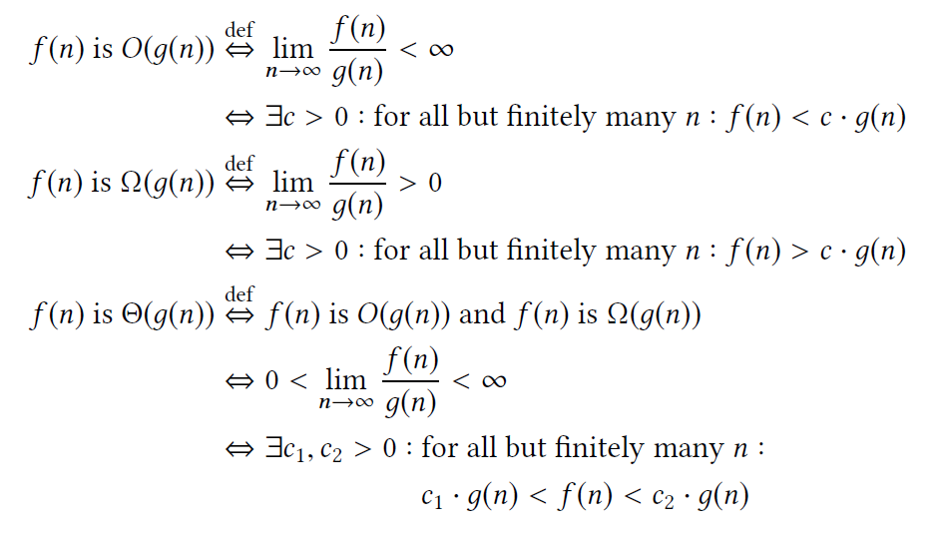
Asymptotic complexity
Big O notation O(n), O(2^{n})
E.g., for sufficiently large integer n, O(2^{n})>O(n^{c})

Slide 27
Binary representation
17 = 10001, 38 = 100110
Bitlength of number k is log₂ k
Complexity of an algorithm taking an integer k as input is computed on its bitlength

Slide 28
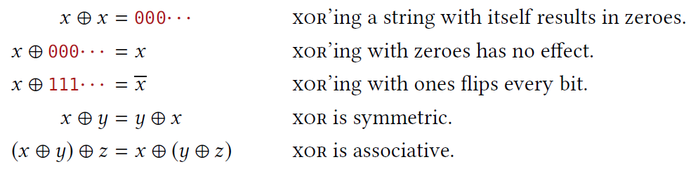
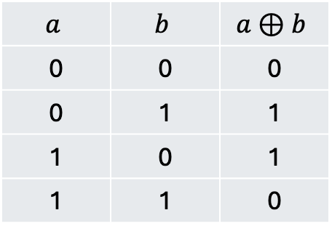

Binary string
${\left\{0,1\right\}}^{n}$ denotes the set of n-bit binary string.
$⊕$ xor:
Same as addition mod 2
$$a$$ | $$b$$ | $$a⊕b$$
0 | 0 | 0
0 | 1 | 1
1 | 0 | 1
1 | 1 | 0

Slide 29
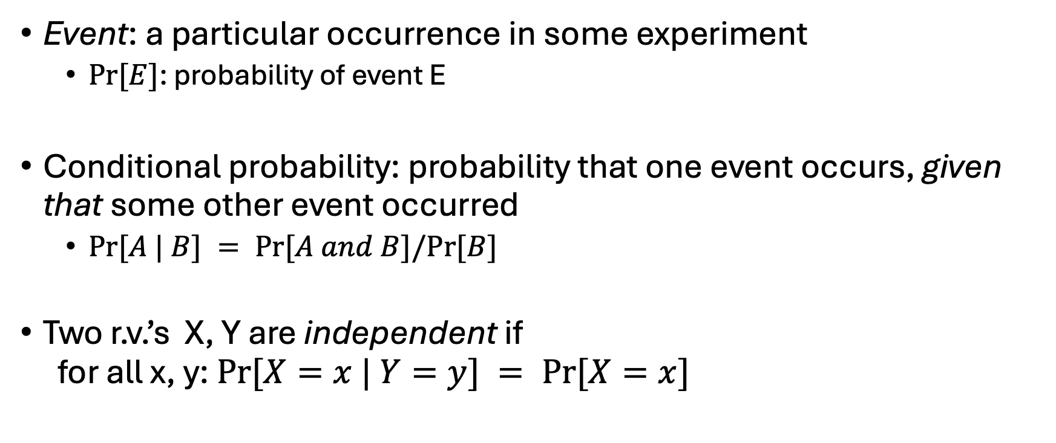
Probability
Event: a particular occurrence in some experiment
$Pr⁡[E]$: probability of event E
Conditional probability: probability that one event occurs, given that some other event occurred
$Pr⁡[A | B] = Pr⁡[A and B]/Pr⁡[B]$
Two r.v.’s X, Y are independent if for all x, y: $Pr⁡[X=x | Y=y] = Pr⁡[X=x]$

Slide 30
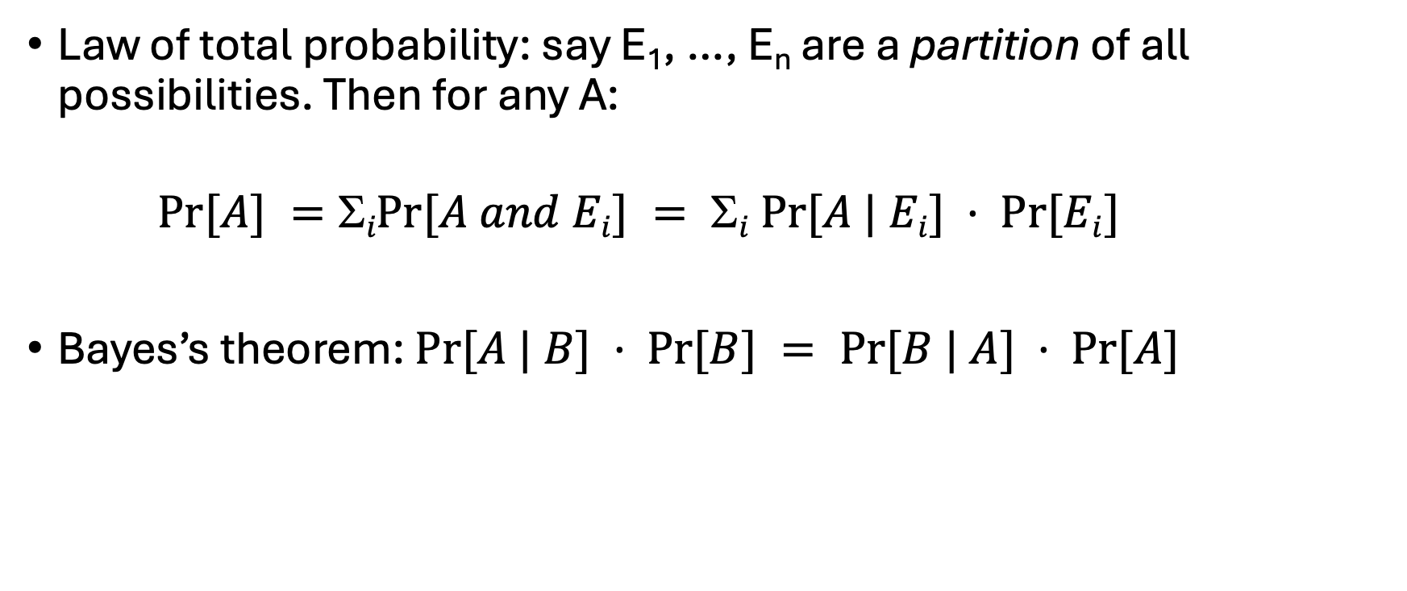
Probability
Law of total probability: say E₁, …, E_{n} are a partition of all possibilities. Then for any A:
$Pr⁡[A] =iPr⁡[A and Ei] = i Pr⁡[A | Ei] · Pr⁡[Ei]$
Bayes’s theorem: $Pr⁡[A | B] · Pr⁡[B] = Pr⁡[B | A] · Pr⁡[A]$

