Slide 1
TA office hour: 3PM-4PM Thursday
Notes:
Housekeeping before we start: TA office hour is Thursday 3-4PM.
Point students to the course page for slides and readings.
Encourage them to come with questions from today's material.

Slide 2
(NOT) All Background You Need for This Course
https://joyofcryptography.com/pdf/chap0.pdf
Notes:
Roadmap slide: the math background we will actually use — logs/exponents, primes, modular arithmetic, asymptotics, probability.
Title is a joke: this is not everything you need, just the minimum to follow the proofs.
Reading: Chapter 0 of Joy of Cryptography (link on slide) — review it before next lecture.
Tell students to flag any of these topics they have not seen before.

Slide 3

Exponentiation and logarithms
$x^{a}⋅x^{b}=x^{a+b}$
${(x^{a})}^{b}=x^{ab}$
${\log_{x}{ab }=\log_{x}{a}}^{ }+\log_{x}{b}$
${alog}_{x}{b }=\log_{x}{b^{a}}$
$x^{a}⋅x^{b}$ is not equal to $x^{ab}$ !!!
Notes:
Recall the three exponent/log identities on the slide — we use them constantly in group-based crypto.
Emphasize the last line: x^a * x^b is x^(a+b), NOT x^(ab). This is the most common student error.
Logs let us move between multiplicative and additive views — that is the whole basis of the discrete-log problem later in the course.

Slide 4
Prime numbers
Prime number p:
p is an integer
p ≥ 2
The only divisors of p are 1 and p
Examples
2, 7, 19 are primes
-3, 0, 1, 6 are not primes
Prime decomposition of a positive integer n:
n = p₁e1 × … × p_{k}^{e}k
Example:
200 = 2³ × 5²
Primality test in polynomial time
^{Read AKS primality test}
Notes:
Definition: p >= 2 whose only divisors are 1 and p. Walk the examples and non-examples (negatives, 0, 1, composites).
Unique prime decomposition: every positive integer factors into primes — state it as the fundamental theorem of arithmetic.
Primality testing is polynomial time (AKS), but factoring is believed hard — that asymmetry is what RSA will rest on.
Assign the AKS reading only as optional background.

Slide 5
Modular arithmetic
Modulo operator for a positive integer n
r = a mod n
equivalent to
a = r + kn
and
r = a - ⎣a/n⎦ n
Example:
29 mod 13 = 3 13 mod 13 = 0 -1 mod 13 = 12
29 = 3 + 2×13 13 = 0 + 1×13 12 = -1 + 1×13
Notes:
Define r = a mod n as the remainder after subtracting the largest multiple of n; a = r + kn.
Work the three examples: 29 mod 13 = 3, 13 mod 13 = 0, and -1 mod 13 = 12.
Stress the negative case — students expect -1, but the result must land in {0,...,n-1}.
This wrap-around is exactly the rotation we will see in the shift cipher.

Slide 6

Modular arithmetic
simplify intermediate values mod n
$a+b+c+…mod n=\left(\left(a+b\right) mod n+c\right)mod n+ …. mod n$
$a⋅b⋅c⋅…mod n=\left(\left(a⋅b\right) mod n⋅c\right)mod n+ …. mod n$
Notes:
Key practical point: you can reduce mod n at every intermediate step of a sum or product.
Both identities on the slide say the same thing — reduction commutes with + and *.
Why it matters: keeps numbers small so modular arithmetic stays efficient on huge cryptographic values.
Quick check with the class: compute (17 * 23) mod 5 both ways.

Slide 7

Modular exponentiation
$x^{a}⋅x^{b}=x^{a+b}$ mod n
${(x^{a})}^{b}=x^{ab}$ mod n
What is $2^{64}$ mod 10?
Notes:
Same exponent rules hold mod n.
Work the in-class question: 2^64 mod 10. Do it by repeated squaring rather than computing 2^64.
2^64 = ((2^2)^2)... — square and reduce mod 10 at each step; answer is 6.
Takeaway: fast modular exponentiation makes public-key crypto practical.

Slide 8
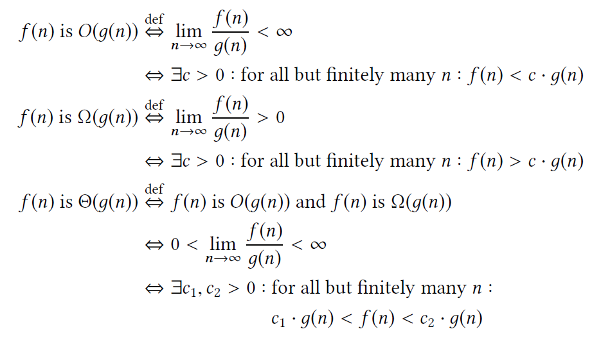
Asymptotic complexity
Big O notation O(n), O(2^{n})
E.g., for sufficiently large integer n, O(2^{n})>O(n^{c})
Notes:
Big-O as our measure of attacker and algorithm cost; we care about growth, not constants.
Contrast polynomial n^c with exponential 2^n: for large n, exponential always dominates.
This is the dividing line for the course: honest parties run in polynomial time, brute-force attacks cost exponential time.
Preview: security will mean 'no polynomial-time attacker succeeds with non-negligible probability'.

Slide 9
Ancient ciphers
Notes:
Section divider: we now move from math background to ancient ciphers.
Roadmap for this block: shift cipher, substitution cipher, Vigenere, Enigma.
Framing question: each scheme looked secure to its designers — why did each one fall?
Goal is to motivate why we need definitions and proofs rather than clever-looking designs.

Slide 10




How to encrypt a message?
PLAY
Notes:
Open with the motivating question: how would you encrypt a message so only your friend can read it?
Play the animation/video and let students propose ideas before showing any scheme.
Draw out the two ingredients they will name: a secret (the key) and a transformation (the algorithm).
Set up Kerckhoffs's principle: assume the adversary knows the algorithm; only the key is secret.

Slide 11
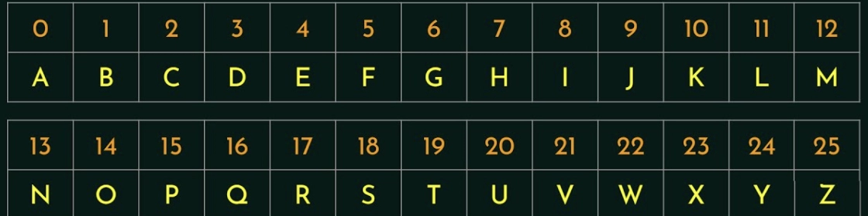
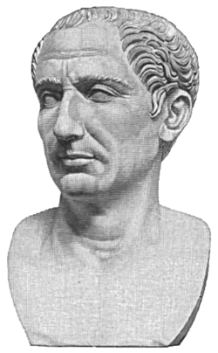
Idea 1: rotation (shift) cipher
C = X + K mod 26
C, X, K are number of corresponding letters.
a | b | c | d | e | f | g | h | i | j | k | l | m | n | o | p | q | r | s | t | u | v | w | x | y | z
Number of Possible Key?
The lecture is so boring !!!
Ymj qjhyzwj nx xt gtwnsl !!!
rotate by 5, K = 5
rotate by 5, K = 5
Notes:
Idea 1: shift every letter by a fixed amount K; here K = 5 turns 'The lecture is so boring' into 'Ymj qjhyzwj...'.
Encryption and decryption use the same K — shift forward, then shift back.
Ask the class the question on the slide: how many possible keys? Only 26 (25 useful ones).
That tiny key space is the fatal flaw — brute force is trivial, which is the next slide.

Slide 12
Idea 2: substitution cipher
original | a | b | c | d | e | f | g | h | i | j | k | l | m | n | o | p | q | r | s | t | u | v | w | x | y | z
replace | u | e | s | f | d | t | a | p | z | v | r | c | i | q | m | g | w | n | o | h | k | j | x | b | l | y
hpd mevdshzjdo mt hpzo smknod und hm zqtmni ohkfdqho uemkh hpd tzdcf mt smigkhdn oszdqsd uqf dqazqddnzqa, uqf hm zqhnmfksd hpdi hm hpd xzfd nuqad mt dbszhzqa uggczsuhzmqo mt smigkhuhzmq uqf hdspqmcmal zq omszdhl. xd xzcc dbgcuzq hpuh smigkhdn oszdqsd zo qmh vkoh uemkh gnmanuiizqa, ekh uemkh smigkhuhzmquc hpzqrzqa uqf hpd ohkfl mt ucamnzhpio. zigmnhuqh hdnio uqf smqsdgho zq hpd tzdcf xzcc ed zqhnmfksdf, uo u gndjzdx hm xpuh xzcc ed cdunqdf zq mhpdn smknodo. xd xzcc dbgcuzq hpd imhzjuhzmq tmn junzmko uogdsho mt mkn iuvmn, zqsckfzqa hpd smnd smknod odwkdqsd zq mkn sknnzskcki, iuhp ndwkzndidqho, okggmnhzqa undu, sm-mgo, dhs.
Try all possible substitutions? 26! = $4×{10}^{26}$
Notes:
Attack on the shift cipher: exhaustive key search. Walk the table of candidate decryptions for each K.
Only one of the 26 candidates is readable English, so the key is identified immediately.
Historical aside: this is the Caesar cipher — a fixed, publicly known shift, so effectively no key at all.
Lesson: a key space small enough to enumerate gives no security, no matter how the transformation looks.

Slide 13
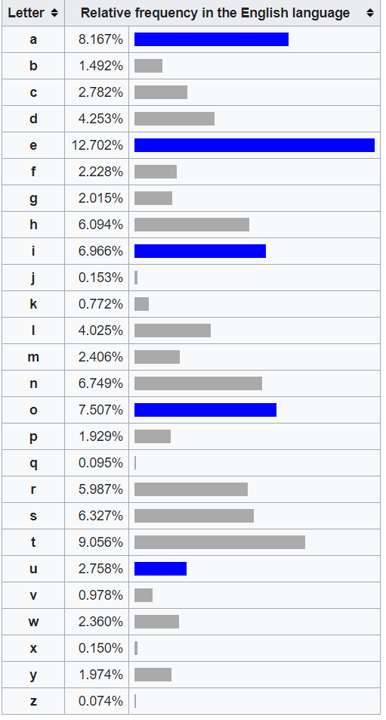
Attack: frequency analysis
hpd mevdshzjdo mt hpzo smknod und hm zqtmni ohkfdqho uemkh hpd tzdcf mt smigkhdn oszdqsd uqf dqazqddnzqa, uqf hm zqhnmfksd hpdi hm hpd xzfd nuqad mt dbszhzqa uggczsuhzmqo mt smigkhuhzmq uqf hdspqmcmal zq omszdhl. xd xzcc dbgcuzq hpuh smigkhdn oszdqsd zo qmh vkoh uemkh gnmanuiizqa, ekh uemkh smigkhuhzmquc hpzqrzqa uqf hpd ohkfl mt ucamnzhpio. zigmnhuqh hdnio uqf smqsdgho zq hpd tzdcf xzcc ed zqhnmfksdf, uo u gndjzdx hm xpuh xzcc ed cdunqdf zq mhpdn smknodo. xd xzcc dbgcuzq hpd imhzjuhzmq tmn junzmko uogdsho mt mkn iuvmn, zqsckfzqa hpd smnd smknod odwkdqsd zq mkn sknnzskcki, iuhp ndwkzndidqho, okggmnhzqa undu, sm-mgo, dhs.
Observation: substitution preserves frequency!!
Notes:
Idea 2: substitution cipher — an arbitrary permutation of the alphabet, so the key space is 26! (about 2^88).
Brute force is now infeasible, yet the scheme is still broken: structure leaks.
Frequency analysis: each plaintext letter always maps to the same ciphertext letter, so letter frequencies carry over.
Point at the ciphertext on the slide — 'h' and 'd' appear most often; they are almost certainly t and e.

Slide 14
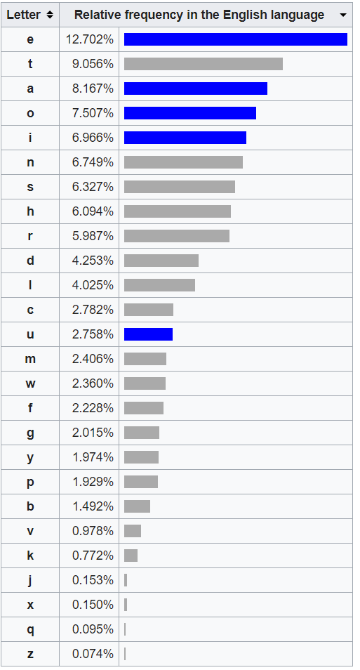
d | 10.85%
h | 10.08%
m | 9.11%
z | 8.53%
q | 7.56%
u | 6.20%
n | 6.01%
s | 5.43%
k | 5.04%
o | 5.04%
c | 3.68%
g | 3.10%
p | 3.10%
i | 3.10%
f | 2.91%
a | 2.13%
t | 1.94%
x | 1.74%
e | 1.36%
j | 0.78%
b | 0.58%
l | 0.58%
v | 0.58%
r | 0.39%
w | 0.19%
y | 0
original | a | b | c | d | e | f | g | h | i | j | k | l | m | n | o | p | q | r | s | t | u | v | w | x | y | z
replace | u | e | s | f | d | t | a | p | z | v | r | c | i | q | m | g | w | n | o | h | k | j | x | b | l | y
Notes:
Show the English letter-frequency distribution: e ~12.7%, t ~9%, a/o/i/n around 7-8%.
Compare it with the ciphertext histogram — the shape is identical, only the labels are permuted.
So the attacker matches the two distributions instead of searching 26! keys.
Common digrams and trigrams (th, he, the) finish the job on any reasonably long ciphertext.

Slide 15
Attacking substitution cipher
hpd mevdshzjdo mt hpzo smknod und hm zqtmni ohkfdqho uemkh hpd tzdcf mt smigkhdn oszdqsd uqf dqazqddnzqa, uqf hm zqhnmfksd hpdi hm hpd xzfd nuqad mt dbszhzqa uggczsuhzmqo mt smigkhuhzmq uqf hdspqmcmal zq omszdhl. xd xzcc dbgcuzq hpuh smigkhdn oszdqsd zo qmh vkoh uemkh gnmanuiizqa, ekh uemkh smigkhuhzmquc hpzqrzqa uqf hpd ohkfl mt ucamnzhpio. zigmnhuqh hdnio uqf smqsdgho zq hpd tzdcf xzcc ed zqhnmfksdf, uo u gndjzdx hm xpuh xzcc ed cdunqdf zq mhpdn smknodo. xd xzcc dbgcuzq hpd imhzjuhzmq tmn junzmko uogdsho mt mkn iuvmn, zqsckfzqa hpd smnd smknod odwkdqsd zq mkn sknnzskcki, iuhp ndwkzndidqho, okggmnhzqa undu, sm-mgo, dhs.
the objectipes og this course are to ingorm students about the gield og comwuter enfineerinf, and to introduce them to the yide ranfe og evcitinf awwlications og comwutation and technolofk in societk. ye yill evwlain that comwuter enfineerinf is not just about wroframminf, but about comwutational thinqinf and the studk og alforithms. imwortant terms and concewts in the gield yill be introduced, as a wrepiey to yhat yill be learned in other courses. ye yill evwlain the motipation gor parious aswects og our major, includinf the core course sexuence in our curriculum, math rexuirements, suwwortinf area, co-ows, etc.
Notes:
Walk through the attack live: assign the most frequent ciphertext letters to e, t, a and look for 'the'.
Once a few letters are fixed, short words and word shapes force the rest of the permutation.
No search over the 26! key space is ever needed — the ciphertext leaks enough structure.
Ask: how long does the ciphertext need to be for this to work? A couple of sentences is usually enough.

Slide 16
The objectives of this course are to inform students about the field of Computer Engineering, and to introduce them to the wide range of exciting applications of computation and technology in society. We will explain that Computer Engineering is not just about programming, but about computational thinking and the study of algorithms. Important terms and concepts in the field will be introduced, as a preview to what will be learned in other courses. We will explain the motivation for various aspects of our major, including the core course sequence in our curriculum, math requirements, supporting area, co-ops, etc.
Notes:
Reveal: the fully recovered plaintext — the course-description paragraph.
Reinforce that the substitution cipher fell without touching its huge key space.
Big-key-space is necessary but nowhere near sufficient for security.
Transition: the flaw is that the mapping is fixed per letter. Next idea varies the shift.

Slide 17
Vigenère (vee-zhuh-ner) cipher
Idea 3: rotation by different shifts
Plaintext | Plaintext value P | Key | Key value K | Ciphertext Value E | Ciphertext
C | 2 | K | 10 | 12 | M
R | 17 | E | 4 | 21 | V
Y | 24 | Y | 24 | 22 | W
P | 15 | K | 10 | 25 | Z
T | 19 | E | 4 | 23 | X
O | 14 | Y | 24 | 12 | M
G | 6 | K | 10 | 16 | Q
R | 17 | E | 4 | 21 | V
A | 0 | Y | 24 | 24 | Y
P | 15 | K | 10 | 25 | Z
H | 7 | E | 4 | 11 | L
Y | 24 | Y | 24 | 22 | W
Notes:
Idea 3: Vigenere — a keyword gives a repeating sequence of shifts instead of one fixed shift.
Position i of the message is shifted by key letter (i mod l), where l is the key length.
Same plaintext letter now maps to different ciphertext letters, so the single-letter frequency signal is smeared out.
Key space grows as 26^l — but as we will see, repetition of the key is the weakness.

Slide 18
Attacking the Vigenère cipher
If the key length is known
Every 3rd letter still follows the letter frequency
Plaintext | Plaintext value P | Key | Key value K | Ciphertext Value E | Ciphertext
C | 2 | K | 10 | 12 | M
R | 17 | E | 4 | 21 | V
Y | 24 | Y | 24 | 22 | W
P | 15 | K | 10 | 25 | Z
T | 19 | E | 4 | 23 | X
O | 14 | Y | 24 | 12 | M
G | 6 | K | 10 | 16 | Q
R | 17 | E | 4 | 21 | V
A | 0 | Y | 24 | 24 | Y
P | 15 | K | 10 | 25 | Z
H | 7 | E | 4 | 11 | L
Y | 24 | Y | 24 | 22 | W
Notes:
Suppose the key length l is known. Then split the ciphertext into l interleaved streams.
Every l-th letter was encrypted with the SAME shift, so each stream is just a shift cipher.
Run frequency analysis independently on each stream to recover each key letter.
So Vigenere reduces to l copies of a problem we already know how to break — the only real secret is l.

Slide 19
How to find the key length?
Try key length of 1, 2, 3,…
If key length is correct: following letter frequency
Notes:
Finding l: just guess l = 1, 2, 3, ... and test each guess.
Test: if the guess is right, each interleaved stream looks like English (spiky frequency profile).
If the guess is wrong, the streams mix several shifts and look close to uniform.
We need a numeric score for 'looks like English' rather than eyeballing histograms — that is the Friedman test.

Slide 20
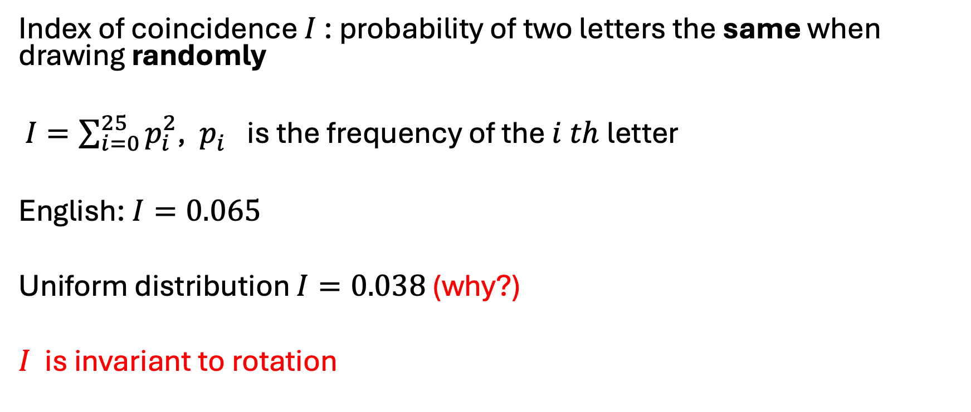
Friedman test
Index of coincidence $I$: probability of two letters the same when drawing randomly
$I=\sum_{i=0}^{25}{p_{i}^{2}}$, $p_{i}^{}$is the frequency of the $i th$letter
English: $I=0.065$
Uniform distribution $I=0.038$ (why?)
$I$ is invariant to rotation
Notes:
Index of coincidence I = sum of p_i^2: the chance two randomly drawn letters are equal.
English gives I = 0.065; a uniform distribution gives 1/26 = 0.038 — ask the class why.
Crucial property: I is invariant under rotation, so a shift cipher does not change it.
Therefore I distinguishes 'one shift applied' (0.065) from 'many shifts mixed' (near 0.038).

Slide 21
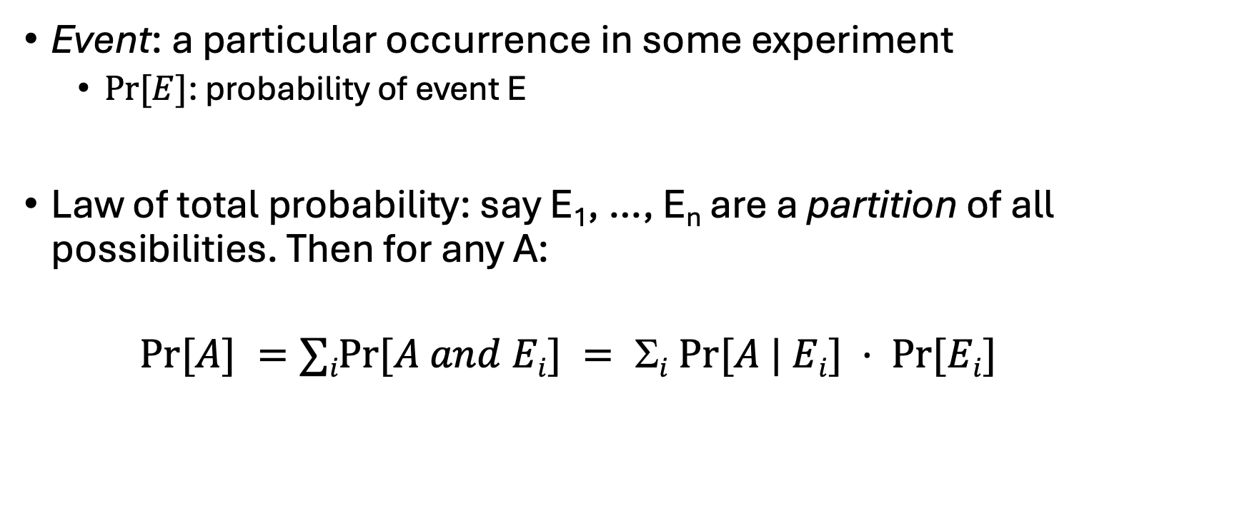
Probability
Event: a particular occurrence in some experiment
$Pr⁡[E]$: probability of event E
Law of total probability: say E₁, …, E_{n} are a partition of all possibilities. Then for any A:
$Pr⁡[A] =∑iPr⁡[A and Ei] = i Pr⁡[A | Ei] · Pr⁡[Ei]$
Notes:
Probability interlude — we need this to make the Friedman computation precise.
Event and Pr[E]; keep everything discrete and finite for now.
Law of total probability: partition the sample space into E1..En and sum Pr[A | Ei] * Pr[Ei].
We will reuse this exact tool later in the one-time-pad proof, so it is worth doing carefully.

Slide 22
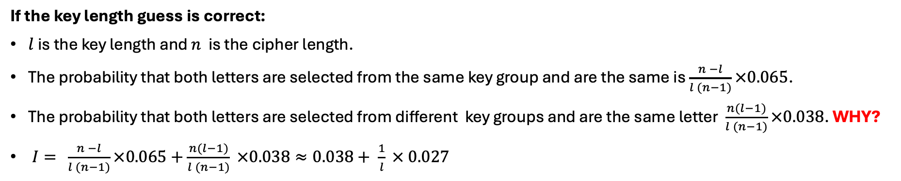
Friedman test
Plaintext | Plaintext value P | Key | Key value K | Ciphertext Value E | Ciphertext
C | 2 | K | 10 | 12 | M
R | 17 | E | 4 | 21 | V
Y | 24 | Y | 24 | 22 | W
P | 15 | K | 10 | 25 | Z
T | 19 | E | 4 | 23 | X
O | 14 | Y | 24 | 12 | M
G | 6 | K | 10 | 16 | Q
R | 17 | E | 4 | 21 | V
A | 0 | Y | 24 | 24 | Y
P | 15 | K | 10 | 25 | Z
H | 7 | E | 4 | 11 | L
Y | 24 | Y | 24 | 22 | W
If the key length guess is correct:
$l$ is the key length and $n$ is the cipher length.
The probability that both letters are selected from the same key group and are the same is $\frac{n −l}{l (n−1)}×0.065$.
The probability that both letters are selected from different key groups and are the same letter $\frac{n(l−1)}{l (n−1)}×0.038$. WHY?
$I= \frac{n −l}{l (n−1)}×0.065+\frac{n(l−1)}{l (n−1)} ×0.038≈0.038+ \frac{1}{l} × 0.027$
Notes:
Now derive the expected index of coincidence for a guessed key length l on ciphertext of length n.
Split into two cases: the two sampled letters come from the same key group (probability (n-l)/(l(n-1))) or different groups.
Same group behaves like English (0.065); different groups behave like uniform (0.038).
Combine the two terms, then pick the l whose predicted I best matches the measured I.

Slide 23

Some other old things
Enigma Machine
Notes:
Enigma: rotor machine used by Germany in WWII — a polyalphabetic cipher with a very large key space.
Broken by Rejewski, then Turing and Bletchley Park, using machine flaws plus known/guessed plaintext (cribs).
Two structural weaknesses: no letter ever encrypts to itself, and operator procedure was predictable.
Moral repeated from earlier: complexity and a huge key space are not security.

Slide 24
Classical cryptography
Design
Try to break
broken
Catastrophic
failure
Deploy
Notes:
Summarize the classical methodology as a loop: design a scheme, try to break it, deploy if nobody breaks it.
The loop has no exit condition — 'nobody I know has broken it' is not evidence of security.
When the break arrives after deployment, the failure is catastrophic and retroactive: past traffic is exposed too.
Build the diagram step by step with the animation as you narrate the cycle.

Slide 25
Modern cryptography
Definitions
Constructions
Proof
reductions
assumptions
Notes:
Modern cryptography replaces the break-and-patch loop with three ingredients: definitions, assumptions, proofs.
Definition: state precisely what the attacker can do and what counts as breaking the scheme.
Construction plus proof: reduce breaking the scheme to breaking a well-studied hard problem (the assumption).
Security becomes conditional but explicit — this is the structure of every theorem in this course.

Slide 26
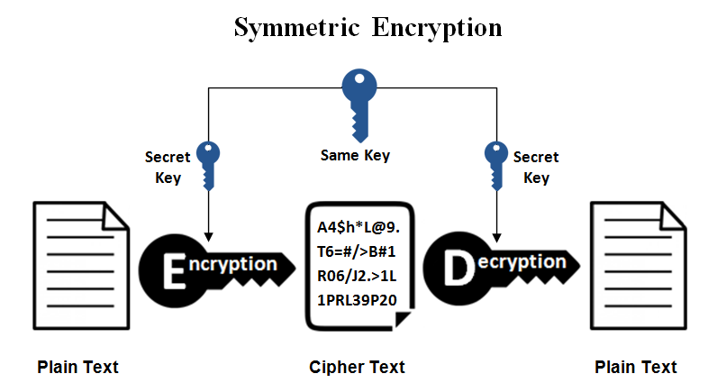
Notes:
Section divider: symmetric-key encryption — sender and receiver share one secret key.
This is the setting for the rest of today: syntax, perfect secrecy, and the one-time pad.
Note the key-distribution problem we are postponing; public-key encryption comes later in the course.
Keep the Kerckhoffs framing: algorithms are public, only the key is secret.

Slide 27

Definitions for encryption
Algorithms:
k: secret key, m: message, c: ciphertext
$k=Gen( )$
$c= Enc(k,m)$
$m=Dec(k,c)$
Notes:
A scheme is a triple of algorithms: Gen produces the key, Enc maps (k, m) to c, Dec maps (k, c) back to m.
Gen is randomized — that is why it is written with empty parentheses: no input, but it tosses coins.
Enc may also be randomized in general; Dec is deterministic.
Discipline to insist on: before asking whether something is secure, write down its syntax.

Slide 28
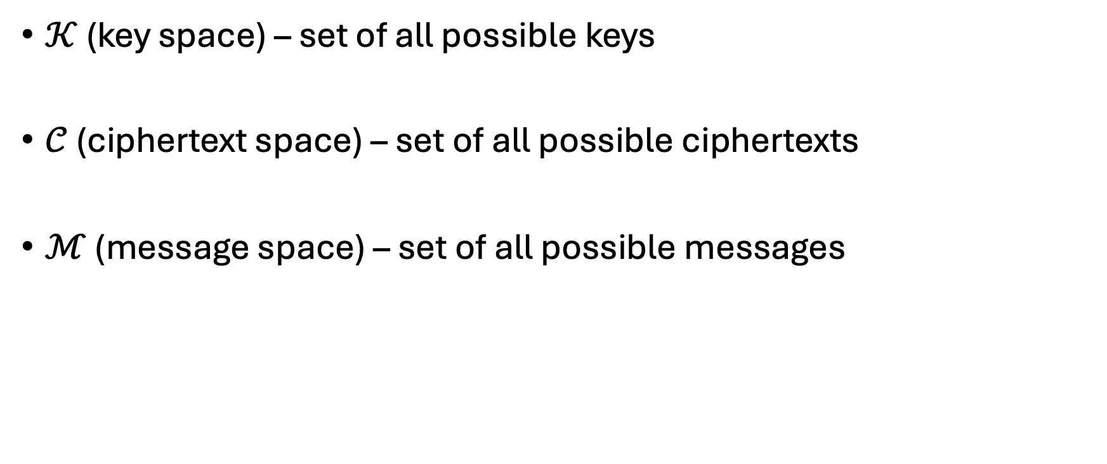
Notation
$𝒦$ (key space) – set of all possible keys
$𝒞$ (ciphertext space) – set of all possible ciphertexts
$ℳ$ (message space) – set of all possible messages
Notes:
Fix notation: K key space, M message space, C ciphertext space.
Gen outputs an element of K; Enc maps K x M into C; Dec maps K x C into M.
Example for the rotation cipher: K = {0, ..., 25}, with M and C strings over the alphabet.
We will compare the size of K with the size of M later — that comparison is the heart of Shannon's bound.

Slide 29
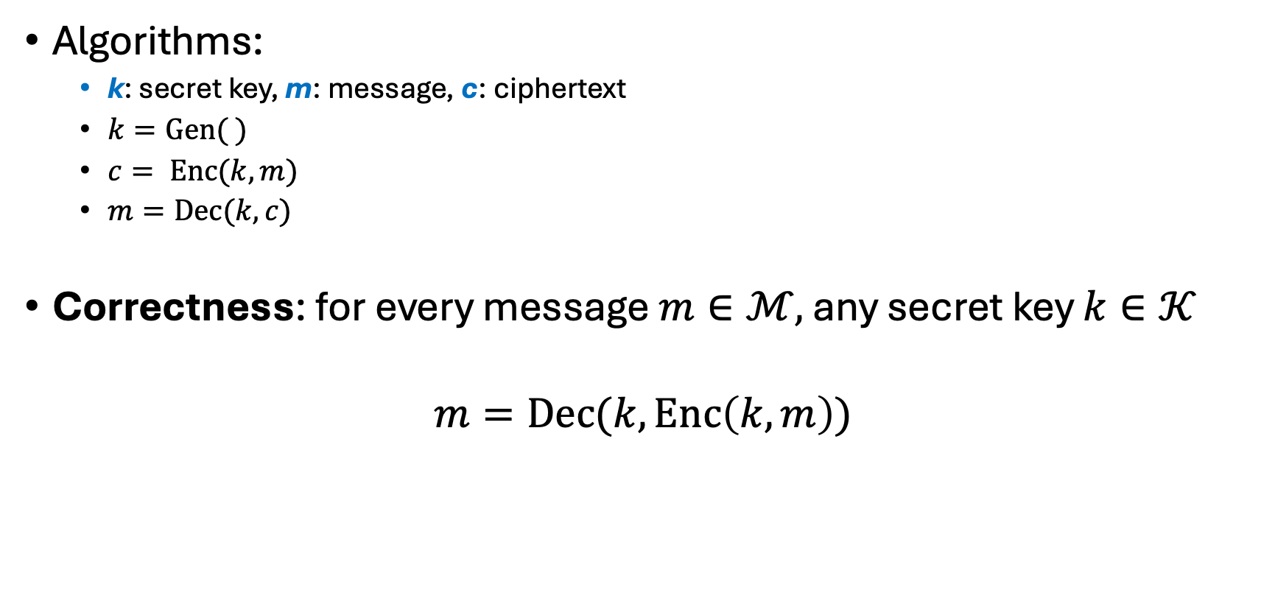
Definitions for encryption
Algorithms:
k: secret key, m: message, c: ciphertext
$k=Gen( )$
$c= Enc(k,m)$
$m=Dec(k,c)$
Correctness: for every message $m∈ℳ,$ any secret key $k∈𝒦$
$$m=Dec(k,Enc\left(k,m\right))$$
Notes:
Add the first requirement: correctness. Dec(k, Enc(k, m)) = m for every m in M and every k in K.
Correctness is about functionality, not security — a scheme can be correct and completely insecure.
Note the quantifiers: every key and every message, not just typical ones.
Next we add the second requirement, secrecy — and that is where probability enters.

Slide 30
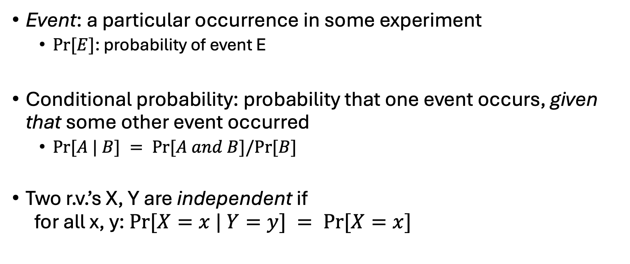
Probability
Event: a particular occurrence in some experiment
$Pr⁡[E]$: probability of event E
Conditional probability: probability that one event occurs, given that some other event occurred
$Pr⁡[A | B] = Pr⁡[A and B]/Pr⁡[B]$
Two r.v.’s X, Y are independent if for all x, y: $Pr⁡[X=x | Y=y] = Pr⁡[X=x]$
Notes:
Probability interlude: conditional probability Pr[A | B] = Pr[A and B] / Pr[B].
Read it as 'update your belief about A after learning B' — exactly what an attacker does with a ciphertext.
Independence: Pr[X = x | Y = y] = Pr[X = x] for all x, y, i.e. learning Y tells you nothing about X.
Preview: perfect secrecy will simply say the message and the ciphertext are independent.

Slide 31
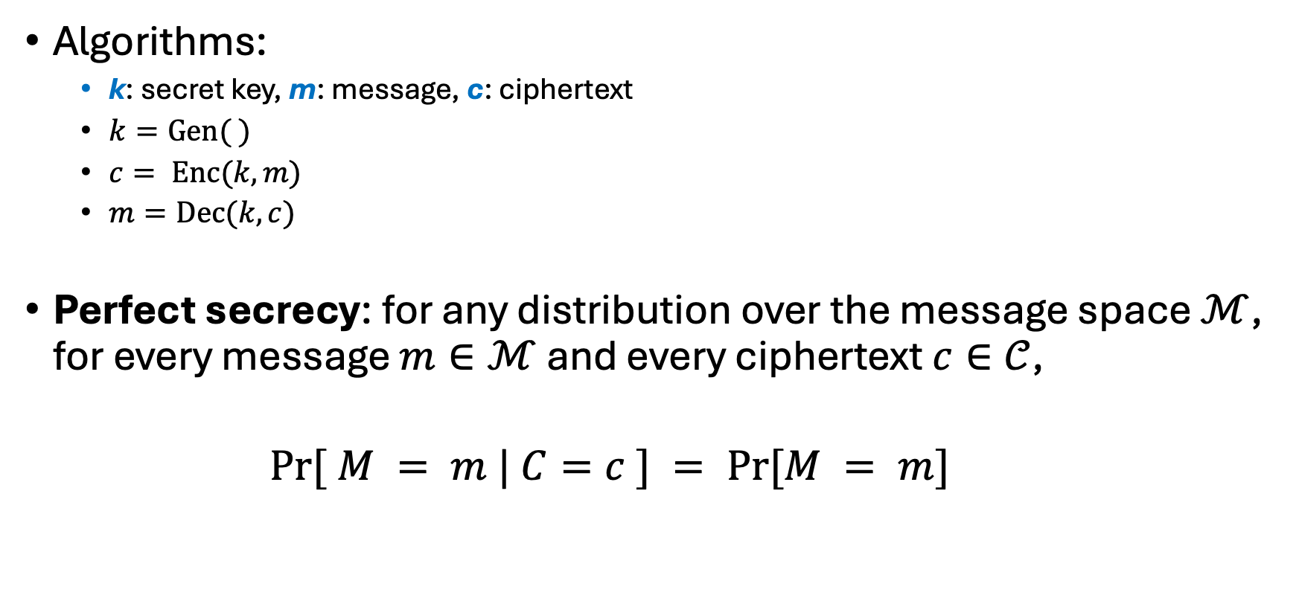
Definitions for encryption
Algorithms:
k: secret key, m: message, c: ciphertext
$k=Gen( )$
$c= Enc(k,m)$
$m=Dec(k,c)$
Perfect secrecy: for any distribution over the message space $ℳ$, for every message $m∈ℳ$ and every ciphertext $c∈𝒞$,
$$Pr⁡[ M = m | C=c ] = Pr⁡[M = m]$$
Notes:
Perfect secrecy (Shannon): for any message distribution, Pr[M = m | C = c] = Pr[M = m].
In words: seeing the ciphertext leaves the attacker's beliefs about the message completely unchanged.
Note the quantifiers — every distribution, every m, every c with positive probability. No bound on attacker running time.
This is information-theoretic security: it holds even against unlimited computing power.

Slide 32
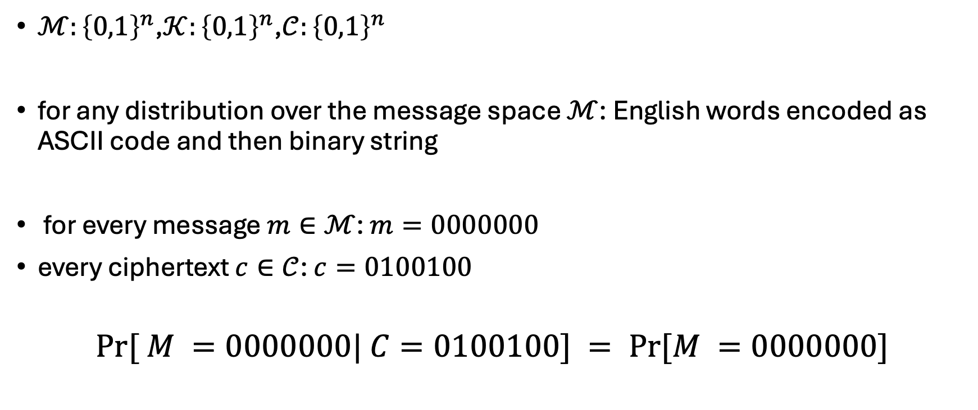
Example
$ℳ:{\left\{0,1\right\}}^{n}$,$𝒦:{\left\{0,1\right\}}^{n}$,$𝒞:{\left\{0,1\right\}}^{n}$
for any distribution over the message space $ℳ$: English words encoded as ASCII code and then binary string
for every message $m∈ℳ$: $m=0000000$
every ciphertext $c∈𝒞$: $c=0100100$
$$Pr⁡[ M =0000000| C=0100100] = Pr⁡[M =0000000]$$
Notes:
Concrete instantiation: M = K = C = {0,1}^n, so all three spaces are n-bit strings.
Walk the definition through the example: message 0000000, ciphertext 0100100.
Perfect secrecy demands Pr[M = 0000000 | C = 0100100] = Pr[M = 0000000] — and the same for every other pair.
Stress that English text is a very non-uniform distribution on M; the definition must hold anyway.

Slide 33
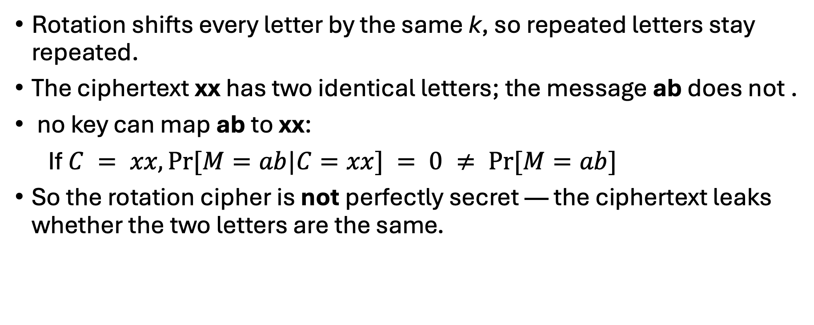
Example: rotation cipher (k = 3)
Rotation shifts every letter by the same k, so repeated letters stay repeated.
The ciphertext xx has two identical letters; the message ab does not .
no key can map ab to xx:
If $C = xx, Pr⁡[M=ab|C=xx] = 0 ≠ Pr⁡[M=ab]$
So the rotation cipher is not perfectly secret — the ciphertext leaks whether the two letters are the same.
Notes:
Counterexample: the rotation cipher is not perfectly secret.
Rotation shifts every letter equally, so repeated letters stay repeated — pattern structure survives encryption.
Concretely: ciphertext xx has two identical letters, message ab does not, so Pr[M = ab | C = xx] = 0, not Pr[M = ab].
One violating pair is enough to kill the definition — this is how we disprove perfect secrecy in general.

Slide 34

An equivalent definition
Algorithms:
k: secret key, m: message, c: ciphertext
$k=Gen()$
$c= Enc(k,m)$
$m=Dec(k,c)$
Perfect secrecy: for any distribution over the message space $ℳ$, for every message $m∈ℳ$ and every ciphertext $c∈𝒞$,
$$Pr⁡[C=c|M=m ] = Pr⁡[C=c]$$
Notes:
Equivalent formulation: Pr[C = c | M = m] = Pr[C = c] for every m and c.
Reading: the ciphertext distribution does not depend on which message was encrypted.
This version is usually the easier one to work with in proofs — no message distribution to condition on.
We prove the equivalence on the next slide with Bayes's theorem.

Slide 35
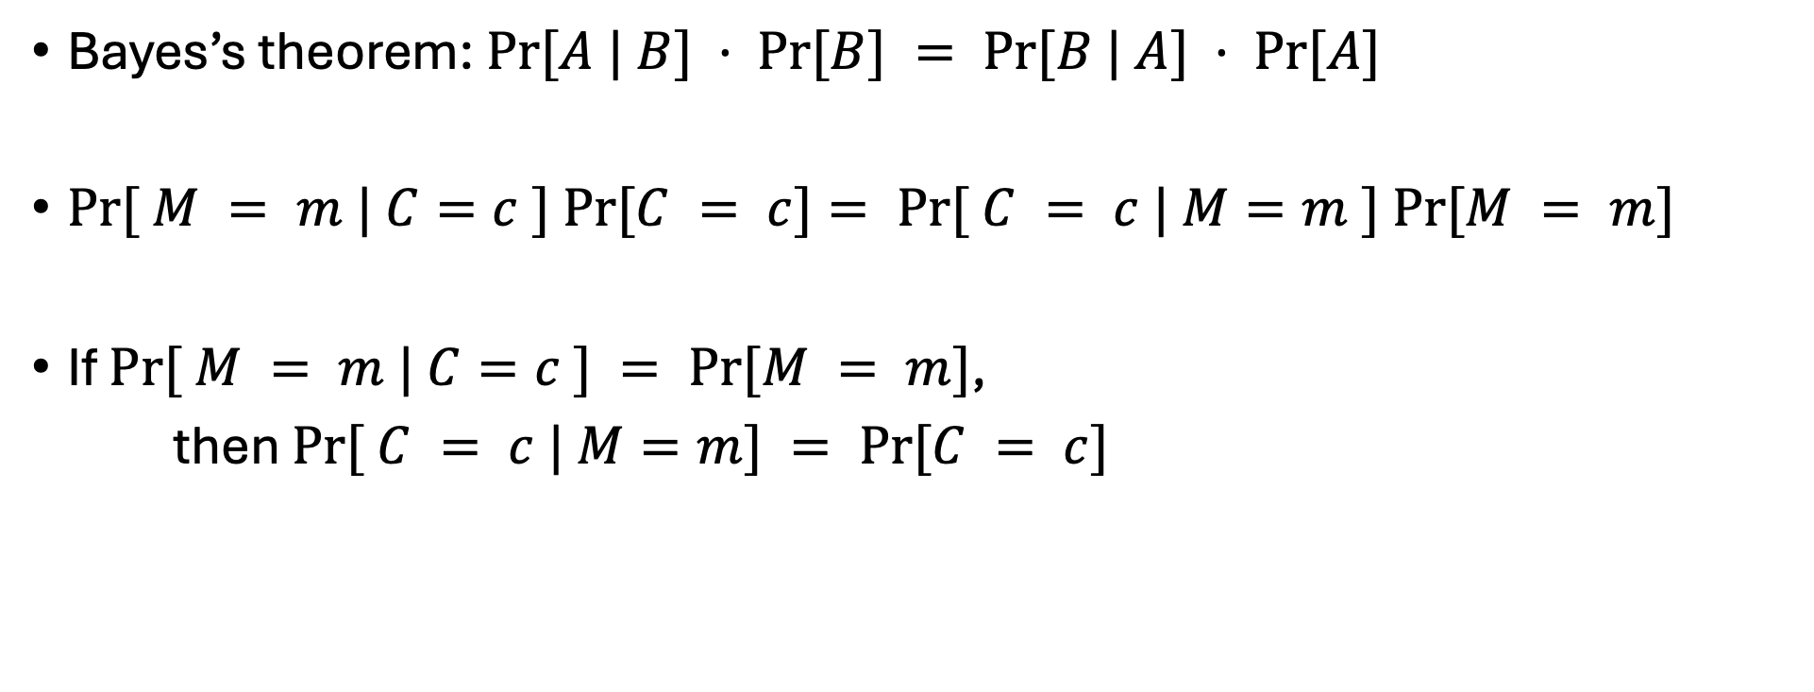
Proof
Bayes’s theorem: $Pr⁡[A | B] · Pr⁡[B] = Pr⁡[B | A] · Pr⁡[A]$
$Pr⁡[ M = m | C=c ] Pr⁡[C = c]= Pr⁡[ C = c | M=m ] Pr⁡[M = m]$
If $Pr⁡[ M = m | C=c ] = Pr⁡[M = m]$,
then $Pr⁡[ C = c | M=m] = Pr⁡[C = c]$
Notes:
Proof of the equivalence, using Bayes: Pr[A|B] Pr[B] = Pr[B|A] Pr[A].
Substitute A = (M = m), B = (C = c) and cancel: if Pr[M=m|C=c] = Pr[M=m], then Pr[C=c|M=m] = Pr[C=c].
The argument is symmetric, so the implication runs both ways — the two definitions are equivalent.
Side condition worth stating: we only consider c with Pr[C = c] > 0, and m with Pr[M = m] > 0.

Slide 36
One-time pad
rotation by different shifts
Key length the same as message length
Notes:
Introduce the one-time pad as the fix: rotate every position by an independent shift.
Key insight: the key is as long as the message — no reuse of shift patterns like Vigenere.
This removes exactly the structure frequency analysis exploited.
Next few slides move from letters mod 26 to bits with XOR, then prove perfect secrecy.

Slide 37
Rotation vs modular addition
Plaintext r with key k = 24 gives ciphertext p
Rotation
Slide the alphabet 24 places forward:
r → s → t → … → o → p
Same as sliding back 2 places,
since 24 ≡ −2 (mod 26)
Modular addition
Index the letters a = 1 … z = 26:
r = 18, k = 24
18 + 24 = 42
42 mod 26 = 16 = p
Rotating by k and adding k mod 26 are two views of the same operation.
Notes:
Two views of the same operation: sliding the alphabet versus adding indices mod 26.
Worked example: r with key 24 gives p. Rotating 24 forward equals rotating 2 back, since 24 = -2 mod 26.
Arithmetic view: r = 18, 18 + 24 = 42, 42 mod 26 = 16 = p.
Take-away: rotation by k is exactly addition of k modulo the alphabet size — which is why modular arithmetic showed up earlier.

Slide 38
XOR
A ⊕ B
Equivalent to addition mod 2
input |  | output
0 | 0 | 0
0 | 1 | 1
1 | 0 | 1
1 | 1 | 0
Notes:
XOR is addition modulo 2 — walk the truth table quickly.
Key properties to name: a XOR a = 0, a XOR 0 = a, associative and commutative.
Consequence: XOR is its own inverse, which is why encryption and decryption are the same operation.
Bitwise XOR on n-bit strings is the binary analogue of shifting letters mod 26.

Slide 39
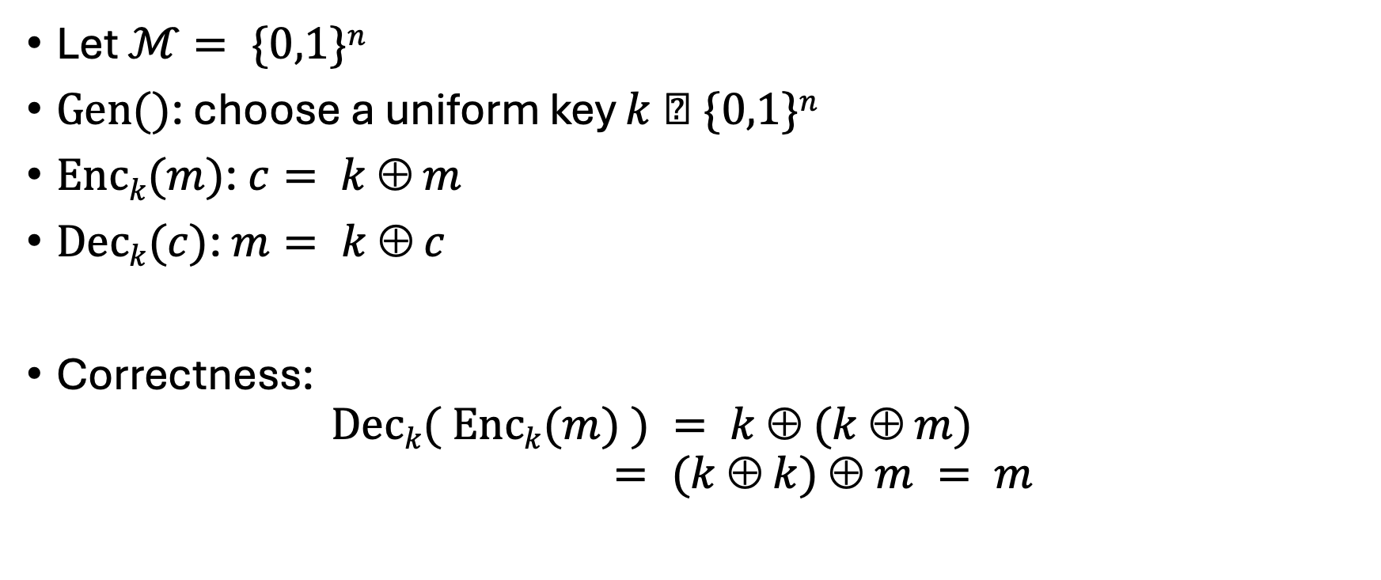
One-time pad
Let $ℳ= \{0,1\}n$
$Gen()$: choose a uniform key $k  \{0,1\}n$
$Enck(m)$: $c= k  m$
$Deck(c)$: $m= k  c$
Correctness: $Deck( Enck(m) ) = k  (k  m)$ $= (k  k)  m = m$
Notes:
Formal one-time pad: M = {0,1}^n; Gen picks k uniformly from {0,1}^n; Enc = k XOR m; Dec = k XOR c.
Correctness in one line: k XOR (k XOR m) = (k XOR k) XOR m = m.
Emphasize 'uniformly at random' — the proof of secrecy uses that, not just secrecy of k.
Also emphasize 'one-time': the key must never be reused, as we will see at the end of the lecture.

Slide 40
One-time pad
n bits
key
n bits
n bits
⊕
message
ciphertext
Notes:
Picture of the scheme: n-bit key, n-bit message, n-bit ciphertext, XORed position by position.
Point out the cost: key material is as long as everything you will ever send.
That is the practical objection to the one-time pad, and the motivation for computational security later.
Ask: where would you store or distribute a key that long?

Slide 41
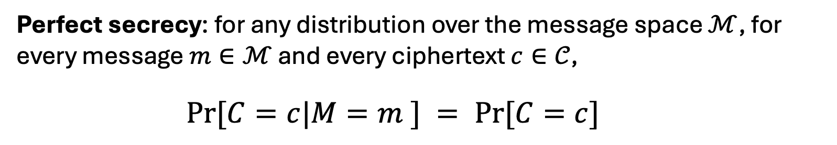
Theorem
Theorem 1: One-time pad encryption is perfectly secure.
Perfect secrecy: for any distribution over the message space $ℳ$, for every message $m∈ℳ$ and every ciphertext $c∈𝒞$,
$$Pr⁡[C=c|M=m ] = Pr⁡[C=c]$$
Notes:
Theorem 1: the one-time pad is perfectly secret.
Restate the definition we will verify: Pr[C = c | M = m] = Pr[C = c] for all m, c.
Proof plan: compute the left side (one line), then compute the right side with the law of total probability.
Both turn out to be 2^-n, independent of m — that is the whole proof.

Slide 42

Proof
$Pr⁡[C=c|M=m] = Pr⁡[k  m =c|M=m]$
$$=Pr⁡[k=m  c | M=m] = 2^{−n}$$
Notes:
Step 1 of the proof: Pr[C = c | M = m] = Pr[k XOR m = c] = Pr[k = m XOR c].
For each fixed m and c there is exactly one key that produces c, so the probability is 2^-n.
Crucially this value does not depend on m — the ciphertext distribution is uniform whatever we encrypt.
Next slide recalls the law of total probability so we can compute Pr[C = c] unconditionally.

Slide 43

Probability
Law of total probability: say E₁, …, E_{n} are a partition of all possibilities. Then for any A:
$Pr⁡[A] =∑i Pr⁡[A and Ei] = i Pr⁡[A | Ei] · Pr⁡[Ei]$
Notes:
Second probability interlude: the law of total probability.
If E1, ..., En partition the sample space, then Pr[A] = sum over i of Pr[A | Ei] Pr[Ei].
Here the partition is 'which message was sent', so we sum over all m in M.
This is the only tool needed to finish the theorem on the next slide.

Slide 44
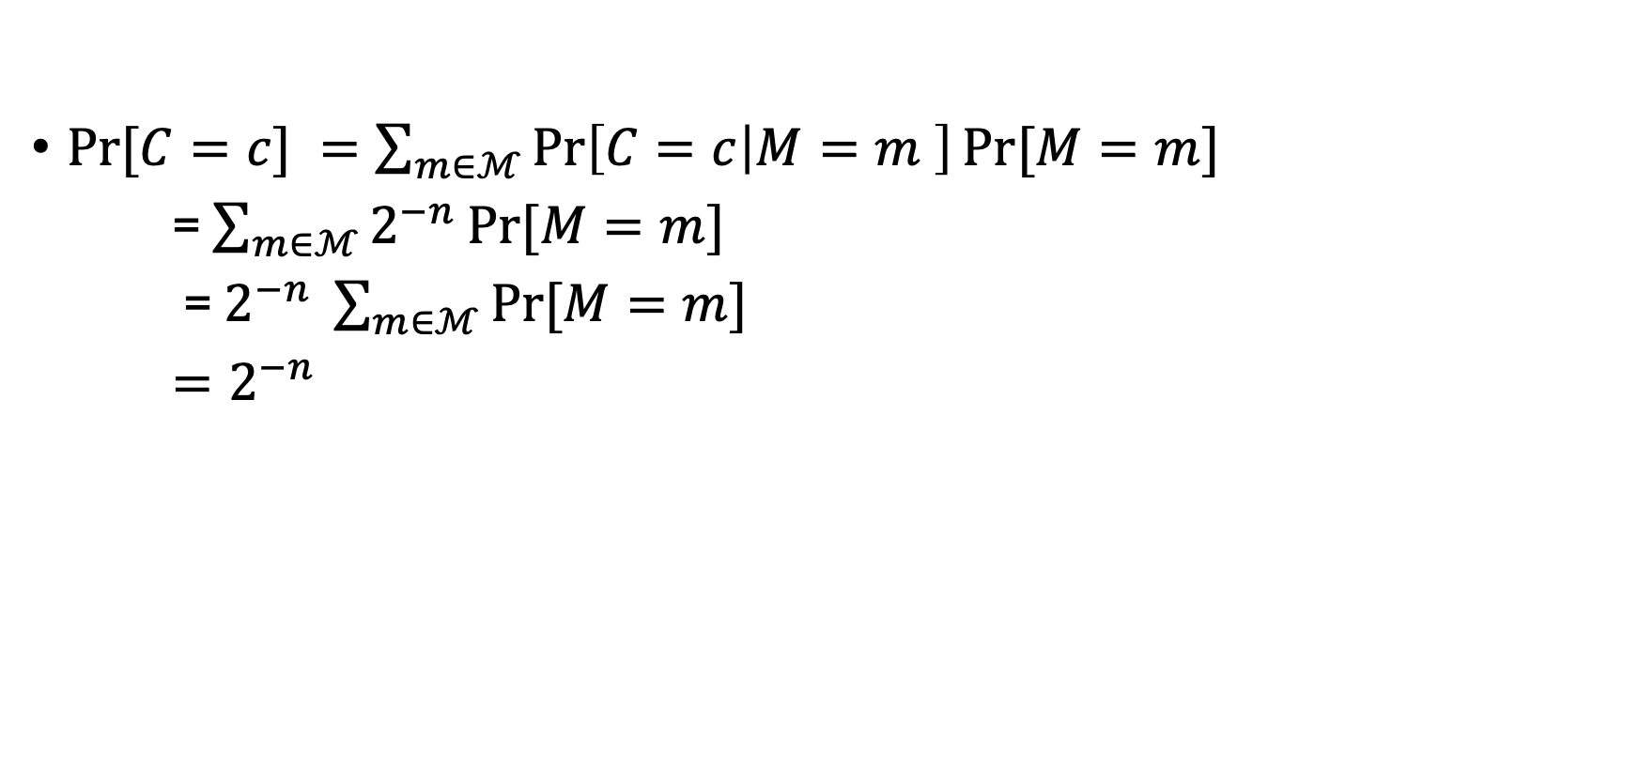
Proof
$Pr⁡[C=c] =\sum_{m∈ℳ}{\operatorname{Pr}\left[C=c | M=m \right]\operatorname{Pr}{[M=m]}}$
= $\sum_{m∈ℳ}{2^{−n}\operatorname{Pr}{[M=m] }}$
= $2^{−n} \sum_{m∈ℳ}{\operatorname{Pr}{[M=m] }}$
$=2^{−n}$
Notes:
Step 2: Pr[C = c] = sum over m of Pr[C = c | M = m] Pr[M = m].
Substitute step 1: every conditional term equals 2^-n, so factor it out of the sum.
The remaining sum of Pr[M = m] over all m is 1, leaving Pr[C = c] = 2^-n.
So Pr[C = c | M = m] = Pr[C = c] = 2^-n, which proves Theorem 1. Note the message distribution was never used.

Slide 45
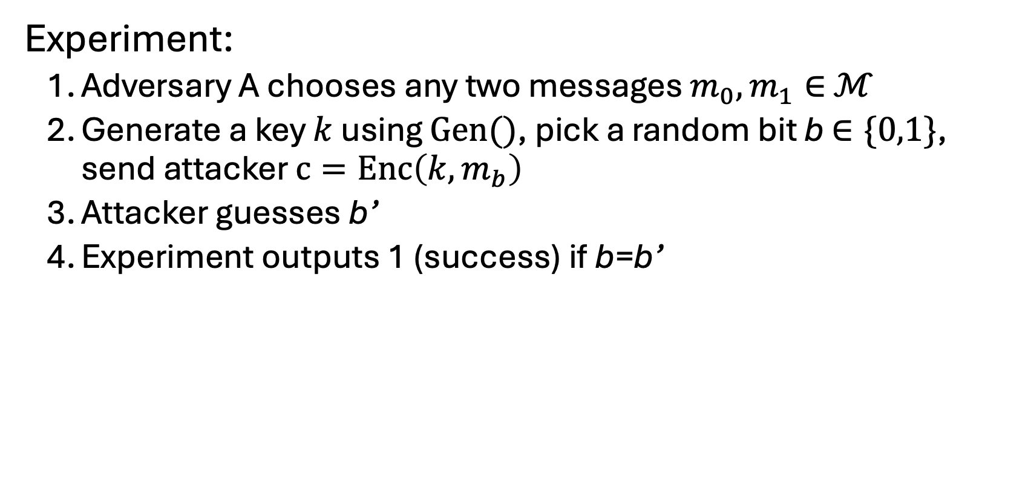
Another definition: perfect indistinguishability
Experiment:
Adversary A chooses any two messages $m_{0}, m_{1}∈$ $ℳ$
Generate a key $k$ using $Gen()$, pick a random bit b $∈\{0,1\}$, send attacker $c=Enc\left(k,m_{b}\right)$
Attacker guesses b’
Experiment outputs 1 (success) if b=b’
Perfectly indistinguishable: for every adversary A
Pr[Experiment outputs 1] = ½
Notes:
Third definition, phrased as a game: the adversary picks m0 and m1, we encrypt one of them at random.
The adversary sees c and guesses which message it was; the experiment outputs 1 if the guess is right.
Perfect indistinguishability: every adversary wins with probability exactly 1/2 — no better than a coin flip.
This game style is how all security definitions in this course will be written from here on.

Slide 46
Perfect indistinguishability
Lemma 2 (2.7 in the book): An encryption scheme is perfectly secret if and only if it is perfectly indistinguishable.
Notes:
Lemma 2 (Katz-Lindell 2.7): perfectly secret if and only if perfectly indistinguishable.
So the belief-based definition and the game-based definition describe exactly the same schemes.
Practical value: pick whichever side is easier — games for proofs about adversaries, probabilities for direct calculation.
Mention that the proof is in the book and follows from the equal-probability lemma on the next slide.

Slide 47
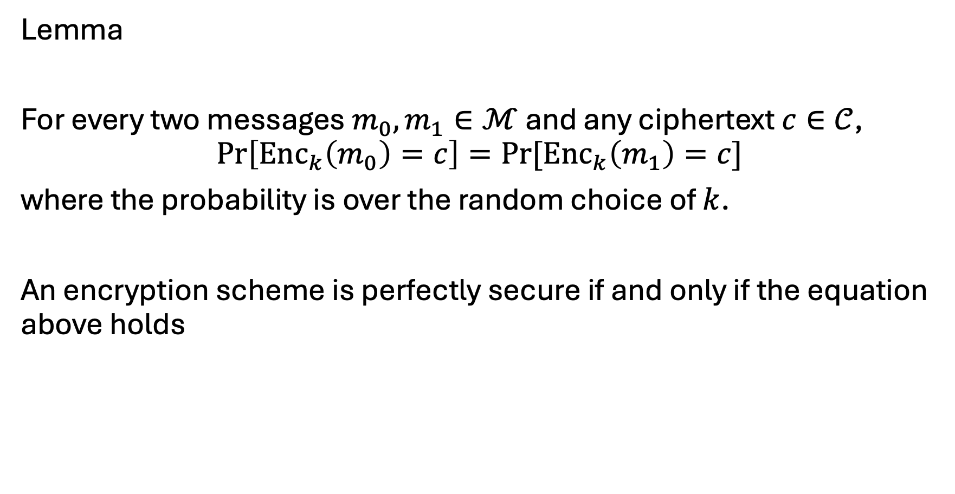
Lemma
For every two messages $m_{0}, m_{1}∈ℳ$ and any ciphertext $c∈𝒞$,
$$\operatorname{Pr}\left[Enc_{k}\left(m_{0}\right)=c\right]=\operatorname{Pr}{[Enc_{k}\left(m_{1}\right)=c]}$$
where the probability is over the random choice of $k$.
An encryption scheme is perfectly secure if and only if the equation above holds
Notes:
Third equivalent characterization: for all m0, m1 and every c, Pr[Enc_k(m0) = c] = Pr[Enc_k(m1) = c], over random k.
Meaning: the ciphertext distribution is identical no matter which message is encrypted.
This is often the most convenient version to check for a concrete scheme — one calculation, no adversary.
Sanity check with the one-time pad: both sides are 2^-n, as we computed.

Slide 48
Using the same key twice?
m₁ ⊕ m₂ is information about m₁, m₂
Is this significant?
No longer perfectly secret!
m₁ ⊕ m₂ reveals where m₁, m₂ differ
Frequency analysis
Exploiting characteristics of ASCII…
Notes:
Closing question: what breaks if we reuse the key? c1 XOR c2 = m1 XOR m2 — the key cancels out.
That leaks real information: exactly the positions where m1 and m2 differ.
With ASCII structure and frequency analysis, that is often enough to recover both messages — this is the classic two-time pad failure.
Hence 'one-time' pad. Next lecture: computational security, so we can encrypt many messages with a short key.

