Slide 1
Last time: Modern Cryptography
Definitions
Constructions
Proof
reductions
assumptions

Slide 2
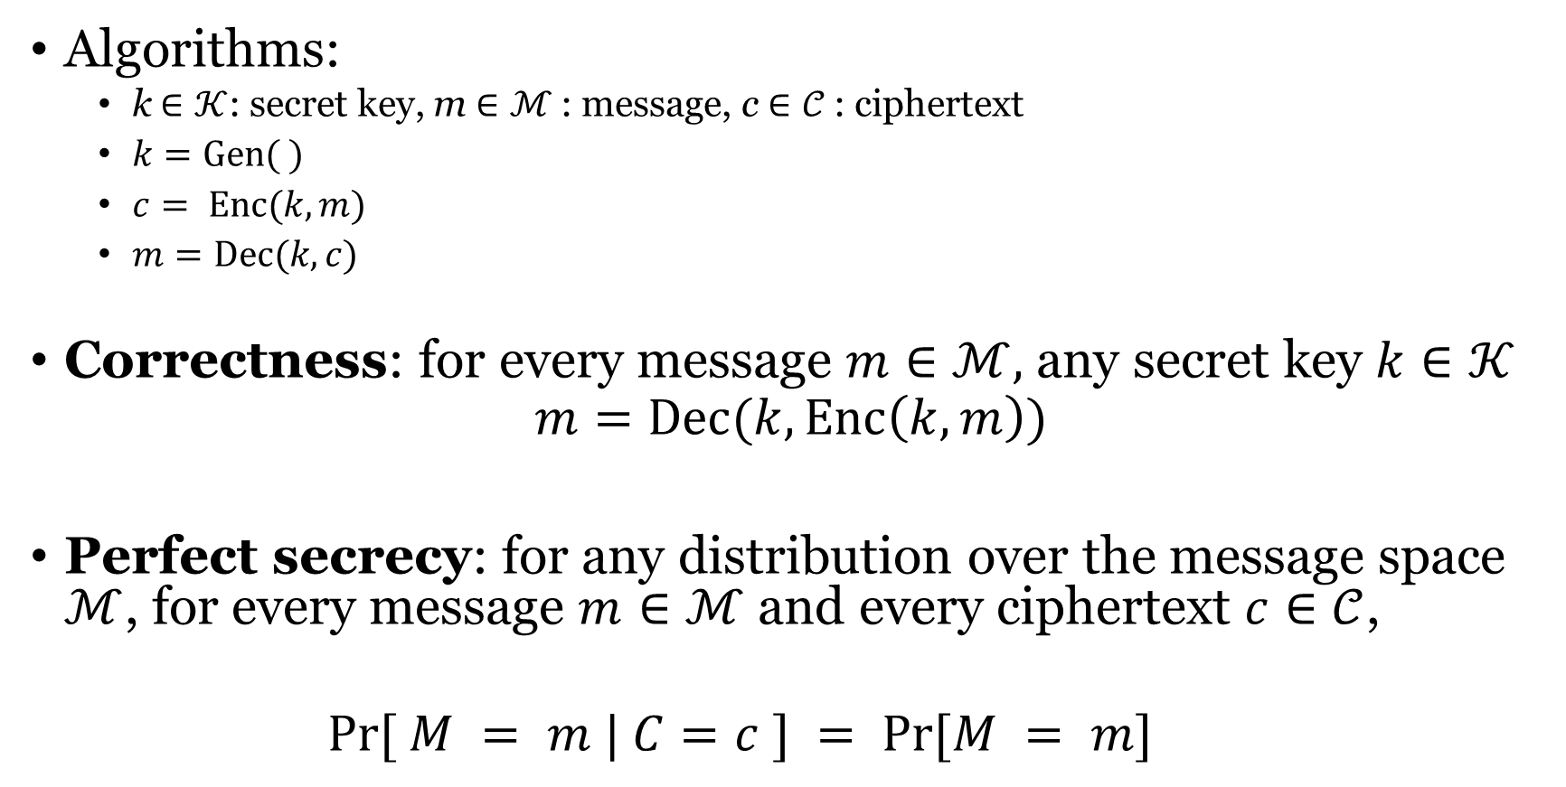
Perfect secrecy
Algorithms:
k$∈𝒦$: secret key, m $∈ℳ$: message, c $∈𝒞$: ciphertext
$k=Gen( )$
$c= Enc(k,m)$
$m=Dec(k,c)$
Correctness: for every message $m∈ℳ,$ any secret key $k∈𝒦$
$$m=Dec(k,Enc\left(k,m\right))$$
Perfect secrecy: for any distribution over the message space $ℳ$, for every message $m∈ℳ$ and every ciphertext $c∈𝒞$,
$$Pr⁡[ M = m | C=c ] = Pr⁡[M = m]$$

Slide 3
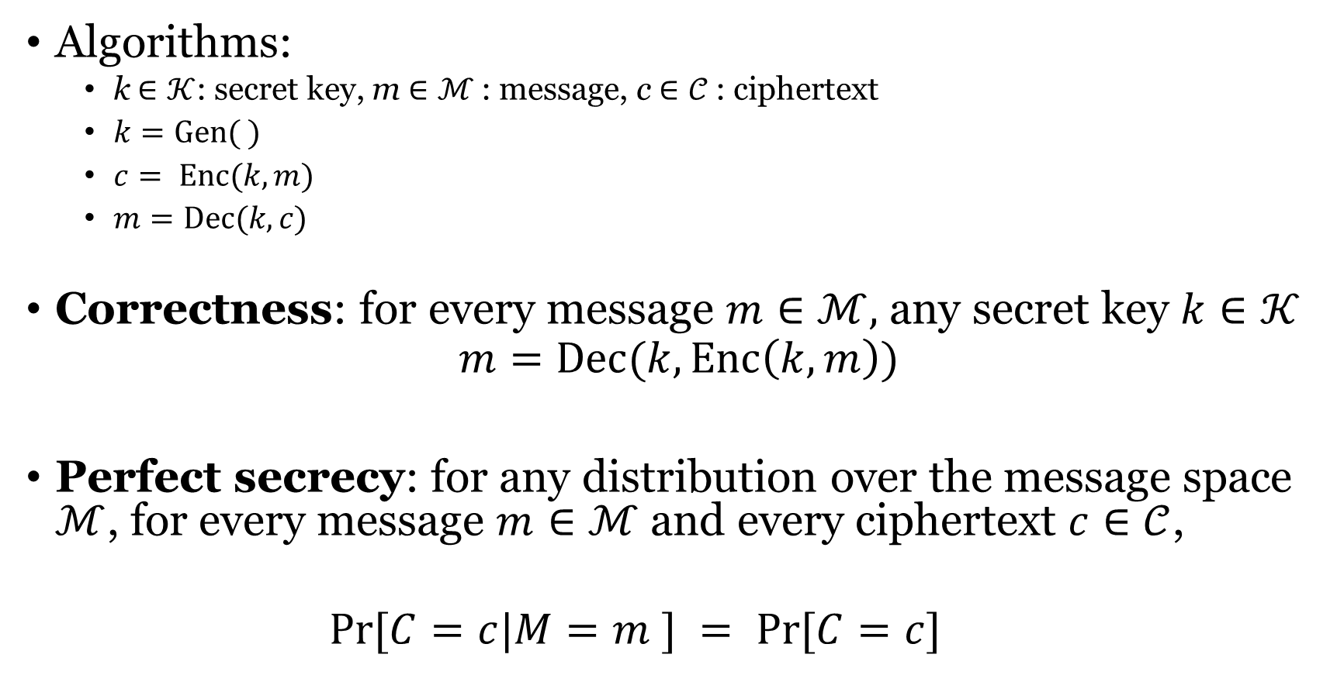
Perfect secrecy v2
Algorithms:
k$∈𝒦$: secret key, m $∈ℳ$: message, c $∈𝒞$: ciphertext
$k=Gen( )$
$c= Enc(k,m)$
$m=Dec(k,c)$
Correctness: for every message $m∈ℳ,$ any secret key $k∈𝒦$
$$m=Dec(k,Enc\left(k,m\right))$$
Perfect secrecy: for any distribution over the message space $ℳ$, for every message $m∈ℳ$ and every ciphertext $c∈𝒞$,
$$Pr⁡[C=c|M=m ] = Pr⁡[C=c]$$

Slide 4
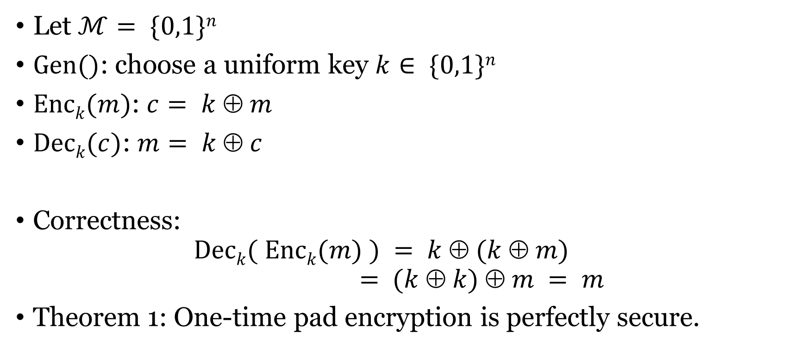
One-time pad
Let $ℳ= \{0,1\}n$
$Gen()$: choose a uniform key $k∈ \{0,1\}n$
$Enck(m)$: $c= k  m$
$Deck(c)$: $m= k  c$
Correctness: $Deck( Enck(m) ) = k  (k  m)$ $= (k  k)  m = m$
Theorem 1: One-time pad encryption is perfectly secure.

Slide 5
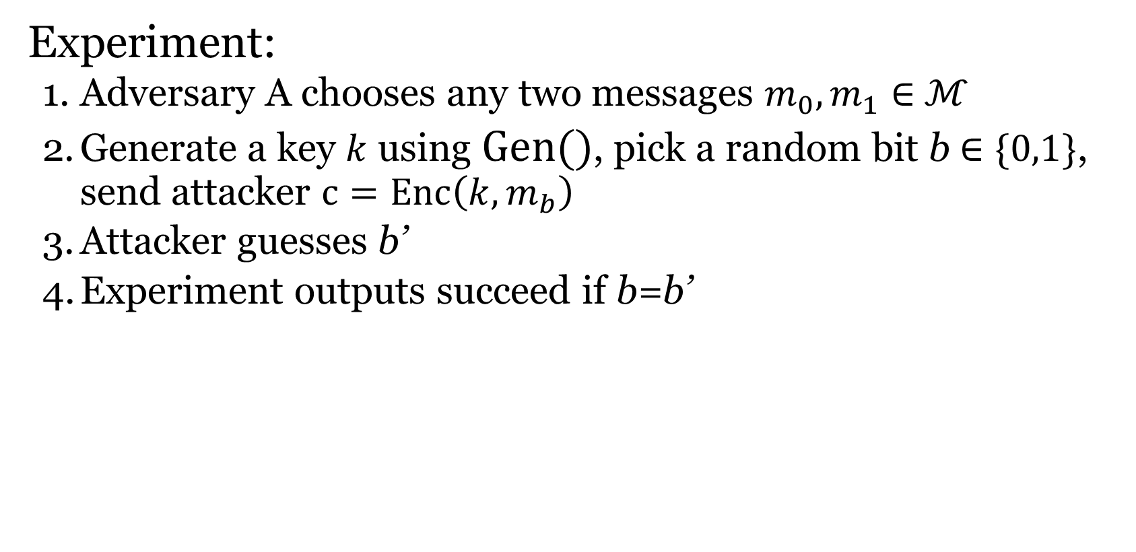
Perfect indistinguishability
Experiment:
Adversary A chooses any two messages $m_{0}, m_{1}∈$ $ℳ$
Generate a key $k$ using $Gen()$, pick a random bit b $∈\{0,1\}$, send attacker $c=Enc\left(k,m_{b}\right)$
Attacker guesses b’
Experiment outputs succeed if b=b’
Perfectly indistinguishable: for every adversary A
Pr[Experiment outputs 1] = ½

Slide 6
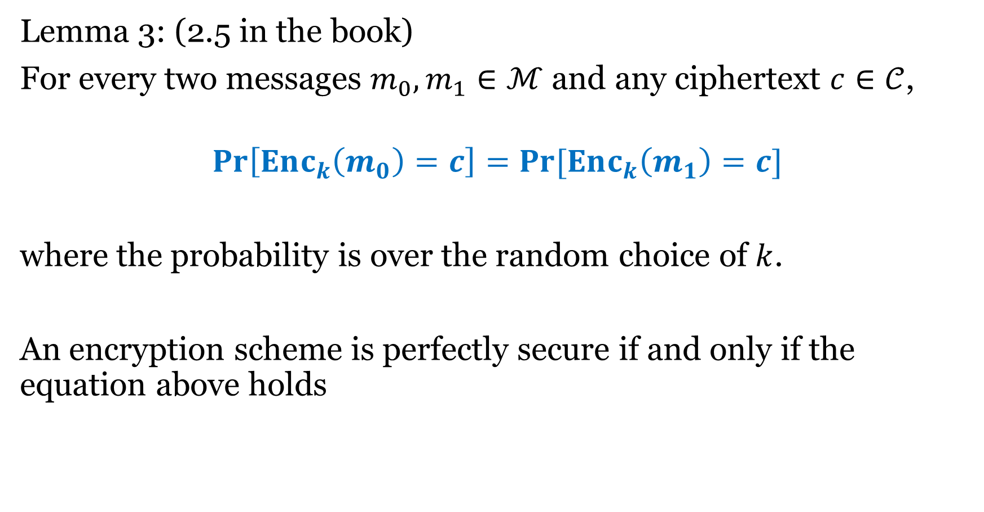
Lemma 3: (2.5 in the book)
For every two messages $m_{0}, m_{1}∈ℳ$ and any ciphertext $c∈𝒞$,
$$\operatorname{Pr}\left[Enc_{k}\left(m_{0}\right)=c\right]=\operatorname{Pr}{[Enc_{k}\left(m_{1}\right)=c]}$$
where the probability is over the random choice of $k$.
An encryption scheme is perfectly secure if and only if the equation above holds

Slide 7
Weakness of one-time pad: can’t reuse the key
m₁ ⊕ m₂ is information about m₁, m₂
Is this significant?
m₁ ⊕ m₂ reveals where m₁, m₂ differ
Frequency analysis
Exploiting characteristics of ASCII…

Slide 8
Weakness of one-time pad
Key length has to be the same as message length

Slide 9
Perfect indistinguishability
Experiment:
Adversary A chooses any two messages $m_{0}, m_{1}∈$ $ℳ$
Generate a key $k$ using $Gen()$, pick a random bit b $∈\{0,1\}$, send attacker $c=Enc\left(k,m_{b}\right)$
Attacker guesses b’
Experiment outputs succeed if b=b’
Perfectly indistinguishable: for every adversary A
Pr[Experiment outputs 1] = ½

Slide 10
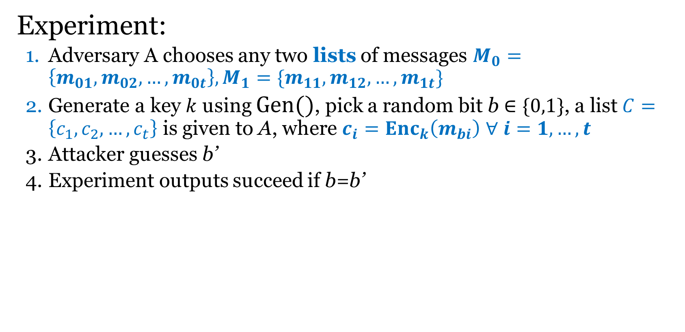
A better definition?
Experiment:
Adversary A chooses any two lists of messages $M_{0}=\left\{m_{01},m_{02},…,m_{0t}\right\}, M_{1}=\{m_{11},m_{12},…,m_{1t}\}$
Generate a key $k$ using $Gen()$, pick a random bit b $∈\{0,1\}$, a list $C=\left\{c_{1},c_{2},…,c_{t}\right\}$ is given to A, where $c_{i}={Enc}_{k}\left(m_{bi}\right)$ $∀ i=1,…,t$
Attacker guesses b’
Experiment outputs succeed if b=b’
Perfectly indistinguishable: for every adversary A
Pr[Experiment outputs 1] = ½

Slide 11

A better definition?
$𝒦:{\left\{0,1\right\}}^{n}$
$ℳ:{\left\{0,1\right\}}^{n+s}$ or $ℳ:{\left\{0,1\right\}}^{∗}$ ?

Slide 12
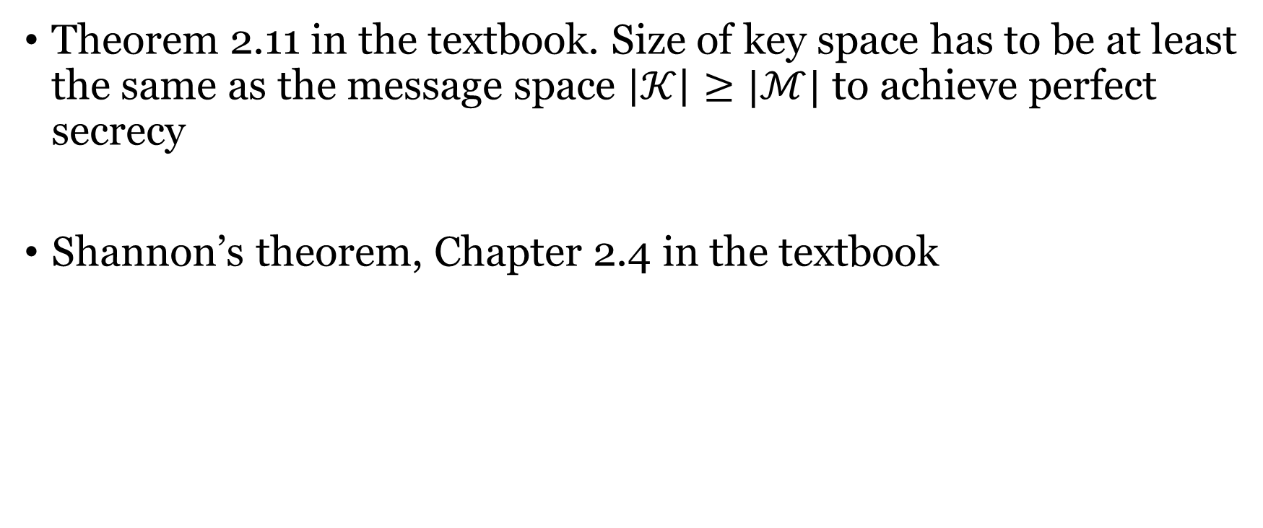
Not possible!!!
Theorem 2.11 in the textbook. Size of key space has to be at least the same as the message space $\left|𝒦\right|≥|ℳ|$ to achieve perfect secrecy
Shannon’s theorem, Chapter 2.4 in the textbook

Slide 13
Computational security
Two relaxations:
Security only against efficient adversaries.
Security can fail with a very small probability

Slide 14
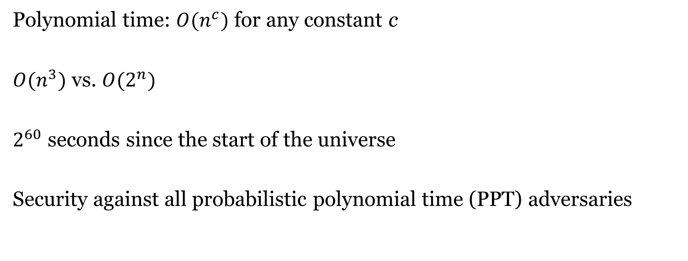
Relaxation 1: efficient adversary
Polynomial time: $O(n^{c})$ for any constant c
$O(n^{3})$ vs. $O(2^{n})$
$2^{60}$ seconds since the start of the universe
Security against all probabilistic polynomial time (PPT) adversaries

Slide 15
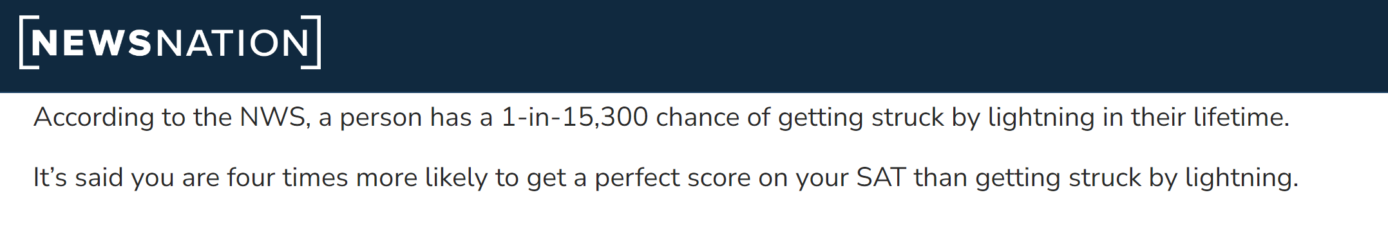


Relaxation 2: small failure probability
Negligible function f: for every polynomial p, there is an integer N such that for all n>N,
$$f\left(n\right)<\frac{1}{p(n)}$$
E.g.,: $2^{−n}=\frac{1}{2^{n}}$ , $2^{−\sqrt{n}}$ , $n^{−\log{n}}$
How small is $2^{−60}$?
$$2^{−14}$$

Slide 16

Negligible function negl(n)
$negl_{1}\left(n\right)+negl_{2}(n)$ is negligible
$negl_{1}\left(n\right)⋅p(n)$ is negligible for any polynomial p

Slide 17
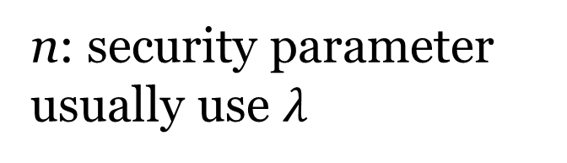
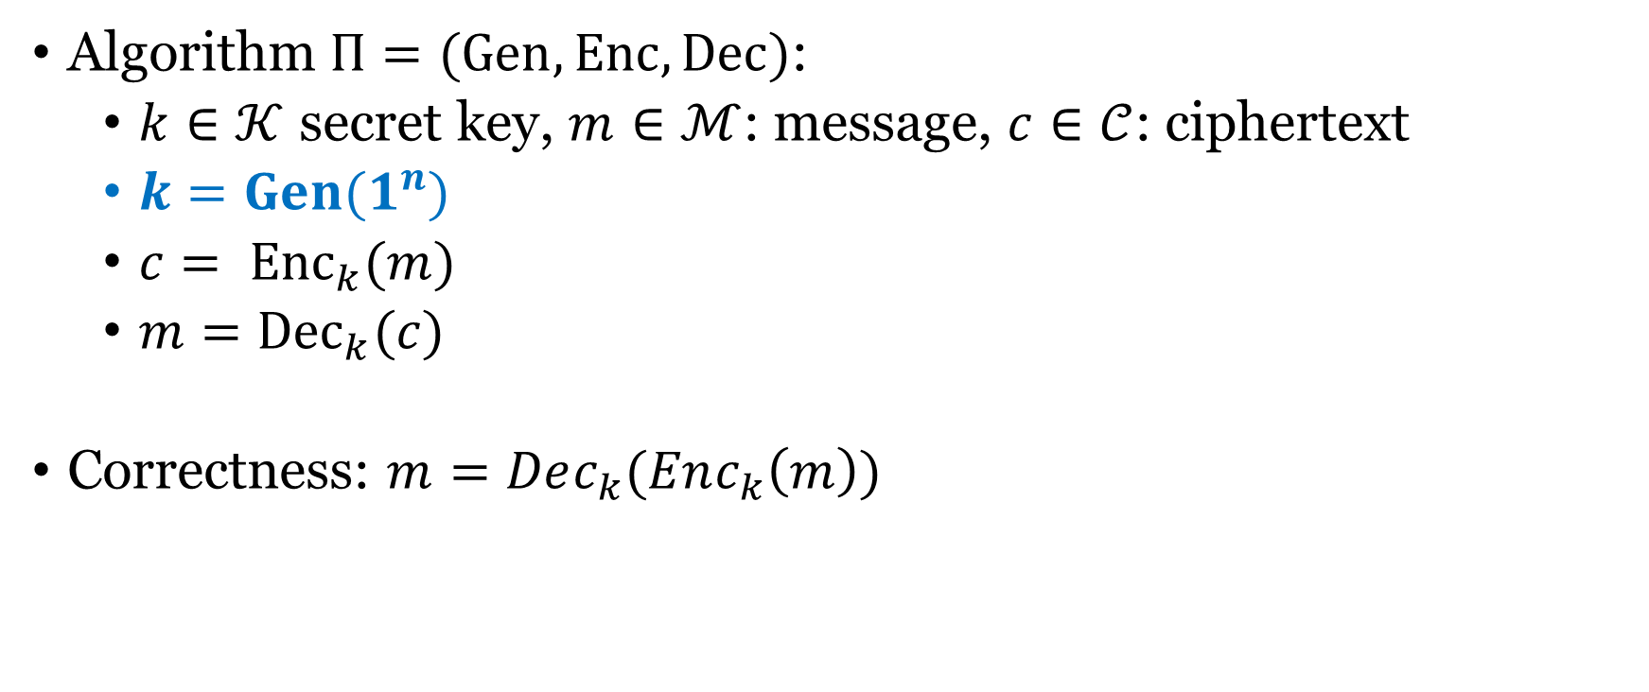
Definition of computational security
Algorithm $Π=(Gen, Enc, Dec)$:
$k∈𝒦$ secret key, $m∈ℳ$: message, $c∈𝒞$: ciphertext
$k=Gen(1^{n})$
$c= {Enc}_{k}(m)$
$m={Dec}_{k}(c)$
Correctness: $m=Dec_{k}(Enc_{k}\left(m\right))$
n: security parameter
usually use $λ$

Slide 18
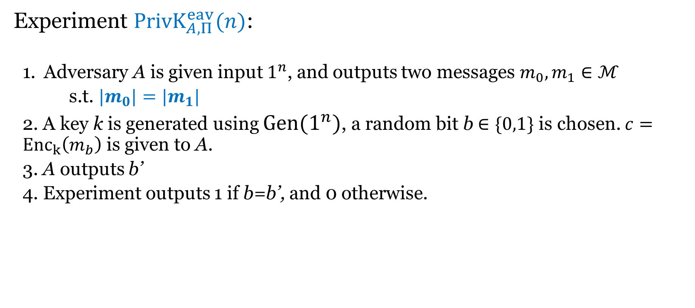
Computation indistinguishability against eavesdropper
Experiment ${PrivK}_{A,Π}^{eav}(n)$:
Adversary A is given input $1^{n}$, and outputs two messages $m_{0}, m_{1}∈ℳ$
s.t. ${|m}_{0}|=|m_{1}|$
2. A key k is generated using $Gen(1^{n})$, a random bit b $∈\{0,1\}$ is chosen. $c={Enc}_{k}\left(m_{b}\right)$ is given to A.
3. A outputs b’
4. Experiment outputs 1 if b=b’, and 0 otherwise.

Slide 19
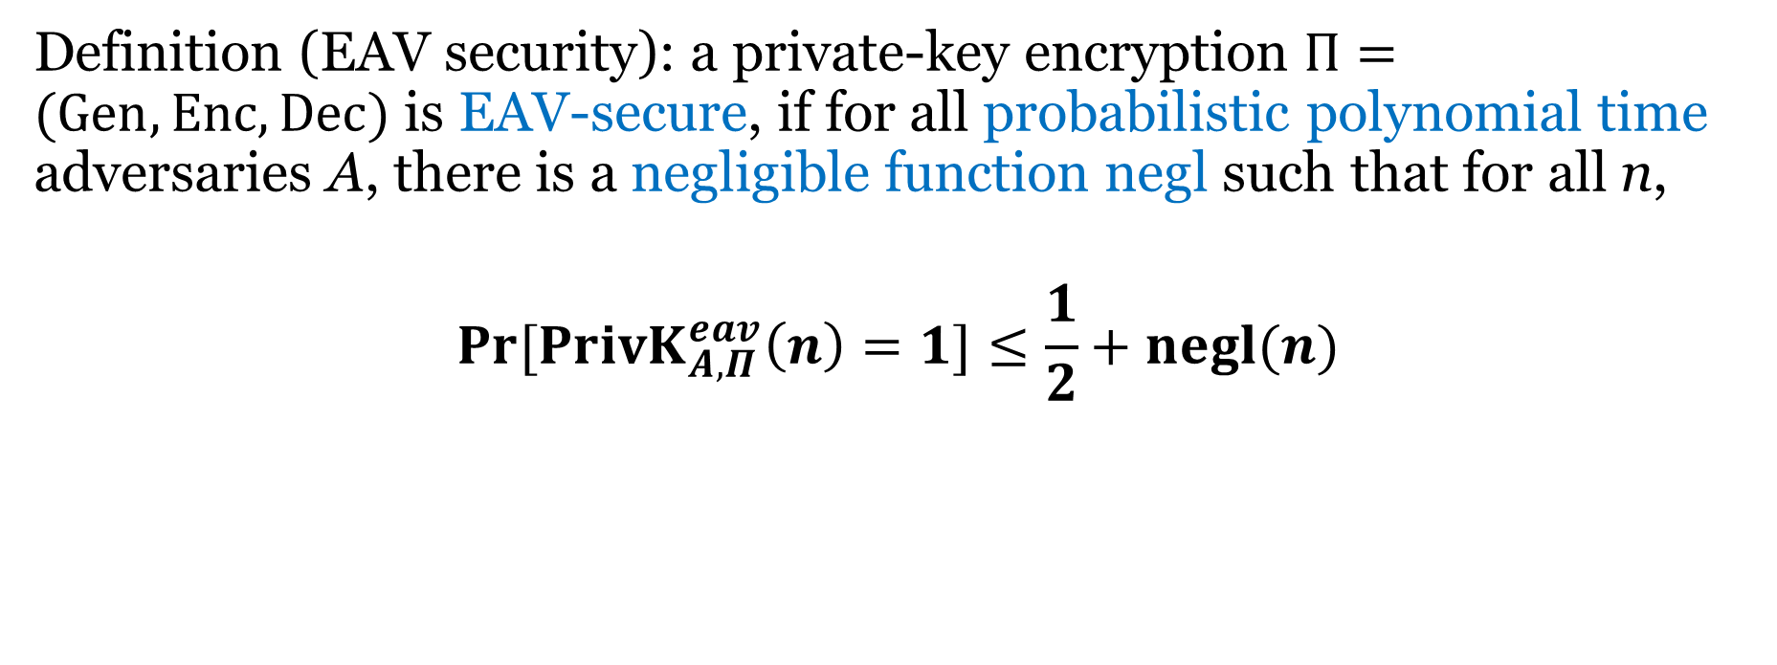
Computational Indistinguishability against eavesdropper
Definition (EAV security): a private-key encryption $Π=(Gen, Enc, Dec)$ is EAV-secure, if for all probabilistic polynomial time adversaries A, there is a negligible function negl such that for all n,
$$\operatorname{Pr}{[{PrivK}_{A,Π}^{eav}\left(n\right)=1}]≤\frac{1}{2}+negl(n)$$

Slide 20
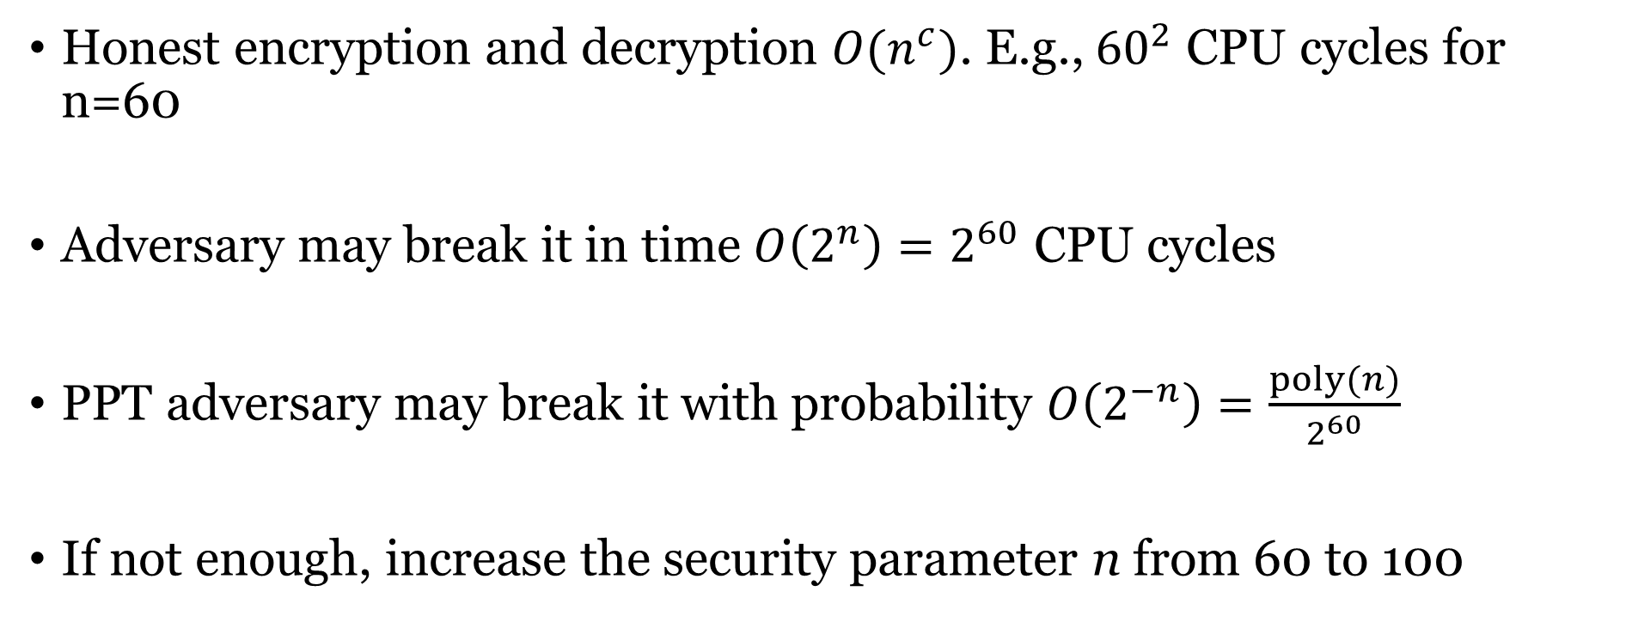
More on the definition
Honest encryption and decryption $O(n^{c})$. E.g., ${60}^{2}$ CPU cycles for n=60
Adversary may break it in time $O\left(2^{n}\right)=2^{60}$ CPU cycles
PPT adversary may break it with probability $O\left(2^{−n}\right)=\frac{poly(n)}{2^{60}}$
If not enough, increase the security parameter n from 60 to 100

Slide 21
Next
Construction to achieve computational EAV security where key is shorter than the message
Security for multiple encryptions

Slide 22
One-time pad
n bits
key
n bits
n bits
⊕
message
ciphertext

Slide 23
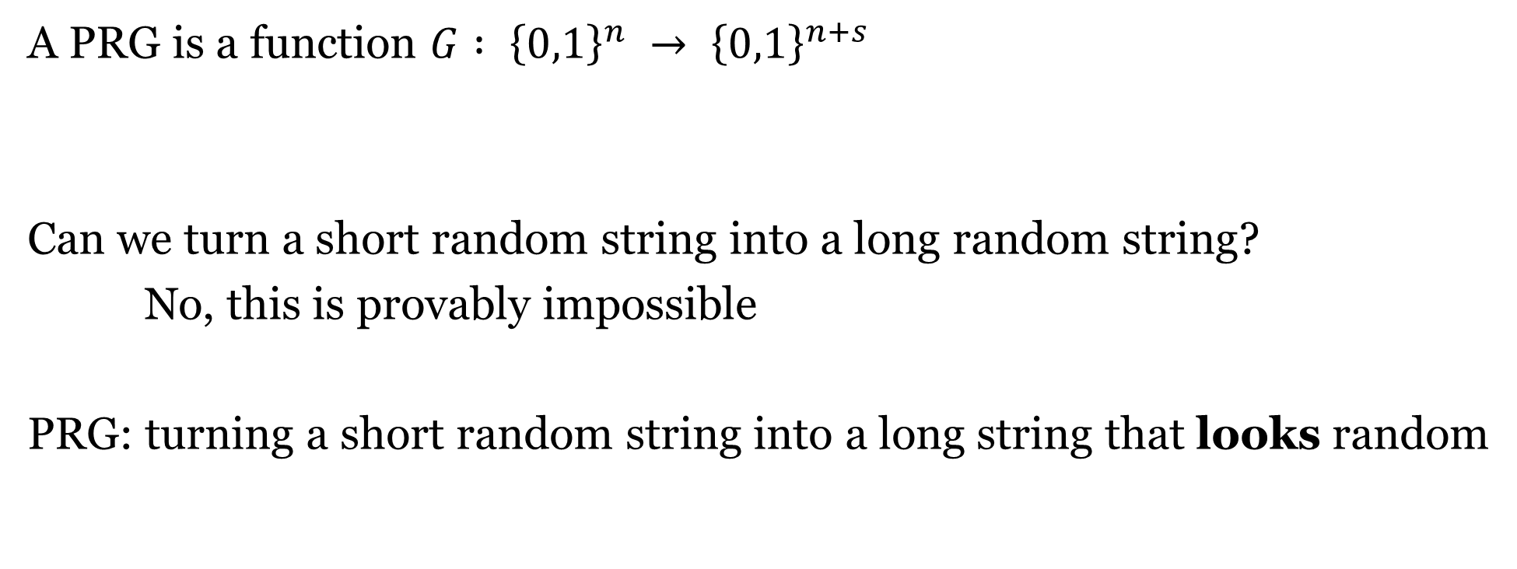
Pseudorandom Generator (PRG)
A PRG is a function $G : {\left\{0,1\right\}}^{n} → {\left\{0,1\right\}}^{n+s}$
Can we turn a short random string into a long random string?
No, this is provably impossible
PRG: turning a short random string into a long string that looks random

Slide 24
01101010
G
101101111011001
111011000110110
My Program
Slide credit to David Heath

Slide 25
01101010
G
101101111011001
111011000110110
My Program
REAL/FAKE

Slide 26
01101010
G
101101111011001
111011000110110
My Program
REAL/FAKE

Slide 27
01101010
G is a PRG if no program can reliably win this game
G
101101111011001
111011000110110
My Program
REAL/FAKE

Slide 28
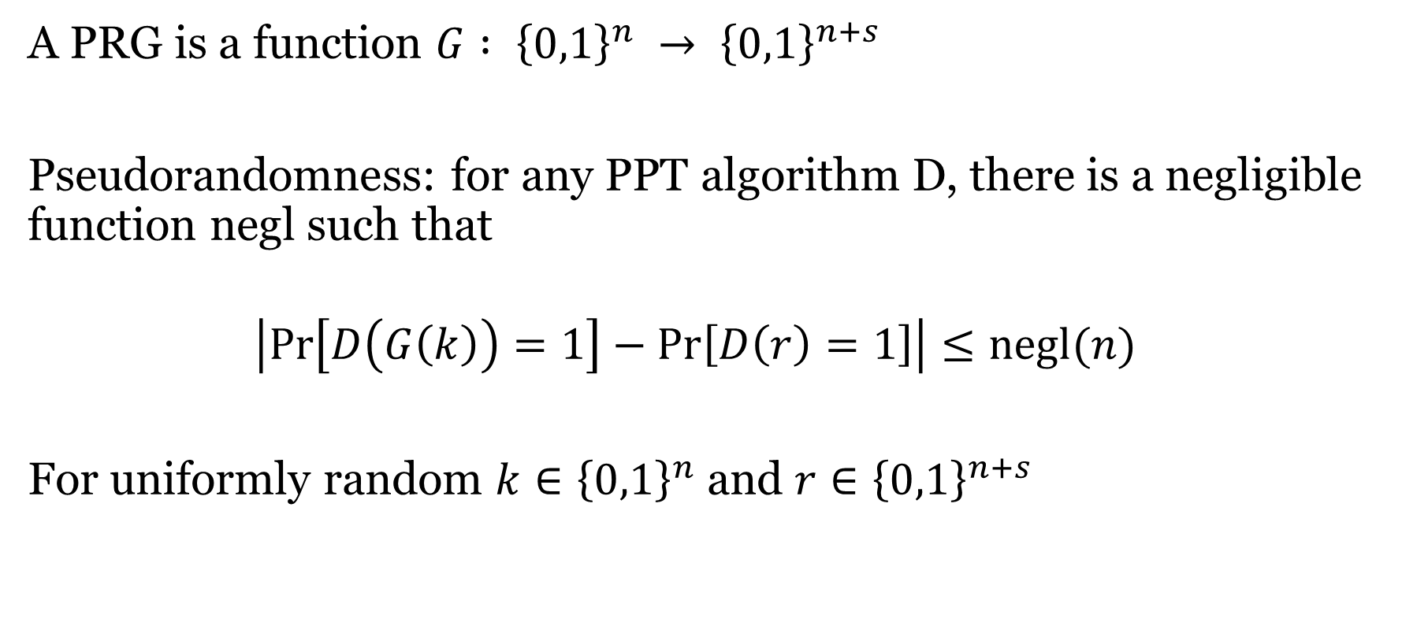
Definition
A PRG is a function $G : {\left\{0,1\right\}}^{n} → {\left\{0,1\right\}}^{n+s}$
Pseudorandomness: for any PPT algorithm D, there is a negligible function negl such that
$$\left|\operatorname{Pr}\left[D\left(G\left(k\right)\right)=1\right]−\operatorname{Pr}\left[D\left(r\right)=1\right]\right|≤negl(n)$$
For uniformly random $k∈{\left\{0,1\right\}}^{n}$ and $r∈{\left\{0,1\right\}}^{n+s}$

Slide 29

Example that is not a PRG
$G : {\left\{0,1\right\}}^{n} → {\left\{0,1\right\}}^{n+1}$ by computing the XOR of the first n bits
D: if $r_{n+1}=⊕_{i=1}^{n}r_{i}$, output 1, otherwise, output 0.

Slide 30
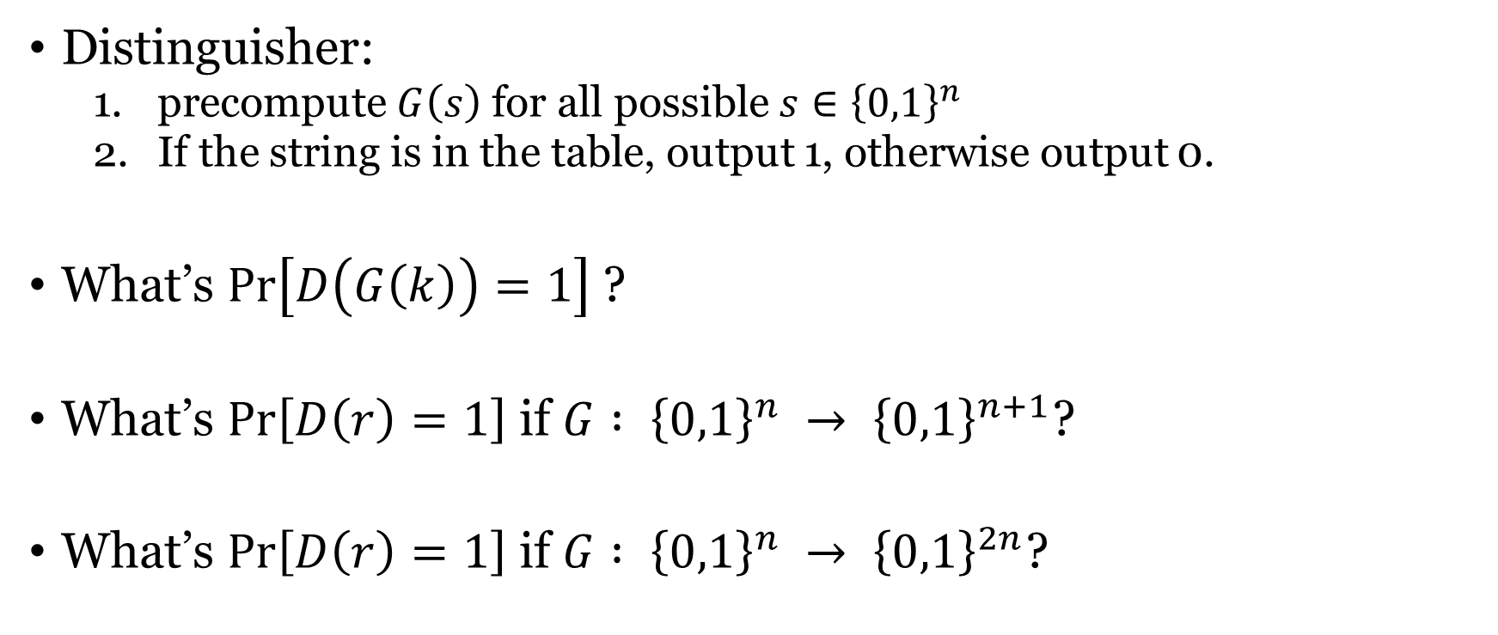
Brute-force search
Distinguisher:
precompute $G\left(s\right)$ for all possible $s∈{\left\{0,1\right\}}^{n}$
If the string is in the table, output 1, otherwise output 0.
What’s $\operatorname{Pr}\left[D\left(G\left(k\right)\right)=1\right]$ ?
What’s $\operatorname{Pr}\left[D\left(r\right)=1\right]$ if $G : {\left\{0,1\right\}}^{n} → {\left\{0,1\right\}}^{n+1}$?
What’s $\operatorname{Pr}\left[D\left(r\right)=1\right]$ if $G : {\left\{0,1\right\}}^{n} → {\left\{0,1\right\}}^{2n}$?

Slide 31
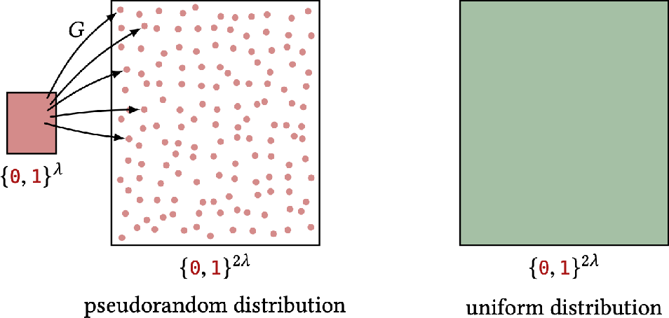
01101010
G
101101111011001
111011000110110

Slide 32
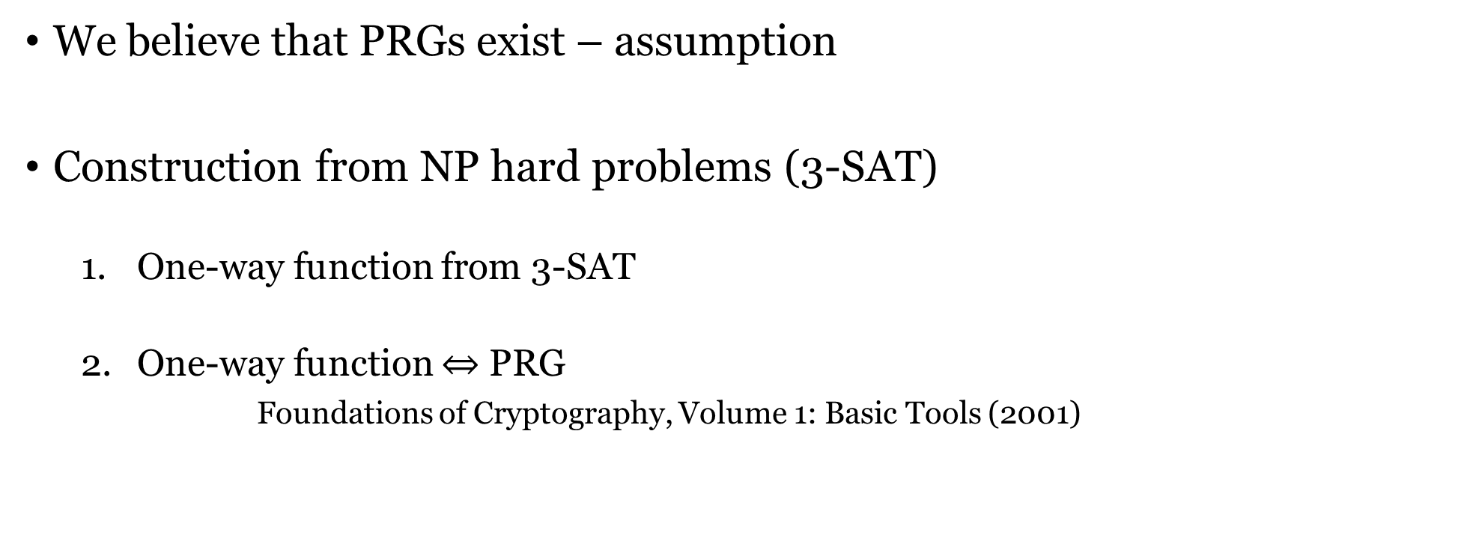
Existence of PRG
We believe that PRGs exist – assumption
Construction from NP hard problems (3-SAT)
One-way function from 3-SAT
One-way function $⇔$ PRG
Foundations of Cryptography, Volume 1: Basic Tools (2001)
(additional assumption on worst-case hardness to average-case hardness)
If PRG exists, then P!=NP

Slide 33
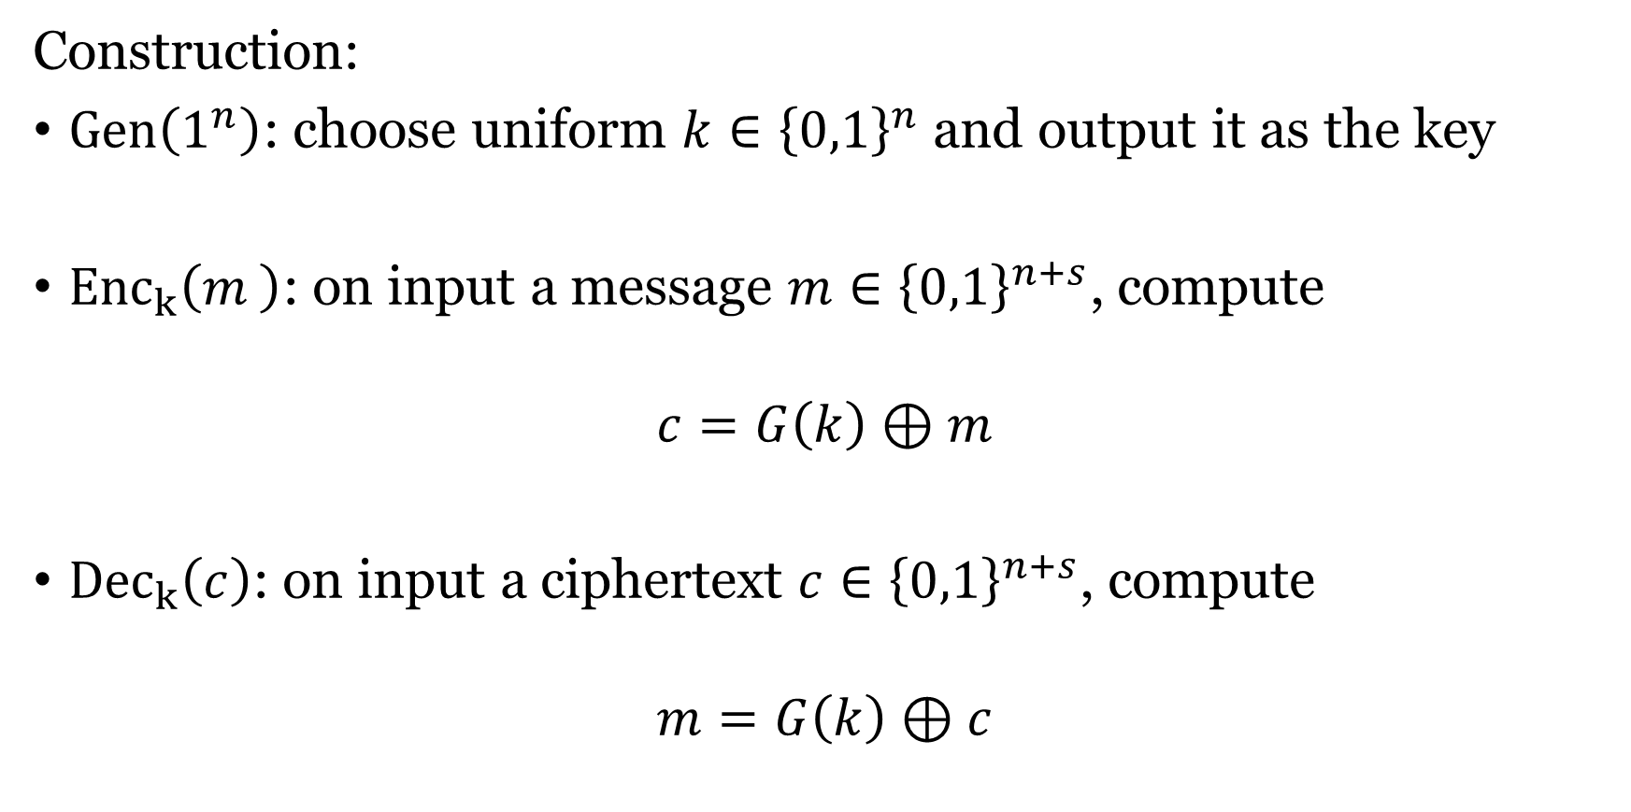
EAV-security from PRG
Construction:
$Gen\left(1^{n}\right)$: choose uniform $k∈{\left\{0,1\right\}}^{n}$ and output it as the key
${Enc}_{k}\left(m_{ }\right)$: on input a message $m∈{\left\{0,1\right\}}^{n+s}$, compute
$$c=G\left(k\right)⊕m$$
${Dec}_{k}\left(c\right)$: on input a ciphertext $c∈{\left\{0,1\right\}}^{n+s}$, compute
$$m=G\left(k\right)⊕c$$

Slide 34
EAV-security from PRG
Theorem: if G is a PRG, then the construction is EAV secure.

