Slide 1

Constrained Sentence Generation by Metropolis-Hastings Sampling
Ning Miao, Hao Zhou, Lili Mou, Rui Yan, Lei Li

Slide 2

Motivation
We often need to add constrains to sentence generation
Hard constrains (eg. keyword2sentence)
Juice -> Brand natural juice, specially made for you
Soft constrains (eg. paraphrase)
The movie is a great success -> It is one of my favorite movies
Current methods are not suited for the problem of general constrained sentence generation
It’s difficult to add constraints to widely-used sequential sentence generation models, such as seq2seq.
Methods dedicated for constrained sentence generation can only handle a specific problem.
Grid Beam Search(GBS)¹ and Constrained Beam Search(CBS)² can only generate sentence from certain keywords
VAE-SVG³ can only do paraphrase

Slide 3
Motivation
Current methods don’t work well in constrained sentence generation
LSTM w/ sep-B/F⁴ is a classical hard constrained generation method, which generates independent backward and forward sequences from the given word and combines the two sequences. So the generated sentences may have a problem with consistency.
Eg: demand -> this is what it does in demand is very necessary .
LSTM w/ asyn-B/F⁴ is similar as LSTM w/ sep-B/F, but it first generates the first half of a sentence and then generates another half conditioned on it. But the generation quality is still not satisfactory.
Eg: player -> The best name of the player is not making a year .
VAE⁵ can be used to derive distributed representations of sentences. And it is believed that the representations reflect semantic similarities of sentences in a degree. So it is a straight forward idea to perform paraphrasing by first encoding a sentence into a representation in Euclidean space, and then decoding the representation after adding some amount of noise to it. Unfortunately, the generated sentences of this method is of low quality.

Slide 4
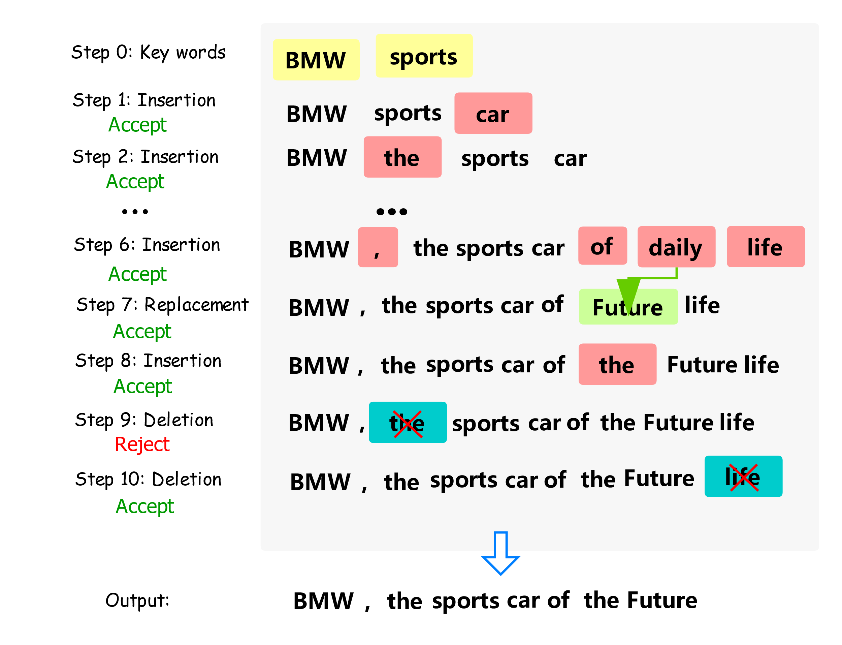
Introduction
We need a practical method for sentence generation under both hard and soft constraint! So we propose Constrained Generation by Metropolis-Hastings sampling (CGMH).
The main idea of CGMH is performing Metropolis-Hastings sampling directly in the space of sentences. The figure on right illustrates CGMH by an example of generating advertisement from keywords.

Slide 5
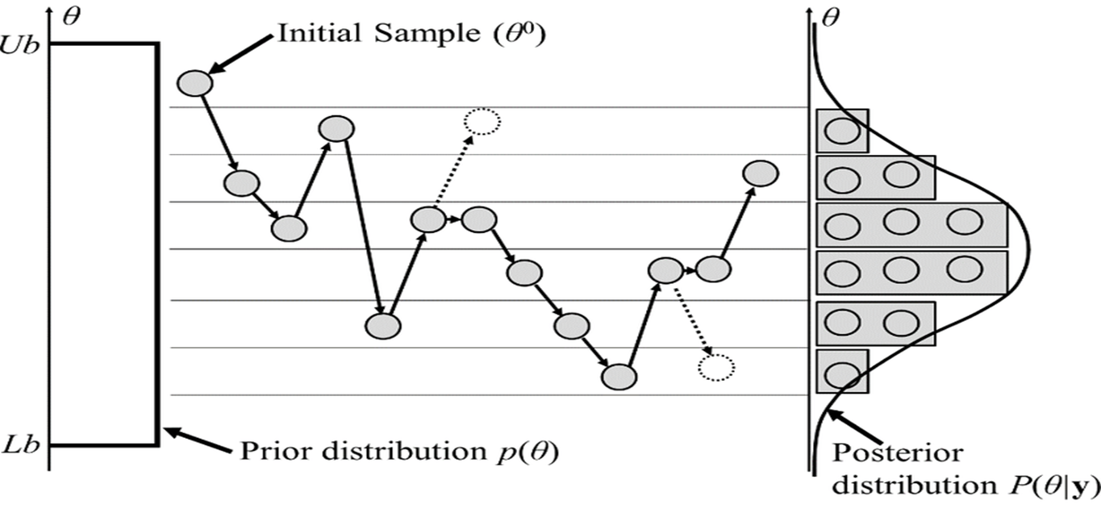
Metropolis-Hastings Sampling
Metropolis-Hastings(MH) sampling is a 2-step Markov Chain Monte-Carlo (MCMC) algorithm
MH first proposes a transition and then accepts or rejects the transition. (Gibbs sampling is a special case of MH sampling, which always accepts transitions.)

Slide 6
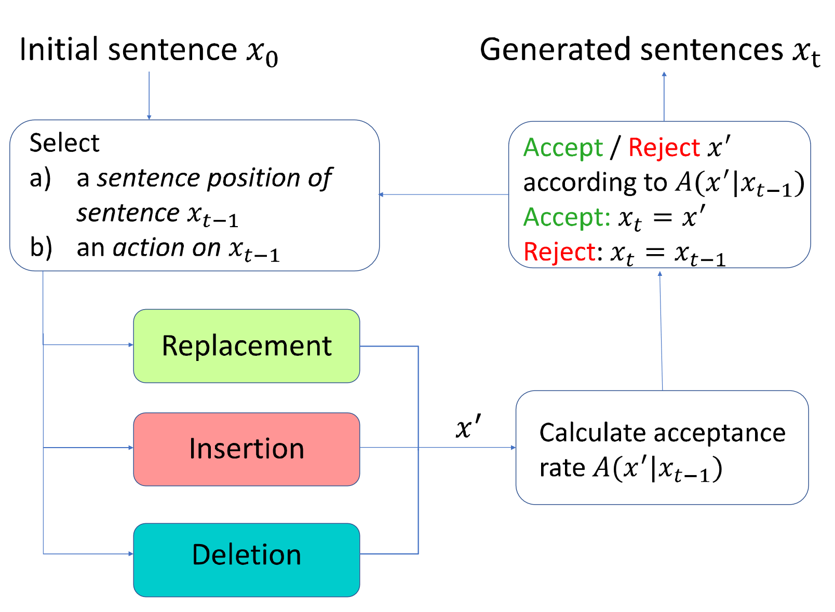

Method
We set the stationary distribution as:
$$π\left(x\right) =P\left(x\right)·P_{C}\left(x\right)$$
P$\left(x\right)=\prod_{t}{P\left(x_{t}|x_{0:t−1}\right) }$is the probability of sentence in a general- purpose language model.
$P_{C}(x)$= $\prod_{i}{P_{C}^{i}\left(x\right)}$ is the indicator function showing whether constraints are satisfied.
We use MH algorithm to sample from$π\left(x\right)$
From a sentence $x_{t−1}$, we propose a new sentence $x^{′}$ by replacement/insertion/deletion of a position of $x_{t−1}$
Calculate the acceptance rate:
$A\left(x^{′} | x_{t−1}\right)=min⁡(1, \frac{π\left(x^{′}\right)·g\left(x_{t−1} | x^{′}\right)}{π\left(x_{t−1}\right)·g\left(x^{′} | x_{t−1}\right)})$
Accept $x^{′}$ with probability $A\left(x^{′} | x_{t−1}\right)$

Slide 7
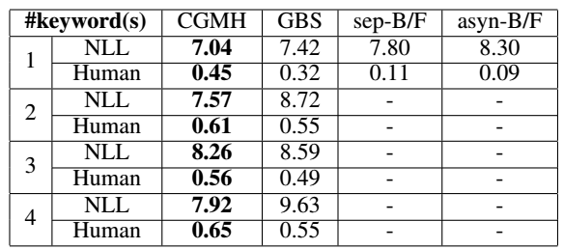
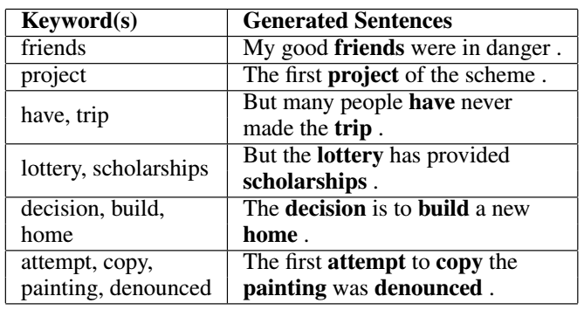
Experiment - Keywords2Sentence Generation
To generate sentence from a variable number of keywords, we simply start sampling from the given keywords. Experimental results show that CGMH outperforms previous work in both NLL and human evaluations.
Keyword(s) | Generated Sentences
friends | My good friends were in danger .
project | The first project of the scheme .
have, trip | But many people have never made the trip .
lottery, scholarships | But the lottery has provided scholarships.
decision, build, home | The decision is to build a new home.
attempt, copy, painting, denounced | The first attempt to copy the painting was denounced.

Slide 8
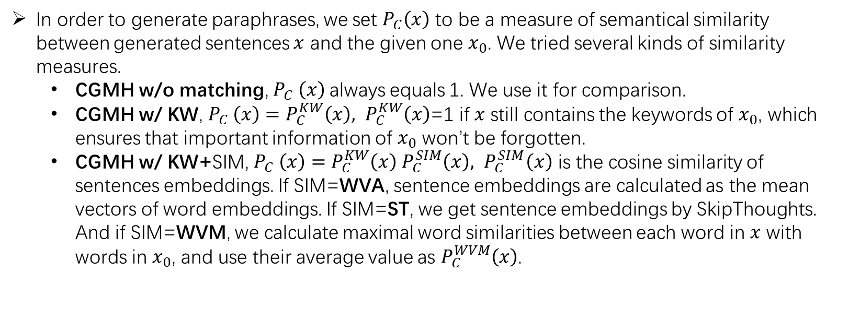
Experiment - Unsupervised Paraphrase Generation
In order to generate paraphrases, we set $P_{C}\left(x\right)$ to be a measure of semantical similarity between generated sentences $x$ and the given one $x_{0}$. We tried several kinds of similarity measures.
CGMH w/o matching, $P_{C} \left(x\right)$always equals 1. We use it for comparison.
CGMH w/ KW, $P_{C} \left(x\right)=P_{C}^{KW}\left(x\right), P_{C}^{KW}\left(x\right)$=1 if $x$ still contains the keywords of $x_{0}$, which ensures that important information of $x_{0}$ won’t be forgotten.
CGMH w/ KW+SIM, $P_{C} \left(x\right)=P_{C}^{KW}\left(x\right)$ $P_{C}^{SIM}\left(x\right), { P}_{C}^{SIM}\left(x\right)$ is the cosine similarity of sentences embeddings. If SIM=WVA, sentence embeddings are calculated as the mean vectors of word embeddings. If SIM=ST, we get sentence embeddings by SkipThoughts. And if SIM=WVM, we calculate maximal word similarities between each word in $x$ with words in $x_{0}$, and use their average value as $P_{C}^{WVM}\left(x\right)$.

Slide 9
Experiment - Unsupervised Paraphrase Generation
CGMH is the first unsupervised model to achieve comparable results with supervised models.
Examples
1,what ‘s the best plan to lose weight ->
what ‘s the best way to slim down quickly
2. how should i control my emotion ->
how do i control my anger
3. why do my dogs love to eat tuna fish ->
why do my dogs like to eat raw tuna and raw fish

Slide 10
Experiment - Unsupervised Error Correction
CGMH outperforms some of the supervised models trained on large parallel corpus.
Erroneous sen1 | Even if we are failed , we have to try to get a new things .
Reference sen1 | Even if we all failed , we have to try to get new things .
Output sen1 | Even if we are failing , we have to try to get some new things ..
Erroneous sen2 | In the world oil price very high right now .
Reference sen2 | In today ‘s world , oil prices are very high right now .
Output sen2 | In the world , oil prices are very high right now .

Slide 11
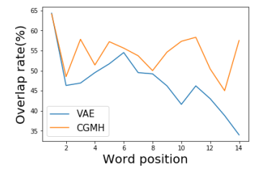
Analysis
Why CGMH performs better than sequential models?
RNN can be thought of as an autoregressive Bayesian network generating words conditioned on previous ones. Hence error will accumulate during generation.
CGMH doesn’t generate sequentially, so error won’t accumulate.
At the same time, CGMH has the ability of self-correction. Please refer to the part of sentence correction.

Slide 12
Reference
[1] Hokamp, C., and Liu, Q. 2017. Lexically constrained decoding for sequence generation using grid beam search. In ACL.
[2] Anderson, P.; Fernando, B.; Johnson, M.; and Gould, S. 2017. Guided open vocabulary image captioning with constrained beam search. In EMNLP.
[3] Gupta, A.; Agarwal, A.; Singh, P.; and Rai, P. 2017. A deep generative framework for paraphrase generation. arXiv preprint arXiv:1709.05074.
[4] Mou, L.; Yan, R.; Li, G.; Zhang, L.; and Jin, Z. 2015. Backward and forward language modeling for constrained sentence generation. arXiv preprint arXiv:1512.06612.
[5] Kingma, Diederik P and Welling, Max. Auto-encoding variational bayes. arXiv preprint arXiv:1312.6114, 2013.
[5] Li, Z.; Jiang, X.; Shang, L.; and Li, H. 2017. Paraphrase generation with deep reinforcement learning. arXiv preprint arXiv:1711.00279.
[5] Junczys-Dowmunt, M., and Grundkiewicz, R. 2016. Phrasebased machine translation is state-of-the-art for automatic grammatical error correction. arXiv preprint arXiv:1605.06353.
[6] Felice, M.; Yuan, Z.; Andersen, Ø. E.; Yannakoudakis, H.; and Kochmar, E. 2014. Grammatical error correction using hybrid systems and type filtering. In CoNLL.
[7] Napoles, C.; Sakaguchi, K.; Post, M.; and Tetreault, J. 2015. Ground truth for grammatical error correction metrics. In ACL.

Slide 13

THANKS.

