Slide 1

Constrained Sentence Generation by Metropolis-Hastings Sampling
Ning Miao, Hao Zhou, Lili Mou, Rui Yan, Lei Li

Slide 2

Constrained Sentence Generation by Metropolis-Hastings Sampling

Slide 3

Motivation
We often need to add constrains to sentence generation
Hard constrains (eg. keyword2sentence)
Juice -> Brand natural juice, specially made for you
果汁->纯天然果汁，只为你
Soft constrains (eg. paraphrase)
The movie is a great success -> It is one of my favorite movies
这部电影取得了成功 -> 这是我最喜欢的电影之一
Current methods don’t work well in constrained sentence generation
It’s difficult to add constraints to widely-used sequential sentence generation models, such as seq2seq and VAE.
Methods dedicated for constrained sentence generation can only handle a specific problem.
GBS and CBS can only generate sentence from certain keywords
VAE-SVG can only do paraphrase

Slide 4
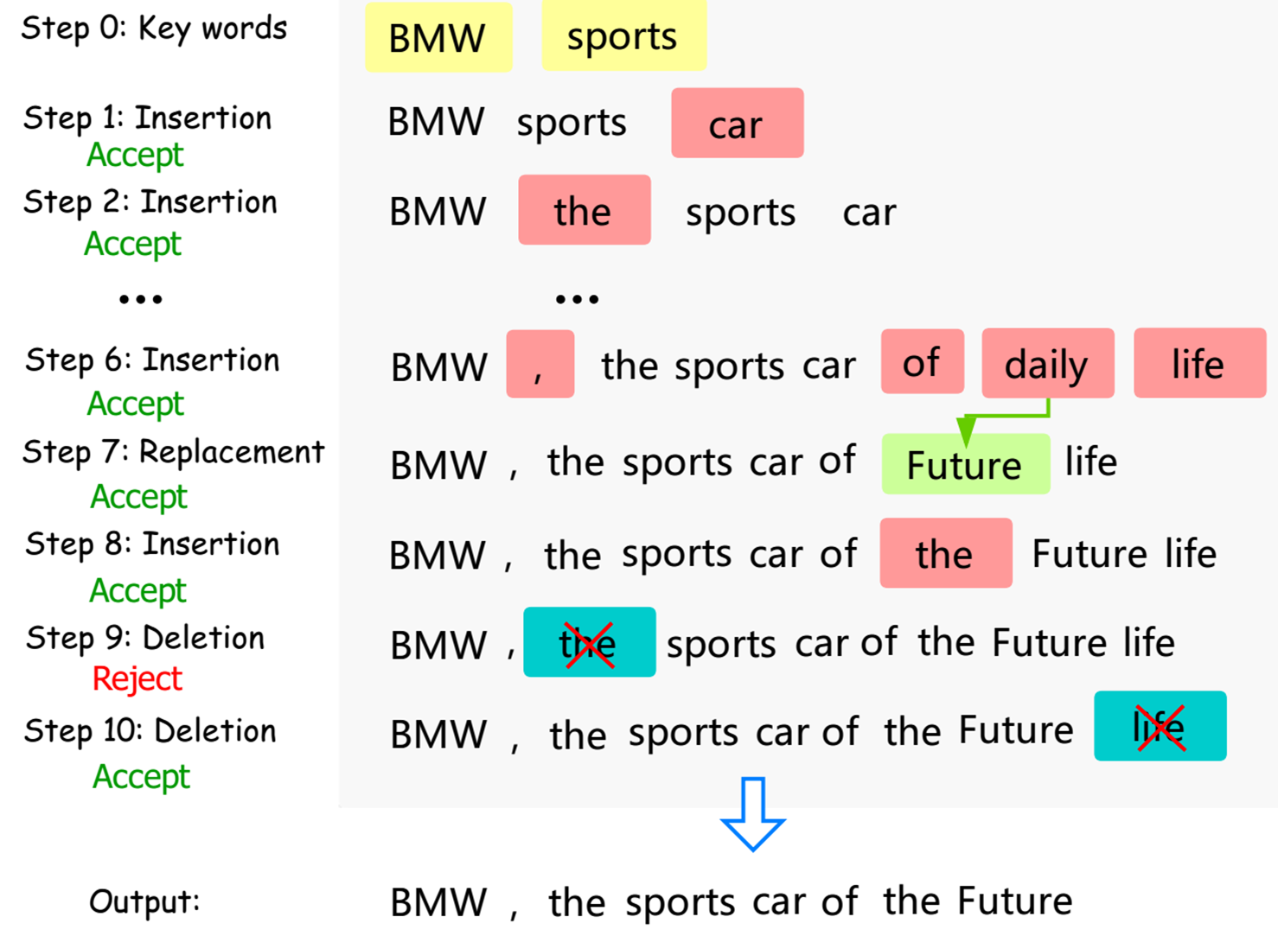
Introduction
We need a practical method for sentence generation under both hard and soft constraint! So we propose Constrained Generation by Metropolis-Hastings sampling (CGMH).
The main idea of CGMH is performing Metropolis-Hastings sampling directly in the space of sentences. The figure on right illustrates CGMH by an example of generating advertisement from keywords.

Slide 5
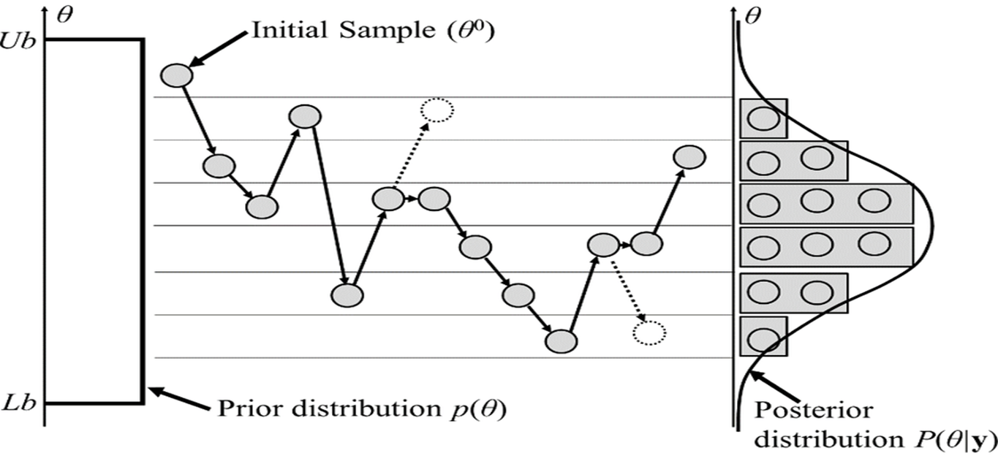
Metropolis-Hastings Sampling
Metropolis-Hastings(MH) sampling is a 2-step Markov Chain Monte-Carlo (MCMC) algorithm
MH first proposes a transition and then accepts or rejects the transition. (Gibbs sampling is a special case of MH sampling, which always accepts transitions.)

Slide 6
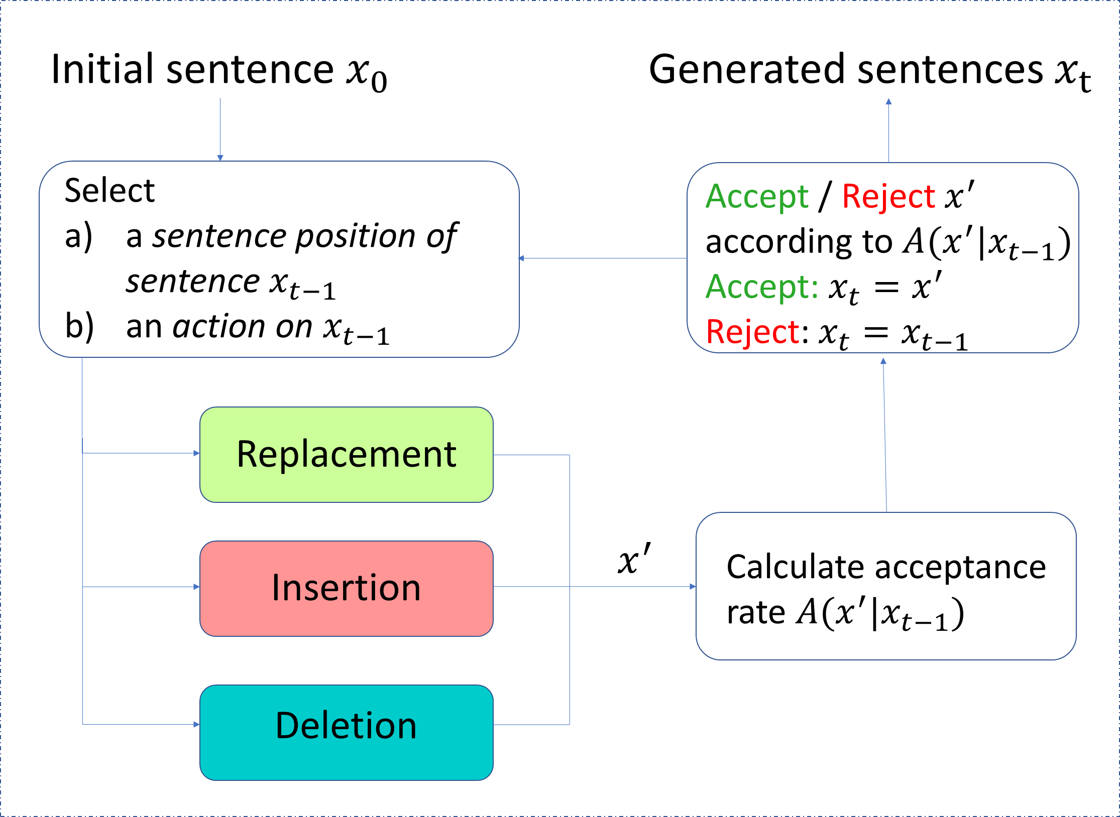
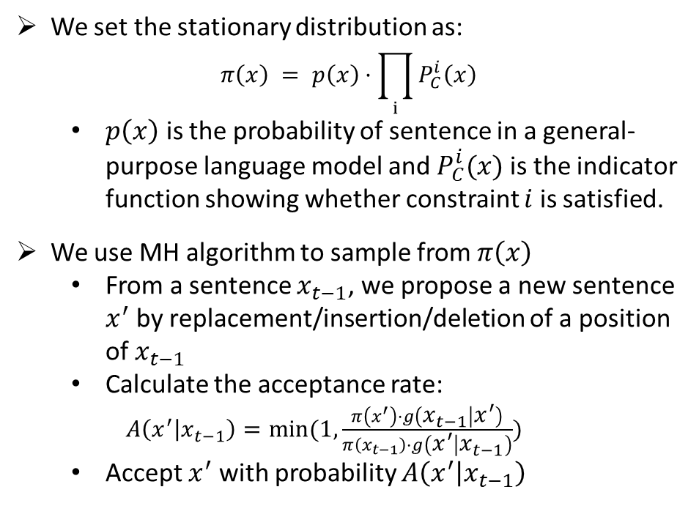
Method
We set the stationary distribution as:
$$π\left(x\right) = p\left(x\right)·\prod_{i}{P_{C}^{i}\left(x\right)}$$
$p\left(x\right)$ is the probability of sentence in a general- purpose language model and $P_{C}^{i}(x)$ is the indicator function showing whether constraint $i$ is satisfied.
We use MH algorithm to sample from$π\left(x\right)$
From a sentence $x_{t−1}$, we propose a new sentence $x^{′}$ by replacement/insertion/deletion of a position of $x_{t−1}$
Calculate the acceptance rate:
$A\left(x^{′} | x_{t−1}\right)=min⁡(1, \frac{π\left(x^{′}\right)·g\left(x_{t−1} | x^{′}\right)}{π\left(x_{t−1}\right)·g\left(x^{′} | x_{t−1}\right)})$
Accept $x^{′}$ with probability $A\left(x^{′} | x_{t−1}\right)$

Slide 7
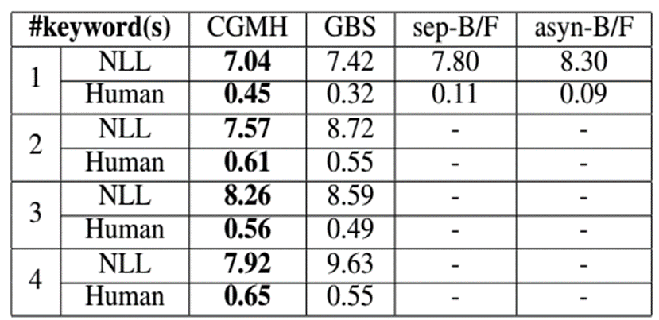
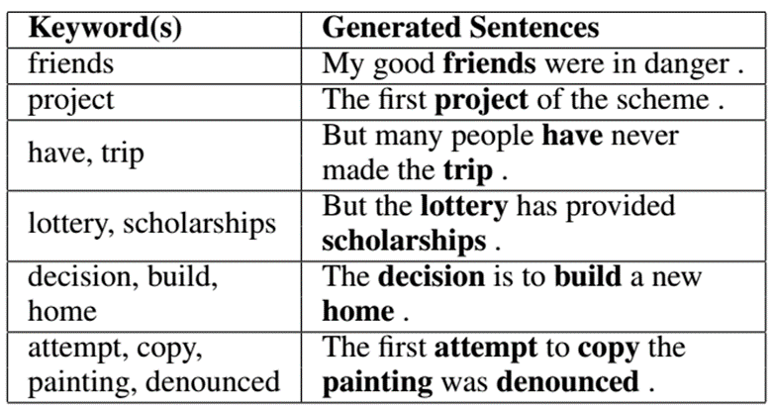
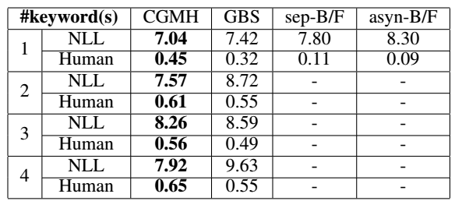
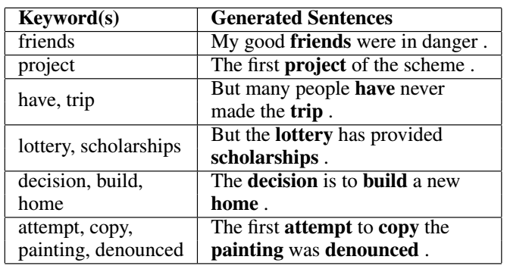
Experiment - Keywords2Sentence Generation
CGMH outperforms previous work in both NLL and human evaluations.

Slide 8
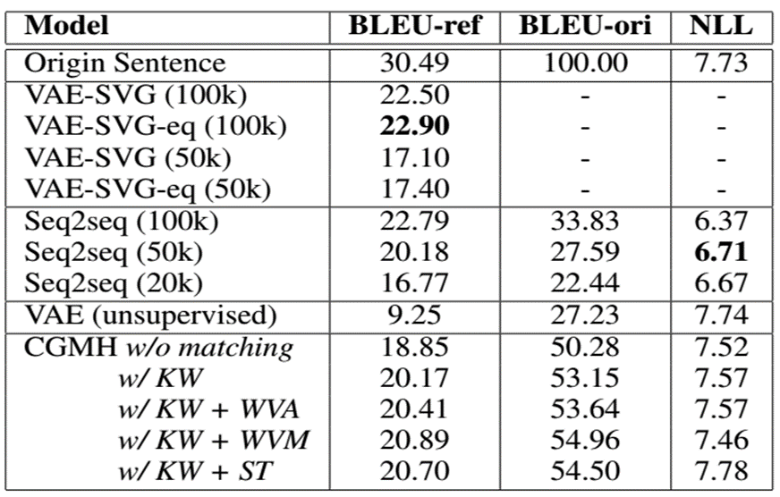
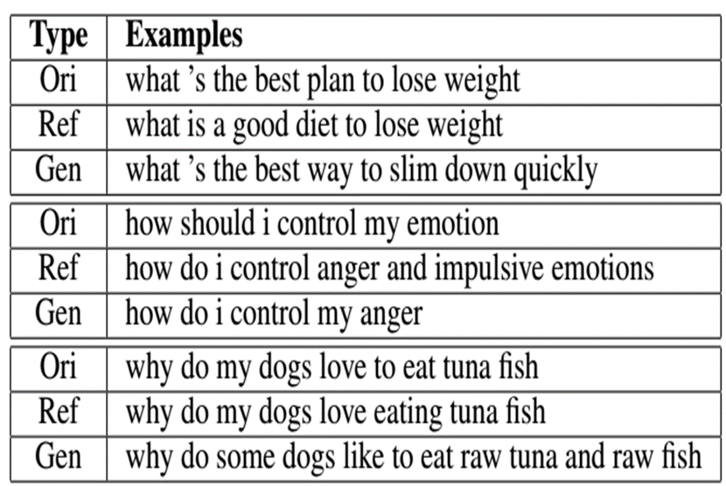
Experiment - Unsupervised Paraphrase Generation
CGMH is the first unsupervised model to achieve comparable results with supervised models.

Slide 9
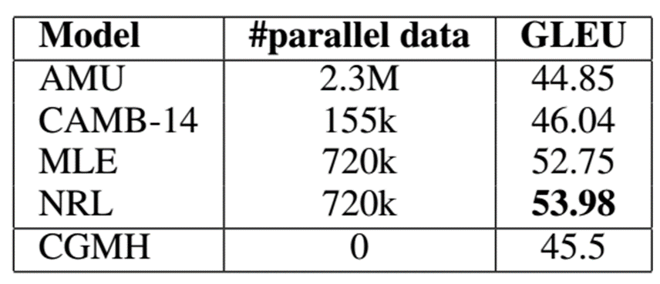
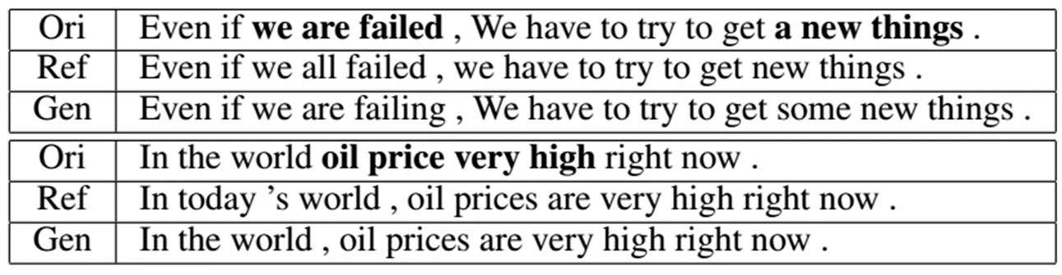
Experiment - Unsupervised Error Correction
CGMH outperforms some of the supervised models trained on large parallel corpus.

Slide 10
Reference
[1] Hokamp, C., and Liu, Q. 2017. Lexically constrained decoding for sequence generation using grid beam search. In ACL.
[2] Li, Z.; Jiang, X.; Shang, L.; and Li, H. 2017. Paraphrase generation with deep reinforcement learning. arXiv preprint arXiv:1711.00279.
[3] Gupta, A.; Agarwal, A.; Singh, P.; and Rai, P. 2017. A deep generative framework for paraphrase generation. arXiv preprint arXiv:1709.05074.
[4] Mou, L.; Yan, R.; Li, G.; Zhang, L.; and Jin, Z. 2015. Backward and forward language modeling for constrained sentence generation. arXiv preprint arXiv:1512.06612.
[5] Junczys-Dowmunt, M., and Grundkiewicz, R. 2016. Phrasebased machine translation is state-of-the-art for automatic grammatical error correction. arXiv preprint arXiv:1605.06353.
[6] Felice, M.; Yuan, Z.; Andersen, Ø. E.; Yannakoudakis, H.; and Kochmar, E. 2014. Grammatical error correction using hybrid systems and type filtering. In CoNLL.
[7] Napoles, C.; Sakaguchi, K.; Post, M.; and Tetreault, J. 2015. Ground truth for grammatical error correction metrics. In ACL.

Slide 11

THANKS.

