Slide 1

Constrained Sentence Generation by Metropolis-Hastings Sampling
Ning Miao, Hao Zhou, Lili Mou, Rui Yan, Lei Li

Slide 2

Motivation
Experiment
Analysis
Introduction
Method

Slide 3

Motivation
We often need to add constrains to sentence generation
Hard constrains (eg. keyword2sentence)
Juice -> Brand natural juice, specially made for you
Soft constrains (eg. paraphrase)
The movie is a great success -> It is one of my favorite movies
Current methods don’t work well in constrained sentence generation
It’s difficult to add constraints to widely-used sequential sentence generation models, such as seq2seq and VAE.
Methods dedicated for constrained sentence generation can only handle a specific problem.
GBS and CBS can only generate sentence from certain keywords
VAE-SVG can only do paraphrase

Slide 4
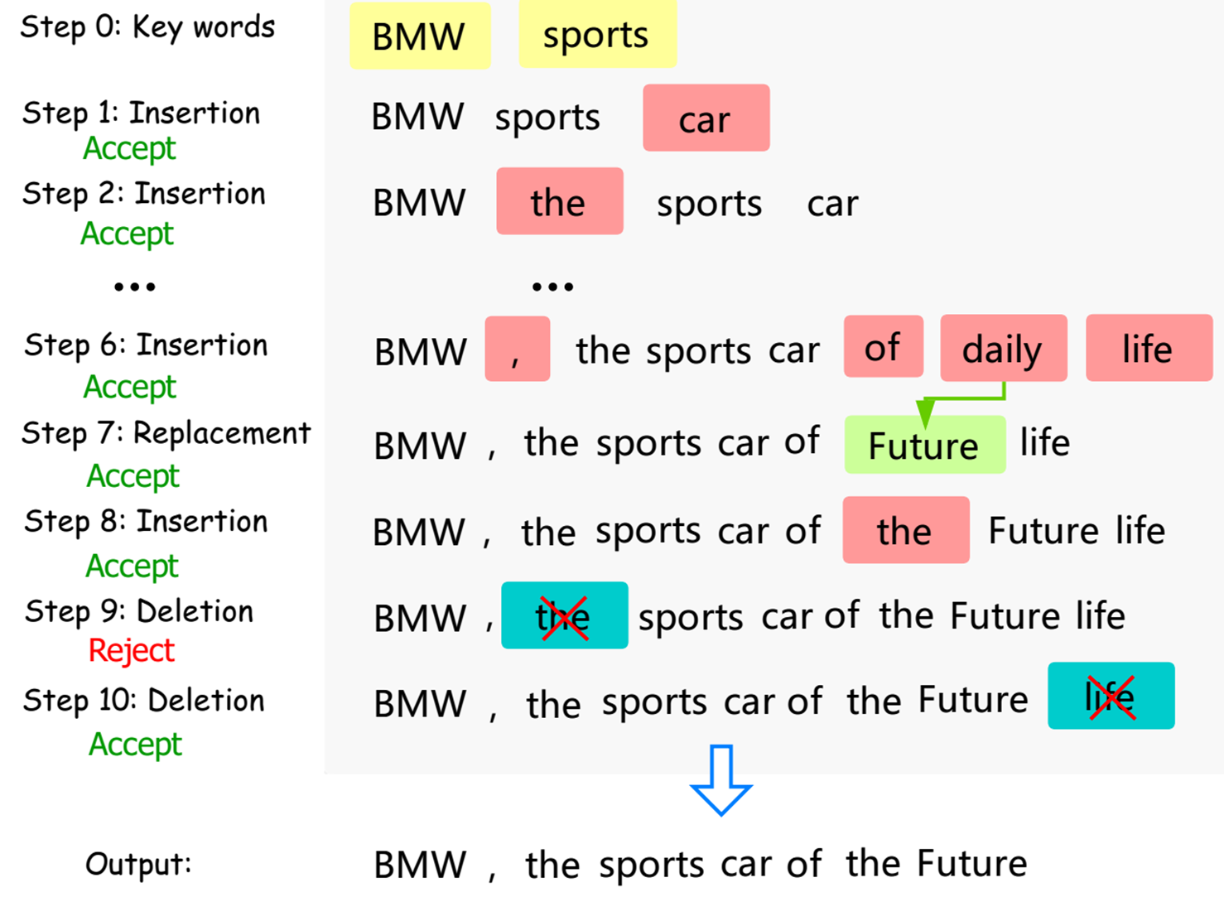
Introduction
We need a practical method for sentence generation under both hard and soft constraint! So we propose Constrained Generation by Metropolis-Hastings sampling (CGMH).
The main idea of CGMH is performing Metropolis-Hastings sampling directly in the space of sentences. The figure on right illustrates CGMH by an example of generating advertisement from keywords.

Slide 5
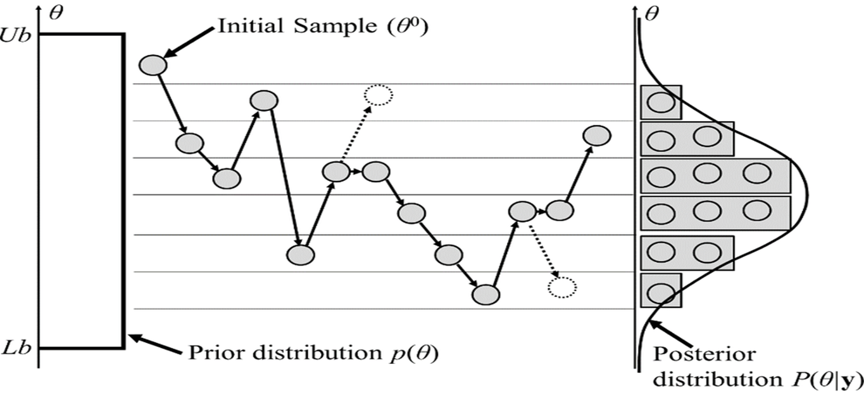
Metropolis-Hastings Sampling
Metropolis-Hastings(MH) sampling is a 2-step Markov Chain Monte-Carlo (MCMC) algorithm
MH first proposes a transition and then accepts or rejects the transition. (Gibbs sampling is a special case of MH sampling, which always accepts transitions.)

Slide 6
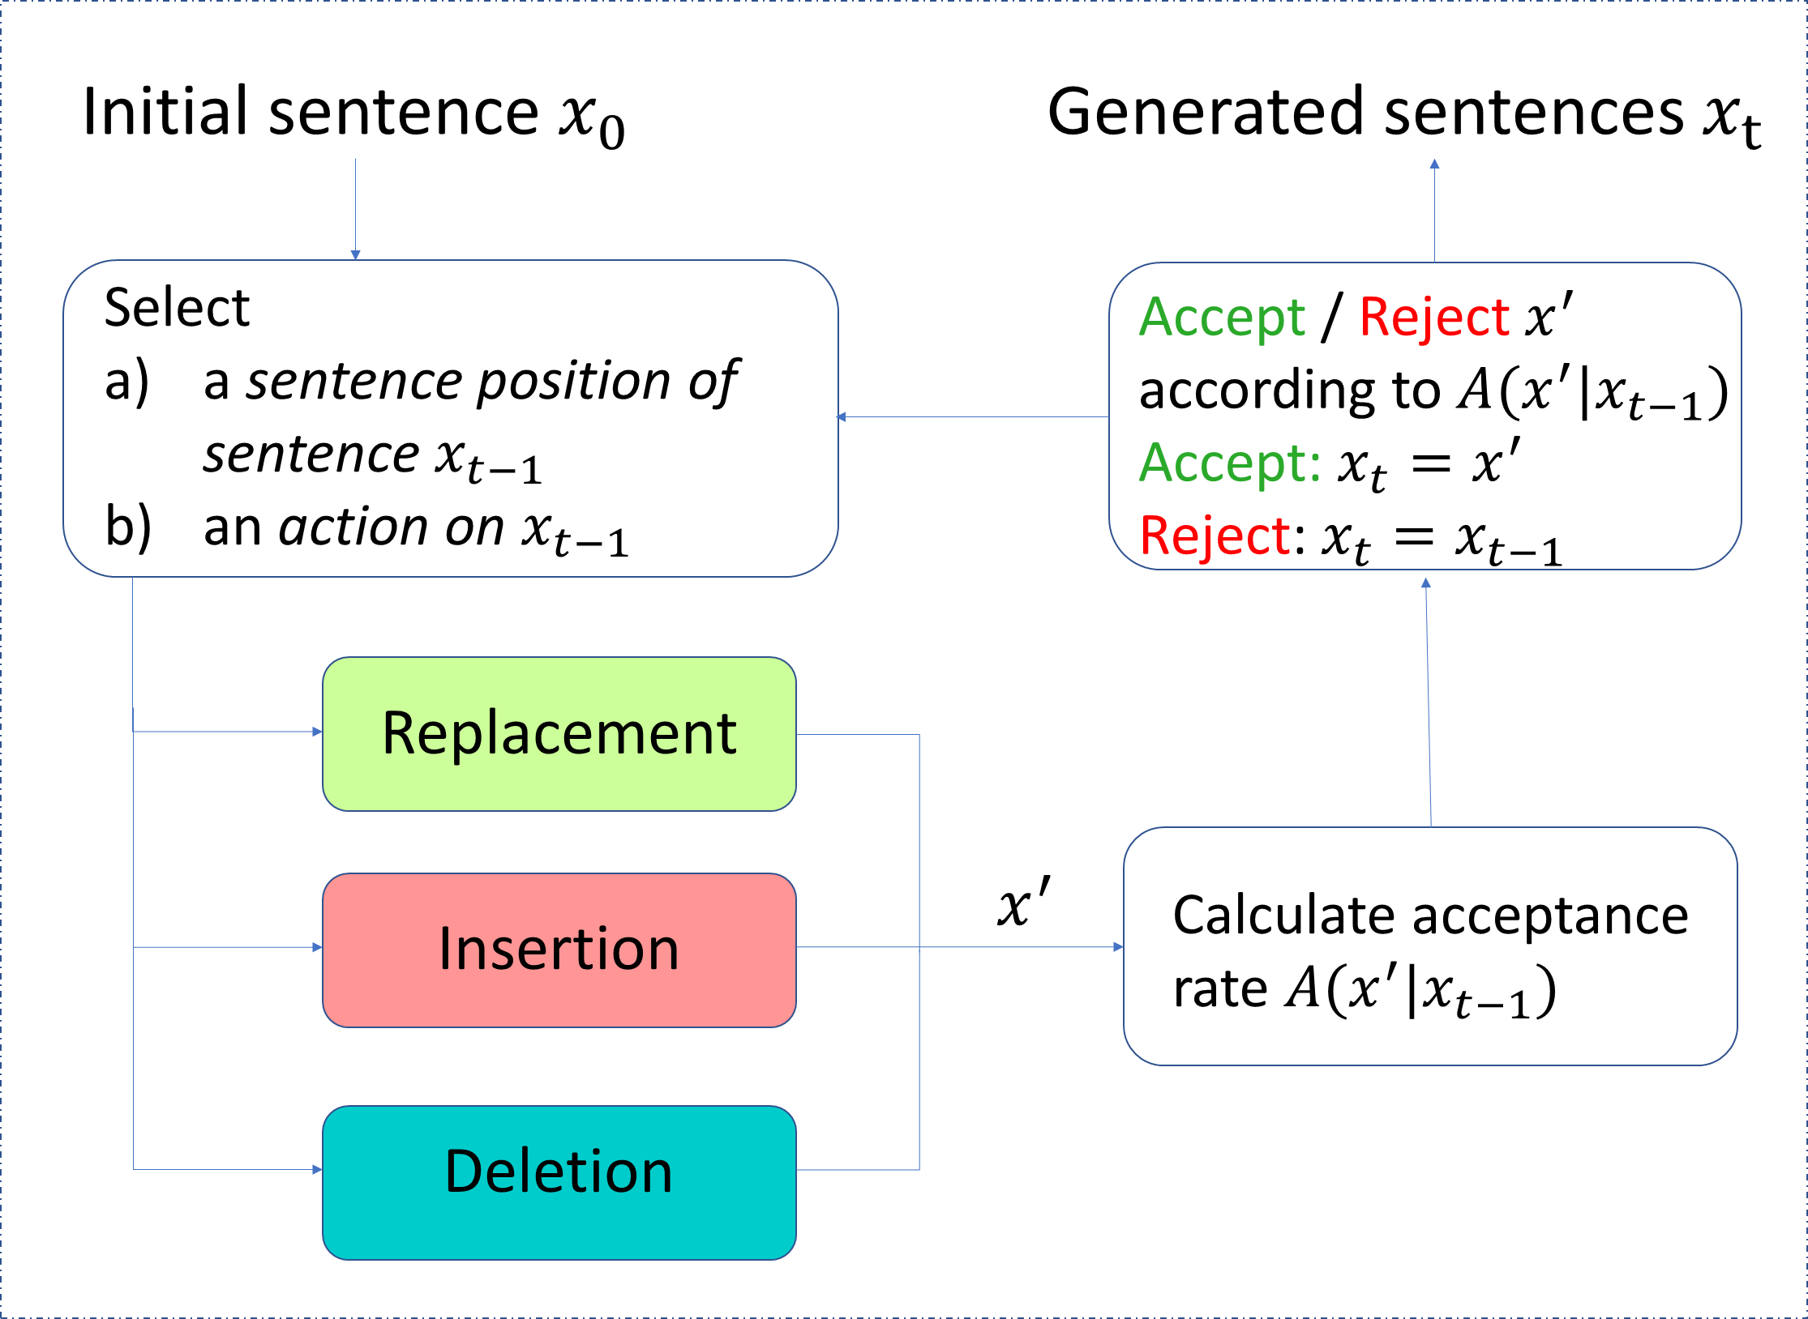
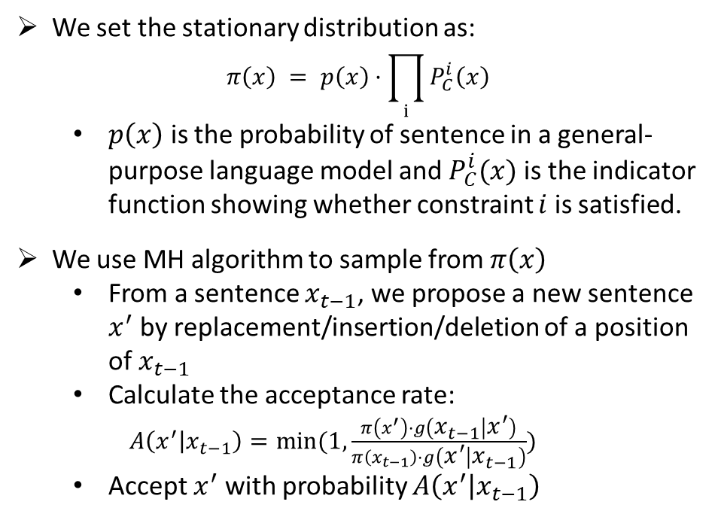
Method
We set the stationary distribution as:
$$π\left(x\right) = p\left(x\right)·\prod_{i}{P_{C}^{i}\left(x\right)}$$
$p\left(x\right)$ is the probability of sentence in a general- purpose language model and $P_{C}^{i}(x)$ is the indicator function showing whether constraint $i$ is satisfied.
We use MH algorithm to sample from$π\left(x\right)$
From a sentence $x_{t−1}$, we propose a new sentence $x^{′}$ by replacement/insertion/deletion of a position of $x_{t−1}$
Calculate the acceptance rate:
$A\left(x^{′} | x_{t−1}\right)=min⁡(1, \frac{π\left(x^{′}\right)·g\left(x_{t−1} | x^{′}\right)}{π\left(x_{t−1}\right)·g\left(x^{′} | x_{t−1}\right)})$
Accept $x^{′}$ with probability $A\left(x^{′} | x_{t−1}\right)$

Slide 7
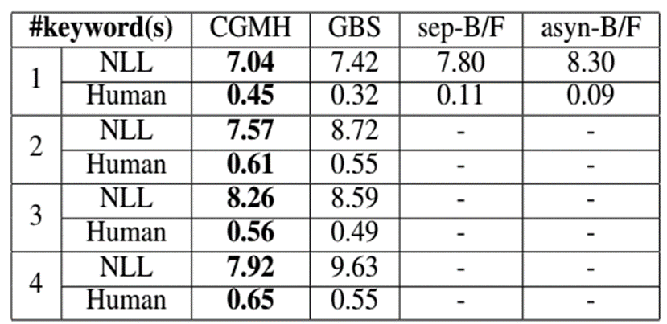
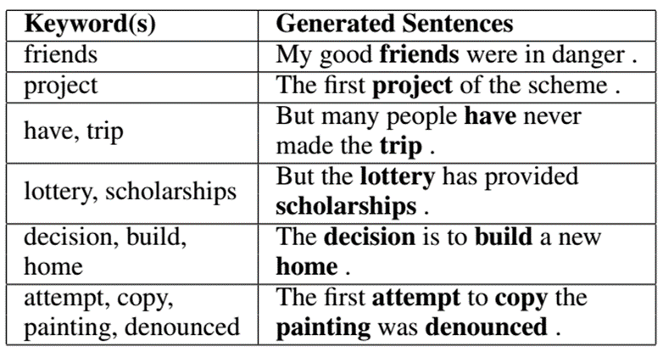
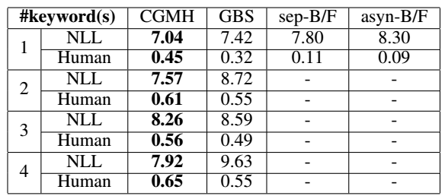
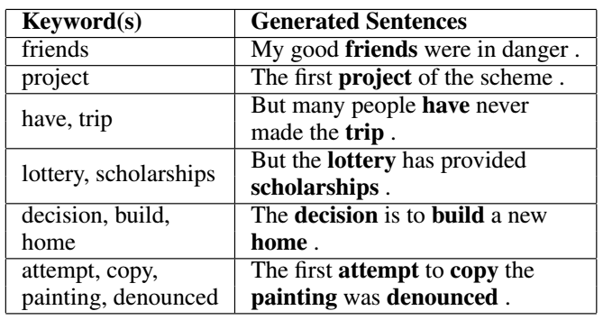
Experiment - Keywords2Sentence Generation
CGMH outperforms previous work in both NLL and human evaluations.

Slide 8
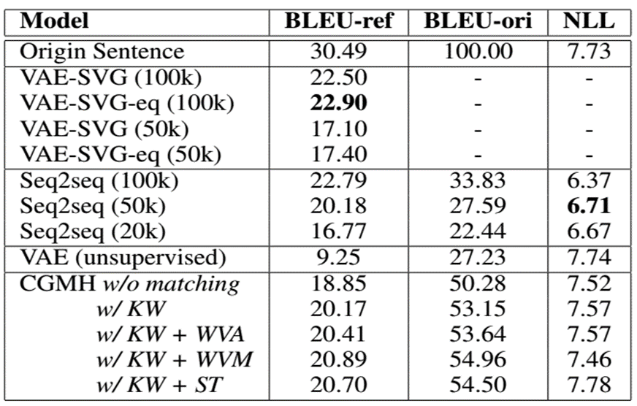
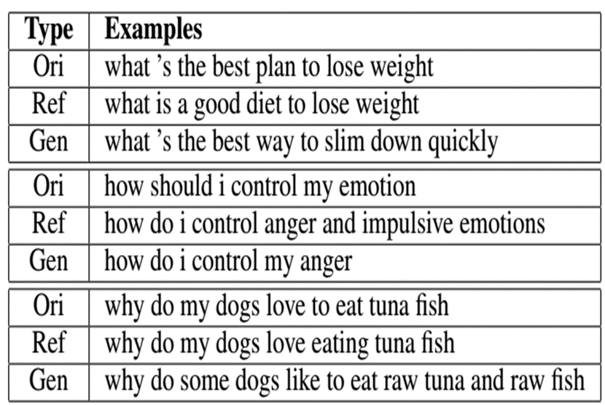
Experiment - Unsupervised Paraphrase Generation
CGMH is the first unsupervised model to achieve comparable results with supervised models.

Slide 9
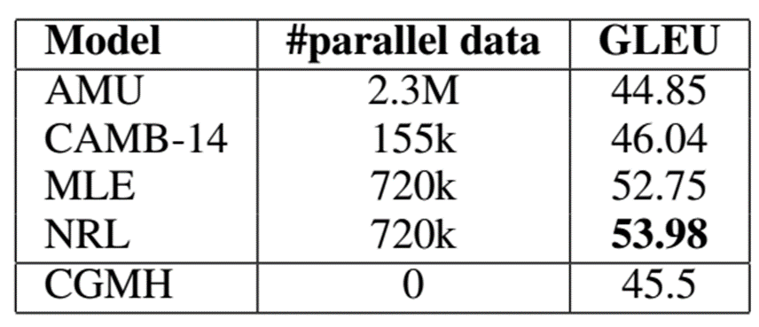
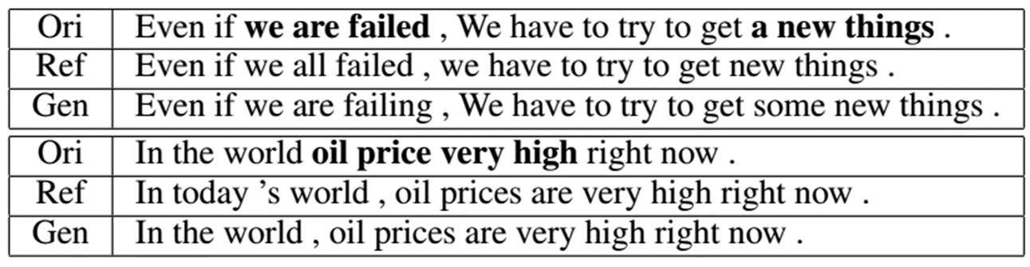
Experiment - Unsupervised Error Correction
CGMH outperforms some of the supervised models trained on large parallel corpus.

Slide 10
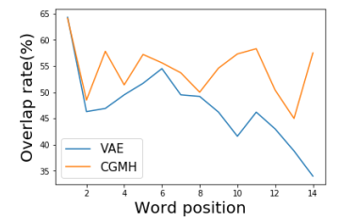
Analysis
Why CGMH performs better than sequential models?
RNN can be thought of as an autoregressive Bayesian network generating words conditioned on previous ones. Hence error will accumulate during generation.
CGMH doesn’t generate sequentially, so error won’t accumulate.
At the same time, CGMH has the ability of self-correction. Please refer to the part of sentence correction.

Slide 11
Main Reference
[1] Hokamp, C., and Liu, Q. 2017. Lexically constrained decoding for sequence generation using grid beam search. In ACL.
[2] Li, Z.; Jiang, X.; Shang, L.; and Li, H. 2017. Paraphrase generation with deep reinforcement learning. arXiv preprint arXiv:1711.00279.
[3] Gupta, A.; Agarwal, A.; Singh, P.; and Rai, P. 2017. A deep generative framework for paraphrase generation. arXiv preprint arXiv:1709.05074.
[4] Mou, L.; Yan, R.; Li, G.; Zhang, L.; and Jin, Z. 2015. Backward and forward language modeling for constrained sentence generation. arXiv preprint arXiv:1512.06612.
[5] Junczys-Dowmunt, M., and Grundkiewicz, R. 2016. Phrasebased machine translation is state-of-the-art for automatic grammatical error correction. arXiv preprint arXiv:1605.06353.
[6] Felice, M.; Yuan, Z.; Andersen, Ø. E.; Yannakoudakis, H.; and Kochmar, E. 2014. Grammatical error correction using hybrid systems and type filtering. In CoNLL.
[7] Napoles, C.; Sakaguchi, K.; Post, M.; and Tetreault, J. 2015. Ground truth for grammatical error correction metrics. In ACL.

Slide 12

THANKS.

