Slide 1




A Spatially Constrained Deep Convolutional Neural Network for Nerve Fiber Segmentation in Corneal Confocal Microscopic Images using Inaccurate Annotations
Ning Zhang¹, Susan Francis², Rayaz A. Malik³, Xin Chen⁴
[1] Department of Electrical and Computer Engineering, University of British Columbia, Canada
[2]Sir Peter Mansfield Imaging Centre, University of Nottingham, UK
[3] Weill Cornell Medicine-Qatar, Qatar
[4] IMA Group, School of Computer Science, University of Nottingham, UK

Slide 2
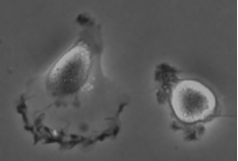
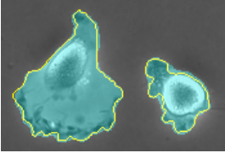
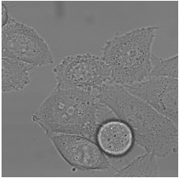
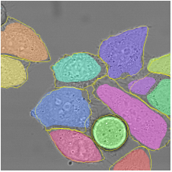
Motivation
Deep convolutional neural networks (DCNN) achieve superior performance in image segmentation when accurate labels are available for fully supervised learning.
Obtain accurate labelling is challenging in medical images.
Fully supervised segmentation result of U-net [1]
[1] Olaf Ronneberger, et al,MICCAI, 2015, pp. 234–241.

Slide 3
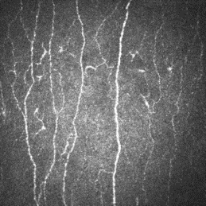
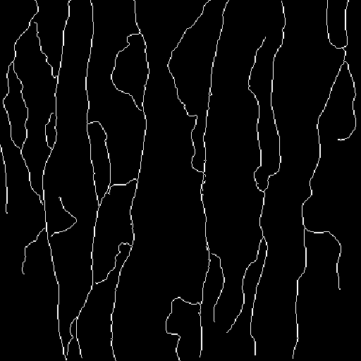
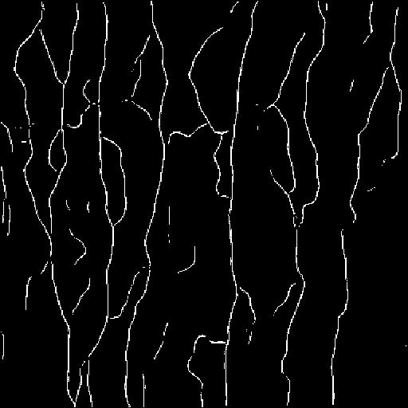
Aim
Train DCNN to achieve good performance using inaccurate labels
Challenges
Fully supervised learning will be misled by these inaccurate labels
Ignore spatial consistency of labels
(a) CCM image
(b) Inaccurate label for training
(c) Output from U-net
Notes:
Captions
3.Unet trainning
Width loss
Spatial consistency

Slide 4
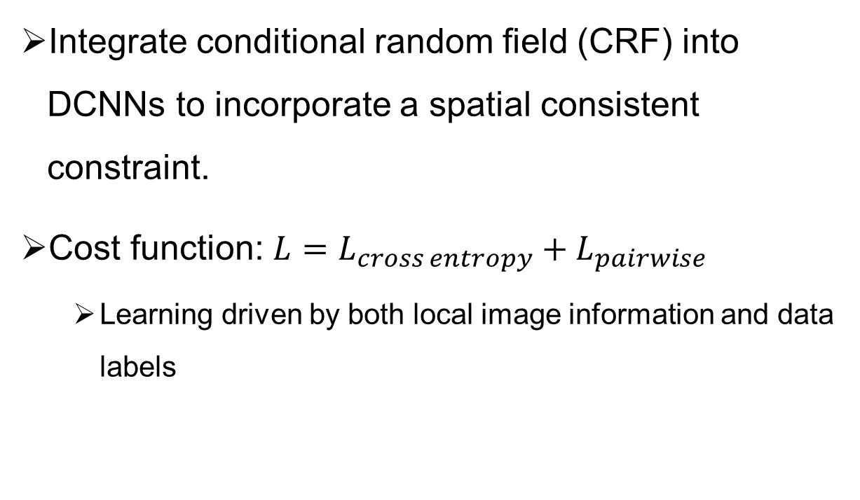
Method
Integrate conditional random field (CRF) into DCNNs to incorporate a spatial consistent constraint.
Cost function: $L=L_{cross entropy}+L_{pairwise}$
Learning driven by both local image information and data labels
Observed image pixel intensity
Label of pixel
Notes:
Still classification
Label edge in CRF model (unary cost and pair cost)
Color edge
3*3

Slide 5




























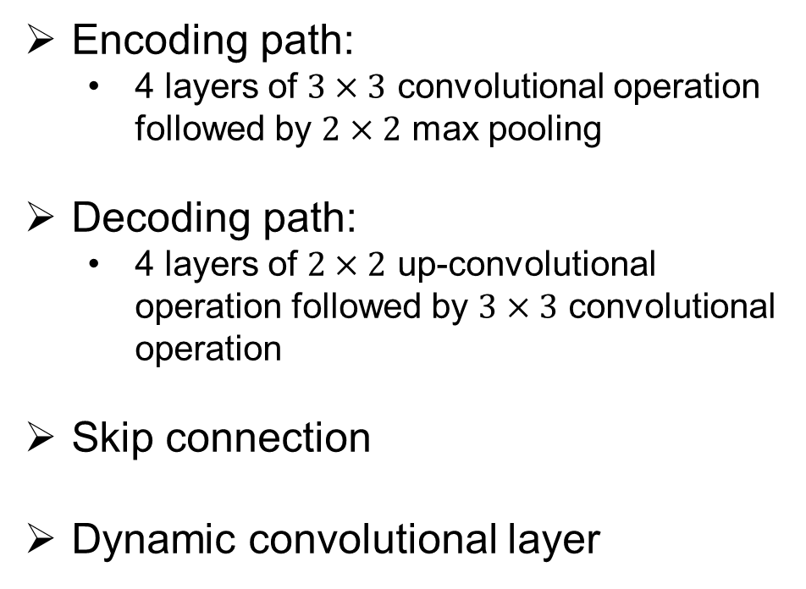



Network structure
$$32$$
$$32$$
$$32$$
$$2$$
$$1$$
Encoding path:
4 layers of $3×3$ convolutional operation followed by $2×2$ max pooling
Decoding path:
4 layers of $2×2$ up-convolutional operation followed by $3×3$ convolutional operation
Skip connection
Dynamic convolutional layer
$$1$$
$$32$$
$$32$$
$$32$$
$$512×512$$
$$512×512$$
$$512×512$$
$$512×512$$
$$spatially consistent cost$$
$$512×512$$
$$512×512$$
$$512×512$$
$$512×512$$
$$64$$
$$64$$
$$64$$
$$64$$
$$64$$
$$cross entropy cost$$
${256}^{2}$
${256}^{2}$
${256}^{2}$
${256}^{2}$
${256}^{2}$
${256}^{2}$
$$128$$
$$128$$
$$128$$
$$128$$
$$128$$
${128}^{2}$
${128}^{2}$
${128}^{2}$
${128}^{2}$
${128}^{2}$
${128}^{2}$
$$conv 3×3, ReLU$$
$$256$$
$$256$$
$$256$$
$$256$$
$$256$$
$$copy and crop$$
${64}^{2}$
${64}^{2}$
${64}^{2}$
$$conv 1×1, ReLU$$
${64}^{2}$
${64}^{2}$
${64}^{2}$
$$dynamic−conv 3×3$$
${32}^{2}$
$$512$$
$$max pool 2×2$$
${32}^{2}$
${32}^{2}$
$$up−conv 2×2$$

Slide 6






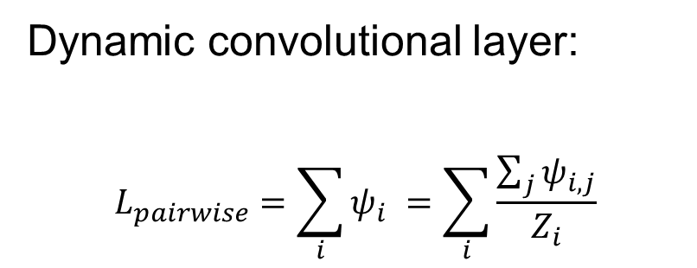

























Network structure
$$32$$
$$32$$
$$32$$
$$2$$
$$1$$
$$1$$
$$32$$
$$32$$
$$32$$
$$512×512$$
$$512×512$$
$$512×512$$
$$512×512$$
$$spatially consistent cost$$
$$512×512$$
$$512×512$$
$$512×512$$
$$512×512$$
$$64$$
$$64$$
Dynamic convolutional layer:
$$L_{pairwise}=\sum_{i}{ψ_{i}} =\sum_{i}{\frac{\sum_{j}{ψ_{i,j}}}{Z_{i}}}$$
$$64$$
$$64$$
$$64$$
$$cross entropy cost$$
${256}^{2}$
${256}^{2}$
${256}^{2}$
${256}^{2}$
${256}^{2}$
${256}^{2}$
$$128$$
$$128$$
$$128$$
$$128$$
$$128$$
${128}^{2}$
${128}^{2}$
${128}^{2}$
${128}^{2}$
${128}^{2}$
${128}^{2}$
$$conv 3×3, ReLU$$
$$256$$
$$256$$
$$256$$
$$256$$
$$256$$
$$copy and crop$$
${64}^{2}$
${64}^{2}$
${64}^{2}$
$$conv 1×1, ReLU$$
${64}^{2}$
${64}^{2}$
${64}^{2}$
$$dynamic−conv 3×3$$
${32}^{2}$
$$512$$
$$max pool 2×2$$
${32}^{2}$
${32}^{2}$
$$up−conv 2×2$$

Slide 7
CRF as 3-by-3 dynamic convolutional layer
…
Output probability map from DCNN

Slide 8
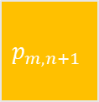
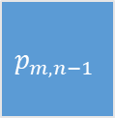
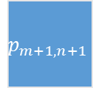
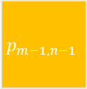
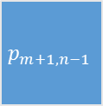

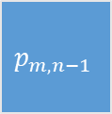
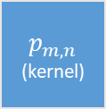
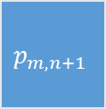
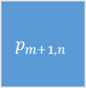
CRF as 3-by-3 dynamic convolutional layer
…
$$p_{m−1,n−1}$$
$$p_{m,n−1}$$
$$p_{m,n+1}$$
$$p_{m,n−1}$$
$$p_{m,n}$$
(kernel)
$$p_{m,n+1}$$
$$p_{m+1,n−1}$$
$$p_{m+1,n}$$
$$p_{m+1,n+1}$$
$p$: belief of a pixel to the predicted label
Output probability map from DCNN

Slide 9
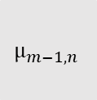
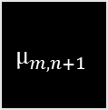
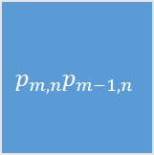
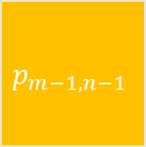
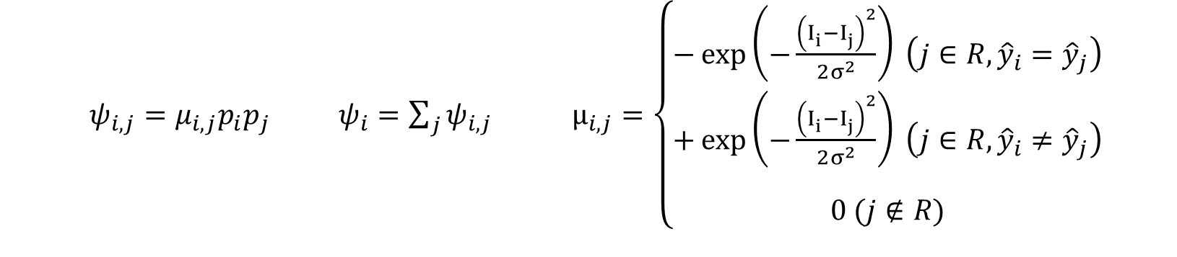
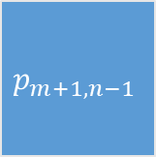
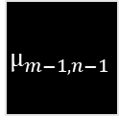
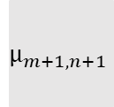
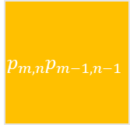
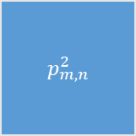
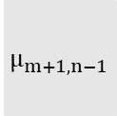

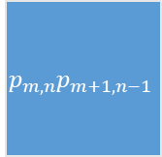
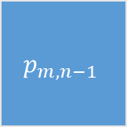


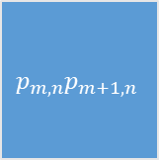
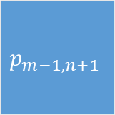
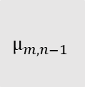

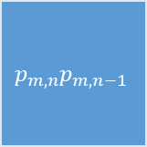
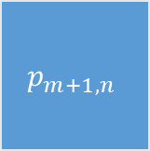
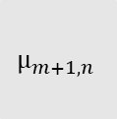
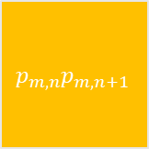
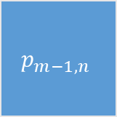
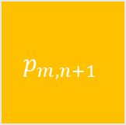
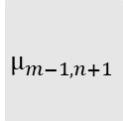
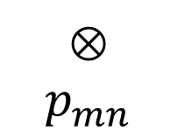
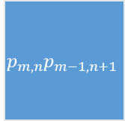
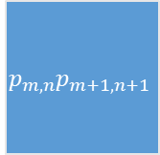
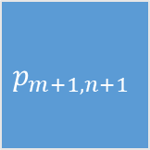
CRF as 3-by-3 dynamic convolutional layer
$ψ_{i,j}=μ_{i,j}p_{i}p_{j}$ $ψ_{i}=\sum_{j}{ψ_{i,j}}$ $μ_{i,j}=\left\{\begin{aligned}−\exp\left(−\frac{{\left(I_{i}^{ }−I_{j}^{ }\right)}^{2}}{2σ^{2}}\right) \left(j∈R,{\hat{y}}_{i}={\hat{y}}_{j}\right) \\ +\exp\left(−\frac{{\left(I_{i}^{ }−I_{j}^{ }\right)}^{2}}{2σ^{2}}\right) \left(j∈R,{\hat{y}}_{i}≠{\hat{y}}_{j}\right) \\ \\ 0 (j∉R)\end{aligned}\right.$
$$p_{m−1,n−1}$$
$$p_{m−1,n}$$
$$p_{m−1,n+1}$$
$${p_{m,n}p}_{m−1,n−1}$$
$${p_{m,n}p}_{m−1,n}$$
$${p_{m,n}p}_{m−1,n+1}$$
$$μ_{m−1,n−1}$$
$$μ_{m−1,n}$$
$$μ_{m−1,n+1}$$
$$p_{m,n−1}$$
$$p_{m,n}$$
(kernel)
$$p_{m,n+1}$$
$${p_{m,n}p}_{m,n−1}$$
$p_{m,n}^{2}$
$${p_{m,n}p}_{m,n+1}$$
$$$$
$$μ_{m,n−1}$$
$$0$$
$$μ_{m,n+1}$$
$$ψ_{i}$$
$$p_{m+1,n−1}$$
$$p_{m+1,n}$$
$$p_{m+1,n+1}$$
$$$$
$$p_{mn}$$
$${p_{m,n}p}_{m+1,n−1}$$
$${p_{m,n}p}_{m+1,n}$$
$${p_{m,n}p}_{m+1,n+1}$$
$$μ_{m+1,n−1}$$
$$μ_{m+1,n}$$
$$μ_{m+1,n+1}$$
Notes:
General theory first
Then computing details

Slide 10
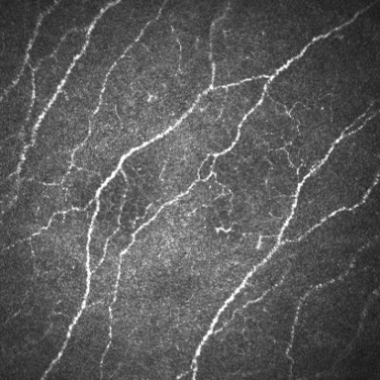
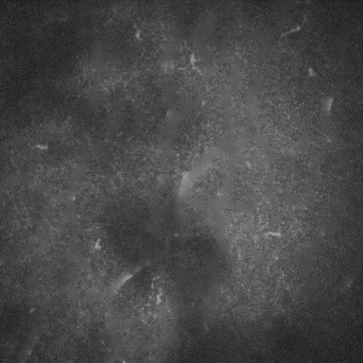
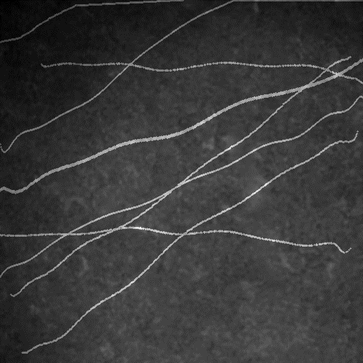
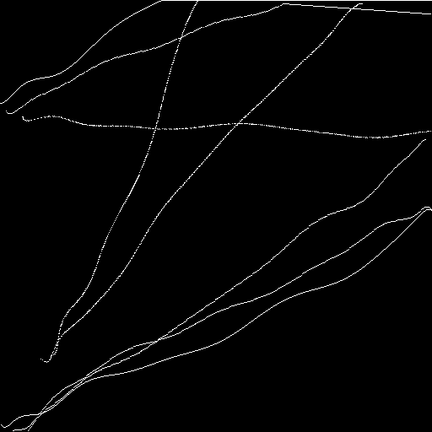

Synthesized dataset
CCM image
Image inpainting
Background
Synthesized image
(input image)
Morphological operation
Generate random
polynomial curves
(ground truth label)
Inaccurate label
(label for training)

Slide 11


Quantitative results of synthesized dataset
500 training, 500 testing, image size: $512×512$
300 epochs, 25% dropout, Adam optimizer with learning rate ${10}^{−4}$
Running time of dynamic convolution (per iteration): 0.036s
Method | Dice | Precision | Recall
Baseline | $$0.38±0.04$$ | $$0.94±0.06$$ | $$0.24±0.03$$
Chen [2] | $$0.67±0.12$$ | $$0.58±0.15$$ | $$0.84±0.07$$
U-net [1] | $$0.60±0.10$$ | $$0.98±0.02$$ | $$0.45±0.03$$
U-net+CRF [3] | $$0.64±0.13$$ | $$0.97±0.03$$ | $$0.50±0.04$$
Proposed | $$0.80±0.12$$ | $$0.90±0.04$$ | $$0.75±0.06$$
[1]Olaf Ronneberger, et al, MICCAI, 2015, pp. 234–241.
[2] Chen X, et al. IEEE Transactions on Biomedical Engineering, 2016, 64(4): 786-794.
[3] Chen L C, et al. arXiv preprint arXiv:1412.7062, 2014.
Notes:
Compare
Handcraft feature
Refine using CRF two step
Two term cost function
Some has higher in one but bad in other evaluation
Overall best in terms of DC

Slide 12

Qualitative results of real CCM Images
(a) CCM image
(b) Inaccurate manual annotation
(c) Result of Chen’s method
(d) Result of U-net
(e) Result of U-net+CRF
(f) Result of our method
(a) (b) (c)
(d) (e) (f)
Notes:
Consistent with numerical result

Slide 13
Summary
Our method integrates CRF with DCNN to achieve image segmentation with inaccurate labels.
Implemented the CRF as a dynamic convolutional layer
Advantages of our method
More accurate segmentation results using inaccurate labels.
Avoid overfitting to the data as local image information is also considered simultaneously.
The proposed dynamic convolutional layer could be integrated to any other DCNN based models.

Slide 14
Thanks for Watching!
Contact:
ningz@ece.ubc.ca,
Xin.Chen@nottingham.ac.uk

Slide 15

The authors are very grateful for support by Poling Program in Nankai University. This work was supported by the National Science Fund for Talent Training in the Basic Sciences ($No. J1103208$).

Slide 16


























Dynamic convolutional layer
$$p_{m−1,n−1}$$
$$p_{m,n−1}$$
$$p_{m,n+1}$$
$$−1$$
$$+1$$
$$+1$$
$$−{p_{m,n}p}_{m−1,n−1}$$
$${+p_{m,n}p}_{m,n−1}$$
$${{+p}_{m,n}p}_{m,n+1}$$
$$p_{m,n−1}$$
$$p_{m,n}$$
(kernel)
$$p_{m,n+1}$$
$$+1$$
$$0$$
(kernel)
$$−1$$
$$+{p_{m,n}p}_{m,n−1}$$
$$0$$
(kernel)
$${−p_{m,n}p}_{m,n+1}$$
$$p_{m+1,n−1}$$
$$p_{m+1,n}$$
$$p_{m+1,n}$$
$$+1$$
$$+1$$
$$+1$$
$$+{p_{m,n}p}_{m+1,n−1}$$
$${+p_{m,n}p}_{m+1,n}$$
$${+p_{m,n}p}_{m+1,n}$$
output from FCN

Slide 17






synthesized dataset
Abstract background
synthesized image
Generate random
polynomial curves
Gaussian noise

Slide 18




synthesized dataset
$512×512$ Input images
(500 for training; 500 for testing )
Abstract background
synthesized image
Inaccurate label
Generate random
polynomial curves
Gaussian noise
$512×512$ binary label for training

