Slide 1


EAST WEST INSTITUTE OF TECHNOLOGY
(Affiliated to Visvesvaraya Technological University, Belgaum) No.63, Anjananagar, Off Magadi Road, Near BEL Layout, Bengaluru, Karnataka 560091
DEPARTMENT OF ELECTRONICS AND COMMUNICATION ENGINEERING
TECHNICAL SEMINAR
ON
“Online Mapping and Motion Planning Under Uncertainty for Safe Navigation in Unknown Environments”
Under the Guidance of :
PRESENTED BY
Prof. DIVYA BN
Asst. Professor,
Dept. of ECE, EWIT
1EW18EC138 – NINGARAJU M

Slide 2
CONTENTS
ABSTRACT
INTRODUCTION
OBJECTIVES
LITERATURE SURVEY
METHODOLOGY
ADVANTAGES
DISADVANTAGES
CONCLUSION
REFERENCES

Slide 3
ABSTRACT
Safe autonomous navigation is an essential and challenging problem for robots operating in highly unstructured or completely unknown environments. Under these conditions, not only robotic systems must deal with limited localization information but also their maneuverability is constrained by their dynamics and often suffers from uncertainty. In order to cope with these constraints, this article proposes an uncertainty-based framework for mapping and planning feasible motions online with probabilistic safety guarantees.
1) incrementally mapping the surroundings to build an uncertainty aware representation of the environment and 2) iteratively (re)planning trajectories.

Slide 4
INTRODUCTION
AUTONOMOUS robots have been increasingly employed to assist humans notably in hazardous or inaccessible environments in recent years.
It include rescue missions in disaster response scenarios, in water ship hull and wind turbine inspections and deep underwater and space exploration.
A fundamental requirement for a robot engaged in any of these applications is to be adept at navigating autonomously through highly unstructured and hostile environments.
This is the first generic architecture capable of jointly dealing with kinodynamic and probabilistic constraints in unknown environments online.

Slide 5
OBJECTIVES
The objective of this paper is to implement planning under kinodynamic constraints deals with challenge of computing trajectories.
The platform has been built to provide services like planning under uncertanity in localization and disturbance in operational environmental.
This platform provides frame work for online mapping-planning and environmental awareness.

Slide 6
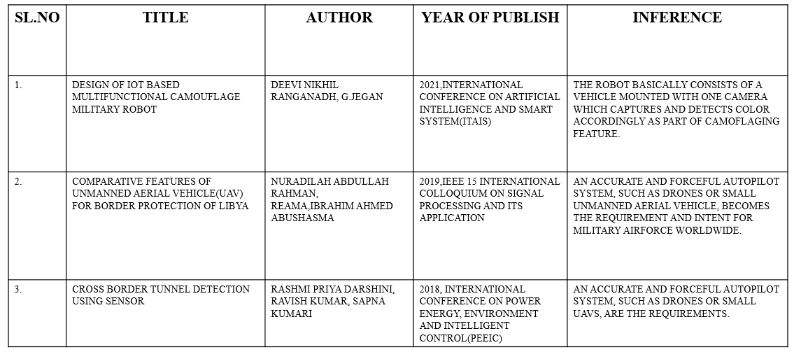
LITERATURE SURVEY

Slide 7
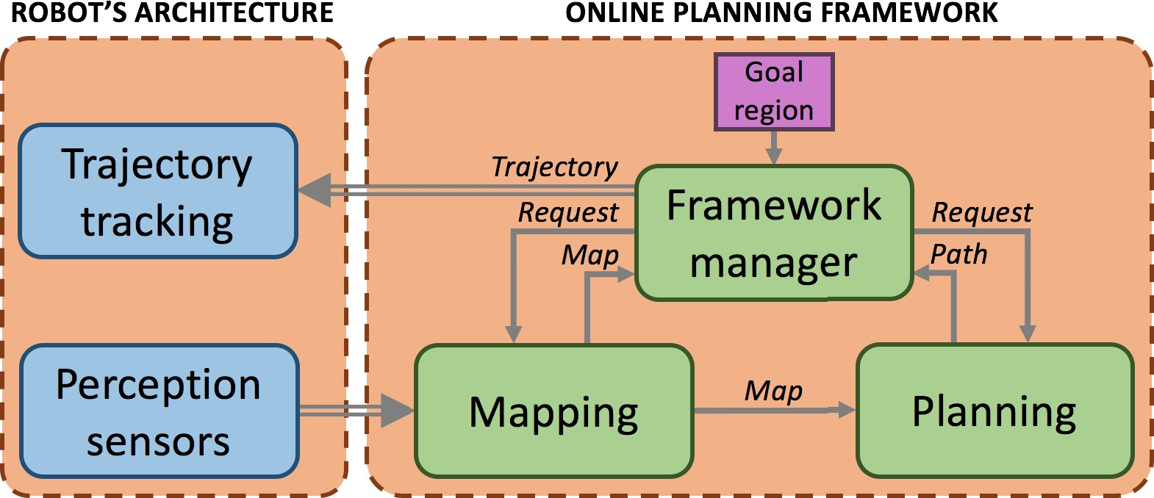
METHODLOGY

Slide 8
A. Motion Uncertainty and Constraints
Consider a mobile robot that operates in a workspace , under motion uncertainty.The uncertainty in the robot’s motion can be due to many reasons.
B. Environment Uncertainty
Some applications in robotics lack complete awareness of the environment, either because there is no information about the surroundings or due to the presence of dynamic elements in the workspace.

Slide 9
C. FRAMEWORK FOR ONLINE NAVIGATION
This article presents a framework that endows a robotic system with the capability of safely navigating through unknown environments. This is achieved by means of online mapping and online motion planning of trajectories that meet motion and probabilistic constraints.
D. INCREMENTALLY MAPPING UNKNOWN ENVIRONMENTS VIA LOCAL MAPS
Incrementally exploring the environment with a location- uncertain system leads to an uncertain representation of the surroundings. Under these conditions, obtaining a consistent and reliable representation of the entire environment is a challenging task commonly addressed with probabilistic inference approaches.

Slide 10
E. MULTILAYERED MOTION PLANNING UNDER ENVIRONMENT AND
MOTION UNCERTAINTY
The planning problem defined in Section III-D has two main requirements
samples feasible states in the system’s state space and
extends and validates the tree of motions in the belief space.
F. NAVIGATION IN UNKNOWN 2-D ENVIRONMENTS
An early version of the work presented in this article has appeared before . This consisted of a simpler framework that evaluated all uncertainties on the fly (in contrast to the proposed cumulative map encoding) while exploring the belief space via a single-layered planner (in contrast to the proposed multilayered guided exploration)

Slide 11
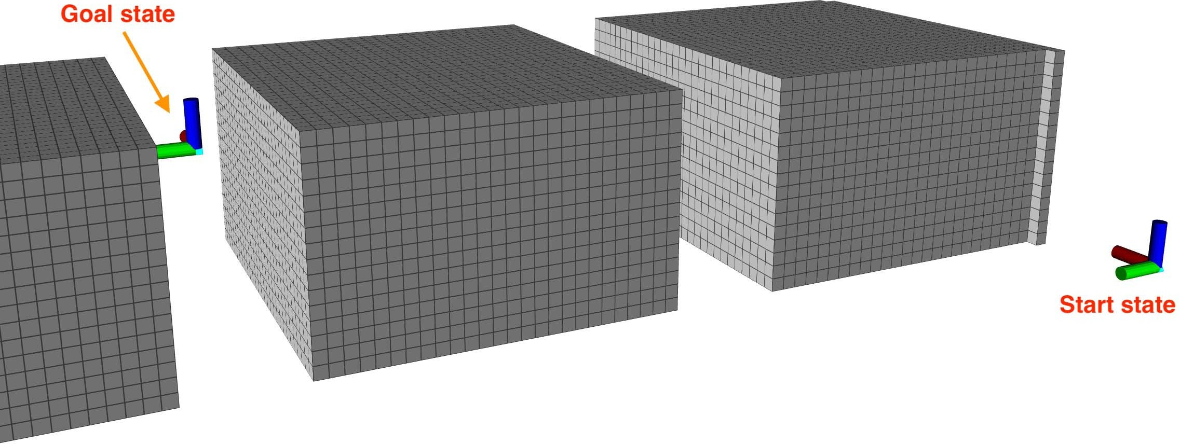
ADVANTAGES
Web maps can easily deliver to up to date information .
Software and hardware for web maps is cheeper .
Product updates can easily distrubuted .
Mappping allows for personalisation

Slide 12

DISADVANTAGES
More costly and complex to develop.
Lack of technical knowledge.
Requires user training and orientation.
Some mapping tools may have limited cartography and graphic design option

Slide 13
CONCLUSION
This article has presented a novel end-to-end framework that probabilistically guarantees the robot’s safety when navigating in unexplored environments. The proposed approach is twofold.
1) incrementally maps the vehicle’s surroundings to build an uncertain representation of the environment
2) plans feasible trajectories (according to the robot’s kinodynamic constraints) with probabilistic safety guarantees (according to the uncertainties in the vehicle’s localization, motion, and mapping).

Slide 14
REFERENCE
A.-A. Agha-Mohammadi, S. Chakravorty, and N. M. Amato, “FIRM: Sampling-based feedback motion-planning under motion uncertainty and imperfect measurements,” Int. J. Robot. Res., vol. 33, no. 2, pp. 268–304, 2014.
A.-A. Agha-Mohammadi, S. Agarwal, S.-K. Kim, S. Chakravorty, and
N. M. Amato, “SLAP: Simultaneous localization and planning under uncertainty via dynamic replanning in belief space,” IEEE Trans. Robot., vol. 34, no. 5, pp. 1195–1214, Oct. 2018.
A.-A. Agha-Mohammadi, E. Heiden, K. Hausman, and G. Sukhatme, “Confidence-rich grid mapping,” Int. J. Robot. Res., vol. 38, nos. 12–13, pp. 1352–1374, Oct. 2019.
A. Agha et al., “NeBula: Quest for robotic autonomy in challeng- ing environments; TEAM CoSTAR at the DARPA subterranean chal- lenge,” 2021, arXiv:2103.11470. [Online]. Available: http://arxiv.org/ abs/2103.11470
R. Alterovitz, T. Simeon, and K. Goldberg, “The stochastic motion roadmap: A sampling framework for planning with Markov motion uncertainty,” in Proc. Robot., Sci. Syst. III, Jun. 2007, pp. 233–241.

Slide 15
THANK YOU

