Slide 1


實事求是
Symbolic Execution Techniques
Static Symbolic Execution,
Dynamic Symbolic Execution,
Selective Symbolic Execution,
Symbolic Backward Execution,
Some Challenges

Slide 2
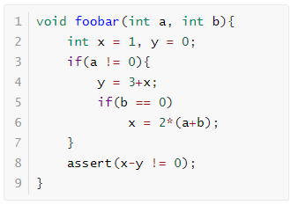
Static Symbolic Execution
function foobar
entry
a = 0
int x=1, y=0;
a != 0, b != 0
a != 0
a = 0, b = 0
y = 3+x
b == 0
每具体执行一次只能获得一条路径，但是又不知道如何去探索新路径，使用普通fuzzing生成可能很难探索到新路径
x = 2*(a+b)
assert();

Slide 3
Static Symbolic Execution
每个分支都需要求解，开销比较大
程序不是自包含的，外部API无法执行
a = V1, b = V2
PC: true
a = V1, b = V2, x = 1, y = 0
PC: true
a = V1, b = V2, x = 1, y = 0
PC: V1 != 0
a = V1, b = V2, x = 1, y = 0
PC: V1 = 0
a = V1, b = V2, x = 1, y = 4
PC: V1 != 0
V1 = 0 ^ 1 - 0 != 0
a = V1, b = V2, x = 1, y = 4
PC: V1 != 0 ^ V2 = 0
a = V1, b = V2, x = 1, y = 4
PC: V1 != 0 ^ V2 != 0
a = V1, b = V2, x = 2*(V1+V2), y = 4
PC: V1 != 0 ^ V2 = 0
V1 != 0 ^ V2 != 0 ^ 1 - 4 != 0
V1 != 0 ^ V2 = 0 ^ 2*(V1+V2) - 4 != 0

Slide 4
Dynamic Symbolic Execution
对于求解的路径可以进行选择
无法解决大型程序
a = V1, b = V2
a = 1,b = 1
PC: true
a = V1, b = V2, x = 1, y = 0
a = 1,b = 1, x = 1, y = 0
PC: true
a = V1, b = V2, x = 1, y = 0
a = 1,b = 1, x = 1, y = 0
PC: V1 != 0
a = V1, b = V2, x = 1, y = 0
PC: V1 = 0
a = V1, b = V2, x = 1, y = 4
a = 1,b = 1, x = 1, y = 4
PC: V1 != 0
a = V1, b = V2, x = 1, y = 4
PC: V1 != 0 ^ V2 = 0
a = V1, b = V2, x = 1, y = 4
a = 1,b = 1, x = 1, y = 4
PC: V1 != 0 ^ V2 != 0

Slide 5
Dynamic Symbolic Execution
对于求解的路径可以进行选择
无法解决大型程序
a = V1, b = V2
a = 1,b = 1
PC: true
a = V1, b = V2, x = 1, y = 0
a = 1,b = 1, x = 1, y = 0
PC: true
a = V1, b = V2, x = 1, y = 0
a = 1,b = 1, x = 1, y = 0
PC: V1 != 0
a = V1, b = V2, x = 1, y = 0
PC: V1 = 0
a = V1, b = V2, x = 1, y = 4
a = 1,b = 1, x = 1, y = 4
PC: V1 != 0
a = V1, b = V2, x = 1, y = 4
PC: V1 != 0 ^ V2 = 0
a = V1, b = V2, x = 1, y = 4
a = 1,b = 1, x = 1, y = 4
PC: V1 != 0 ^ V2 != 0

Slide 6
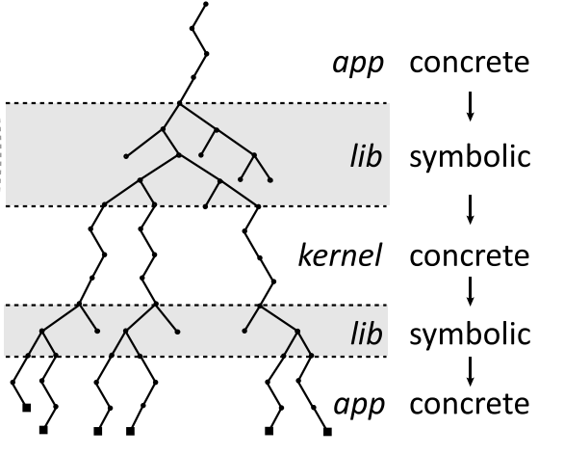
Selective Symbolic Execution
假设app中包含函数 A，调用 lib 中的函数 B，并且B中涉及到未知的外部接口
1
具体执行 -> 符号执行：B被完全的符号执行，并且也会使用从A中获得的具体值具体执行
2
符号执行 -> 具体执行：对当前路径进行约束求解并且将B的参数具体化，从而探索具体的外部接口的值
3
具体执行 -> 符号执行：使用当前分支下的具体返回值直接替代外部接口，继续进行符号执行
4
符号执行 -> 具体执行：接受具体执行的返回值，对过程中收集的约束进行求解，进行新的具体执行。

Slide 7
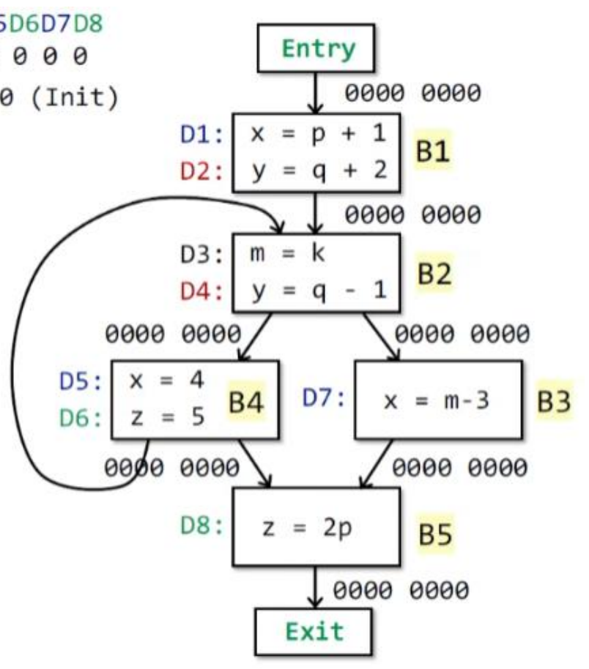
Backward Symbolic Execution
目的：生成覆盖目标行的测试输入
方案：从目标点书法，反向符号执行到函数入口
要求：必须有完整的控制流图

Slide 8
Path Selection

Slide 9
Memory Model

Slide 10
Interaction With The Environment

Slide 11
Path Explosion

Slide 12
Constraint Solving

