Slide 1


實事求是
Symbolic Execution Techniques
Static Symbolic Execution,
Dynamic Symbolic Execution,
Selective Symbolic Execution,
Symbolic Backward Execution,
Some Challenges

Slide 2
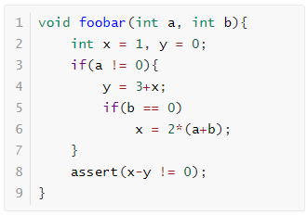
Concrete Execution
function foobar
entry
a = 0
int x=1, y=0;
a != 0, b != 0
a != 0
a = 0, b = 0
y = 3+x
b == 0
每具体执行一次只能获得一条路径，但是又不知道如何去探索新路径，使用普通fuzzing生成可能很难探索到新路径
x = 2*(a+b)
assert();

Slide 3
Static Symbolic Execution
每个分支都需要求解，开销比较大
程序不是自包含的，外部API无法执行
a = V1, b = V2
PC: true
a = V1, b = V2, x = 1, y = 0
PC: true
a = V1, b = V2, x = 1, y = 0
PC: V1 != 0
a = V1, b = V2, x = 1, y = 0
PC: V1 = 0
a = V1, b = V2, x = 1, y = 4
PC: V1 != 0
V1 = 0 ^ 1 - 0 != 0
a = V1, b = V2, x = 1, y = 4
PC: V1 != 0 ^ V2 = 0
a = V1, b = V2, x = 1, y = 4
PC: V1 != 0 ^ V2 != 0
a = V1, b = V2, x = 2*(V1+V2), y = 4
PC: V1 != 0 ^ V2 = 0
V1 != 0 ^ V2 != 0 ^ 1 - 4 != 0
V1 != 0 ^ V2 = 0 ^ 2*(V1+V2) - 4 != 0

Slide 4
Dynamic Symbolic Execution
对于求解的路径可以进行选择
无法解决大型程序
a = V1, b = V2
a = 1,b = 1
PC: true
a = V1, b = V2, x = 1, y = 0
a = 1,b = 1, x = 1, y = 0
PC: true
a = V1, b = V2, x = 1, y = 0
a = 1,b = 1, x = 1, y = 0
PC: V1 != 0
a = V1, b = V2, x = 1, y = 0
PC: V1 = 0
a = V1, b = V2, x = 1, y = 4
a = 1,b = 1, x = 1, y = 4
PC: V1 != 0
a = V1, b = V2, x = 1, y = 4
PC: V1 != 0 ^ V2 = 0
a = V1, b = V2, x = 1, y = 4
a = 1,b = 1, x = 1, y = 4
PC: V1 != 0 ^ V2 != 0

Slide 5
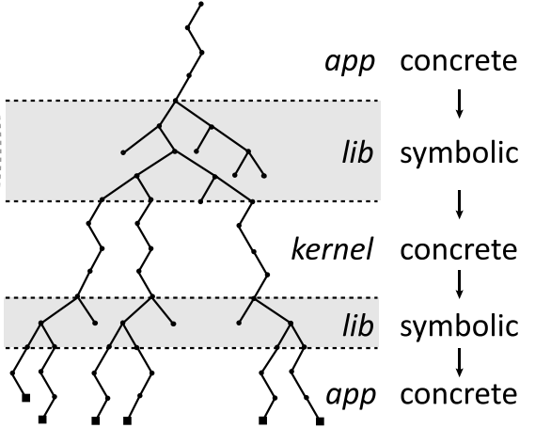
Selective Symbolic Execution
假设app中包含函数 A，调用 lib 中的函数 B，并且B中涉及到未知的外部接口
1
具体执行 -> 符号执行：B被完全的符号执行，并且也会使用从A中获得的具体值具体执行
2
符号执行 -> 具体执行：对当前路径进行约束求解并且将B的参数具体化，从而探索具体的外部接口的值
3
具体执行 -> 符号执行：使用当前分支下的具体返回值直接替代外部接口，继续进行符号执行
4
符号执行 -> 具体执行：接受具体执行的返回值，对过程中收集的约束进行求解，进行新的具体执行。

Slide 6
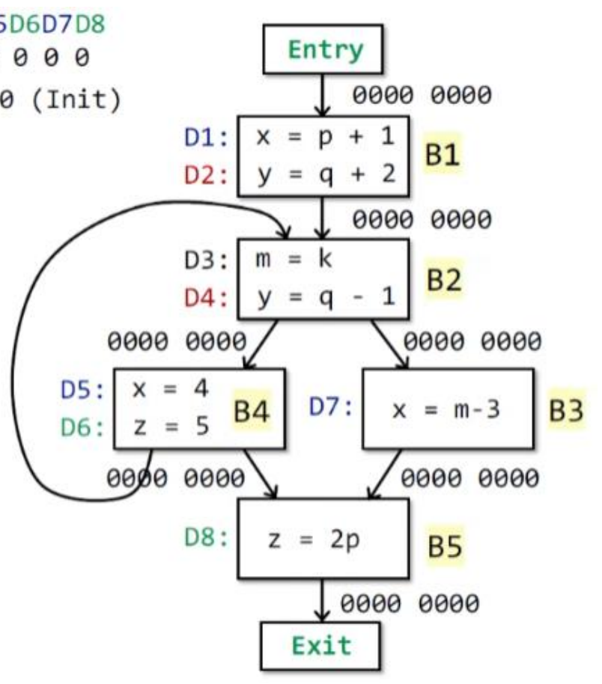
Backward Symbolic Execution
目的：生成覆盖目标行的测试输入
方案：从目标点出发，反向符号执行到函数入口
要求：必须有完整的控制流图

Slide 7
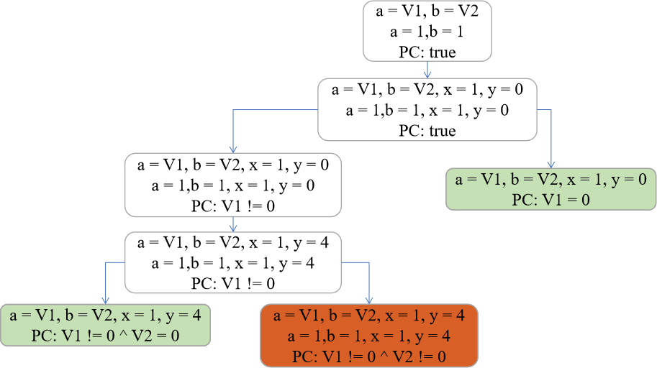
Path Selection
1
Depth-first search：对内存需求小，但是受循环影响大
2
Breadth-first search：对内存需求大，但是可以更快发现bug
3
Coverage optimize search：选择与未覆盖指令最近的分支
4
subpath-guided search：选择探索次数最少的路径

Slide 8
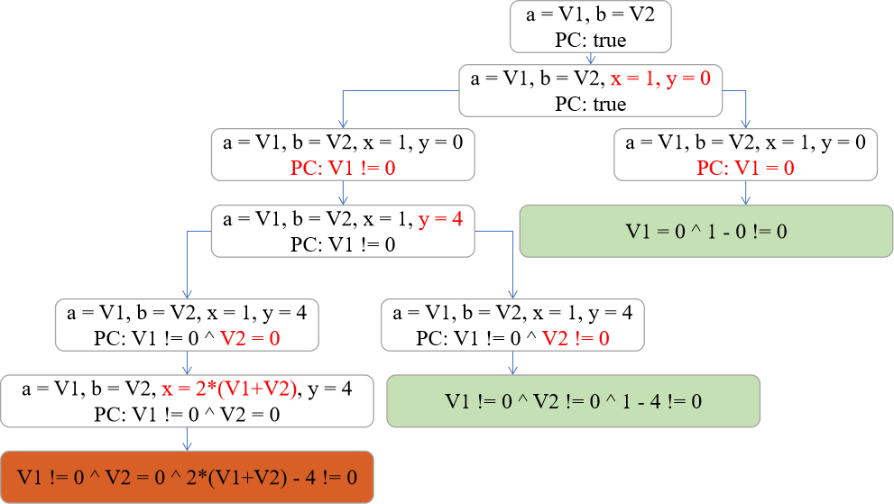
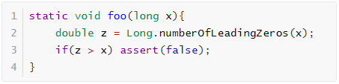
Challenge
1
Memory：符号执行如何处理指针、数组或其他复杂对象?
2
Environment：对库和系统代码的调用可能会导致未知的效果，符号执行如何处理跨软件堆栈的交互?
3
Path Explosion：符号执行如何处理路径爆炸?
4
Constraint Solving：约束求解器可以怎样来提高效率、准确性？

Slide 9
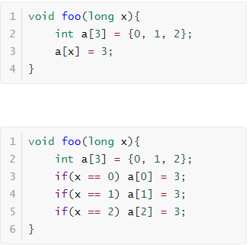
Memory Model—Fully Memory
x = V1
PC: true
x = V1, a[0] = 0, a[1] = 1 ,a[2] = 2
PC: true
x = V1, a[0] = 0, a[1] = 1 ,a[2] = 2
PC: V1 = 0
x = V1, a[0] = 0, a[1] = 1 ,a[2] = 2
PC: V1 = 2
x = V1, a[0] = 0, a[1] = 1 ,a[2] = 2
PC: V1 = 1
假设数组是依靠内存分配函数分配给指针的，就不能知道数组的大小，也就是还不能建模指针。
x = V1, a[0] = 0, a[1] = 3 ,a[2] = 2
PC: V1 = 1
x = V1, a[0] = 3, a[1] = 1 ,a[2] = 2
PC: V1 = 0
x = V1, a[0] = 0, a[1] = 1 ,a[2] = 3
PC: V1 = 2

Slide 10
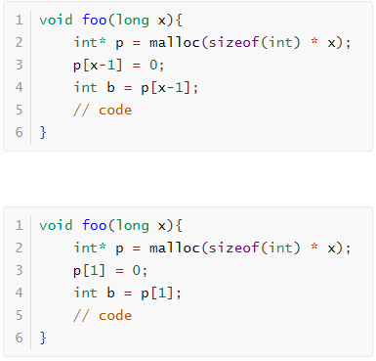
Memory Model—Address Concretization
x = 1
PC: true
x = V1
x = 1
PC: true
x = 1, p = 0x0000
PC: true
x = V1, p = 0x0000
x = 1, p = 0x0000
PC: true
x = 1, p = 0x0000, p[1] = 0
PC: true
x = V1, p = 0x0000, p[1] = 0
x = 1, p = 0x0000, p[1] = 0
PC: true
x = 1, p = 0x0000, p[1] = 0, b= 0
PC: true
x = V1, p = 0x0000, p[1] = 0, b = 0
x = 1, p = 0x0000, p[1] = 0, b= 0
PC: true
准确性损失过大，可以取两个内存模型的均衡，分析不同次具体执行时地址是否是接近的，如果比较接近则只使用一个指针。Fully Memory(每个指针对应一个状态)——Address Concretization(所有指针对应同一个状态)——Patial Memory(多个指针对应一个状态)

Slide 11
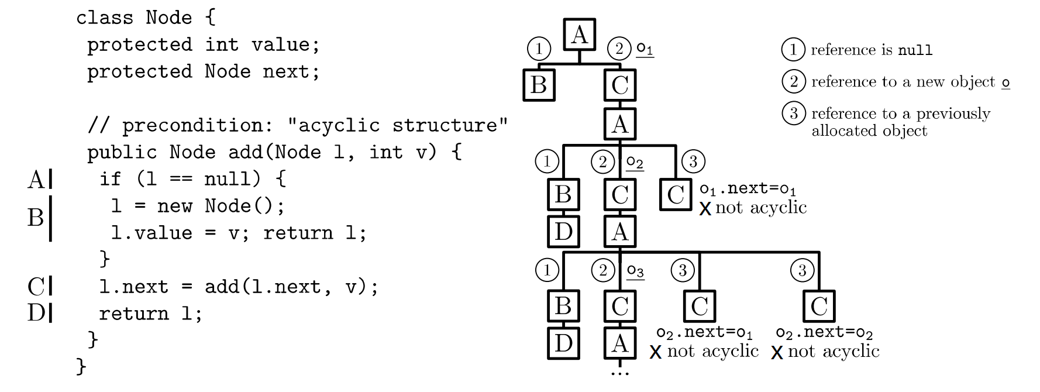
Memory Model—Object

Slide 12
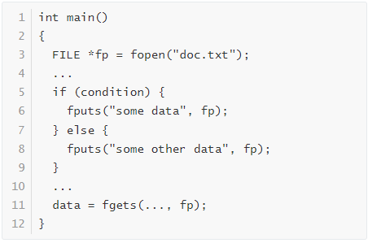
Interaction With The Environment
1
直接执行对环境的调用
2
对环境进行建模
3
分叉整个系统状态

Slide 13
Path Explosion

