Slide 1

The Useful Timer
By: code war

Slide 2
Agenda
Guiding question –
Features –
Demo –
Challenges –
Future improvement –
Special Thanks –
Q&A –

Slide 3
How often do you set the same timer repeatedly?
Notes:
Useful when it comes to routine

Slide 4
Save yourself some hassle!
Save time laps for specific events
Automatically time for the chosen event by the pre-set time laps
Add as many timers as needed
Perfect for you and I, us, multitaskers
Notes:
This timer is extremely useful as you wouldn’t need to set different timers every time you do an activity. Just save your activity and the time it needs to the website and whenever you click the activity your time is set for you!
For example: If you usually sleep for 8 hours, just save it to the timer and click on sleep and your timer will run for you!

Slide 5
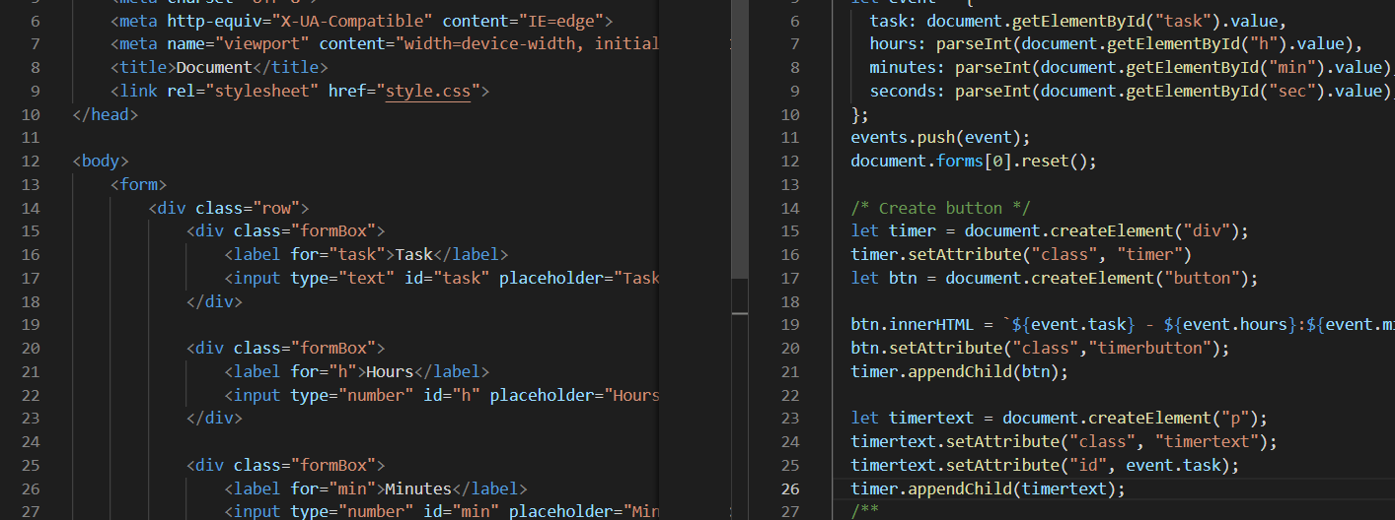
Demo
Languages used
HTML
CSS
Javascript
Click here to view demo

Slide 6
What we learned/enhanced AKA – challenges
Front-end Coding
Writing in HTML, CSS, JavaScript
We only knew Python, Java, and some C prior to this event
Soft skills​
Teamwork: Tasks were split among members and put together​
Communication: Ensuring that the goals were aligned and not hesitate to ask for help​
Problem breakdown: Break a project into small pieces​
Persistence: Continue working on the project despite a member dropped out​
Give up when appropriate: Switch project and accept sunk cost​

Slide 7
Future Improvements
Fixing the bugs:
Edge cases
if reclick on the event button, the timer will run two times at the same time
if add two button of the same name, the same time is counting down
timer and button move when run
Adding more features:
Having a sound notification when time is up
Improve the user experience and interface

Slide 8
Special Thanks
[Unity] Anita He
[Microsoft] Furaha Damién
[Facebook] Hani Damlaj
[Mentor] Jacob Reznikov
[Mentor] Jonas Vinson

Slide 9
Thank you – Q&A

