Slide 1
Investigating Effects of Nonlinear Acoustic Propagation on Shear Wave Speed Estimates
Ningrui Li
Lab Meeting, April 24, 2015

Slide 2
Objectives
Determine if varying the degree of nonlinearity in acoustic propagation causes changes in shear wave speed estimates at different focal depths.

Slide 3
Methods
Generate intensity fields using 3D KZK simulation with various attenuation and nonlinearity coefficients.
Simulate stresses and corresponding axial displacements using LS-DYNA and FEM post-processing tools.

Slide 4
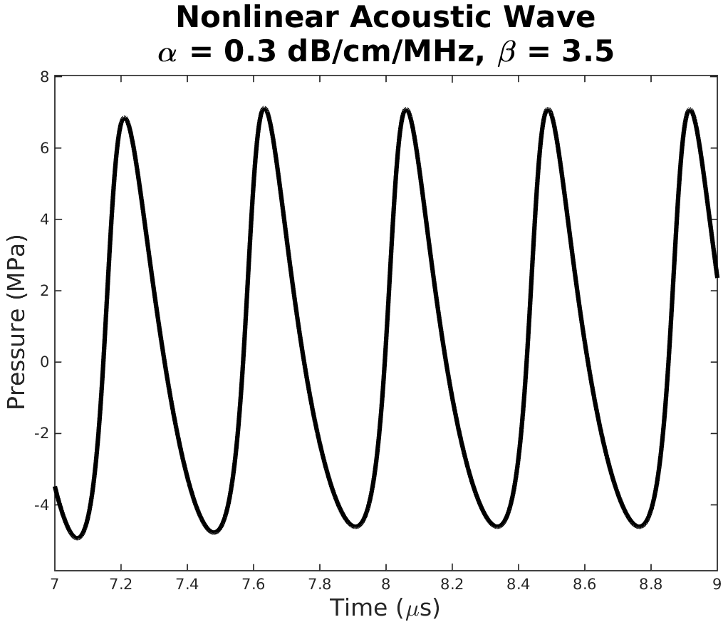

Methods – Generating Intensity Fields
Simulated C5-2 using Field II
2.36 MHz, 7 cycles, $\sim 4×{10}^{5} \text{Pa}$ amplitude
30 mm and 70 mm focal depths
α = [0.005, 0.3, 0.45, 1.0, 1.5] dB/cm/MHz
β = [0.0, 3.5, 7.0]

Slide 5
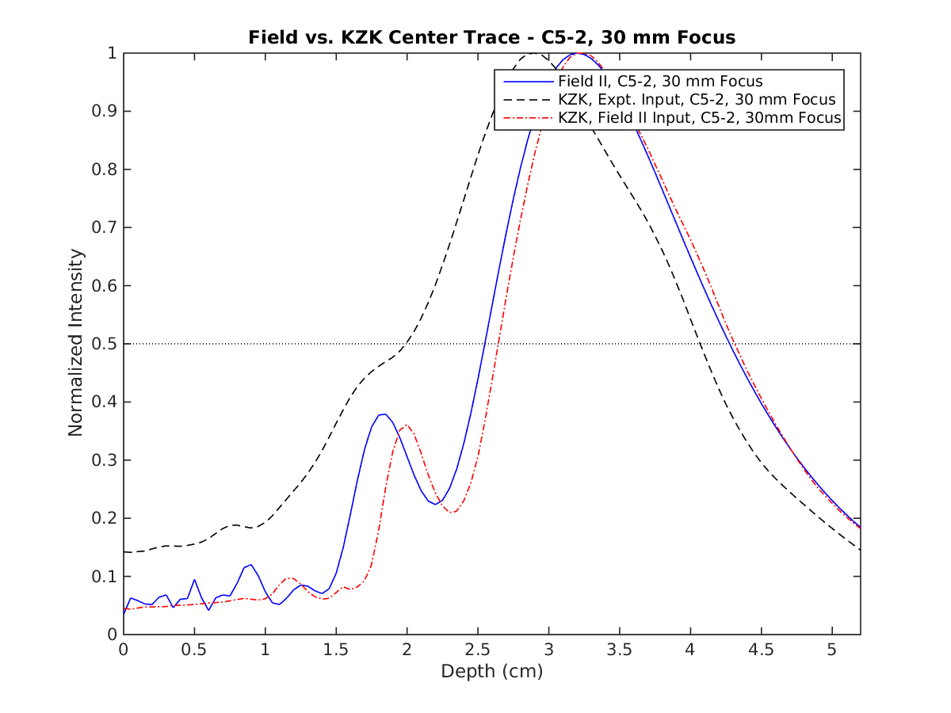
Validation with Field II – 30 mm Focus
Axial intensities down the center (lat = 0mm, ele = 0mm)
α = 0.005 dB/cm/MHz
β = 0
Notes:
Next series of plots are all center trace plots -> plots of axial intensities down the center of mesh.

Slide 6
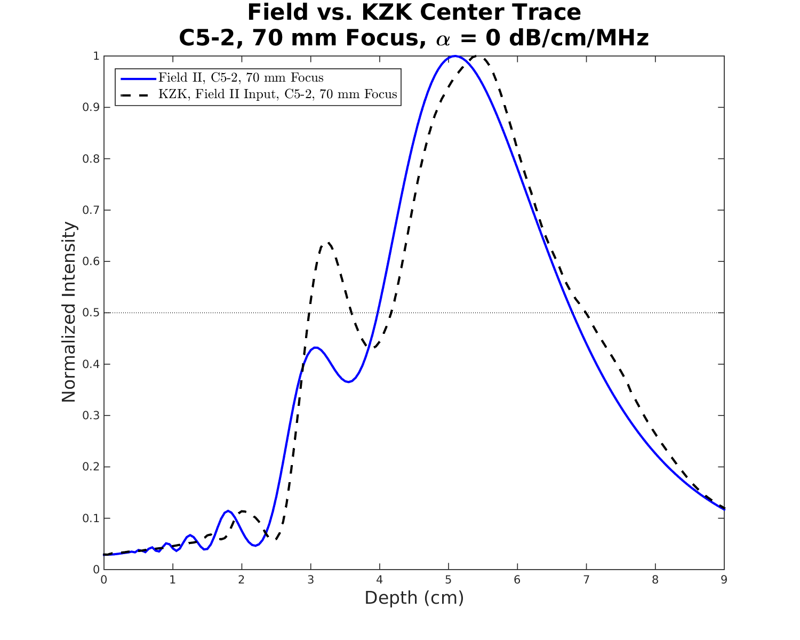
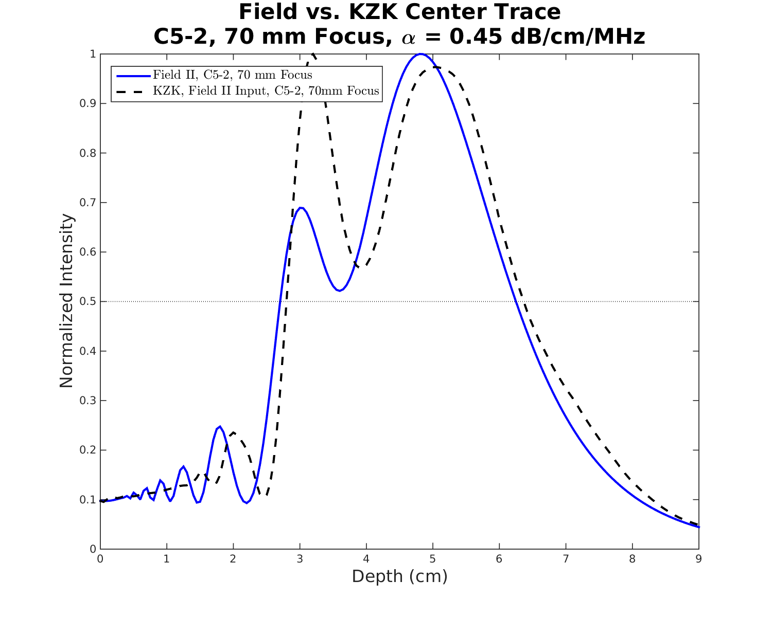
Validation with Field II – 70 mm Focus
α = 0 dB/cm/MHz
α = 0.45 dB/cm/MHz
Notes:
Attenuation differences between Field II and KZK sim? Match up slightly better for no attenuation cases for identical sim inputs when KZK sim run in linear mode.

Slide 7
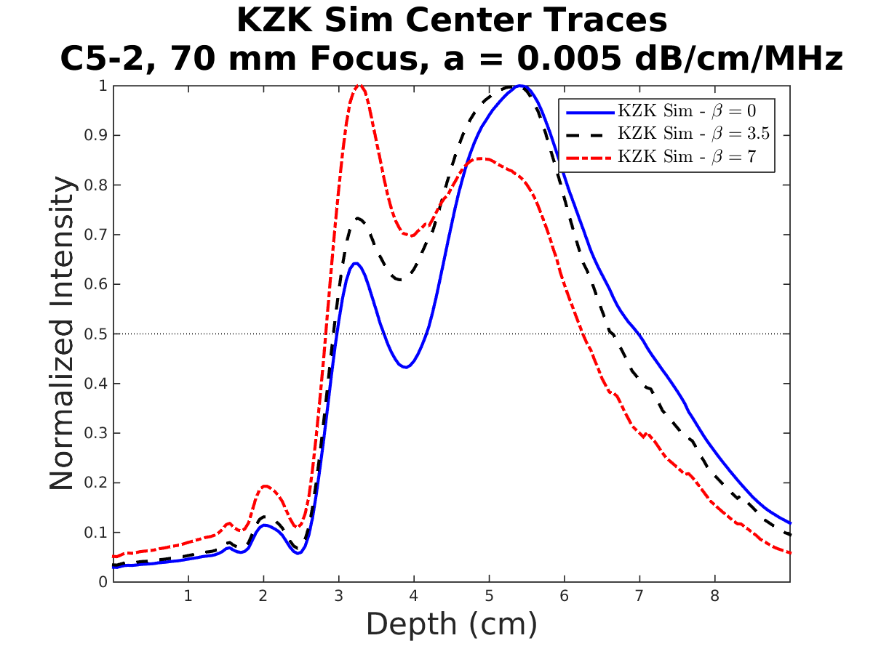
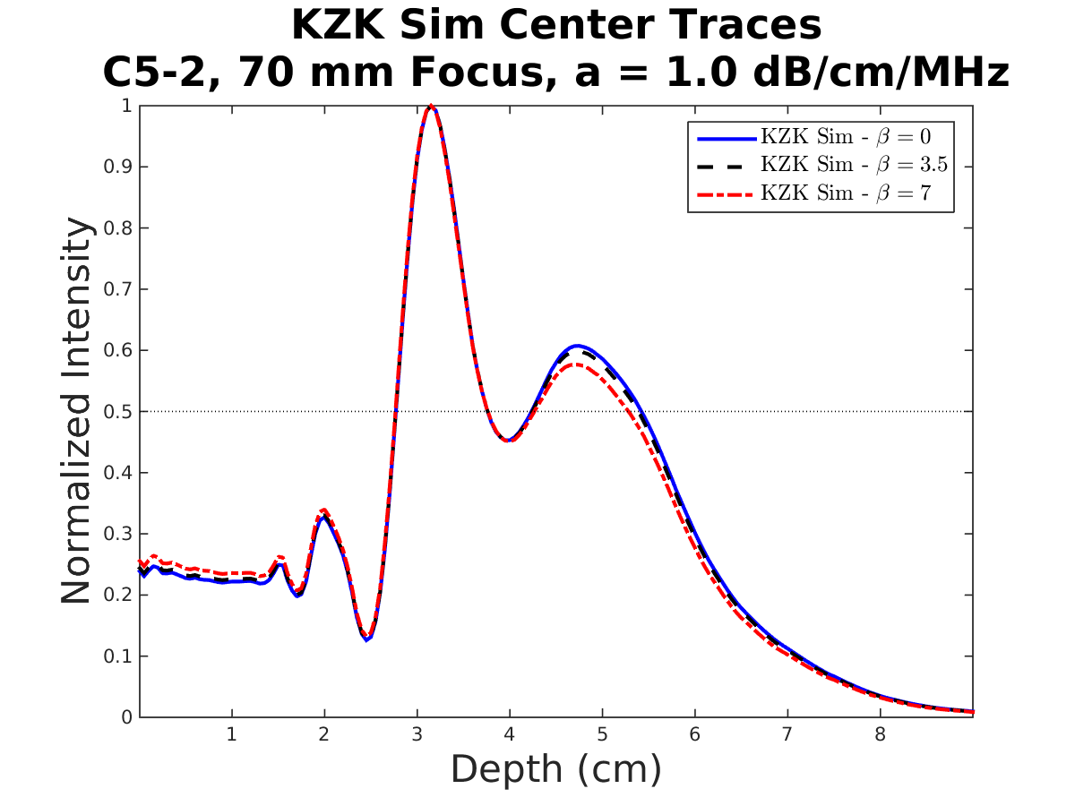
Intensity Fields with Increasing Nonlinearity
Notes:
As nonlinearity increases, the peak intensities occur at shallower depths. However, nonlinear affects are mitigated for greater attenuation levels.

Slide 8
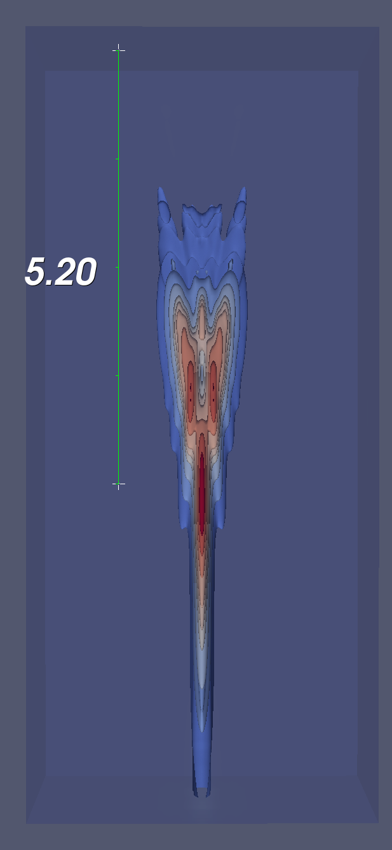
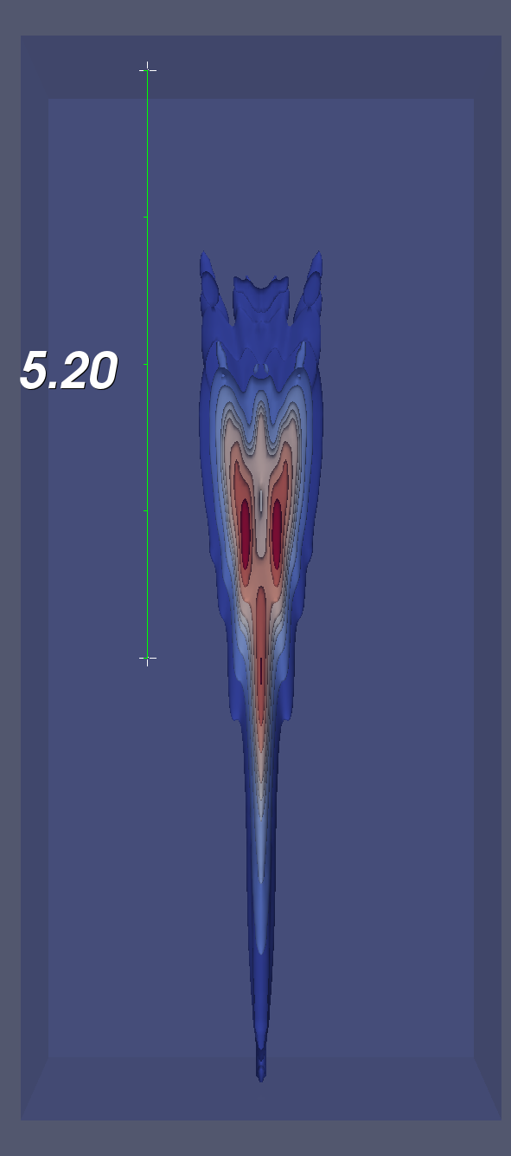
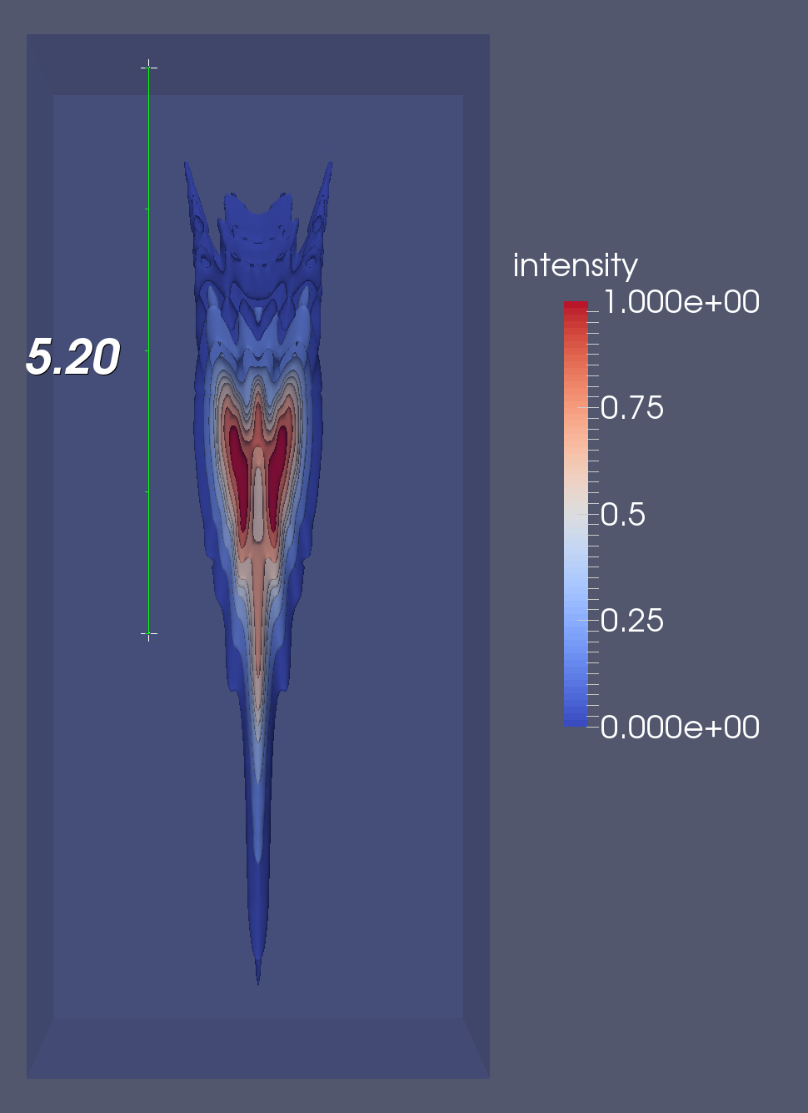
Intensity Fields with Increasing Nonlinearity
70 mm focus, α = 0.005 dB/cm/MHz
lateral
depth
β = 0.0
β = 3.5
β = 7.0

Slide 9
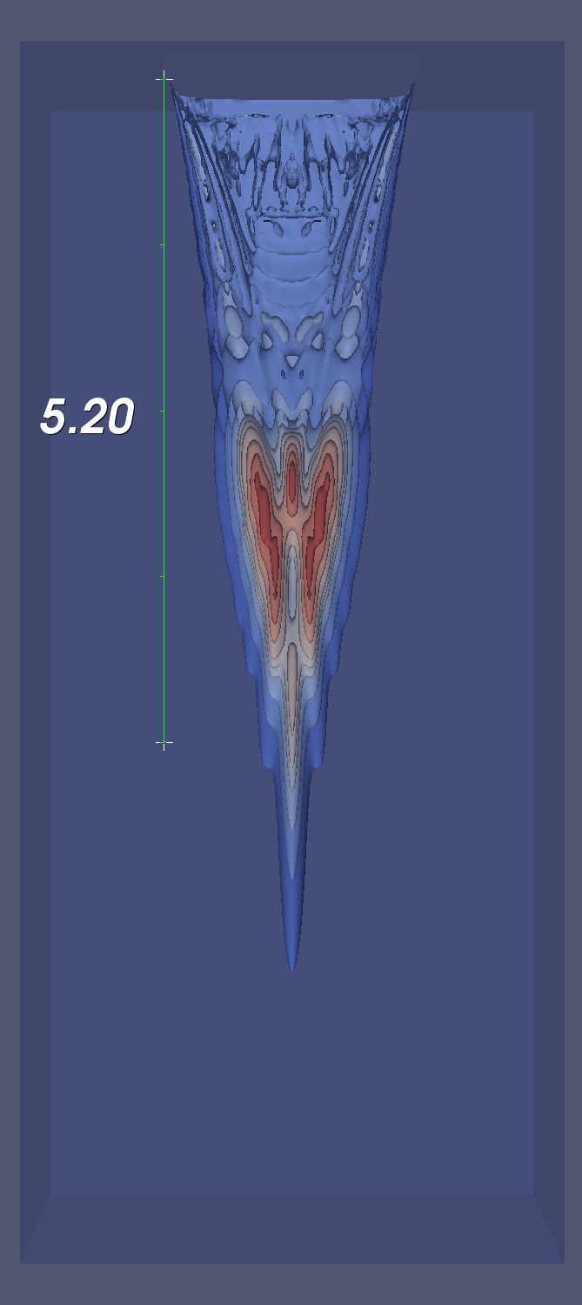
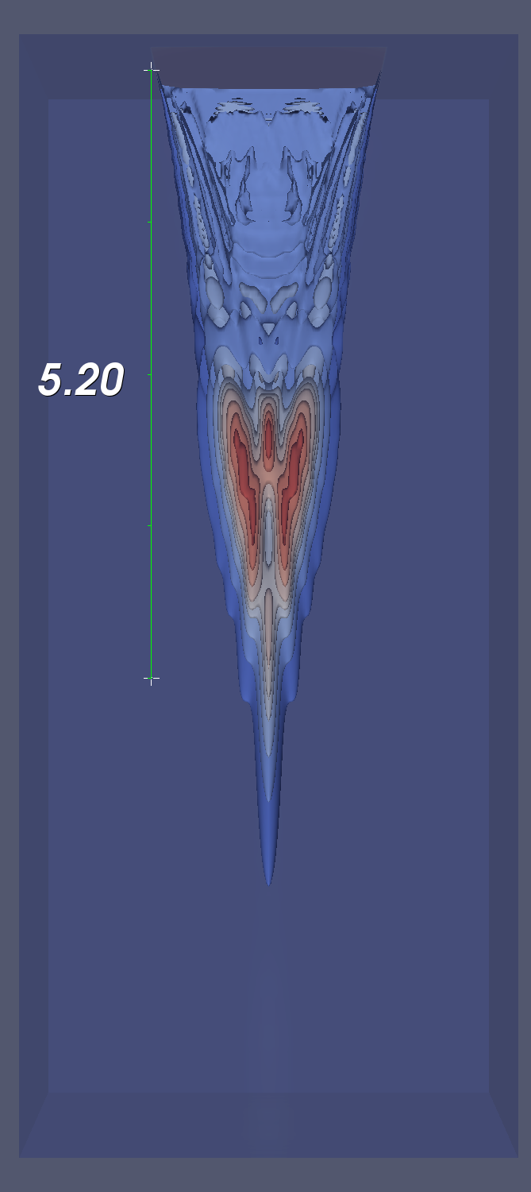
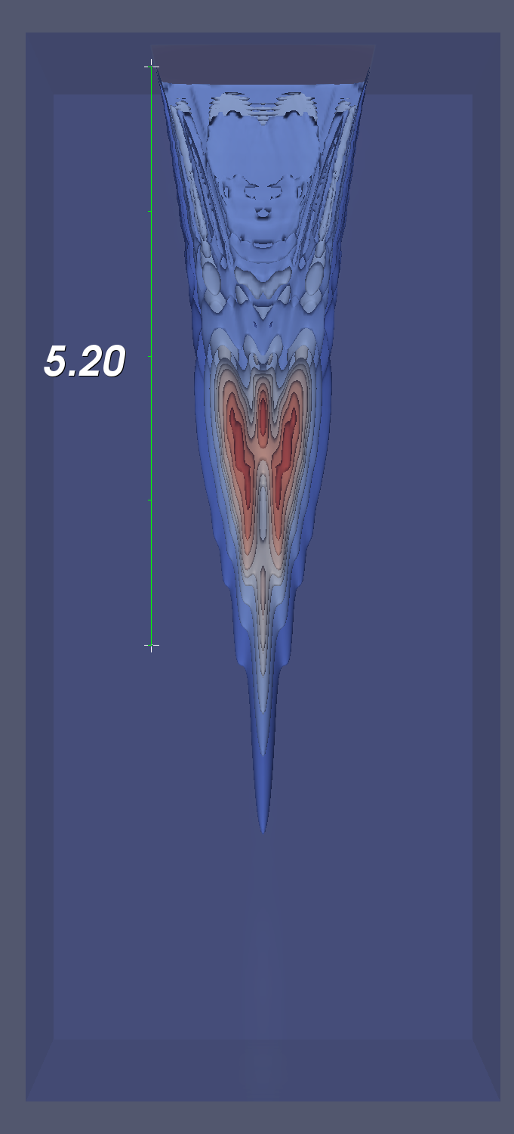
Intensity Fields with Increasing Nonlinearity
70 mm focus, α = 1.0 dB/cm/MHz
lateral
depth
β = 0.0
β = 3.5
β = 7.0

Slide 10
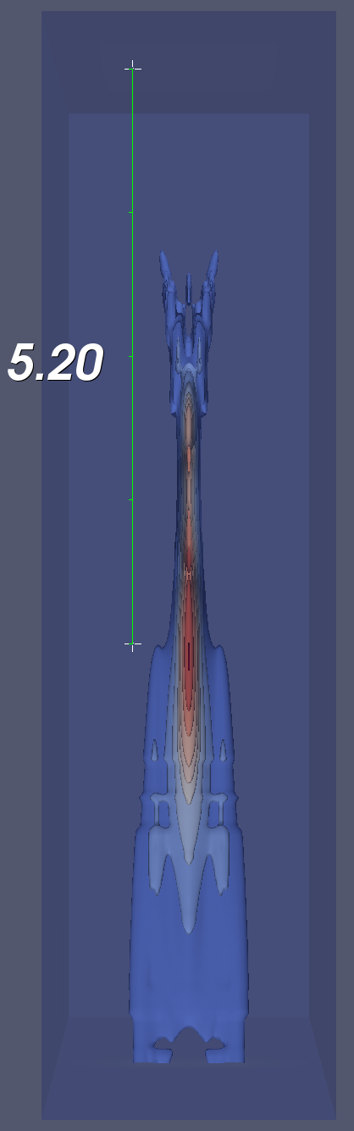
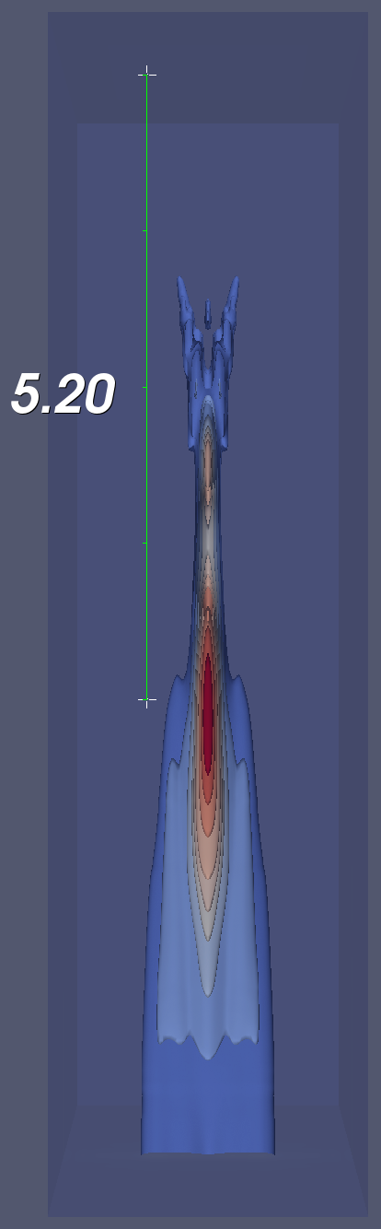
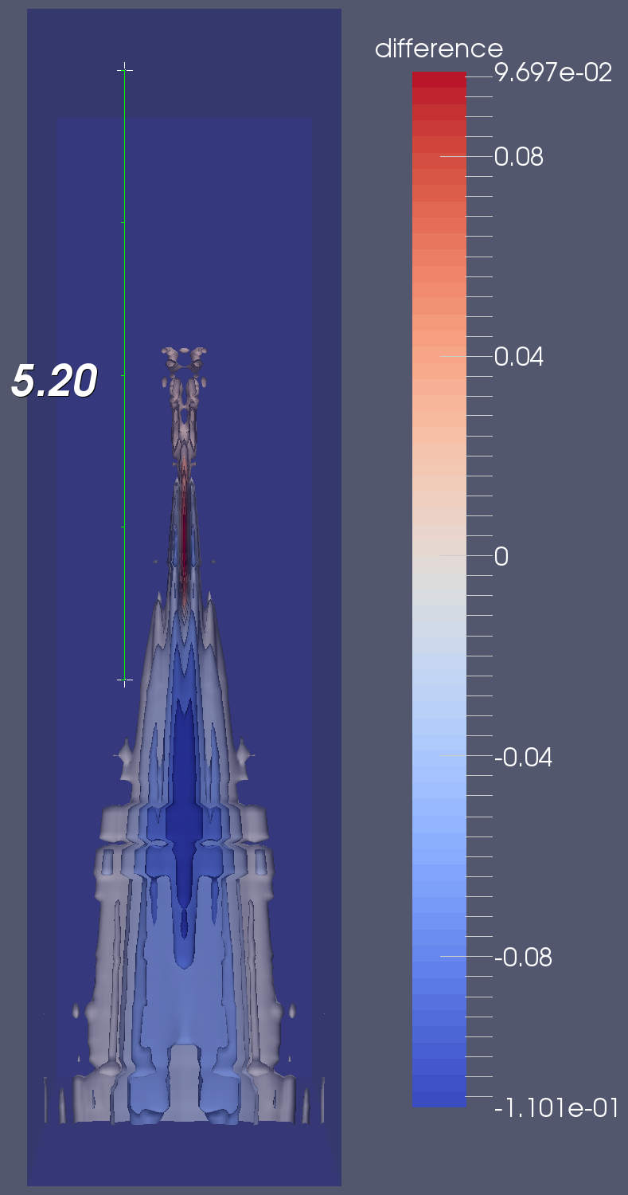
Intensity Fields with Increasing Nonlinearity
elevation
depth
-
=
β = 3.5
β = 0.0
Notes:
Possible out-of-plane sources???

Slide 11
Methods – Shear Wave Simulations
Imitated dyna*.mat intensity output file
Linearly interpolated 3D KZK sim intensity output to uniformly spaced set of nodes
Exploited quarter symmetry → added boundary conditions and PMLs
Simulated ARFI excitation in LS-DYNA
E = 3.0 kPa, ν = 0.45 (quick runtimes)
300 μs excitation duration, 25 ms total duration

Slide 12
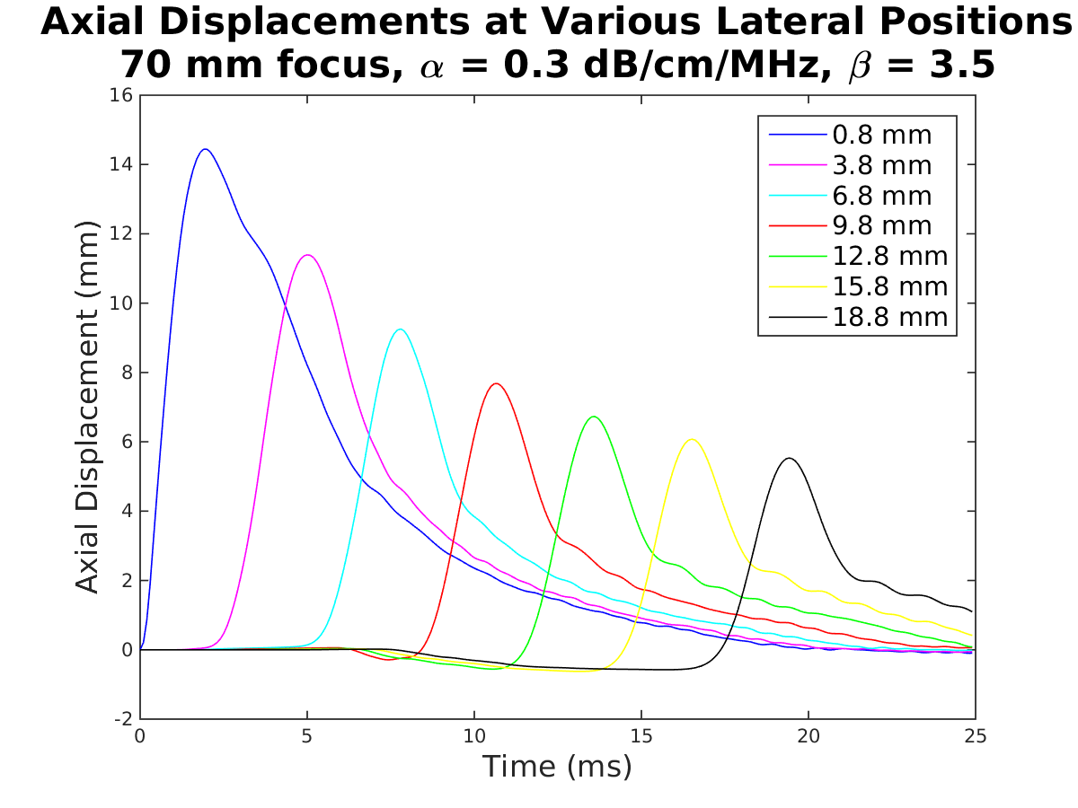
Axial Displacements Plot

Slide 13
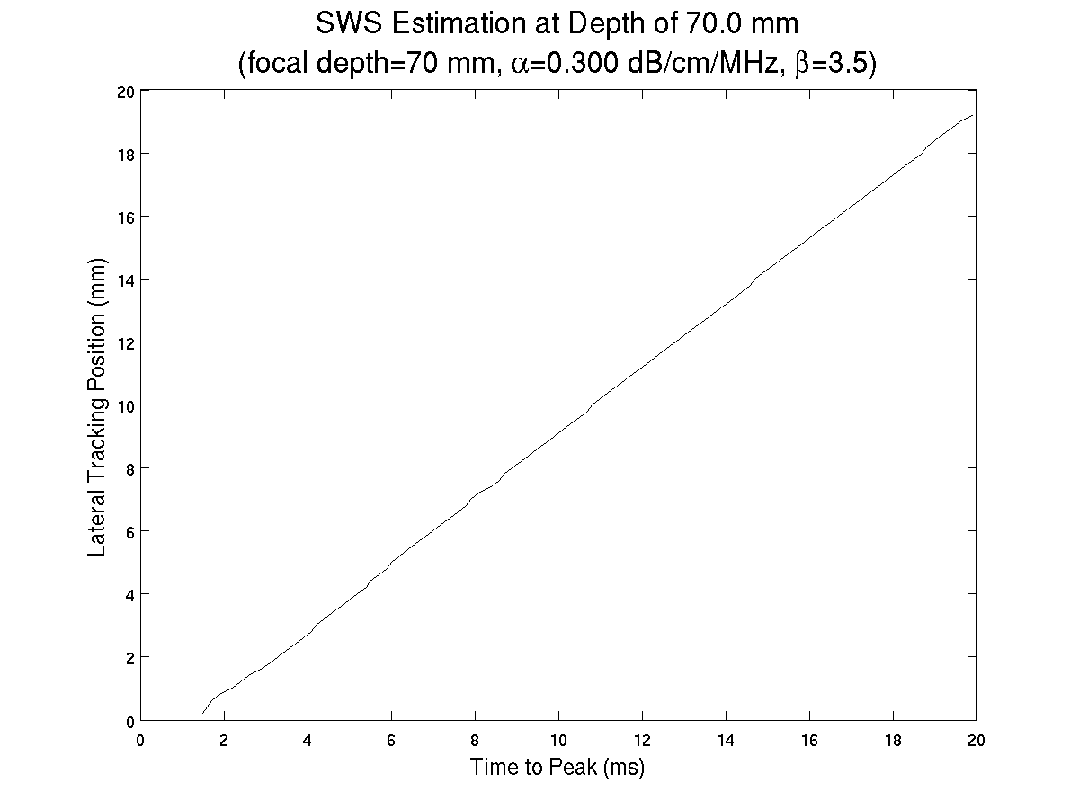
Time-to-Peak Shear Wave Speed Estimation

Slide 14

Expected SWS Calculation
$$\text{shear} \text{modulus}=μ=\frac{E}{2(1+ν)}$$
$$SWS=\sqrt{\frac{μ}{ρ}}$$
$$SWS=\sqrt{\frac{E}{2\left(1+ν\right)ρ}}=\sqrt{\frac{3000 \text{Pa}}{2(1+0.45)(1030\frac{\text{kg}}{{\text{m}}^{\text{3}}})}}$$
$$SWS≈1 \text{m}\text{/}\text{s}$$

Slide 15
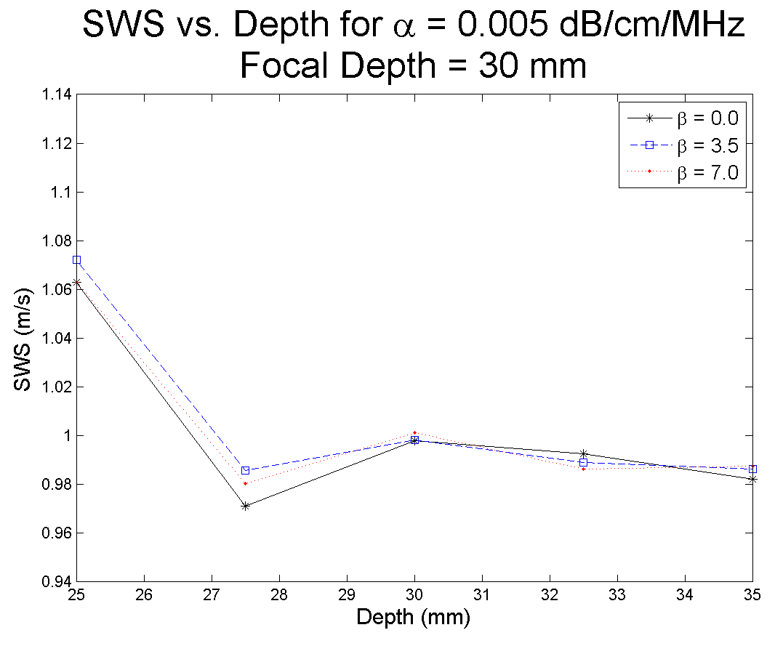
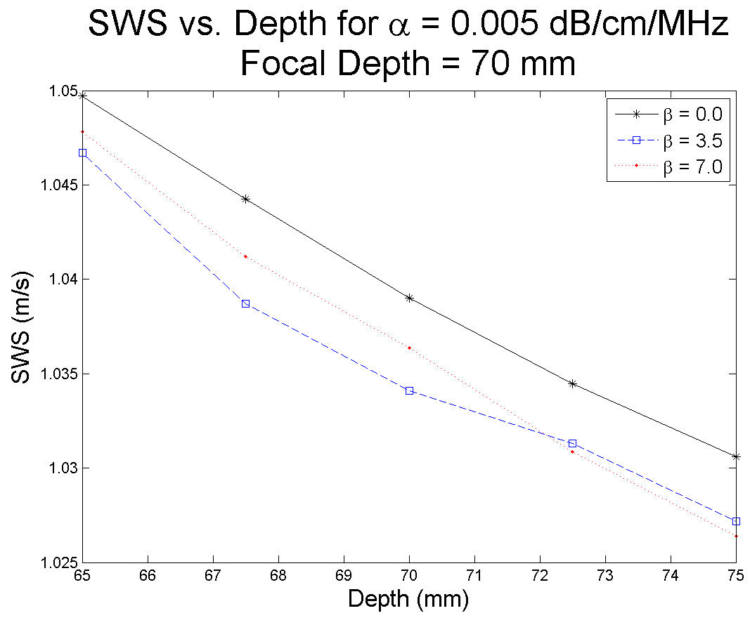
SWS Measurements at Different Focal Depths

