Slide 1
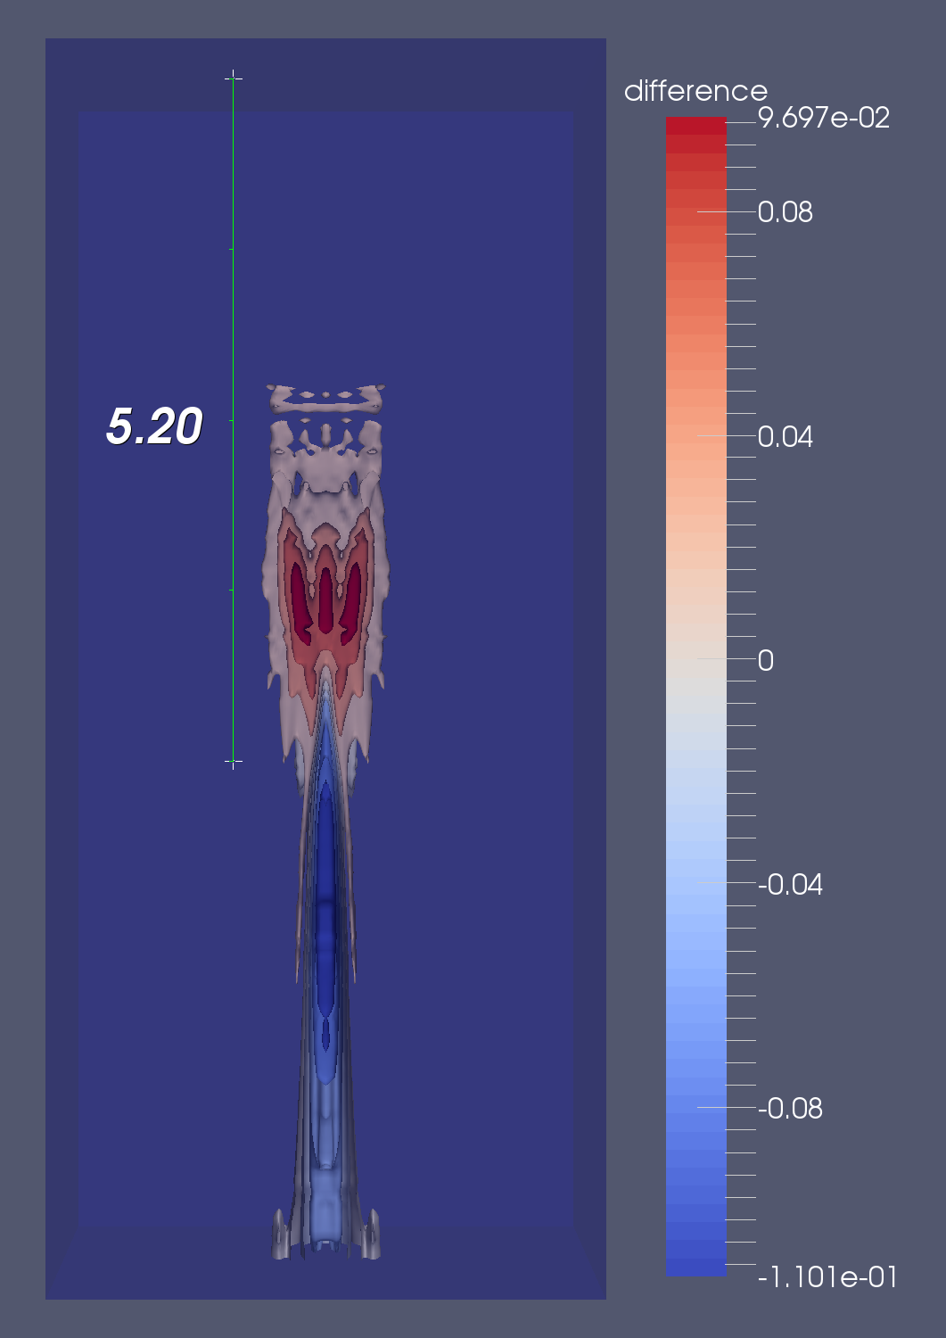
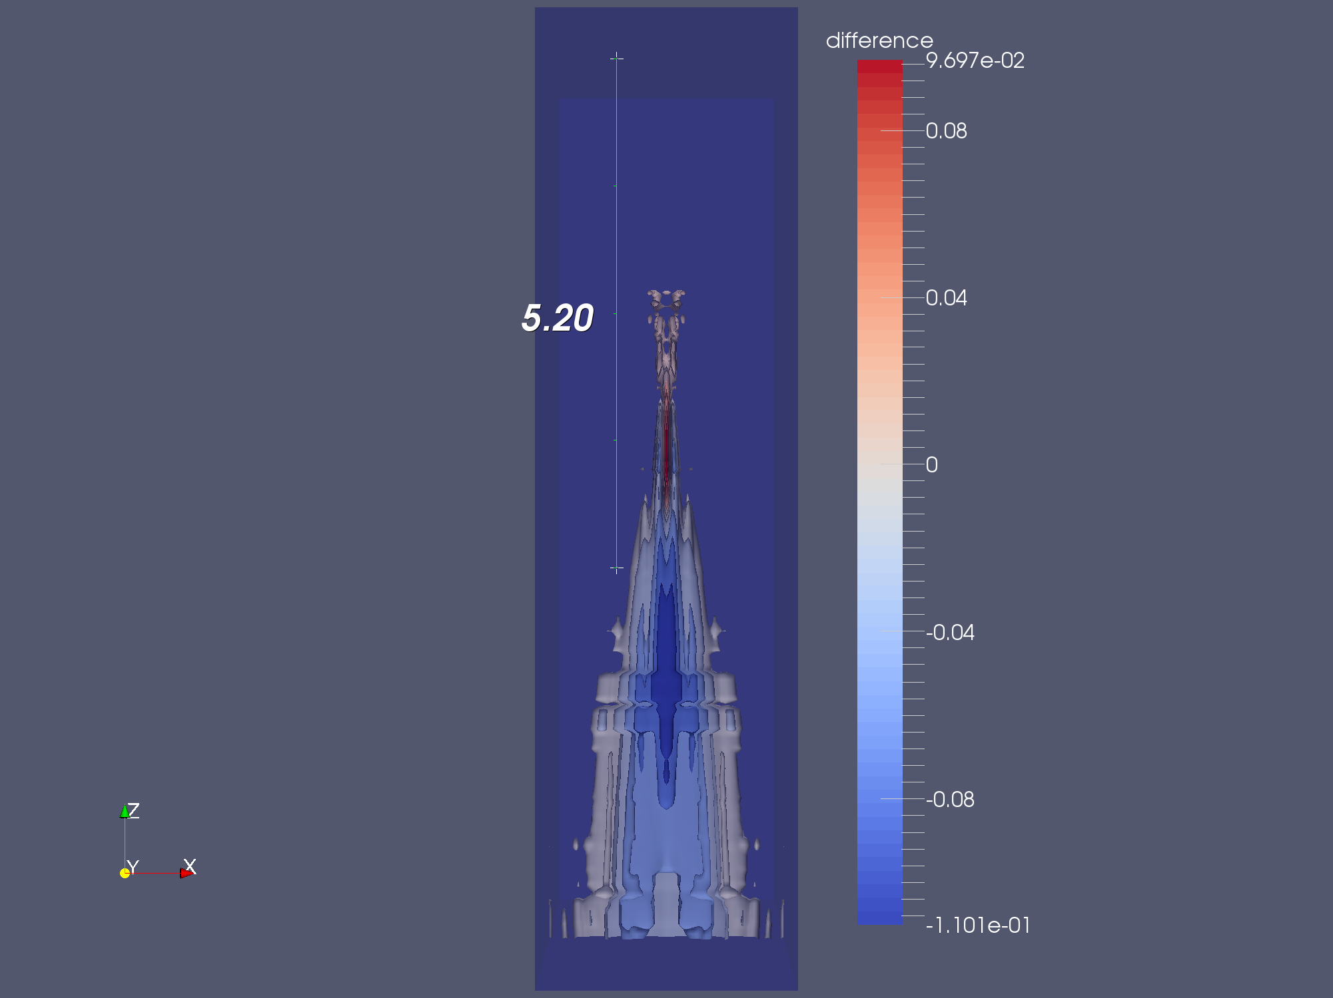
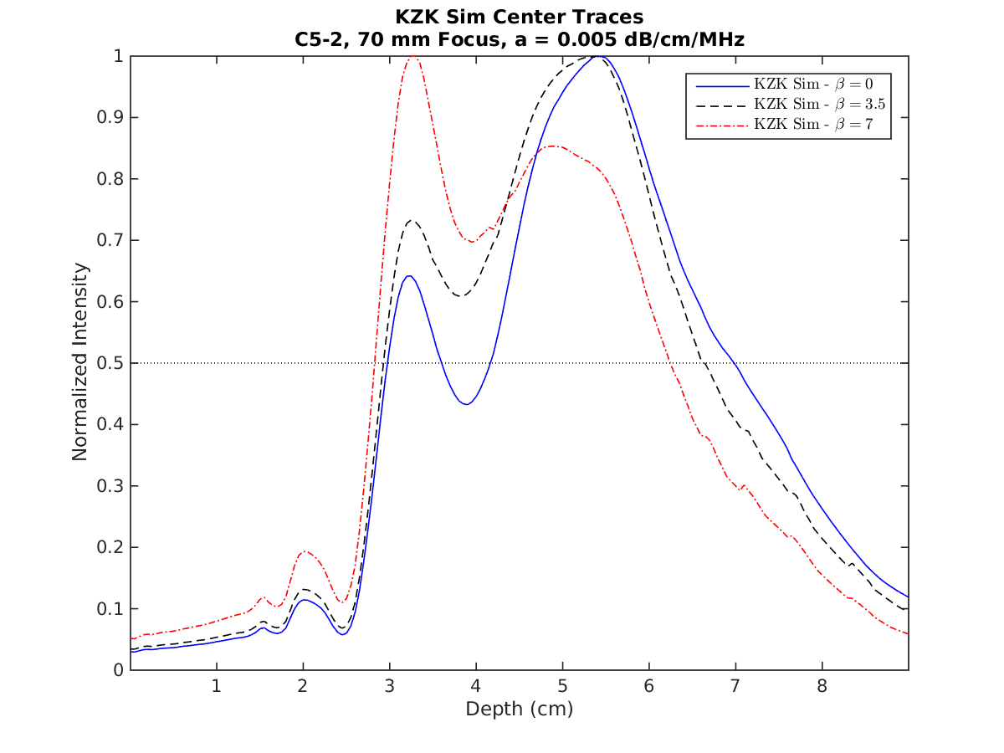
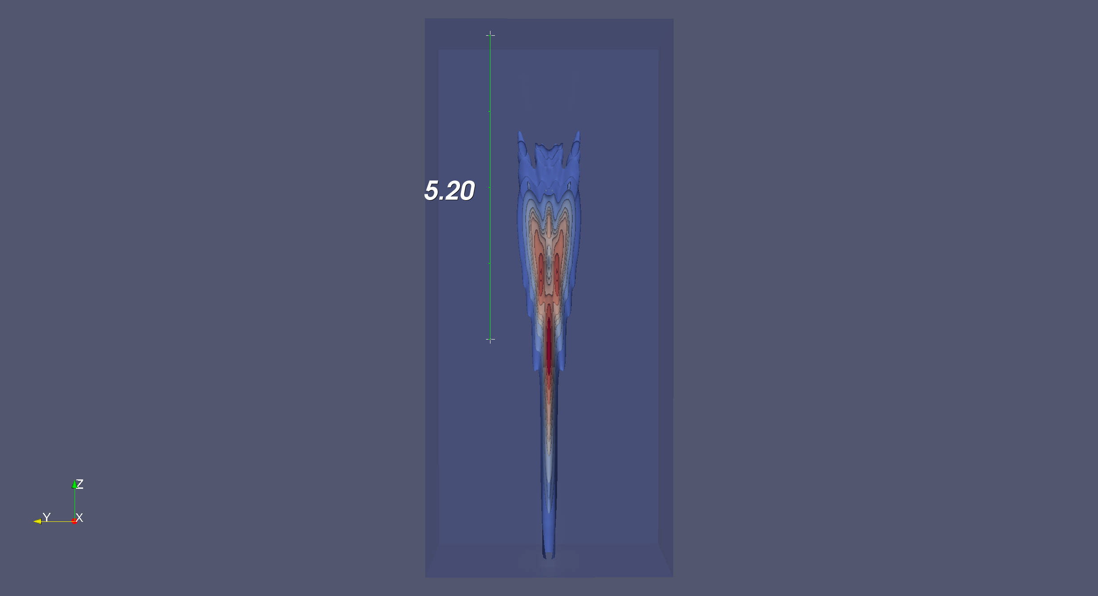
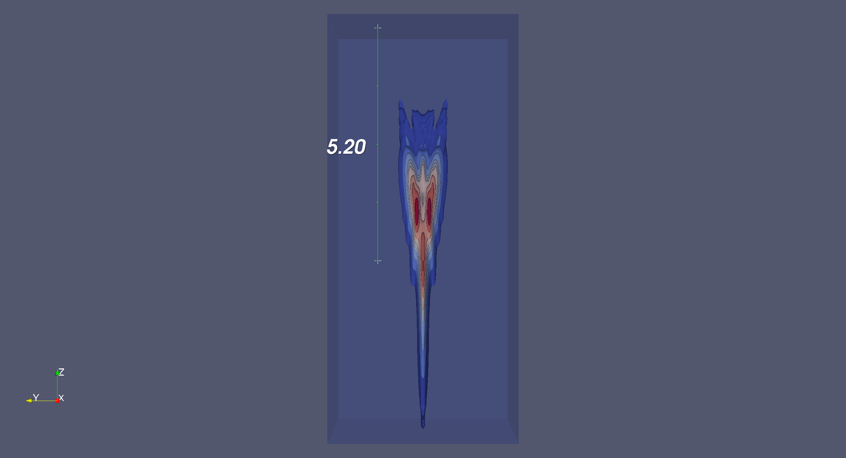
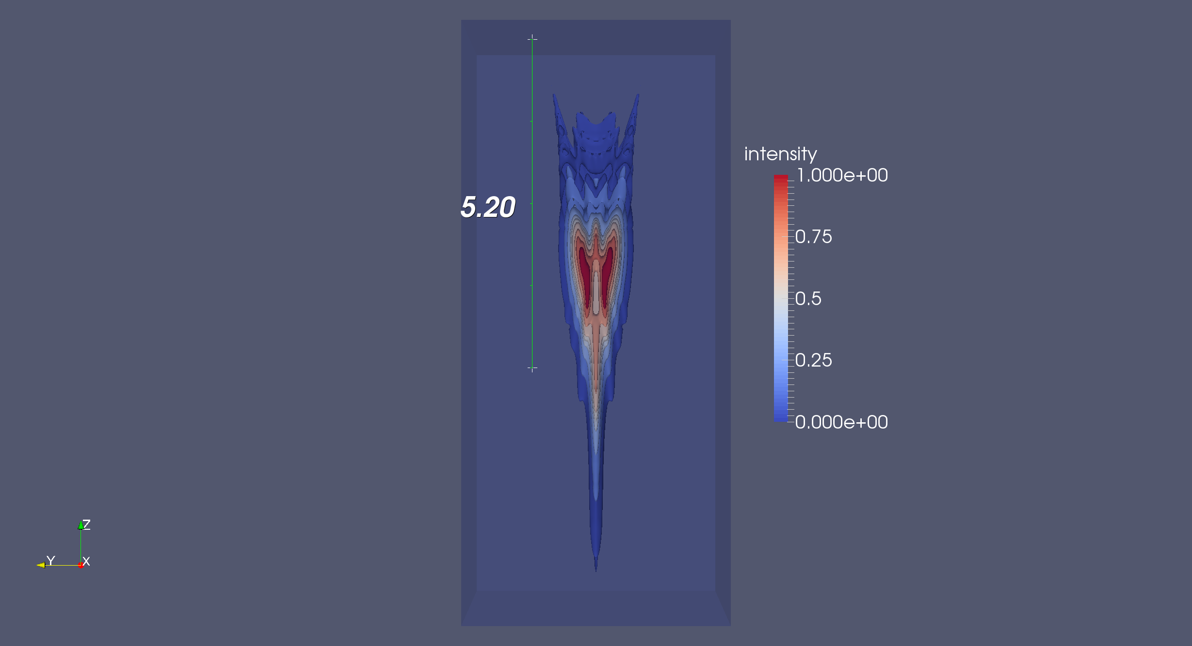
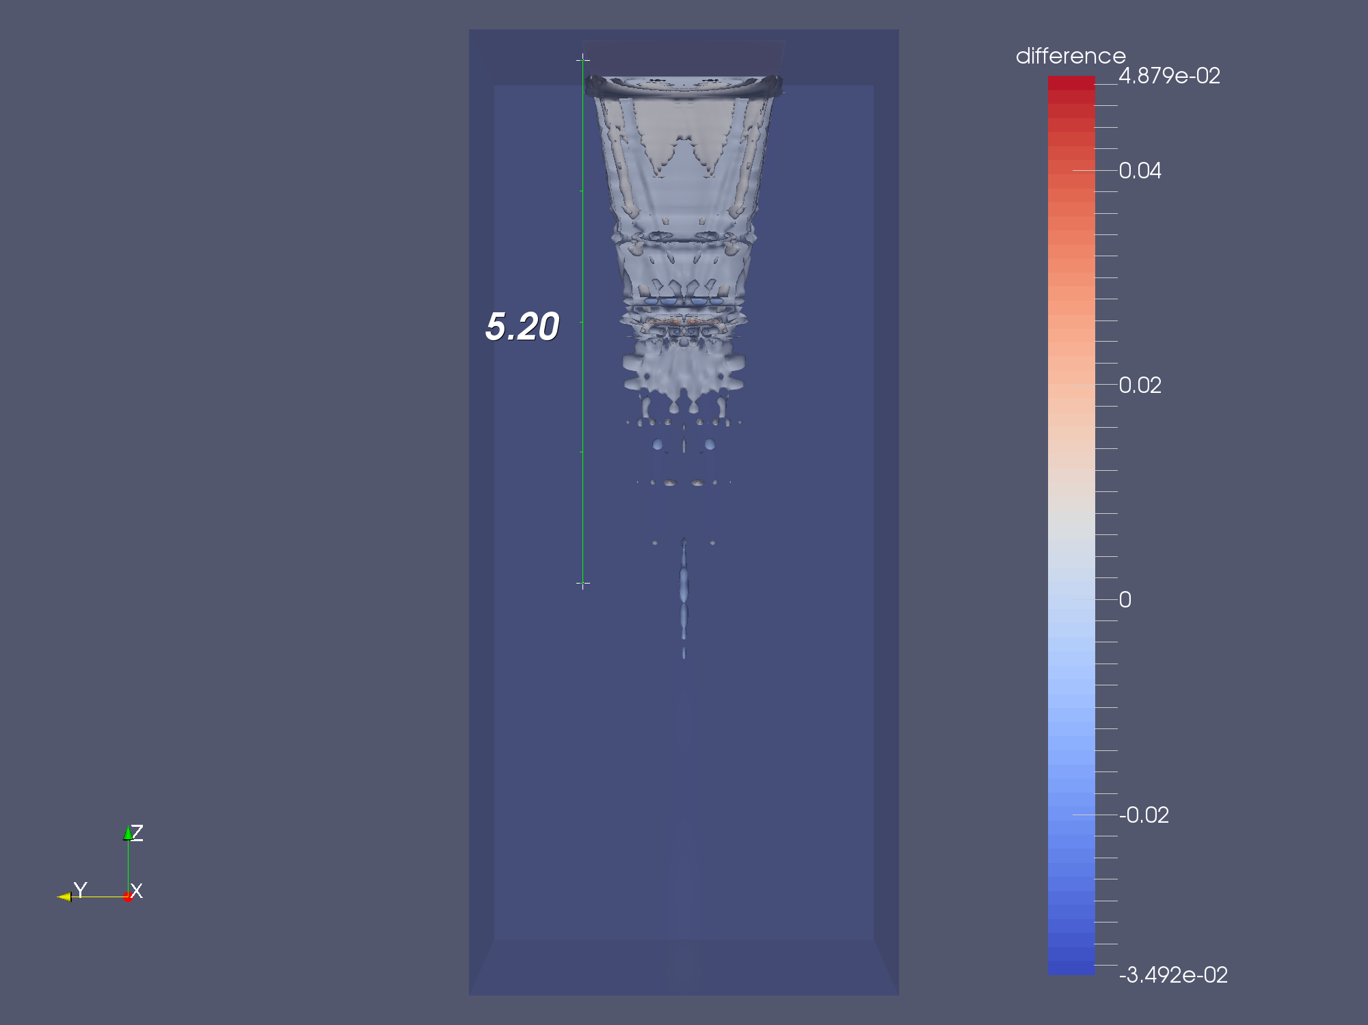
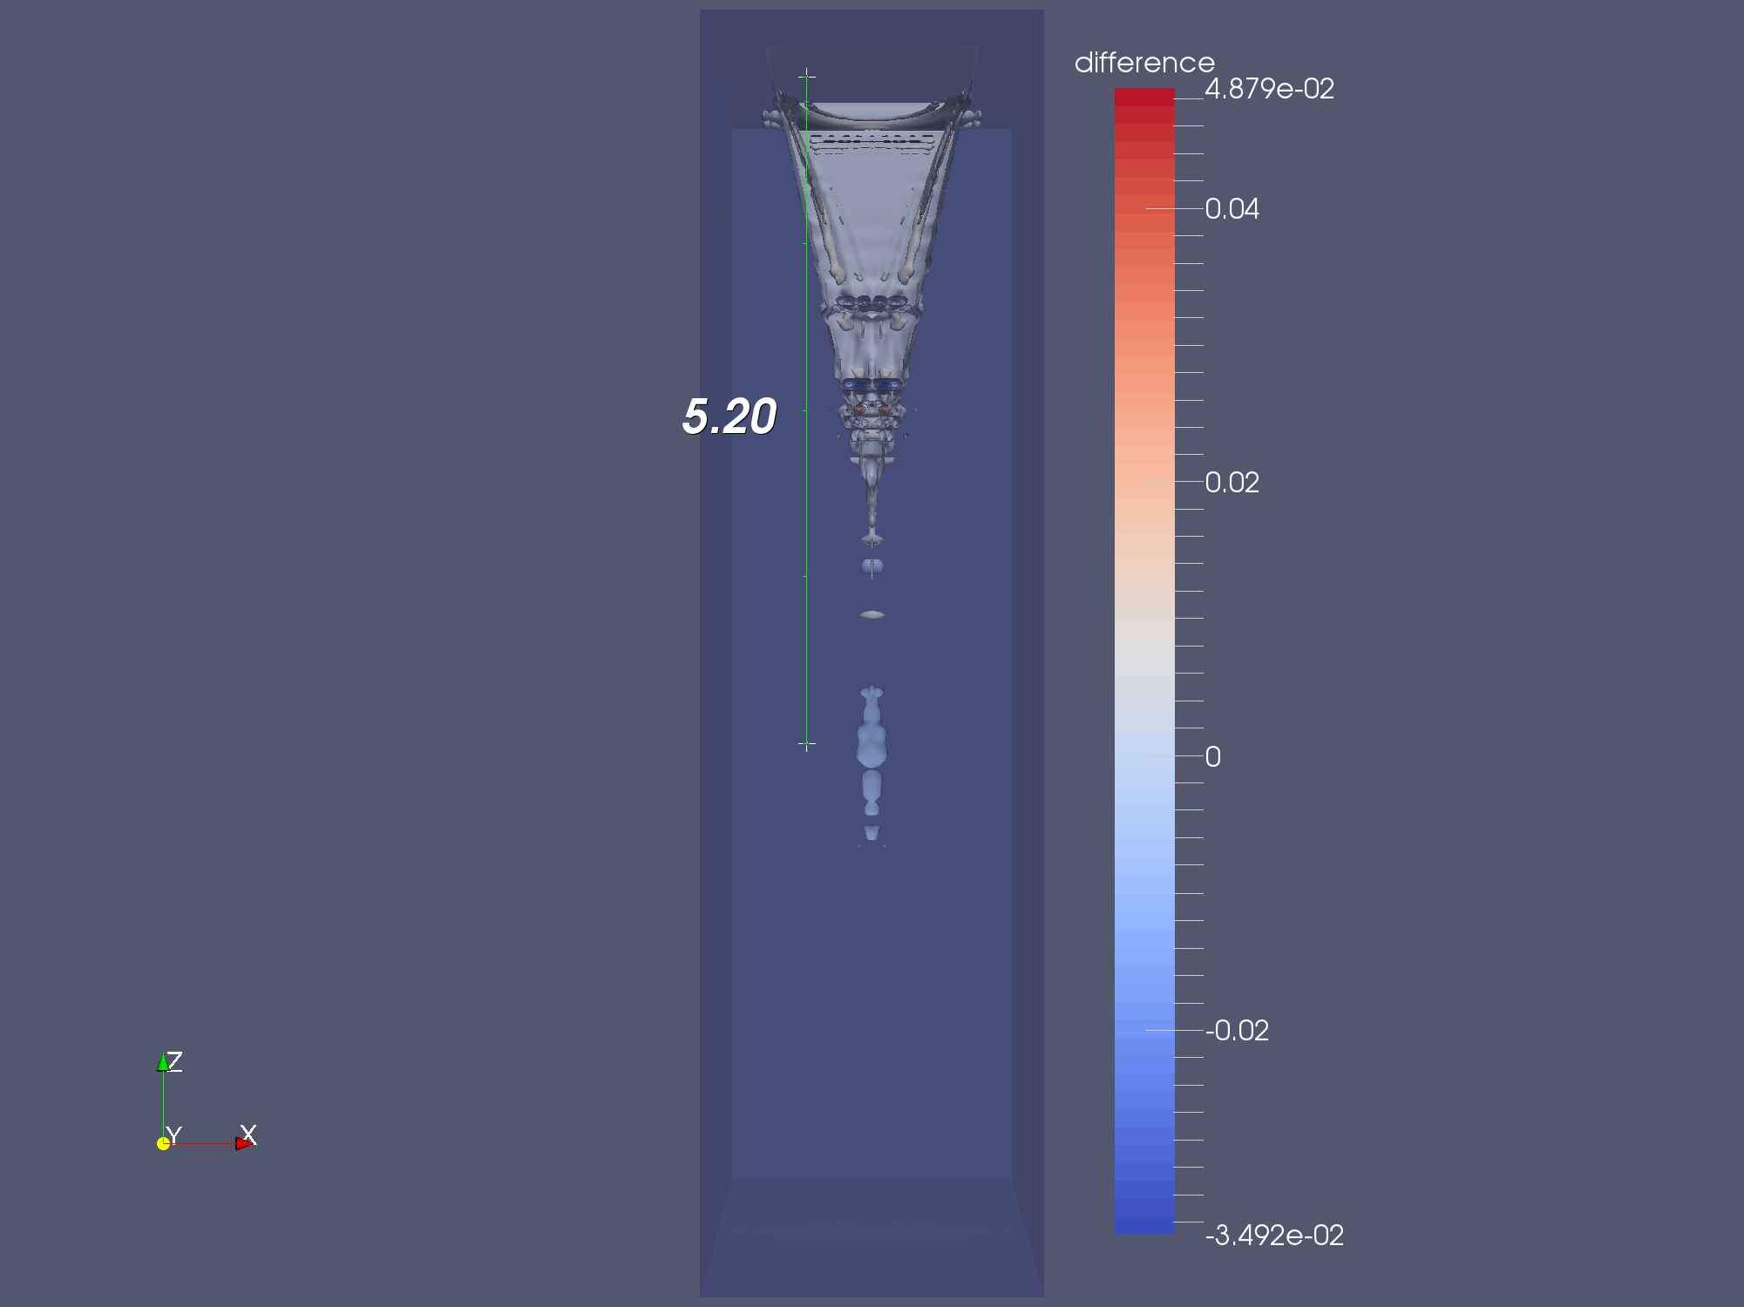
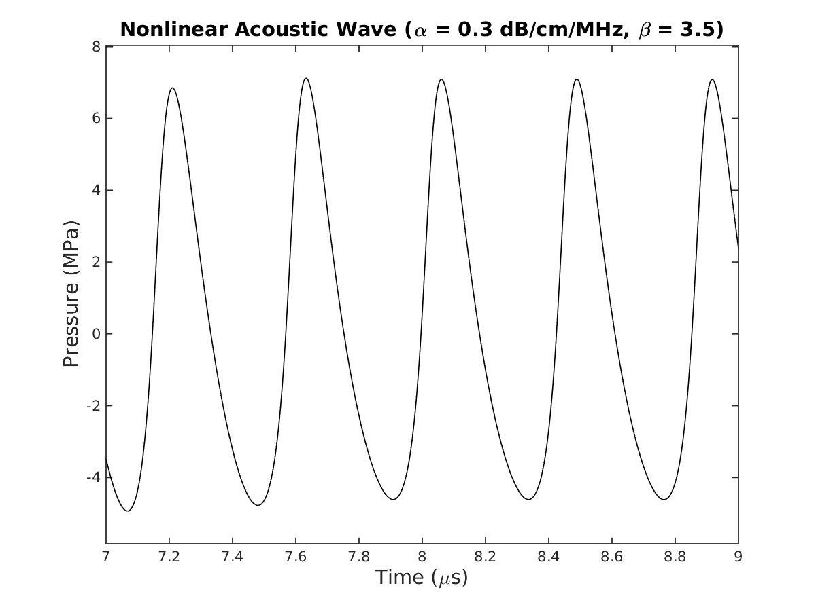
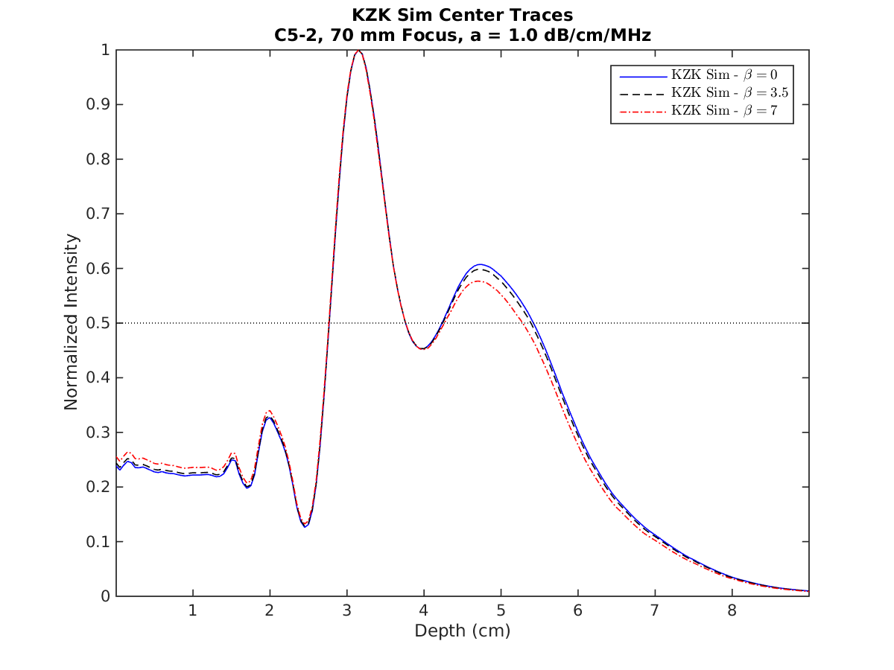
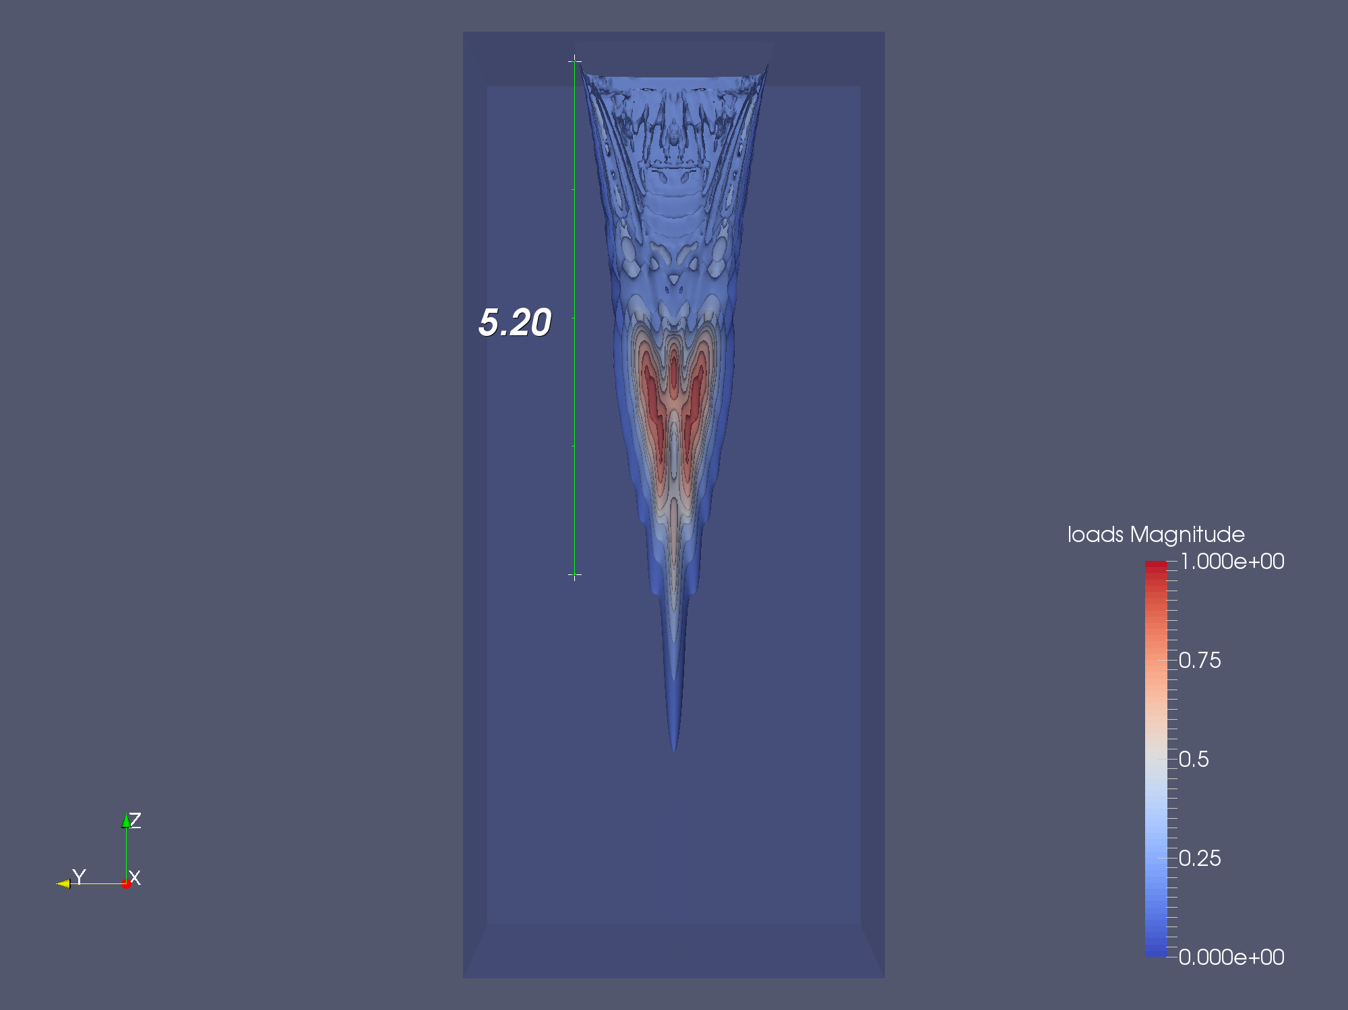
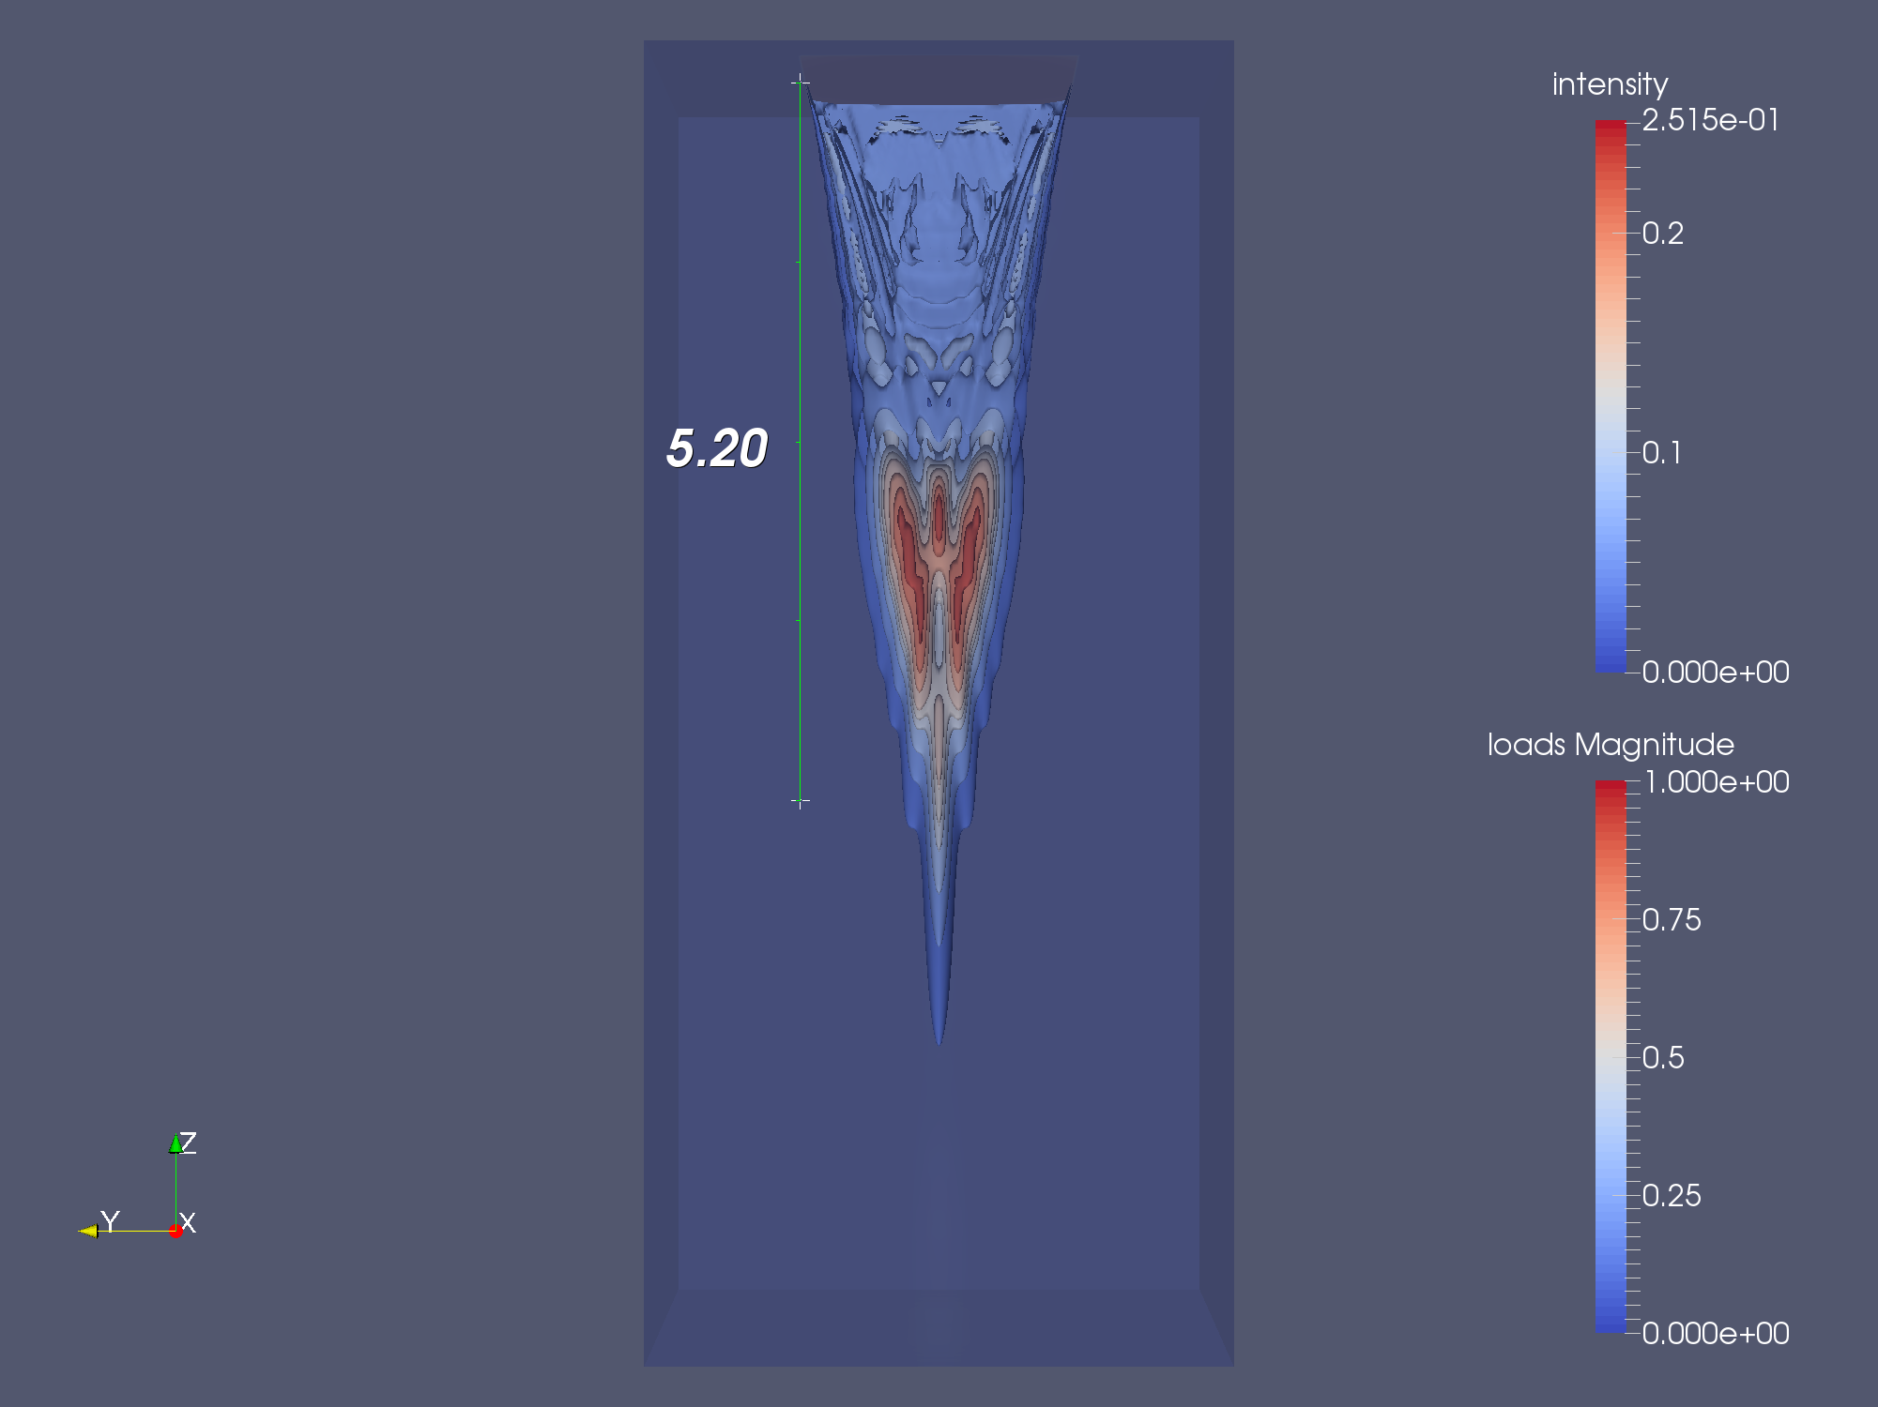
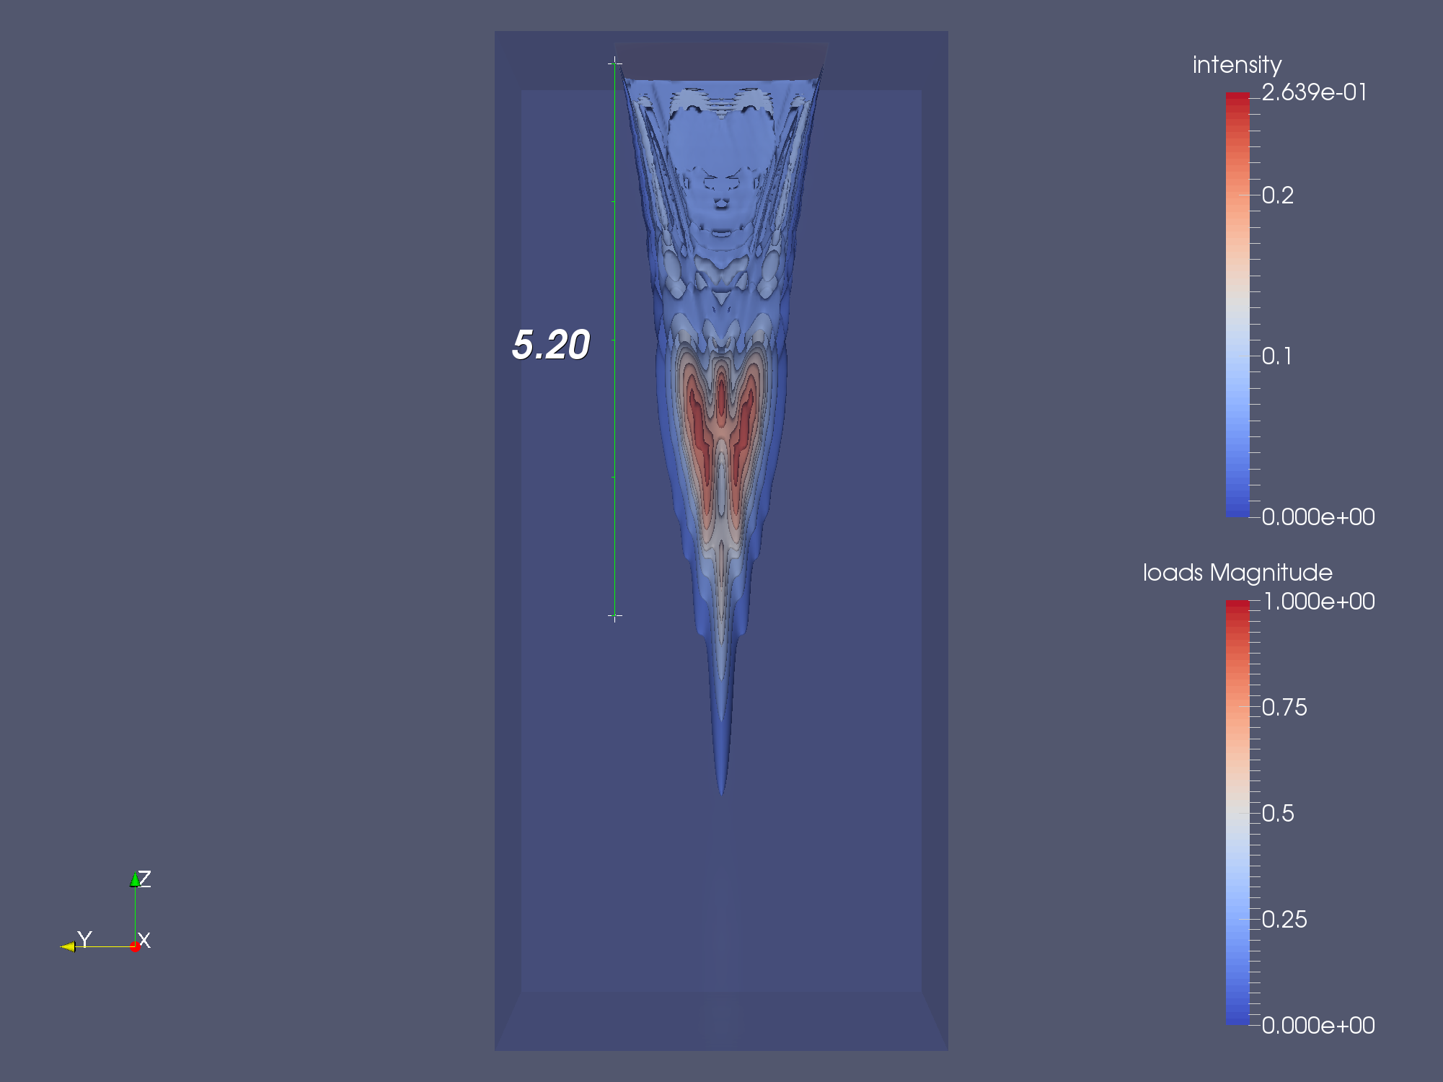
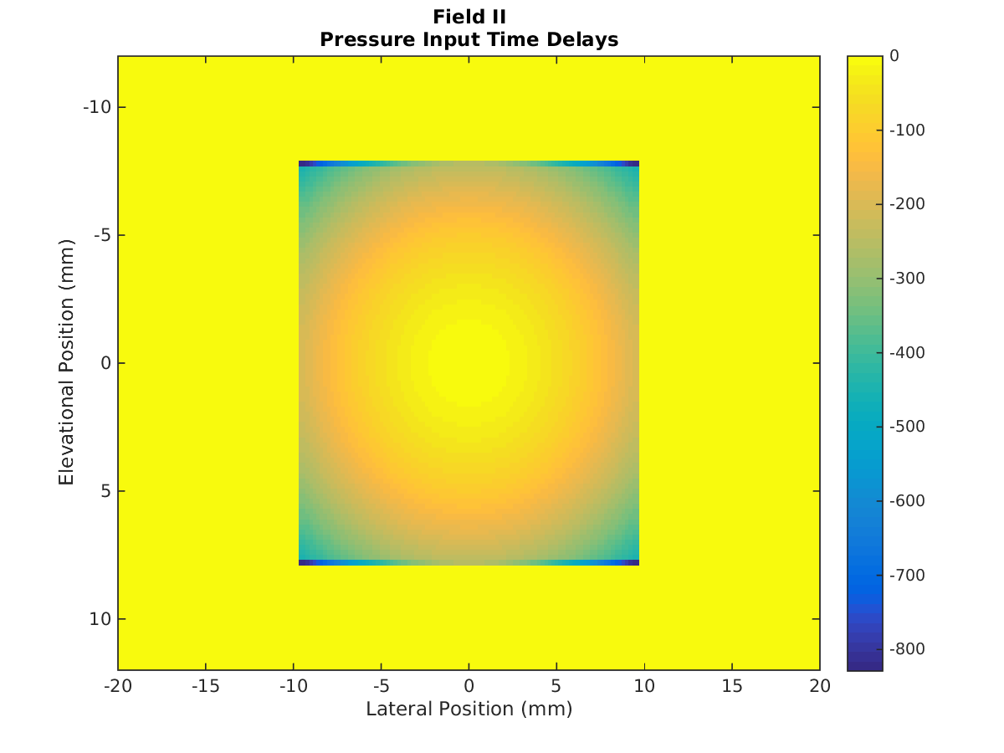
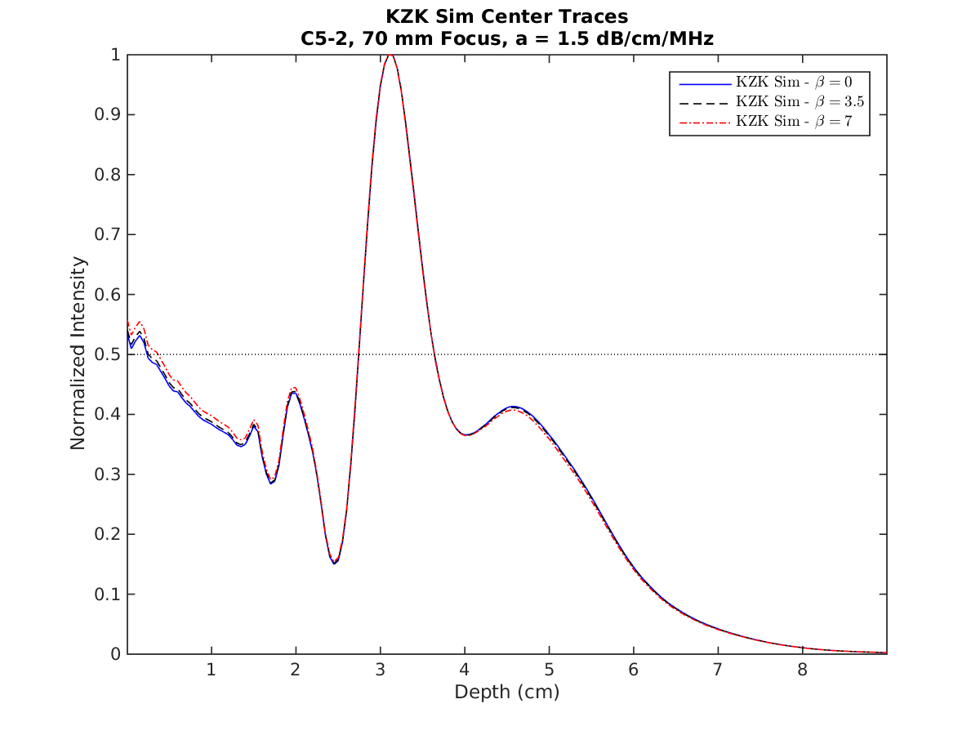
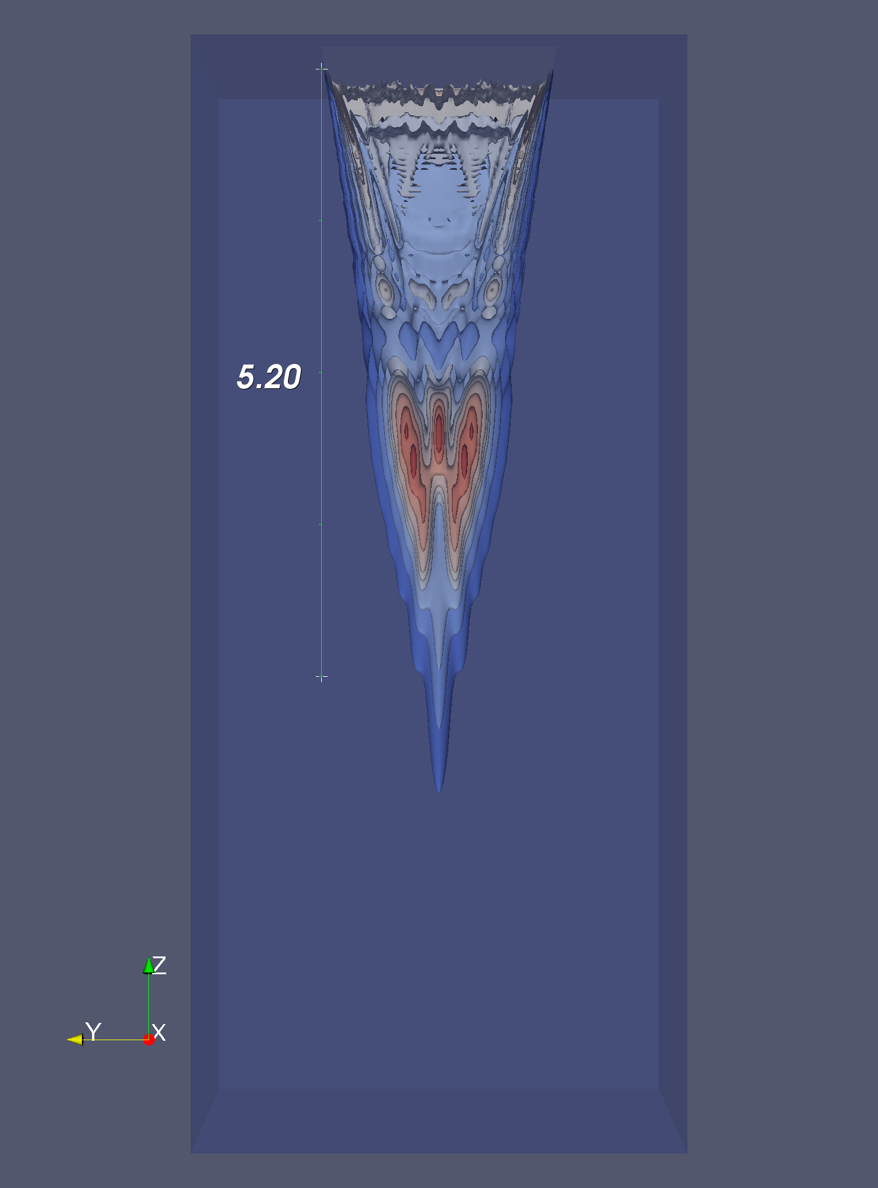
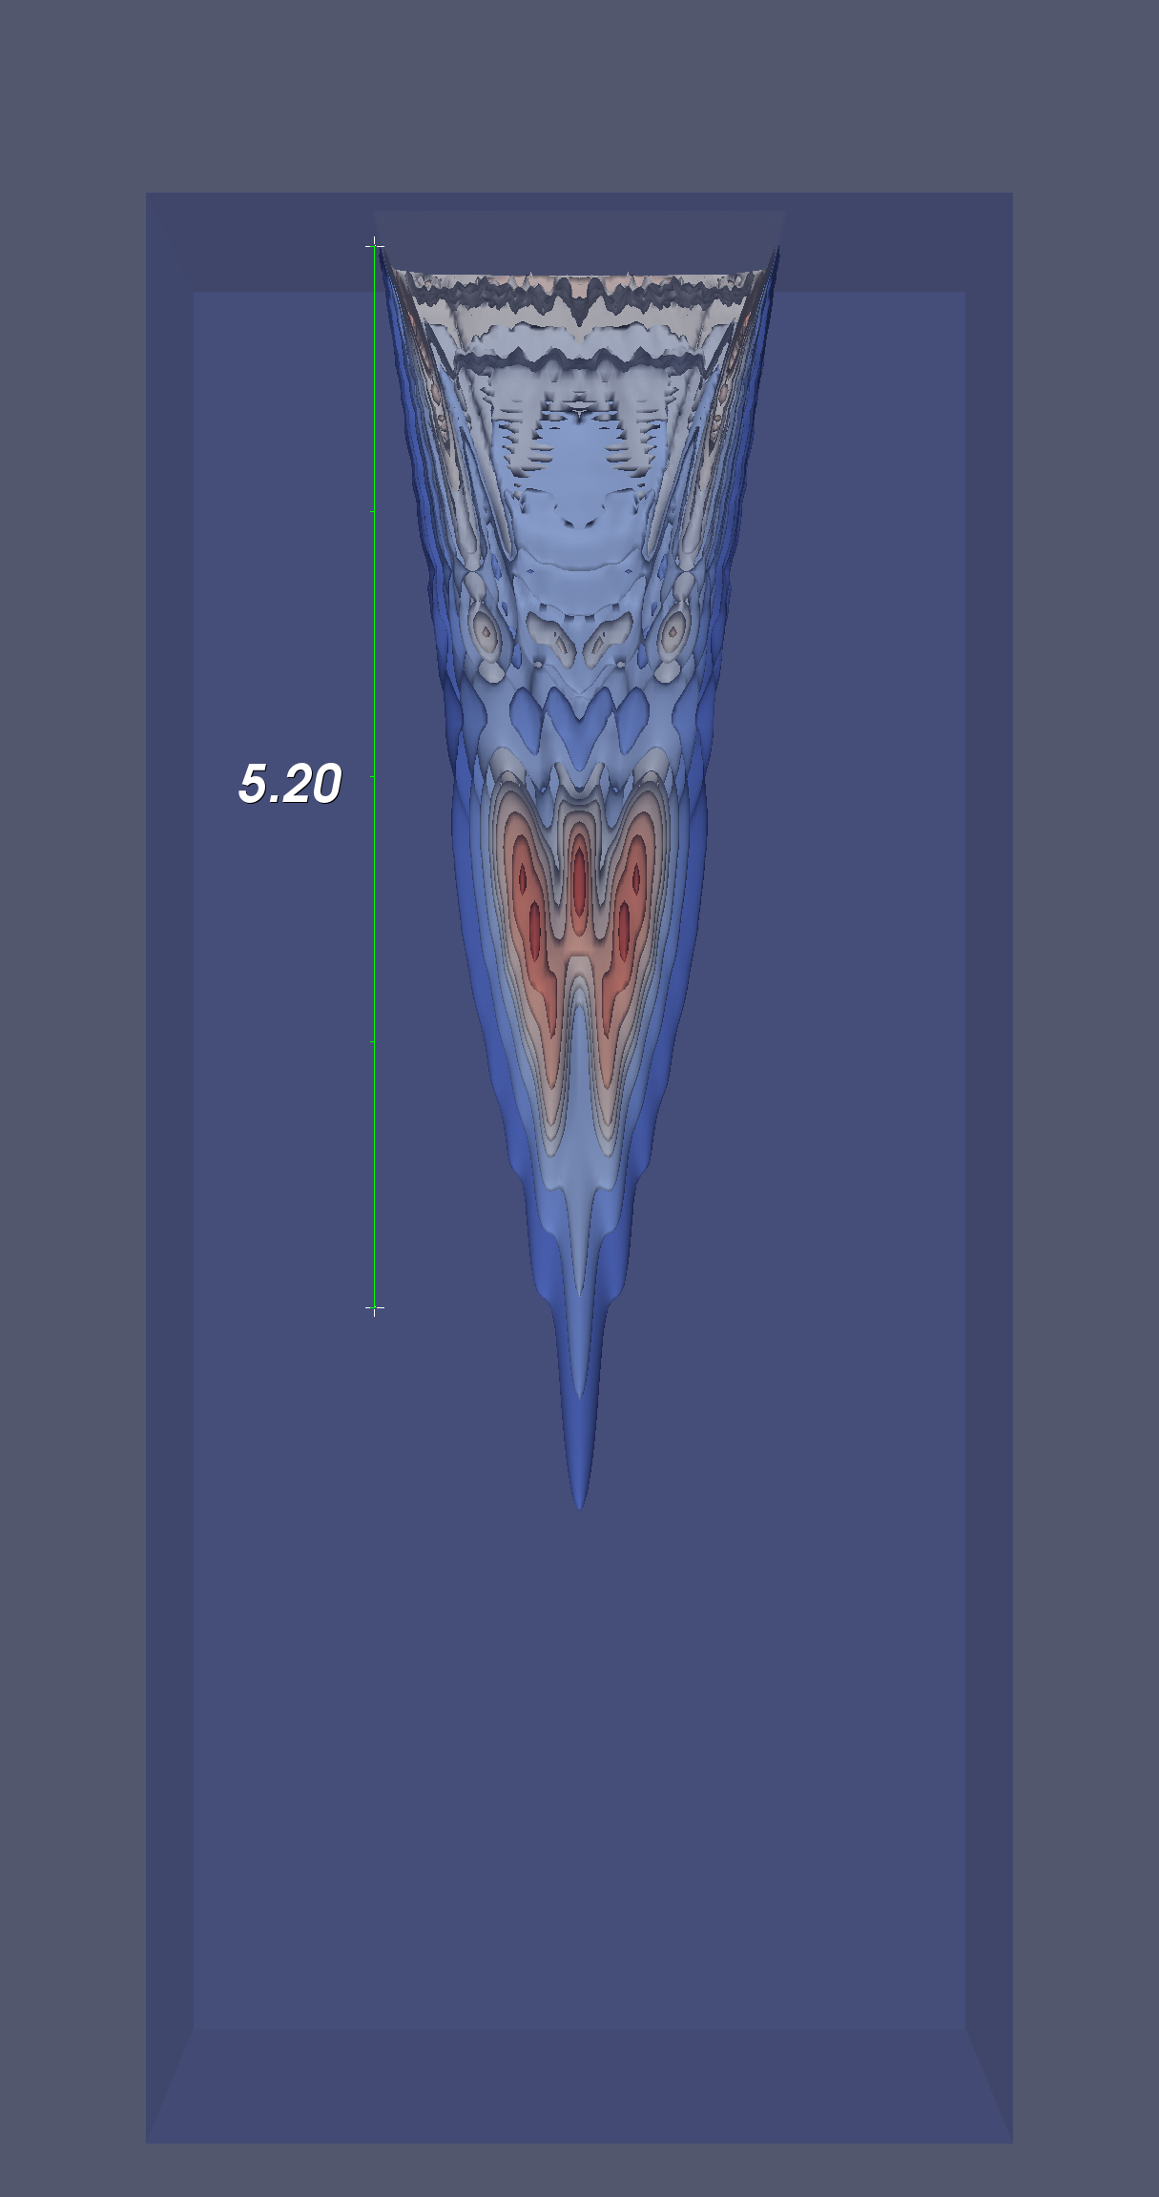
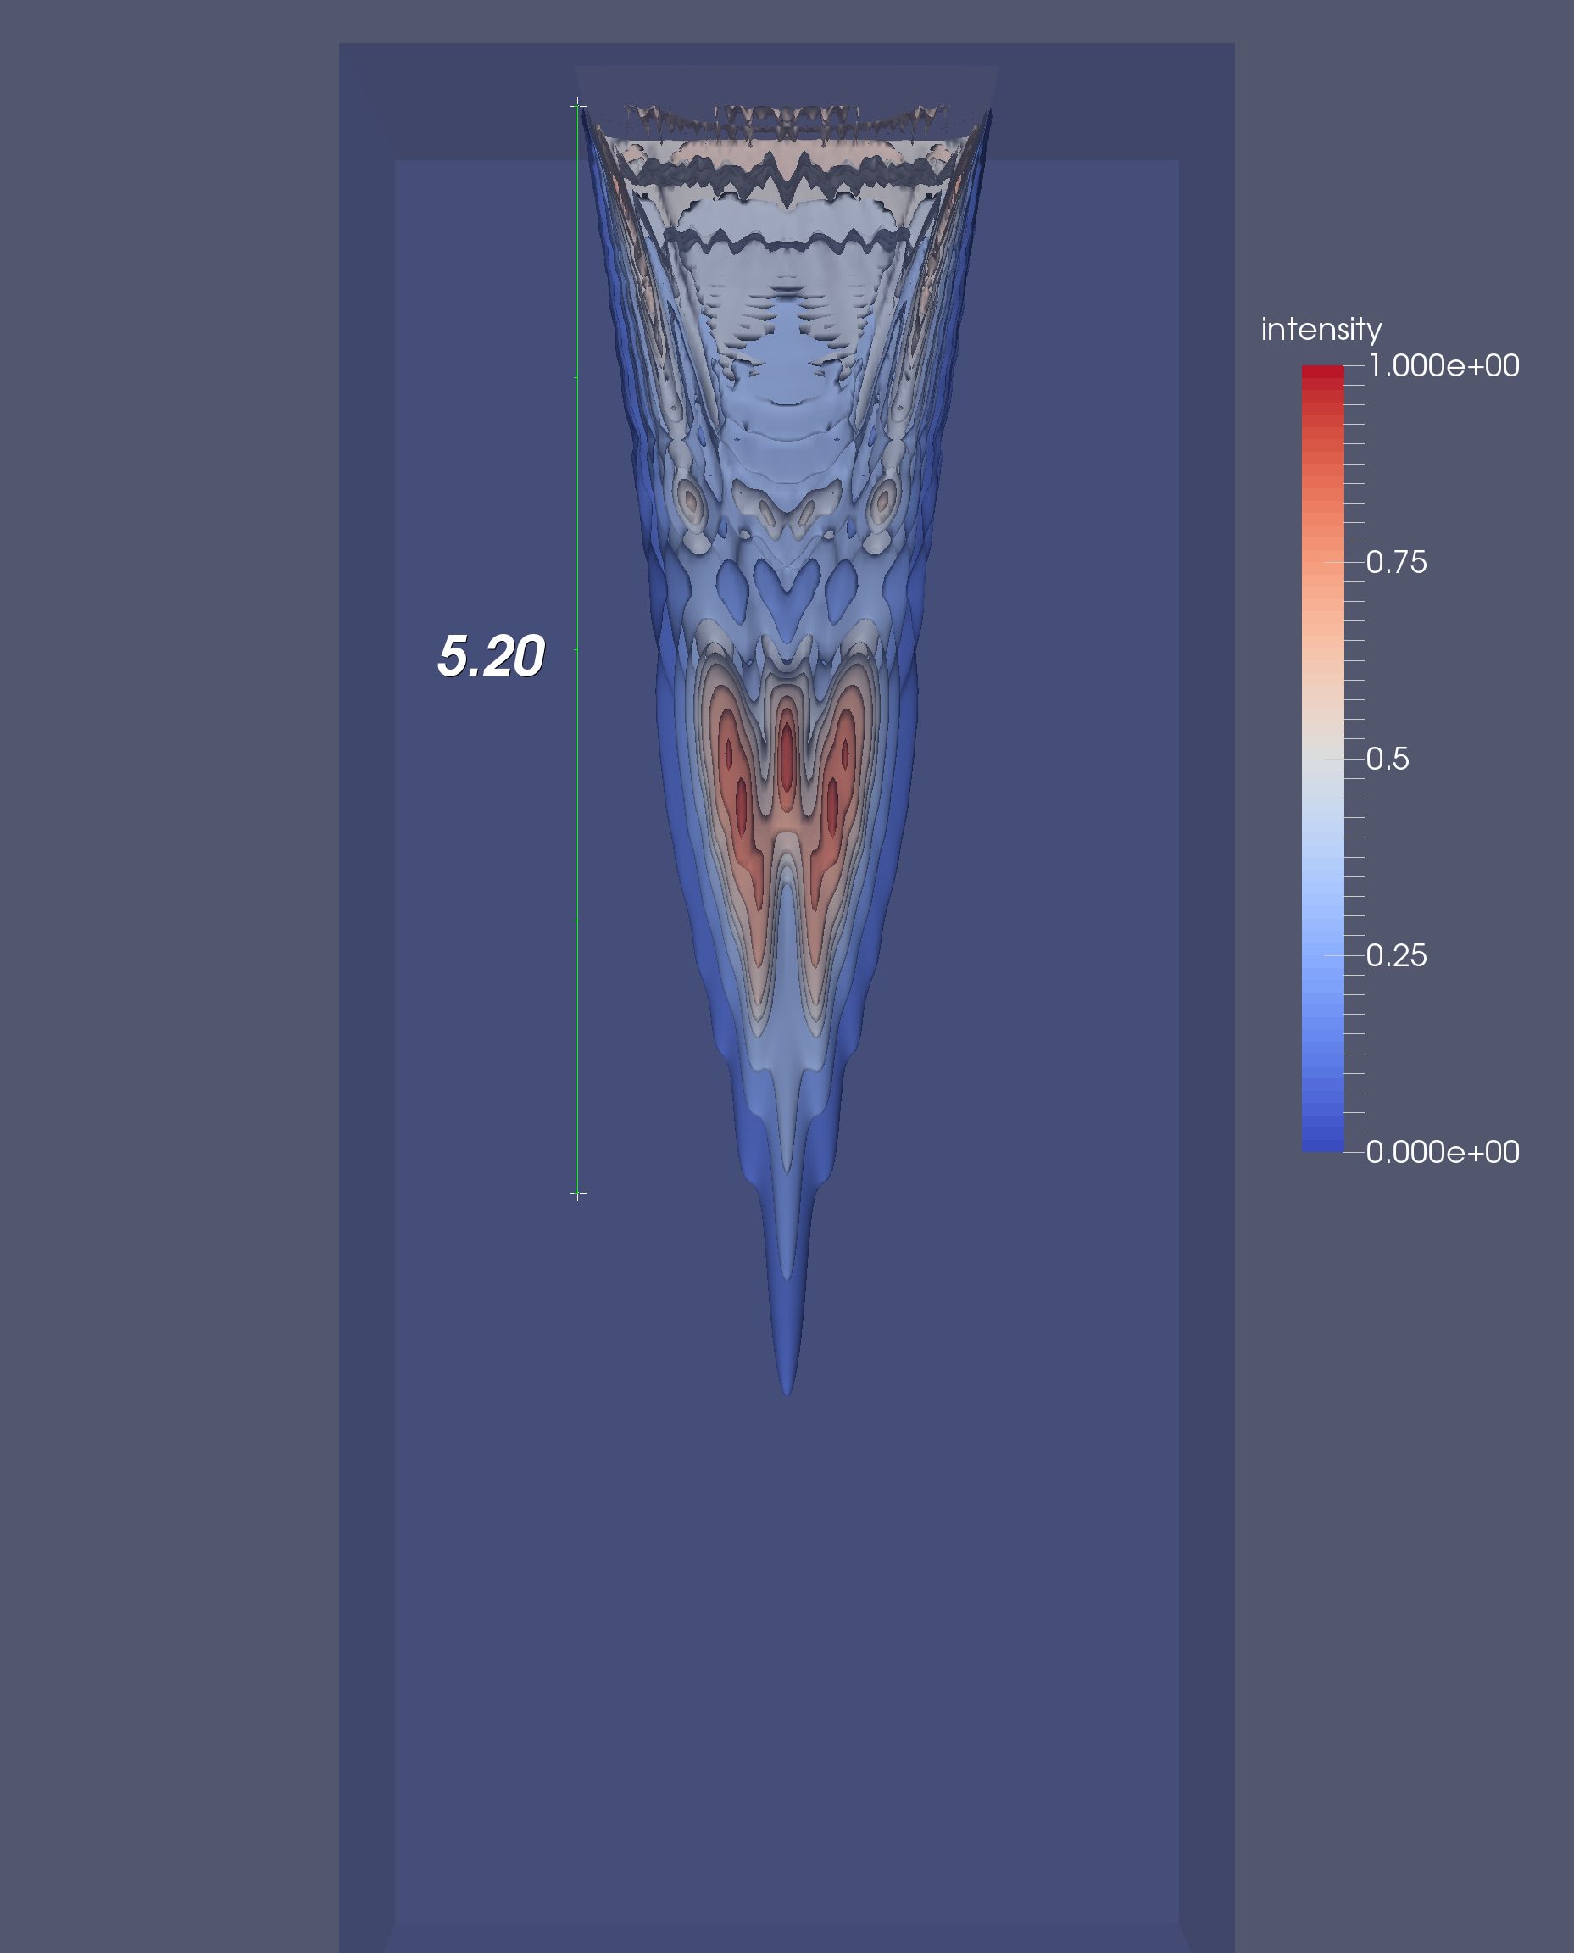
Simulating the Effects of Nonlinear Acoustic Propagation on Radiation Force
Ningrui Li, Mark L. Palmeri, Kathryn R. Nightingale
Department of Biomedical Engineering, Duke University, Durham, NC, United States.
INTRODUCTION
RESULTS
RESULTS
Shear waves can be induced in tissues by acoustic radiation force created using an ultrasound probe. The shear wave speed of tissue can be measured by tracking the propagation of shear waves from their source using time-of-flight methods [1]. Tissue stiffness can be characterized using these shear wave speed measurements.
Shear wave speed measurements have been shown to exhibit a depth dependent bias, which has the potential to cause misdiagnosis [2]. It was hypothesized that this depth dependence was caused by out-of-plane shear wave sources generated through nonlinear effects in acoustic propagation. These nonlinear effects are due to localized heating caused by acoustic waves with high pressure amplitudes This increases the sound speed in that specific region. Figure 1 shows the resulting sawtooth wave.
The Khokhlov-Zabolotskaya-Kuznetsov (KZK) nonlinear wave equation [3] was used to simulate acoustic waves propagating in differing media with various nonlinear coefficients. The simulated intensity field distributions showed that as nonlinearity increased, the maximum intensities tended towards shallower, laterally offset locations. It was also shown that as attenuation increased, the effects of nonlinearity were also diminished.
The 3D intensity data were visualized using MATLAB and ParaView. Plots of the normalized axial intensities at the center lateral and elevation positions can be seen in the leftmost column. Contour plots of the normalized intensities generated with β = 0, 3.5, and 7 were created in ParaView for α = 0.005, 1.0, and 1.5 dB/cm/MHz cases. The highest intensity areas were colored red, while the lowest intensity locations were colored blue. A 5.20 cm long ruler protruding down from the top was added as a scale.
The effect of nonlinearity on intensity distribution appeared to be less pronounced for greater amounts of attenuation. Nonlinearity appeared to be negligible for an attenuation of 1.5 dB/cm/MHz.
Center Lateral Plane
Center Elevation Plane
α = 0.005 dB/cm/MHz
β = 0
β = 3.5
β = 7
α = 0.005 dB/cm/MHz
α = 1.0 dB/cm/MHz
β = 0
β = 3.5
β = 7
These plots were generated by subtracting the β = 3.5 normalized intensity fields from the β = 0 intensity fields for the 0.005 dB/cm/MHz and 1.0 dB/cm/MHz cases. Contour plots of the resulting matrix were made. Note that the magnitude of the differences is an order of magnitude lower for the 1.0 dB/cm/MHz case.
Figure 1: Nonlinear Acoustic Wave
CONCLUSIONS
METHODS
A curvilinear C5-2 transducer focused at 70 mm in depth was simulated with 7 excitation cycles at an excitation frequency of 2.36 MHz to generate the face pressures used as an input to the KZK simulations. These face pressure waves was scaled to an amplitude of 0.4 MPa to match pressure amplitudes that were measured experimentally. As shown in Figure 2, appropriate time delays were applied to focus the acoustic waves correctly.
α = 1.0 dB/cm/MHz
The effect of increasing nonlinearity on the intensity distribution of a focused ultrasound beam was investigated computationally using the KZK simulation. The results of these simulations provided strong evidence suggesting that as the nonlinear coefficient of the medium increased, the intensity field peaked at shallower positions that were offset on the lateral axis.
It was also found that as the attenuation of the material increased, the effects of nonlinearity were dampened. This agreed well with what was predicted, since nonlinear effects were most prominent when pressure waves with immense amplitudes caused local temperature and sound speed increases.
Finally, the next step is to simulate the shear waves created using these intensity data. This will help further characterize the bias on shear wave speed measurements. This information will be crucial for developing methods to possibly correct for this depth dependent measurement bias.
β = 0
β = 3.5
β = 7
α = 1.5 dB/cm/MHz
REFERENCES
[1] Sarvazyan, A. P., Rudenko, O. V., Swanson, S. D., Fowlkes, J. B., & Emelianov, S. Y. (1998). Shear wave elasticity imaging: a new ultrasonic technology of medical diagnostics. Ultrasound in medicine & biology, 24(9), 1419-1435.
[2] Zhao, H., Song, P., Urban, M. W., Kinnick, R. R., Yin, M., Greenleaf, J. F., & Chen, S. (2011). Bias observed in time-of-flight shear wave speed measurements using radiation force of a focused ultrasound beam. Ultrasound in medicine & biology, 37(11), 1884-1892.
[3] Pinton, G. F., Dahl, J., Rosenzweig, S., & Trahey, G. E. (2009). A heterogeneous nonlinear attenuating full-wave model of ultrasound. IEEE Transactions on Ultrasonics, Ferroelectrics, and Frequency Control, 56(3), 474-488.
Figure 2: Simulated Element Time Delays
Using these face pressure inputs, KZK simulations were run with various combinations of attenuation coefficients (α = 0.005, 0.3, 1.0, and 1.5 dB/cm/MHz) and nonlinear coefficients (β = 0, 3.5, and 7). The resulting intensity fields were normalized and compared.
Notes:
1

