Slide 1
Investigating Effects of Nonlinear Acoustic Propagation on Shear Wave Speed Estimates
Ningrui Li
Lab Meeting, April 24, 2015

Slide 2
Objectives
Determine if varying the degree of nonlinearity in acoustic propagation causes changes in shear wave speed estimates at different focal depths.
Notes:
The goal of this project is use simulations to investigate whether the effects of nonlinear acoustic propagation explains the depth dependence observed in shear wave speed measurements

Slide 3
Methods
Generate intensity fields using 3D KZK simulation with various attenuation and nonlinearity coefficients.
Simulate stresses and corresponding axial displacements using LS-DYNA and FEM post-processing tools.

Slide 4
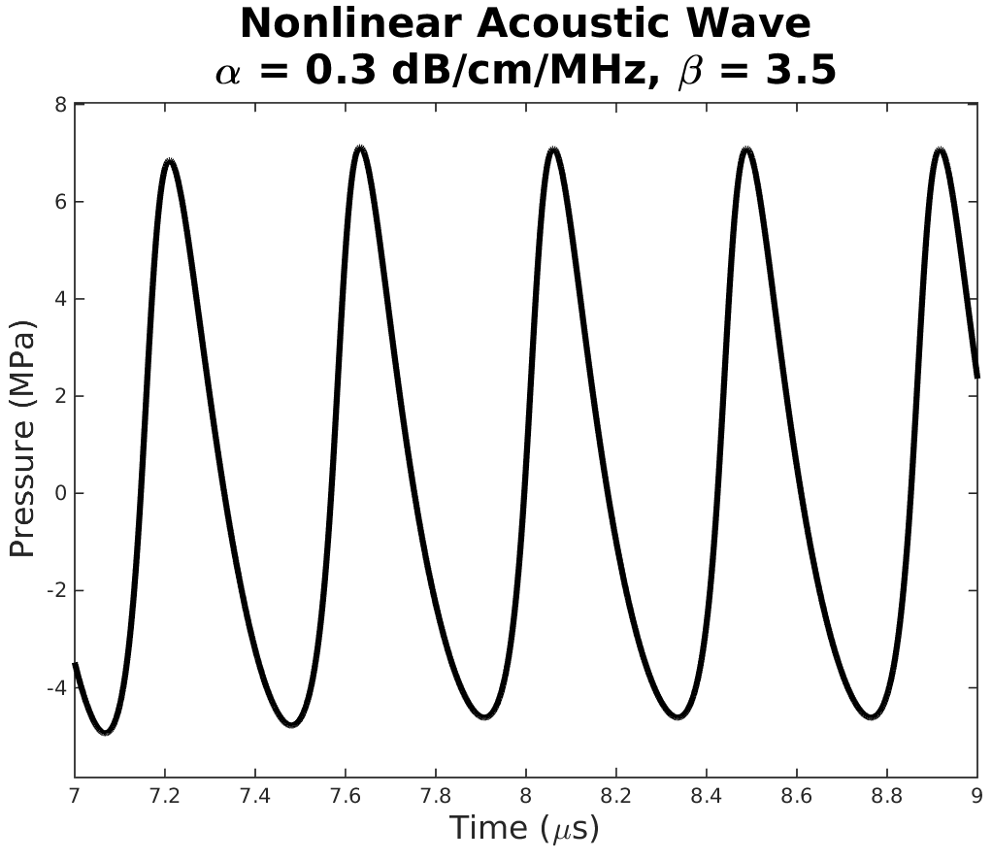

Methods – Generating Intensity Fields
Simulated C5-2 using Field II
2.36 MHz, 7 cycles, $\sim 0.4 \text{M}\text{Pa}$ amplitude
30 mm and 70 mm focal depths
α = [0.005, 0.3, 0.45, 1.0, 1.5] dB/cm/MHz
β = [0.0, 3.5, 7.0]

Slide 5
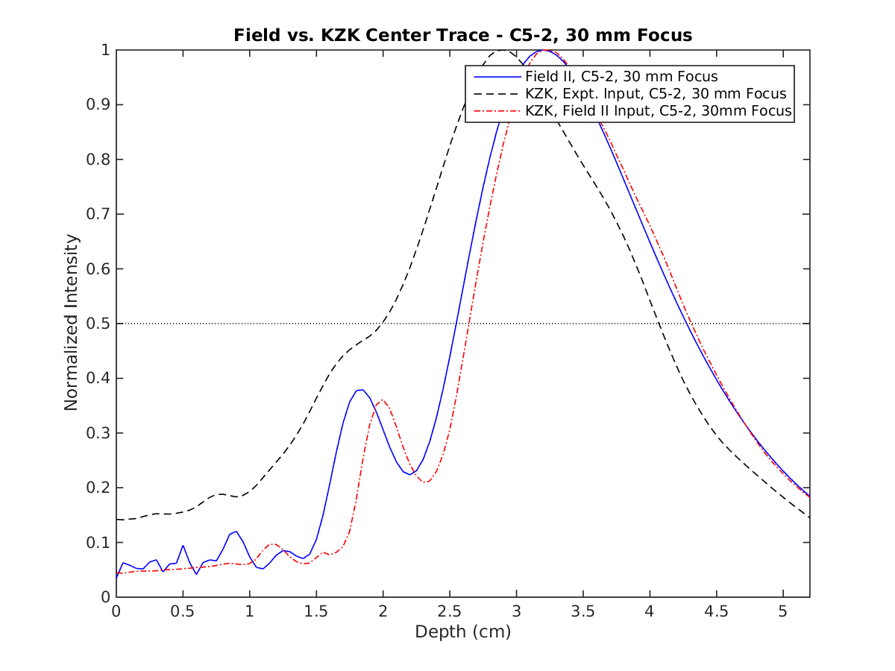
Validation with Field II – 30 mm Focus
Axial intensities down the center (lat = 0mm, ele = 0mm)
α = 0.005 dB/cm/MHz
β = 0
Notes:
Ran the KZK sim in linear mode (beta = 0) to compare w/ Field II intensity field
Next series of plots are all center trace plots -> plots of axial intensities down the center of mesh (intersection of lateral and elevational axes)

Slide 6
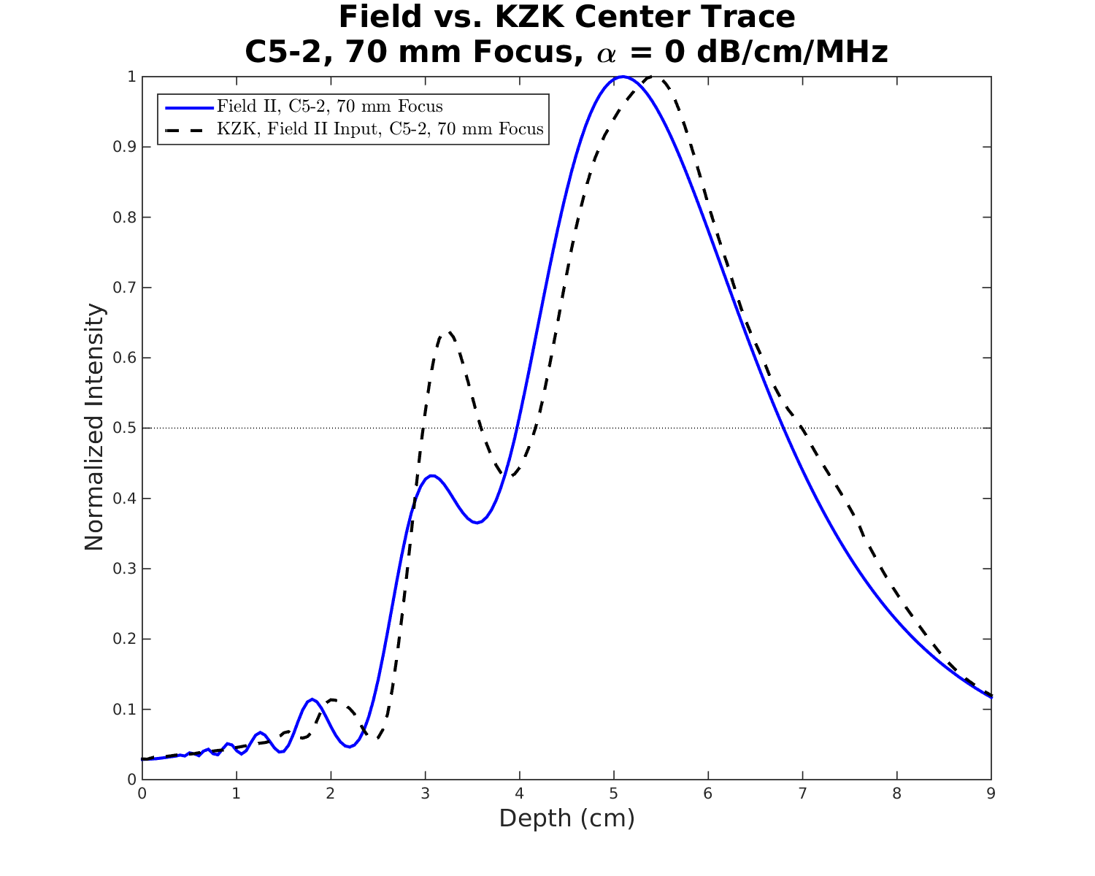
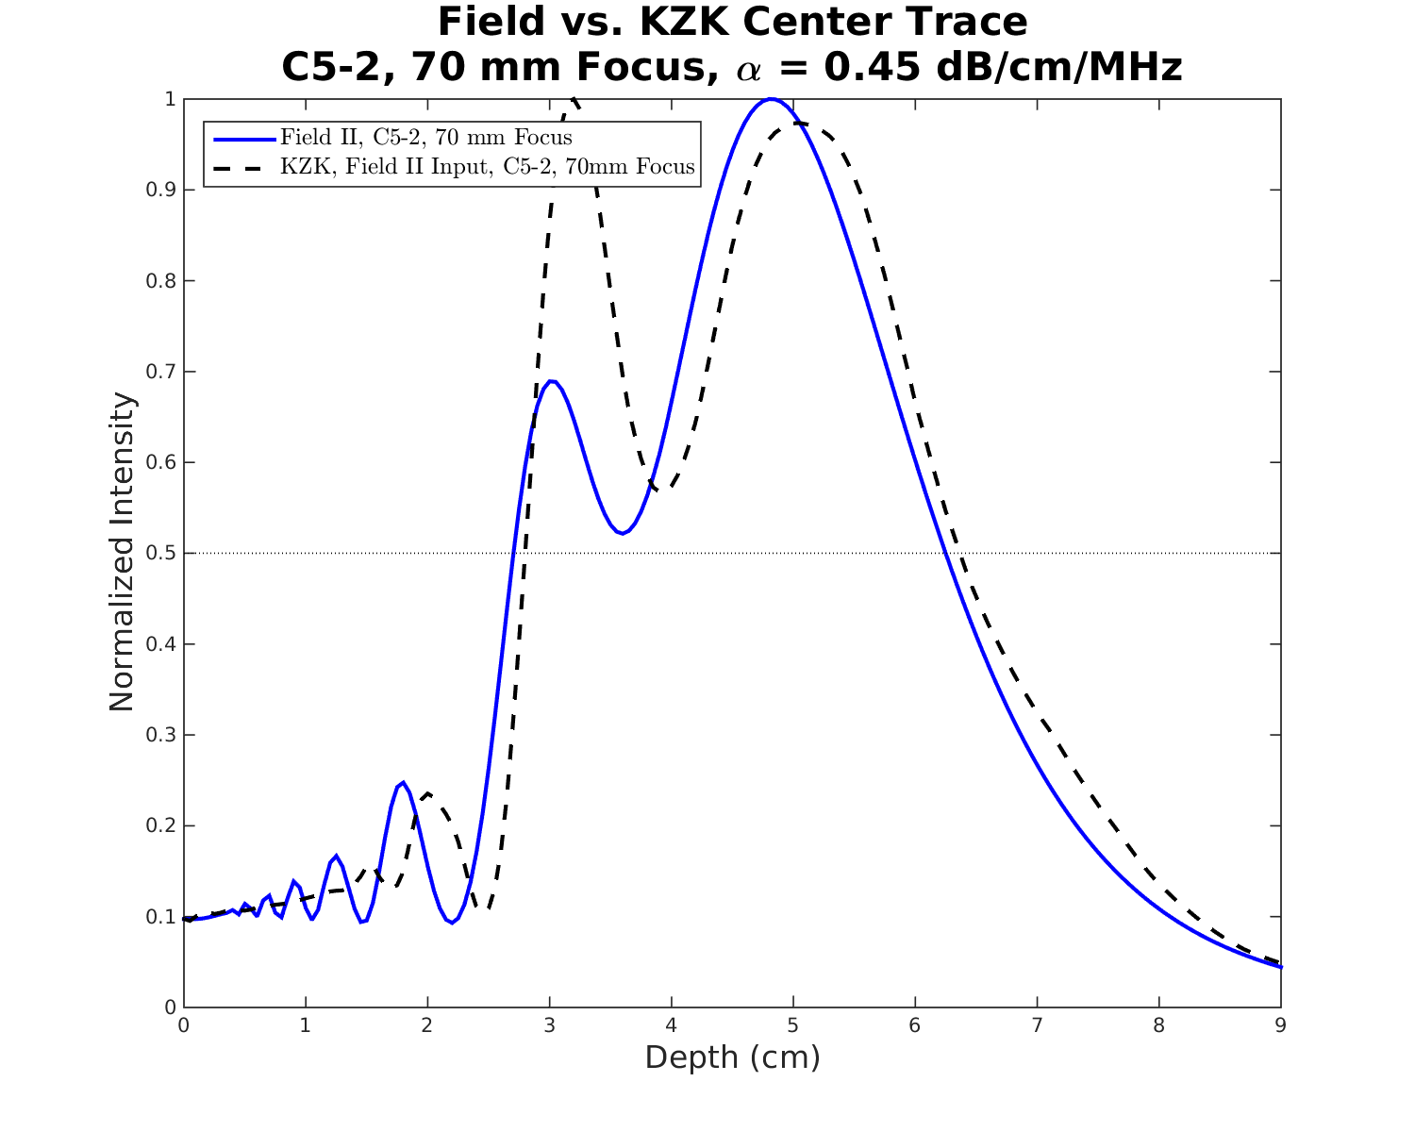
Validation with Field II – 70 mm Focus
α = 0 dB/cm/MHz
α = 0.45 dB/cm/MHz
Notes:
Differences in attenuation calculations between Field II and KZK sim? Match up slightly better for no attenuation cases for identical sim inputs when KZK sim run in linear mode.

Slide 7
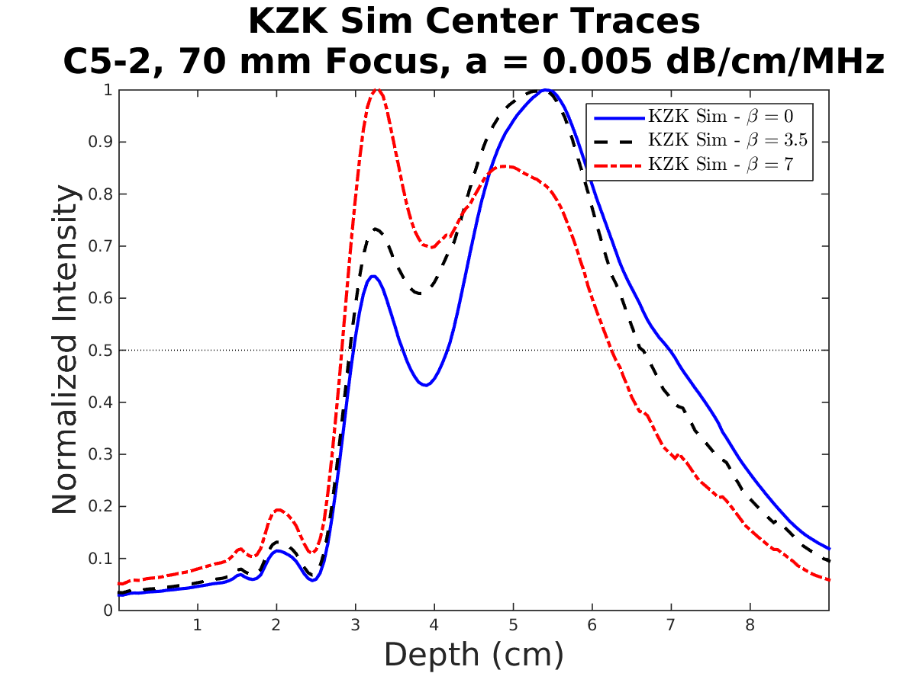
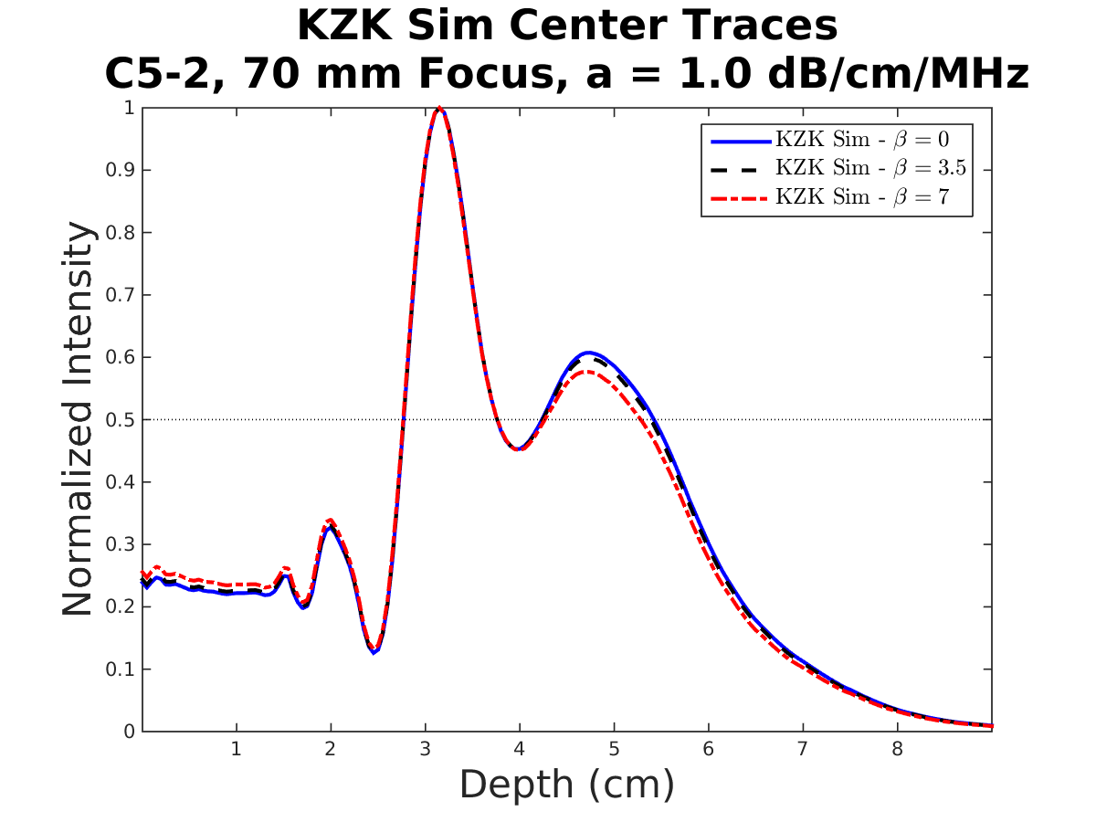
Intensity Fields with Increasing Nonlinearity
Notes:
As nonlinearity increases, the peak intensities occur at shallower depths. However, nonlinear affects are mitigated for greater attenuation levels.

Slide 8
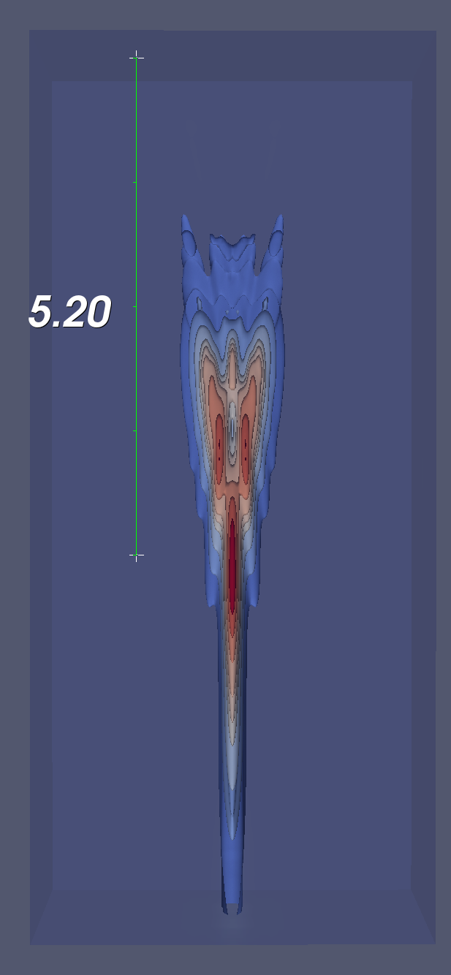
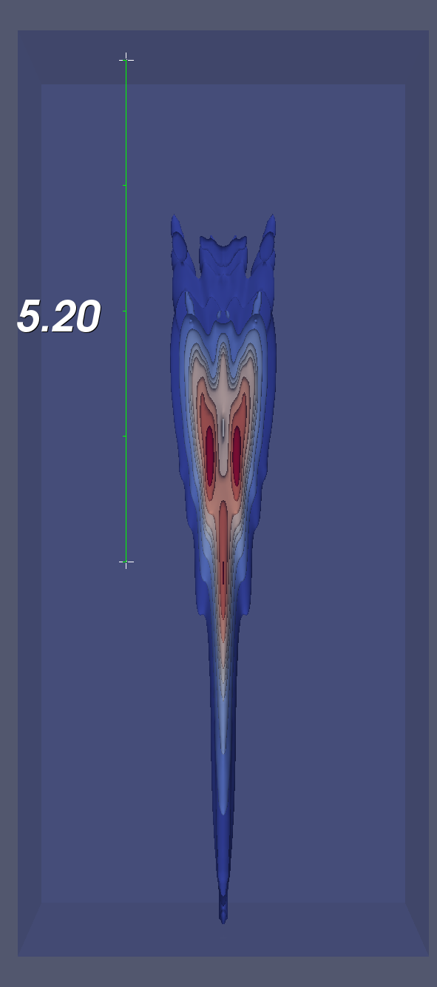
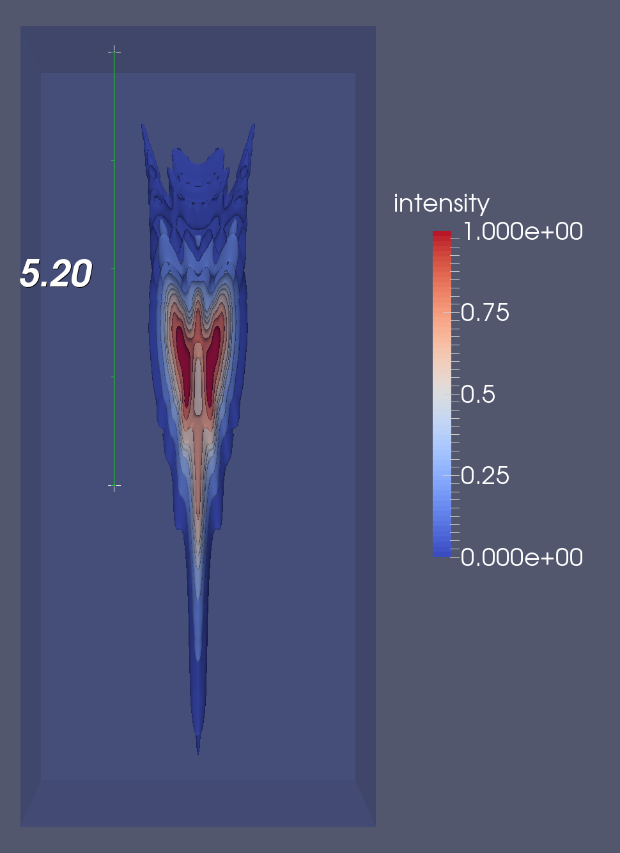
Intensity Fields with Increasing Nonlinearity
70 mm focus, α = 0.005 dB/cm/MHz
lateral
depth
β = 0.0
β = 3.5
β = 7.0
Notes:
As nonlinearity increases, the peak intensities occur at shallower and more laterally offset positions.

Slide 9
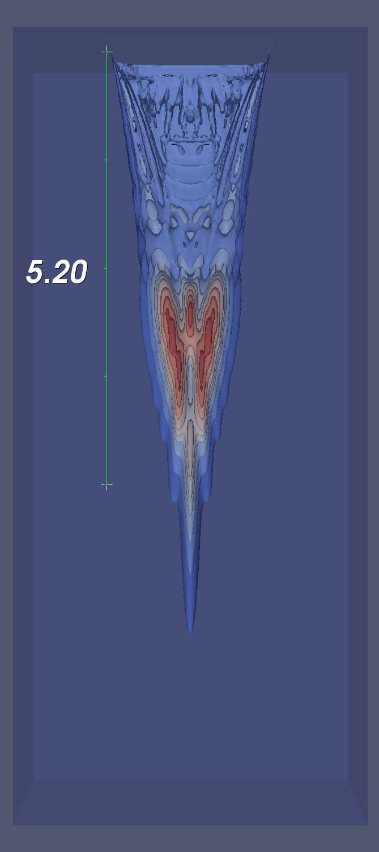
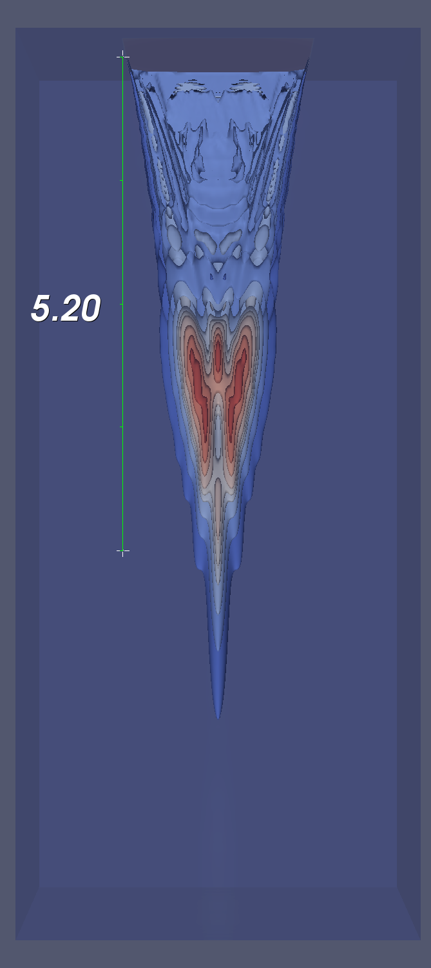
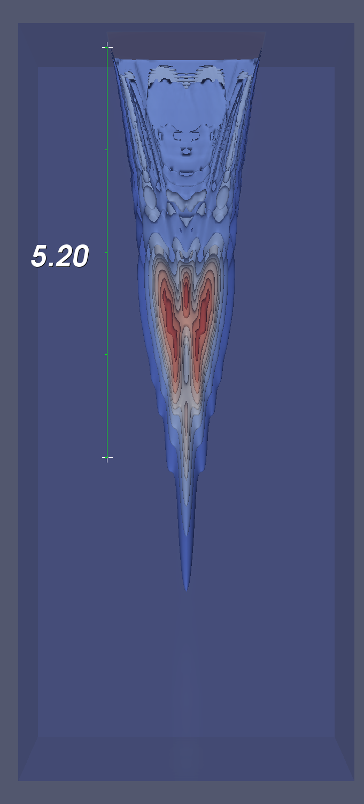
Intensity Fields with Increasing Nonlinearity
70 mm focus, α = 1.0 dB/cm/MHz
lateral
depth
β = 0.0
β = 3.5
β = 7.0
Notes:
However, if the attenuation is high enough, the amplitude of the sound waves is reduced, and nonlinear effects are no longer as influential.

Slide 10
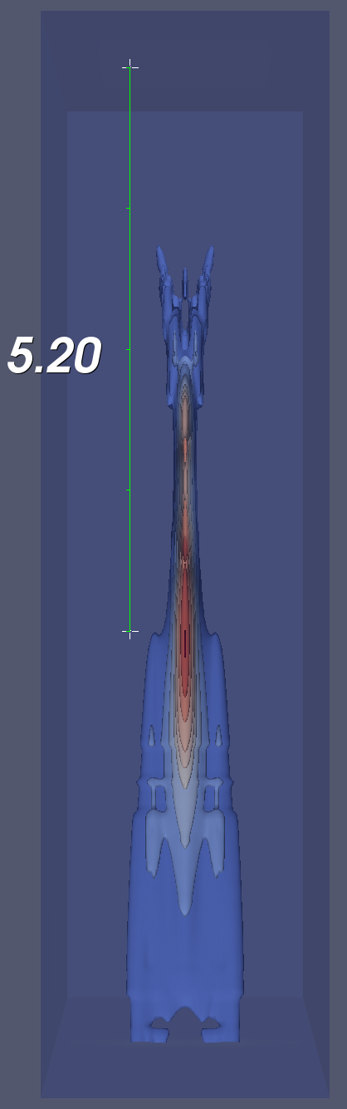
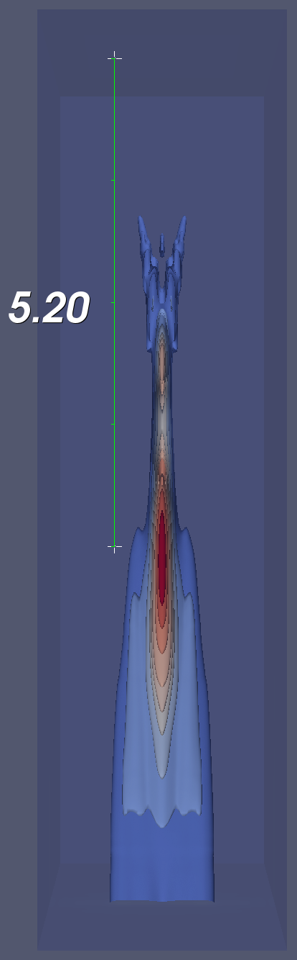
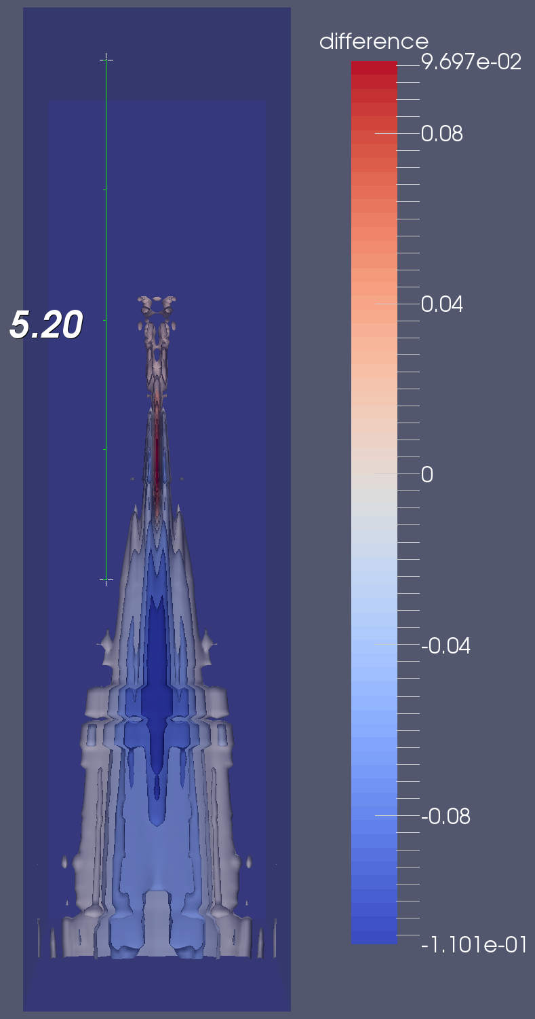
Intensity Fields with Increasing Nonlinearity
elevation
depth
-
=
β = 3.5
β = 0.0
Notes:
Possible out-of-plane sources??? Though changes are very miniscule.

Slide 11
Methods – Shear Wave Simulations
Imitated dyna*.mat intensity output file
Linearly interpolated 3D KZK sim intensity output to uniformly spaced set of nodes
Exploited quarter symmetry → added boundary conditions and PMLs
Simulated ARFI excitation in LS-DYNA
E = 3.0 kPa, ν = 0.45 (quick runtimes)
300 μs excitation duration, 25 ms total duration

Slide 12
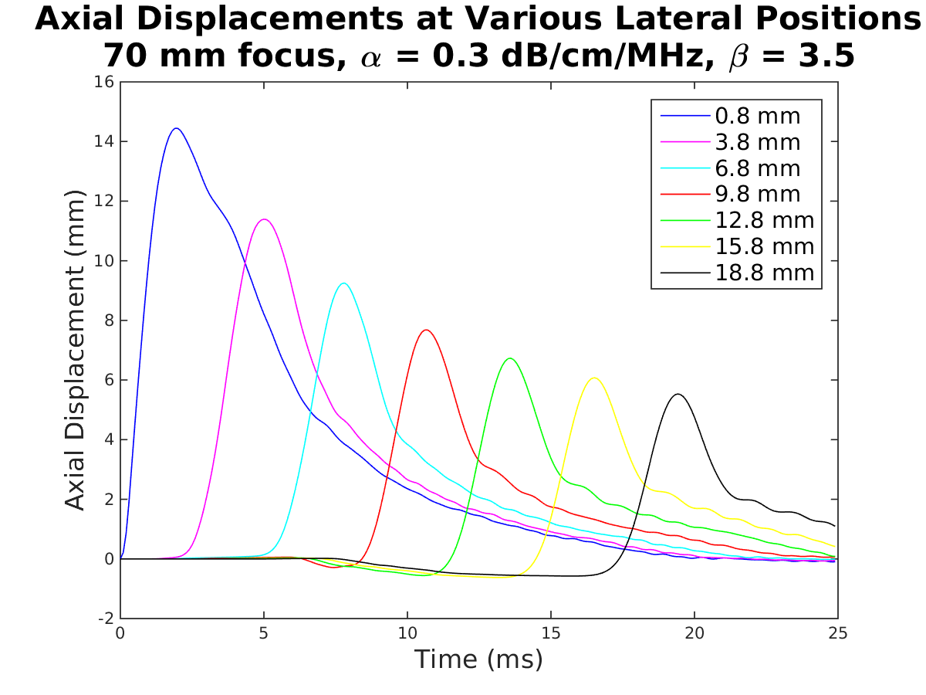
Axial Displacements Plot

Slide 13
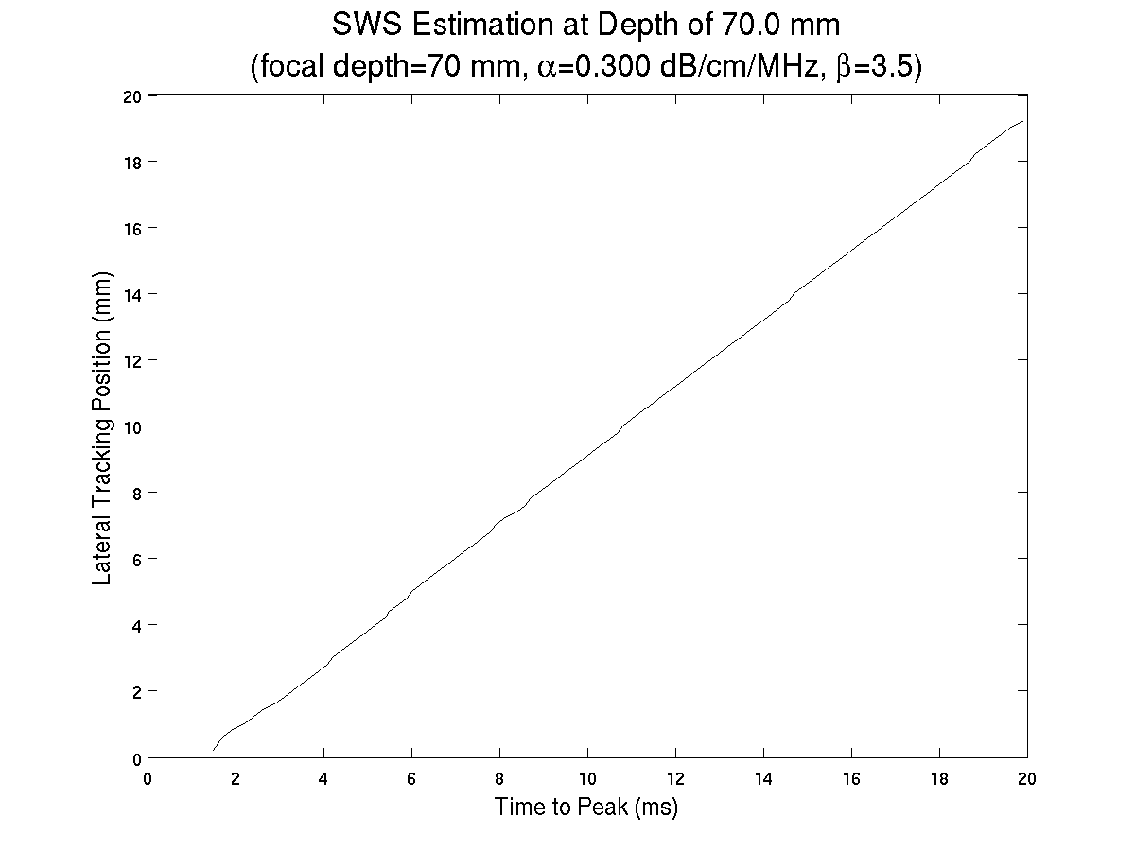
Time-to-Peak Shear Wave Speed Estimation

Slide 14

Expected SWS Calculation
$$\text{shear} \text{modulus}=μ=\frac{E}{2(1+ν)}$$
$$SWS=\sqrt{\frac{μ}{ρ}}$$
$$SWS=\sqrt{\frac{E}{2\left(1+ν\right)ρ}}=\sqrt{\frac{3000 \text{Pa}}{2(1+0.45)(1030\frac{\text{kg}}{{\text{m}}^{\text{3}}})}}$$
$$SWS≈1 \text{m}\text{/}\text{s}$$

Slide 15
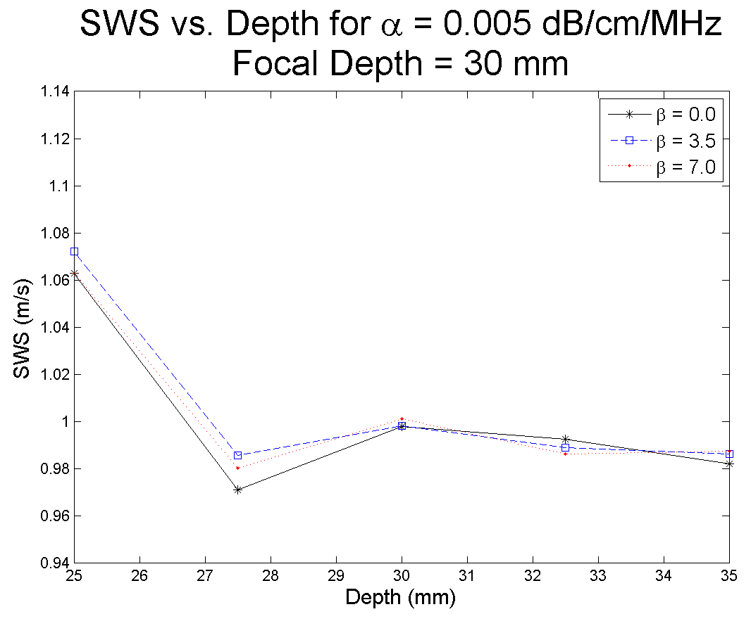
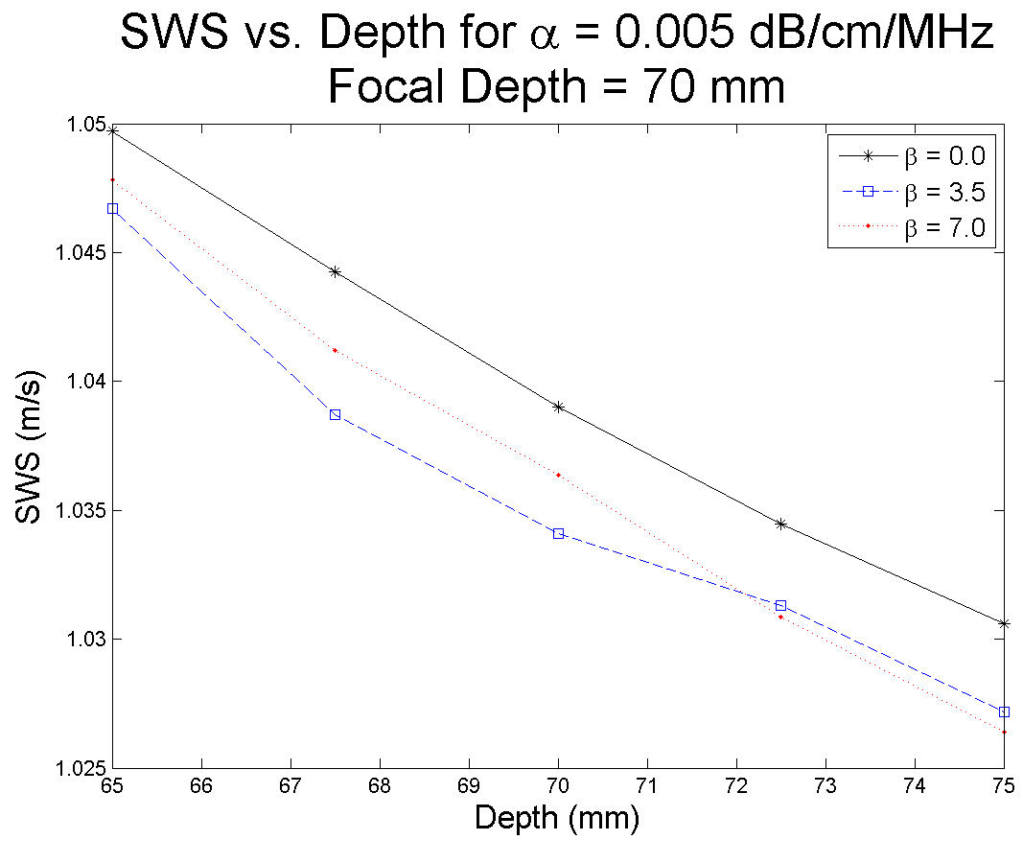
SWS Measurements at Different Focal Depths

Slide 16
Conclusions
Increasing the degree of nonlinearity causes peak intensities to shift to shallower, laterally offset positions.
The effects of nonlinearity were greatly dampened for attenuations of around 1.0 to 1.5 dB/cm/MHz.
Shear wave speeds vary slightly when measured using different focal depths.

Slide 17
Future Work
Validating 3D KZK simulation results using Field II, k-Wave, and experimental data.
Simulating intensity fields and corresponding shear waves for a range of focal depths, as well as in media with different material properties.
Notes:
Reminder to mention Gianmarco has updated 3D KZK sim code that has quarter symmetry mode + written in C, so it should have a much quicker runtime. He is also working on a parallel version of the KZK sim code.

