Slide 1
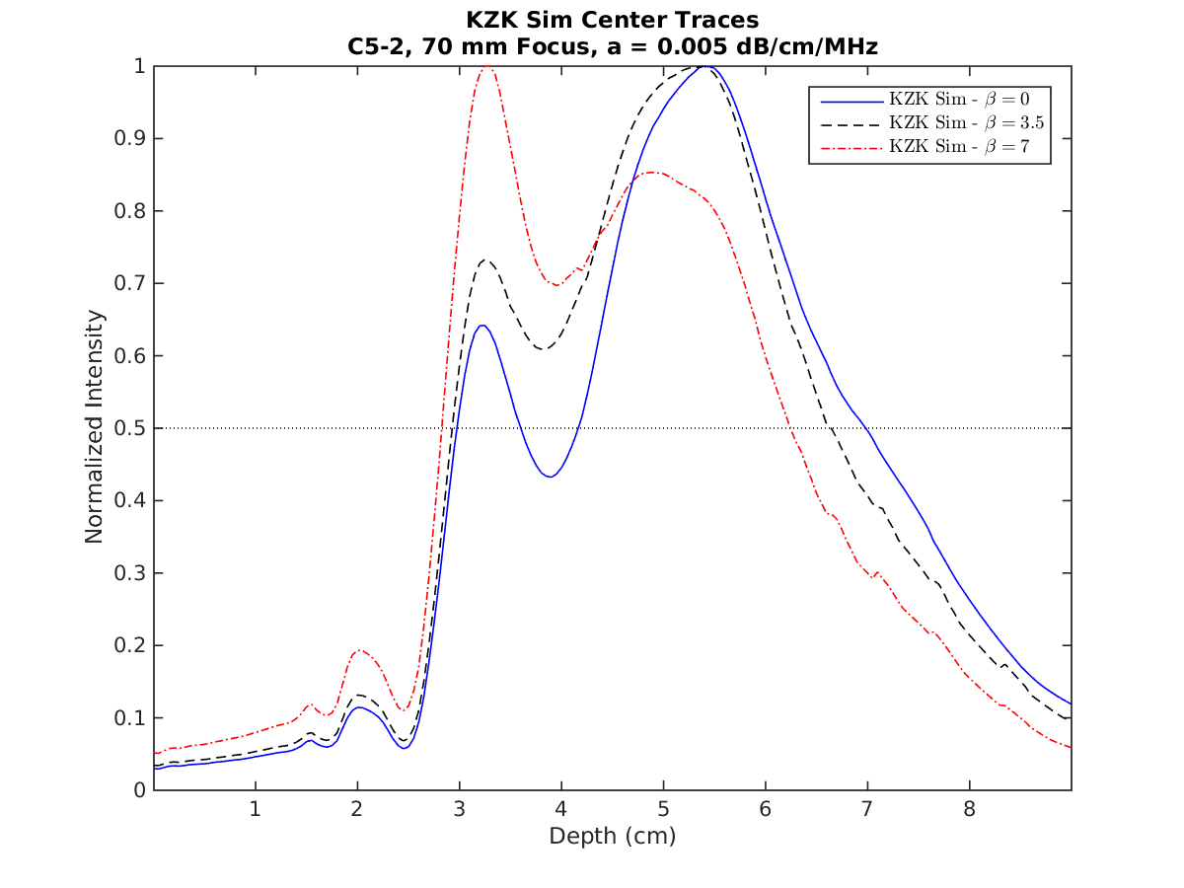
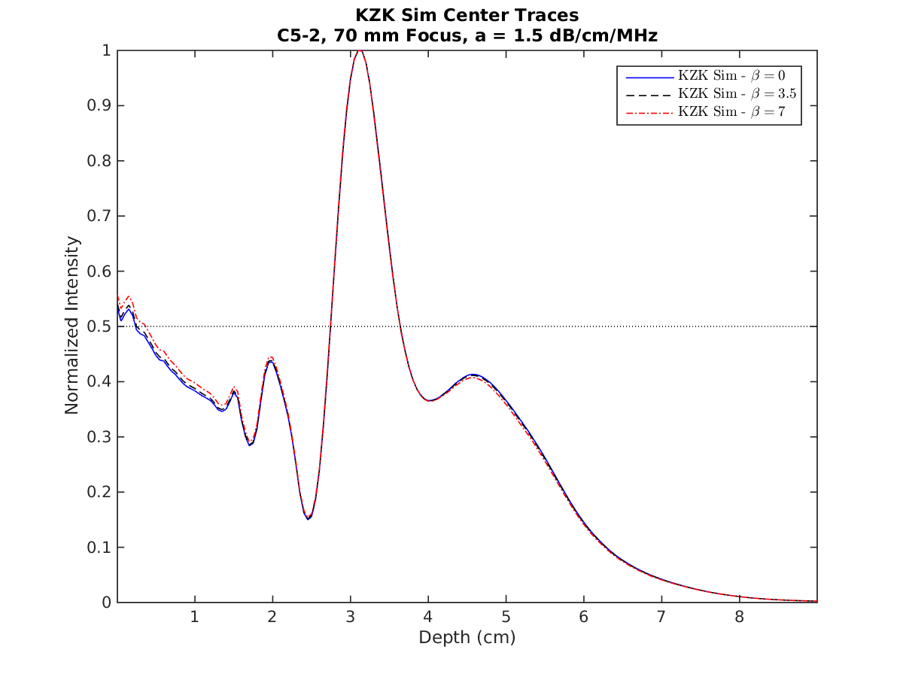
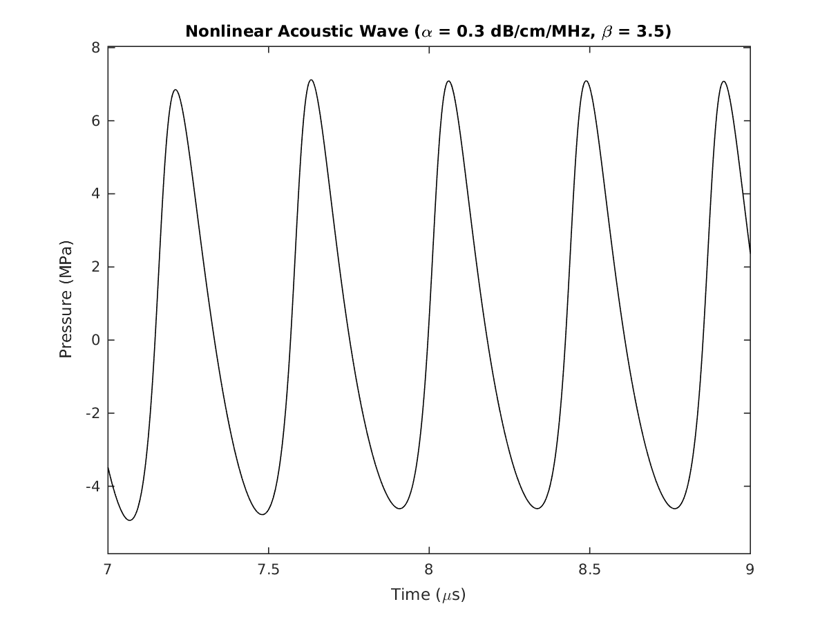
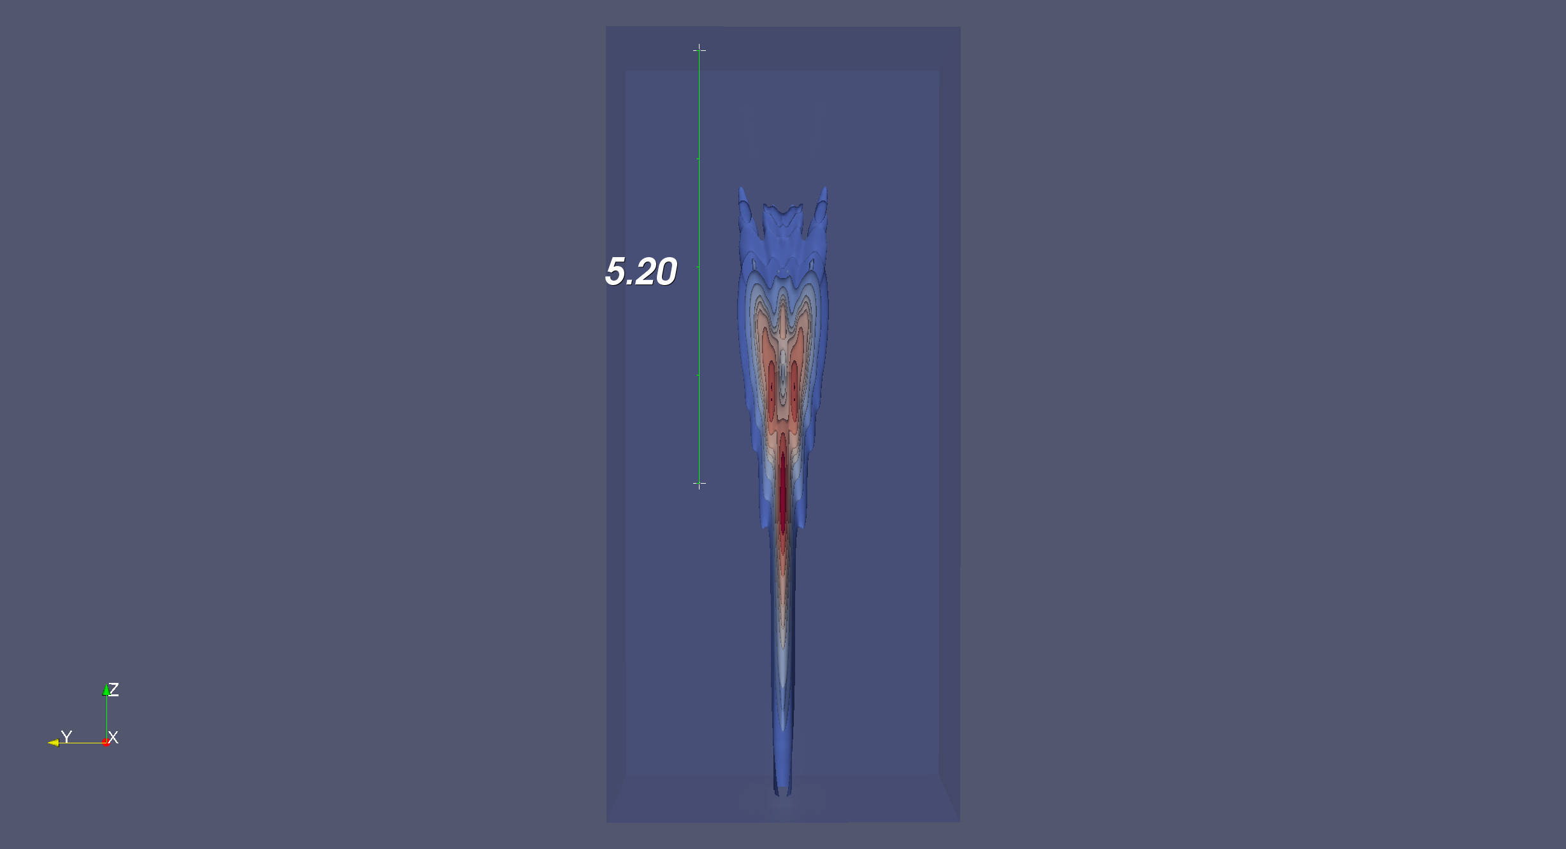
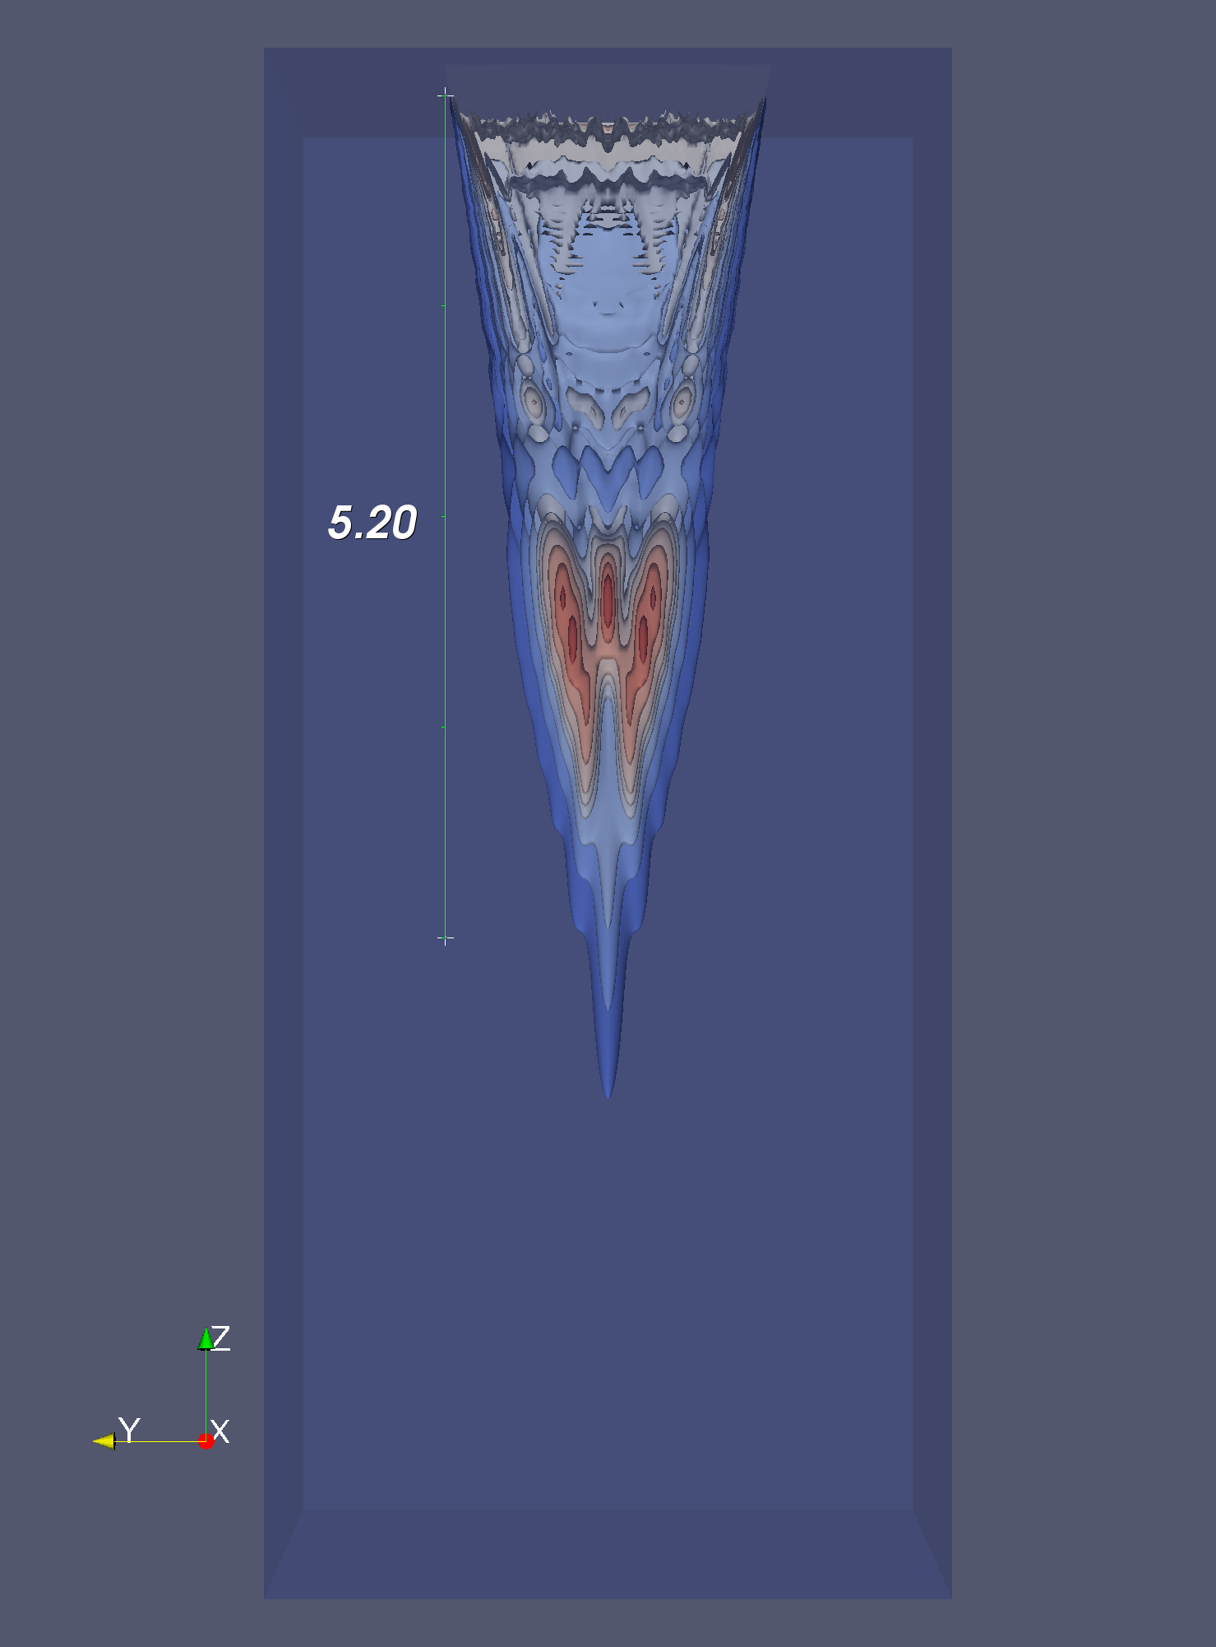
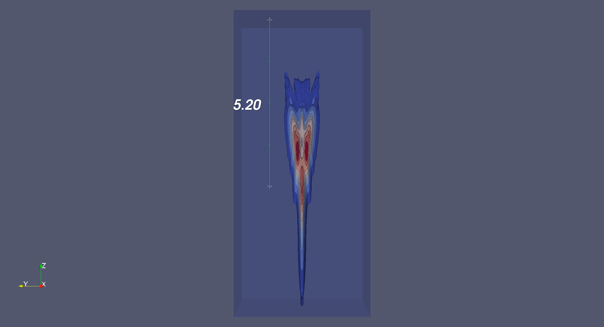
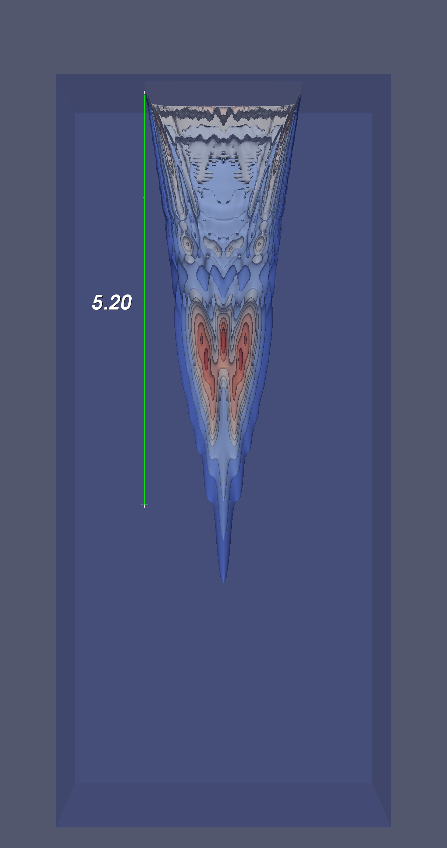
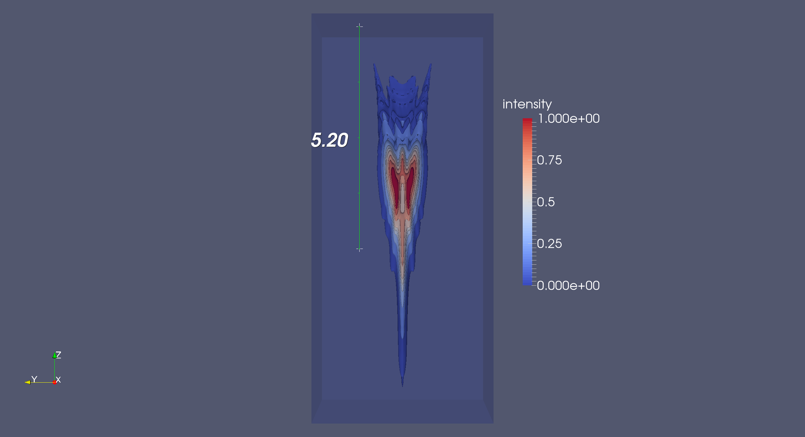
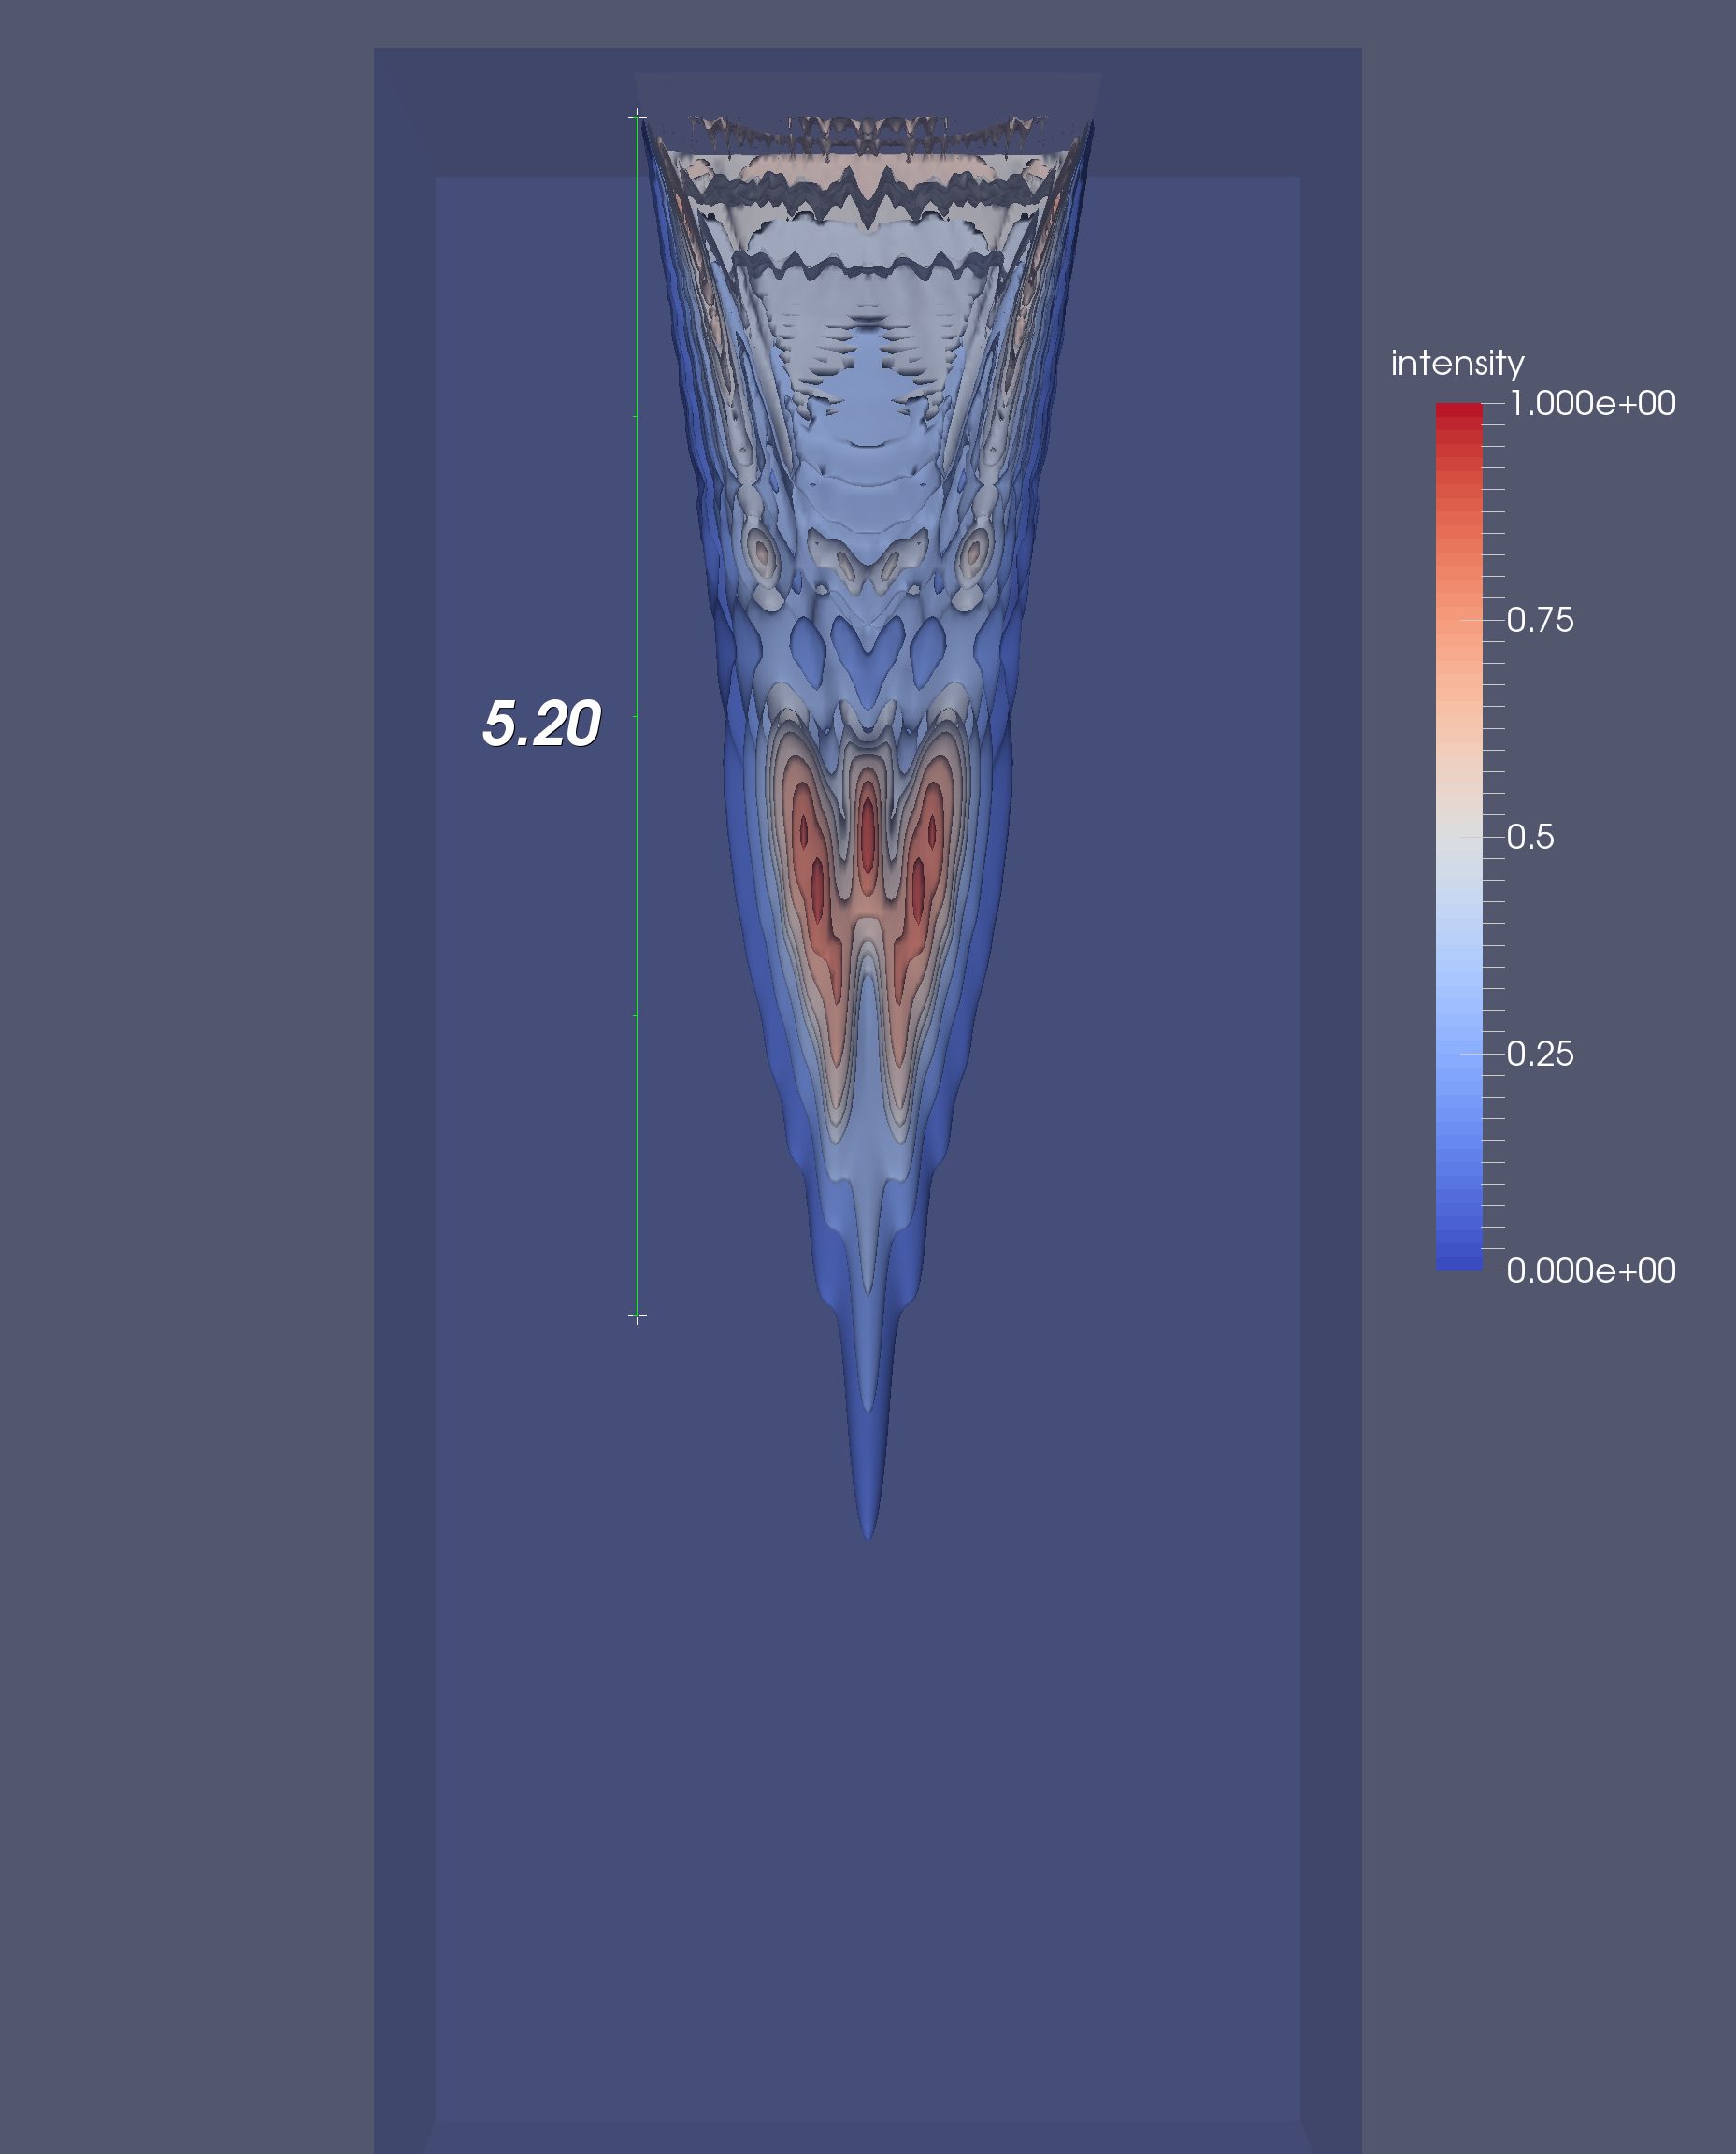
Simulating the Effects of Nonlinear Acoustic Propagation on Radiation Force
Ningrui Li, Mark L. Palmeri, Kathryn R. Nightingale
Department of Biomedical Engineering, Duke University, Durham, NC, United States.
INTRODUCTION
RESULTS
RESULTS
Shear waves can be induced in tissues by acoustic radiation force created using an ultrasound probe. The shear wave speed of tissue can be measured by tracking the propagation of shear waves from their source using time-of-flight methods [1]. Tissue stiffness can be characterized using these shear wave speed measurements, and this allows differentiation between healthy tissue and lesions.
However, shear wave speed measurements have been shown to exhibit a depth dependent bias, which has the potential to cause misdiagnosis [2]. It was hypothesized that this depth dependence was caused by out-of-plane shear wave sources generated through nonlinear effects in acoustic propagation. The Khokhlov-Zabolotskaya-Kuznetsov (KZK) nonlinear wave equation [3] was used to simulate acoustic waves propagating in differing media with various nonlinear coefficients . The simulated intensity field distributions showed that as nonlinearity increased, the maximum intensities tended towards shallower locations.
α = 0.005 dB/cm/MHz
α = 1.5 dB/cm/MHz
METHODS
CONCLUSIONS
REFERENCES
[1] Sarvazyan, A. P., Rudenko, O. V., Swanson, S. D., Fowlkes, J. B., & Emelianov, S. Y. (1998). Shear wave elasticity imaging: a new ultrasonic technology of medical diagnostics. Ultrasound in medicine & biology, 24(9), 1419-1435.
[2] Zhao, H., Song, P., Urban, M. W., Kinnick, R. R., Yin, M., Greenleaf, J. F., & Chen, S. (2011). Bias observed in time-of-flight shear wave speed measurements using radiation force of a focused ultrasound beam. Ultrasound in medicine & biology, 37(11), 1884-1892.
[3] Pinton, G. F., Dahl, J., Rosenzweig, S., & Trahey, G. E. (2009). A heterogeneous nonlinear attenuating full-wave model of ultrasound. Ultrasonics, Ferroelectrics, and Frequency Control, IEEE Transactions on, 56(3), 474-488.
Notes:
<number>

