Slide 1
Simulating Shear Wave Speeds from 3D KZK Simulation
Ningrui Li
Lab Meeting, April 24, 2015

Slide 2
Objectives
Determine if varying the degree of nonlinearity in acoustic propagation causes changes in shear wave speed estimates at different focal depths.

Slide 3
Methods
Generate intensity fields using 3D KZK simulation with various attenuation and nonlinearity coefficients.
Simulate stresses and corresponding axial displacements using LS-DYNA and FEM post-processing tools.

Slide 4
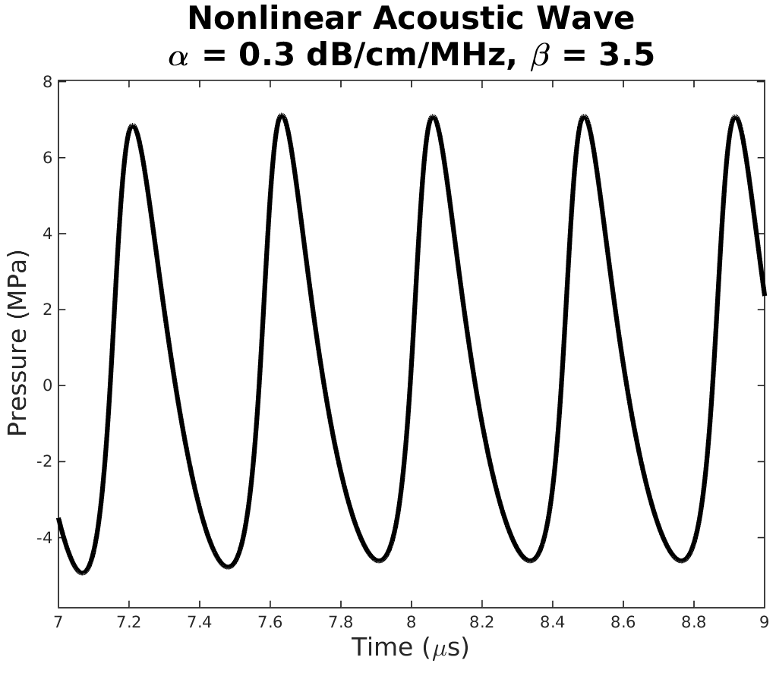

Methods – Generating Intensity Fields
Simulated C5-2 using Field II
2.36 MHz, 7 cycles, $\sim 4×{10}^{5} \text{Pa}$ amplitude
30 mm and 70 mm focal depths
α = [0.005, 0.3, 0.45, 1.0, 1.5] dB/cm/MHz
β = [0.0, 3.5, 7.0]

Slide 5
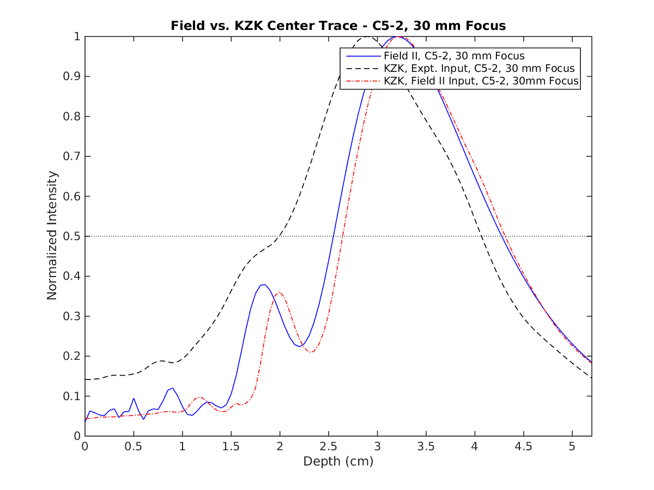
Validation with Field II – 30 mm Focus
Axial intensities down the center (lat = 0mm, ele = 0mm)
α = 0.005 dB/cm/MHz
β = 0

Slide 6
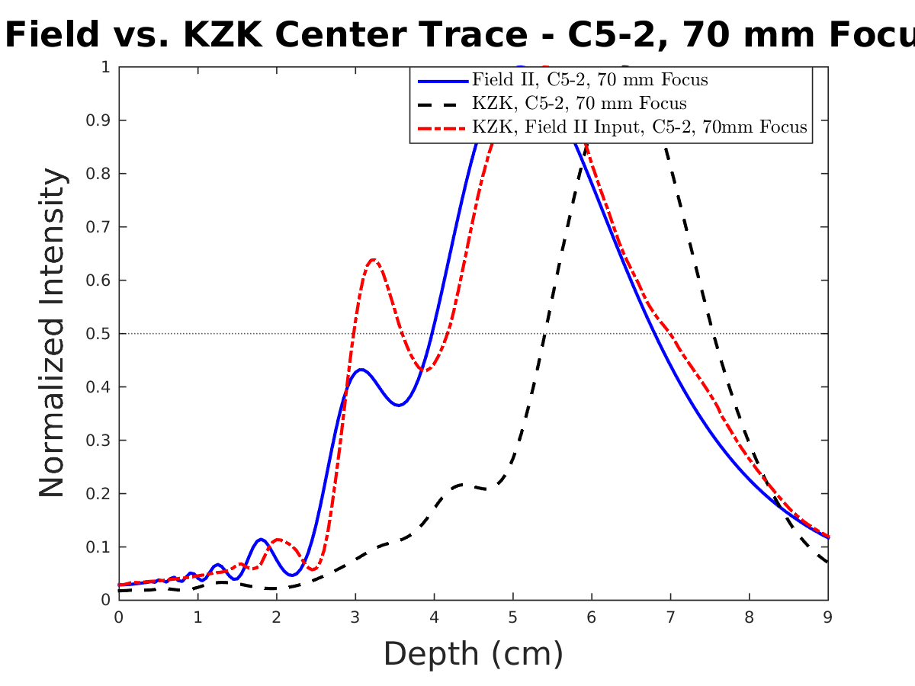
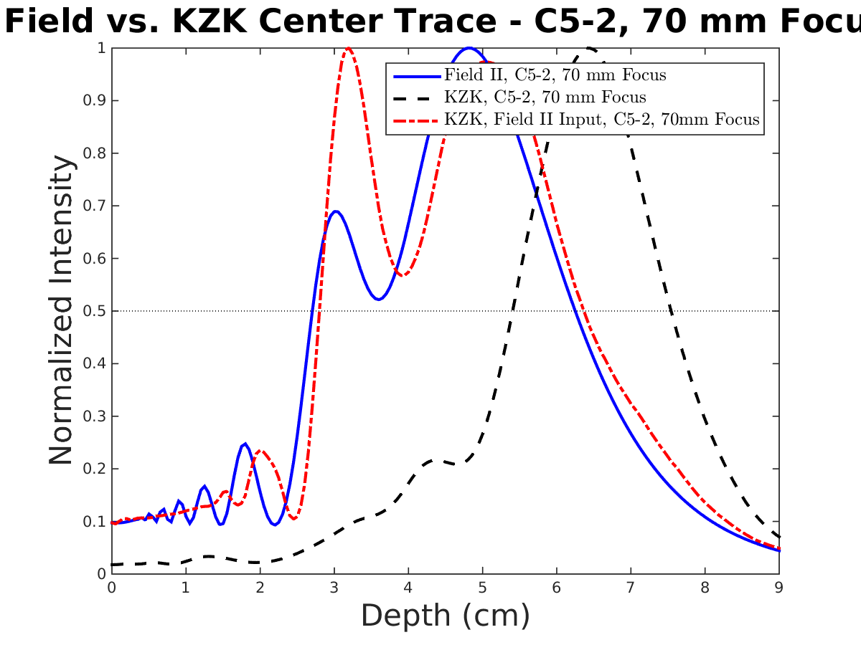
Validation with Field II – 70 mm Focus
α = 0.005 dB/cm/MHz
α = 0.45 dB/cm/MHz

