Slide 1
Generating Radiation Force Field from KZK Intensity Field
Ningrui Li
Lab Meeting, 12/2/14

Slide 2
Objective
Using the intensity field output from the KZK simulation, calculate the corresponding nodal loads using existing FEM tools and simulate the stress states with LS-DYNA.

Slide 3
Methods
Imitated field2dyna.m output dyna.mat file
Linearly interpolated KZK intensity field to uniformly spaced node set.
Added other parameters, like attenuation and sound speed
Simulated ARFI excitation in DYNA
E = 9 kPa, ν = 0.45
250 μs timesteps for 10 ms

Slide 4
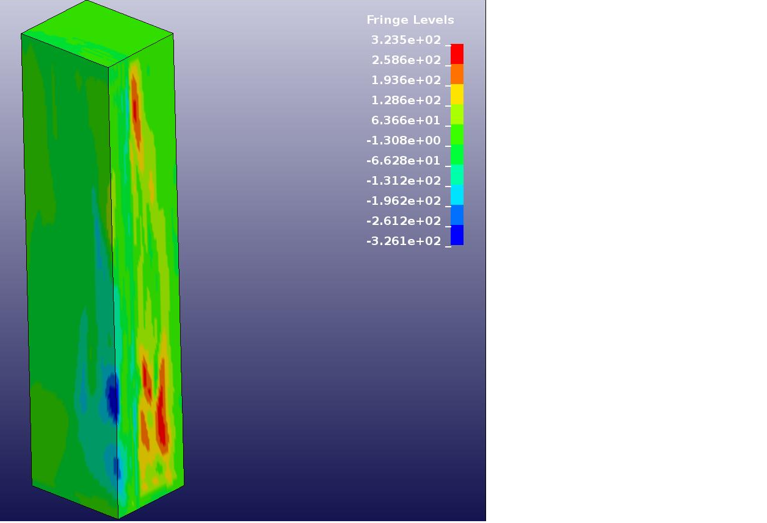
Results
zx-stress at 6.25 ms

