Slide 1
KZK Sim – Differences in Intensity Fields due to Nonlinearity
Lab Meeting
3/6/2015

Slide 2
Objective
Examine the differences in intensity distributions generated by running the KZK simulations with varying nonlinear coefficients.

Slide 3
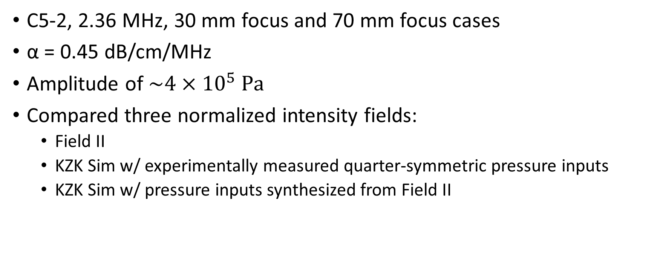
Validation with Field II
C5-2, 2.36 MHz, 30 mm focus and 70 mm focus cases
α = 0.45 dB/cm/MHz
Amplitude of $\sim 4×{10}^{5} \text{Pa}$
Compared three normalized intensity fields:
Field II
KZK Sim w/ experimentally measured quarter-symmetric pressure inputs
KZK Sim w/ pressure inputs synthesized from Field II

Slide 4
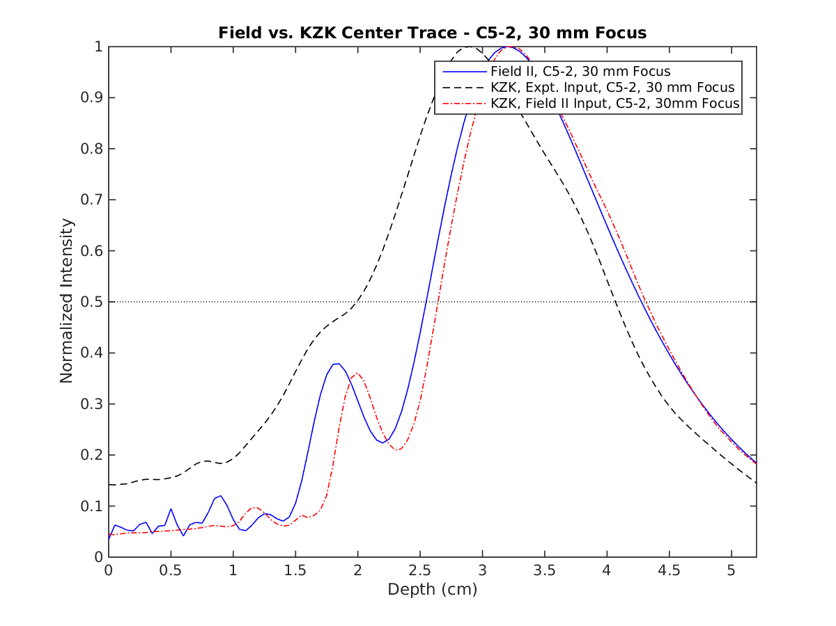
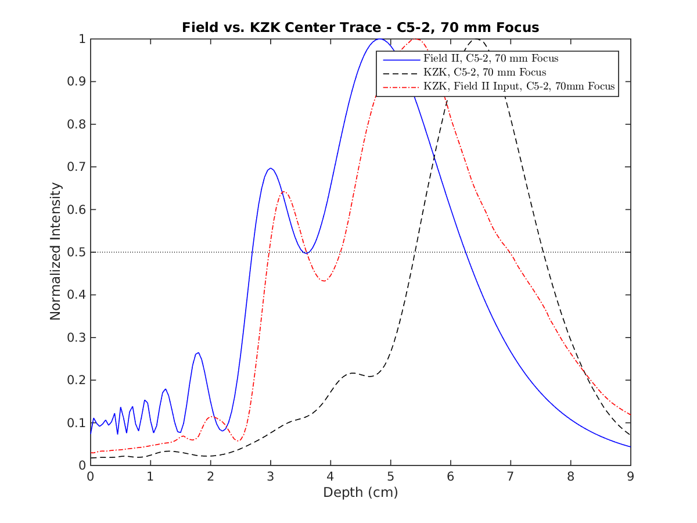
Validation with Field II

Slide 5
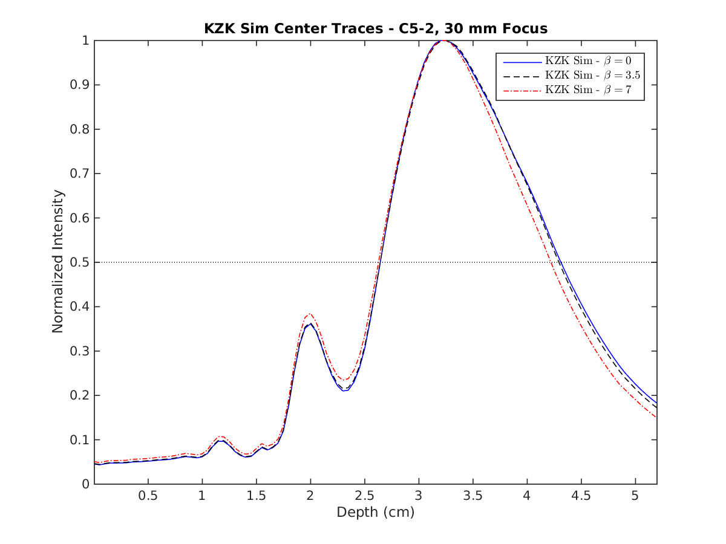

30 mm Focus, β = 0, 3.5, 7 Comparison
C5-2, 2.36 MHz
α = 0.45 dB/cm/MHz
Amplitude of $\sim 4×{10}^{5} \text{Pa}$
β = 0, 3.5, 7

Slide 6
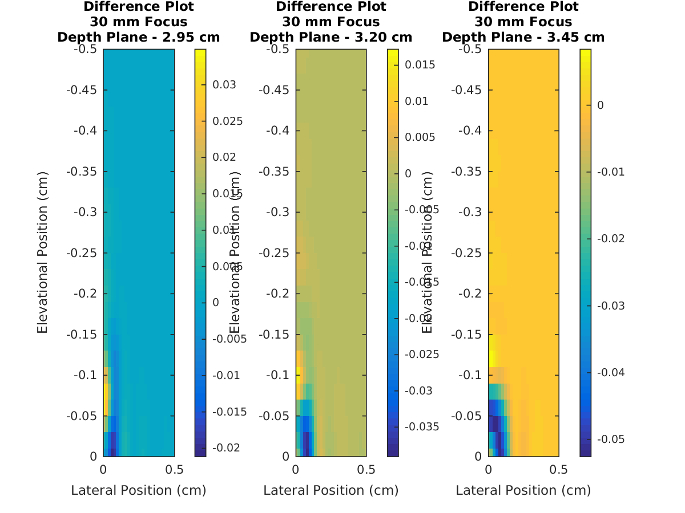
30 mm Focus, β = 0 and β = 7 Comparison

Slide 7
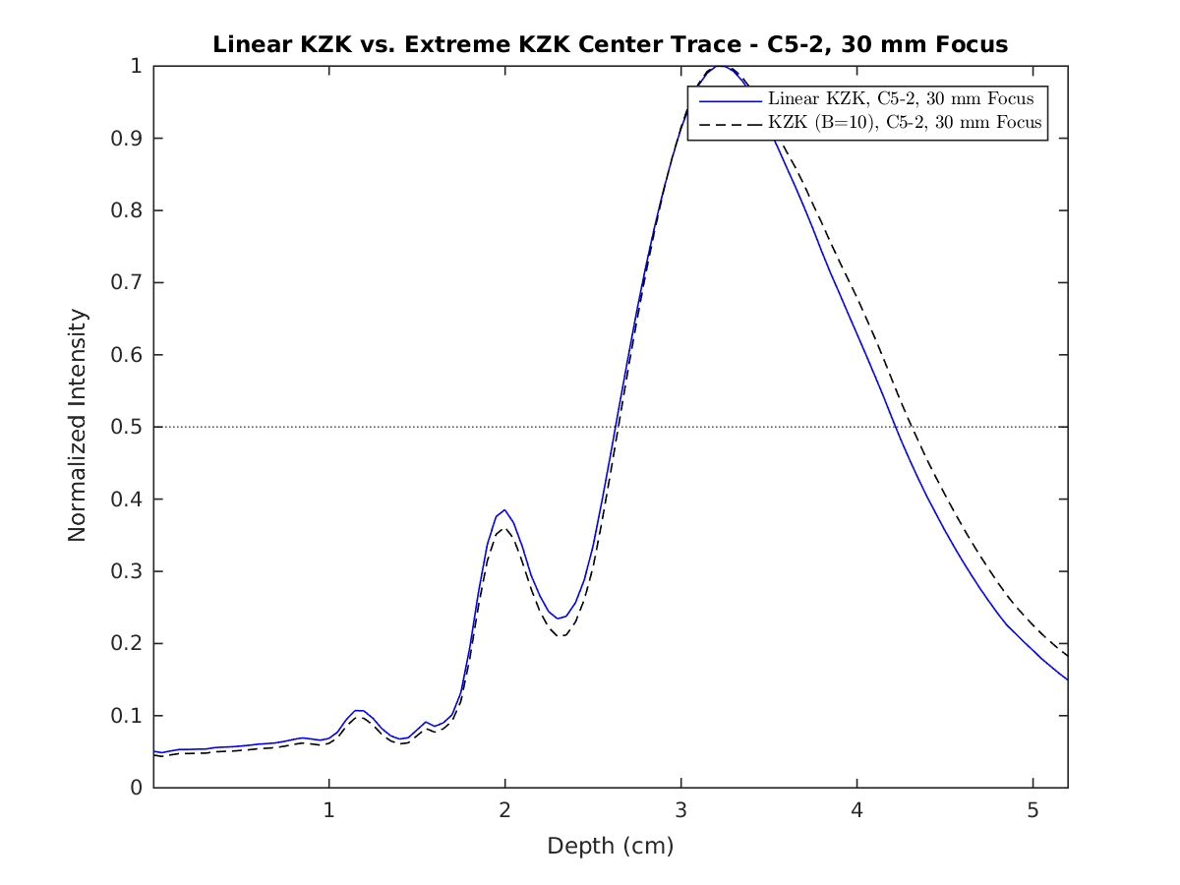
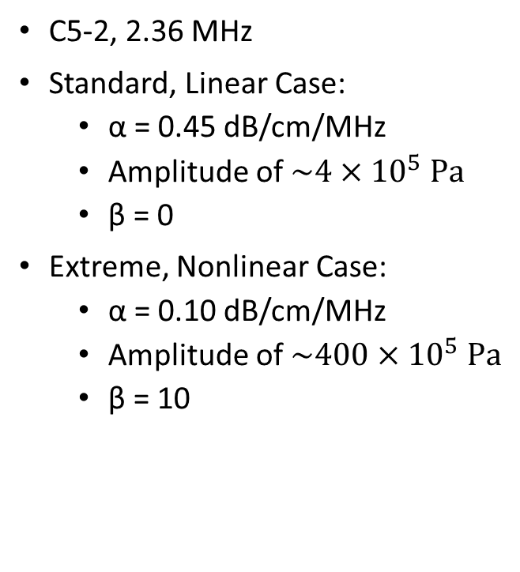
30 mm Focus, Extreme Nonlinear Comparison
C5-2, 2.36 MHz
Standard, Linear Case:
α = 0.45 dB/cm/MHz
Amplitude of $\sim 4×{10}^{5} \text{Pa}$
β = 0
Extreme, Nonlinear Case:
α = 0.10 dB/cm/MHz
Amplitude of $\sim 400×{10}^{5} \text{Pa}$
β = 10
30 mm Focus, β = 0, 3.5, 7 Comparison

Slide 8
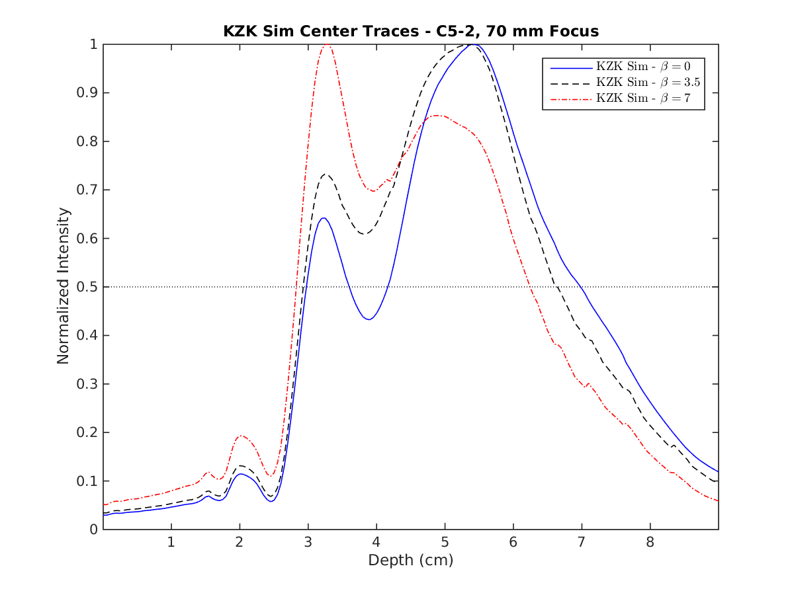

70 mm Focus, β = 0, 3.5, 7 Comparison
C5-2, 2.36 MHz
α = 0.45 dB/cm/MHz
Amplitude of $\sim 4×{10}^{5} \text{Pa}$
β = 0, 3.5, 7

Slide 9
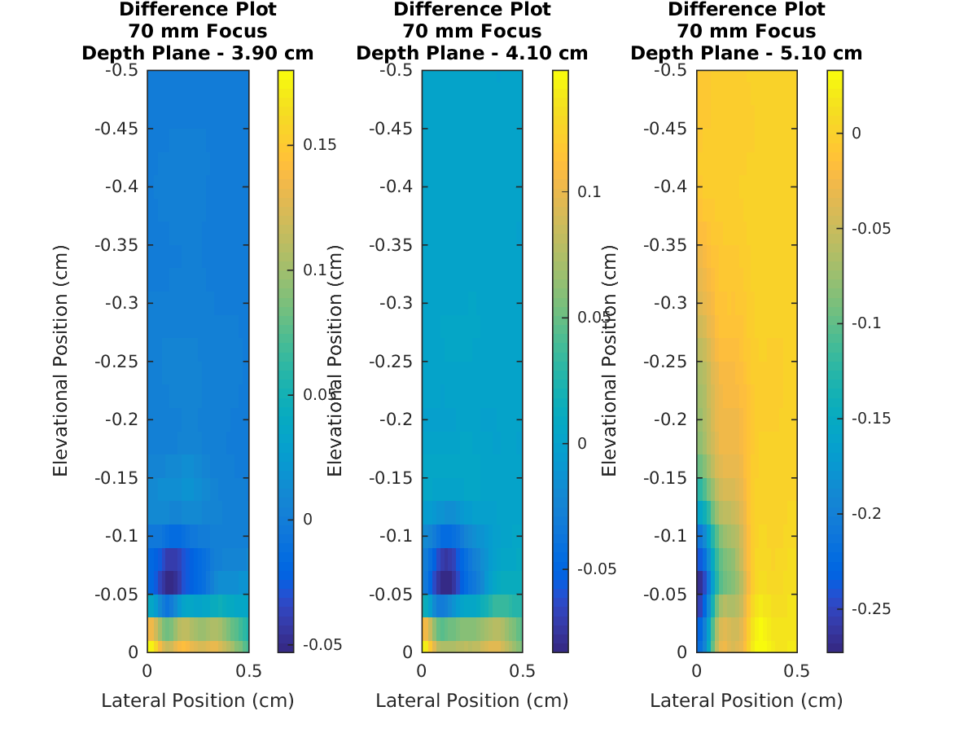
70 mm Focus, β = 0 and β = 7 Comparison

