Slide 1
Real-Time 3-D Visualization for Prostate ARFI Imaging
Ningrui Li
Lab Meeting, 4/18/16
Notes:
ls –d images/bmode/tiny/bmode_p59*.jpg | ./build/Debug/ARFIVisualization.exe

Slide 2
Objective
Integrate real-time 3D visualization into the current prostate imaging workflow
Feedback from clinician allows for focus on most prominent diseased regions
Notes:
I’ve been working on developing a 3D visualization system that I plan on integrating into our prostate imaging workflow. In our current setup, ARFI volumes are built offline after image acquisition, but I’m interested in implementing a way to construct and visualize these volumes in real-time during the imaging process.
ARFI volumes are built up by sweeping in 1 degree intervals and acquiring sagittal image planes at each location. However, if we are able to construct these volumes in real-time, we can identify suspicious regions, communicate with the rotation stage to return to that region, and sample more finely around that volume sector.

Slide 3
Block Diagram
Rotation Stage
Scanner
ER7B Probe
Patient
Visualization System
User
Notes:
Here, we introduce a visualization system into our setup. This system will be hosted on a laptop that is connected to the scanner.

Slide 4
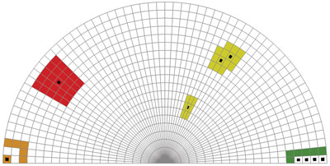
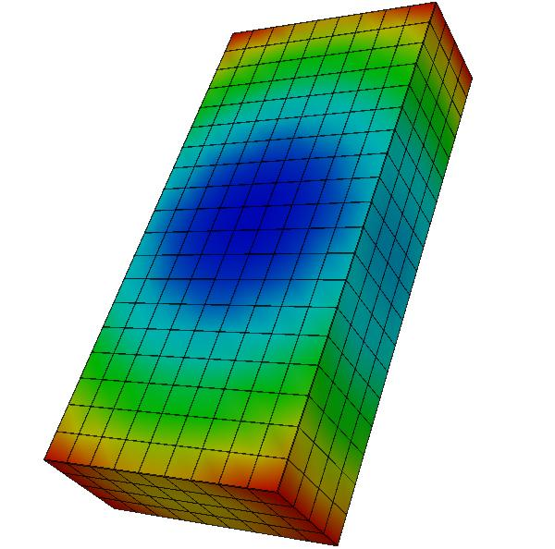
VTK Dataset Types
vtkUnstructuredGrid
Arbitrary combination of every possible cell type
vtkStructuredGrid
Uniformly spaced set of points
Notes:
vtkUnstructuredGrid image from: https://blog.kitware.com/source/files/28_2118110326.jpg
vtkStructuredGrid image from: http://www.win.tue.nl/~wstahw/edu/2Z860/college1/points.jpg

Slide 5
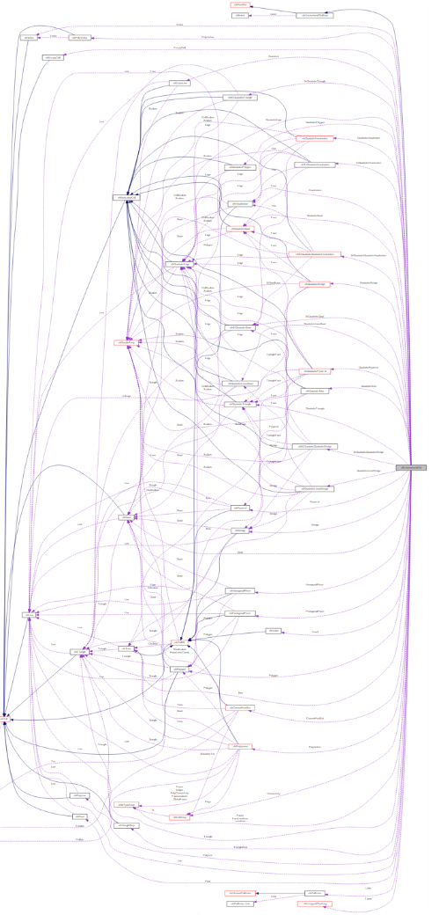
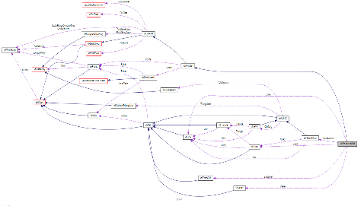
VTK Dataset Types – Collaboration Diagrams
vtkUnstructuredGrid
vtkStructuredGrid

Slide 6
VTK Pipeline
Read in image data into an unstructured grid.
Re-sample image data onto a structured grid.
Slice/clip structured image volume.

Slide 7
VTK Pipeline
Read in image data into an unstructured grid.
Re-sample image data onto a structured grid.
Slice/clip structured image volume.

Slide 8
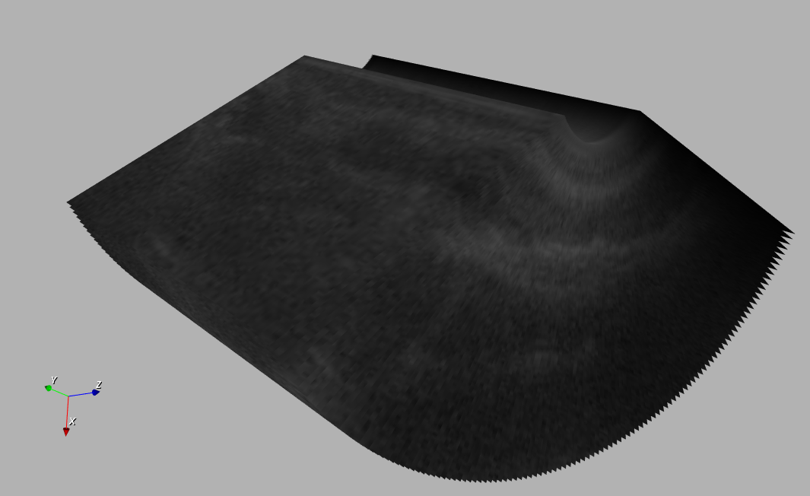
Reading Image Data
vtkJPEGReader
Read in individual images.
vtkTransformFilter
Orient image planes through translation and rotation
vtkAppendFilter
Combine all image planes into a single unstructured grid.
Discrete image planes combined into a single vtkUnstructuredGrid.
Notes:
The VTK libraries have a ton of functions for reading in image files of varying formats.
vtkTransformFilter for rotating the image plane about an axis to get to the right elevational angle offset.
The offset of each image plane and the amount of spacing between each plane can be manually set and doesn’t have to be uniform because this is an unstructured grid.

Slide 9
VTK Pipeline
Read in image data into an unstructured grid.
Re-sample image data onto a structured grid.
Slice/clip structured image volume.

Slide 10
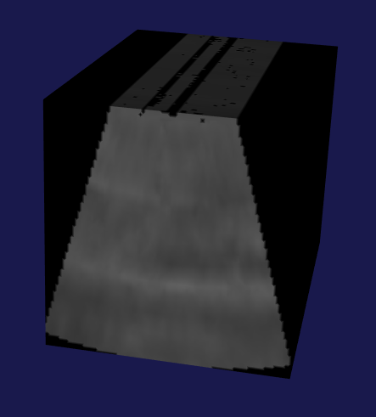
Re-sampling onto a Structured Grid
vtkDelaunay3D
Triangulate the unstructured grid dataset.
vtkStructuredGrid
Define resolution and bounds of a structured grid.
vtkProbeFilter
Sample the triangulated dataset at each structured grid point.
Structured grid with re-sampled image volume data.
Notes:
Before we can interpolate our data onto a structured grid, we need to apply the 3D Delaunay triangulation to convert our dataset into tetrahedrals.

Slide 11
VTK Pipeline
Read in image data into an unstructured grid.
Re-sample image data onto a structured grid.
Slice/clip structured image volume.

Slide 12
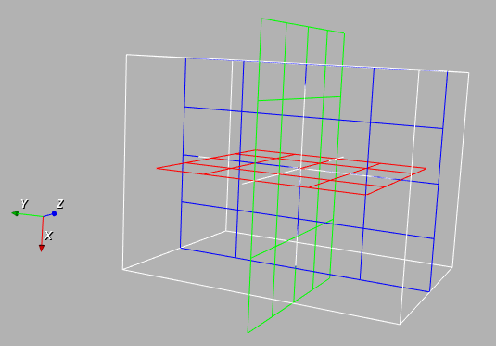
Manipulating Slice Planes
vtkPlaneWidget
Interactive planes controlled by user.
vtkProbeFilter
Triangulated dataset re-sampled at each structured grid point.
vtkPlane
Implicit function defining the slice plane.
vtkClipDataSet
Clips the image volume using the given slice plane.
vtkPlaneWidgets oriented in the three orthogonal slice directions.
Notes:
Each of the colored planes is a plane widget. They can be moved around using the mouse or keyboard to select which regions of the image volume you want to slice through.

