Slide 1
CS5228 · MIDTERM PROGRESS REPORT
HDB Monthly Rent
Prediction
TARGET
Monthly
rent
Data audit, EDA, validation design and feature roadmap
Singapore public housing rental listings
Housing · time · location
Team Member:
Wang Ningyu A0351143R
Zhu Tianyi A0226497R
Xie Lin A0350849U
Zhang Baowen A0356563W
Prepared for the project progress checkpoint
Notes:
Source: project README.md; reports/data_quality_report.md; reports/data_quality_after_cleaning.md; reports/figures/*.png. Baseline RMSE is intentionally marked pending because raw CSVs and baseline result outputs were not present in the workspace at authoring time.

Slide 2
MIDTERM PROGRESS REPORT
Problem definition
Predict monthly HDB rent from structured rental records and contextual features.
Target
MONTHLY_RENT
Unit of prediction
One rental record
Metric
RMSE
Primary use case
Estimate future-month rent under distribution shift
Core modelling question: how much accuracy comes from housing attributes, time, and location?
CS5228 · HDB monthly rent prediction
02
Notes:
Source: project README.md; reports/data_quality_report.md; reports/data_quality_after_cleaning.md; reports/figures/*.png. Baseline RMSE is intentionally marked pending because raw CSVs and baseline result outputs were not present in the workspace at authoring time.

Slide 3
MIDTERM PROGRESS REPORT
Data overview
150,000
50,000
2021-01 → 2025-03
2025-03 → 2026-07
training rows
test rows
labelled period
prediction period
Main fields
Auxiliary sources
•
Address: town, block, street
•
HDB block coordinates and planning areas
•
Housing: flat type, model, floor area
•
MRT stations, schools, shopping malls
•
Time: approval month, lease commence year
•
COE prices and stock-market history
•
Target: monthly rent
The test period is later than most labelled data, so time-aware validation is central to the design.
CS5228 · HDB monthly rent prediction
03
Notes:
Source: project README.md; reports/data_quality_report.md; reports/data_quality_after_cleaning.md; reports/figures/*.png. Baseline RMSE is intentionally marked pending because raw CSVs and baseline result outputs were not present in the workspace at authoring time.

Slide 4
MIDTERM PROGRESS REPORT
Data cleaning decisions
Standardise
Parse
Construct
Preserve
Text case, whitespace and flat-type formats
Dates, currency strings and numeric fields
Rent year/month index and flat age
Original rows and raw files for reproducibility
Key choices
•
Drop constant predictors from the first model: FEE = 0 and FURNISHED = yes
•
Do not deduplicate records: identical inputs can map to different rent labels
•
Convert YEAR_COMPLETED = -1 to missing rather than an artificial year
•
Use only open MRT stations in the first location experiment
CS5228 · HDB monthly rent prediction
04
Notes:
Source: project README.md; reports/data_quality_report.md; reports/data_quality_after_cleaning.md; reports/figures/*.png. Baseline RMSE is intentionally marked pending because raw CSVs and baseline result outputs were not present in the workspace at authoring time.

Slide 5
MIDTERM PROGRESS REPORT
Audit findings that shape the model
100%
address match coverage
Interpretation
•
The address key is a reliable join to HDB block data.
0
missing cells in raw main tables
•
Repeated inputs are not necessarily errors.
•
Unobserved factors still explain rent variation.
425
complete duplicate rows in train
•
Cleaning should reduce ambiguity without deleting evidence.
13,191
input groups with multiple rent labels
CS5228 · HDB monthly rent prediction
05
Notes:
Source: project README.md; reports/data_quality_report.md; reports/data_quality_after_cleaning.md; reports/figures/*.png. Baseline RMSE is intentionally marked pending because raw CSVs and baseline result outputs were not present in the workspace at authoring time.

Slide 6
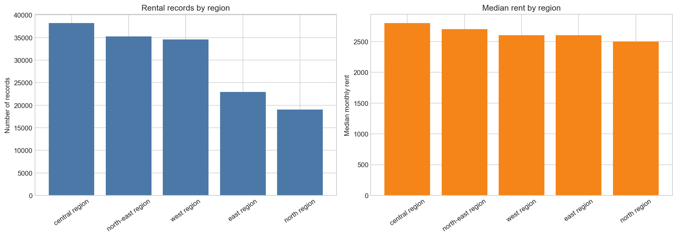
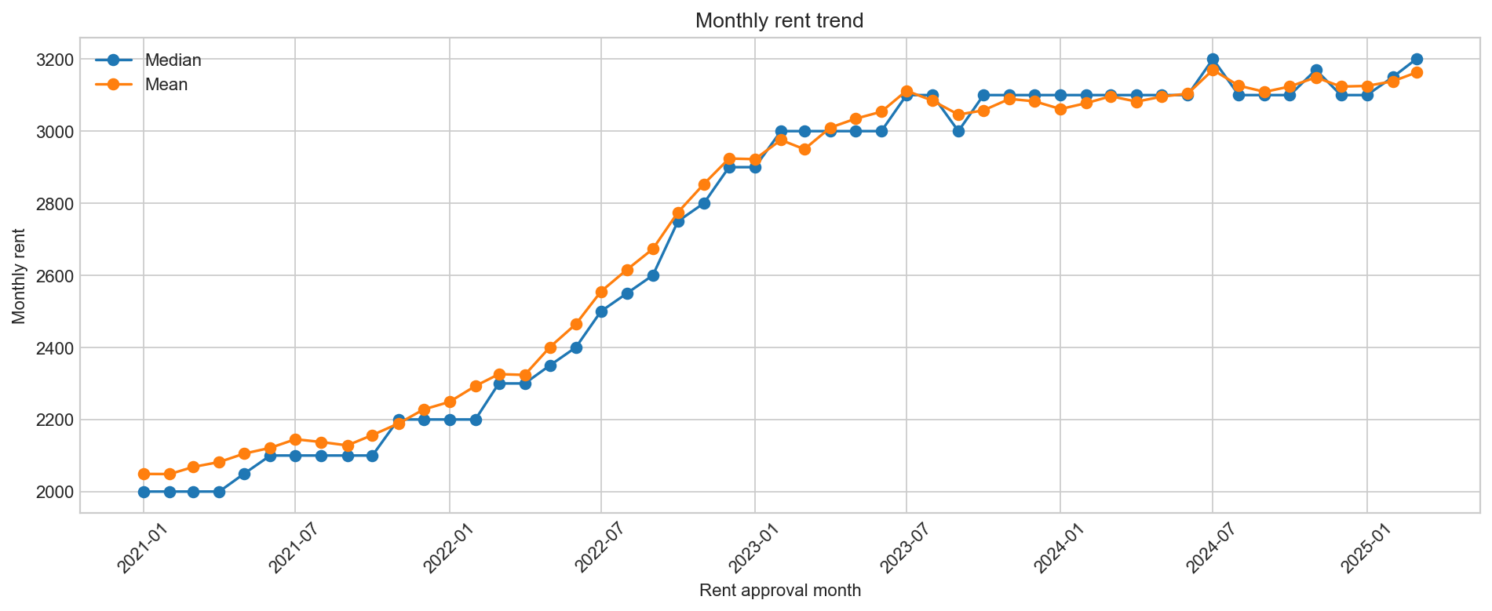
MIDTERM PROGRESS REPORT
EDA: rent moves with time and geography
Regional pattern
Temporal pattern
Central region has the largest sample and the highest median rent among the five regions.
Median and mean rent rise from 2021 to 2025, with a flatter level after 2023.
CS5228 · HDB monthly rent prediction
06
Notes:
Source: project README.md; reports/data_quality_report.md; reports/data_quality_after_cleaning.md; reports/figures/*.png. Baseline RMSE is intentionally marked pending because raw CSVs and baseline result outputs were not present in the workspace at authoring time.

Slide 7
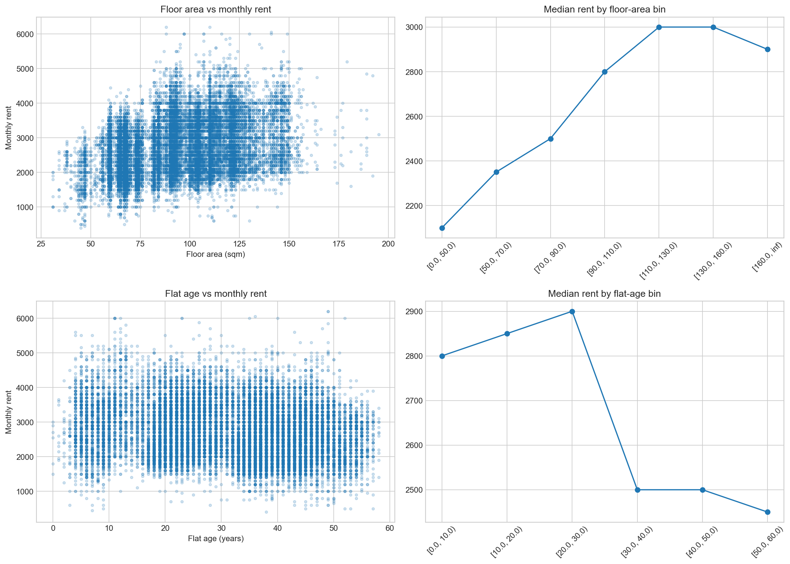
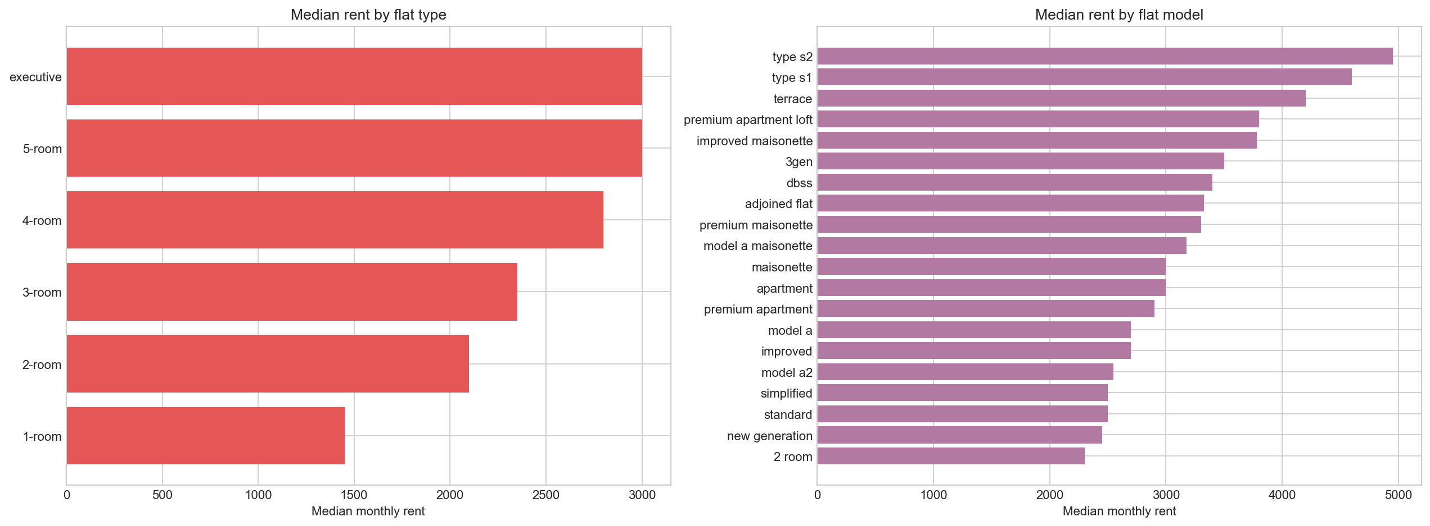
MIDTERM PROGRESS REPORT
EDA: housing attributes separate rent levels
Composition matters
Continuous features add signal
Larger flat types and premium models command higher medians, with clear separation across categories.
Rent increases with floor area, while older flats show a lower median after roughly 30 years.
CS5228 · HDB monthly rent prediction
07
Notes:
Source: project README.md; reports/data_quality_report.md; reports/data_quality_after_cleaning.md; reports/figures/*.png. Baseline RMSE is intentionally marked pending because raw CSVs and baseline result outputs were not present in the workspace at authoring time.

Slide 8
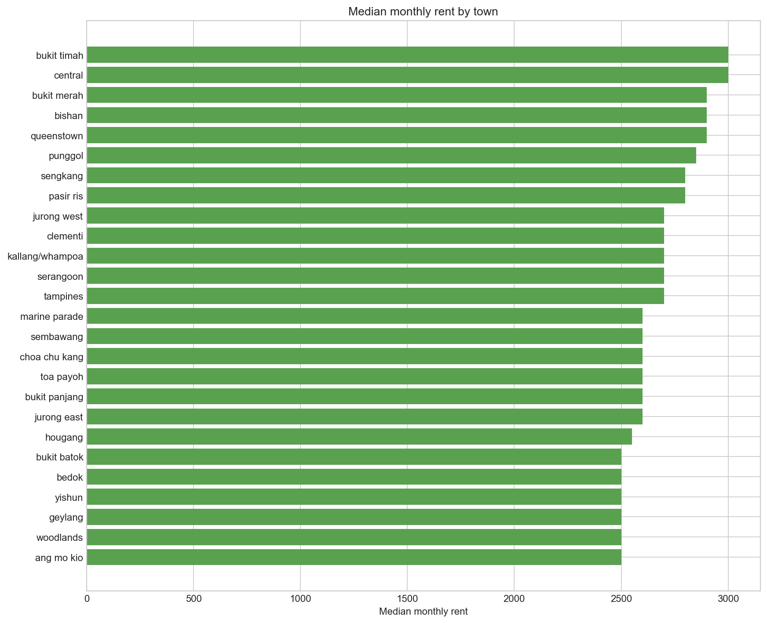
MIDTERM PROGRESS REPORT
EDA: town-level variation is substantial
What this suggests
•
Location is not captured fully by broad region labels.
•
Town and block identifiers may encode stable local effects.
•
A coordinate join can turn location into measurable distance features.
•
Town-level error analysis should remain in the final evaluation.
CS5228 · HDB monthly rent prediction
08
Notes:
Source: project README.md; reports/data_quality_report.md; reports/data_quality_after_cleaning.md; reports/figures/*.png. Baseline RMSE is intentionally marked pending because raw CSVs and baseline result outputs were not present in the workspace at authoring time.

Slide 9
MIDTERM PROGRESS REPORT
Validation design and baseline status
Primary split
Baseline results
Hold out the latest 3 approval months in the labelled training data.
Best temporal RMSE: 562.59
Train: 2021-01 to 2024-12 (141,076 rows)
Validation: 2025-01 to 2025-03 (8,924 rows)
Validation split | Global median | Town + flat type | One-hot Ridge
Temporal | 844.60 | 712.92 | 562.59
Random | 753.12 | 668.48 | 505.20
Secondary check
Random 80/20 split, seed 42
Use the temporal RMSE as the primary benchmark because it mirrors the future-month test setting.
CS5228 · HDB monthly rent prediction
09
Notes:
Source: project README.md; reports/data_quality_report.md; reports/data_quality_after_cleaning.md; reports/figures/*.png. Baseline RMSE is intentionally marked pending because raw CSVs and baseline result outputs were not present in the workspace at authoring time.

Slide 10
MIDTERM PROGRESS REPORT
Auxiliary data for location and context
Source
Rows
Planned use
HDB blocks
9,464
Coordinates, planning area, region, completion year
MRT stations
243
231 open, 12 planned
Schools
337
Coordinates available
Shopping malls
113
Coordinates available
COE prices
539
Multiple rounds within month-category
Stock prices
91,642
Daily history; 85 rows missing market values
The first expansion should use the cleanest, most defensible join: HDB block coordinates.
CS5228 · HDB monthly rent prediction
10
Notes:
Source: project README.md; reports/data_quality_report.md; reports/data_quality_after_cleaning.md; reports/figures/*.png. Baseline RMSE is intentionally marked pending because raw CSVs and baseline result outputs were not present in the workspace at authoring time.

Slide 11
MIDTERM PROGRESS REPORT
Planned location feature scheme
1
2
3
4
Address join
Spatial features
Accessibility
Validation
TOWN + BLOCK + STREET → HDB block
Latitude, longitude, planning area, region
Distance to open MRT, schools and malls
Ablation by feature group on the same split
Leakage guardrails
•
Use only stations marked open for historical records
•
Only merge context that would have been observable by the approval month
•
Compare location features against the no-location baseline
CS5228 · HDB monthly rent prediction
11
Notes:
Source: project README.md; reports/data_quality_report.md; reports/data_quality_after_cleaning.md; reports/figures/*.png. Baseline RMSE is intentionally marked pending because raw CSVs and baseline result outputs were not present in the workspace at authoring time.

Slide 12
MIDTERM PROGRESS REPORT
Limitations, risks and next steps
Current limitations
Next two iterations
•
No final location features yet
•
Join HDB coordinates and build distance features
•
COE and stock aggregates need explicit rules
•
Run feature-group ablations and error slices
•
Input groups can share labels with different rents
•
Select the final model and generate submission
Success criterion: improvements must hold on the future-month split, not only on a random split.
CS5228 · HDB monthly rent prediction
12
Notes:
Source: project README.md; reports/data_quality_report.md; reports/data_quality_after_cleaning.md; reports/figures/*.png. Baseline RMSE is intentionally marked pending because raw CSVs and baseline result outputs were not present in the workspace at authoring time.

Slide 13
MIDTERM PROGRESS REPORT
Takeaways
01
The task is a future-month rent prediction problem. Current Ridge RMSE: 562.59.
02
Cleaning improved consistency while preserving observations.
03
Time, housing type, floor area and geography show clear signal.
04
Location features are the next major experiment, with leakage controls.
Questions and feedback
CS5228 · HDB monthly rent prediction
13
Notes:
Source: project README.md; reports/data_quality_report.md; reports/data_quality_after_cleaning.md; reports/figures/*.png. Baseline RMSE is intentionally marked pending because raw CSVs and baseline result outputs were not present in the workspace at authoring time.

