Slide 1
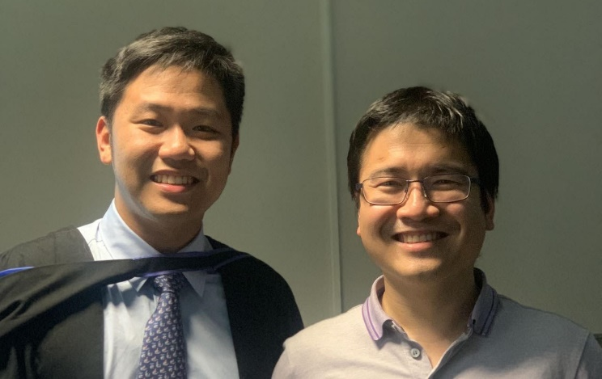
Falconn++: A locality-sensitive filtering approach for approximate nearest neighbor search
Ninh Pham, Tao Liu
University of Auckland
MIT, Oct 15, 2022

Slide 2

Nearest neighbor search in sphere
Nearest neighbor search (NNS) in a unit sphere:
Given a data set X of size n and a query q in d dimensional unit sphere, return the point x ∈ X such that the dist(q, x) = $\left\|x−q\right\|$ is minimum.
x₂
x₃
x₁ is the top-1.
x₁
q
q^{T}x₂
q^{T}x₁
q^{T}x₃

Slide 3
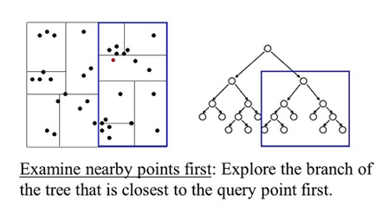
Challenges of NNS
Curse of dimensionality:
Given a polynomial indexing space n^{O(1)}d^{O(1)}, existing a sublinear time algorithm to solve exact NNS refutes SETH [Wil18].
Indexing space or query time must be exponential in d.
Classic solutions: KD Tree
Space: O(n)
Range query: O(dn^{1-1/d})

Slide 4
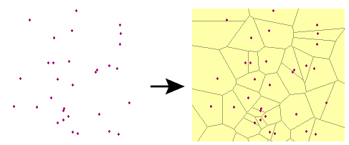
Challenges of NNS
Curse of dimensionality:
Given a polynomial indexing space n^{O(1)}d^{O(1)}, existing a sublinear time algorithm to solve exact NNS refutes SETH [Wil18].
Indexing space or query time must be exponential in d.
Classic solutions: Voronoi decomposition
Space: O(n^{O(d)})
Time: O(d^{O(1)}log n)

Slide 5
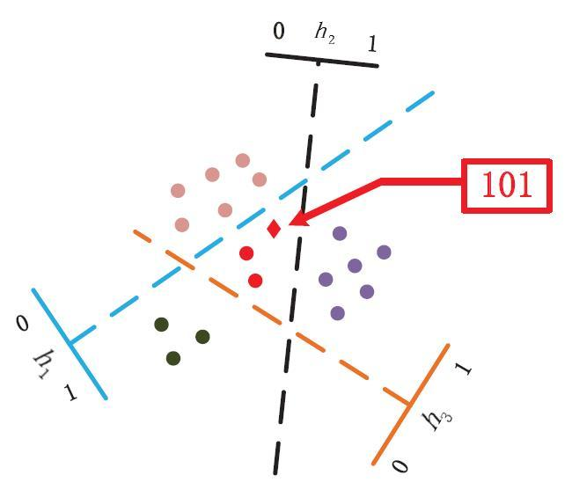
Approximate NNS
Approximate NNS (ANNS):
Returns x’ such that dist(q, x’) ≤ c dist(q, x)
Locality-sensitive hashing (LSH) [IM98]:
Theoretical guarantee to find x’
Sublinear query time O(n^{ρ}), ρ ≈ 1/c²
Subquadratic indexing space O(n^{1+ρ})
But…

Slide 6
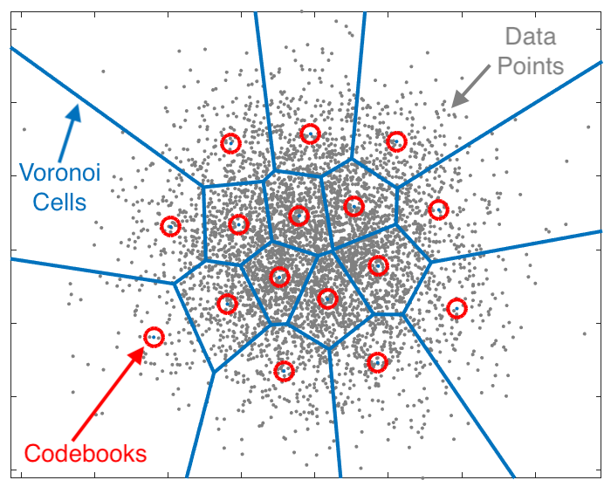
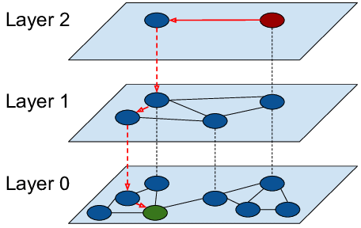
Approximate NNS
Approximate NNS (ANNS):
Seek high empirical search recalls for top-k NNS (e.g. tiny c)
Data-dependent approaches surpass LSH.
Graph-based index
Vector quantization

Slide 7
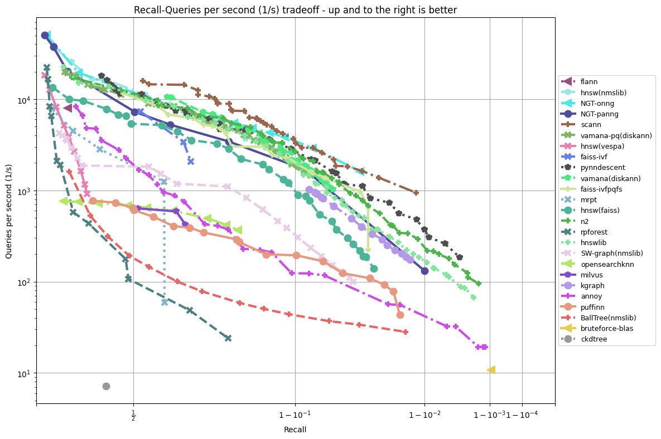
NYTimes256
LSH
Tree-based
https://github.com/erikbern/ann-benchmarks/

Slide 8
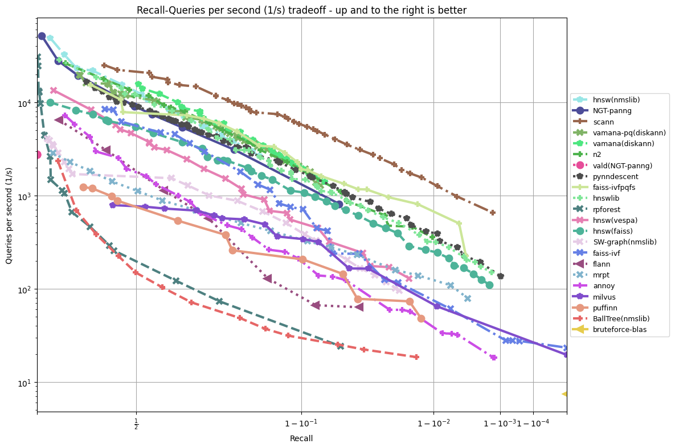
Glove100
LSH
Tree-based
https://github.com/erikbern/ann-benchmarks/

Slide 9
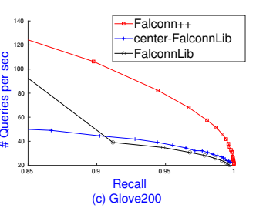
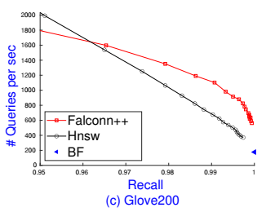
Falconn++
A practical locality-sensitive filtering approach
Lower query time complexity than Falconn, an optimal LSH scheme on angular distance.
Empirical higher recall-speed tradeoffs than Falconn
Competitive with HNSW on high recall regimes
64 threads
1 thread

Slide 10

Locality-sensitive hashing (LSH)
Definition [IM98]:
Given a distance function dist(. , .) and positive values r, c, p₁, p₂ where p₁ > p₂, c > 1. A family of functions H is called (r, cr, p₁, p₂)-sensitive if for uniformly chosen h ∈ H and all x, y ∈ R^{d} :
If dist(x, y) ≤ r then Pr [h(x) = h(y)] ≥ p₁$;$ (close points)
If dist(x, y) ≥ cr then Pr [h(x) = h(y)] ≤ p₂. (far away points)
r
cr

Slide 11
Hash tables construction
Parameter settings:
k = ln(n)/ln(1/p₂)
𝜌 = ln(1/p₁)/ln(1/p₂)
L = n^{𝜌}
Space: O(dn + n^{1+𝜌})

Slide 12
Hash tables lookup
Filtering
Refinement
Time: Hashing time + O(dn^{𝜌})

Slide 13
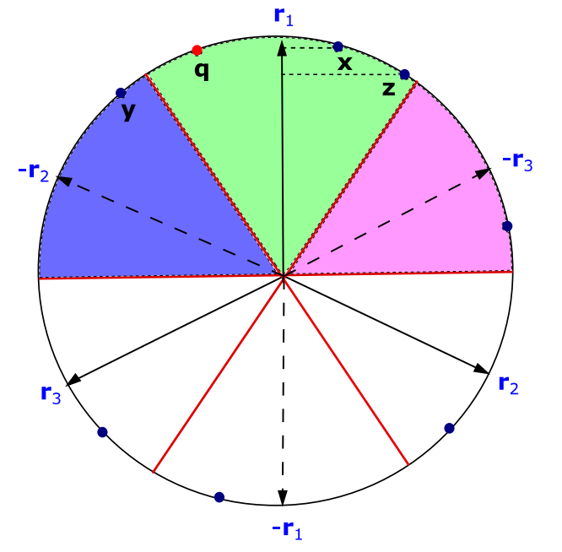

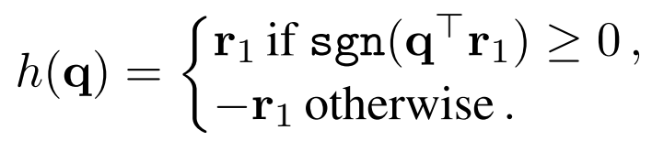
Falconn [AIL+15]
Construct a spherical Voronoi using D random vectors r_{i} ~ N^{d}(0, 1)
x and q collide if sharing the closest or furthest random vector.
Assume
Example:
h(x) = h(z) = h(q) = r₁
h(y) = -r₂

Slide 14
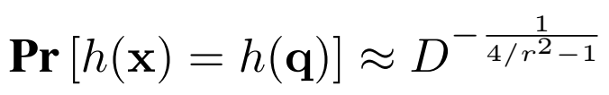
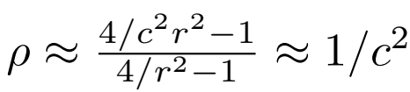
Falconn’s takeaways
Given D random vectors, if dist(x, q) = r, then
Given a small c, (r, cr, p₁, p₂)-sensitive Falconn has
Lower bound [OZW14]: 𝜌 ≥ 1/c² – o(1) if p₂ ≥ 1/n

Slide 15
Practical multi-probe Falconn
To reduce L, probe the bucket of the next closest or furthest random vectors
Require a large qProbes
Compute up to 0.1n distances to achieve recall of 90% in Glove300
Example:
q is next closest to –r₂
The blue wedge is the next probe

Slide 16
Geometric intuition
Use random projections to find x s.t. x^{T}q is maximum.
x₁
r₂
x₃
x₂
r₃
q
q^{T}x₃
q^{T}x₂
q^{T}x₁
r₁
r₄
r₅

Slide 17
Geometric intuition
Use a large number of random projections.
x₁
r₂
x₃
Among 5 random vectors r_{i}, r₁ is closest to q and the projections into r₁ preserves the dot product order.
x₂
r₃
q
q^{T}x₃
q^{T}x₂
q^{T}x₁
r₁^{T}x₃
r₁^{T}x₂
r₁^{T}x₁
r₁
r₄
r₅

Slide 18
CEOs [Pha21]
Use a large number of random projections.
x₁
Indexing: Generate many random vectors r_{i}, precompute the dot product order L_{i} for r_{i}
r₂
x₃
x₂
Querying: Find r_{i} closest to q and return the top-1 NNS from L_{i}
r₃
q
q^{T}x₃
q^{T}x₂
q^{T}x₁
r₁^{T}x₃
r₁^{T}x₂
r₁^{T}x₁
r₁
r₄
r₅

Slide 19




CEOs: Dimensionality reduction
x₁
r₂
x₃
x₂
Among 5 random vectors r_{i}, we only use r₁ to estimate dot products.
r₃
q
r₁
r₄
r₅
r₁
r₂
r₃
r₄
r₅
x₁
1.2
0.9
4
-2
-4
-3
-3
x₂
0.5
0.5
3
-1
-3
-4
-4
x₃
0.1
0.7
1
-3
-2
-3
-3
q
1.5
0.1
9
4
-8
-3
0

Slide 20
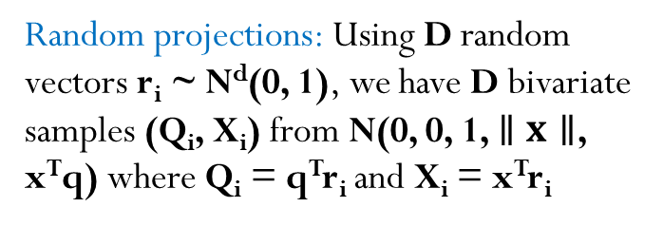

Concomitants of Extreme Order statistics
Random projections: Using D random vectors r_{i} ~ N^{d}(0, 1), we have D bivariate samples (Q_{i}, X_{i}) from N(0, 0, 1, $∥x∥$, x^{T}q) where Q_{i} = q^{T}r_{i} and X_{i} = x^{T}r_{i}
X_{i} = x^{T}r_{i}
x
1.2
0.9
5
-2
4
-3
-3
q
1.5
0.1
8
4
9
-3
0
Q_{i} = q^{T}r_{i}
Assume $∥q∥$ = 1

Slide 21
Concomitants of Extreme Order statistics
Random projections: Using D random vectors r_{i} ~ N^{d}(0, 1), we have D bivariate samples (Q_{i}, X_{i}) from N(0, 0, 1, $∥x∥$, x^{T}q) where Q_{i} = q^{T}r_{i} and X_{i} = x^{T}r_{i}
X_{[2]}
X_{[3]}
X_{[1]}
X_{[5]}
X_{[4]}
X_{i} = x^{T}r_{i}
x
1.2
0.9
5
-2
4
-3
-3
Order statistics: Sort D pairs (Q_{i}, X_{i}) by Q-value, we form the order statistics where Q₍₁₎ is the first order statistics and X_{[1]} is the concomitant of the first order statistics.
q
1.5
0.1
8
4
9
-3
0
Q_{i} = q^{T}r_{i}
Q₍₂₎
Q₍₃₎
Q₍₁₎
Q₍₅₎
Q₍₄₎
Assume $∥q∥$ = 1

Slide 22
Concomitants of Extreme Order statistics
Concomitants of
Extreme Order statistics
Random projections: Using D random vectors r_{i} ~ N^{d}(0, 1), we have D bivariate samples (Q_{i}, X_{i}) from N(0, 0, 1, $∥x∥$, x^{T}q) where Q_{i} = q^{T}r_{i} and X_{i} = x^{T}r_{i}
X_{[2]}
X_{[3]}
X_{[1]}
X_{[5]}
X_{[4]}
X_{i} = x^{T}r_{i}
x
1.2
0.9
5
-2
4
-3
-3
Order statistics: Sort D pairs (Q_{i}, X_{i}) by Q-value, we form the order statistics where Q₍₁₎ is the first order statistics and X_{[1]} is the concomitant of the first order statistics.
q
1.5
0.1
8
4
9
-3
0
Q_{i} = q^{T}r_{i}
Q₍₂₎
Q₍₃₎
Q₍₁₎
Q₍₅₎
Q₍₄₎
Assume $∥q∥$ = 1
Extreme order statistics: When D is sufficiently large, Q₍₁₎ is the extreme order statistics and X_{[1]} is the concomitant of the extreme order statistics.
Extreme Order statistics

Slide 23
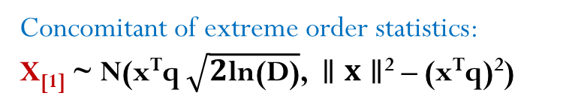
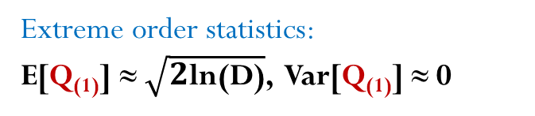

Theory of Concomitants of Extreme Order statistics [DG74]
Concomitants of
Extreme Order statistics
X_{[2]}
X_{[3]}
X_{[1]}
X_{[5]}
X_{[4]}
X_{i} = x^{T}r_{i}
x
1.2
0.9
5
-2
4
-3
-3
Extreme order statistics: Q₍₁₎ is the maximum variable among D random variables Q_{i} = q^{T}r_{i} ~ N(0, 1).
q
1.5
0.1
8
4
9
-3
0
Q_{i} = q^{T}r_{i}
Q₍₂₎
Q₍₃₎
Q₍₁₎
Q₍₅₎
Q₍₄₎
Assume $∥q∥$ = 1
Extreme Order statistics
Extreme order statistics:
E[Q₍₁₎] ≈ $\sqrt{2\text{l}\text{n}\text{(}\text{D}\text{)}}$, Var[Q₍₁₎] ≈ 0
Concomitant of extreme order statistics:
X_{[1]} ~ N(x^{T}q $\sqrt{2\text{l}\text{n}\text{(}\text{D}\text{)}}$, $∥x∥$² – (x^{T}q)²)

Slide 24
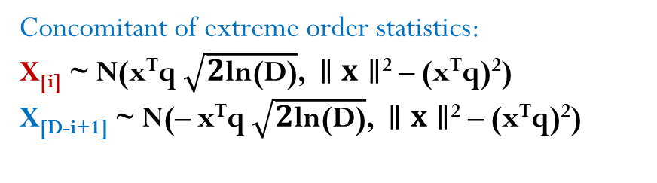

Theory of Concomitants of Extreme Order statistics [DG74]
Concomitants of
Extreme Order statistics
X_{[D-1]}
X_{[1]}
X_{[2]}
X_{[D]}
X_{i} = x^{T}r_{i}
x
1.2
0.9
-5
-2
4
3
-8
Top s₀ maximum and minimum order statistics: Q_{(i)} and Q_{(D-i+1)} where i = 1, ... , s₀
q
1.5
0.1
-8
4
9
7
-9
Q_{i} = q^{T}r_{i}
Q_{(D-1)}
Q₍₁₎
Q₍₂₎
Q_{(D)}
Assume $∥q∥$ = 1
Extreme Order statistics
Extreme order statistics:
E[Q_{(i)}] ≈ $\sqrt{2\text{l}\text{n}\text{(}\text{D}\text{)}}$
E[Q_{(D-i+1)}] ≈ $−\sqrt{2\text{l}\text{n}\text{(}\text{D}\text{)}}$
Concomitant of extreme order statistics:
X_{[i]} ~ N(x^{T}q $\sqrt{2\text{l}\text{n}\text{(}\text{D}\text{)}}$, $∥x∥$² – (x^{T}q)²)
X_{[D-i+1]} ~ N(– x^{T}q $\sqrt{2\text{l}\text{n}\text{(}\text{D}\text{)}}$, $∥x∥$² – (x^{T}q)²)
X_{[i]} and X_{[D-i+1]} are independent asymptotically.

Slide 25
Connection to multi-probe Falconn
Falconn: If
Use r₁ corresponding to Q₍₁₎ as hash value
Use Q_{(i)} and Q_{(D-i)} as probing buckets where i = 1, ... , s₀
CEOs: If
Use X_{[1]} = x^{T}r₁ to estimate x^{T}q
Use X_{[i]} and X_{[D-i]} as estimators of x^{T}q where i = 1, ... , s₀
Falconn++ = Falconn + CEOs
Partition n points
into 2D buckets
Scale each bucket by keeping
x with largest x^{T}r_{i}

Slide 26
Falconn++: A locality-sensitive filtering
A locality-sensitive filtering (LSF) mechanism:
Given a distance function dist(. , .) and positive values r, c, q₁, q₂ where q₁ > q₂, c > 1. For an (r, cr, p₁, p₂)-sensitive function h and x, y in h(q) :
If dist(x, q) ≤ r then Pr [x is not filtered] ≥ q₁
If dist(y, q) ≥ cr then Pr [y is not filtered] ≤ q₂
Combine LSH and LSF:
Pr [h(x) = h(q), x is not filtered] ≥ p₁q₁
Pr [h(y) = h(q), y is not filtered] ≤ p₂q₂
We need ln(1/q₁) / ln(1/q₂) ≤ ρ ≈ 1/c² to achieve a new exponent ρ’ ≤ ρ

Slide 27
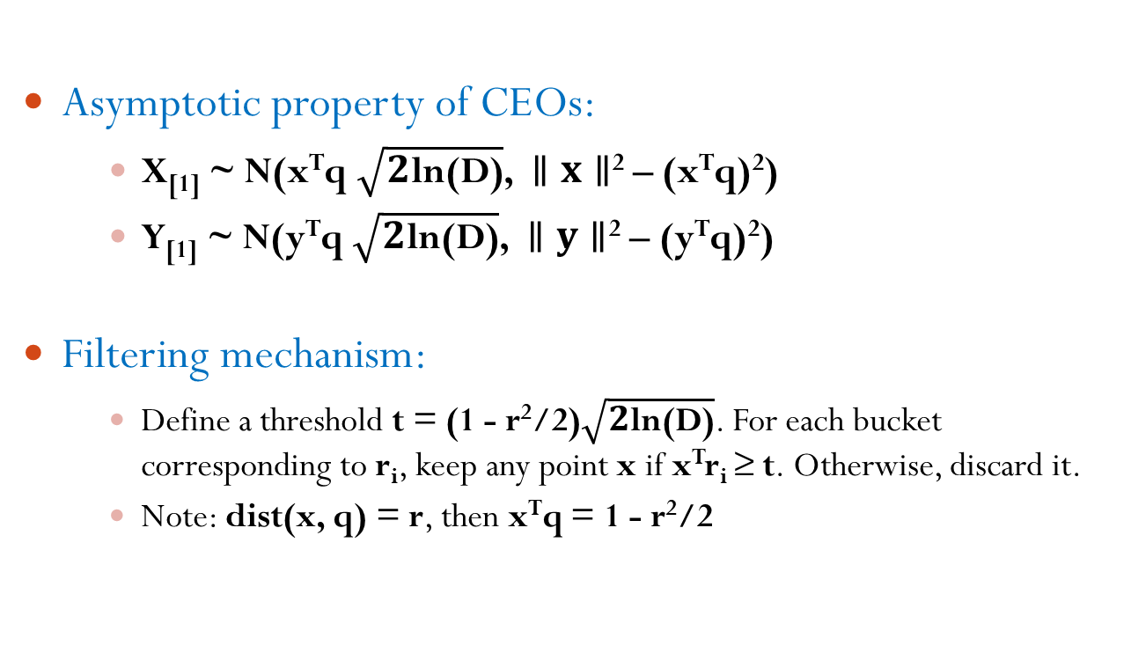
Falconn++
Asymptotic property of CEOs:
X_{[1]} ~ N(x^{T}q $\sqrt{2\text{l}\text{n}\text{(}\text{D}\text{)}}$, $∥x∥$² – (x^{T}q)²)
Y_{[1]} ~ N(y^{T}q $\sqrt{2\text{l}\text{n}\text{(}\text{D}\text{)}}$, $∥y∥$² – (y^{T}q)²)
Filtering mechanism:
Define a threshold t = (1 - r²/2)$\sqrt{2\text{l}\text{n}\text{(}\text{D}\text{)}}$. For each bucket corresponding to r_{i}, keep any point x if x^{T}r_{i} ≥ t. Otherwise, discard it.
Note: dist(x, q) = r, then x^{T}q = 1 - r²/2

Slide 28
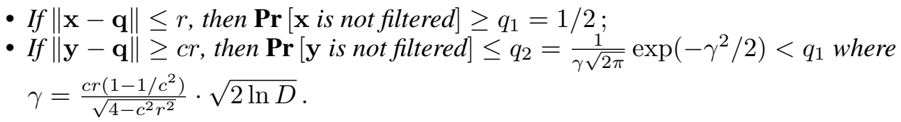
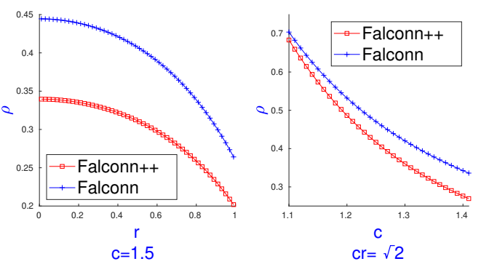
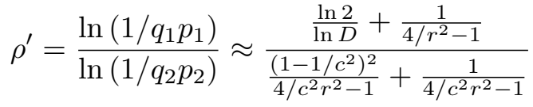
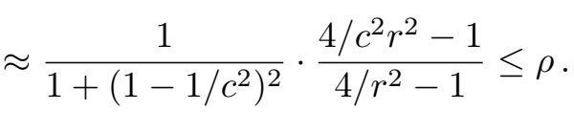
Falconn++’s takeaways
For sufficiently large D random projections, c > 1,
New exponent ρ’ ≈ 1/(2c² – 2 + 1/c²)

Slide 29
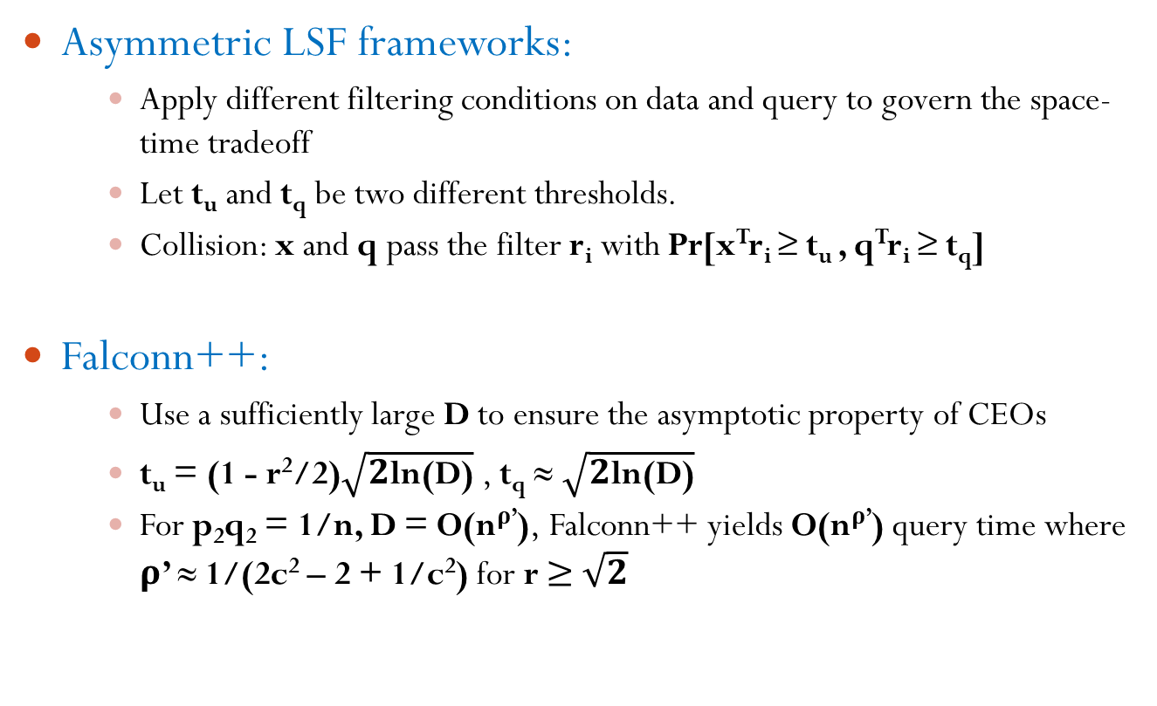
Connection to LSF framework [ALRW17]
Asymmetric LSF frameworks:
Apply different filtering conditions on data and query to govern the space-time tradeoff
Let t_{u} and t_{q} be two different thresholds.
Collision: x and q pass the filter r_{i} with Pr[x^{T}r_{i} ≥ t_{u} , q^{T}r_{i} ≥ t_{q}]
Falconn++:
Use a sufficiently large D to ensure the asymptotic property of CEOs
t_{u} = (1 - r²/2)$\sqrt{2\text{l}\text{n}\text{(}\text{D}\text{)}}$ , t_{q} ≈ $\sqrt{2\text{l}\text{n}\text{(}\text{D}\text{)}}$
For p₂q₂ = 1/n, D = O(n^{ρ’}), Falconn++ yields O(n^{ρ’}) query time where ρ’ ≈ 1/(2c² – 2 + 1/c²) for r ≥ $\sqrt{2}$

Slide 30
Practical implementations
Data-dependent setting:
Select a scaling factor 0 <α < 1 to scale each bucket of size B to α B
Adapt t to various density
Easy to govern the memory footprint (i.e. # points in a table)
Multi-probe indexing:
For each point x, hash it into iProbes buckets corresponding the iProbes closest or furthest random vectors
Scale each bucket of size B to α B/iProbes
Other heuristics:
Pseudo-random rotation HD₃HD₂HD₁ to simulate random projections
Center the data point X
Limit scaling: keep max(k, α B/iProbes) points in a bucket

Slide 31
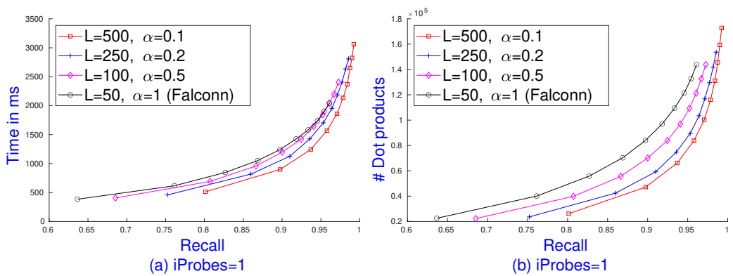
Falconn++: Scaling bucket
Experiment on Glove200 with 1.2M points with k = 20:
D = 256, 2 combined LSH functions, each table has 4D² buckets
Falconn: qProbes = {1000, … , 20000}, Falconn++: qProbes/α

Slide 32
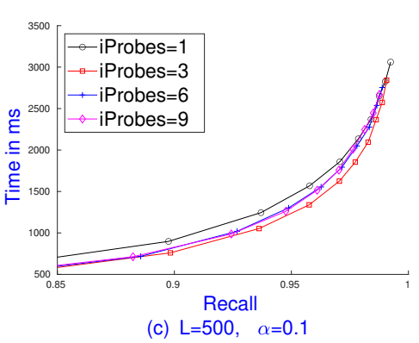
Falconn++: Multi-probe indexing
Observation:
Overfitting: Large iProbes degrades performance
iProbes = 2D is as similar as theoretical LSF framework
Setting iProbes:
k ≈ n ∙ iProbes/4D²
Each bucket has roughly k=20 points, especially sparse buckets
iProbes = 3: 1.2M ∙ 3/2¹⁸=16
Glove200, k = 20

Slide 33
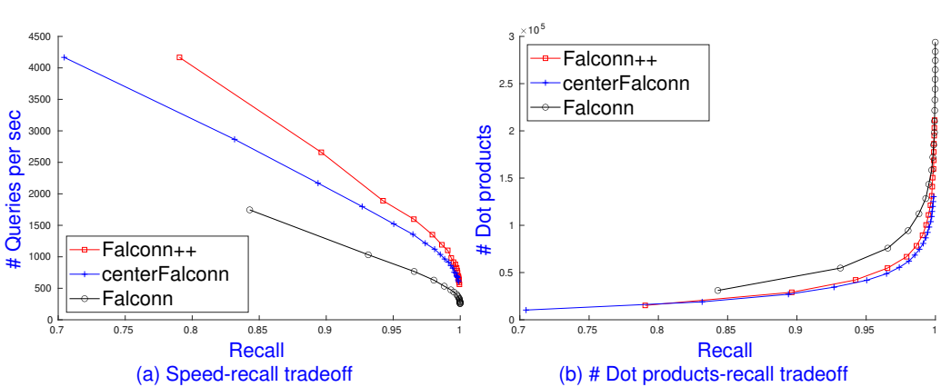
Falconn++: Centering data
Experiment on Glove200 with k = 20:
D = 256, 2 combined LSH functions, 4D² buckets/table, L = 500
Falconn++: α = 0.1, iProbes = 3, qProbes/α

Slide 34
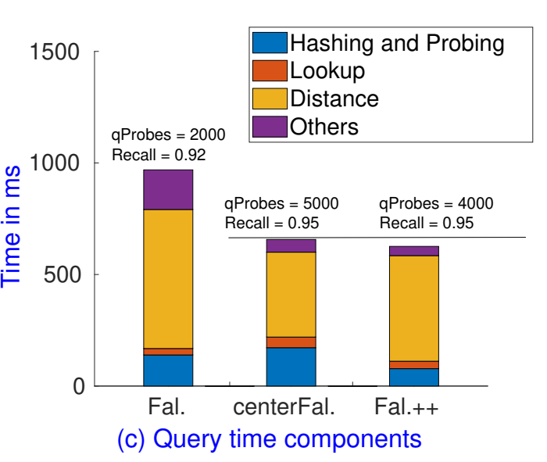
Falconn++: Limit scaling & centering
Observations:
After centering, buckets are more balanced.
With α = 0.1, iProbes = 3, and keep max(k, αB/iProbes) points, # points/table ≈ 2.42 n
Less qProbes and hash evaluation time than Falconn
Future improvement:
SimHash signatures to reduce distance computation time
Glove200, k = 20

Slide 35

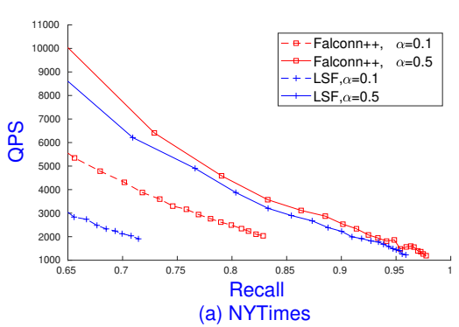
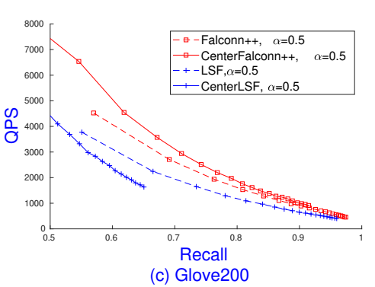
Falconn++ vs. Theoretical LSF
LSF: Select t_{u} s.t.
Falconn++: No limit scaling, only centering
iProbes = 1, D = {128, 256}, L = 100, 2 combined LSH/LSF functions

Slide 36
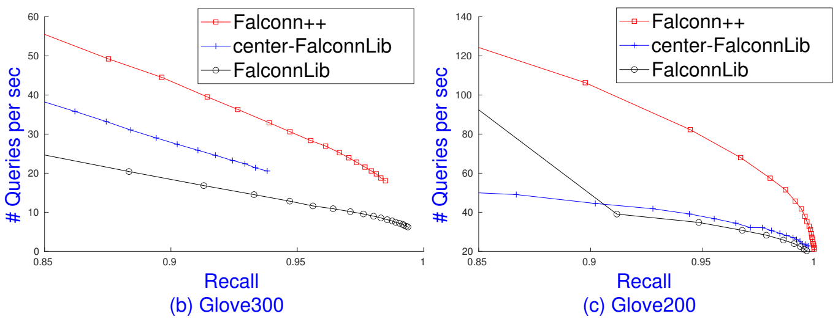
Falconn++ vs. FalconnLib
Glove300 and Glove200 with k = 20 and 1 thread:
L = 500, D = 256, α = 0.1, iProbes = {1, 3}, 4D² buckets/table
Falconn: L = 50 (Glove300), L = 1210 (Glove200)

Slide 37
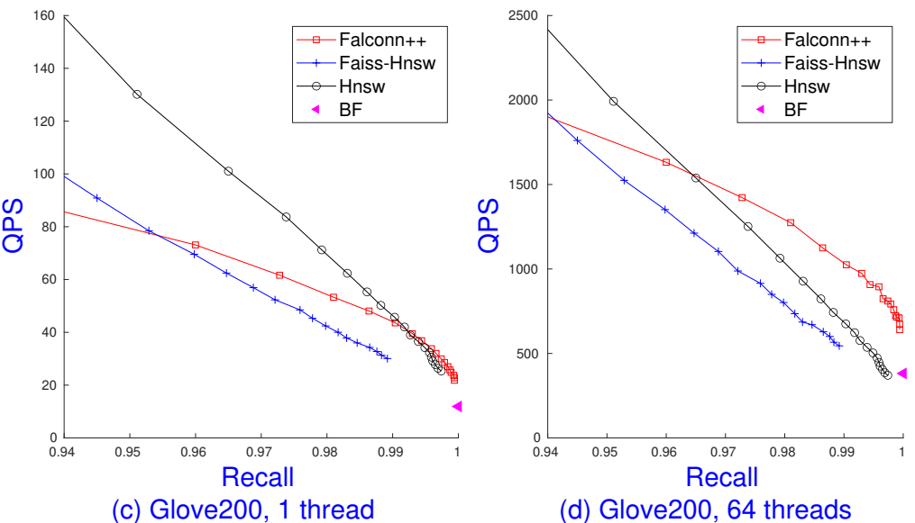
Falconn++ vs Hnsw
Parameter settings:
Hnsw: ef-index = 200, M = 512, vary ef-query
Falconn++: D = 256, L = 350, α = 0.01, iProbes = 3, vary qProbes
Indexing
Space: 5.4GB
Hnsw: 13.7 mins
Falconn++: 1.1 mins

Slide 38
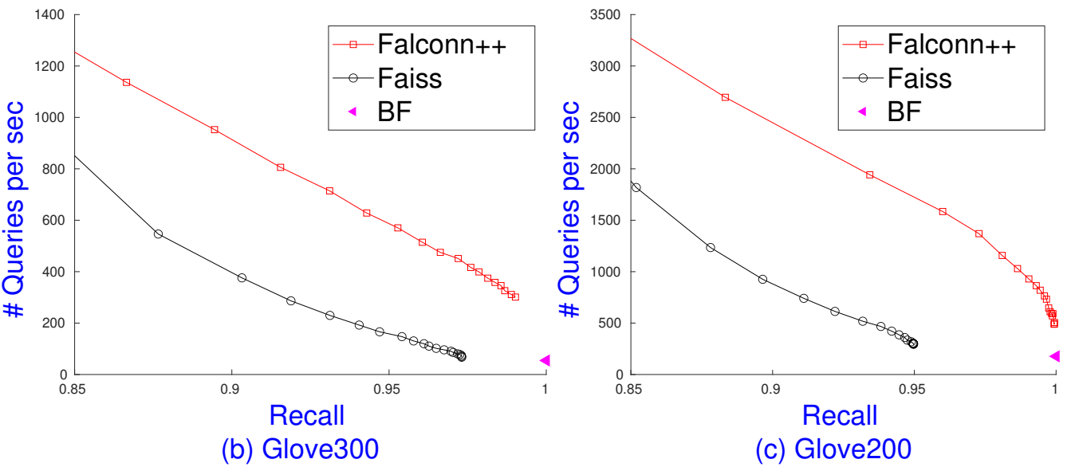
Falconn++ vs Faiss
Parameter settings:
Faiss: m = 256, nlist=1000, 8 bits/centroid, vary probe
Falconn++: D = 256, L = 350, α = 0.01, iProbes = 3, vary qProbes

Slide 39

Open problem
Practical LSH & LSF pattern:
Existing for Euclidean distance with ρ = 1/c²
Characterize # random projections D
Characterize the scaling factor α

