Slide 1
Presentations
CSC 201- Computer Applications

Slide 2
Outline
Short Introduction
View Modes:
Normal
Slide Sorter
Slide Show
Notes Page
Slide Master and Title Master
Inserting Objects:
Diagrams
Charts
Tables
Format Options
Slide Design
Slide Layout
Background
Slide Effects
Slide Animation
Slide Transitions
Running your Slideshow:
Colors and Effects
Slide Hiding
Preparing your slideshow for Packaging
Saving as a Video

Slide 3
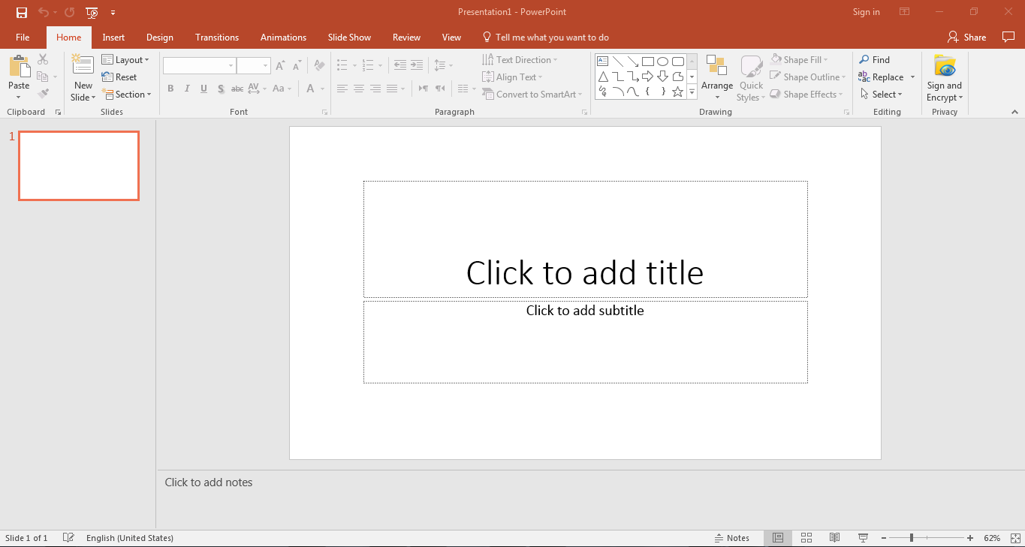
View Mode: Normal
Slide Notes

Slide 4
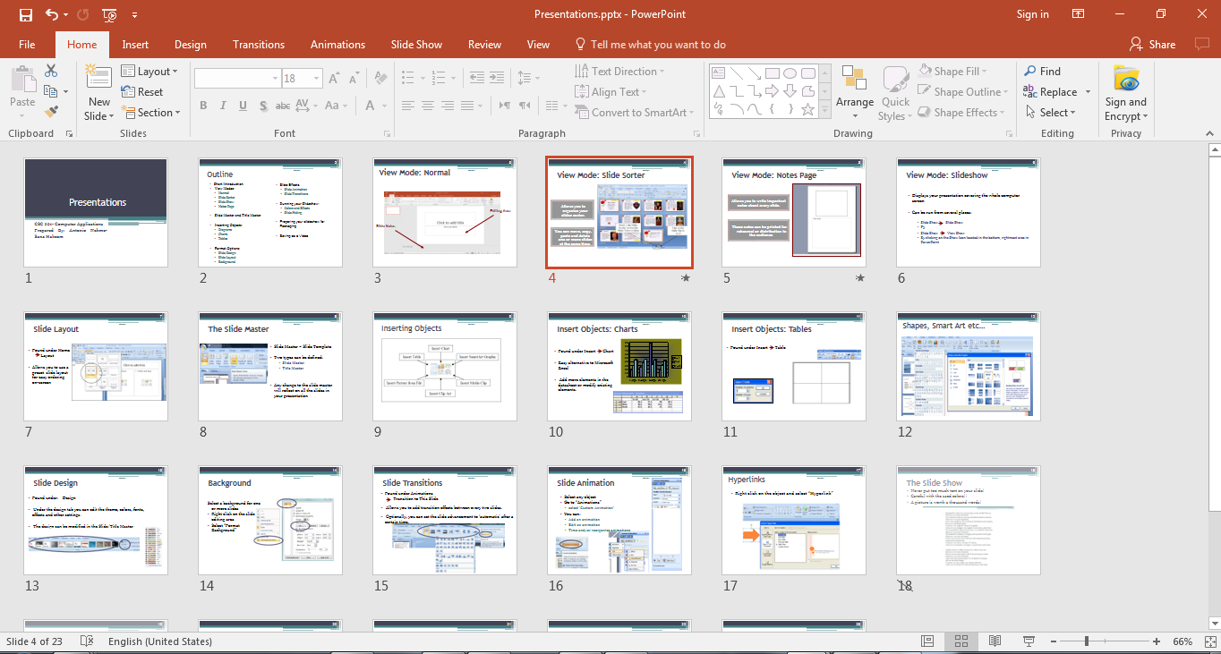
View Mode: Slide Sorter
Allows you to organize your
slides easier.
You can move, copy, paste and delete one or more slides at the same time.
Slide Shorter tool in the Slide View Toolbar

Slide 5
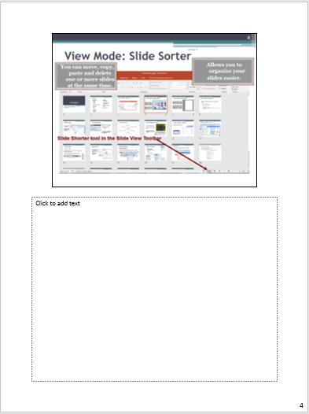
View Mode: Notes Page
Allows you to write important notes about every slide.
These notes can be printed for rehearsal or distribution to the audience.

Slide 6
View Mode: Slideshow
Displays your presentation covering the whole computer screen
Can be run from several places:
Slide Show Slide Show
F5
Slide Show View Show
By clicking on the Show Icon located in the bottom, rightmost area of the slide view toolbar.

Slide 7
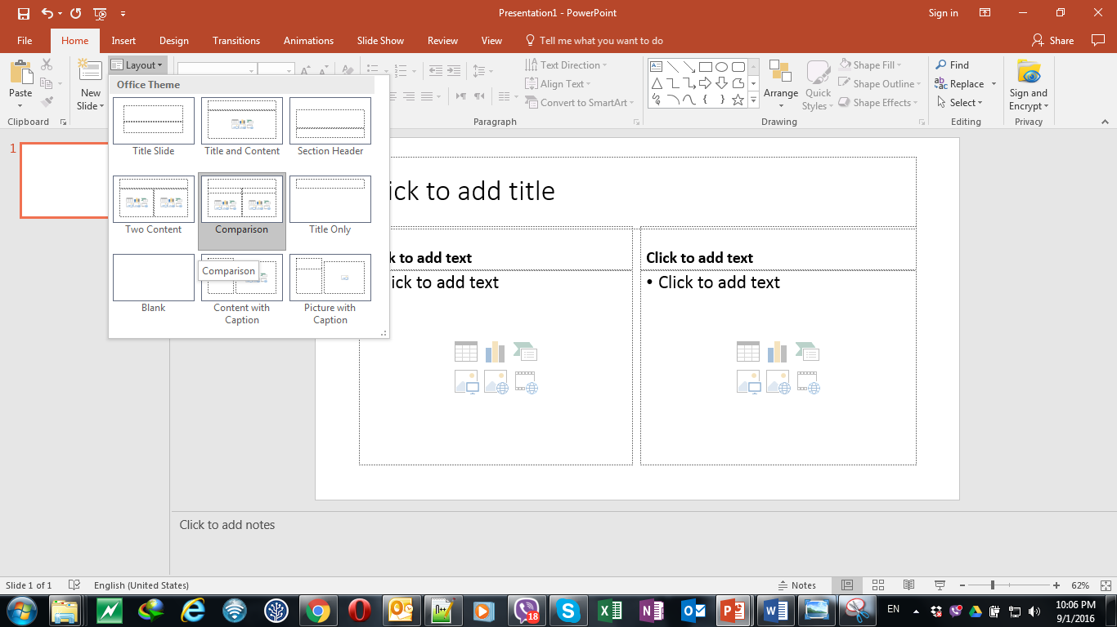
Slide Layout
Found under Home Layout
Allows you to use a preset slide layout for easy ordering on-screen

Slide 8
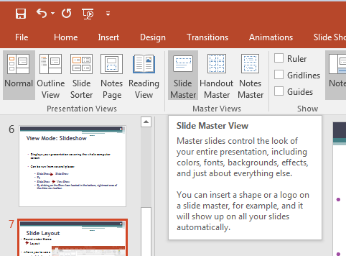
The Slide Master
Slide Master = Slide Template
Two types can be defined:
Slide Master
Title Master
Any change to the slide master will reflect on all the slides in your presentation

Slide 9
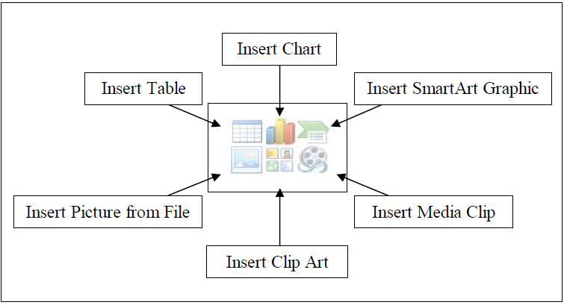

Inserting Objects

Slide 10
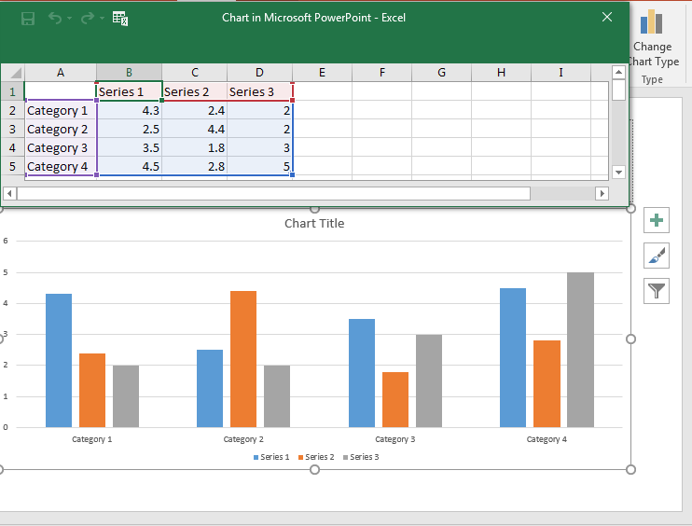
Insert Objects: Charts
Found under Insert Chart
Easy alternative to Microsoft Excel
Add more elements in the datasheet or modify existing elements.

Slide 11
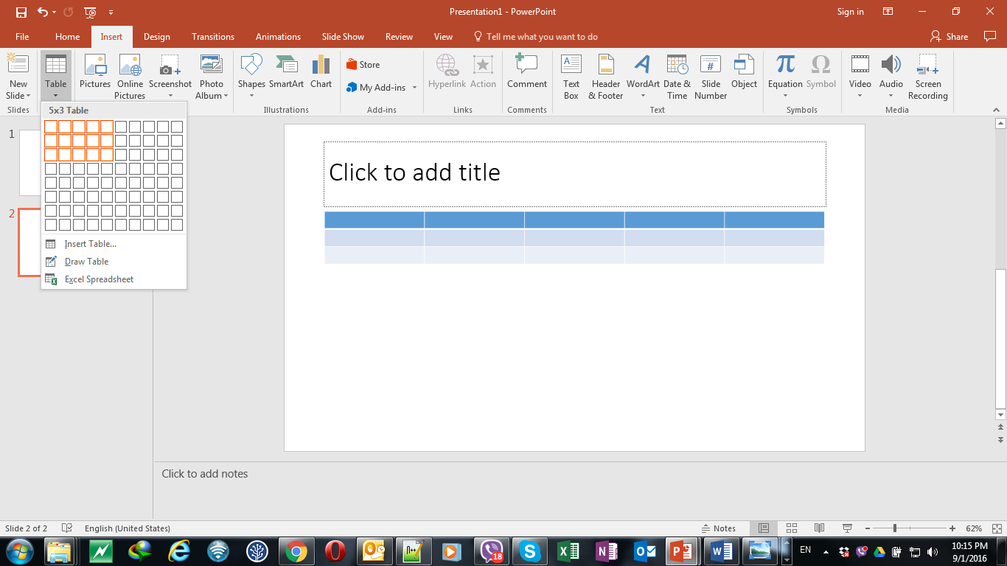
Insert Objects: Tables
Found under Insert Table

Slide 12
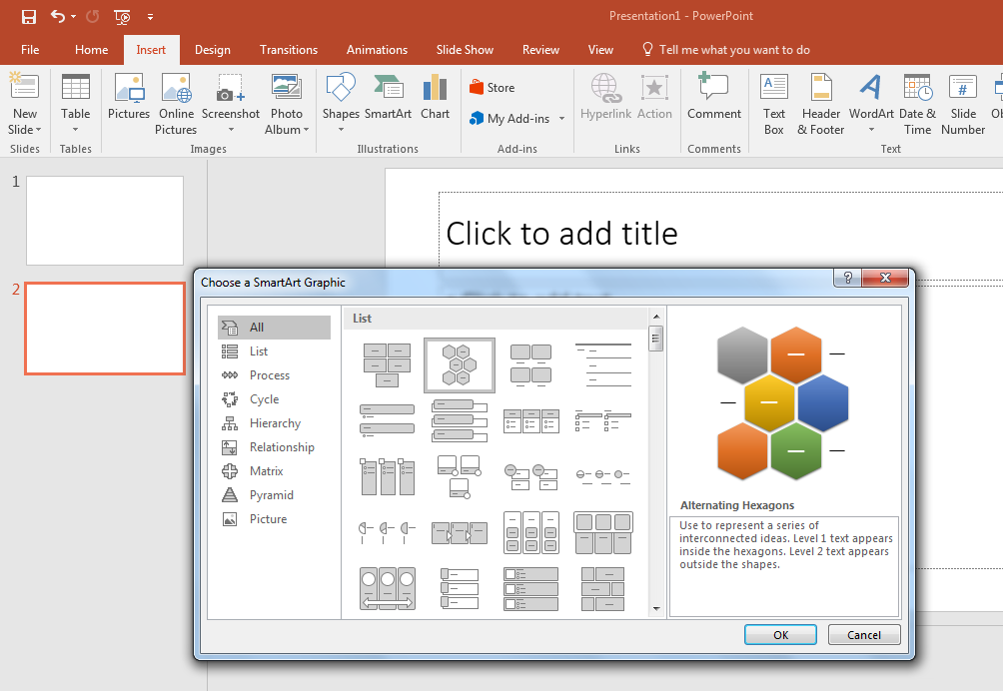
Shapes, Smart Art etc…

Slide 13
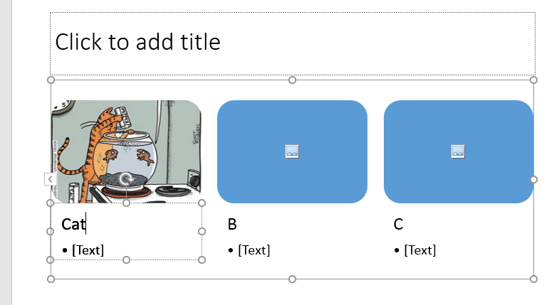

Slide 14
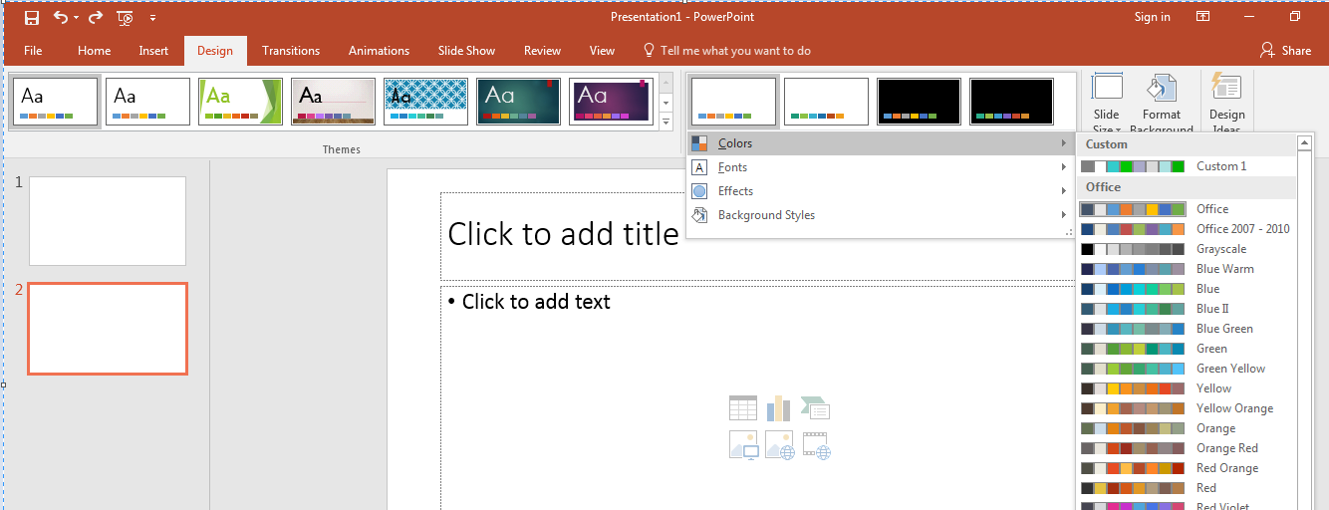
Slide Design
Found under: Design
Under the design tab you can edit the theme, colors, fonts, effects and other settings.
The design can be modified in the Slide/Title Master

Slide 15
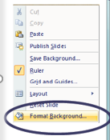
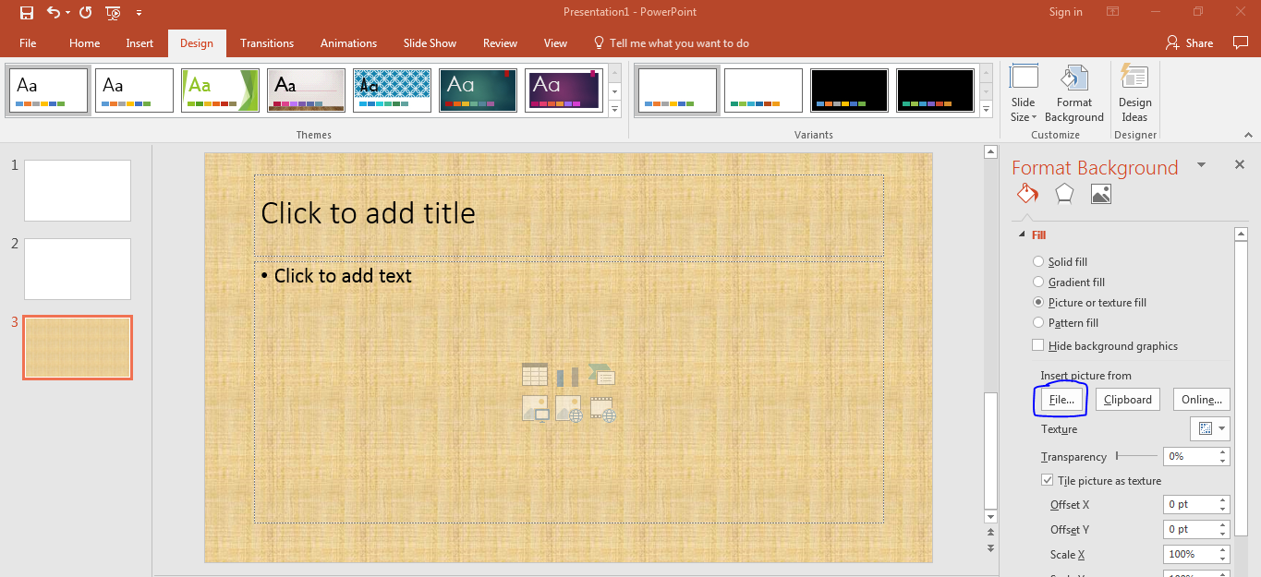
Background
Select a background for one or more slides
Right click on the slide editing area
Select “Format Background”

Slide 16
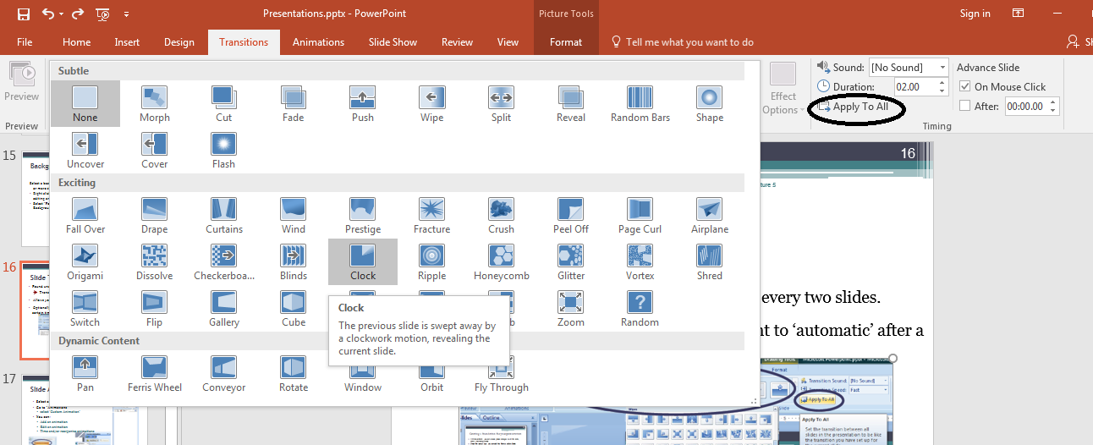
Slide Transitions
Found under Animations
Transition to This Slide
Allows you to add transition effects between every two slides.
Optionally, you can set the slide advancement to ‘automatic’ after a certain time.

Slide 17
Slide Animation
Select any object
Go to “Animations”
select ‘Custom Animation’
You can:
Add an animation
Edit an animation
Time and/or reorganize animations

Slide 18
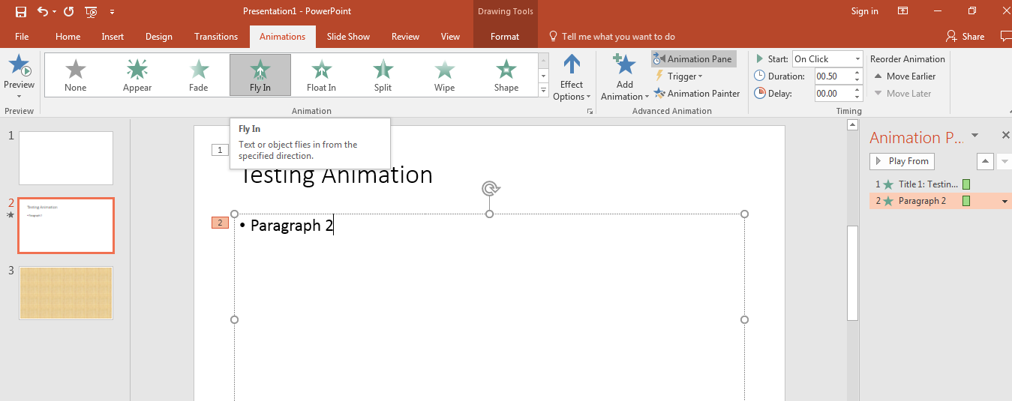

Slide 19

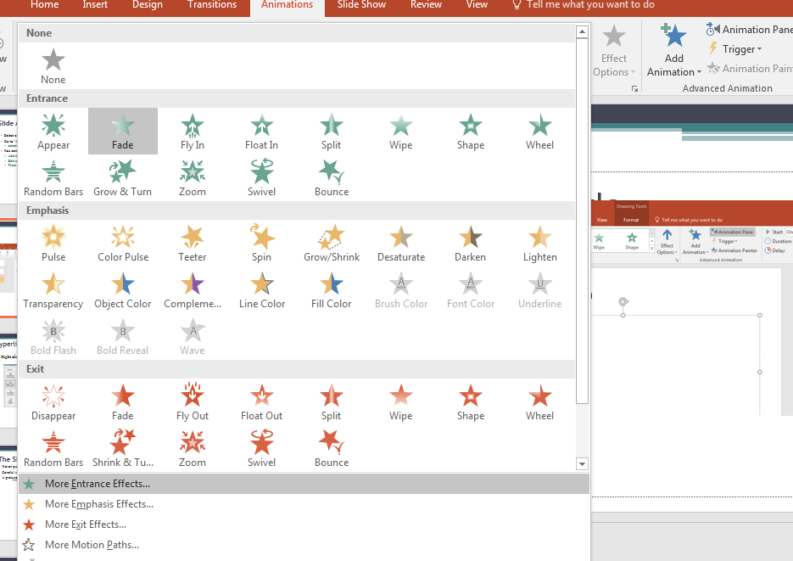
Click for more effects

Slide 20
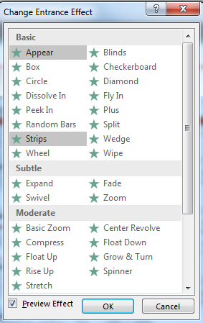
Select the effect that you like from the list

Slide 21
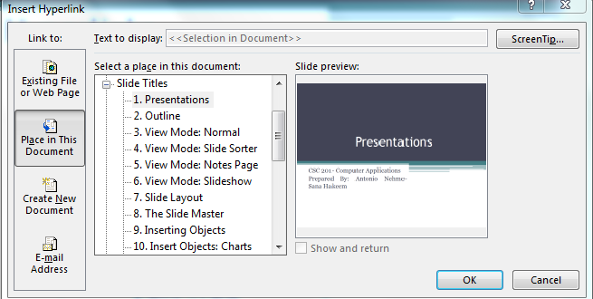
Hyperlinks
Right click on the object and select “Hyperlink”

Slide 22
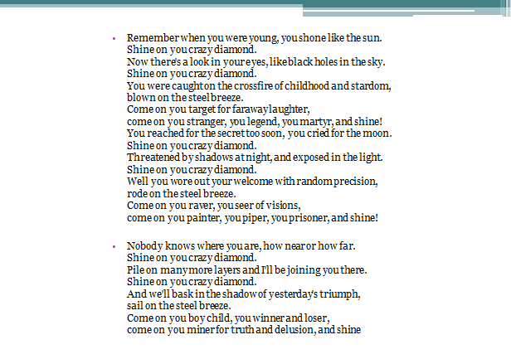
The Slide Show
Never put too much text on your slide!
Careful with the used colors!!
A picture is worth a thousand words!

Slide 23
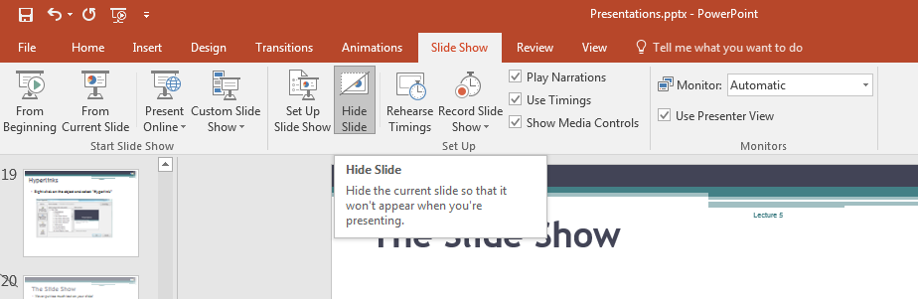
The Slide Show
Slide Hiding

Slide 24
Packaging
The Pack-and-go feature:
Compact format on USB or CD-ROM
Include Fonts and Objects
Include a standalone viewer

Slide 25
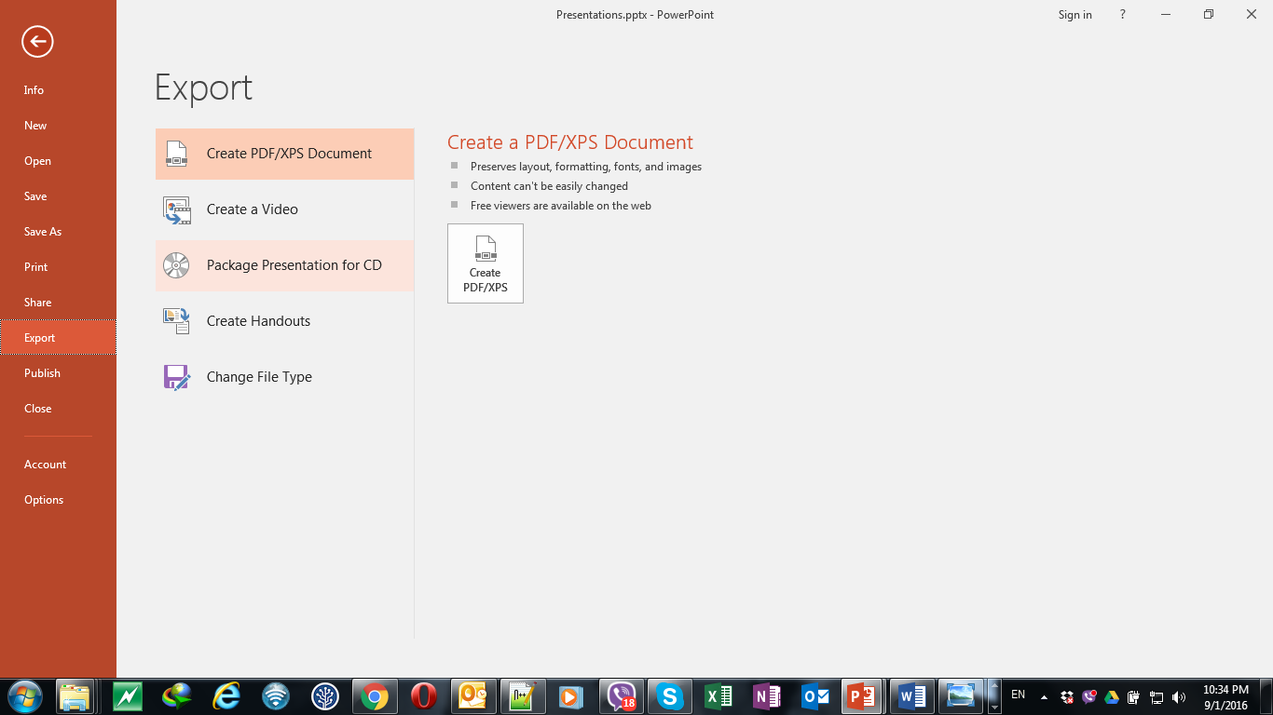

Slide 26
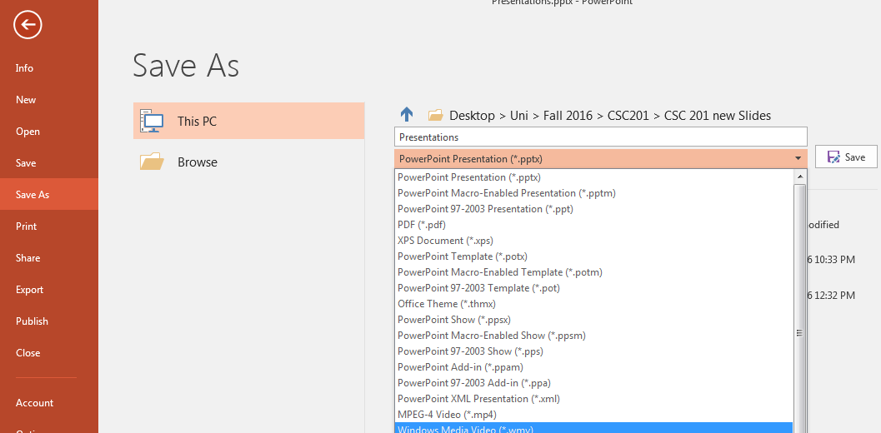
Saving As A Video
Save As…
Select “.wmv” as the type

Slide 27
Application
You’ll have to prepare a 5-10 slides presentation in which you apply what you have learned in this Lecture.

Slide 28
The presentation should include slides with different layouts.
You will have to include :
Pictures- Charts and Tables
SmartArt
Animations and Transitions
Hyperlinks
Background pictures and themes
Make sure you define a Master Slide with your name being in the Footer

