Slide 1
Computer Application
Chapter 5
Microsoft Visio 2016 (Flow Charts)

Slide 2

Microsoft Visio 2016
Helps make your diagrams more meaningful, flexible, and responsive to your needs.
Has thousands of shapes that meet industry standards (BPMN 2.0, IEEE, UML 2.4)
Editions:
- Visio Professional 2016
- Visio Standard 2016

Slide 3
Visio diagrams
Organization Charts
Network Diagrams
Workflows
Home or Office Plans

Slide 4
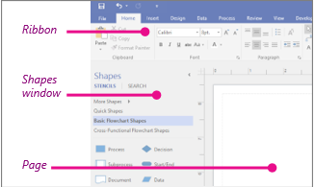
Visio Window
three main areas of the Visio program

Slide 5
Visio Window
The ribbon contains all of the tabs in Visio. Things like changing text size, switching to different drawing tools, etc are here.
The Shapes window contains your stencils and shapes. More on those later.
The page itself is where you put shapes, connect them, and so on.

Slide 6
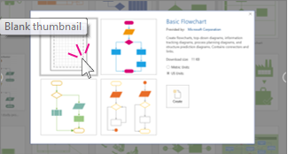
Steps To Create Visio Diagrams
You use the same three basic steps to create nearly all of them:
Choose and open a template
Click File > New > Categories > Flowchart.
Single-click Basic Flowchart, and then double-click a template:

Slide 7
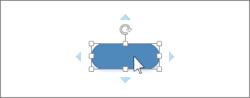
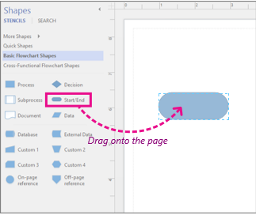
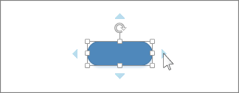
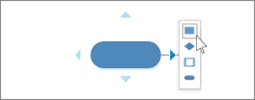
Steps To Create Visio Diagrams
Drag and connect shapes

Slide 8

Steps To Create Visio Diagrams
Add text to shape
Click the shape and start typing

Slide 9
Start Your First Activity
Open Visio
Choose and open a blank template

Slide 10
Visio shapes
Visio shapes are ready-made objects that you drag onto your drawing page.
The shape that you put on your drawing is a copy (instance), the original shape remains on the stencil (master shape).

Slide 11
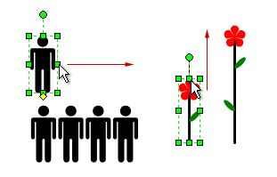
Start Your First Activity
Drag shapes onto your drawing page
Resize some of them
Add special behavior by stretching, right-clicking or moving the yellow control handle on the shape

Slide 12
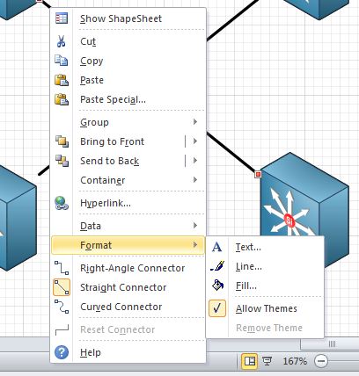
Tip !
Right-Click the shape to see if there are any special commands on its shortcut menu

Slide 13
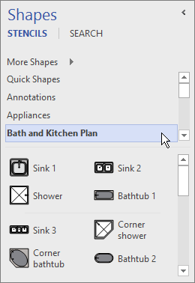
Stencils
Visio stencils hold collections of shapes
The shapes in each stencil have something in common

Slide 14
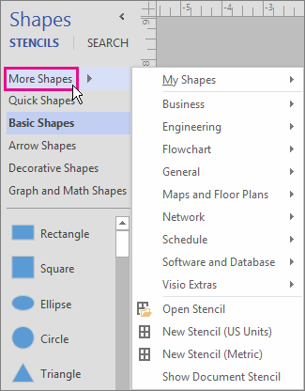
Start Your First Activity
Open Other Stencils (Shapes->More Shapes)
Drag different shapes from two different categories

Slide 15
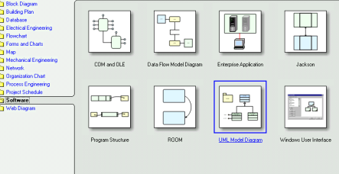
Templates
When you want to create a diagram:
Start with a template for that type of diagram (or the nearest type if there isn’t an exact match – you can always change the settings to be what you want).

Slide 16
Start Your First Activity
Open New Project
Choose any template
Open Another New Project
Choose a different template
Compare the different stencils and settings (grid size and ruler measurements)

Slide 17
Computer Application
Chapter 5: Visio 2016: Hands On
Basic Flowcharts: Org Chart

Slide 18
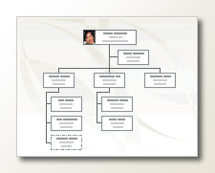
Create A Basic Organization Chart
An organization chart (org chart) is a diagram that shows relationships among employees, titles, and groups.

Slide 19
Recap: Steps To Create Visio Diagrams
You use the same three basic steps to create nearly all of them:
Choose and open a template
Drag and connect shapes
Add text to shapes

Slide 20
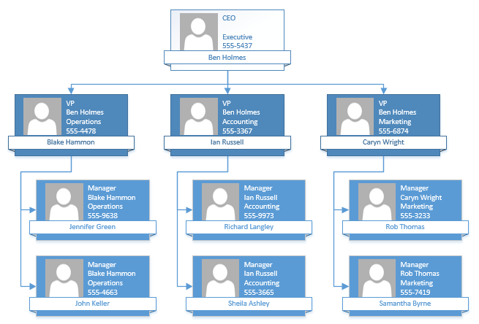
Visio Org Chart: To-do

Slide 21
Automatically generate a chart from an existing data source
Data sources you can use:
Microsoft Excel worksheet
Text file
Etc.

Slide 22
Automatically generate a chart from an existing data source
Write the following information in a new text file:
Name, Reports_to, Title, Department, Telephone
Joe Boss, ,CEO,Executive,x5555 Jane Mgr, Joe Boss, Manager,Product Development,x6666 John Pos, Jane Mgr, Developer,Product Development,x6667

Slide 23
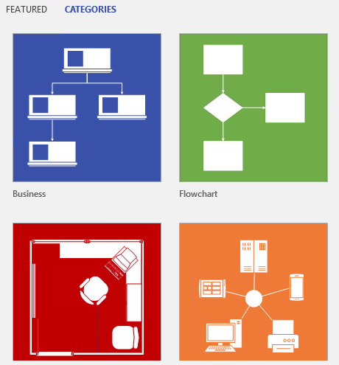
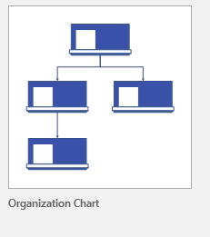
Automatically generate a chart from an existing data source
In Visio 2016, click File > New > Business > Organization Chart, and then click Create.

Slide 24
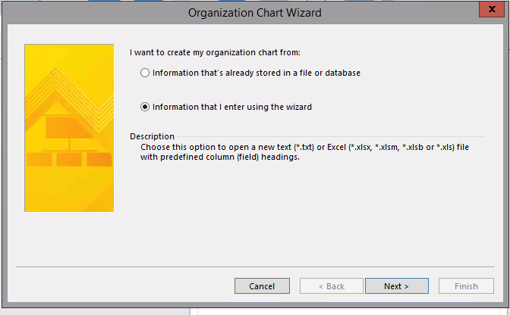
Automatically generate a chart from an existing data source
On the first page of the wizard, select Information that I enter using the wizard, and then click Next.

Slide 25
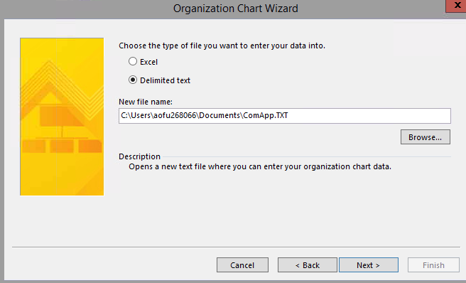
Automatically generate a chart from an existing data source
Select Excel or Delimited text(in our case), type a name for the new file, and then click Next.

Slide 26
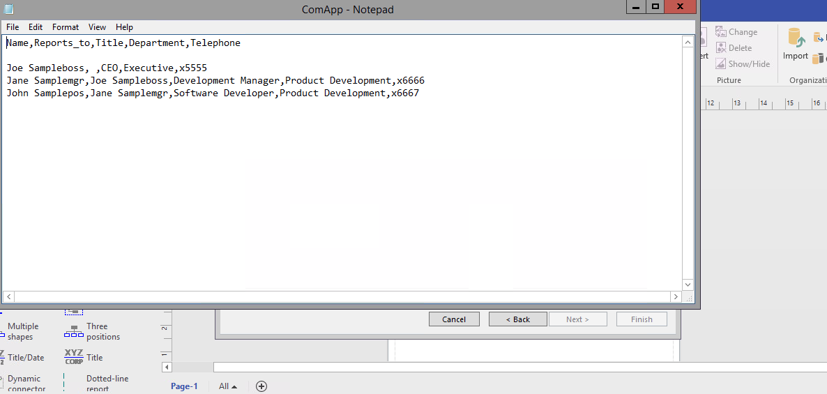
Automatically generate a chart from an existing data source
Exit either Excel or Notepad, and then complete the wizard.

Slide 27
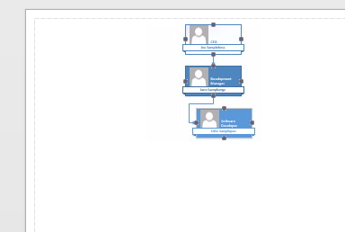
Automatically generate a chart from an existing data source
You will have the following chart:

Slide 28
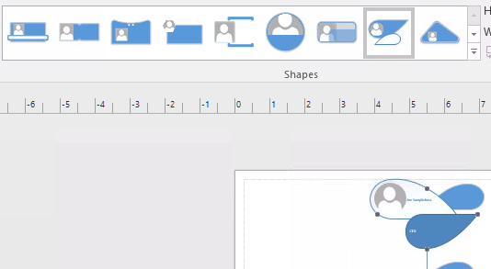
Finalizing The Chart
Change the layout, theme and font of the chart
Export the project as PDF and PNG

Slide 29
Computer Application
Chapter 5: Visio 2016: Hands On
Basic Flowcharts: Timeline

Slide 30
Create a timeline
Timelines help you plan and communicate project schedules by showing project phases and deadlines in a format that’s easy to read and understand.

Slide 31
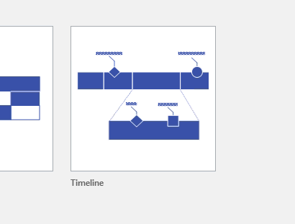
Choose a template
To find the right template to start from, go to File > Schedul and, in select Timeline.

Slide 32
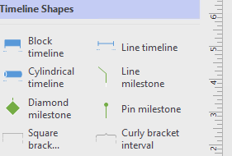
Add a base timeline shape
Drag one of the timeline shapes (Block, Line, or Cylindrical) onto the drawing page.

Slide 33
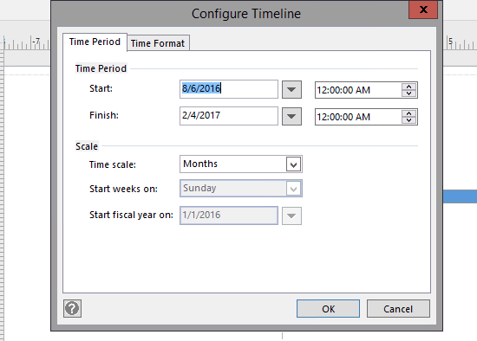

Add a base timeline shape
Set the Start and Finish dates and times.
(To change any of these settings later, you can right-click the timeline, and then click Configure Timeline.)

Slide 34
milestones, intervals, and markers
Milestone: Indicate a specific milestone date on the timeline
Interval: Indicate a critical time span on the timeline.
Today marker: Reflect the amount of time that has passed since the project began.

Slide 35

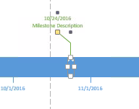
Indicate a milestone on a timeline
Drag a milestone shape drop it directly on top of the timeline.

Slide 36
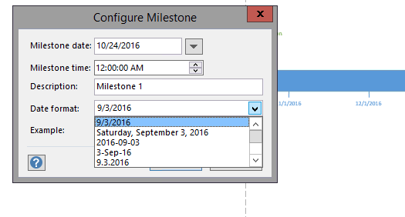
Indicate a milestone on a timeline
Type or select the date and time for the milestone.
Type the label you want to show for the milestone as a description.
Choose how you want the date to look (in the Date Format List).

Slide 37

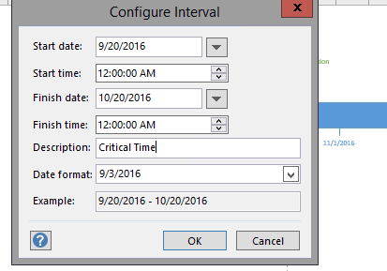
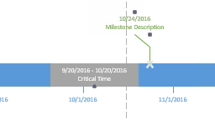
Indicate a time span on a timeline
Drop an interval shape
Set the start and end dates for the time span
Type a label
Choose the date format.

Slide 38


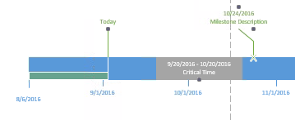
Indicate elapsed time on a timeline
Drop the Elapsed time shape directly on top of the timeline.
Drag the Today marker shape onto the timeline.
(N.B: Each time you open a timeline drawing with an Elapsed time or Today marker shape on it, the shapes shift to align with the current real-world date.)

