Slide 1
Analyse Financial Data with Python Capstone
Portfolio recommendation

Slide 2
Stocks Included
Stock | Name | Sector
AMZN | Amazon | Tech
JPM | JP Morgan | Banking
LLY | Elli Lilly | Pharma
LVMUY | Louis Vouitton | Luxury
MSFT | Microsoft | Tech
NFLX | Netflix | Tech
SHEL | Shell | Energy / Oil & Gas
SPOT | Spotify | Tech

Slide 3
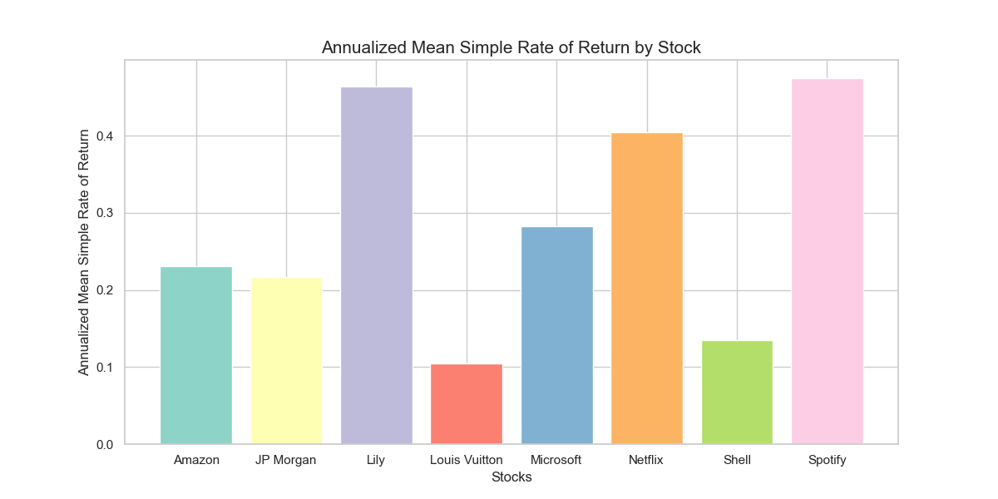
Annualized Mean Simple Rate of Return

Slide 4
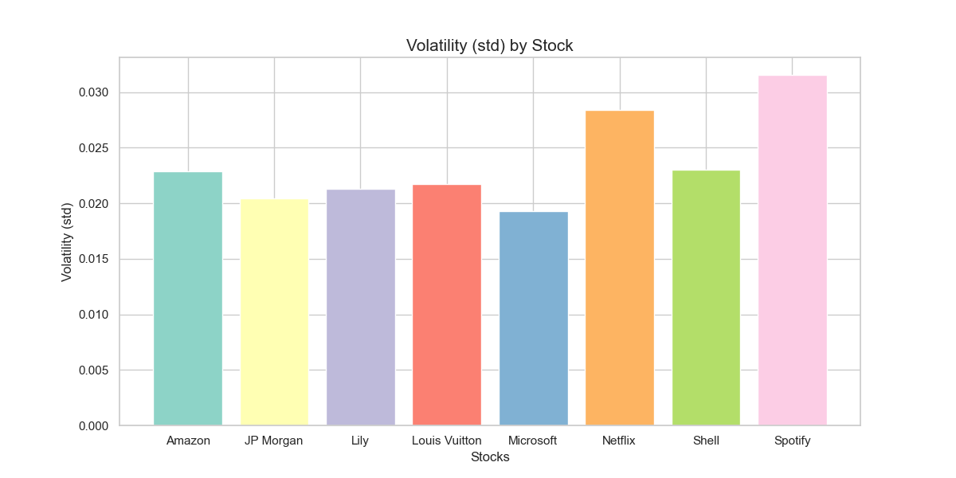
Volatility (std) by Stock

Slide 5
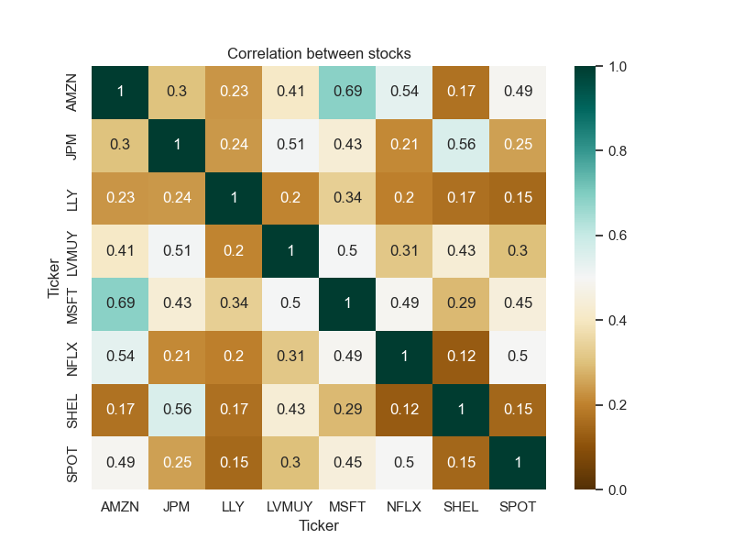
Correlation between stocks

Slide 6
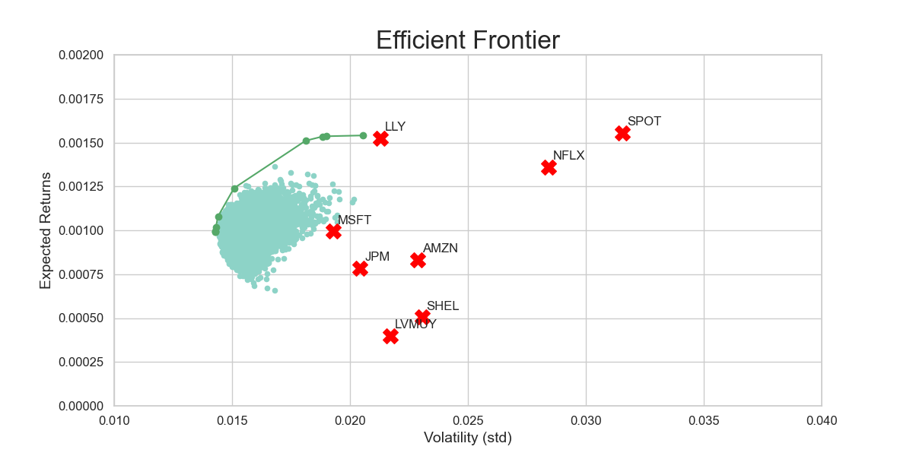
Efficient Frontier

Slide 7
Portfolio Recommendation
High Return for reasonable risk (given higher risk appetite of customer)
Returns | Volatility | AMZN Weight | JPM Weight | LLY Weight | LVMUY Weight | MSFT Weight | NFLX Weight | SHEL Weight | SPOT Weight
0.001366 | 0.016811 | 0.064717 | 0.003696 | 0.472574 | 0.022938 | 0.050702 | 0.220106 | 0.026174 | 0.139092

