Slide 1

INCS-4810
Presented by:
Negin Sorati, Bita Kiyani, Brhamjot Singh
Submitted to:
Victor Mendez
Submission Date:
May 21, 2024

Slide 2
01
Creating an IACS Network.
Overview
Scanning the Network for Vulnerability
Planning and designing the payload to exploit the vulnerability
02
03
Securing the Network according the Industrial cybersecurity standards

Slide 3
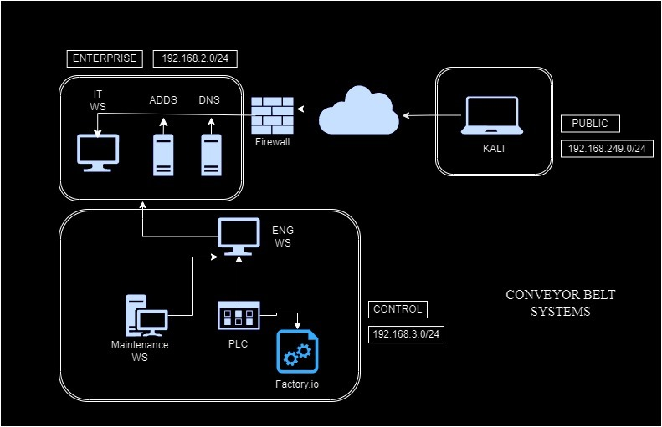
Initial Network Topology
Network Area:
External Area (Public)
Enterprise Area (IT)
Control Area (OT)

Slide 4

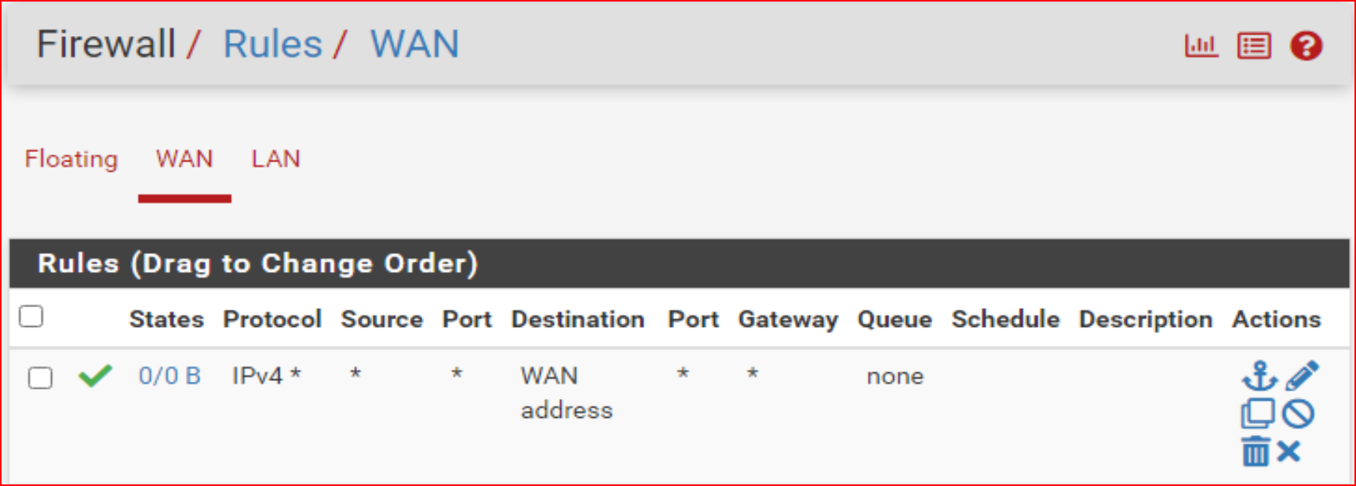
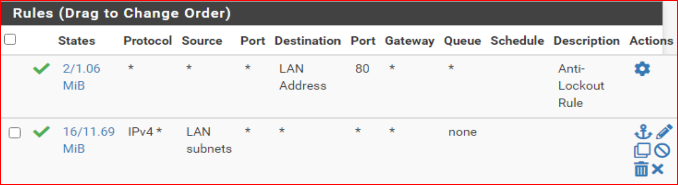
Pfsense Network Firewall Configuration
WAN (External) Interface Rules
LAN (IT) Interface Rules
WAN (External) Interface Rules
2. LAN (IT) Interface Rules

Slide 5
System Components – OT
OT Workstation:
Windows 10 machine connecting IT and OT networks
PLC Workstation:
Windows 10 with OpenPLC Editor and Runtime
Cygwin64 for Unix-like environment
Factory IO:
Windows 10 system for 3D simulation of industrial processes

Slide 6
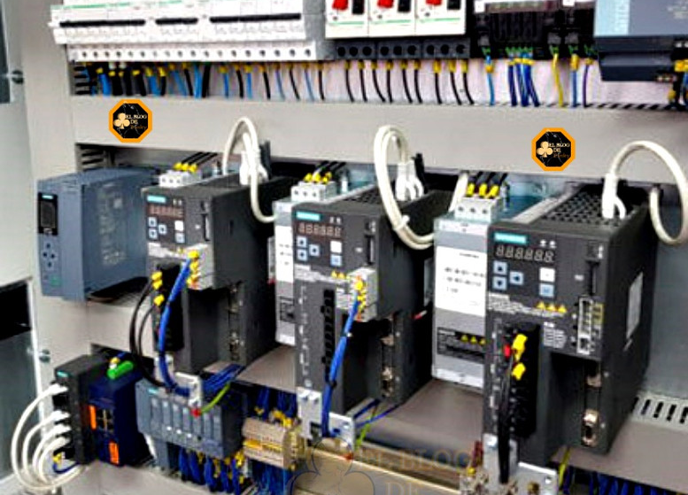
Ladder Logic Programming and Execution
Programming:
OpenPLC Editor for ladder logic diagrams
Execution:
Upload and run on OpenPLC Runtime
This Photo by Unknown Author is licensed under CC BY

Slide 7

Network Configuration
Modbus TCP/IP:
Connects PLC workstation and Factory IO
Modbus Server Configuration:
Runs on PLC workstation
Uses default TCP port 502

Slide 8

Visualization with Factory IO
Setup:
Connects to Modbus server on PLC workstation
Configured IP address and port in Factory IO
See the result

Slide 9

ATTACK
Starting with the
Searching (Reconnaissance)
Gathered Information about the factory!
They are using private web server for rolling out driver updates.
Working on Payload
Weaponization
+ Delivery
Creating a simple reverse shell PowerShell script.
Obfuscating it so that it bypasses AV
Create a public webserver for the delivery of payload

Slide 10
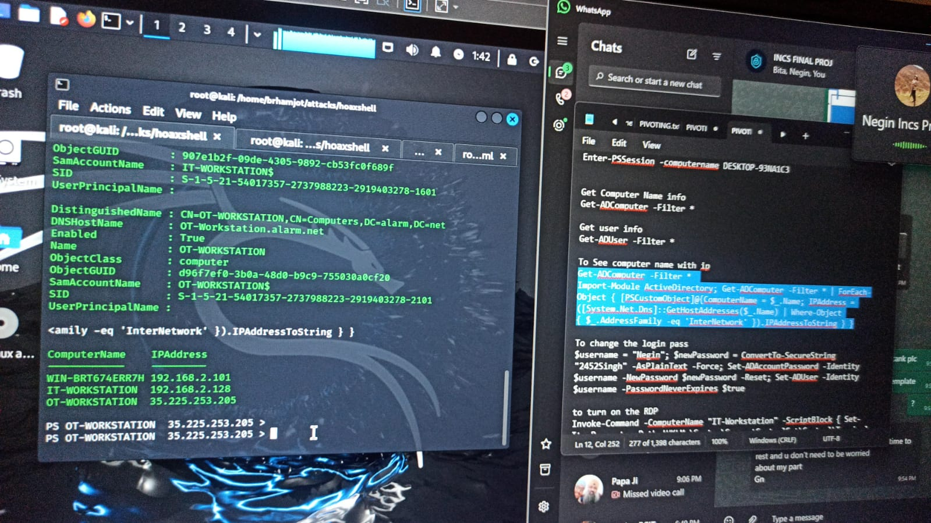

Exploiting Access 😏
Reverse completely hidden!
Network Scan (Nmap, AD DS tools and pings)
Changed the password of all the users to “GodsEye”.
Changed the RDP settings and turned OFF NLA.
AT last, RDP into the controller’s Workstation.
Uninstall the PLC driver.
Uploaded new program in PLC.
Do a DDOS attack on the controller to make it stop Working

Slide 11
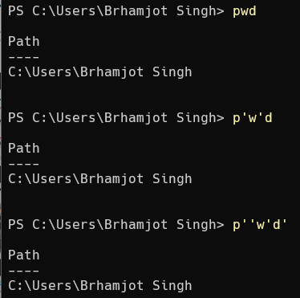

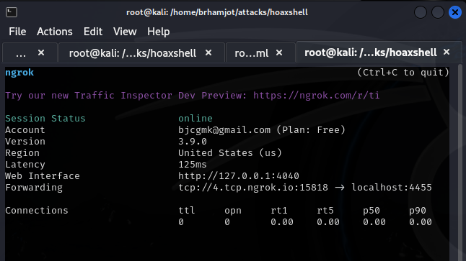
Exploiting Access 😏
Reverse completely hidden!
Network Scan (Nmap, AD DS tools and pings)
Changed the password of all the users to “GodsEye”.
Changed the RDP settings and turned OFF NLA.
Translating My Private IP to a Public IP
AT last, RDP into the controller’s Workstation.
Uninstall the PLC driver and upload a new program in PLC to stop the conveyor belt.
Do a DDOS attack on the controller to make it stop Working

Slide 12
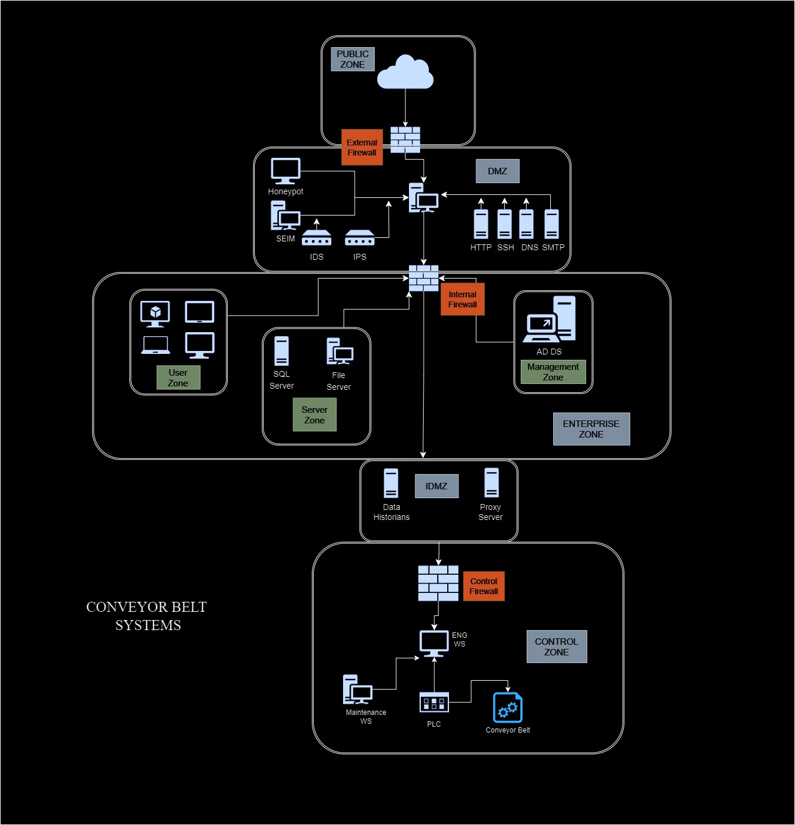
Making Our Network Secure !!

Slide 13
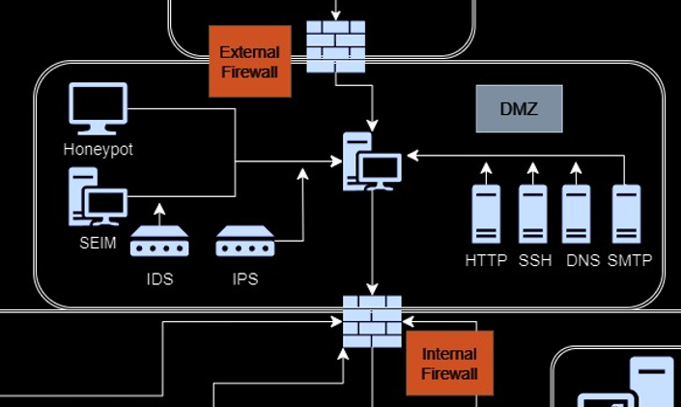
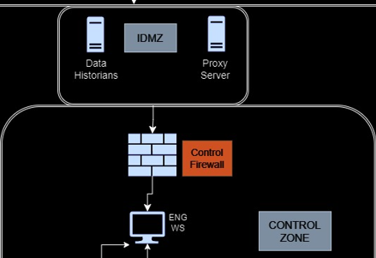
Segmented Network
Into Different Zones
DMZ- Demilitarized Zone
Added SEIM
Honey-Pot
Firewalls
ACL – Access control List
Block the unused Ports
Set up general Cybersecurity (ISA/IEC standards)
According to Cybersecurity Standards
Zero-trust
Role-based Users with limited access

Slide 14
Provide Training – Spread Awareness
We can be safe from these types of Threat actors
THANKYOU!!
Firewalls
ACL – Access control List
Block the unused Ports
Open for Feedback and questions ☺
Set up general policies
According to Cybersecurity Standards
Zero-trust
Role-based Users with limited access

