Slide 1
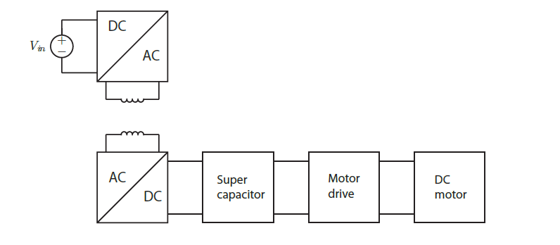
Contactless charging
Charged KITT within 3 minutes and 45 seconds!

