Slide 1



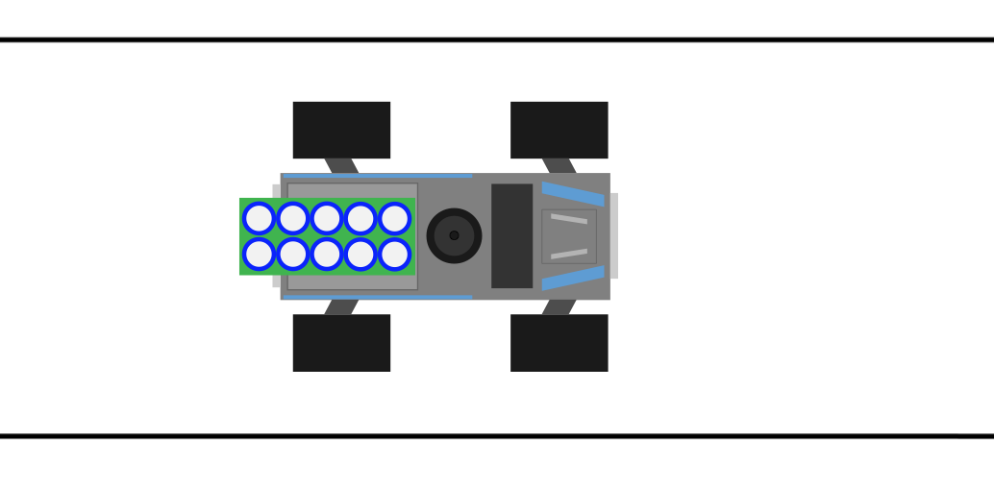
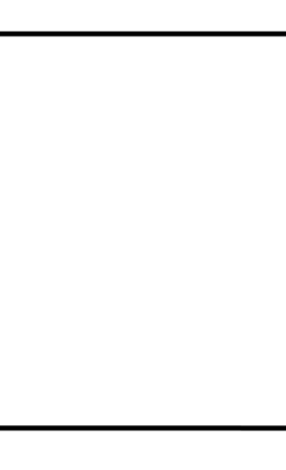
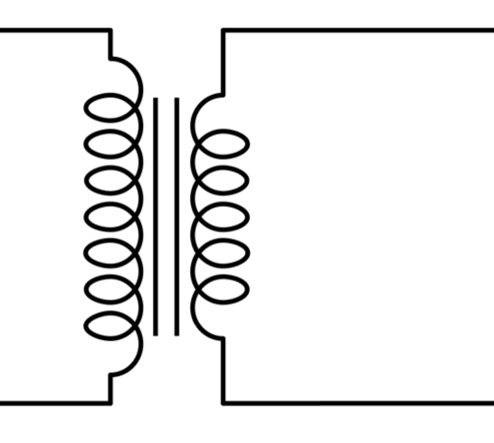
Final presentation – group B2
Julio Ballesteros, Sjoerd Bosma, Wessel Bruinsma, Robin Hes
20-6-2014

Slide 2
Introduction
Autonomous car (KITT) driving to one or more waypoints
Short overview of our design
Introduction to each component its unique features
Finally a short recap and possible future work

Slide 3
Final thoughts
Working prototype (up to challenge 2, for lack of more testing)
TODO:
Fix ASIO lag
Small improvements to obstacle detection using Doppler + more accurate localisation using actual speed of sound and QR

