Slide 1
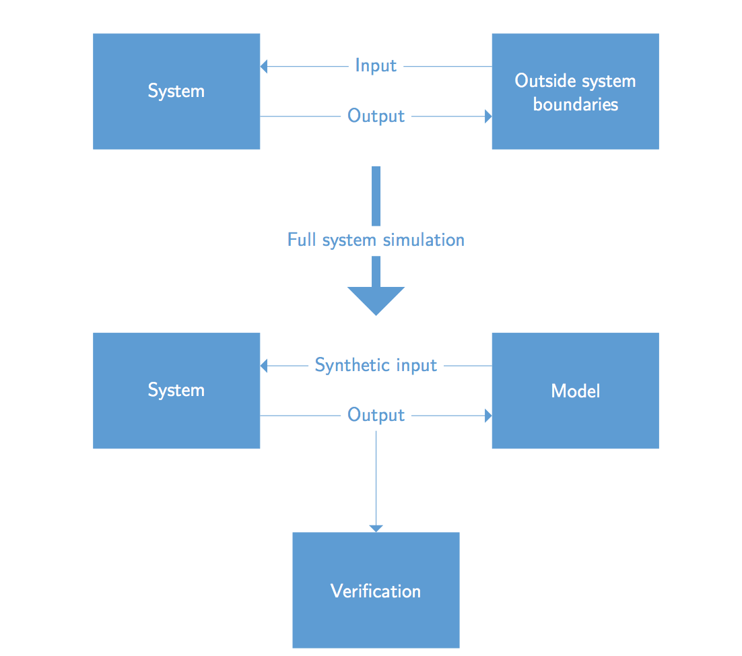
System verification
Our approach

