Slide 1
EPO4 – Final presentation
Electric Transport 2020
Group B2 – Julio Ballesteros, Sjoerd Bosma, Wessel Bruinsma, Robin Hes
20-6-2014

Slide 2
System overview

Slide 3
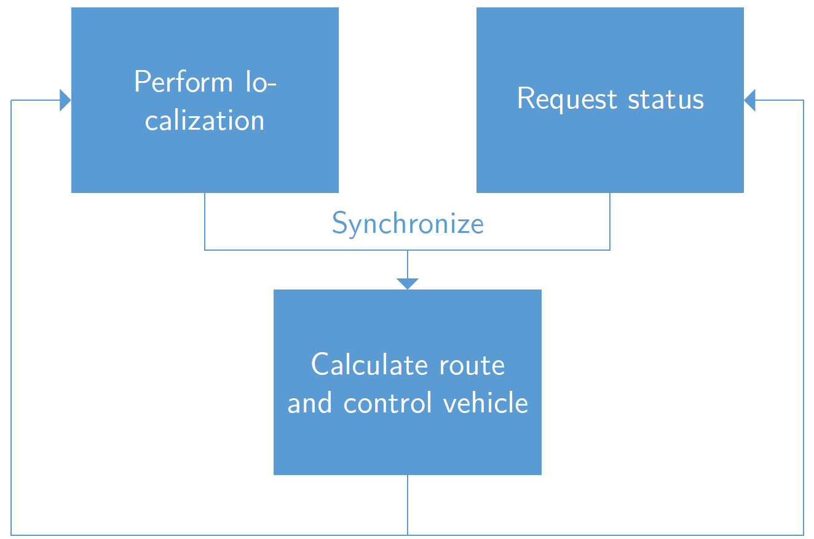
GUI & Communication

