Slide 1
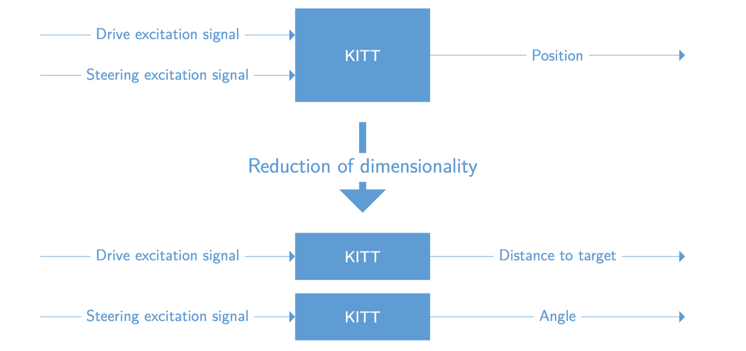
Controlling KITT
Our approach

Slide 2
Controlling KITT
System overview

