Slide 1



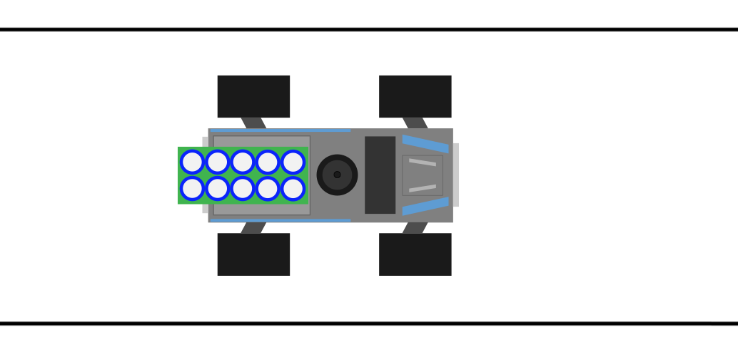

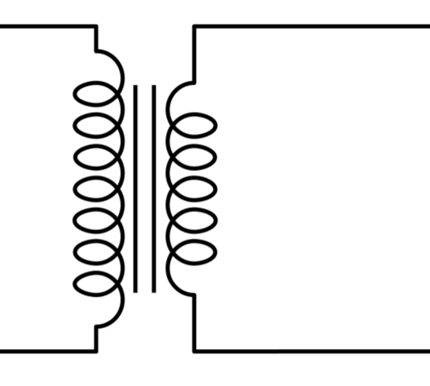
Final presentation – group B2
Julio Ballesteros, Sjoerd Bosma, Wessel Bruinsma, Robin Hes
20-6-2014

Slide 2
Introduction
Autonomous car (KITT) driving to one or more waypoints
Short overview of our design
Introduction to each component its unique features
Finally a short recap and possible future work
(Interactive demo if desired?)

Slide 3
System overview

Slide 4
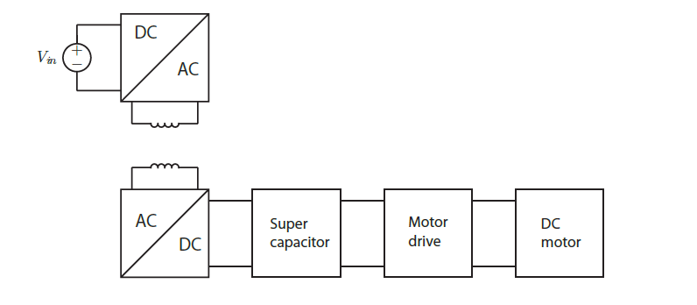
Contactless charging
Charged KITT within 3 minutes and 45 seconds!

Slide 5
Localization
Overview
SVD filtering
Signal filtering

Slide 6
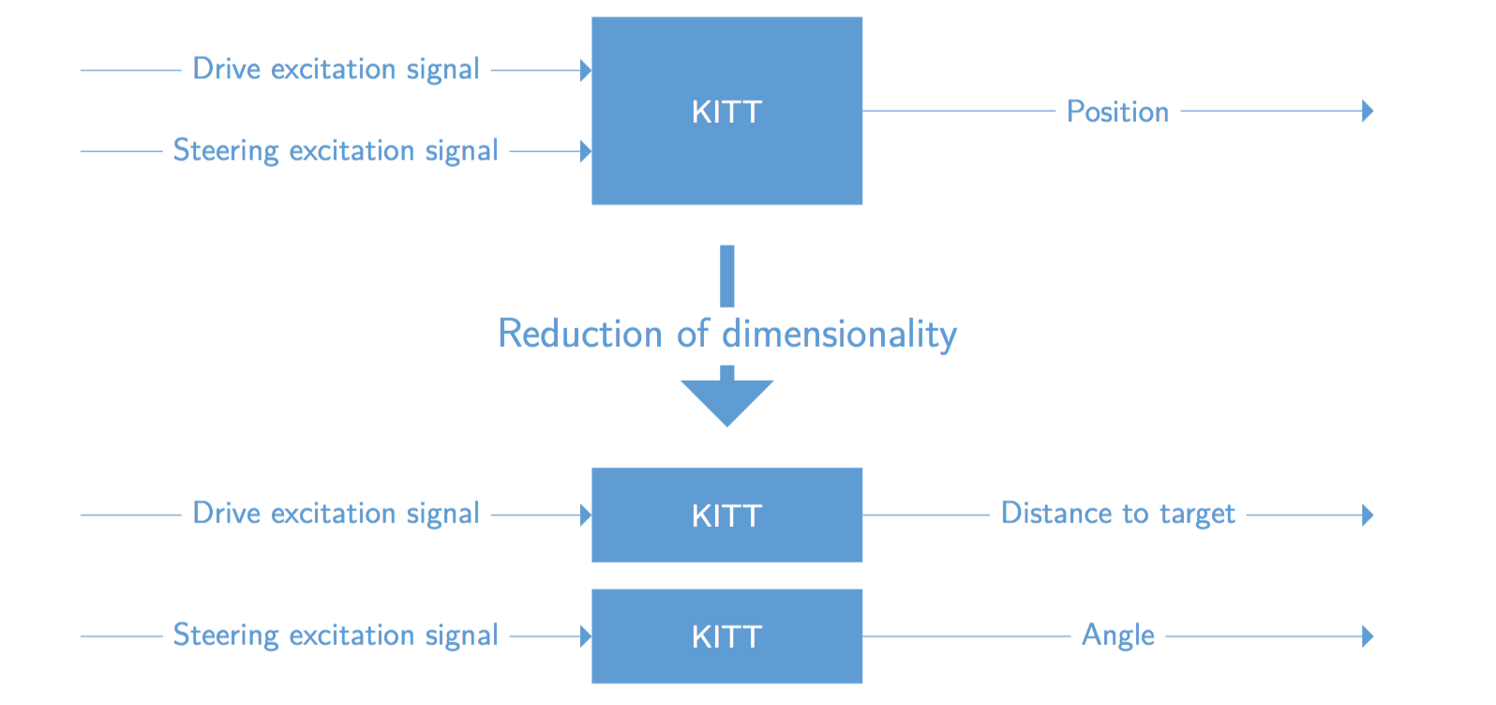
Controlling KITT
Our approach

Slide 7
Controlling KITT
Overview

Slide 8
GUI & Communication
Overview

Slide 9
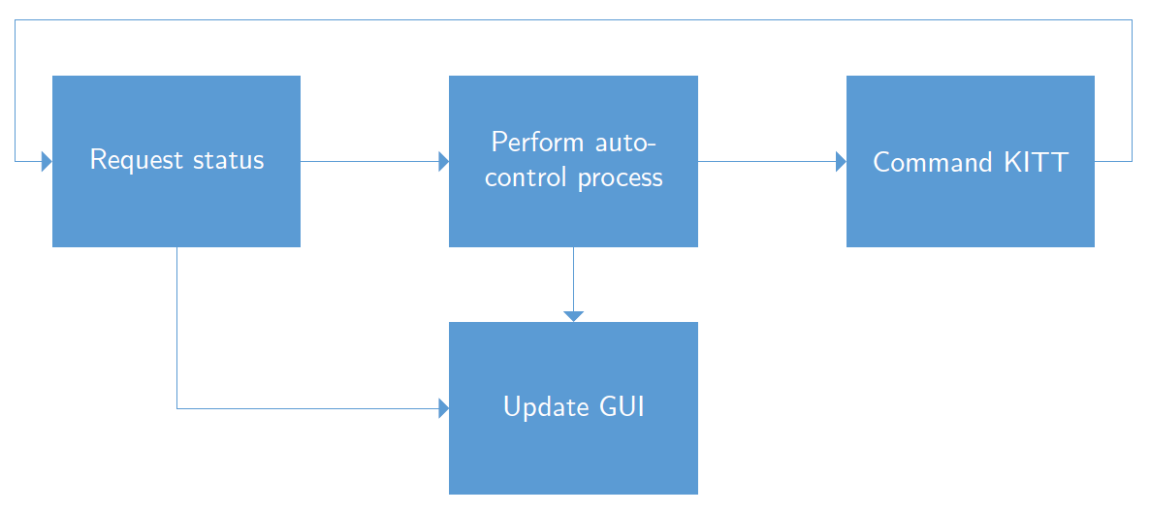
GUI & Communication
Interaction flow

Slide 10
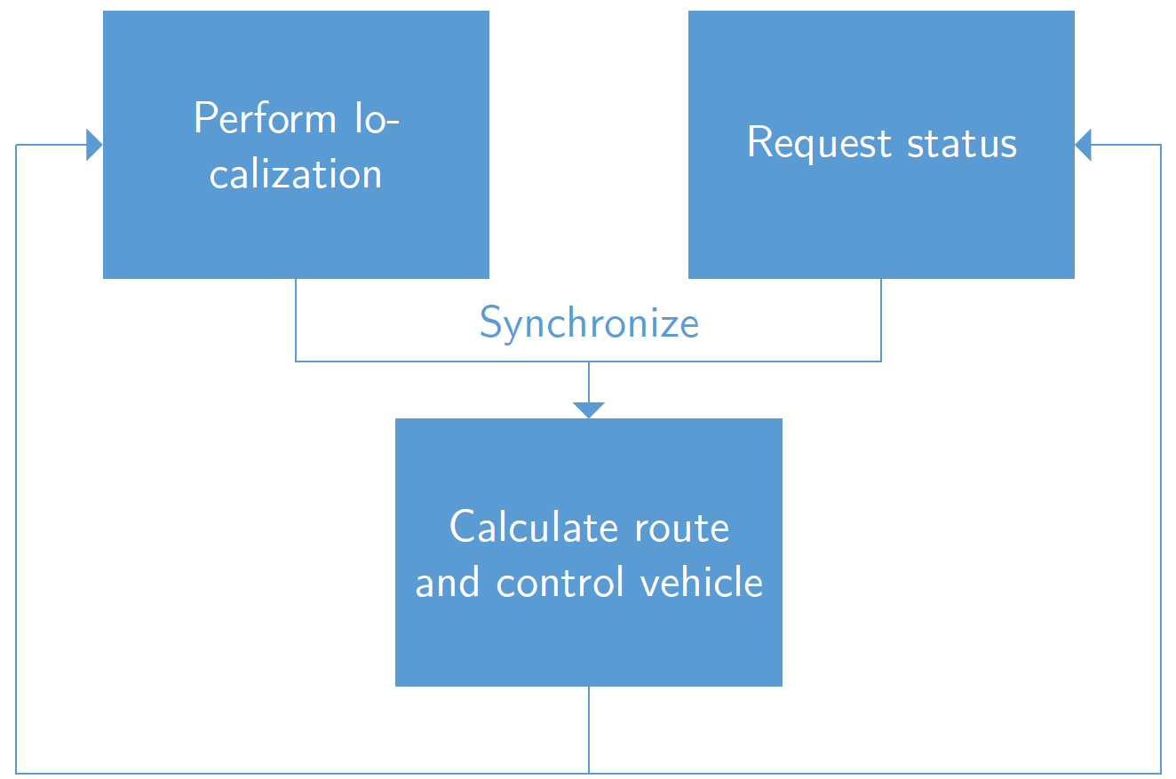
GUI & Communication
Controller flow

Slide 11
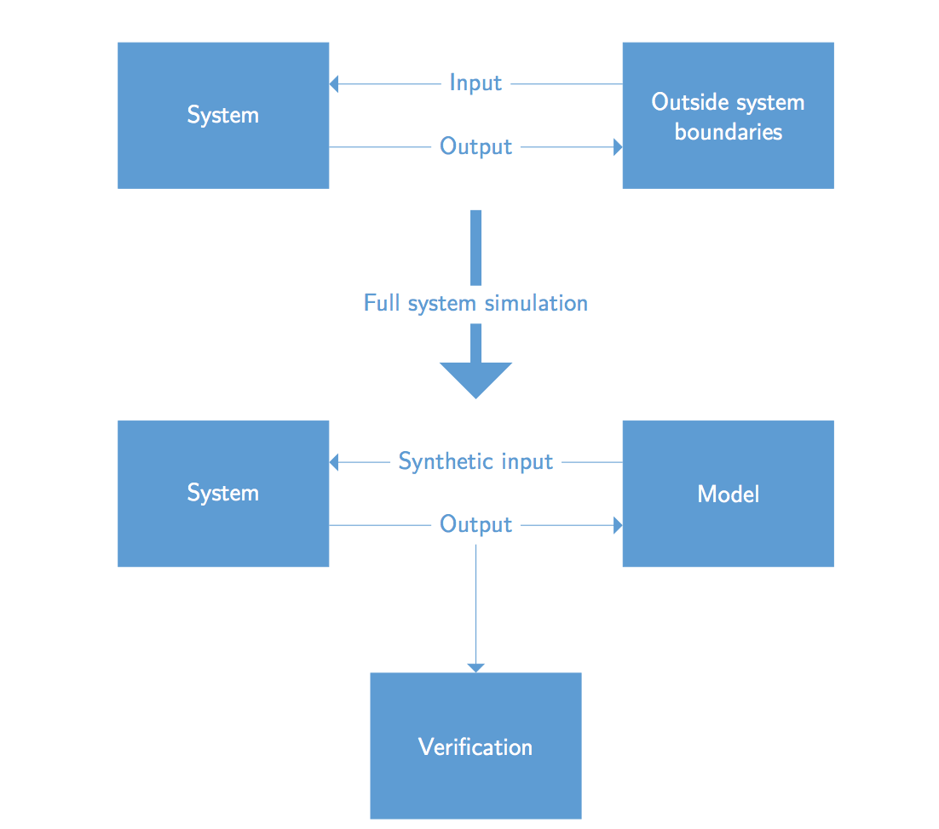
System verification
Our approach

Slide 12
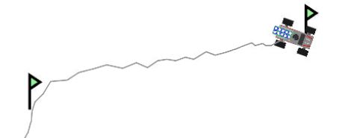
Final thoughts
Working prototype (up to challenge 2, for lack of more testing)
TODO:
Fix ASIO lag
Small improvements to obstacle detection using Doppler
More accurate localisation using actual speed of sound and QR

