Slide 1
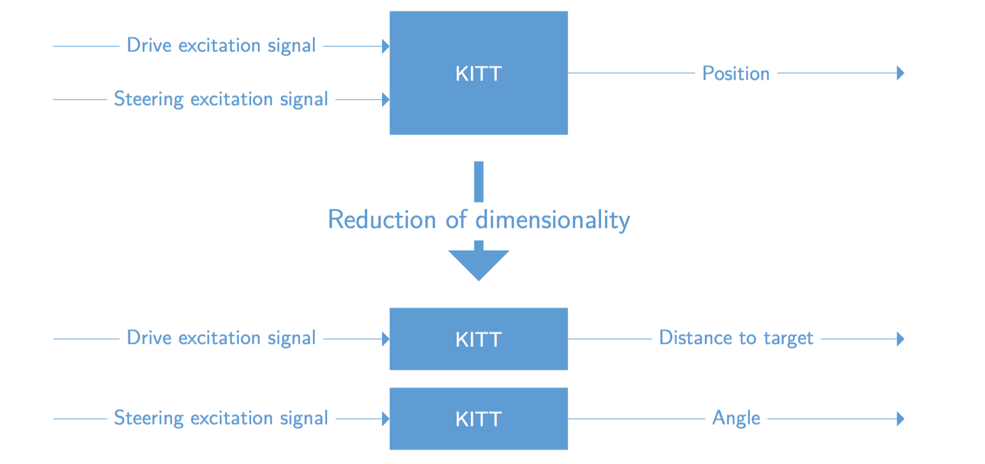
Controlling KITT
Our approach

Slide 2
Controlling KITT
System overview

Slide 3
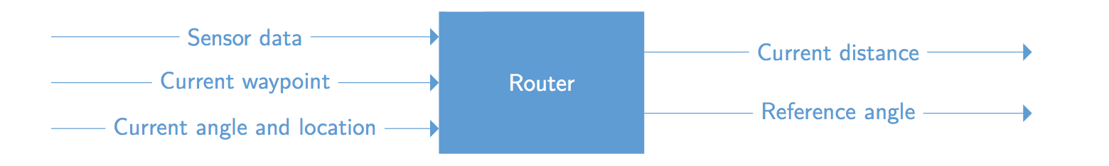
Controlling KITT
Router

Slide 4
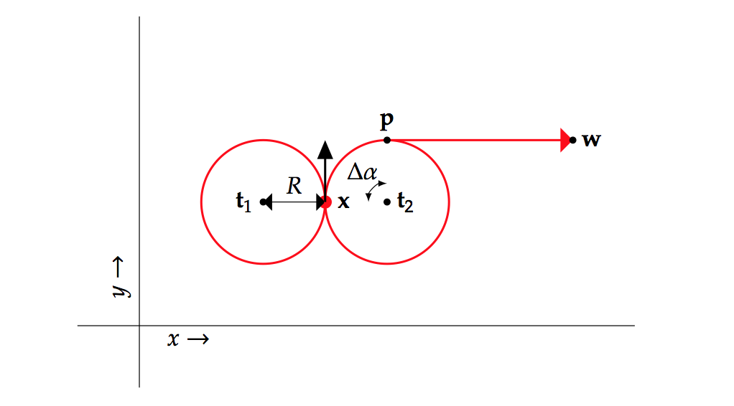
Controlling KITT
Router – distance calculation

Slide 5
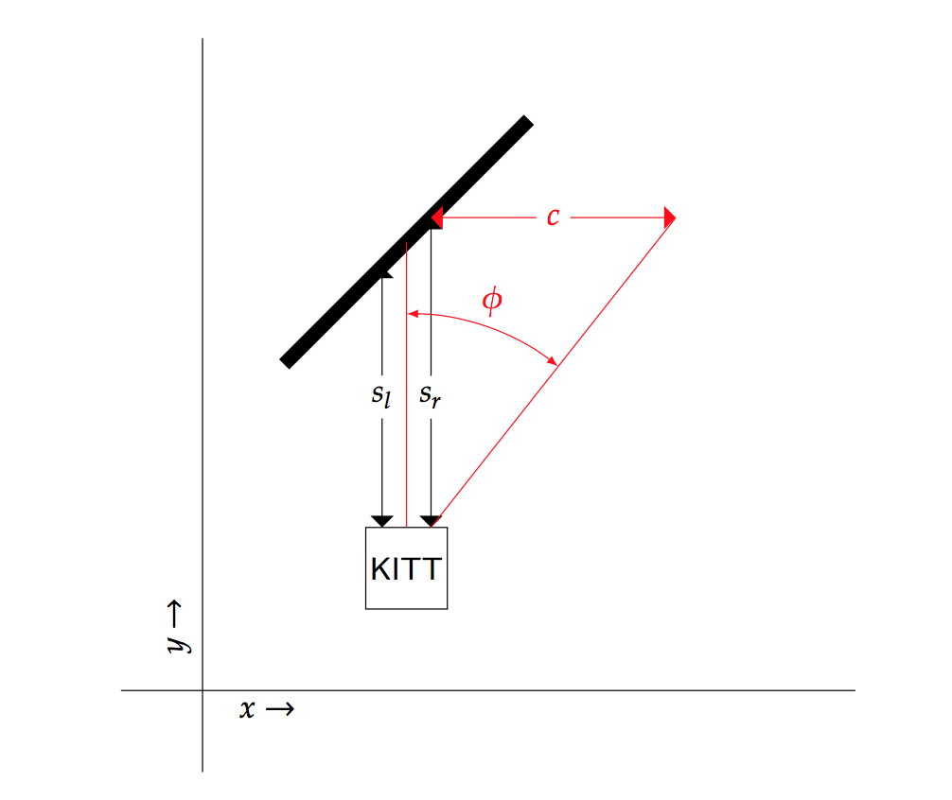
Controlling KITT
Router – obstacle avoidance

Slide 6
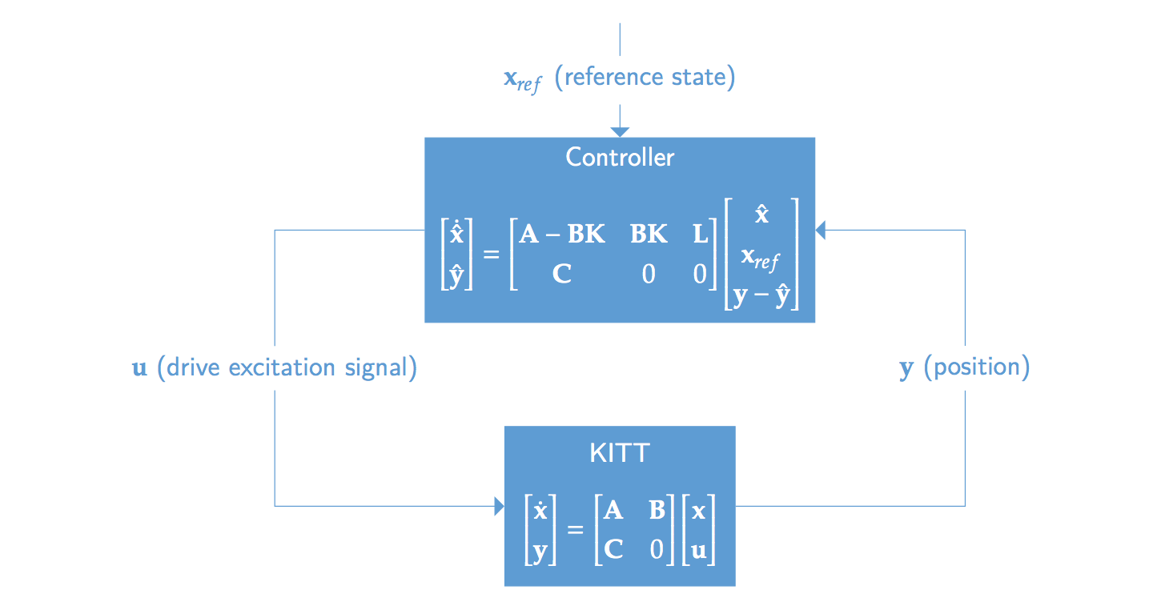
Controlling KITT
Distance and angle controller

