Slide 1
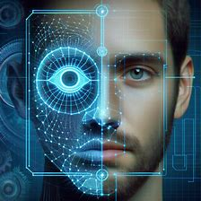
IRIS RECOGNITION vs FACE RECOGNITION
In our study, we aim to conduct a comprehensive comparison between two biometric recognition methods: face recognition and iris recognition. These two modalities exhibit distinct characteristics in terms of usage, approaches, algorithms, use cases, and performance metrics.
Biometric systems course – cybersecurity master degree at Sapienza University
Group members: Noemi Giustini, Filippo Guerra, Filippo Olimpieri, Ludovica Garufi

Slide 2
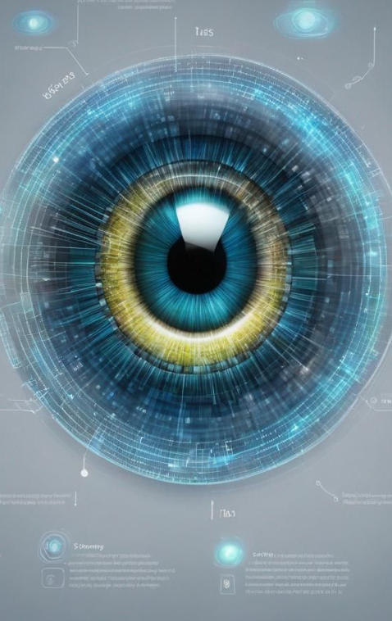
Iris Recognition
Iris recognition is a cutting-edge biometric technology that uses the unique and complex patterns of the human iris to identify individuals.
Iris recognition focuses on capturing and analysing the unique patterns of the iris to establish a person's identity, offering a non-intrusive and efficient means of biometric authentication.
The Daugman method, introduced in the 1990s, involves normalization using Rubber Sheet Model. This method has proven to be highly accurate and robust, capable of handling variations in lighting conditions and other environmental factors.

Slide 3
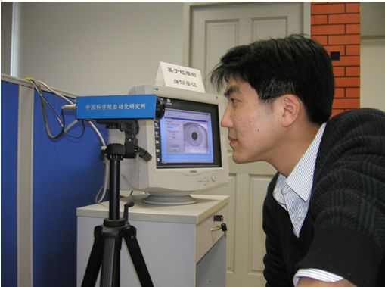
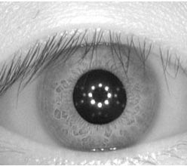
Iris recognition - Dataset
The CASIA Iris Image Database (CASIA-Iris) has got over 3’000 users across 70 countries.
CASIA-IrisV4 is an extension that comprises six subsets, including CASIA-Iris-Interval. It contains a total of 54,601 iris images from over 1,800 genuine subjects and 1,000 virtual subjects, collected or synthesized under near- infrared illumination.
The CASIA-Iris-Interval dataset offers a comprehensive collection of iris images, captured using a specialized CASIA close-up iris camera within indoor environments. This unique dataset consists of images taken during two distinct sessions for most subjects

Slide 4
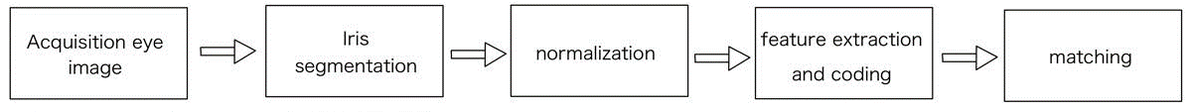
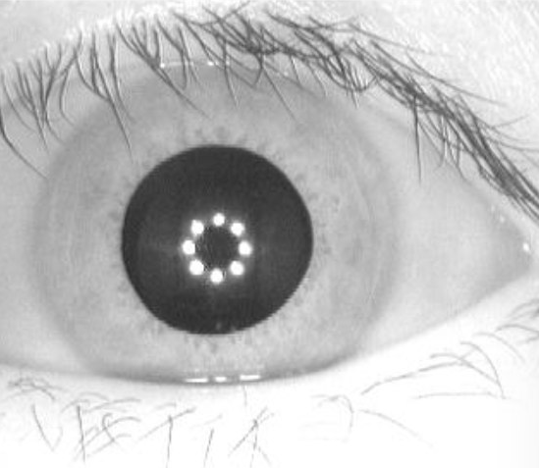


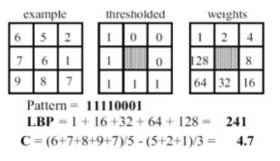

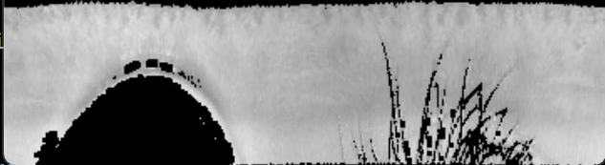
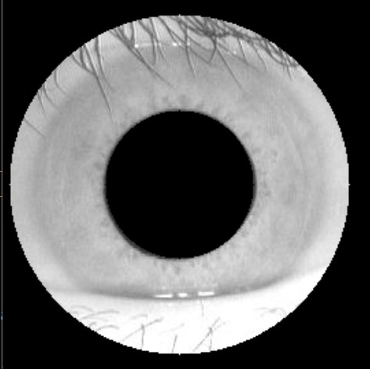
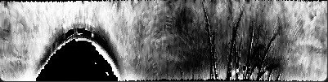
Iris identification Approach
Threshold + erosion filter
LBP
Rubber sheet model
+
threshold masks
HoughCircles + findContours

Slide 5
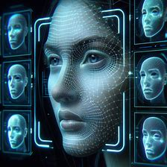
Face Recognition
Face recognition, has gained significant attention due to its wide-ranging applications in security and human-computer interaction. The ability to automatically identify and verify individuals based on facial features has become an important technology in various industries.

Slide 6
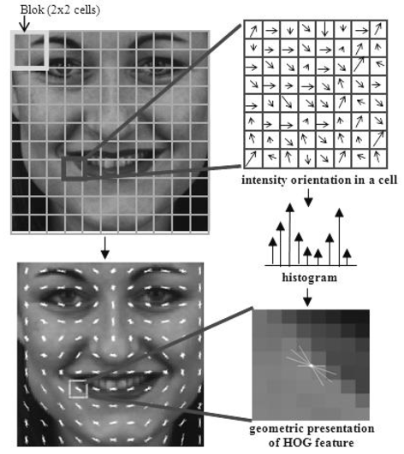
Face identification approach
Face_recognition is a library in Python for face recognition tasks. This library employs the Histogram of Oriented Gradients (HOG) model for face detection, alignment, and recognition.
HOG is a feature descriptor used in computer vision, where the image is divided into cells, and histograms of gradient orientations are computed for each cell. These histograms are concatenated to form the descriptor.
The HOG descriptor offers advantages such as invariance to geometric and photometric transformations, except for changes in object orientation, making it effective for face recognition tasks.

Slide 7
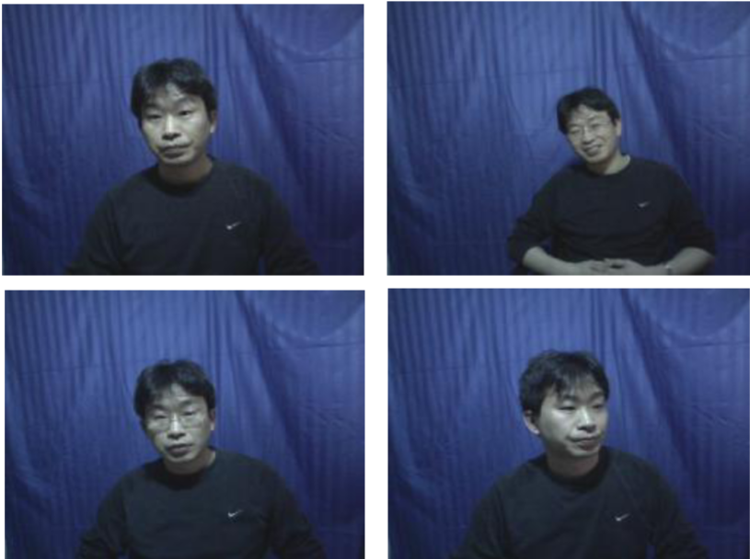
Face recognition - Dataset
The CASIA Face Image Database Version 5.0 (CASIA-FaceV5) is a dataset comprising 2,500 colour facial images collected from 500 different subjects.
These facial images were captured using a Logitech USB camera during a single session. Each facial image in the CASIA-FaceV5 dataset is stored as a 16-bit colour BMP file with a resolution of 640x480 pixels.
One of the key features of CASIA-FaceV5 is the inclusion of various intra-class variations commonly encountered in real-world scenarios. These variations encompass factors such as illumination, pose, expression, presence of eyeglasses, imaging distance.

Slide 8
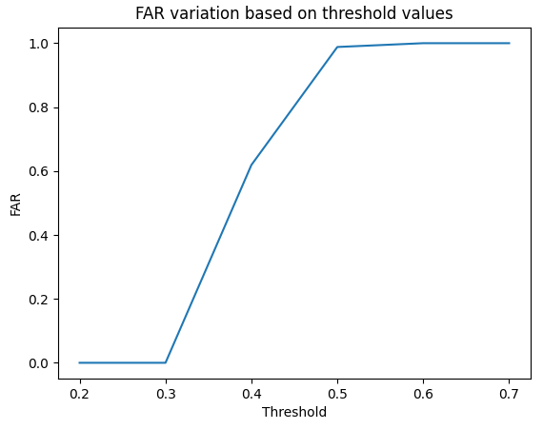
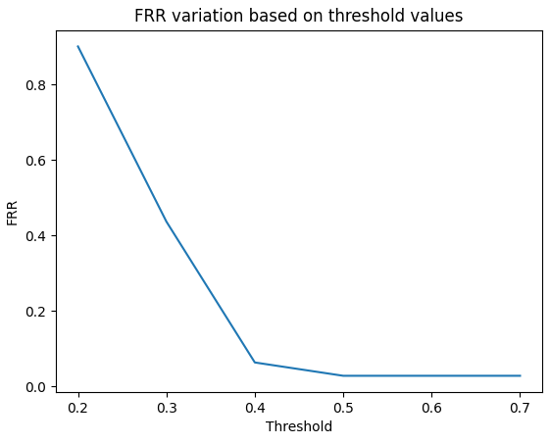
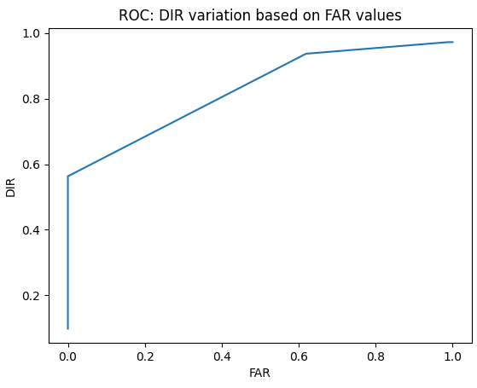
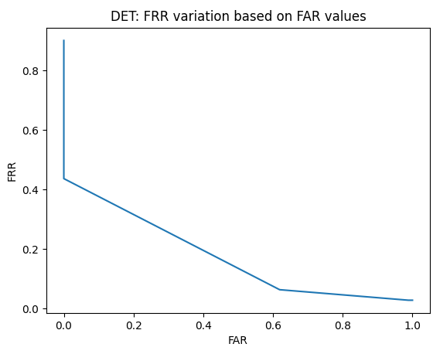
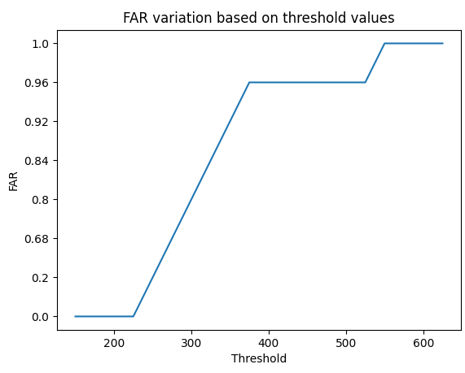
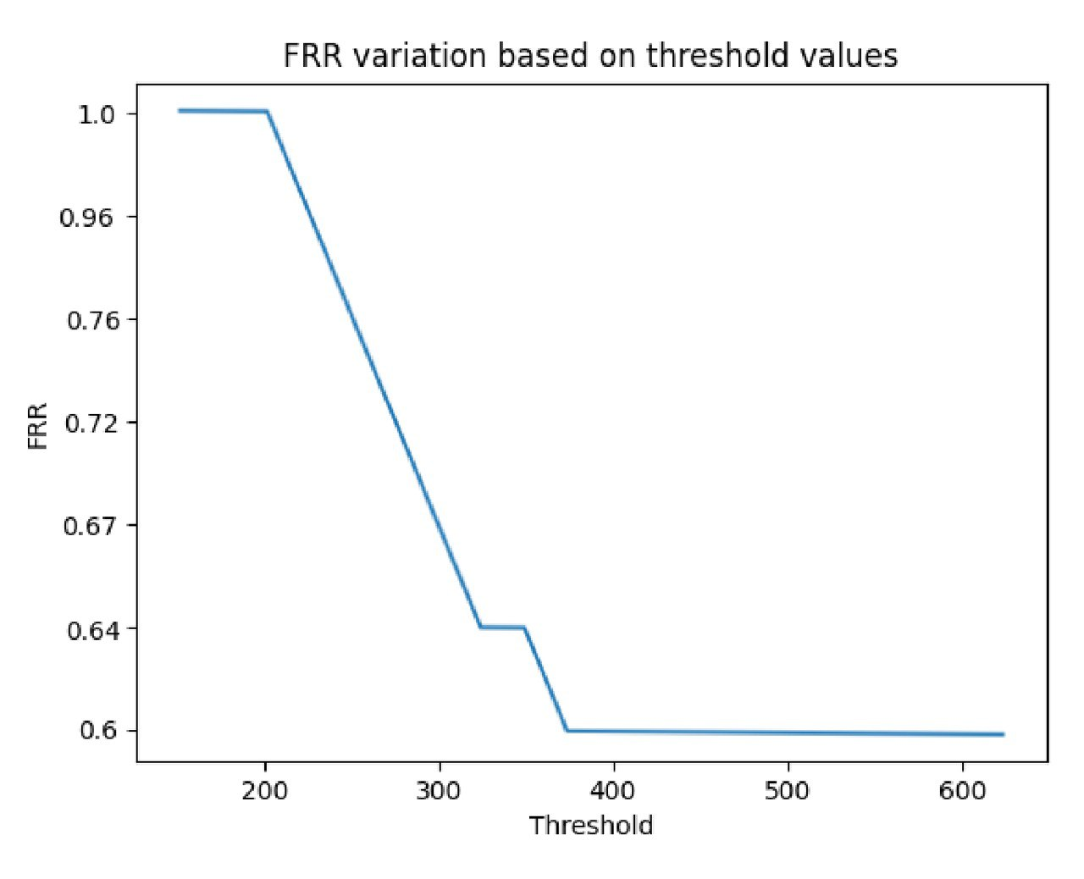
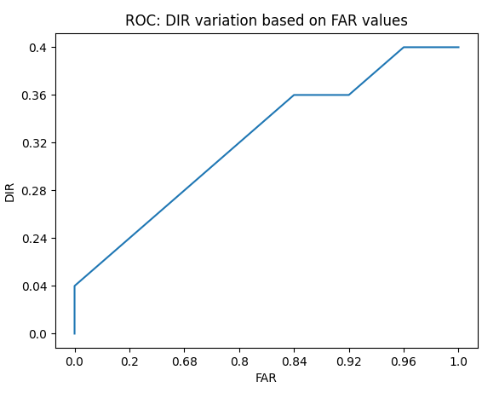
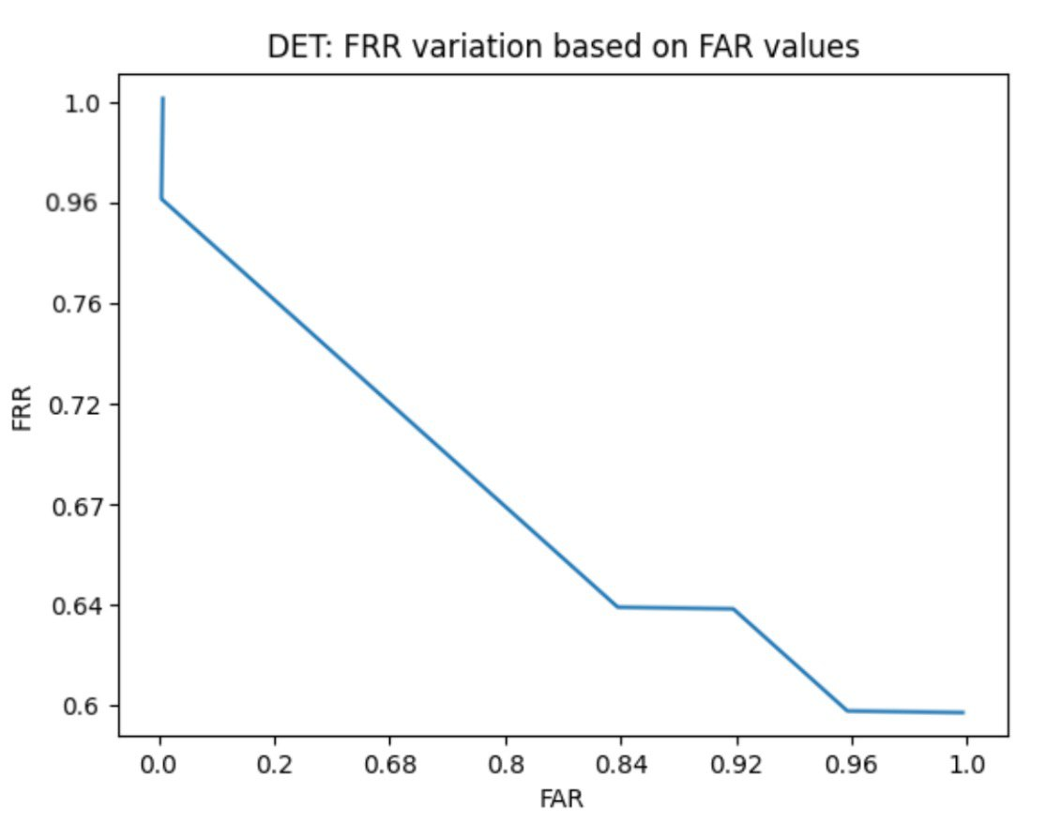
Performance evaluation
 | FAR | FRR | ROC | DET
IRIS
FACE

Slide 9
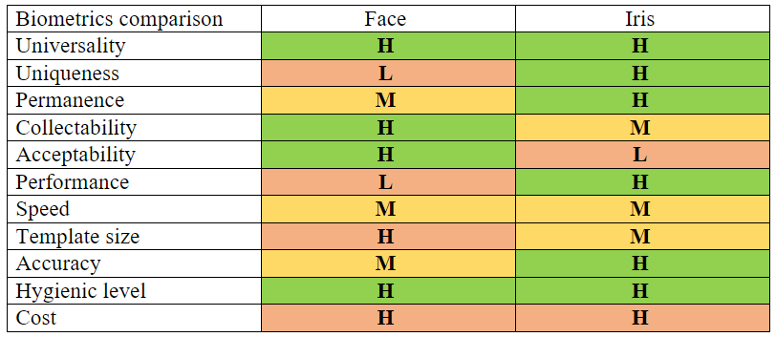
Comparison and Conclusion

Slide 10
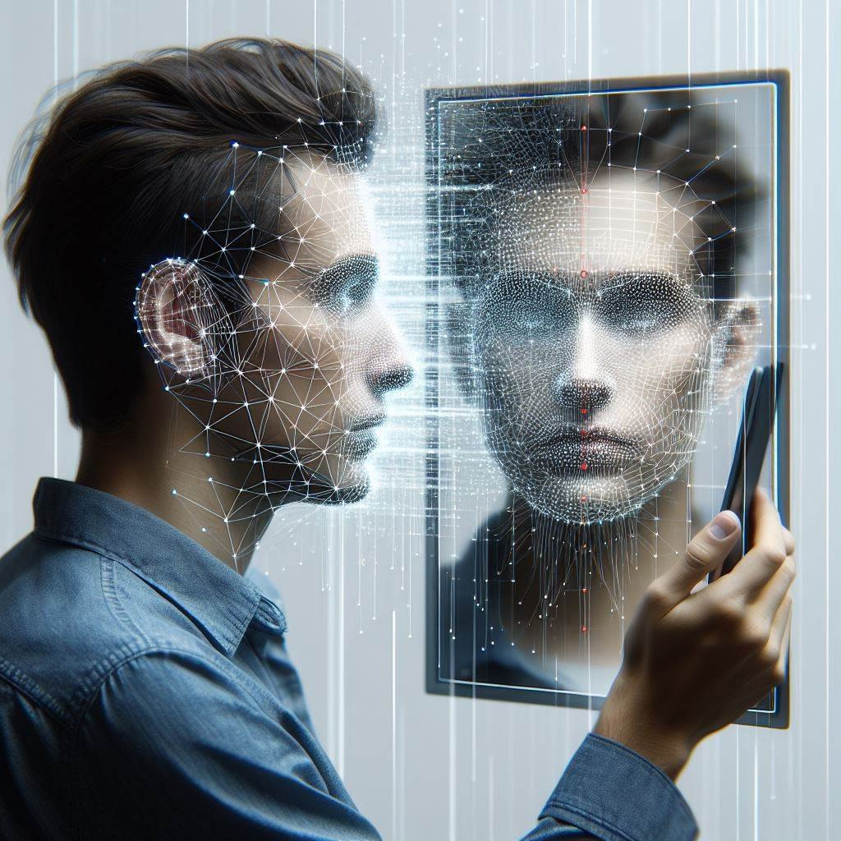
Face Re-Identification Demo
In our demo we use a computer's webcam for real-time face recognition. It introduces the concept of re-identification (re-ID), which aims to match individuals across different video sources and time frames using various features like appearance and behaviour.
Viola-Jones Algorithm
Developed by Paul Viola and Michael Jones, this algorithm is a cornerstone in face detection technology, known for its real-time efficiency.
Haar-like Features
Rectangular filters that capture variations in pixel intensities, crucial for the algorithm's ability to detect faces accurately.
Cascade of Classifiers
A series of filters that work to eliminate non-face areas, ensuring rapid and precise detection of faces in various environments.

Slide 11
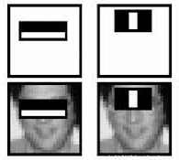
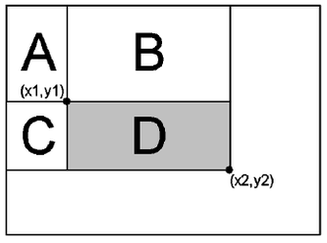
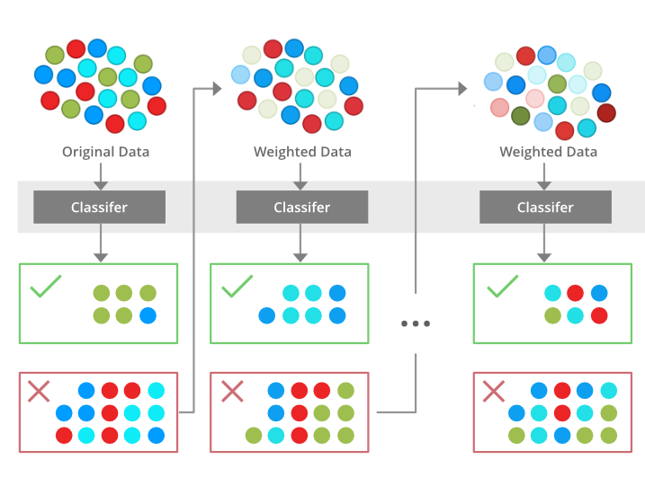

Viola-Jones algorithm
Acquisition face image
Face detection
Haar feature extraction
Integral image calculation
Boosting
Cascade of classifier

